Slide 1
Exercise 4
The objective of this exercise is to revise a part of instruction from your current training material using the material (instructional methods, engagement strategies and facilitation techniques) in this program.
You will be reviewing a section of material that can be introduced, presented and closed-out in 10 minutes.
Prepare a draft of the introduction and closing for the piece as well as the material itself.

Slide 2
Exercise 4
Timing
You will have 20 minutes for preparation.
You will work in teams and have:
  10 minutes for team discussion
  5 minutes to discuss with the entire group (5 time 3 = 15 minutes)
Move to the Review & Close
Copyright 1992-2015, Leadership Strategies, Inc. V15.03

Slide 3
The Engaging Trainer Virtual Edition
Copyright 1992-2015, Leadership Strategies, Inc. V15.03
Duplication prohibited without consent

Slide 4
A4. Agenda
DAY 1
DAY 2
DAY 3
Manual 6
Getting Started
Planning For Results
Review
Ex #2: Your Start
D. Delivering for Results
Review
  F. Confirming Results & Closing
  G. Managing Dysfunction
LUNCH
LUNCH
LUNCH
Ex #1: Experiential Learning
Starting with Impact
Homework
Ex #3: Inviting Participation
E. Managing Visual
Information
Homework
Ex #4: Redesigning Your Session for Results
H. Next Steps
Close
Manual
11
Copyright 1992-2015, Leadership Strategies, Inc. V15.03
Duplication prohibited without consent

Slide 5
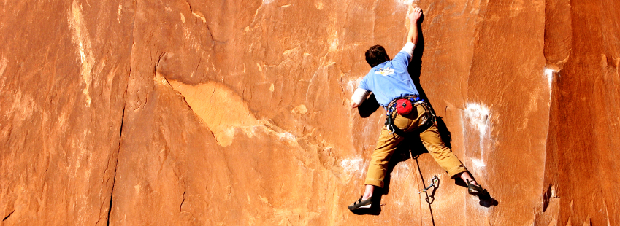
H. Next Steps
Copyright 1992-2015, Leadership Strategies, Inc. V15.03

Slide 6

Point Winner!
Cherie!

Slide 7

Let’s Start with a Review
Course Content
Course Objectives
Personal Objectives
Parking Boards
Notes:
Now that we have reviewed techniques to ensure our classroom training is implemented in our organizations, let’s move on to closing our training sessions…..Who can remember our suggestion for when you know the session is running behind?….Which team can review our best practices around addressing this situation?…..Great…
NOTE: The key is not to rush through the material – instead, to reduce scope/content and make informed decisions with the group.
Once we are ready to move to the close, these are the four key points to the closing…. Let’s take a look at each.

Slide 8
Let’s Start with a Review
Course Content
Course Objectives
Personal Objectives
Parking Boards
Copyright 1992-2015, Leadership Strategies, Inc. V15.03
Notes:
Now that we have reviewed techniques to ensure our classroom training is implemented in our organizations, let’s move on to closing our training sessions…..Who can remember our suggestion for when you know the session is running behind?….Which team can review our best practices around addressing this situation?…..Great…
NOTE: The key is not to rush through the material – instead, to reduce scope/content and make informed decisions with the group.
Once we are ready to move to the close, these are the four key points to the closing…. Let’s take a look at each.

Slide 9
Review – Course Content
Course Modules
Appendices
Instructional Methods
Engagement Strategies
Visual Aids
References
Handouts
Miscellaneous
Getting Started
Understanding What Delivers Results
Planning for Results
Starting with Impact
Delivering for Results
Managing Visual Information
Closing & Confirming Results
Managing Dysfunction
Next Steps
Copyright 1992-2015, Leadership Strategies, Inc. V15.03
Notes:
Next, let’s review the Course Objectives……(for each objective)…..
We said we were going to………Did we do that? (Find choral response.)……OK, may I check it off? (Again, look for choral response and then check it off on the flip chart of Course Objectives… Step through all objectives repeating the process.)
[When completed with Course Objectives, review their Personal Objectives…….Typical approach is to divide the sticky notes evenly to the teams, set the clock for five minutes and have the teams prepared to read their sticky notes and one item discussed in the course that addressed each Personal Objective…..Do this by moving from team-to-team, one sticky note at a time……..If there are any that were not covered, ask: “Do they need to be covered” If no, discard; if yes, ask how much time is needed and set timer/address.]

Slide 10
Let’s Start with a Review
Course Content
Course Objectives
Personal Objectives
Parking Boards
Copyright 1992-2015, Leadership Strategies, Inc. V15.03
Notes:
Now that we have reviewed techniques to ensure our classroom training is implemented in our organizations, let’s move on to closing our training sessions…..Who can remember our suggestion for when you know the session is running behind?….Which team can review our best practices around addressing this situation?…..Great…
NOTE: The key is not to rush through the material – instead, to reduce scope/content and make informed decisions with the group.
Once we are ready to move to the close, these are the four key points to the closing…. Let’s take a look at each.

Slide 11

COURSE OBJECTIVES
Participants will be able to:
Describe the best practices related to teaching adults and develop training that appeals to all learning styles.
Develop learning objectives that are targeted to participant needs.
Use engagement strategies and experiential training concepts to create new training programs and improve existing ones.
Duplication prohibited without consent
Notes:
For each one, ask, “Did we do it?”

Slide 12
COURSE OBJECTIVES
Participants will be able to:
Effectively use visual aids to increase learning and enhance memory retention.
Utilize facilitation techniques in training delivery including:
  Opening and closing effectively.
  Maintaining high energy levels.
  Managing dysfunctional behavior.
Confirm skill and knowledge transfer.
Duplication prohibited without consent
Notes:
For each one, ask, “Did we do it?”

Slide 13
Let’s Start with a Review
Course Content
Course Objectives
Personal Objectives
Parking Boards
Copyright 1992-2015, Leadership Strategies, Inc. V15.03
Notes:
Now that we have reviewed techniques to ensure our classroom training is implemented in our organizations, let’s move on to closing our training sessions…..Who can remember our suggestion for when you know the session is running behind?….Which team can review our best practices around addressing this situation?…..Great…
NOTE: The key is not to rush through the material – instead, to reduce scope/content and make informed decisions with the group.
Once we are ready to move to the close, these are the four key points to the closing…. Let’s take a look at each.

Slide 14

REVIEW PERSONAL OBJECTIVES
Manual
9-4
Duplication prohibited without consent
Notes:
A similar approach is taken with the objectives or key issues they offered during the opening
Ask if it was covered….if so, cross off that category
If not, ask if it needs to be covered now.
If not, ask what should be done. Either not important cover now or move to Action List for future
The key is that it demonstrates to the participants that what they thought was important was both noted and addressed
ALTERNATIVELY:
If you have more time, you can assign the personal objective categories to teams and give them five minutes to work in their teams to identify what they learned in the class to address each post-it. Then give 2 minutes per team to report back. Requires about 15 minutes.

Slide 15
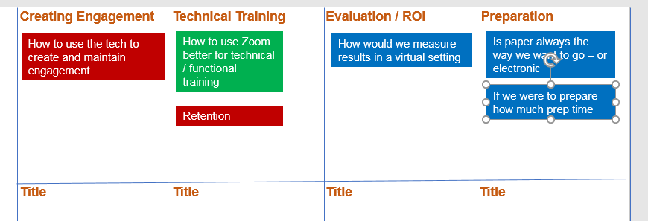
Personal Objectives
Notes:
This is an example of what the slide will look like after you paste the personal objectives onto this slide. Ask participants to put a checkmark next to anything that they feel they got some strategy, technique, or tool for. Have them put a question mark next to anything they sill have a question about.

Slide 16
Personal Objectives
Annotation
2 minutes
Notes:
Paste the personal objectives identified in the opening of the course here. Ask participants to put a checkmark next to anything that they feel they got some strategy, technique, or tool for. Have them put a question mark next to anything they sill have a question about.

Slide 17
Let’s Start with a Review
Course Content
Course Objectives
Personal Objectives
Parking Boards
Copyright 1992-2015, Leadership Strategies, Inc. V15.03
Notes:
Now that we have reviewed techniques to ensure our classroom training is implemented in our organizations, let’s move on to closing our training sessions…..Who can remember our suggestion for when you know the session is running behind?….Which team can review our best practices around addressing this situation?…..Great…
NOTE: The key is not to rush through the material – instead, to reduce scope/content and make informed decisions with the group.
Once we are ready to move to the close, these are the four key points to the closing…. Let’s take a look at each.

Slide 18

PARKING BOARDS
Actions
Coming Attractions
Issues
Duplication prohibited without consent
Notes:
MW: One slide; keep words; add image
To avoid having the Parking Boards becoming the “cemetery” – the place where things die next begin the review of these
Start clearing the Parking Boards by starting with the Issues List
Go over slide

Slide 19
H. Next Steps
H1. Identifying Your JEWELS
H2. Planning Change
Manual
143
Copyright 1992-2015, Leadership Strategies, Inc. V15.03

Slide 20

EVALUATION
20
Duplication prohibited without consent
Notes:
15782486
MW: One slide; keep words (I have reduced words); add image
A similar approach is taken with the objectives or key issues they offered during the opening
Ask if it was covered….if so, cross off that category
If not, ask if it needs to be covered now.
If not, ask what should be done. Either not important cover now or move to Action List for future
The key is that it demonstrates to the participants that what they thought was important was both noted and addressed
This can make a big impact on all of your meetings if you always begin with objectives, getting their objectives and then closing by showing they were addressed

Slide 21
E3. Course Evaluation
Pay it Forward!
You have benefited from the comments and suggestions from others who have taken the class, now it’s your turn to help others who come after you to benefit from your comments.
Take the 6-minute evaluation survey now…See link in the chatbox.
We will start back in 6-minutes.
-

Slide 22
Breakout: Key Learnings / Applications
Teams
8 minutes
Assign a new team leader.
In your teams, give people two minutes to think about what they will do in the next 30 days to implement their learnings.
Share responses with one another and select one person to share with the entire group what he/she will do.
-

Slide 23
Named Annotations
Annotation
3 minutes
What will you implement in the next 30 days?
Goe
Sue
Fred
Notes:
For a smaller group. Insert a table with everyone’s names and a space for them to annotate

Slide 24
If we can help…
Project Leadership Training
Assisting in developing your vision, project charter
Project Activation
Three-day workshop can be abbreviated to one or two days
Skills Training Courses
The Facilitative Consultant
The Effective Facilitator
Notes:
Several of you asked what other training is available….This slide is an outline of other courses that might be of interest to some or all of you……Let me briefly cover these tracks……..

Slide 25
What’s Next
Virtual Meetings 101
The Basics
A. Getting Started
B. Masterful Virtual Meeting Vision
C. Masterful Preparation
D. Masterful Start
E. Masterful Execution and Close
Virtual Meetings 201
Group Dynamics
F. Opening and Review
G. Managing Dysfunction
Masterfully
H. Addressing Disagreement Masterfully
Virtual Meetings 301
Advanced Techniques
I. Opening and Review
J. Setting up for Engagement
K. Virtual Engagement Strategies
L. Wrap-up and Close
-
The Facilitative Leader
The Facilitative Consultant
The Engaging Trainer
Copyright 1992-2020, Leadership Strategies, Inc. V20.04
Duplication prohibited without consent
Notes:
Here is our agenda for the next two days. Let’s take a look at the problems you have identified in your teams and see where we will be addressing each of the categories that we have identified.
[Ask teams which agenda item will address their typical meeting problems and map their grouped meeting problems to the appropriate agenda item. If there is a problem area/group, address how to handle that area]

Slide 26


Show How You Use Facilitation to be an Engaging Trainer
Have someone take a picture of you delivering your next training
Post on Facebook, LinkedIn, Twitter or Instagram with #effectivefacilitator and @Leadstrat
Monthly award to person with the most “Likes”!
@leadershipstrategies
@LeadStrat

Slide 27


Raving facilitators,
Share your power!
SHARE. In your first 30 days after this course, let your classmates know your success in using the tools and techniques. ‘Like’/follow us and post on our social media:
    Twitter - @leadstrat
    Facebook – www.facebook.com/leadstrat
    LinkedIn – search “Leadership Strategies”
JOIN THE COMMUNITY. Become part of the community of thousands of facilitators who have taken The Effective Facilitator or who are interested in facilitation. See how facilitation has helped others and share your story.
Download our meeting app - LeadStrat! Mini manual in the app!

Slide 28



Questions?
Notes:
[THIS SLIDE MAY OR MAY NOT BE INCLUDED →] We fundamentally believe facilitation is a skill that applies in a multitude of situations. We also are confident that in our quest to “share the power of facilitation with the world” that connecting via social media is a way for all of us to collectively share our successes, our challenges and our facilitation work. To “facilitate” that process, we want to ensure you are aware of how we can all stay connected using social media.
How many of you have found many of the skills in the class helpful? [raise your hand] I know that one of the things I did after attending was share what I learned with many of my colleagues. Have some of you already thought about that? [nod your head]
Then ,one request we would like to make of you is to update your “education or classes attended” on your LinkedIn profile. That visibility will help all of us to “share the power” I have been referring to. Any questions? [facilitate the discussion]

Slide 29



CONGRATULATIONS!
Be sure to download our meeting app, LeadStrat. Mini-manual in the app!
Notes:
So, let me now congratulate you [start the round of applause] and move to the class close [remember, model the close from Principle 9]

Slide 30
The Engaging Trainer Virtual Edition
Copyright 1992-2015, Leadership Strategies, Inc. V15.03
Duplication prohibited without consent

