Slide 1
The Engaging Trainer Virtual Edition
Copyright 1992-2015, Leadership Strategies, Inc. V15.03
Duplication prohibited without consent

Slide 2
A4. Agenda
DAY 1
DAY 2
DAY 3
Manual 6
Getting Started
Planning For Results
Review
Ex #2: Your Start
D. Delivering for Results
Review
  F. Confirming Results & Closing
  G. Managing Dysfunction
LUNCH
LUNCH
LUNCH
Ex #1: Experiential Learning
Starting with Impact
Homework
Ex #3: Inviting Participation
E. Managing Visual
Information
Homework
Ex #4: Redesigning Your Session for Results
H. Next Steps
Close
Manual
11
Copyright 1992-2015, Leadership Strategies, Inc. V15.03
Duplication prohibited without consent

Slide 3

F. CONFIRMING RESULTS AND CLOSING
Notes:
Timing: Between 45 and 60 minutes depending upon the size of the class
Flip Charts:
Flip Chart 1: Closing Techniques that are Best and Least Effective (1 flip chart per team)
Flip Chart 2: Course Objectives
Flip Chart 3: Personal Objectives
Flip Chart 4: Day One Agenda and Sample Agenda

Slide 4
F. Confirming Results and Closing
F1. Confirming Knowledge Transfer
F2. Reviewing to Close
F3. Evaluating
F4. Wrapping-Up
F5. Conducting the Debrief
-
Manual
107
Notes:
Checkpoint: We have just completed our review of the first few days with a game of Jeopardy!….What we are about to do next is address Confirming Results and Closing….. And, this module is important because the close has a lot to do with ensuring our training is “sticky” or has impact when our participants return to their day-to-day work. The way we close has so much to do with ensuring our participants leave with a commitment to implementing many of the new tools or techniques they have picked up during the training…… So, let’s get started with these five techniques or best practices.

Slide 5
F. Confirming Results and Closing
What are the tools we are using today for confirming results?
  Are there others that would “help us help them” to learn? To engage? To stimulate curiosity?
Which tools that we are using today are least effective?
  Why?
  What can we consider to improve them?
-
Notes:
Let’s start this by asking each team to share what they find are the most effective and least effective ways of confirming results…..To do that, let’s select a new team lead….Since this is our first engagement for today, I will ask you to select your team lead……Let’s all put our hands in the air, raise a finger (a nice one), and, on the count of 3, let’s point to the person on our team that was the most likely to succeed in the high school class…. Here we go – 1, 2, 3, point……OK, we have our team leads.
Let me ask each team to move to the flip chart closest to their team table…. Team lead, you will grab the marker and do the writing……I want you to think about the tools you use today as a part of confirming results in your training sessions – the tools that you find most beneficial, the ones that work best for you as well as those that you find least effective and just don’t work for you……Please make your lists…..And, be prepared to share with us the “whys” for the items on each list……Let’s get started… I will give you three minutes……Any questions?.....OK, let’s get started….
[At the end of the time, rotate from team-to-team and facilitate the debrief of each team’s flip charts.]
NOTE: Consider sharing with them the point that when we conduct an engagement similar to this prior to beginning a new topic, it helps us with at least two things – 1) identifying where the knowledge is deep and where it is not and 2) allowing us to avoid going deep in areas they already know…… In other words, we avoid teaching people what they already know.

Slide 6
Reconsidering Engagement Methods
Breakouts
8 minutes
The purpose of this activity is to share your experiences and insights and learn
from each other.
Old team leader selects new team leader.
Team leaders, record on a Word or other document your team's answers to the following questions:
1. What are the tools we are using today for confirming results?
  Are there others that would “help us help them” to learn? To engage? To stimulate curiosity?
2. Which tools that we are using today are least effective?
  Why?
  What can we consider to improve them?
When we return to the main group, team leaders will report out.
Questions?
Notes:
Let’s start this by asking each team to share what they find are the most effective and least effective ways of confirming results…..To do that, let’s select a new team lead….Since this is our first engagement for today, I will ask you to select your team lead……Let’s all put our hands in the air, raise a finger (a nice one), and, on the count of 3, let’s point to the person on our team that was the most likely to succeed in the high school class…. Here we go – 1, 2, 3, point……OK, we have our team leads.
Let me ask each team to move to the flip chart closest to their team table…. Team lead, you will grab the marker and do the writing……I want you to think about the tools you use today as a part of confirming results in your training sessions – the tools that you find most beneficial, the ones that work best for you as well as those that you find least effective and just don’t work for you……Please make your lists…..And, be prepared to share with us the “whys” for the items on each list……Let’s get started… I will give you three minutes……Any questions?.....OK, let’s get started….
[At the end of the time, rotate from team-to-team and facilitate the debrief of each team’s flip charts.]
NOTE: Consider sharing with them the point that when we conduct an engagement similar to this prior to beginning a new topic, it helps us with at least two things – 1) identifying where the knowledge is deep and where it is not and 2) allowing us to avoid going deep in areas they already know…… In other words, we avoid teaching people what they already know.

Slide 7

F1. CONFIRMING KNOWLEDGE TRANSFER
Notes:
Good morning, it is a pleasure to be here with you this morning. Welcome to The Effective Facilitator. You know, of all the courses we train people in at LSI, facilitation is personally my favorite. As we go along, I think you will see the reason. Why? Because I love facilitating. Although it is what we do for a living at LSI, most of us just cannot stop ourselves, whether it be a biz meeting, a client session, or a church board meeting. If things begin to stall out or get unfocused, we are the people in the room that will say, “If it’s OK, I’d like to try something that may help us focus a little better… May I?”
What is really great about facilitation is that the questioning techniques, the methods for focusing a group or building consensus go far beyond the business environment. These skills and techniques can be used in your social life as well. It works with family and friends. Whether you are trying to build a strategic plan, deciding where to take the family for vacation, or planning a surprise party for Grandma’s 70th birthday, facilitation will serve the purpose.
With that said, we realize that facilitation is an art, not a science. No one can tell you that if you do A, B and C you will end up with X, Y and Z. But, there are a set of broad fundamental principles that, if you use them and understand them, will serve you well.
Over the next (three) days, we are going to build a framework for you to use in facilitating sessions. The foundations of the framework are the 10 fundamental principles. What makes the framework so applicable are the 100+ techniques for applying the principles. In our time together, you will hear about the techniques, use them, and get feedback on them. We want to teach you how to be an extremely effective facilitator; and, in those rare moments when you are not, we want to provide a framework to help you understand why. It’s a fast-paced course, and we are not going to waste any time. When it’s over, our goal is to have you walk away saying this was one of the most productive (three) days you have spent in your life. If you think about it, that’s what facilitation is all about – making us all more productive!

Slide 8
F1. Confirming Knowledge Transfer
Reviewing for Knowledge Transfer
Testing and Quizzing
Dots
Jewels
Backward Build-up
Course Action Planning
Climate Checks
Support Groups
Course Action Plan
Simplified Course Action Plan
Contracting with Yourself
-
Manual
108-109
Notes:
We have just completed our engagement strategy to get us started…..Now, let’s move to some of the techniques we have listed, and let’s emphasize those that we have not covered in our engagement activity.

Slide 9

Reviewing for Knowledge Transfer
Repetition must be varied:
Tell
Show a slide
Give an example
Use a visual
Cover during review
Create a video clip
Types of Review
End-of-module/program review
Competition using dots
Competition using games
-
Manual
108-109
Notes:
So, let’s get started with the opening where we will cover the following 10 topics.

Slide 10
Testing and Quizzing
Written Tests or
Quizzes:
Oral Tests or
Quizzes:
Self-check
  Pre-test and Post-test
Reinforcement for all participants
Short, clear questions
Handle incorrect answers
Instruments
-
Manual
109-111
Notes:
So, let’s get started witWhat about tests and quizzes?…….What type of training is especially suited for these types of reviews? Good, compliance topics and, perhaps, new product knowledge would be some of those…...How about oral quizzes?…How many of you use these? (Raise your hand.)……How about how we have used some of these techniques in the last few days?……What have we done to avoid our friend, Dominating Don, from answering the questions we ask?..... That’s right – we typically direct questions to the teams and, on occasion, to an individual…….We have also used some round-robins.
h the opening where we will cover the following 10 topics.

Slide 11
Dots
Correct answers during discussion
Correct answers during oral quizzes
Participation or sharing
Helpfulness to another participant
Articulating a great way to use the material/skill back on the job
-
Manual
111-112
Notes:
How about dots? How many of you already use dots?.....Good, how many of you will try them based on how we have used them in our class the last few days?.... You know, what we have found is that some “healthy competition” raises those competitive juices and encourages engagement and the behaviors we want to see as facilitators.

Slide 12

Jewels
Have participants identify critical learning points.
The 10 Jewels
1.
2.
3.
Manual
112
Notes:
How about asking the participants to identify their jewels?.......How many use that technique?…..(Name), how do you do that in your sessions?..... Others?

Slide 13
Backward Build-up
Opening
Closing
Have a participant READ the description of the full item. Repeat the item yourself.
Point to where you are in the series on a graphic illustration.
Structure the KEY POINTS for each item in the series.
REVIEW the item and KEY POINTS.
Before going on to the next item, REVIEW prior items quickly.
From time to time, review the KEY POINTS of prior items.
-
Manual
113
Notes:
What about Backward Build-up? Do you know what we mean by that? …….OK, let me explain and point out a few places where we have done that over the last two+ days………You will find this technique will result in participants leaving the class with a lot more knowledge content through this varied reinforcement of the most important points…..Let me check in with each team and see how they believe we have used Backward Build-up the last few days….(Purple) team, get us started….. Now, on to the (blue) team, etc.

Slide 14

Backward Build-up Example - Opening
“Margaret, please read the description of the User Level Decision Maker on page 56.”
  “That’s right, the User Level Decision Maker is the one who provides input concerning how well the product performs.”
Four Levels of Decision Makers
User Level
Economic Level
“Here on the graphic you can see that the User Level Decision Maker falls between the Gatekeeper Level and the Influencer Level.”
“The User Level Decision Maker is knowledgeable about the general use of the product and may be more than one individual.”
Influencer Level
Gatekeeper Level
-
Manual
114
Notes:
Here is a good example of Backward Build-up. (Name), would you please take us through this slide?……Thanks… Any questions?

Slide 15
Backward Build-up Example - Closing
“Okay, we’ve just covered the Economic Level Decision Maker --- the person responsible for the decision to spend dollars or invest capital. This person is usually not accessible and may be one individual or a group (committee, board, etc.)”
“So, we started by discussing the Gatekeeper Level, the door opener. We moved to the User Level, the input person. Then, we talked about the Influencer Level, the person experienced in the selling situation. And, finally, the Economic Level Decision Maker, or the actual buyer.”
Four Levels of Decision Makers
User Level
Economic Level
Influencer Level
Gatekeeper Level
-
Manual
115
Notes:
Alright, another one for the closing…..(Name), your turn…..Read this for us……Thanks.

Slide 16

Course Action Planning
To maximize the effectiveness of “Action Planning:”
A specific skill the trainee identifies as having particular meaning or relevance
Should include a statement of commitment
Should include a specific date
Should be signed-off-on
Action Plan
-
Manual
116
Notes:
This is a great technique….. How many of you use this today? (Raise your hand.)....... In your organization you might find it very helpful, as we discussed before, to get the managers’ buy-in before the class…. Then, to put some “icing on the cake,” you might consider asking the participants to share their Course Action Plans with their managers in a future coaching session…. It is a great technique for holding ourselves accountable for application of new tips and/or techniques……. Does anyone use something like this today?........(Name), would you share how you do that?…….Thanks.

Slide 17
Sample Course Action Plan
Area
Purpose
Objectives
Critical Success Factors
Barriers
Resources
Initiatives
Time
Sign
Manual
117-118
Notes:
Here is a template of one Course Action Plan……

Slide 18

Sample Simplified Course Action Plan
-
One thing you will take from the course and apply back on-the-job
Manual
119
Notes:
And, a more simplified template….. We will share with you later today our From Classroom to Application format.

Slide 19

Sample Contract
My key learning's for this section:
In my current position, I can use this learning to:
I am going to share this information with:
I plan to develop my skills in this area by __________.
Manual
119
Notes:
Earlier in my career, I found it helpful to use a “Contract” between myself and my people…..I have also found this to be helpful between peers… It is another form of accountability to ensure we get impact from our training….. Who uses a Contract in some form today?…… (Name), would you share with us how you have implemented that?… Great……You can also “Contract” with yourself or try the Future’s Letter from our Engagement Strategies in your Appendix….or you may have them sent to “future participants” for use in a class to be held at a later date

Slide 20

Climate Checks
Subject | I know very little about this | I know this but need to practice | I am proficient with this one
Manual
120
Notes:
Climate checks….. Does anyone use these today?…..(Name), would you share with us first this time? And, then, I will review our example……. Good…. Let’s move on.

Slide 21
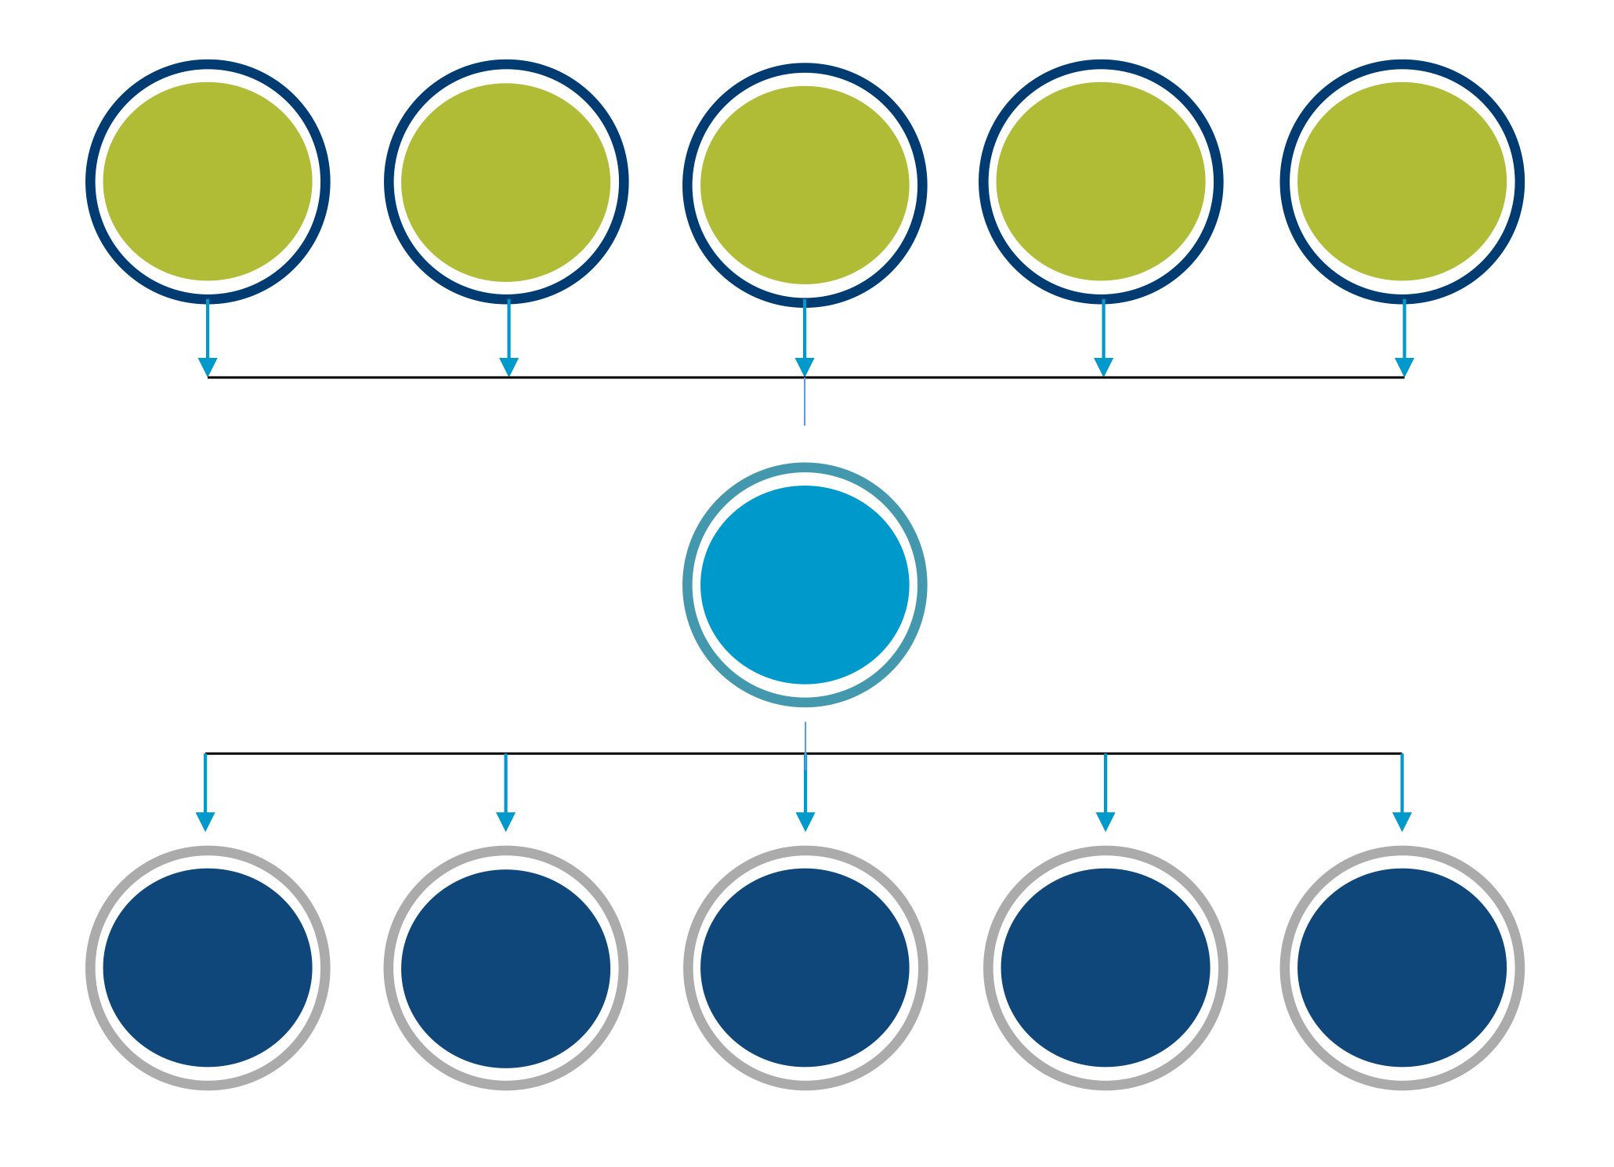
Support Groups
I will seek support from:
I will provide support to:
Manual
121
Notes:
Whether you use dyads, triads or group –to-group, these techniques are about helping each other in holding ourselves accountable for some post-course action …..Think of it as a form of assigning yourself another conscience…………. Has anyone else found these to be effective?……OK, (name), share with us how you have implemented these.

Slide 22
Review
What are four methods for confirming knowledge transfer?
Reviewing for Knowledge Transfer
Testing and Quizzing
Points
Jewels
Backward Build-up
Course Action Planning
Climate Checks
Support Groups
Notes:
OK, it is time for our Principle review. Let’s go from my right to left starting with the (purple) team [review, award dots, etc.]

Slide 23
Review
What are three ways you can use points to reinforce engagement and transfer of learning?
Correct answers during discussion
Correct answers during oral quizzes
Participation or sharing
Helpfulness to another participant
Articulating a great way to use the material/skill back on the job

Slide 24
Review
What are three methods for action planning?
Course Action Plan
Simplified Course Action Plan
Contracting with Yourself

Slide 25

F2. REVIEWING TO CLOSE
Notes:
OK, it is time for our Principle review. Let’s go from my right to left starting with the (purple) team [review, award dots, etc.]

Slide 26
Closing a Session – Close Books!
Annotation
2 minutes
  Imagine you have finished the last agenda item in what has been a great session. You want to wrap things up well. Think about all the things that need to happen for you to wrap up the session and leave the room. Think about the things you have to do with the people, with the materials, and so on. What are those things?
-

Slide 27
Closing a Session
Annotate
2 minutes
Red
Green
Blue
Purple

Slide 28
Closing a Session
Annotate
2 minutes
Red
Green
Blue

Slide 29
Closing a Session
Annotate
2 minutes

Slide 30

F2. Reviewing To Close
Course Content
Session Purpose
Personal Objectives
Parking Boards
-
Notes:
Now that we have reviewed techniques to ensure our classroom training is implemented in our organizations, let’s move on to closing our training sessions…..Who can remember our suggestion for when you know the session is running behind?….Which team can review our best practices around addressing this situation?…..Great…
NOTE: The key is not to rush through the material – instead, to reduce scope/content and make informed decisions with the group.
Once we are ready to move to the close, these are the four key points to the closing…. Let’s take a look at each.

Slide 31

Review Course Content
Review the content mentioning…
  Activities
  Exercises
Use slides or wall charts
-
Manual
122

Slide 32

Review Session Purpose
Ensure that the training objective purpose has been accomplished
Have participants confirm
-
Manual
122
Notes:
Then, go back to the course objectives and Review Session Purpose….. A nice technique here is to read (or have a participant read) each objective… And, then, ask the participants, “Did we accomplish this objective?”…. Wait for a response…Then, ask, “May I check this objective off?”……Do this for each objective…..It gives a sense of accomplishment to the participants…..We established the Purpose/Objectives at the session opening, and we now confirmed that at the end…..On to the……

Slide 33
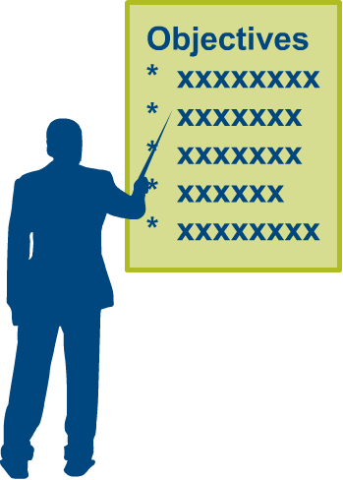
Review Personal Objectives
Step through the participants’ personal objectives that were documented early in the session
With each objective, ask “was this fulfilled?”
Check off each “yes,” circle each “no”
Discuss why the circled objectives were not met and what should be done to follow-up
-
Manual
122
Notes:
That’s right – the participants’ Personal Objectives….Remember, we asked for these at the beginning of the session, and we will confirm them at the end of the session…..Or, for those not accomplished, determine if they need to be addressed or not…..(Cover the slide points.)

Slide 34
Virtual Tip: Review Participants’ Key Topics
# | Name | Key Topic:
1 | Dorothy | Revisit best practices and keep discussion going
2 | Michael | Deal with tech glitches
3 | Lisa | Get better interactive online activities
4 | Ben | Good overview of all things virtual
5 | Tim | How to get people engaged. Interactive
6 | Susan | More ideas and to experience engagement strategies
7 | Janice | Details to make virtual sessions continually engaging
8 | Leigh Ann | Learn and watch
9 | Christina | Keep the attention of others. Those on call paying attention
10 | Steve | Rusty. All the little tips, tricks, best practices.
11 | Chris | Apply facilitation skills
12 | Cathy | Everything mentioned. Better facilitator
13 | Bill | More tips and tricks. Smooth and as polished as in face to face
Manual
9-3
Notes:
HERE IS AN EXAMPLE SLIDE BOARD USED TO REVIEW PARTICIPANT KEY TOPICS

Slide 35

Review Parking Boards
Review the Coming Attractions board to address participant issues that arose
For each, ask:
  Have we covered it?
  Should the item be placed on the Action List?
-
Manual
123
Notes:
Now, it is time to ensure the Parking Boards do not become the cemeteries…. You know – the place where all parked items die…. No, this technique will ensure that we address every item on each of the three Parking Boards……First, the Coming Attractions List……

Slide 36
Review Parking Boards
Review the Issues List to address participant issues that arose
Issues List
For each, ask:
  Have we covered it?
  Should the item be placed on the Action List
Manual
123
Notes:
Now, it is time to ensure the Parking Boards do not become the cemeteries…. You know – the place where all parked items die…. No, this technique will ensure that we address every item on each of the three Parking Boards……First, the Coming Attractions List……

Slide 37
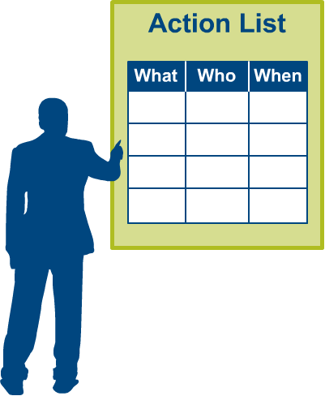
Review Parking Boards
Review the Action List
  Confirm who has agreed to do what and by when
-
Manual
123
Notes:
And, then to the Action List…..(Cover the slide.)

Slide 38
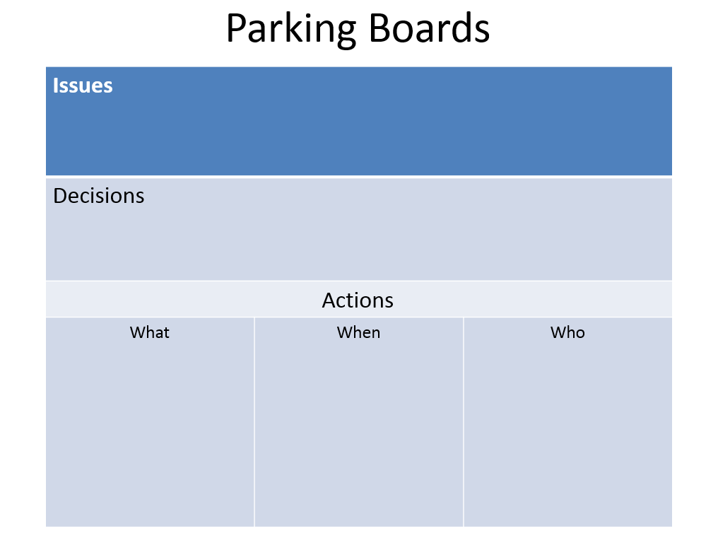
Virtual Tip: Review Parking Boards
Manual
9-4

Slide 39

F3. EVALUATING

Slide 40
F3. Evaluating
Evaluate
Session
Facilitator/ Trainer
Performance
Comments
Feedback is a critical part of the continuous improvement cycle
Encourage specific comments
Do a group review if possible
-
Manual
124
Notes:
Now that we have done our Review, let’s move to the Evaluate phase of the close…..How many of us do not want to improve? (Raise your hand.)....That’s good – nobody…. Well, the Evaluating process is about continuous feedback…..We want to ask people what we did well and also what we can do to make things even better……Let me ask each team to share one technique you use to get feedback on what you are doing that is resonating as well as areas for improvement…. Get us started, (green) team….(Go from team to team.)
NOTE: Point out some ways to get feedback such as:
Pluses and Deltas
More of and Less of
Things We Liked and Things to Make Future Sessions Even Better
Gain feedback at an interim point if you think that would help a session get better.
Note the four areas we are evaluating….Let’s discuss each one…
Session: Things like which module was best or most beneficial; which was least
Facilitator: How did the facilitator(s) do in terms of items like responsiveness to the group, responding to questions, engaging the participants?
Performance: Against session and personal objectives
Comments: Specifics on things that were really good and things to make the session better

Slide 41
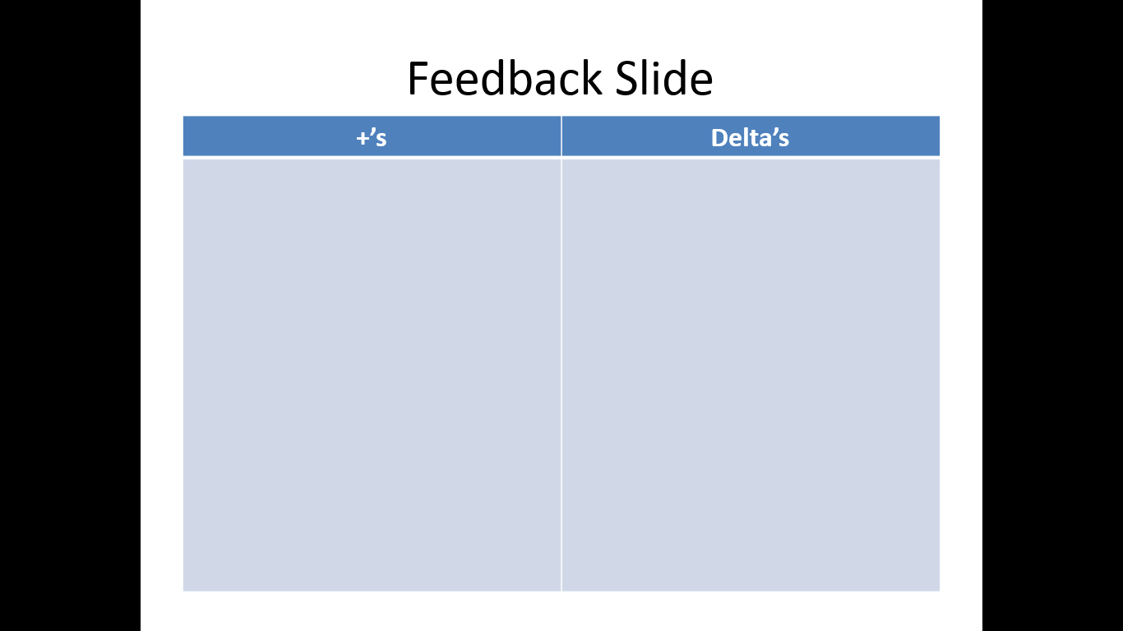
Virtual Tip: Ask Participants to Evaluate
Use a whiteboard, slideboard or screen share to document the feedback.
Encourage specific comments – whether positive or negative.
Not in Manual
Notes:
SAMPLE FEEDBACK SLIDE
Use a whiteboard, slideboard or screen share to document the feedback.
Encourage specific comments – whether positive or negative.

Slide 42
Virtual Tip: Feedback Slide
More Of | Less Of

Slide 43
Virtual Tip: Feedback Slide
Things We Liked | Ways to Make It Better

Slide 44

F4. WRAPPING UP

Slide 45
F4. Wrapping Up
Close and Set the Stage
Thank the participants for their participation
Remind participants of the next step if necessary:
  Place, date, time, and topic of the next session
  Certificates
  Travel expenses, etc.
-
Formally end the session
Manual
126
Notes:
It is now time to Wrap Up…….So, remember that the participants invested their time…. Thank them for their time and engagement……Then, where appropriate, remind them of any next steps with the necessary details like where/when with information on things like travel arrangements, reimbursement, etc…..And, then, formally end the session.

Slide 46
F4. Wrapping Up
Partial Close
DO
DON’T
Use a partial close if the program has several components
Review the participant objectives
Evaluate
Hold the debriefing session
-
Manual
126
Notes:
Returning to our multiple-day training sessions, here are those things that we cover at the end of each component or day, and the items on the right should be covered only at the end of the entire session…..As the facilitator, I often find it helpful to review the participant objectives at the end of each day to ensure I have a plan for addressing those that are appropriate……. Any other points you would like to make or further questions?

Slide 47

F5. CONDUCTING THE DEBRIEF

Slide 48
F5. Conducting the Debrief
Meet with the course sponsor, other trainers and/or designers:
  Session objectives?
  Participation?
  Content?
    Did it work? Taught correctly?
    Add or delete?
  Any confusion?
  Exercises and activities?
  Timing?
  Participant comments?
-
Redesign
  Yes
  No
Manual
127
Notes:
Then, let’s ensure we conduct a debrief session with the sponsor, other trainers and course designers…… Some of the important items to cover in these debriefs are listed on the slide……. Has someone conducted a debrief session in the recent past? (Raise your hand.)……(Name), would you share with us the items you addressed and how you conducted this debrief?
One last note – the nearer to the end of the training session you can conduct the debrief, the fresher the material will be and the most benefit you will accrue from this important step…

Slide 49
Virtual Tip: Conducting the Debrief
When debriefing virtual training add:
Did the participants effectively use the necessary features of the virtual meeting platform?
Should additional features be introduced in future sessions?
-
Not in Manual

Slide 50

REVIEW
Notes:
Let’s do some review of what we have just covered [use teams, award dots, etc.]

Slide 51
Review
What are the four parts of the closing sequence?
Review
Evaluate
Close
Debrief

Slide 52
Review
What are the questions to clear the Coming Attractions board?
Have we covered it?
Should the item be placed on the Actions list?

Slide 53
Review
What are the three parts of the action list?
What
Who
When

Slide 54
Review
What are the items to evaluate for a facilitated session?
Session
Facilitator
Performance
Comments

Slide 55
Review
What are the steps to close a facilitated session?
Thank participants
Remind participants of next steps
  Confirm place, date, time and purpose of any next session
Formally end the session

Slide 56
F. Confirming Results and Closing
F1. Confirming Knowledge Transfer
F2. Reviewing to Close
F3. Evaluating
F4. Wrapping-Up
F5. Conducting the Debrief
Notes:
Checkpoint: We have just completed our review of the first few days with a game of Jeopardy!….What we are about to do next is address Confirming Results and Closing….. And, this module is important because the close has a lot to do with ensuring our training is “sticky” or has impact when our participants return to their day-to-day work. The way we close has so much to do with ensuring our participants leave with a commitment to implementing many of the new tools or techniques they have picked up during the training…… So, let’s get started with these five techniques or best practices.

Slide 57

Introvert Minute Best Practices

Slide 58
The Engaging Trainer Virtual Edition
Copyright 1992-2015, Leadership Strategies, Inc. V15.03
Duplication prohibited without consent

