Slide 1
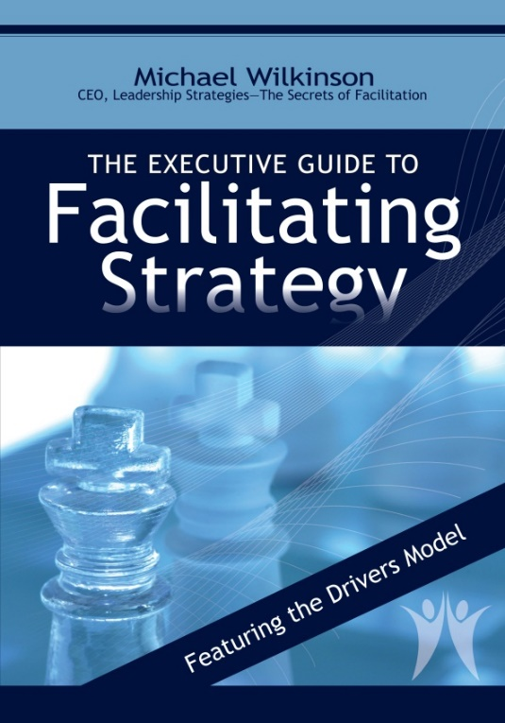
Strategic Thinking
& Alignment
A Special Session for CDC Leaders
(Adapted from our training workshop,
Secrets to Facilitating Strategy)

Slide 2
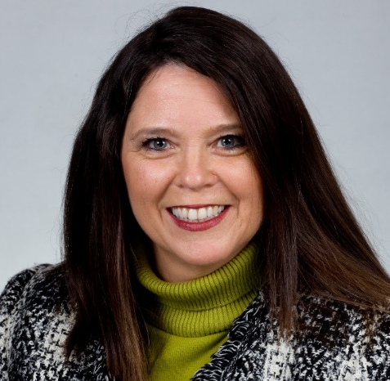
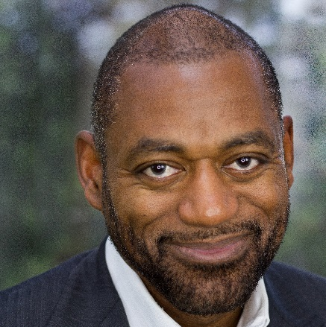
Getting Started
Facilitator
Moderator
Patty Gaddis
Business Development Manager
Michael Wilkinson, CMF™
Founder and Managing Director
Notes:
[SPEAKER: Patty]
I’ll introduce our presenter, Michael Wilkinson, in just a moment.

Slide 3

Who is Leadership Strategies?
A market leader in facilitation training and services
(currently in our 25th year)
Over 25,000 trained in facilitation and strategy
Over 600 facilitators under contract (FindaFacilitator.com)
9 out of 38 Certified Master Facilitators™ (INIFAC)
Public workshops in over 10 major U.S. cities, and wherever you are (virtual and private, onsite)
-

Slide 4
Who is Leadership Strategies?
Office of the Director
National Center for HIV, STD and TB Prevention
National Center for Infectious Diseases
National Center for Injury Prevention and Control
National Immunization Project
Division of Cancer Prevention and Control
Division of Diabetes Translation
Division of HIV/AIDs Prevention
Division of Reproductive Health
CDC University
Community Outreach Branch
Community Health and Program Services Branch
Health Information Systems and Survey Board
Human Resource Management Office
Information Resource Management Office
Management Analysis and Systems Office
Office of Health and Safety
Office of Enterprise Communication
Office of Minority Health
Office of Women’s Health
Office of Public Health and Preparedness Response
Incident Management Training and Development Program
Strategy Partner
of Choice
for CDC

Slide 5



Our Presenter
Michael Wilkinson, CMF ™
Founder and Managing Director at Leadership Strategies
Author of five books, including
  The Secrets of Facilitation
  The Executive Guide to
  Facilitating Strategy
Board Member, International Institute for Facilitation
Inducted into the International Facilitation Hall of Fame
-

Slide 6
A. Session Objectives
Offer a meaningful definition of “Strategic Thinking” that gets beyond the nebulous business speak
Provide a “Strategic Roadmap” for guiding “Strategic Thinking”
Introduce the core competencies and tools for leveraging the power of “Strategic Thinking” and alignment
-
Notes:
[SPEAKER: Patty]
We know many of you belong to organizations who are either acting on or developing solid strategic plans to reach your goals, and are perhaps looking for ways to ensure that you go about developing plans that have solid input, consensus, and buy-in. If your current strategy hasn’t been producing the results you expected, or you’re gearing up for how to manage your efforts heading into next year, this webinar today will help you either modify your current strategic plan or develop one for the year ahead.
You’ll walk away with an understanding of:
strategic planning – how we define it at Leadership Strategies and the best process and components to incorporate in planning
why most plans fail, the key pitfalls, and ways to avoid the high failure rate of most plans!
strategies for selling the plan inside – so that you’re engaging other leaders at your organization and gaining true buy-in
and next steps to learn more – since we can’t cover everything about strategic planning best practices in 60 minutes alone

Slide 7
Your Key Topics
What are the most important topics you want to ensure are discussed around strategic thinking or strategic planning?

Slide 8
Session Agenda
A. Session Objectives
B. What is Strategic Thinking?
C. The Drivers Model
D. From Strategic Thinking to
Strategic Planning
E. A Sample Strategic Plan
F. The Strategy Process
G. Why Most Plan Fail
H. Three-Step Monitoring Process
I. The Leadership Briefing
J. The 10 Pitfalls to Avoid
K. Practice in Strategic Thinking
L. Special Applications of
the Drivers Model
M. Your Key Points
N. For Those Wanting to Learn More
-
Notes:
[SPEAKER: Patty]
Today, we will run through:
Strategic planning – what it is and the process and components to do it RIGHT
The executive briefing – how you can sell the plan inside for buy-in and implementation
Next steps
And again, we’ll wrap up a brief Q&A session.

Slide 9
B. What is Strategic Thinking
Manual
Page 3
The process in which one or more people assess the current, envision a future, and define a path for creating that future.

Slide 10
Strategic Thinking Example #1
GTE and NEC
Telephone
Switching
Semi-
Conductors
Regional
Telephone
Telecomm
Products
-
Lighting
Products
Computers
Semi-
Conductors

Slide 11
Strategic Thinking Example #1
GTE and NEC
Telephone
Switching
Semi-
Conductors
Regional
Telephone
Telecomm
Products
-
Lighting
Products
Computers
Semi-
Conductors

Slide 12

Strategic Thinking Example #2
The Atlanta Airport

Slide 13
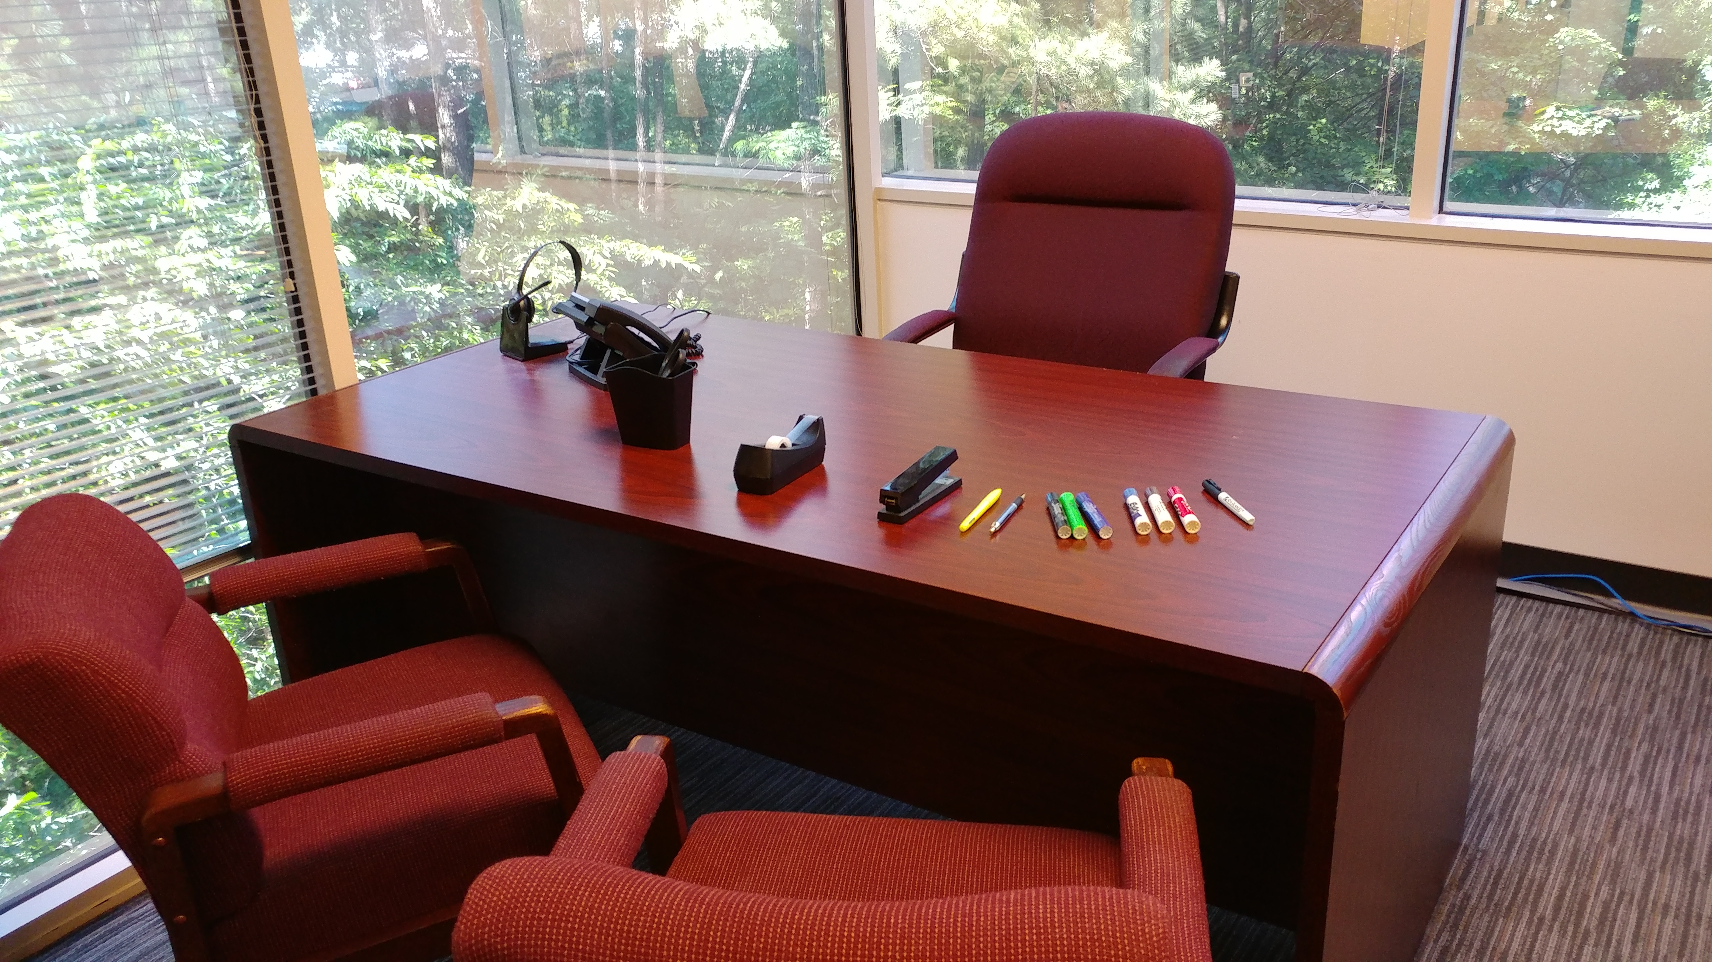
Strategic Thinking Example #3
Leadership Strategies
  From Home Office to …?

Slide 14
Session Agenda
A. Session Objectives
B. What is Strategic Thinking?
C. The Drivers Model
D. From Strategic Thinking to
Strategic Planning
E. A Sample Strategic Plan
F. The Strategy Process
G. Why Most Plan Fail
H. Three-Step Monitoring Process
I. The Leadership Briefing
J. The 10 Pitfalls to Avoid
K. Practice in Strategic Thinking
L. Special Applications of
the Drivers Model
M. Your Key Points
N. For Those Wanting to Learn More
-
Notes:
[SPEAKER: Patty]
Today, we will run through:
Strategic planning – what it is and the process and components to do it RIGHT
The executive briefing – how you can sell the plan inside for buy-in and implementation
Next steps
And again, we’ll wrap up a brief Q&A session.

Slide 15








C. The Drivers Model
Manual
Page 5
Barriers
-
Monitor
CSFs
CSFs

Slide 16
The Drivers Model – Buying a Home
3.5 baths
Private office
Playroom
Barriers
$600K - $30K down payment
High credit card balances
Find a House
Savings plan $600/month
CSFs
Work weekends $600/month
Cut up credit cards
-
MONITOR!
View 10/homes month
CSFs
X - Floors, paint, rain
 - Neighbors, attic

Slide 17
The Drivers Model
The 5 Key Points
Think you are here
1. Start with an accurate picture of today!

Slide 18
The Drivers Model
2. Create a Shared Vision
1. Start with an accurate picture of today!

Slide 19
The Drivers Model
2. Create a Shared Vision
1. Start with an accurate picture of today!

Slide 20
The Drivers Model
2. Create a Shared Vision
3. Understand your Barriers and CSFs
Barriers
CSFs
CSFs
1. Start with an accurate picture of today!

Slide 21
The Drivers Model
2. Create a Shared Vision
3. Understand your Barriers and CSFs
Barriers
4. Define your Drivers
CSFs
CSFs
1. Start with an accurate picture of today!

Slide 22
The Drivers Model
2. Create a Shared Vision
3. Understand your Barriers and CSFs
Barriers
4. Define your Drivers
CSFs
5. MONITOR!
CSFs
1. Start with an accurate picture of today!

Slide 23
Session Agenda
A. Session Objectives
B. What is Strategic Thinking?
C. The Drivers Model
D. From Strategic Thinking to
Strategic Planning
E. A Sample Strategic Plan
F. The Strategy Process
G. Why Most Plan Fail
H. Three-Step Monitoring Process
I. The Leadership Briefing
J. The 10 Pitfalls to Avoid
K. Practice in Strategic Thinking
L. Special Applications of
the Drivers Model
M. Your Key Points
N. For Those Wanting to Learn More
-
Notes:
[SPEAKER: Patty]
Today, we will run through:
Strategic planning – what it is and the process and components to do it RIGHT
The executive briefing – how you can sell the plan inside for buy-in and implementation
Next steps
And again, we’ll wrap up a brief Q&A session.

Slide 24
Poll #1: Group’s Experience Level
How many strategic planning efforts have you been involved with in the past?
0
1-2
3-5
6-10
More than 10
Notes:
SPEAKER: Michael; commentary by Patty

Slide 25
D. From Strategic Thinking to Strategic Planning
Terms and Definitions
A Sample Strategic Plan
Why Do Most Plans Fail?
The Ten Pitfalls

Slide 26
Terms and Definitions
Manual
Page 6
Vision
Mission
Guiding Principles
Goals
Objectives
Critical Success Factors
Barriers
Strategies
Actions

Slide 27
Session Agenda
A. Session Objectives
B. What is Strategic Thinking?
C. The Drivers Model
D. From Strategic Thinking to
Strategic Planning
E. A Sample Strategic Plan
F. The Strategy Process
G. Why Most Plan Fail
H. Three-Step Monitoring Process
I. The Leadership Briefing
J. The 10 Pitfalls to Avoid
K. Practice in Strategic Thinking
L. Special Applications of
the Drivers Model
M. Your Key Points
N. For Those Wanting to Learn More
-
Notes:
[SPEAKER: Patty]
Today, we will run through:
Strategic planning – what it is and the process and components to do it RIGHT
The executive briefing – how you can sell the plan inside for buy-in and implementation
Next steps
And again, we’ll wrap up a brief Q&A session.

Slide 28
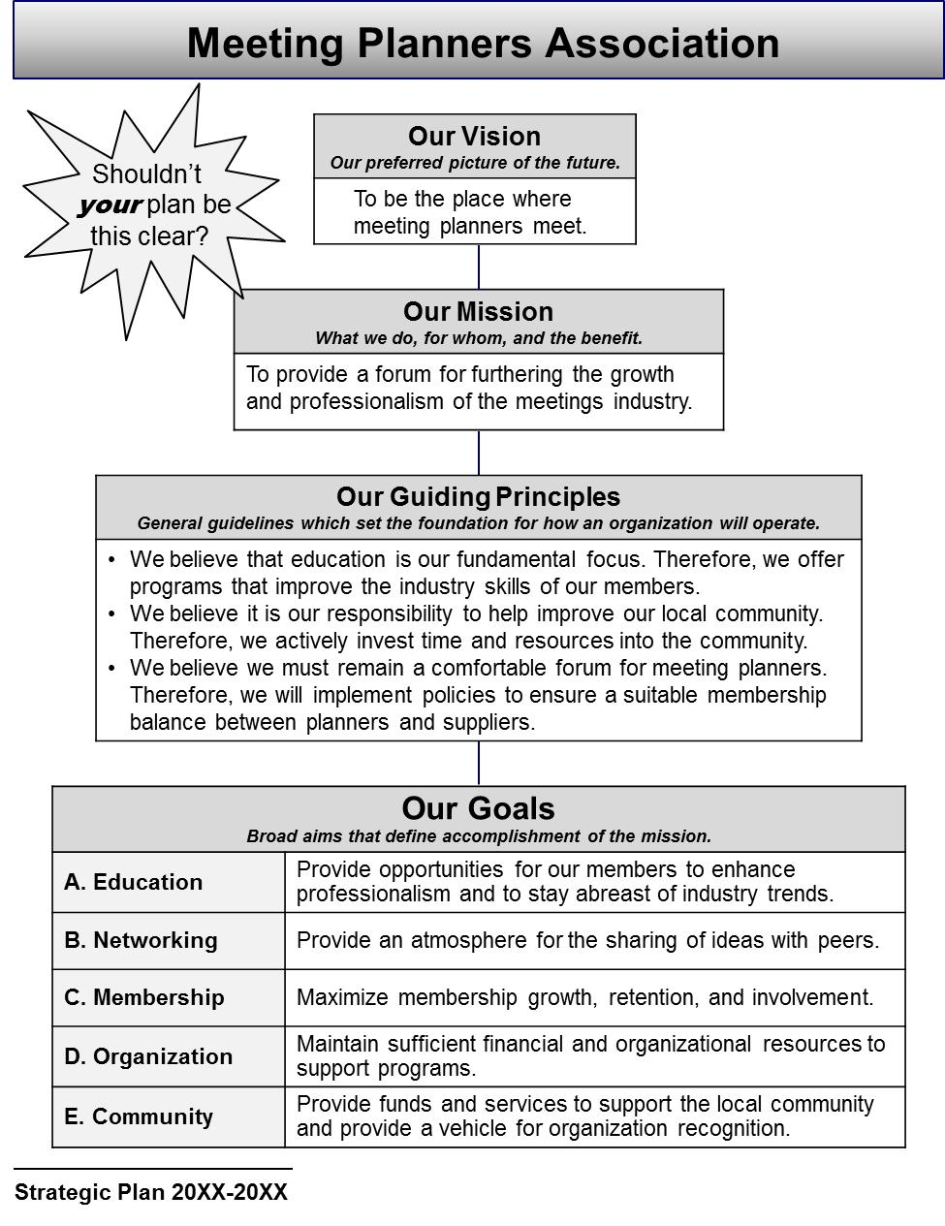
E. A Sample Strategic Plan
Manual
Page 8
Front Page
The Drivers Model typically produces four-page plan layouts –easily-digestible and portable documentation that do not sit on shelves!
The front page typically features:
  Vision
  Mission
  Guiding Principles
  Goals

Slide 29
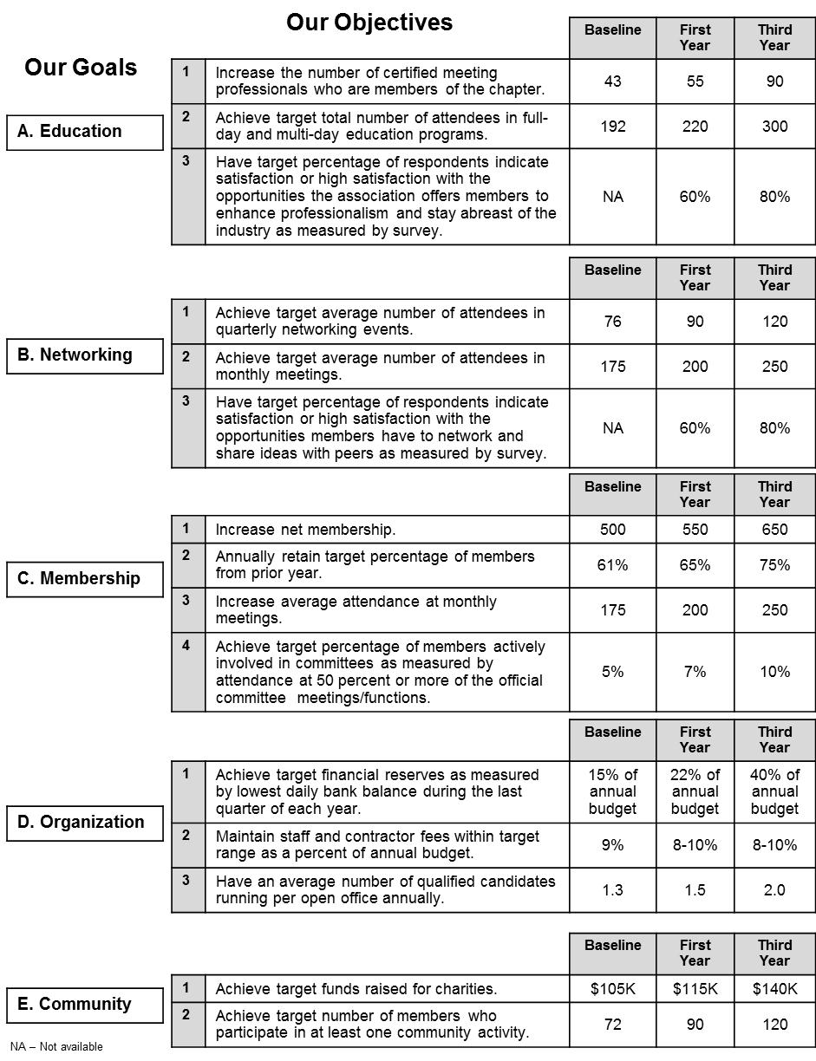
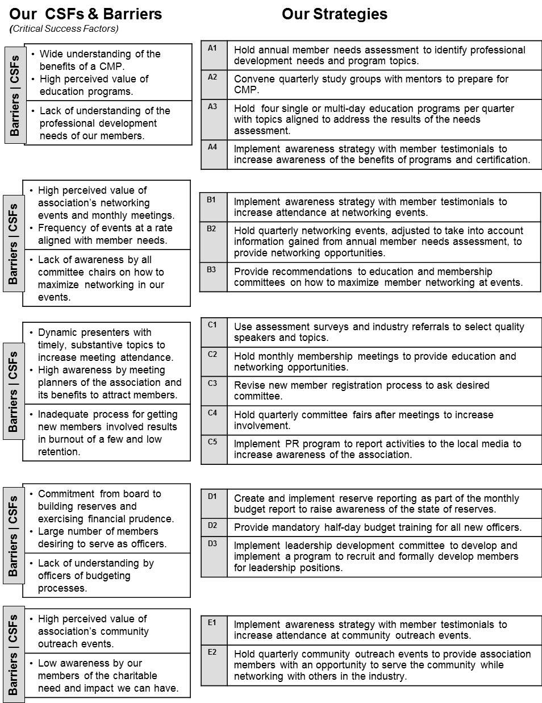
E. A Sample Strategic Plan
Interior Pages

Slide 30
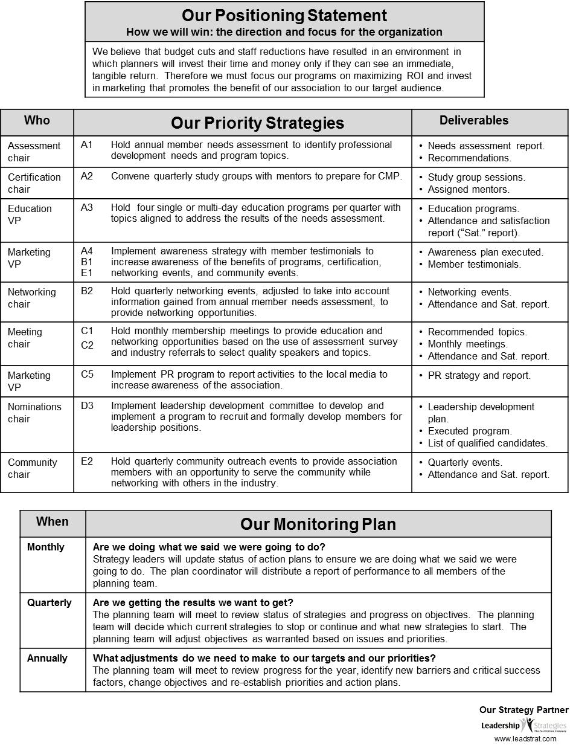
E. A Sample Strategic Plan
Back Page
The back page
often features:
  Positioning Statements
  Responsibilities for Priority Strategies
  Monitoring Plan

Slide 31
Action Plans
Additional
Series of 1-2 page Action Plans; one for each Priority Strategy
Strategy: | C5. Implement PR program to report activities to the local media
Objectives Supported: | Membership: 1. Increase net membership Membership: 2. Increase average attendance at monthly meetings
Owner: | Marketing VP
Deliverables: | PR strategy and report
Due Date: | Feb 1 / Year 2 | Person-Days: | 27 | Total Costs: | $9,500
Action Step | Who | Due | Person-Days | Costs
1. Assemble new PR Team | Exec Committee | Feb 1 | 1 | N/A
2. Develop PR objectives | PR Team | Feb 15 | 3 | N/A
3. Develop promotion program | PR Team | Mar 1 | 3 | N/A
4. Hold Board presentation on PR strategy to gain approval | PR Team, Board | Mar 15 | 1 | N/A
5. Develop assets for PR strategy | PR Team | May 1 | 15 | $9,500
6. Assess promotion effectiveness | PR Team | Jan 15 / Y2 | 2 | N/A
7. Produce PR report of results | PR Team | Feb 1 / Y2 | 2 | N/A
Action Plans
Specific steps to be taken,
by whom, and by when, to implement a Priority Strategy.
-

Slide 32
Poll #2: Mission – True or False?
The mission of an organization defines the preferred picture of the future of that organization.
Answer: FALSE
Why: The VISION defines the preferred picture of the futures, whereas the MISSON is a statement of the organization’s overall purpose.
-

Slide 33
Sample Vision, Mission
Manual
Page 13
Vision
The preferred picture of the future
Our Vision
To be the place where meeting planners meet.
Vision answers:
If you are successful at achieving your mission, what will the future look like?
Our Mission
To provide a forum for furthering the growth and professionalism of the meetings industry.
Mission
A statement of the overall purpose of the organization
CDC Vision? (former)
Healthy people in a healthy world.
-
Mission answers:
What do we do?
For whom do we do it?
What’s the benefit?
CDC Mission? (former)
To promote health and quality of life
by preventing the spread of disease
and disability.

Slide 34
Sample Goals, Objectives
Manual
Page 14
Goals
Broad, long-term aims that define accomplishment of the mission
Membership Goal
Maximize membership growth, retention and involvement.
Objectives
Specific, quantifiable, realistic targets that measure the accomplishment of a goal
Membership Objectives
Increase net membership from 500 to 650. Annually retain 75% of members from the prior year. Increase average attendance from 175 to 250 per meeting. Achieve 10% committee involvement.
What’s the difference between goals and objectives?
What happens if you have goals but no objectives?
What happens if you have objectives but no goals?
-

Slide 35
Goal: Maximize membership growth.
What is wrong with the objective below?
Objective: “Hold two membership drives this year.”
Specific Measurable Achievable Realistic Time-bound
-
The Problem: It measures ACTIVITY not RESULTS

Slide 36
Poll #3: Goal or Objective
Is this a goal or an objective?
“Increase membership in the alumni association by at least 15%.”
Answer: OBJECTIVE
-

Slide 37
Sample Critical Success Factors, Barriers, Strategies
CSFs, Barriers, Strategies
Manual
Page 15
Membership Objectives
Increase net membership from 500 to 650. Annually retain 75% of members from the prior year. Increase average attendance from 175 to 250 per meeting. Achieve 10% committee involvement.
Critical Success Factors
Key conditions that must be created to achieve one or more objectives
Barriers
Existing or potential challenges that hinder the achievement of objectives.
Strategies
Broad activities required to achieve an objective, create a critical condition, or overcome a barrier
Critical Success Factors
High awareness by meeting planners of the association and its benefits Dynamic presenters with timely, substantive topics
Barriers
Inadequate process for getting new members involved results in burn-out of a few and low retention High membership turnover hinders consistent growth
Strategies
Use assessment surveys and industry referrals to select quality speakers and topics. Revise new member registration process to ask desired committee.
-
Why would an organization invest in a strategy that DID NOT address
something critical to their success or a major barrier standing in their way?
-
37

Slide 38
Action Plan
Series of 1-2 page Action Plans; one for each Priority Strategy
Strategy: | C5. Implement PR program to report activities to the local media
Objectives Supported: | Membership: 1. Increase net membership Membership: 2. Increase average attendance at monthly meetings
Owner: | Marketing VP
Deliverables: | PR strategy and report
Due Date: | Feb 1 / Year 2 | Person-Days: | 27 | Total Costs: | $9,500
Action Step | Who | Due | Person-Days | Costs
1. Assemble new PR Team | Exec Committee | Feb 1 | 1 | N/A
2. Develop PR objectives | PR Team | Feb 15 | 3 | N/A
3. Develop promotion program | PR Team | Mar 1 | 3 | N/A
4. Hold Board presentation on PR strategy to gain approval | PR Team, Board | Mar 15 | 1 | N/A
5. Develop assets for PR strategy | PR Team | May 1 | 15 | $9,500
6. Assess promotion effectiveness | PR Team | Jan 15 / Y2 | 2 | N/A
7. Produce PR report of results | PR Team | Feb 1 / Y2 | 2 | N/A
Action Plans
Specific steps to be taken,
by whom, and by when, to implement a Priority Strategy.
-

Slide 39

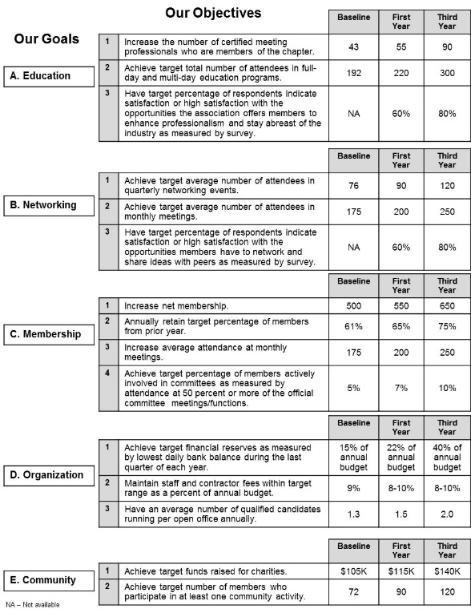
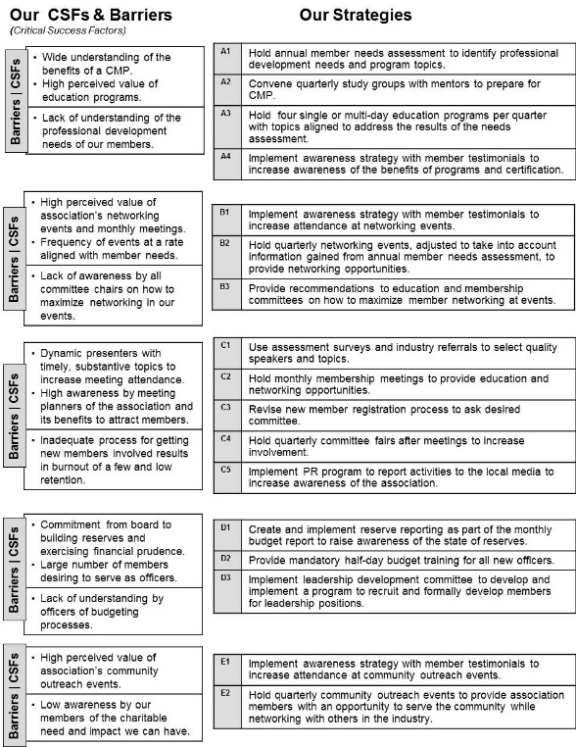
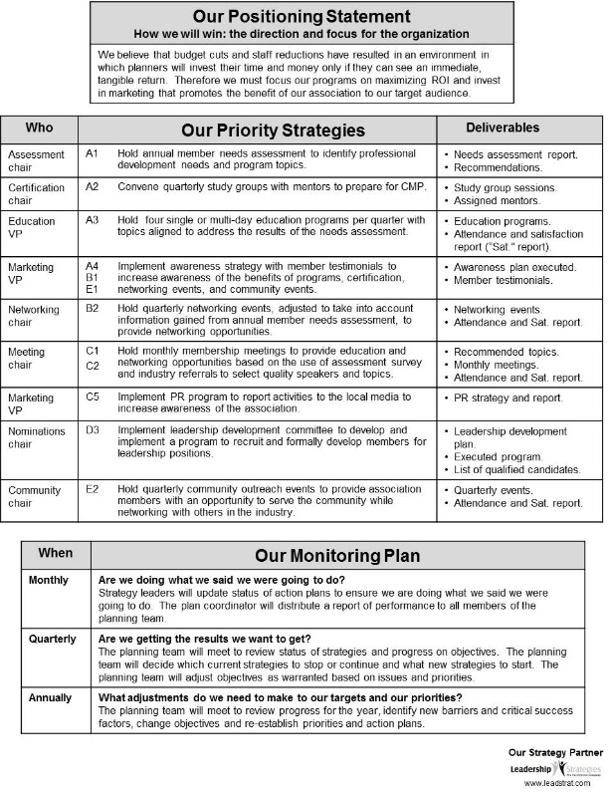
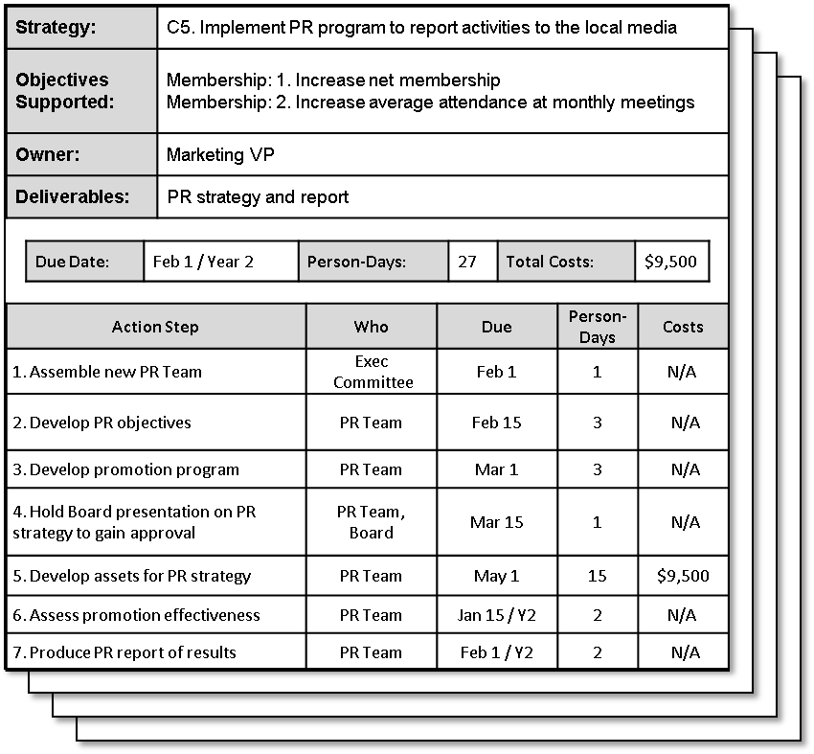
Strategy Sessions
Manual
Page 17
Strategic Direction
Implementation Planning
-
Action Planning

Slide 40
Session Agenda
A. Session Objectives
B. What is Strategic Thinking?
C. The Drivers Model
D. From Strategic Thinking to
Strategic Planning
E. A Sample Strategic Plan
F. The Strategy Process
G. Why Most Plan Fail
H. Three-Step Monitoring Process
I. The Leadership Briefing
J. The 10 Pitfalls to Avoid
K. Practice in Strategic Thinking
L. Special Applications of
the Drivers Model
M. Your Key Points
N. For Those Wanting to Learn More
-
Notes:
[SPEAKER: Patty]
Today, we will run through:
Strategic planning – what it is and the process and components to do it RIGHT
The executive briefing – how you can sell the plan inside for buy-in and implementation
Next steps
And again, we’ll wrap up a brief Q&A session.

Slide 41
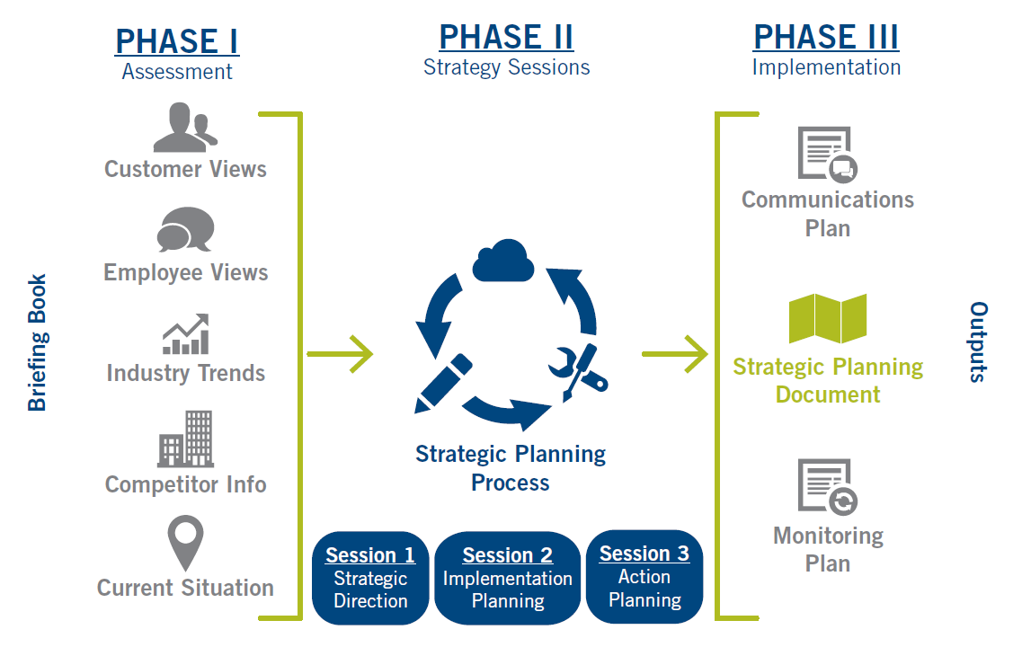
F. The Strategy Phases
Manual
Page 19
PHASE I
Assessment
PHASE II
Strategy Sessions
PHASE III
Implementation
-

Slide 42
Session Agenda
A. Session Objectives
B. What is Strategic Thinking?
C. The Drivers Model
D. From Strategic Thinking to
Strategic Planning
E. A Sample Strategic Plan
F. The Strategy Process
G. Why Most Plan Fail
H. Three-Step Monitoring Process
I. The Leadership Briefing
J. The 10 Pitfalls to Avoid
K. Practice in Strategic Thinking
L. Special Applications of
the Drivers Model
M. Your Key Points
N. For Those Wanting to Learn More
-
Notes:
[SPEAKER: Patty]
Today, we will run through:
Strategic planning – what it is and the process and components to do it RIGHT
The executive briefing – how you can sell the plan inside for buy-in and implementation
Next steps
And again, we’ll wrap up a brief Q&A session.

Slide 43

Manual
Page 20
QUESTION: Why do most plans fail?

Slide 44
The Strategy Phases
-

Slide 45
The Stephen Covey Urgent/Important Matrix
Manual
Page 20
URGENT
NOT URGENT
IMPORTANT
Vital client issues
Major deadlines
Crisis
Strategic Plan!
-
NOT IMPORTANT
Other people’s crises
Some emails and calls
Purposeless meetings
Workplace gossip
Busywork
Aimless surfing

Slide 46
The Stephen Covey Urgent/Important Matrix
Manual
Page 20
URGENT
NOT URGENT
IMPORTANT
Vital client issues
Major deadlines
Crisis
Strategic Plan!
-
NOT IMPORTANT
Other people’s crises
Some emails and calls
Purposeless meetings
Workplace gossip
Busywork
Aimless surfing

Slide 47
5 Keys to Accountability
Manual
Page 21
Defined work
Accepted responsibility
Monitoring and reporting progress
Rewards for achievement
Consequences for inadequate performance

Slide 48
Session Agenda
A. Session Objectives
B. What is Strategic Thinking?
C. The Drivers Model
D. From Strategic Thinking to
Strategic Planning
E. A Sample Strategic Plan
F. The Strategy Process
G. Why Most Plan Fail
H. Three-Step Monitoring Process
I. The Leadership Briefing
J. The 10 Pitfalls to Avoid
K. Practice in Strategic Thinking
L. Special Applications of
the Drivers Model
M. Your Key Points
N. For Those Wanting to Learn More
-
Notes:
[SPEAKER: Patty]
Today, we will run through:
Strategic planning – what it is and the process and components to do it RIGHT
The executive briefing – how you can sell the plan inside for buy-in and implementation
Next steps
And again, we’ll wrap up a brief Q&A session.

Slide 49
H. Three-Step Monitoring Process
Manual
Page 22
Monthly
Did we do what we said we were going to do?
Review status of priority strategies.
Quarterly
Annually
-

Slide 50
Three-Step Monitoring Process
Sample Dashboard Summary
 |  | Jan | Feb | Mar | Apr | May
 | Done 100
 | >75% 75
 | <75% 50
C1 | Use assessment surveys and industry referrals to select quality speakers and topics
C3 | Revise new member registration process to ask desired committee
D2 | Provide mandatory half-day budget training for all new officers

Slide 51
Three-Step Monitoring Process
Sample Dashboard Summary |  | 77% C+
 |  | Jan | Feb | Mar | Apr | May
 | Done 100 | 3
 | >75% 75 | 6
 | <75% 50 | 2
C1 | Use assessment surveys and industry referrals to select quality speakers and topics
C3 | Revise new member registration process to ask desired committee
D2 | Provide mandatory half-day budget training for all new officers

Slide 52
Three-Step Monitoring Process
Sample Dashboard Summary |  | 77% C+ | 89% B+
 |  | Jan | Feb | Mar | Apr | May
 | Done 100 | 3 | 7
 | >75% 75 | 6 | 3
 | <75% 50 | 2 | 1
C1 | Use assessment surveys and industry referrals to select quality speakers and topics
C3 | Revise new member registration process to ask desired committee
D2 | Provide mandatory half-day budget training for all new officers

Slide 53
Three-Step Monitoring Process
Sample Dashboard Summary |  | 77% C+ | 89% B+ | 91% A-
 |  | Jan | Feb | Mar | Apr | May
 | Done 100 | 3 | 7 | 8
 | >75% 75 | 6 | 3 | 2
 | <75% 50 | 2 | 1 | 1
C1 | Use assessment surveys and industry referrals to select quality speakers and topics
C3 | Revise new member registration process to ask desired committee
D2 | Provide mandatory half-day budget training for all new officers

Slide 54
Three-Step Monitoring Process
Sample Dashboard Summary |  | 77% C+ | 89% B+ | 91% A- | 84% B
 |  | Jan | Feb | Mar | Apr | May
 | Done 100 | 3 | 7 | 8 | 6
 | >75% 75 | 6 | 3 | 2 | 3
 | <75% 50 | 2 | 1 | 1 | 2
C1 | Use assessment surveys and industry referrals to select quality speakers and topics
C3 | Revise new member registration process to ask desired committee
D2 | Provide mandatory half-day budget training for all new officers

Slide 55
Three-Step Monitoring Process
Sample Dashboard Summary |  | 77% C+ | 89% B+ | 91% A- | 84% B | 95% A
 |  | Jan | Feb | Mar | Apr | May
 | Done 100 | 3 | 7 | 8 | 6 | 10
 | >75% 75 | 6 | 3 | 2 | 3 | 1
 | <75% 50 | 2 | 1 | 1 | 2 | 0
C1 | Use assessment surveys and industry referrals to select quality speakers and topics
C3 | Revise new member registration process to ask desired committee
D2 | Provide mandatory half-day budget training for all new officers

Slide 56
Three-Step Monitoring Process
Monthly
Did we do what we said we were going to do?
Review status of priority strategies.
Quarterly
Are we making the progress we intended to make?
Review performance against objectives.
Annually
Are we going in the right direction?
Update the strategic plan.
-

Slide 57
Session Agenda
A. Session Objectives
B. What is Strategic Thinking?
C. The Drivers Model
D. From Strategic Thinking to
Strategic Planning
E. A Sample Strategic Plan
F. The Strategy Process
G. Why Most Plan Fail
H. Three-Step Monitoring Process
I. The Leadership Briefing
J. The 10 Pitfalls to Avoid
K. Practice in Strategic Thinking
L. Special Applications of
the Drivers Model
M. Your Key Points
N. For Those Wanting to Learn More
-
Notes:
[SPEAKER: Patty]
Today, we will run through:
Strategic planning – what it is and the process and components to do it RIGHT
The executive briefing – how you can sell the plan inside for buy-in and implementation
Next steps
And again, we’ll wrap up a brief Q&A session.

Slide 58
I. What is a Strategy Briefing?
Manual
Page 23
A 60- to 90-minute session where the team answers:
(in-person or virtually)
What are the most important issues the plan must address?
How does the Drivers Model typically work?
What changes must we make to the Drivers Model to ensure all of our issues are addressed?
What information do we need to gather in advance?
How shall we move forward?
-

Slide 59
I. Benefits of an Executive Briefing
Agreement on the issues to be addressed
Team buy-in on the process
A common strategy language
A customized approach to fit your team’s needs
The information to gather and assignments for gathering it
Increased commitment to participate and follow through
-
Your Secret Weapon for Selling the Plan Inside!

Slide 60
Session Agenda
A. Session Objectives
B. What is Strategic Thinking?
C. The Drivers Model
D. From Strategic Thinking to
Strategic Planning
E. A Sample Strategic Plan
F. The Strategy Process
G. Why Most Plan Fail
H. Three-Step Monitoring Process
I. The Leadership Briefing
J. The 10 Pitfalls to Avoid
K. Practice in Strategic Thinking
L. Special Applications of
the Drivers Model
M. Your Key Points
N. For Those Wanting to Learn More
-
Notes:
[SPEAKER: Patty]
Today, we will run through:
Strategic planning – what it is and the process and components to do it RIGHT
The executive briefing – how you can sell the plan inside for buy-in and implementation
Next steps
And again, we’ll wrap up a brief Q&A session.

Slide 61
J. The Ten Pitfalls to Avoid
Manual
Page 24
Not planning
Not including key people in the planning effort
Planning before undertaking a situation assessment
Develop a mission statement first
Confusing goals and objectives
Measuring activity instead of results
Jumping straight to strategies after developing objectives
Not developing detailed action plans for strategies
Not gaining buy-in before implementing the plan
Not monitoring the plan
Not planning
Not including key people in the planning effort
Planning before undertaking a situation assessment
Develop a mission statement first
Confusing goals and objectives
Measuring activity instead of results
Jumping straight to strategies after developing objectives
Not developing detailed action plans for strategies
Not gaining buy-in before implementing the plan
Not monitoring the plan
___________
____ ________
___________ _______________
__________ ____________
_______ ____________
_________ ________
____________
________ ______
____ ___
_____________
Notes:
Key Points
Have former team leaders appoint a new team leader.
Give the teams 5 minutes to fill in the blanks to the 10 pitfalls; have the team leaders record the responses in their manuals
After the 5 minutes, collect the manuals of team leaders and pass the manual to the next team leader to score.
Have the entire group give the answer to each of the ten pitfalls, and ask team leaders to check the ones that are correct.
At the end have the team leaders add up the number of checks to get a score for the team and pass the manuals back to the team leader whose book they scored.
Award the winning team with applause.

Slide 62
Session Agenda
A. Session Objectives
B. What is Strategic Thinking?
C. The Drivers Model
D. From Strategic Thinking to
Strategic Planning
E. A Sample Strategic Plan
F. The Strategy Process
G. Why Most Plan Fail
H. Three-Step Monitoring Process
I. The Leadership Briefing
J. The 10 Pitfalls to Avoid
K. Practice in Strategic Thinking
L. Special Applications of
the Drivers Model
M. Your Key Points
N. For Those Wanting to Learn More
-
Notes:
[SPEAKER: Patty]
Today, we will run through:
Strategic planning – what it is and the process and components to do it RIGHT
The executive briefing – how you can sell the plan inside for buy-in and implementation
Next steps
And again, we’ll wrap up a brief Q&A session.

Slide 63
K. Practice Strategic Thinking
Manual
Page 25
During this workshop time, you will have the opportunity to practice putting the strategic thinking tools into application.
You will join with 2 or 3 other members of the class and choose a topic area for applying the tools.
You may choose a program, a department, or an entire organization. As well, you might choose an existing project, an anticipated project, or something the team makes up (e.g., starting a restaurant).
Once your team chooses the organization/project for strategic thinking, record it in your manual.
-

Slide 64
1. Mission
Manual
Page 26
A mission statement is a statement of the overall purpose of an organization. The mission states:
- What you do
- For whom you do it
- The benefit.
Examples
Our mission is to provide consumers with high quality, price competitive automobiles to meet their transportation needs.
To promote health and quality of life by preventing and controlling disease, injury, and disability.
-

Slide 65
Mission - Quality Check
Does the mission statement broadly describe the overall purpose of the organization?
Does the mission statement indicate the industry or market that the organization serves?
Does the mission statement contain enough specificity to distinguish this organization's mission from that of other organizations in the same industry?
-

Slide 66
Sample Mission Statements
What
For Whom
Benefit
Industry
To combine aggressive strategic marketing with quality products and services at competitive prices to provide the best insurance value for consumers.
To create superior value for our customers, employees, communities, and investors through the production, conversion, delivery, and sale of energy and energy services.
To help our clients achieve their financial objectives by serving as their tax and financial partner.
To organize the world's information and make it universally accessible and useful.
(Aflac)
(Duke Energy Corporation)
(H&R Block)
(Google)
-

Slide 67
Sample Mission Statements
What
For Whom
Benefit
Industry
We are a market-focused, process-centered organization that develops and delivers innovative solutions to our customers, consistently outperforms our peers, produces predictable earnings for our shareholders, and provides a dynamic and challenging environment for our employees.
We will provide branded products and services of superior quality and value that improve the lives of the world's consumers.
(Ashland Oil)
(Global Gillette)
-

Slide 68
Sample Mission Statements
What
For Whom
Benefit
Industry
The Company's primary objective is to maximize long-term stockholder value, while adhering to the laws of the jurisdictions in which it operates and at all times observing the highest ethical standards.
(Dean Foods Corporation)
-

Slide 69
Mission – Success Strategies
Once the goals have been identified, review the mission statements of other organizations.
Discuss the strengths and weaknesses of various mission statements.
Review the goals of your organization.
Break-up into teams to develop candidate mission statements that incorporate the ideas within the goals.
-

Slide 70
Mission – Success Strategies
Review the mission statements; identify strengths of each.
Select as a starting point the mission statement receiving the most support; spend a few minutes editing with the group.
Avoid wasting too much time having the entire planning team "word smith" the mission by assigning a writing committee to assemble a draft for later review.
-

Slide 71
Breakout: Mission Statement
What do we do?
For whom?
What’s the benefit?
Mission/Purpose

Slide 72
2. Goals
Manual
Page 28
Goals are broad, long-term aims that define accomplishment of the mission.
Example
"Profitability - Maximize growth and profitability"

Slide 73
Goals - Quality Check
As a group, do the goals represent all of the key areas of strategic focus for the organization?
Have brief descriptions been provided for each of the goals?
Do the descriptions adequately explain the overall aim of each goal?
-

Slide 74
Goals - Quality Check
Are the goals global in scope and exclude references to specific quantities or time frames?
If we achieve these goals, and only these goals, will we most likely have fulfilled its mission?
Sample Infinite Verbs | Sample Finite Verbs
Provide Maximize Promote Maintain | Establish Develop Implement Build
-

Slide 75
Goals – Success Strategies
1. After completing the visioning exercise, review each small group's visioning items.
2. Identify common or critical themes (not quantities or time frames) among the groups.
3. Word the common themes generically enough to ensure that the points within each group's visioning results are included in one or more of the common/critical themes.
-

Slide 76
Goals – Success Strategies
4. Once the common themes are agreed upon, provide definitions to each one by asking, "What words describe our intention with this goal?" Use the vision elements from the visioning exercise as a guide.
5. Ask, "If we achieve these broad goals, does this mean we are successful? Is anything missing?"
-

Slide 77
Breakout: Goals
Brainstorm success elements for your area, by identify up to ten accomplishments for the future. Group the elements into categories to define your goal areas.
Develop a goal statement for one of the goal areas,
Make sure the goals start with an “infinite” verb and not a “finite” verb.
-
-
Sample Infinite Verbs | Sample Finite Verbs
Provide Maximize Promote Maintain | Establish Develop Implement Build

Slide 78
3. Objectives
Manual
Page 31
Objectives are specific, quantifiable, realistic targets that measure the accomplishment of a goal over a specified period.
-
Examples
Increase revenues by 12% annually.
Limit increases in overhead costs to 2% over the next year.
Achieve a 5% annual reduction in management staff through increased automation.

Slide 79
Objectives
Two ways to look at objectives
-
The Moon | The Mountains
Set very high, potentially unrealistic expectations. If you miss, at least you will have achieved something.
Set high, but realistic, objectives. If you don't achieve them, be upset.

Slide 80
Objectives - Quality Check
Are the objectives SMART?
  Specific, Measurable, Achievable, Relevant, Time-bound
Do the objectives measure results and not just activity?
Ask: “If all the objectives are achieved, will the goal be accomplished?”
-
Objective Verbs | Strategy Verbs
Increase Reduce Achieve Maintain Have | Establish Develop Implement Revise Utilize

Slide 81
Objectives – Success Strategies
Determine the “yard stick,” or “measures” by goal area.
Determine which measures are the best indicators.
Convert the measures into objectives by defining specific targets.
For each objective, set the baseline & interim milestones.
Note: It may be necessary to recommend changes to the wording of the goal in order to set reasonable, measurable objectives.
-

Slide 82
Breakout: Objectives
Develop objectives for the goal statement you created.
Make sure your objectives are SMART!
Specific-Measurable-Achievable-Relevant-Time Bound
Objective | Baseline | 1st Year | 3rd Year

Slide 83
4. Critical Success Factors
Manual
Page 34
Critical Success Factors are key conditions that must be created to achieve one or more objectives.
Example – Ford Motor Company
What are the key conditions, if they create them, will drive their success in beating Toyota and Honda?
-

Slide 84
CSFs - Quality Check
Have the most critical conditions that must be created to achieve the objectives been identified?
Are the CSFs stated as nouns with conditional adjectives (e.g., “effective dealer network”) and not as verbs (e.g., “develop”)?
Do you have at least two and no more than seven CSFs per goal?
-

Slide 85
CSFs – Success Strategies
Steps
Review the objectives for each goal and ask yourself, “What key conditions must be created for these objectives to be achieved?"
Limit your CSFs to those things that can be impacted by the organization.
A goal typically has no fewer than two, and no more than seven.
Don't just restate the objectives.
-
-
-

Slide 86
5. Barriers
Manual
Page 35
Barriers are existing or potential challenges that hinder the achievement of one or more objectives.
Examples
Inefficient northeast plant.
Price competition from Japanese manufacturers.
Public perception of poor quality by domestic manufacturers.
-

Slide 87
Barriers - Quality Check
Have the major barriers impacting success been identified?
Are the barriers phrased in such a way as to encourage strategies for overcoming them?
Do the barriers avoid duplication with the critical success factors?
-

Slide 88
Barriers – Success Strategies
Steps
Review the objectives for each goal and ask, "Why aren't these objectives achieved already? What is standing in our way?"
Consider starting the barrier with “Lack of”, “Insufficient” or “Inadequate.”
-

Slide 89
Barriers – Success Strategies
Steps
Limit your barriers to those things that can be impacted by the organization.
It is NOT necessary to have a critical success factor and barrier in the same area.
A goal typically has no fewer than two, and no more than seven.
-

Slide 90
Exercise: CSF / Barriers
Develop CSFs and barriers for the goal area.
CSFs | Barriers

Slide 91
6. Strategies
Manual
Page 37
Strategies are broad activities required to achieve an objective, control a critical success factor, or overcome a barrier.
Examples
Establish partnership with Japanese manufacturer to revamp the northeast plant.
Implement program to widely promote our success as a quality producer.
-

Slide 92
Strategies – Quality Check
Are the strategies phrased as activities to be accomplished and NOT results to be achieved?
Do the strategies address the critical factors and barriers?
If the strategies are implemented is it highly likely that the objectives will be achieved?
-
Objective Verbs | Strategy Verbs
Increase Reduce Achieve Maintain Have | Establish Develop Implement Revise Utilize

Slide 93
Strategies – Success Strategies
Steps
Review the objectives to identify one or more key strategies to address the objective.
Review the critical success factors.
Review the barriers.
Review potential strategies identified earlier.
Combine strategies where appropriate.
-

Slide 94
Exercise: Strategies
Develop strategies for the goal area, being sure to address the CSFs and barriers.
Make sure the strategies start with a strategy verb.
Objective Verbs | Strategy Verbs
Increase Reduce Achieve Maintain Have | Establish Develop Implement Revise Utilize
-

Slide 95
Session Agenda
A. Session Objectives
B. What is Strategic Thinking?
C. The Drivers Model
D. From Strategic Thinking to
Strategic Planning
E. A Sample Strategic Plan
F. The Strategy Process
G. Why Most Plan Fail
H. Three-Step Monitoring Process
I. The Leadership Briefing
J. The 10 Pitfalls to Avoid
K. Practice in Strategic Thinking
L. Special Applications of
the Drivers Model
M. Your Key Points
N. For Those Wanting to Learn More
-
Notes:
[SPEAKER: Patty]
Today, we will run through:
Strategic planning – what it is and the process and components to do it RIGHT
The executive briefing – how you can sell the plan inside for buy-in and implementation
Next steps
And again, we’ll wrap up a brief Q&A session.

Slide 96
L. Special Applications of the Drivers Model
Managing Your Boss
What does your boss believe are
her most important objectives?
Barriers
What does your boss believe is
standing in the way of her success?
Monitor!
How will you ensure that
what you are doing is recognized and valued by your boss?
-
CSFs
What are you doing, or not doing, to overcome
the barriers or achieve the key conditions?
CSFs
What does your boss believe are
key conditions for her success?
96 | 6-25

Slide 97
L. Special Applications of the Drivers Model
Change Management
The Vision of Change
Barriers
Barriers to Change
Monitor!
-
Monitoring Change
CSFs
The Drivers of Change
CSFs
The Case
for Change
The Key Conditions
for Change
97 | 6-23

Slide 98
L. Special Applications of the Drivers Model
Coaching
Vision of Success
- Behaviors
- Measures of success
Barriers
Barriers to Success
Monitor!
-
Monitor Progress
CSFs
Strategies for Success
CSFs
- Strengths
- Areas for Improvement
Key Conditions
for Success
98 | 6-24

Slide 99
L. Special Applications of the Drivers Model
Having a Coaching Conversation
Where are you today? (Your strengths, areas for improvement)
Where would you like to be? What’s your vision of success?
What do you see as the barriers to getting there? Why aren’t you there already?
What are your critical success factors? What are the conditions, that if they are created, well propel you to your vision?
What are key strategies for getting there? What help do you need from the organization?
What do you start on first?
How will we monitor progress?
-
99 | 6-24

Slide 100
Session Agenda
A. Session Objectives
B. What is Strategic Thinking?
C. The Drivers Model
D. From Strategic Thinking to
Strategic Planning
E. A Sample Strategic Plan
F. The Strategy Process
G. Why Most Plan Fail
H. Three-Step Monitoring Process
I. The Leadership Briefing
J. The 10 Pitfalls to Avoid
K. Practice in Strategic Thinking
L. Special Applications of
the Drivers Model
M. Your Key Points
N. For Those Wanting to Learn More
Notes:
[SPEAKER: Patty]
Today, we will run through:
Strategic planning – what it is and the process and components to do it RIGHT
The executive briefing – how you can sell the plan inside for buy-in and implementation
Next steps
And again, we’ll wrap up a brief Q&A session.

Slide 101
M. Your Key Points
As you consider the key points made in the workshop, what are the topics or concepts you found to be the most valuable?
__________________________________________________
__________________________________________________
__________________________________________________
__________________________________________________

Slide 102
Your Action Strategies
What is one thing that you can do within the first month after this workshop to begin using the JEWELS you identified?
__________________________________________________
__________________________________________________
__________________________________________________
__________________________________________________

Slide 103




N. For Those Wanting to Know More…
PROMOTE
PROVIDE
MODEL
Looking to introduce strategy to your team or organization?
Looking to train your team or organization in strategic planning?
Looking to secure a facilitator for an upcoming session?
-
Strategy Briefing
Strategy Training
Strategy Facilitation
Notes:
Add the third option – (promote) Looking to introduce strategy to your team or organization? Strategy Briefing – DONE
Strat fac – model – DONE
Strat training – provide – DONE

Slide 104
Strategic Thinking Training
-
Monitor
What is our overall goal?
How will we measure success?
What is critical for our success, and
what is standing in our way?
What will we do?
How will we monitor our progress?

