Slide 1
The Facilitative Leader

Slide 2


6 | Facilitating Your Strategy
-

Slide 3
Checkpoint
1 | Getting Started, Facilitating Yourself
2 | Facilitating Communication
3 | Facilitating and Coaching Individuals
4 | Facilitating Your Team
5 | Facilitating Agreement
6 | Facilitating Your Strategy
7 | Facilitating Meetings Part 1
8 | Facilitating Meetings Part 2
Notes:
OK, while we have this methodology diagram in front of us, let’s go back to our grouped objectives. [Go back to each category from the grouped objectives collected earlier and ask the group where that item will be covered. Match their objectives to the principles – essentially the agenda for the class – and demonstrate how to adapt the agenda to meet the need for any group that will not map to a principle.]

Slide 4
TAFA - What does it mean to “Take a Facilitative Approach?”
The Seven TAFA Principles
Start with the why, not with the what.
Understand and empower, don’t command and control.
Create the vision, not the solution.
Connect first; correct second.
Equip for success; monitor for results.
Engage conflict; resolve dysfunction.
Drive participation, not just input.
-
S
U
C
C
E
E
D

Slide 5
Ground Rules
Always open for questions
The open issues list
Respect the speaker
Avoid “bar discussion”
Start on time, end on time
Repetition to train the mind
No beeps or buzzes
Team Cheers
“Choo Choo”

Slide 6


Your Materials
Course manual
Spring Forward exercise packet
Mini manual
Mobile App: Search “LeadStrat” or “Leadership Strategies”
-
Slide # | Manual #

Slide 7
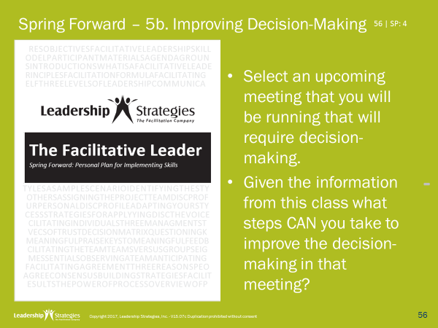
Homework Review
Which meeting did you select?
How did you define consensus?
What strategies did you use to get to consensus?

Slide 8
6 | Facilitating Your Strategy
Strategic Planning: The Drivers Model
Sample Strategic Plan Part I: Mission, Vision, Goals, Objectives
Exercise 6a: Defining Goals and Objectives
Sample Strategic Plan Part II: CSFs, Barriers, Strategies, Actions
The Strategy Process
Why Most Plans Fail
Three-Step Monitoring Process
The Leadership Briefing
The 10 Pitfalls to Avoid
Special Applications of the Drivers Model
-

Slide 9
6 | Facilitating Your Strategy
Strategic Planning: The Drivers Model
Sample Strategic Plan Part I: Mission, Vision, Goals, Objectives
Exercise 6a: Defining Goals and Objectives
Sample Strategic Plan Part II: CSFs, Barriers, Strategies, Actions
The Strategy Process
Why Most Plans Fail
Three-Step Monitoring Process
The Leadership Briefing
The 10 Pitfalls to Avoid
Special Applications of the Drivers Model

Slide 10
A. Strategic Planning: The Drivers Model
What Strategic Planning Often Looks Like
Executive management sets the overall vision for the organization, identifies the key strategies to achieve the vision, and establishes the critical measures to monitor progress.
Why are the arrows going down?
Strategic Plan
-
Top-Down Planning
Bottom-Up Results
Dept. Plan
Dept. Plan
Dept. Plan
Project
Plan
Policies / Procedures
Project
Plan
Policies / Procedures
Project
Plan
Policies / Procedures
Key Concept LINKAGE
10 | 6-2

Slide 11
A. Strategic Planning: The Drivers Model
The 4 Strategic Questions
Where are we today?
Where do we want to be?
What do we do to get there?
How will we monitor our progress?
-
11 | 6-2

Slide 12



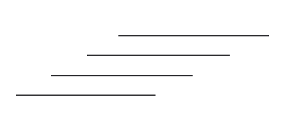

A. Strategic Planning: The Drivers Model
The Drivers Model
Barriers
-
Monitor!
CSFs
√
√
√ √
X
X
X
X
CSFs
12 | 6-3

Slide 13
A. Strategic Planning: The Drivers Model
Purchasing a House
3.5 Baths
Private office
Playroom
Barriers
$300K - $15K Down Payment
High Credit Card Balances
-
Monitor!
Find a House
Savings plan $300/month
CSFs
Work weekends $300/month
Cut up credit cards
View 10/homes month
CSFs
X - Floors, paint, rain
√ - Neighbors, attic
13 | 6-3

Slide 14
A. The Drivers Model
5 Key Points
Barriers
Belief
1. Start with an accurate picture of today!
14 | 6-3

Slide 15
A. Strategic Planning: The Drivers Model
5 Key Points
2. Create a Shared Vision
1. Start with an accurate picture of today!
15 | 6-3

Slide 16
A. Strategic Planning: The Drivers Model
5 Key Points
2. Create a Shared Vision
3. Understand your Barriers and CSFs
Barriers
CSFs
CSFs
1. Start with an accurate picture of today!
16 | 6-3

Slide 17
A. Strategic Planning: The Drivers Model
5 Key Points
2. Create a Shared Vision
3. Understand your Barriers and CSFs
-
Barriers
5. Monitor
CSFs
4. Define your Drivers
CSFs
1. Start with an accurate picture of today!
17 | 6-3

Slide 18
6 | Facilitating Your Strategy
Strategic Planning: The Drivers Model ☑
Sample Strategic Plan Part I: Mission, Vision, Goals, Objectives
Exercise 6a: Defining Goals and Objectives
Sample Strategic Plan Part II: CSFs, Barriers, Strategies, Actions
The Strategy Process
Why Most Plans Fail
Three-Step Monitoring Process
The Leadership Briefing
The 10 Pitfalls to Avoid
Special Applications of the Drivers Model

Slide 19

A SAMPLE STRATEGIC PLAN: Meeting Planners
A. Sample Strategic Plan Part I: Mission, Vision, Goals, Objectives

Slide 20
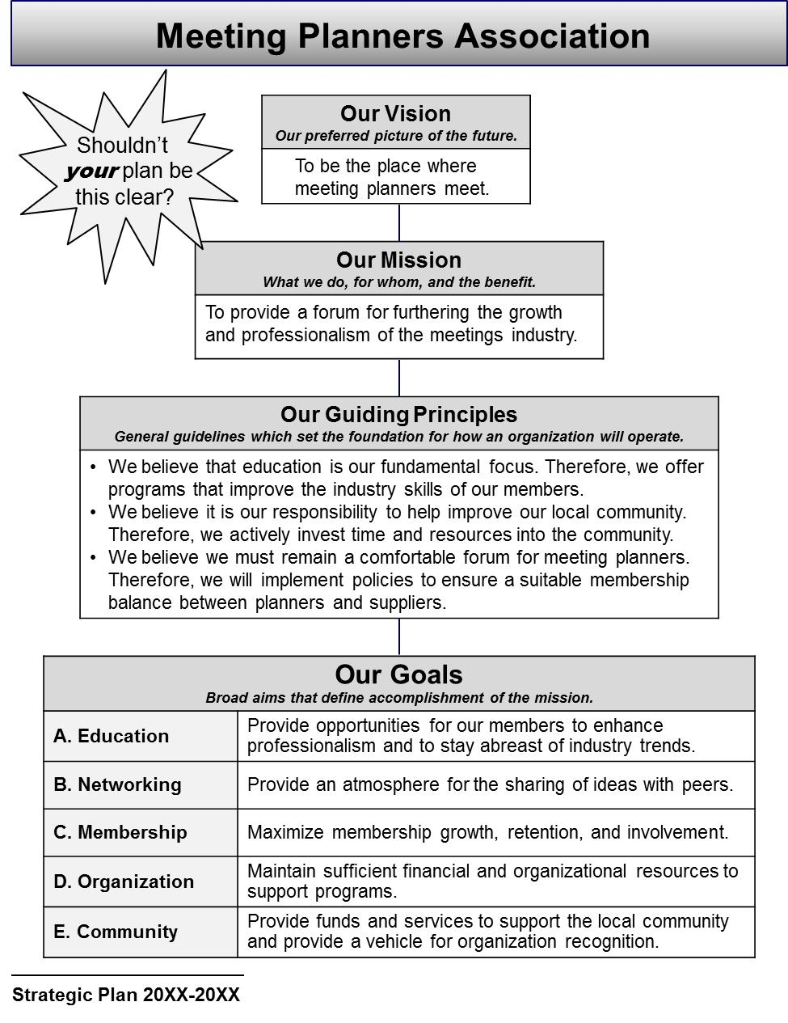
A. Sample Strategic Plan Part I: Mission, Vision, Goals, Objectives
Front Page
The Drivers Model typically produces 4-page plan layouts –easily-digestible and portable documents that don’t sit on shelves!
The front page typically features:
Vision
Mission
Goals
Guiding Principles
20 | 6-6

Slide 21
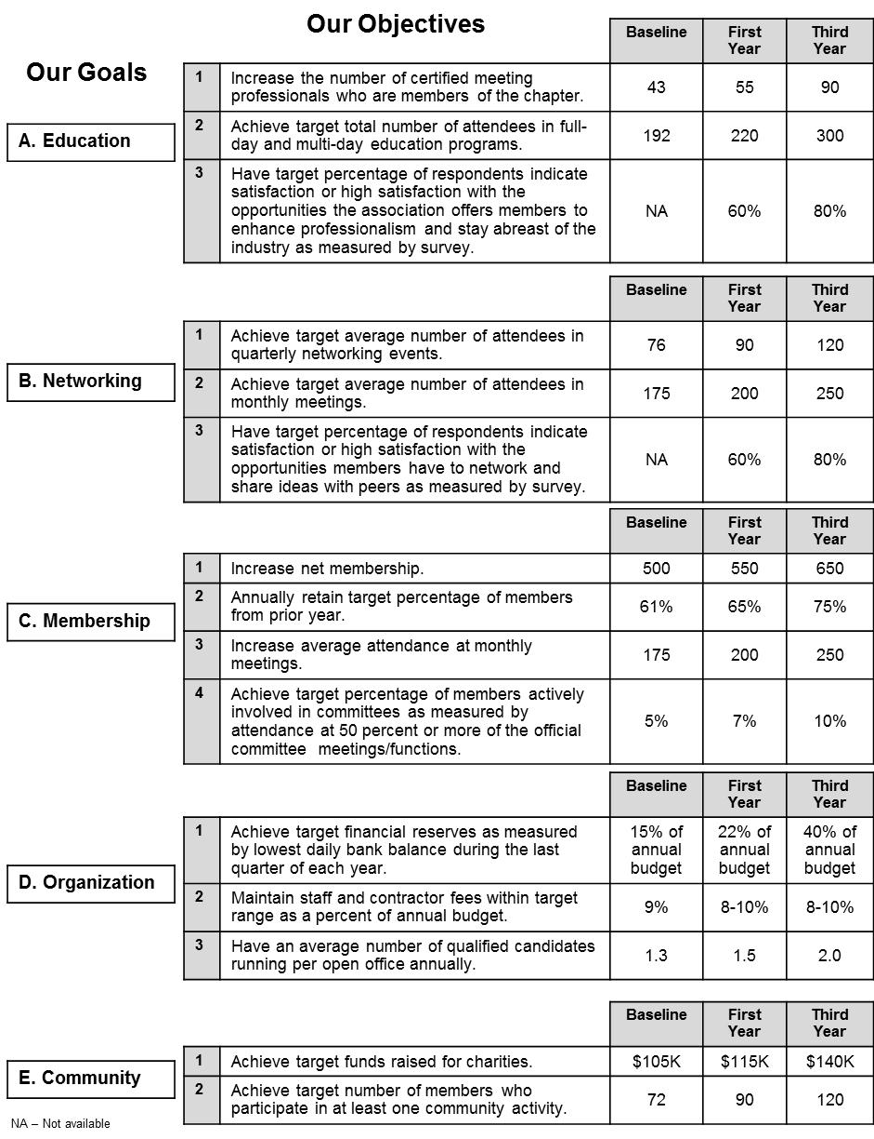
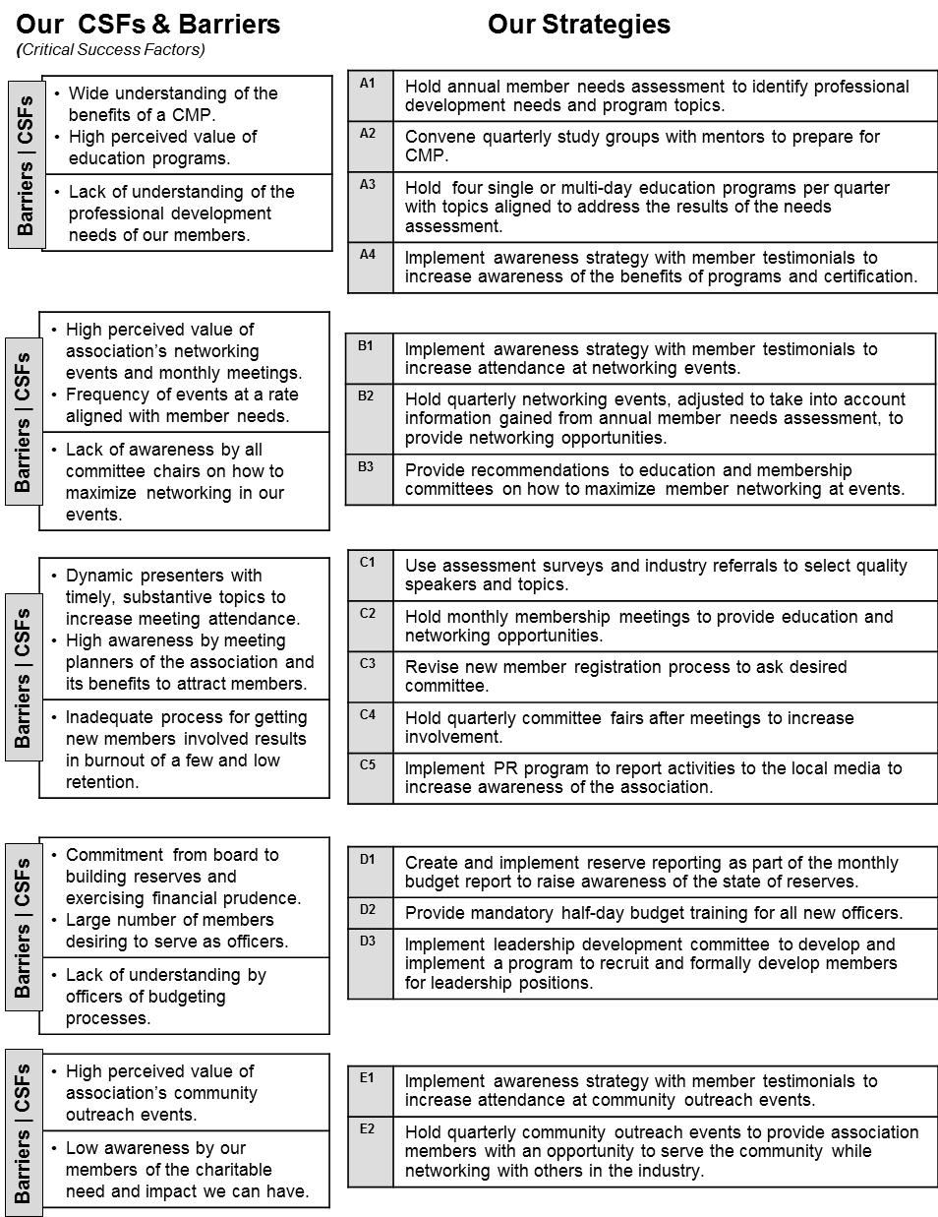
A. Sample Strategic Plan Part I: Mission, Vision, Goals, Objectives
Interior Pages
-

Slide 22
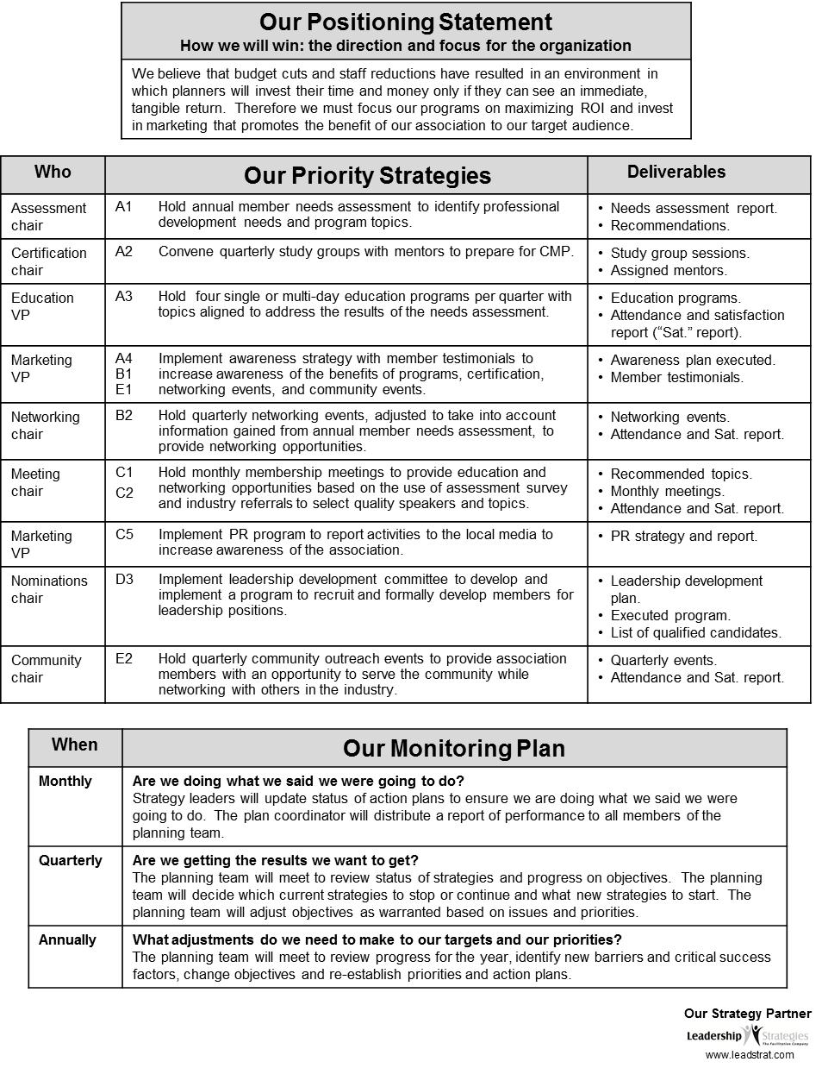
A. Sample Strategic Plan Part I: Mission, Vision, Goals, Objectives
Back Page
The back page often features:
Positioning Statements
Responsibilities for Priority Strategies
Monitoring Plan

Slide 23
A. Sample Strategic Plan Part I: Mission, Vision, Goals, Objectives
Strategy: | C1. Implement PR program to report activities to the local media
Objectives Supported: | Membership: 1. Increase net membership Membership: 2. Increase average attendance at monthly Meetings
Owner: | Marketing VP
Deliverables: | PR strategy and report
Additional
Action Plans
Series of 1-2 page Action Plans; one for each priority strategy
Due Date: | Feb 1 / Year 2 | Person-Days: | 27 | Total Costs: | $9,500
Action Step | Who | Due | Person-Days | Costs
1. Assemble new PR Team | Exec Committee | Feb 1 | 1 | N/A
2. Develop PR objectives | PR Team | Feb 15 | 3 | N/A
3. Develop promotion program | PR Team | Mar 1 | 3 | N/A
4. Hold Board presentation on PR strategy to gain approval | PR Team, Board | Mar 15 | 1 | N/A
5. Develop assets for PR strategy | PR Team | May 1 | 15 | $9,500
6. Assess promotion effectiveness | PR Team | Jan 15 / Y2 | 2 | N/A
7. Produce PR report of results | PR Team | Feb 1 / Y2 | 2 | N/A
Notes:
Removed the sample goal statements…not relevant for the flow.

Slide 24
A. Sample Strategic Plan Part I: Mission, Vision, Goals, Objectives
Mission and Vision
Our Vision
To be the place where meeting planners meet.
Vision
The preferred picture of the future
Our Mission
To provide a forum for furthering the growth and professionalism of the meetings industry.
Vision answers:
If you are successful at achieving your mission, what will the future look like?
CDC Vision? (former)
Healthy people in a healthy world.
-
Mission
A statement of the overall purpose of the organization
CDC Mission? (former)
To promote health and quality of life by preventing the spread of disease and disability.
Mission answers:
What do we do?
For whom do we do it?
What’s the benefit?

Slide 25
A. Sample Strategic Plan Part I: Mission, Vision, Goals, Objectives
Goals and Objectives
Goals
Broad, long-term aims that define accomplishment of the mission
Membership Goal
Maximize membership growth, retention and involvement.
Objectives
Specific, quantifiable, realistic targets that measure the accomplishment of a goal
Membership Objectives
Increase net membership from 500 to 650. Annually retain 75% of members from the prior year. Increase average attendance from 175 to 250 per meeting. Achieve 10% committee involvement.
What’s the difference between goals and objectives?
What happens if you have goals but no objectives?
What happens if you have objectives but no goals?
What is wrong with the following objective?
Hold 2 membership drives this year.
-
Measures ACTIVITY not RESULTS

Slide 26
6 | Facilitating Your Strategy
Strategic Planning: The Drivers Model ☑
Sample Strategic Plan Part I: Mission, Vision, Goals, Objectives ☑
Exercise 6a: Defining Goals and Objectives
Sample Strategic Plan Part II: CSFs, Barriers, Strategies, Actions
The Strategy Process
Why Most Plans Fail
Three-Step Monitoring Process
The Leadership Briefing
The 10 Pitfalls to Avoid
Special Applications of the Drivers Model

Slide 27
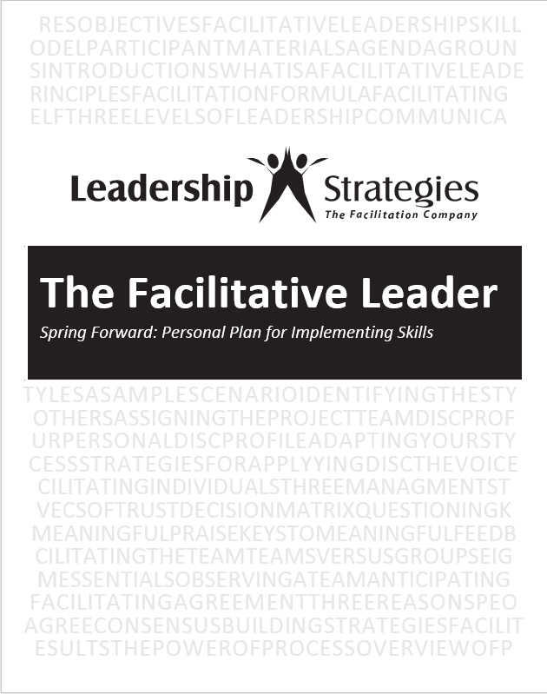
Spring Forward – 6a. Defining Goals and Objectives
-
Working with your partner, define a key goal for your organization, along with at least one objective.

Slide 28
6 | Facilitating Your Strategy
Strategic Planning: The Drivers Model ☑
Sample Strategic Plan Part I: Mission, Vision, Goals, Objectives ☑
Exercise 6a: Defining Goals and Objectives ☑
Sample Strategic Plan Part II: CSFs, Barriers, Strategies, Actions
The Strategy Process
Why Most Plans Fail
Three-Step Monitoring Process
The Leadership Briefing
The 10 Pitfalls to Avoid
Special Applications of the Drivers Model

Slide 29
C. Sample Strategic Plan Part II: CSFs, Barriers, Strategies, Actions
Critical Success Factors
Key conditions that must be created to achieve one or more objectives
Critical Success Factors
High awareness by meeting planners of the association and its benefits Dynamic presenters with timely, substantive topics
CSFs, Barriers, Strategies
Strategies
Utilize assessment survey and industry referrals to select quality speakers and topics. Revise new member registration process to ask desired committee. Hold quarterly committee fairs after meetings. Implement PR program to report activities to the local media.
Membership Objectives
Increase net membership from 500 to 650. Annually retain 75% of members from the prior year. Increase average attendance from 175 to 250 per meeting. Achieve 10% committee involvement.
Barriers
Inadequate process for getting new members involved results in burn-out of a few and low retention High membership turnover hinders consistent growth
-
Barriers
Existing or potential challenges that hinder the achievement of objectives.
Strategies
Broad activities required to achieve an objective, create a critical condition, or overcome a barrier

Slide 30
C. Sample Strategic Plan Part II: CSFs, Barriers, Strategies, Actions
Critical Success Factors
High awareness by meeting planners of the association and its benefits Dynamic presenters with timely, substantive topics
CSFs, Barriers, Strategies
Strategies
Utilize assessment survey and industry referrals to select quality speakers and topics. Revise new member registration process to ask desired committee. Hold quarterly committee fairs after meetings. Implement PR program to report activities to the local media.
The Key Question
Why would an organization invest in a strategy that didn’t address something critical to their success or a major barrier standing in their way?
-
Barriers
Inadequate process for getting new members involved results in burn-out of a few and low retention High membership turnover hinders consistent growth
Strategies
Broad activities required to achieve an objective, create a critical condition, or overcome a barrier

Slide 31
C. Sample Strategic Plan Part II: CSFs, Barriers, Strategies, Actions
Strategy: | C1. Implement PR program to report activities to the local media
Objectives Supported: | Membership: 1. Increase net membership Membership: 2. Increase average attendance at monthly Meetings
Owner: | Marketing VP
Deliverables: | PR strategy and report
Action Plans
Series of 1-2 page Action Plans; one for each priority strategy
Due Date: | Feb 1 / Year 2 | Person-Days: | 27 | Total Costs: | $9,500
Action Step | Who | Due | Person-Days | Costs
1. Assemble new PR Team | Exec Committee | Feb 1 | 1 | N/A
2. Develop PR objectives | PR Team | Feb 15 | 3 | N/A
3. Develop promotion program | PR Team | Mar 1 | 3 | N/A
4. Hold Board presentation on PR strategy to gain approval | PR Team, Board | Mar 15 | 1 | N/A
5. Develop assets for PR strategy | PR Team | May 1 | 15 | $9,500
6. Assess promotion effectiveness | PR Team | Jan 15 / Y2 | 2 | N/A
7. Produce PR report of results | PR Team | Feb 1 / Y2 | 2 | N/A
Action Plans
Specific steps to be taken, by whom and by when, to implement a strategy.
-
Notes:
Removed the sample goal statements…not relevant for the flow.

Slide 32
C. Sample Strategic Plan Part II: CSFs, Barriers, Strategies, Actions
Dividing the Plan
Strategic Direction
Implementation Planning
-
Strategy: | C1. Implement PR program to report activities to the local media
Objectives Supported: | Membership: 1. Increase net membership Membership: 2. Increase average attendance at monthly meetings
Owner: | Marketing VP
Deliverables: | PR strategy and report
Action Planning
Due Date: | Feb 1 / Year 2 | Person-Days: | 27 | Total Costs: | $9,500
Action Step | Who | Due | Person-Days | Costs
1. Assemble new PR Team | Exec Committee | Feb 1 | 1 | N/A
2. Develop PR objectives | PR Team | Feb 15 | 3 | N/A
3. Develop promotion program | PR Team | Mar 1 | 3 | N/A
4. Hold Board presentation on PR strategy to gain approval | PR Team, Board | Mar 15 | 1 | N/A
5. Develop assets for PR strategy | PR Team | May 1 | 15 | $9,500
6. Assess promotion effectiveness | PR Team | Jan 15 / Y2 | 2 | N/A
7. Produce PR report of results | PR Team | Feb 1 / Y2 | 2 | N/A

Slide 33
6 | Facilitating Your Strategy
Strategic Planning: The Drivers Model ☑
Sample Strategic Plan Part I: Mission, Vision, Goals, Objectives ☑
Exercise 6a: Defining Goals and Objectives ☑
Sample Strategic Plan Part II: CSFs, Barriers, Strategies, Actions ☑
The Strategy Process
Why Most Plans Fail
Three-Step Monitoring Process
The Leadership Briefing
The 10 Pitfalls to Avoid
Special Applications of the Drivers Model

Slide 34
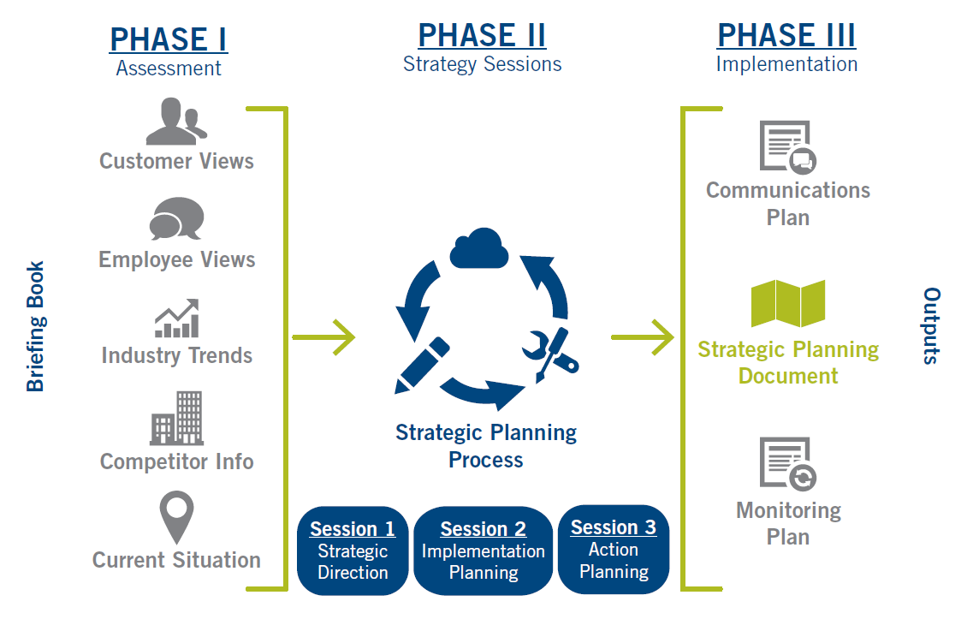
D. The Strategy Process
The Phases
PHASE I Assessment
PHASE II Strategy Sessions
PHASE III Implementation
-
Briefing Book
Output
Session 1 Strategic Direction
Session 2 Implementation Planning
Session 3 Action Planning
34 | 6-17

Slide 35
6 | Facilitating Your Strategy
Strategic Planning: The Drivers Model ☑
Sample Strategic Plan Part I: Mission, Vision, Goals, Objectives ☑
Exercise 6a: Defining Goals and Objectives ☑
Sample Strategic Plan Part II: CSFs, Barriers, Strategies, Actions ☑
The Strategy Process ☑
Why Most Plans Fail
Three-Step Monitoring Process
The Leadership Briefing
The 10 Pitfalls to Avoid
Special Applications of the Drivers Model
-

Slide 36
E. Why Most Plans FAIL
-
Many strategic plans don’t get fully implemented, but instead get put on a bookshelf never to be seen again…until the next strategic planning cycle.
Why is that?
36 | 6-18

Slide 37
E. Why Most Plans FAIL
PHASE I Assessment
PHASE II Strategy Sessions
PHASE III Implementation
Briefing Book
Output
Session 1 Strategic Direction
Session 2 Implementation Planning
Session 3 Action Planning
-
Why?

Slide 38
The Covey Urgency/Importance Matrix
E. Why Most Plans FAIL
URGENT
NOT URGENT
IMPORTANT
Vital client issues
Major deadlines
Crisis
-
Strategic Plan!
NOT IMPORTANT
Other people’s crises
Some emails and calls
Purposeless meetings
Workplace gossip
Busywork
Aimless surfing
38 | 6-18
Notes:
Removed the titles…it doesn’t serve us and could cause confusion to have Important/Not urgent labeled as “prevention”

Slide 39
E. Why Most Plans FAIL
How do you increase accountability for implementation?
Defined work
Accepted responsibility
Monitoring and reporting process
Rewards for achievement
Consequences for inadequate performance
-
39 | 6-19

Slide 40
E. Why Most Plans FAIL
Monthly:
Did we do what we said we were going to do?
Review status of priority strategies.
-
40 | 6-20

Slide 41
6 | Facilitating Your Strategy
Strategic Planning: The Drivers Model ☑
Sample Strategic Plan Part I: Mission, Vision, Goals, Objectives ☑
Exercise 6a: Defining Goals and Objectives ☑
Sample Strategic Plan Part II: CSFs, Barriers, Strategies, Actions ☑
The Strategy Process ☑
Why Most Plans Fail ☑
Three-Step Monitoring Process
The Leadership Briefing
The 10 Pitfalls to Avoid
Special Applications of the Drivers Model

Slide 42
F. Three-Step Monitoring Process
Sample Dashboard Summary
 |  | Jan | Feb | Mar | Apr | May
 | Done 100
 | >75% 75
 | <75% 50
A1 | Educate on screening recommendations
B3 | Develop a life course/life stage approach to disease prevention
C1 | Develop and implement marketing plan for Division
42 | 6-20

Slide 43
F. Three-Step Monitoring Process
Sample Dashboard Summary |  | 77% C+
 |  | Jan | Feb | Mar | Apr | May
 | Done 100 | 3
 | >75% 75 | 6
 | <75% 50 | 2
A1 | Educate on screening recommendations
B3 | Develop a life course/life stage approach to disease prevention
C1 | Develop and implement marketing plan for Division
25
43 | 6-20

Slide 44
F. Three-Step Monitoring Process
Sample Dashboard Summary |  | 77% C+ | 89% B+
 |  | Jan | Feb | Mar | Apr | May
 | Done 100 | 3 | 7
 | >75% 75 | 6 | 3
 | <75% 50 | 2 | 1
A1 | Educate on screening recommendations
B3 | Develop a life course/life stage approach to disease prevention
C1 | Develop and implement marketing plan for Division
44 | 6-20

Slide 45
F. Three-Step Monitoring Process
Sample Dashboard Summary |  | 77% C+ | 89% B+ | 91% A-
 |  | Jan | Feb | Mar | Apr | May
 | Done 100 | 3 | 7 | 8
 | >75% 75 | 6 | 3 | 2
 | <75% 50 | 2 | 1 | 1
A1 | Educate on screening recommendations
B3 | Develop a life course/life stage approach to disease prevention
C1 | Develop and implement marketing plan for Division
45 | 6-20

Slide 46
F. Three-Step Monitoring Process
Sample Dashboard Summary |  | 77% C+ | 89% B+ | 91% A- | 84% B
 |  | Jan | Feb | Mar | Apr | May
 | Done 100 | 3 | 7 | 8 | 6
 | >75% 75 | 6 | 3 | 2 | 3
 | <75% 50 | 2 | 1 | 1 | 2
A1 | Educate on screening recommendations
B3 | Develop a life course/life stage approach to disease prevention
C1 | Develop and implement marketing plan for Division
46 | 6-20

Slide 47
F. Three-Step Monitoring Process
Sample Dashboard Summary |  | 77% C+ | 89% B+ | 91% A- | 84% B | 95% A
 |  | Jan | Feb | Mar | Apr | May
 | Done 100 | 3 | 7 | 8 | 6 | 10
 | >75% 75 | 6 | 3 | 2 | 3 | 1
 | <75% 50 | 2 | 1 | 1 | 2 | 0
A1 | Educate on screening recommendations
B3 | Develop a life course/life stage approach to disease prevention
C1 | Develop and implement marketing plan for Division
47 | 6-20

Slide 48
F. Three-Step Monitoring Process
Monthly:
Did we do what we said we were going to do?
Review status of priority strategies.
Quarterly:
Are we making the progress we intended to make?
Review performance against objectives.
Annually:
Are we going in the right direction?
Update the strategic plan.
-
48 | 6-20

Slide 49
6 | Facilitating Your Strategy
Strategic Planning: The Drivers Model ☑
Sample Strategic Plan Part I: Mission, Vision, Goals, Objectives ☑
Exercise 6a: Defining Goals and Objectives ☑
Sample Strategic Plan Part II: CSFs, Barriers, Strategies, Actions ☑
The Strategy Process ☑
Why Most Plans Fail ☑
Three-Step Monitoring Process ☑
The Leadership Briefing
The 10 Pitfalls to Avoid
Special Applications of the Drivers Model

Slide 50
G. The Leadership Briefing
What is it?
A 60- to 90-minute session (in-person or virtual) to address seven questions:
What are the most important issues our plan must address?
How does the Drivers Model typically work?
For each issue, where in the Drivers Model will the issue first be addressed? (e.g., Will it become a goal, objective, barrier?)
What do you like about the Drivers Model?
What changes do we need to make to ensure it works for us?
What information needs to be gathered in advance and by whom?
How shall we move forward?
-
50 | 6-21
Notes:
Add boilerplate

Slide 51
G. The Leadership Briefing
The Benefits and Key Products
Agreement on the issues to be addressed
Team buy-in on the process
A common strategy language
A customized approach to fit your team’s needs
The information to gather and assignments for gathering it
Increased commitment to participate and follow through
-
Your Secret Weapon for Selling the Plan Inside!
51 | 6-21

Slide 52
6 | Facilitating Your Strategy
Strategic Planning: The Drivers Model ☑
Sample Strategic Plan Part I: Mission, Vision, Goals, Objectives ☑
Exercise 6a: Defining Goals and Objectives ☑
Sample Strategic Plan Part II: CSFs, Barriers, Strategies, Actions ☑
The Strategy Process ☑
Why Most Plans Fail ☑
Three-Step Monitoring Process ☑
The Leadership Briefing ☑
The 10 Pitfalls to Avoid
Special Applications of the Drivers Model

Slide 53
H. The 10 Pitfalls to Avoid
Not planning
Not including key people in the planning effort
Planning before undertaking a situation assessment
Develop a mission statement first
Confusing goals and objectives
Measuring activity instead of results
Jumping straight to strategies after developing objectives
Not developing detailed action plans for strategies
Not gaining buy-in before implementing the plan
Not monitoring the plan
Not planning
Not including key people in the planning effort
Planning before undertaking a situation assessment
Develop a mission statement first
Confusing goals and objectives
Measuring activity instead of results
Jumping straight to strategies after developing objectives
Not developing detailed action plans for strategies
Not gaining buy-in before implementing the plan
Not monitoring the plan
___________
____ ________
__________ ______________
_________ ___________
_______ ____________
_________ ________
____________
______ ______
____ __
____________
53 | 6-22
Notes:
Key Points
Have former team leaders appoint a new team leader.
Give the teams 5 minutes to fill in the blanks to the 10 pitfalls; have the team leaders record the responses in their manuals
After the 5 minutes, collect the manuals of team leaders and pass the manual to the next team leader to score.
Have the entire group give the answer to each of the ten pitfalls, and ask team leaders to check the ones that are correct.
At the end have the team leaders add up the number of checks to get a score for the team and pass the manuals back to the team leader whose book they scored.
Award the winning team with applause.

Slide 54
6 | Facilitating Your Strategy
Strategic Planning: The Drivers Model ☑
Sample Strategic Plan Part I: Mission, Vision, Goals, Objectives ☑
Exercise 6a: Defining Goals and Objectives ☑
Sample Strategic Plan Part II: CSFs, Barriers, Strategies, Actions ☑
The Strategy Process ☑
Why Most Plans Fail ☑
Three-Step Monitoring Process ☑
The Leadership Briefing ☑
The 10 Pitfalls to Avoid ☑
Special Applications of the Drivers Model

Slide 55
I. Special Applications of the Drivers Model
Change Management
The Vision of Change
Barriers
Barriers to Change
Monitor!
-
Monitoring Change
CSFs
The Drivers of Change
CSFs
The Case for Change
The Key Conditions for Change
55 | 6-23

Slide 56
I. Special Applications of the Drivers Model
Coaching
Vision of Success - Behaviors
- Measures of success
Barriers
Barriers to Success
Monitor!
-
Monitor Progress
CSFs
Strategies for Success
CSFs
- Strengths - Areas for Improvement
Key Conditions for Success
56 | 6-24

Slide 57
I. Special Applications of the Drivers Model
Having a Coaching Conversation
Where are you today? (Your strengths, areas for improvement)
Where would you like to be? What’s your vision of success?
What do you see as the barriers to getting there? Why aren’t you there already?
What are your critical success factors? What are the conditions, that if they are created, well propel you to your vision?
What are key strategies for getting there? What help do you need from the organization?
What do you start on first?
How will we monitor progress?
-
57 | 6-24

Slide 58
I. Special Applications of the Drivers Model
Managing Your Boss
What does your boss believe are her most important objectives?
Barriers
What does your boss believe is standing in the way of her success?
Monitor!
How will you ensure that what you are doing is recognized and valued by your boss?
-
CSFs
What are you doing, or not doing, to overcome the barriers or achieve the key conditions?
CSFs
What does your boss believe are key conditions for her success?
58 | 6-25

Slide 59
Review
What are the 4 Strategic Questions?
Where are we today?
Where do we want to be?
What do we do to get there?
How will we monitor our progress?

Slide 60
Review
What are the 5 steps in using the Drivers Model?
Start with an accurate picture of today!
Create a shared vision.
Understand your Barriers and CSFs.
Define your Drivers.
Monitor!

Slide 61
Review
Are the following Goals or Objectives?
Deepen our penetration with existing clients.
Goal
Gain 15% more referrals this year than last year.
Objective
Maximize employee engagement.
Goal
Increase revenue by 10%.
Objective
Achieve 80% or better on annual employee engagement survey.
Objective
-

Slide 62
Review
Which letter should go with which definition?
C
Barriers
Strategies
Critical Success Factors
Key conditions that must be created to achieve one or more objectives.
Existing or potential challenges that hinder the achievement of objectives.
Broad activities required to achieve an objective, create a critical condition, or overcome a barrier.
A
B

Slide 63
Review
Specific steps to be taken by whom and by when, to implement strategy is the definition of which of the following?
Strategy
Action plan
Three Step Monitoring

Slide 64
Review
What are the three phases of the Strategy Process?
Assessment
Strategy Sessions
Implementation

Slide 65
Review
When should you implement each step of Three-Step Monitoring?
__________:
Did we do what we said we were going to do?
Review status of priority strategies.
__________:
Are we making the progress we intended to make?
Review performance against objectives.
__________:
Are we going in the right direction?
Update the strategic plan.
Monthly
Quarterly
Annually

Slide 66
Review
State three benefits of the Leadership Briefing?
Team buy-in on the process
A common strategy language
Agreement on the issues to be addressed

Slide 67
Spring Forward – 6b. Defining CSFs, Barriers, and Strategy
In Class
Working with your partner, for the objective you identified earlier, define at least one critical success factor, barrier and strategy.
-

Slide 68

Spring Forward – 6b. Defining CSFs, Barriers, and Strategy
Homework
Working with your partner, for the objective you identified earlier, define at least one critical success factor, barrier and strategy.
-

Slide 69
6 | Facilitating Your Strategy
Strategic Planning: The Drivers Model
Sample Strategic Plan Part I: Mission, Vision, Goals, Objectives
Exercise 6a: Defining Goals and Objectives
Sample Strategic Plan Part II: CSFs, Barriers, Strategies, Actions
The Strategy Process
Why Most Plans Fail
Three-Step Monitoring Process
The Leadership Briefing
The 10 Pitfalls to Avoid
Special Applications of the Drivers Model

Slide 70
TAFA -
“Take a Facilitative Approach”
Tools and Concepts in This Module
S
U
C
C
E
E
D
Start with the why, not with the what.
Understand and empower, don’t command and control.
Create the vision, not the solution.
Connect first; correct second.
Equip for success; monitor for results.
Engage conflict; resolve dysfunction.
Drive participation, not just input.
The Drivers Model
Strategic Plan
Mission, Vision, Goals, Objectives
Critical Success Factors, Barriers, Strategies, Actions
The Strategy Process
Three-Step Monitoring Process
70 | 6-26

Slide 71
Checkpoint
1 | Getting Started, Facilitating Yourself
2 | Facilitating Communication
3 | Facilitating and Coaching Individuals
4 | Facilitating Your Team
5 | Facilitating Agreement
6 | Facilitating Your Strategy
7 | Facilitating Meetings Part 1
8 | Facilitating Meetings Part 2

Slide 72
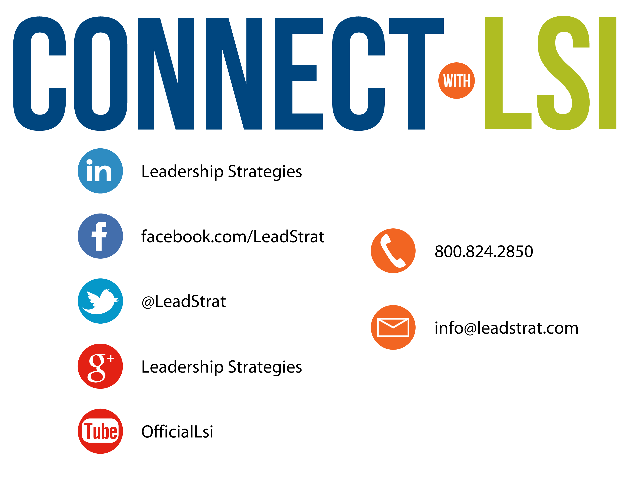


Questions?
etraining@leadstrat.com
800.824.2850
Or, submit your questions for open discussion
on the Linked-In “Leadership Strategies
Facilitation & Leadership Community” Group
Join us on Facebook at
www.Facebook.com/Leadstrat
and Twitter @Leadstrat

Slide 73
The Facilitative Leader
Congratulations!
- Completed Module 6: Facilitating Your Strategy
- Next: Facilitating Meetings Part I

Slide 74
The Facilitative Leader
Congratulations!
- Completed Module 6: Facilitating Your Strategy
- Next: Facilitating Meetings Part 1
- Homework
-Evaluations

Slide 75
The Facilitative Leader
Congratulations!
- Course completed!
- Post-test
- MVP
- Classroom to application
- Evaluations

