Slide 1
The Facilitative Leader

Slide 2
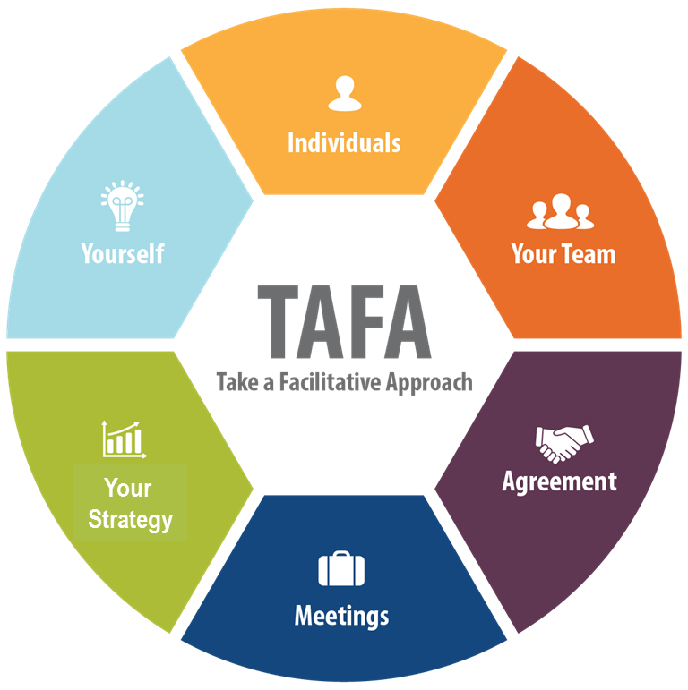

5 | Facilitating Agreement
-

Slide 3
Checkpoint
1 | Getting Started, Facilitating Yourself
2 | Facilitating Communication
3 | Facilitating and Coaching Individuals
4 | Facilitating Your Team
5 | Facilitating Agreement
6 | Facilitating Your Strategy
7 | Facilitating Meetings Part 1
8 | Facilitating Meetings Part 2
Notes:
OK, while we have this methodology diagram in front of us, let’s go back to our grouped objectives. [Go back to each category from the grouped objectives collected earlier and ask the group where that item will be covered. Match their objectives to the principles – essentially the agenda for the class – and demonstrate how to adapt the agenda to meet the need for any group that will not map to a principle.]

Slide 4
TAFA - What does it mean to “Take a Facilitative Approach?”
The Seven TAFA Principles
Start with the why, not with the what.
Understand and empower, don’t command and control.
Create the vision, not the solution.
Connect first; correct second.
Equip for success; monitor for results.
Engage conflict; resolve dysfunction.
Drive participation, not just input.
-
S
U
C
C
E
E
D

Slide 5
Ground Rules
Always open for questions
The open issues list
Respect the speaker
Avoid “bar discussion”
Start on time, end on time
Repetition to train the mind
No beeps or buzzes
Team Cheers
“Choo Choo”

Slide 6


Your Materials
Course manual
Spring Forward exercise packet
Mini manual
Mobile App: Search “LeadStrat” or “Leadership Strategies”
-
Slide # | Manual #

Slide 7
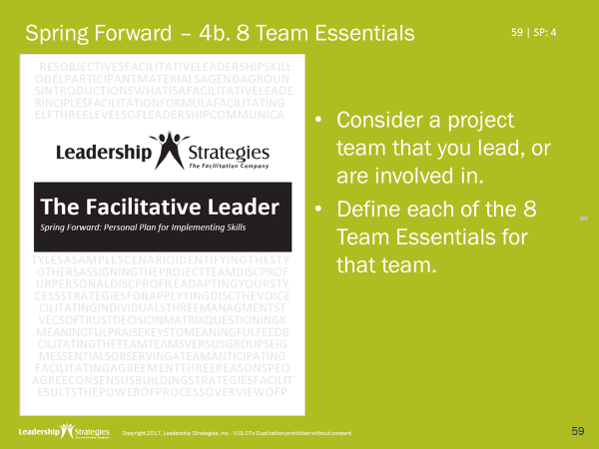
Homework Review
Which project team did you select?
Which of the 8 team essentials did you find most difficult ot define?

Slide 8
8 Team Essentials
1. Purpose
2. Deliverables
3. Constraints
4. Resources
5. Accountability
6. Solution Process
7. Leadership
8. Teamwork
The mission or reason for being
The service outcomes or results expected
The time by when the deliverable is to be completed; additional limitations or conditions
The people who participate on the team, time, funds
The person or group from whom the team receives its charge and to whom it is accountable
The method used to produce the deliverable
The method used to make decisions, assign tasks, establish policies, address issues, etc.
-
The level of trust, communication, and participation

Slide 9
5 | Facilitating Agreement
Decision-Making Alternatives
Understanding Disagreement
The 3 Reasons People Disagree
Identifying and Resolving Level 3
Using Delineation to Resolve Level 1
Using Strengths and Weaknesses and Merge to Resolve Level 2
5-Finger Consensus
Exercise: Resolving a disagreement
-

Slide 10
5 | Facilitating Agreement
Decision-Making Alternatives
Understanding Disagreement
The 3 Reasons People Disagree
Identifying and Resolving Level 3
Using Delineation to Resolve Level 1
Using Strengths and Weaknesses and Merge to Resolve Level 2
5-Finger Consensus
Exercise: Resolving a disagreement

Slide 11
A. Decision-Making Alternatives
When Does a Group Have a Decision?
The leader decides
The leader decides after a discussion
Simple majority
Super majority
Unanimous agreement
Consensus: “I can live with it and support it”
Five-finger consensus
11 | 5-2

Slide 12
5 | Facilitating Agreement
Decision-Making Alternatives ☑
Understanding Disagreement
The 3 Reasons People Disagree
Identifying and Resolving Level 3
Using Delineation to Resolve Level 1
Using Strengths and Weaknesses and Merge to Resolve Level 2
5-Finger Consensus
Exercise: Resolving a disagreement

Slide 13
B. Understanding Disagreements
Disagreements in the Workplace
Think about the disagreements that frequently occur in your workplace.
Think about the topics people disagree on, whether to do this, or do that…the things that people tend to argue over.
What are examples of the things people disagree about in the workplace?
-
13 | 5-2

Slide 14
8 Team Essentials
1. Purpose
2. Deliverables
3. Constraints
4. Resources
5. Accountability
6. Solution Process
7. Leadership
8. Teamwork
The mission or reason for being
The service outcomes or results expected
The time by when the deliverable is to be completed; additional limitations or conditions
The people who participate on the team, time, funds
The person or group from whom the team receives its charge and to whom it is accountable
The method used to produce the deliverable
The method used to make decisions, assign tasks, establish policies, address issues, etc.
The level of trust, communication, and participation
14 | 5-3

Slide 15
B. Understanding Disagreement
Mountains
Beaches
15 | 5-3

Slide 16
B. Understanding Disagreement Role Play from The Secrets of Facilitation
Sherry I’ve been thinking about our vacation for next year, and I’ve got it! There’s a 10-day tour of Italy that takes us to eight cities, including Rome, Venice, Tuscany and Florence. It’s perfect. What do you think?
Michael That does sound like a wonderful tour. But, I have really been look forward to going to the beach this year.
Sherry Oh, come on, Snook’ems. Let’s go to Italy. We haven’t been there before. It’ll be fun.
Michael Oh, Sweetheart, Darling, Baby (said in a deep baritone voice of singer Barry White). Let’s go to the beach. It’ll be quiet and restful.
-
16 | 5-3

Slide 17
B. Understanding Disagreement Role Play from The Secrets of Facilitation
Sherry Now, Michael, you’ve been out of town a lot this year, which has left me home to do both my job and take care of the kids solo. So, we really should do what I want to do. Let’s do Italy.
Michael You are right, Sherry. I have been out of town a lot this year, and it has worn me out. I really need a break. Let’s go to the beach.
Sherry No, we are going to Italy.
Michael No, we are going to the beach.
Sherry Italy!
Michael Beach!
-
17 | 5-3

Slide 18
B. Understanding Disagreement
Key Points
Mountains and Beaches =
Best Achievable Outcome =
Positions =
The Key =
The Method =
Positions
Win-Lose
Tip of the iceberg
Get under the surface to the real issues
-
Ask Questions!
18 | 5-4

Slide 19
5 | Facilitating Agreement
Decision-Making Alternatives ☑
Understanding Disagreement ☑
The 3 Reasons People Disagree
Identifying and Resolving Level 3
Using Delineation to Resolve Level 1
Using Strengths and Weaknesses and Merge to Resolve Level 2
5-Finger Consensus
Exercise: Resolving a disagreement

Slide 20

C. The 3 Reasons People Disagree
Level 1 (Information)
Each has not clearly heard and understood the other’s alternative and/or the person’s reasons for supporting the alternative.
-
20 | 5-4

Slide 21
C. The 3 Reasons People Disagree Role Play from The Secrets of Facilitation
Joe I've been thinking about this for some time. I think we should close down the home office in Denver and just operate the business out of our three satellite locations in Los Angeles, Chicago and New York.
Laura Are you out of your mind? That can’t work.
Joe Sure it can. You said yourself that there is a home office mentality that sometimes forgets that there's a customer. We get rid of the home office, and this problem goes away. As well we save a whole lot of money, something we happened to need about now.
Laura No, I don’t think so. Joe, we have been partners for some time. But this has to be the craziest idea you have come up with in a while.
Joe I don't understand why you don't like it.
-
21 | 5-4

Slide 22
C. The 3 Reasons People Disagree Role Play from The Secrets of Facilitation
Laura Well, first of all, we have a home office because there are certain administrative activities that need to go on. So, genius, are we going to stop billing our customers? And what about legal counsel? Are we going to have each of the field offices have their own? That sounds pretty inefficient to me. And what about all the price breaks we get by central purchasing? Will we end up paying more because each of the field offices are buying their own stuff? And what about...?
Joe Hold on a second. I'm not sure you are hearing me. I said close down the home office not decentralize. We still need to centralize certain functions. But let's centralize them in the field. For example, we could have New York take over billing activities and other administrative functions. We could have Los Angeles responsible for HR. Their HR coordinator out there is better than anyone we've ever hired here in Denver. And…
-
22 | 5-4

Slide 23
C. The 3 Reasons People Disagree Role Play from The Secrets of Facilitation
Laura I get it. You would then have Chicago handle customer service and operations. You may be on to something. We could even offer jobs to those who are willing to make the transfer. By doing all this, we drop the overhead of the fourth office and we increase our customer focus at the same time. I like it. But why didn't you say that in the first place?
Joe I did say it. You just weren't listening. I said I wanted to operate our business out of the three satellite locations. What did you think I meant?
Level 1 – Lack of Shared Information
-
23 | 5-4

Slide 24

C. The 3 Reasons People Disagree
Level 2 (Value)
They have had different experiences or hold different values that result in a different preference.
-
24 | 5-4

Slide 25
C. The 3 Reasons People Disagree Role Play from The Secrets of Facilitation
Recall
Sherry Now, Michael, you’ve been out of town a lot this year, which has left me home to do both my job and take care of the kids solo. So, we really should do what I want to do. Let’s do Italy.
Michael You are right, Sherry. I have been out of town a lot this year, and it has worn me out. I really need a break. Let’s go to the beach.
Sherry No, we are going to Italy.
Michael No, we are going to the beach.
Sherry Italy!
Michael Beach!
Level 2 – Different Values or Experiences
What does Michael value?
What does Sherry value?
-
25 | 5-4

Slide 26

C. The 3 Reasons People Disagree
Level 3 (Personality)
The disagreement is based on personality, past history with one another, or other factors that have nothing to do with the alternatives.
-
26 | 5-4

Slide 27
5 | Facilitating Agreement
Decision-Making Alternatives ☑
Understanding Disagreement ☑
The 3 Reasons People Disagree ☑
Identifying and Resolving Level 3
Using Delineation to Resolve Level 1
Using Strengths and Weaknesses and Merge to Resolve Level 2
5-Finger Consensus
Exercise: Resolving a disagreement

Slide 28
D. Identifying and Resolving Level 3 Role Play from The Secrets of Facilitation
Tom One of the things I think we can do to improve our board governance is to add one or two board members with strong financial backgrounds. This way, we can better understand the financial ramifications of some of the proposals we are considering.
Francis That won’t work.
Tom Sure it will, we just need to make sure we get the right people.
Francis No, it won’t work.
Facilitator You may be right, Francis. Please explain why you believe it won’t work?
Francis It just won’t work.
-
28 | 5-5

Slide 29
D. Identifying and Resolving Level 3 Role Play from The Secrets of Facilitation
Facilitator Okay…Well, how might we improve it?
Francis There’s no way to improve it. It just won’t work.
Facilitator Help us understand, Francis, why are you so convinced it won’t work?
Francis It just won’t work. He thought of it. It won’t work!
Level 3 – Personality, Past History, Outside Factors
-
29 | 5-4

Slide 30
D. Identifying and Resolving Level 3
A disagreement based on personality or past history cannot be resolved within a session – don’t attempt to resolve it.
Recognition:
Irrational
No commitment to finding a solution
Action:
Take it to a higher source
-
30 | 5-5

Slide 31
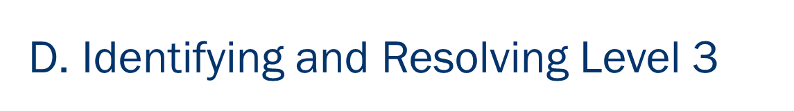

Role Play: Justin and Avery
| M: N/A
Is this a Level 1, Level 2, or Level 3 disagreement?
Notes:
ADD ROLE PLAY TO BACK OF MANUAL
[Use the Jason and Avery role play for engagement and end it with a discussion about whether or not this is a Level 1, 2 or 3 disagreement; then step through applying the techniques that follow to move to agreement]

Slide 32
Role Play: Justin and Avery
| M: N/A
First: Rule out Level 3
Assume Level 1
-
Notes:
[facilitate the discussion regarding the Level of disagreement and stress the key to eliminate the Level 3 (because, if a Level 3, you take it to a higher authority) and then begin by assuming it is a Level 1 and move to the next slide, Delineation]

Slide 33
5 | Facilitating Agreement
Decision-Making Alternatives ☑
Understanding Disagreement ☑
The 3 Reasons People Disagree ☑
Identifying and Resolving Level 3 ☑
Using Delineation to Resolve Level 1
Using Strengths and Weaknesses and Merge to Resolve Level 2
5-Finger Consensus
Exercise: Resolving a disagreement

Slide 34
E. Using Delineation to Resolve Level 1
| M: N/A
Step 1: Start with Agreement
Step 2: Confirm Source of Disagreement
Step 3: DELINEATE the Alternatives
-
34 | 5-6
Notes:
The first words might sound something like this, “Whoa, let’s hold on for a second here [turn the attention from the parties that are disagreeing to you, the meeting leader], I would like to try something different here.”
[then start with agreement] Sounds like we are talking about important stuff here [one, yes] and it appears we both agree that [insert something like the topic under discussion and position yourself in front of the flip chart]
[now, acknowledge, the disagreement] it sounds like were we disagree is [acknowledge the disagreement while writing the alternatives on a flip chart]
Once the alternatives have been delineated and the four key questions have been answered, check to see if consensus had been reached. If so, you had a Level 1 disagreement and you are finished. If not, move on to the next step

Slide 35
Delineation – Back to Role Play
| M: N/A
E. Using Delineation to Resolve Level 1
EVERYONE
KEY MANAGERS
Notes:
Let’s see how Delineation works with our Jason and Avery disagreement. [use the role play to document the facts and arrive at the 4 key questions answered]

Slide 36
E. Using Delineation to Resolve Level 1
For each alternative, direct specific questions to its supporter(s).
Alternative #1
How much?
How long?
Who is involved?
What is involved?
Alternative #2
How much?
How long?
Who is involved?
What is involved?
Check to determine if consensus has been reached.
-
36 | 5-7

Slide 37
How could this have been Level 1?
| M: N/A
E. Using Delineation to Resolve Level 1
EVERYONE
500 people
1-day version
KEY MANAGERS
Oh, 1-day version? Why didn’t you say that?
Notes:
Here is a good example of how we might find out we had a Level 1 disagreement. When we ask Avery which version of the training and he responds with the 1-day version, Jason might respond, “Oh, one day? Why didn’t you say that in the first place, etc? That is what we mean by a lack of shared information; often times, led by the culprit of “assumptions.”

Slide 38
5 | Facilitating Agreement
Decision-Making Alternatives ☑
Understanding Disagreement ☑
The 3 Reasons People Disagree ☑
Identifying and Resolving Level 3 ☑
Using Delineation to Resolve Level 1 ☑
Using Strengths and Weaknesses and Merge to Resolve Level 2
5-Finger Consensus
Exercise: Resolving a disagreement

Slide 39
F. Using Strengths and Weaknesses and Merge to Resolve Level 2
Identify the strengths of each alternative.
Alternative #1: Italy | Alternative #2: Beach
Strengths | Strengths
Varied locations Places we haven’t been Lots to do | Rest Sleep in same bed Water sports
Then, identify the weaknesses of each.
Weaknesses | Weaknesses
Hectic schedule Repack every day No water sports | Same location Nothing different Same activities
-
Check to determine if consensus has been reached.
39 | 5-9

Slide 40
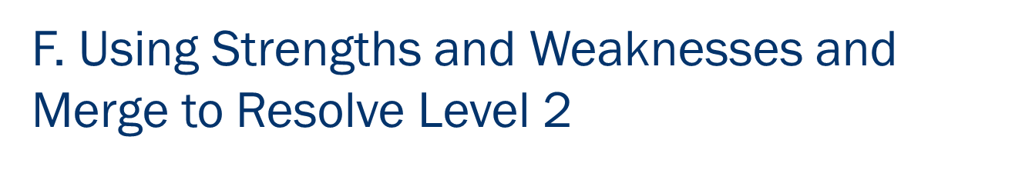
Strengths – Back to Role Play
| M: N/A
EVERYONE
KEY MANAGERS
Notes:
Let’s see how Strengths & Weaknesses works with our Jason and Avery disagreement. [use the role play to document the Strengths & Weaknesses of each alternative; emphasize Strengths and Strengths and then Weaknesses and Weaknesses – often the Strength of one alterative will help identify the Weaknesses of the other; consider assigning a team to support Everyone and another to support Key Managers for the roll play]

Slide 41
F. Using Strengths and Weaknesses and Merge to Resolve Level 2
Identify key strengths of each
Create a new alternative that incorporates the key strengths
Delineate merged alternatives once they are identified
After defining merged alternatives, take a consensus check
Alternative #1: Italy | Alternative #2: Beach
Strengths | Strengths
Varied locations* Places we haven’t been* Lots to do | Rest* Sleep in same bed* Water sports
Alternative #3: A Cruise!
-
41 | 5-11

Slide 42
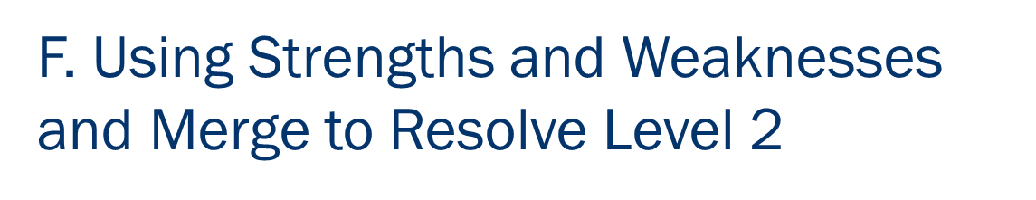
Merge – Back to Role Play
| M: N/A
EVERYONE
KEY MANAGERS
Notes:
Let’s see how Merging works with our Jason and Avery disagreement. [use the role play to identify the key strength or two of each alternative; then ask, “Is there a new alternative that we have not seen that capitalizes on these key strengths?” – often someone will offer something like, train the trainer, etc.]

Slide 43
5 | Facilitating Agreement
Decision-Making Alternatives ☑
Understanding Disagreement ☑
The 3 Reasons People Disagree ☑
Identifying and Resolving Level 3 ☑
Using Delineation to Resolve Level 1 ☑
Using Strengths and Weaknesses and Merge to Resolve Level 2 ☑
5-Finger Consensus
Exercise: Resolving a disagreement

Slide 44
G. 5-Finger Consensus
Using 5-Finger Consensus
5 – Strongly agree
4 – Agree
3 – Will go with group’s decision
2 – Disagree
1 – Strongly disagree
1st vote
2nd vote
-
3rd vote - majority rules
44 | 5-11
Notes:
We call it 5 Finger Consensus. [well written in The Secrets of Facilitation book]
In this case, we delineate to ensure all participants are dealing with the same set of facts. Then, we typically call for a vote. And the way we call for that vote is as follows. First we ask all participants to put their hands in the air, in a fist. Why a fist? [go over the issue with the senior person putting up 5 fingers and how difficult that is for others to show 1 or 2; it influences the other voters]
In the first round: if all participants have 3, 4 or 5 fingers up, we have consensus
If in the first round, we have any 1s or 2s, we ask one of the people that does not support the decision to discuss their concerns. Then we have someone speak to the alternative. We ask for other comments, further discussion. When the discussion is over, we ask, “Before we call for the 2nd vote, are there any changes we want to make to this proposed alternative?” If so, we are back to Round 1 since it is a new proposal. If not, we move the Round 2
In Round 2, if there are all 2s, 3s, 4s, and 5s, we have arrived at consensus. Why, we have agreed to this Decision Process earlier in the session. In this round if there are any 1’s we repeat the process from Round 1 with dissenters and supporters.
In the 3rd Round, it is simply majority rules.
Think about the process of 5 Finger Consensus, think about how we just talked it through, why would you think this would work? [facilitate the discussion; the key point that we want to ensure that is covered is that the process allows people to feel heard, when people feel heard, the feel honored and that the group understands their concerns, etc.]
Any questions or comments on 5 Finger Consensus? [facilitate the discussion]

Slide 45
What if consensus continues to be a problem?
Allow some time to pass.
Take a short break or move on.
Return to the topic later.
-
A fresh look at the issue often yields a better understanding and a greater willingness to “live with” an alternative.
45 | 5-12

Slide 46
5 | Facilitating Agreement
Decision-Making Alternatives ☑
Understanding Disagreement ☑
The 3 Reasons People Disagree ☑
Identifying and Resolving Level 3 ☑
Using Delineation to Resolve Level 1 ☑
Using Strengths and Weaknesses and Merge to Resolve Level 2 ☑
5-Finger Consensus ☑
Exercise: Resolving a disagreement

Slide 47
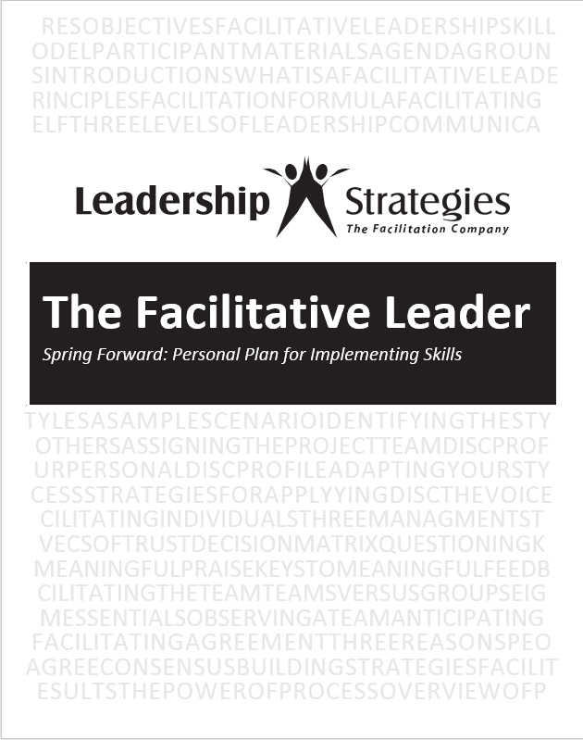
Spring Forward – 5a. Resolving a Disagreement
Based on the topics listed earlier, pick three topics common in your experience
Record:
The type of disagreement (Level 1, 2, or 3) for each
Potential consensus-building strategies to address each topic

Slide 48
Review
When does a group have a decision? Name 3 ways?
The leader decides
The leader decides after a discussion
Simple majority
Super majority
Unanimous agreement
Consensus: “I can live with it and support”
Five-finger consensus
-

Slide 49
Review
What is the reason behind each level of 3 disagreement?
Level 1
Lack of Shared Information
Level 2
Different Values or Experience
Level 3
Personality, Past History, Outside Factors
-

Slide 50
Review
How do you resolve a level-3 disagreement?
Take it to a higher source

Slide 51
Review
What are the 3 steps in delineation?
Start with agreement
Confirm source of disagreement
Delineate the alternatives

Slide 52
Review
If identifying strengths and weaknesses for each alternative results in gaining agreement/consensus, which level of disagreement do you have?
Level 1 – lack of shared information

Slide 53
Review
What are the two merge questions?
What are the one or two most important strengths of each alternative?
Is there a potential solution that combines these key strengths?

Slide 54
Review
The 5-Finger Consensus process uses how many rounds of voting?
Three Rounds
If the person who recommended the alternative decides to make changes to it, you should proceed to which round of voting?
1st Vote
-

Slide 55
Review
When trying to get to consensus, and nothing seems to be working, what last technique can you use?
Take a break

Slide 56
Spring Forward – 5b. Improving Decision-Making
In Class
Select an upcoming meeting that you will be running that will require decision-making.
Given the information from this class what steps CAN you take to improve the decision-making in that meeting?
-

Slide 57
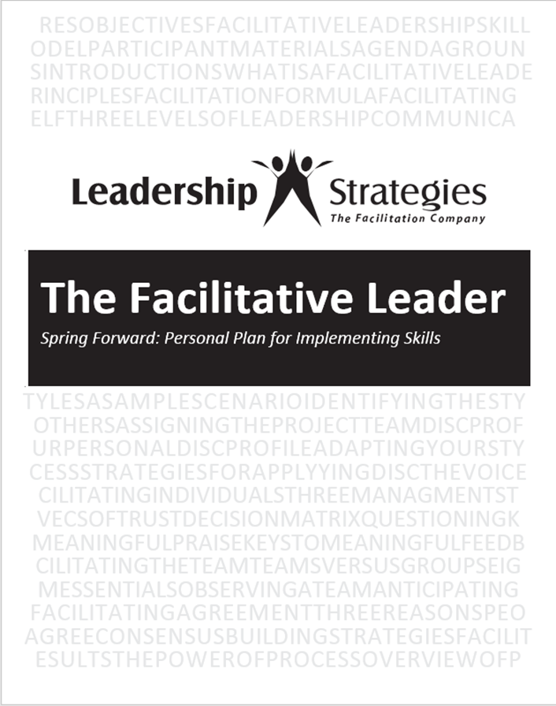
Spring Forward – 5b. Improving Decision-Making
Homework
Select an upcoming meeting that you will be running that will require decision-making.
Given the information from this class what steps WILL you take to improve the decision-making in that meeting?
-

Slide 58
5 | Facilitating Agreement
Decision-Making Alternatives
The 3 Reasons People Disagree
Identifying and Resolving Level 3
Using Delineation to Resolve Level-1
Using Strengths and Weaknesses and Merge to Resolve Level-2
5-Finger Consensus
Exercise: Resolving a disagreement

Slide 59
TAFA -
“Take a Facilitative Approach”
Tools and Concepts in This Module
S
U
C
C
E
E
D
Start with the why, not with the what.
Understand and empower, don’t command and control.
Create the vision, not the solution.
Connect first; correct second.
Equip for success; monitor for results.
Engage conflict; resolve dysfunction.
Drive participation, not just input.
Decision–Making Alternatives
The 3 Reasons People Disagree
Techniques for Resolving Disagreements
5-Finger Consensus
59 | 5-14

Slide 60
Checkpoint
1 | Getting Started, Facilitating Yourself
2 | Facilitating Communication
3 | Facilitating and Coaching Individuals
4 | Facilitating Your Team
5 | Facilitating Agreement
6 | Facilitating Your Strategy
7 | Facilitating Meetings Part 1
8 | Facilitating Meetings Part 2

Slide 61
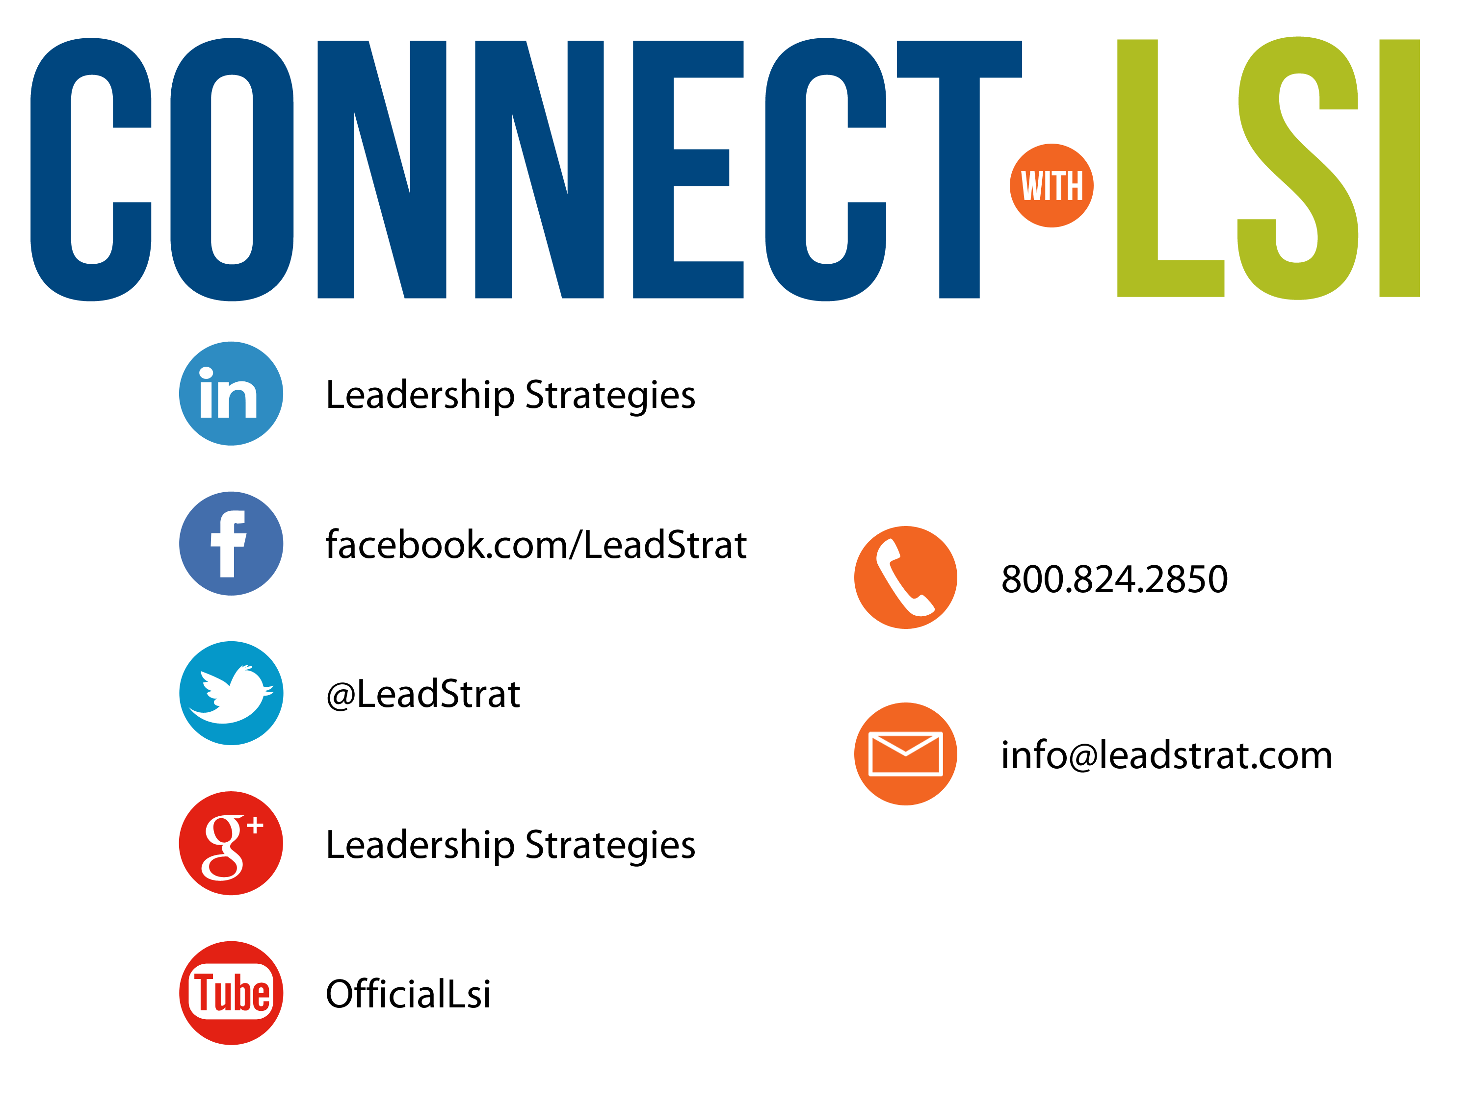


Questions?
etraining@leadstrat.com
800.824.2850
Or, submit your questions for open discussion
on the Linked-In “Leadership Strategies
Facilitation & Leadership Community” Group
Join us on Facebook at
www.Facebook.com/Leadstrat
and Twitter @Leadstrat

Slide 62
The Facilitative Leader
Congratulations!
- Completed Module 5: Facilitating Agreement
- Next: Facilitating Your Strategy

Slide 63
The Facilitative Leader
Congratulations!
- Completed Module 5: Facilitating Yourself
- Next: Facilitating Communication
- Evaluations

Slide 64
The Facilitative Leader
Congratulations!
- Course completed!
- Post-test
- MVP
- Classroom to application
- Evaluations

