Slide 1
The Facilitative Leader

Slide 2
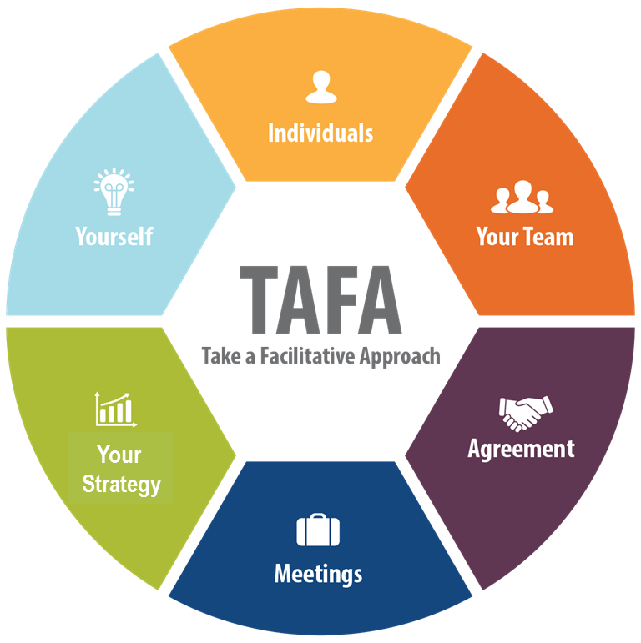

4 | Facilitating Your Team
-

Slide 3
Checkpoint
1 | Getting Started, Facilitating Yourself
2 | Facilitating Communication
3 | Facilitating and Coaching Individuals
4 | Facilitating Your Team
5 | Facilitating Agreement
6 | Facilitating Your Strategy
7 | Facilitating Meetings Part 1
8 | Facilitating Meetings Part 2
Notes:
OK, while we have this methodology diagram in front of us, let’s go back to our grouped objectives. [Go back to each category from the grouped objectives collected earlier and ask the group where that item will be covered. Match their objectives to the principles – essentially the agenda for the class – and demonstrate how to adapt the agenda to meet the need for any group that will not map to a principle.]

Slide 4
TAFA - What does it mean to “Take a Facilitative Approach?”
The Seven TAFA Principles
Start with the why, not with the what.
Understand and empower, don’t command and control.
Create the vision, not the solution.
Connect first; correct second.
Equip for success; monitor for results.
Engage conflict; resolve dysfunction.
Drive participation, not just input.
-
S
U
C
C
E
E
D

Slide 5
Ground Rules
Always open for questions
The open issues list
Respect the speaker
Avoid “bar discussion”
Start on time, end on time
Repetition to train the mind
No beeps or buzzes
Team Cheers
“Choo Choo”

Slide 6


Your Materials
Course manual
Spring Forward exercise packet
Mini manual
Mobile App: Search “LeadStrat” or “Leadership Strategies”
-
Slide # | Manual #

Slide 7
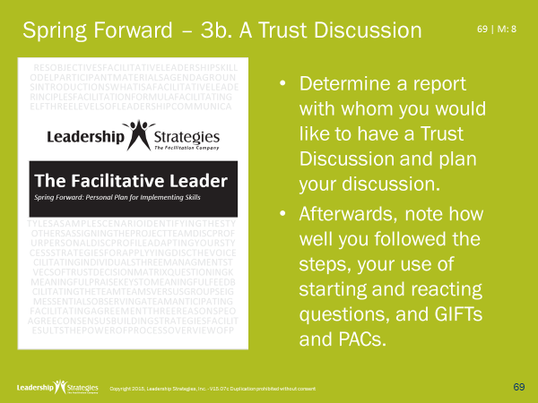
Homework Review
What direct report did you choose?
What went well?
What could you do better next time?

Slide 8
4 | Facilitating Your Team
Teams v. Groups
8 Team Essentials
Anticipating Team Issues
Team Norms
Accountability: 5 Critical Elements
Solution Processes
Managing Change Resistance
Developing Recommendations
Exercise: Chartering a Team
-

Slide 9
4 | Facilitating Your Team
Teams v. Groups
8 Team Essentials
Anticipating Team Issues
Team Norms
Accountability: 5 Critical Elements
Solution Processes
Managing Change Resistance
Developing Recommendations
Exercise: Chartering a Team

Slide 10

A. Teams v. Groups
What are the differences?
 | Team |  | Group
A.
B.
C.
D.
E.
F.
G
H.

Slide 11
A. Teams v. Groups
 | Group or Team? | Why? (Use A-H)
1. Symphony orchestra
2. Americans on a bus tour of France
3. U. S. Congress
4. 1992 Atlanta Braves (first place)
5. 1990 Atlanta Braves (last place)
6. Volunteers rescuing a child stuck in a well
7. Cast of a play
8. Our organization

Slide 12
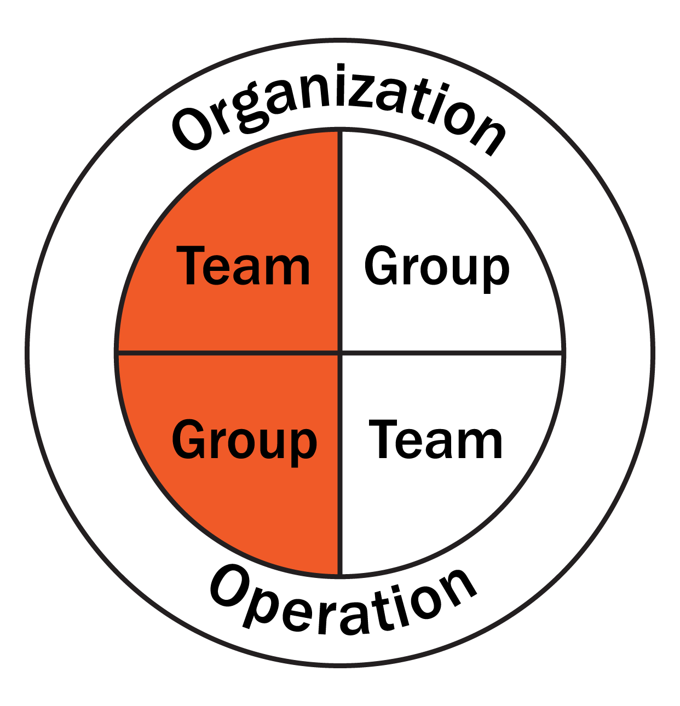
A. Teams v. Groups
Organization v. Operation
Which example?

Slide 13
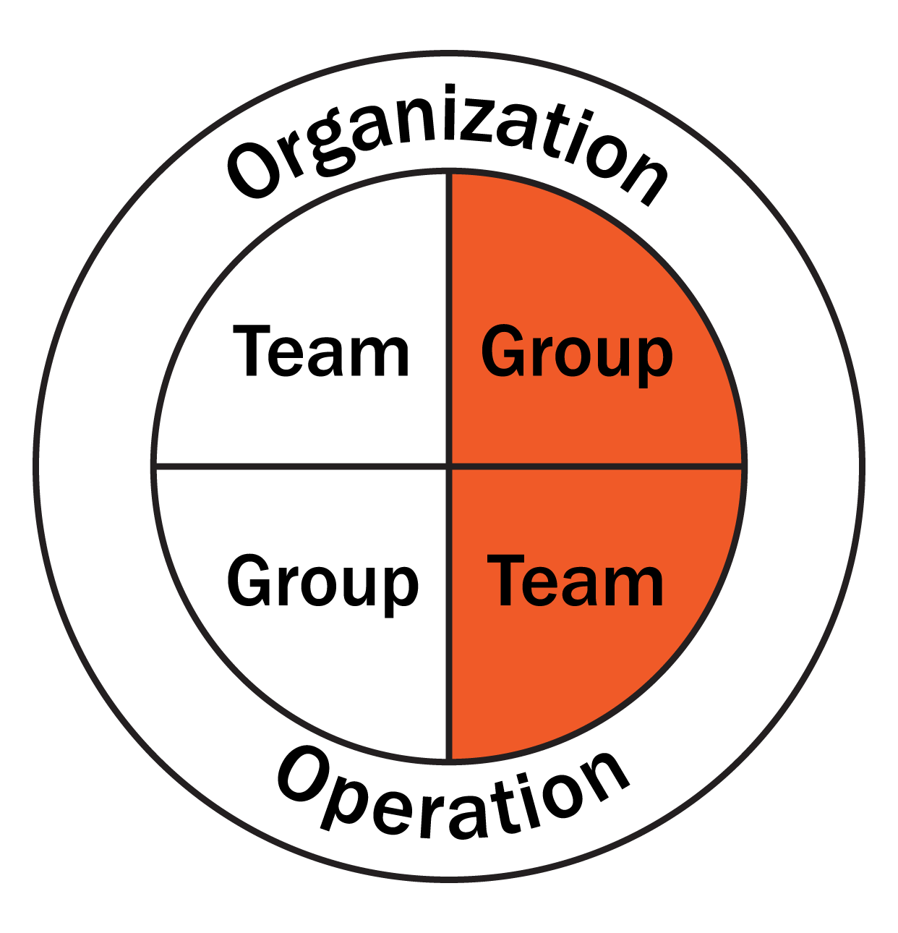
A. Teams v. Groups
Organization v. Operation
Which example?

Slide 14
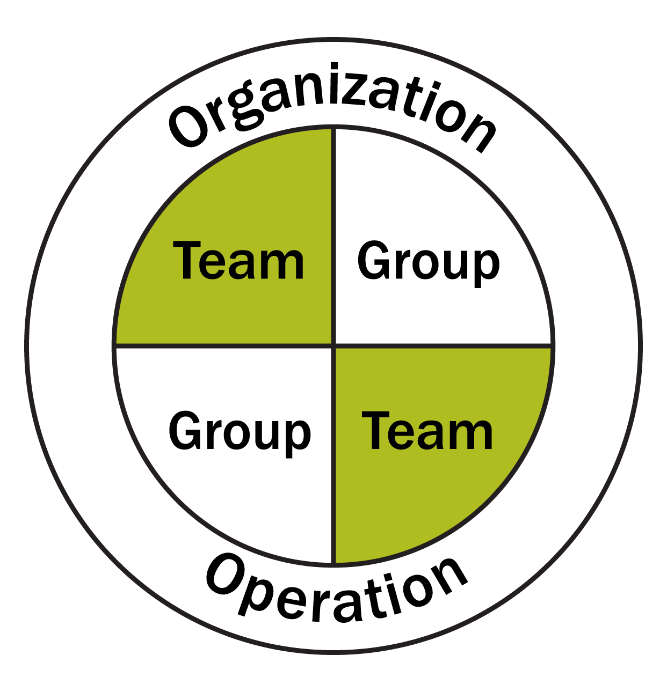
A. Teams v. Groups
Sustained Success Requires
Organized as a Team
Operating as a Team
Excellent _____________
Organization versus Operation
Which example?
-
Notes:
Green box appears to be offscreen?

Slide 15
4 | Facilitating Your Team
Teams v. Groups ☑
8 Team Essentials
Anticipating Team Issues
Team Norms
Accountability: 5 Critical Elements
Solution Processes
Managing Change Resistance
Developing Recommendations
Exercise: Chartering a Team

Slide 16
B. 8 Team Essentials
1. Purpose
2. Deliverables
3. Constraints
4. Resources
5. Accountability
6. Solution Process
7. Leadership
8. Teamwork
The mission or reason for being
The service outcomes or results expected
Should be given to team
The time by when the deliverable is to be completed; additional limitations or conditions
The people who participate on the team, time, funds
The person or group from whom the team receives its charge and to whom it is accountable
Why this line?
The method used to produce the deliverable
Team should create
-
The method used to make decisions, assign tasks, establish policies, address issues, etc.
The level of trust, communication, and participation

Slide 17
B. 8 Team Essentials
 | D | I | S | C | Most and Least?
Purpose |  |  |  |  | The mission or reason for being
Deliverable |  |  |  |  | The service outcomes or results expected
Constraints |  |  |  |  | The time by when the deliverable is to be completed; additional limitations or conditions
Accountability |  |  |  |  | The person or group from whom the team receives its charge and to whom it is accountable
Members |  |  |  |  | The people who participate on the team, time, funds
Leadership |  |  |  |  | The method used to make decisions, assign tasks, establish policies, address issues, etc.
Work Process |  |  |  |  | The method used to produce the deliverable
Teamwork |  |  |  |  | The level of trust, communication, and participation
M
L
M
L
L
M
L
M
M
L
M
L
L
M
L
M
What action might you take based on this information?
-

Slide 18
4 | Facilitating Your Team
Teams v. Groups ☑
8 Team Essentials ☑
Anticipating Team Issues
Team Norms
Accountability: 5 Critical Elements
Solution Processes
Managing Change Resistance
Developing Recommendations
Exercise: Chartering a Team

Slide 19
C. Anticipating Team Issues
What issues could you anticipate from each DISC style leader? What actions might you take IN ADVANCE to prevent the issues from occurring?
 | Issue | Prevention Strategy
High D
High I
High S
High C

Slide 20
4 | Facilitating Your Team
Teams v. Groups ☑
8 Team Essentials ☑
Anticipating Team Issues ☑
Team Norms
Accountability: 5 Critical Elements
Solution Processes
Managing Change Resistance
Developing Recommendations
Exercise: Chartering a Team

Slide 21
D. Team Norms
A positive attitude can keep the team productive
Consider adopting project team norms to encourage good team behavior
Norms must be developed and agreed upon by the team – not imposed by management
Our Team Rules
Arrive early for team meetings
There is no “I” in TEAM
Notify the team early if deadlines will be missed
We are here for the client
Team business stays within the team
Address all challenges with a positive attitude
21 | 4-7

Slide 22
D. Team Norms
Sample Team Norms
Arrive at least five minutes early for all team meetings, so we can start and end on time.
We don’t air our dirty linen outside the team.
If you have a problem with a project team member, take it to that person first BEFORE discussing it with others.
If a problem cannot be resolved between team members, the team members, together, should bring the issue to the project manager.
-
22 | 4-7

Slide 23
4 | Facilitating Your Team
Teams v. Groups ☑
8 Team Essentials ☑
Anticipating Team Issues ☑
Team Norms ☑
Accountability: 5 Critical Elements
Solution Processes
Managing Change Resistance
Developing Recommendations
Exercise: Chartering a Team

Slide 24
E. Accountability: 5 Critical Elements
How do you increase accountability?
Defined work
Accepted responsibility
Monitoring and reporting process
Rewards for achievement
Consequences for inadequate performance
-
24 | 4-8

Slide 25
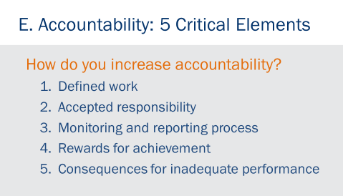
Questions
Why is defined work so important?
What is the difference between assigned responsibility and accepted responsibility?
Why is monitoring and reporting important?
What happens if you DON’T have rewards and consequences?
-
25 | 4-9

Slide 26
4 | Facilitating Your Team
Teams v. Groups ☑
8 Team Essentials ☑
Anticipating Team Issues ☑
Team Norms ☑
Accountability: 5 Critical Elements ☑
Solution Processes
Managing Change Resistance
Developing Recommendations
Exercise: Chartering a Team

Slide 27

F. Solution Processes
Process: A systematic series of actions directed to some end.
Problem Identification
Lack of common direction among departments
…
Problem Type
Disagreement surrounding how to solve an issue
A process is ineffective or inefficient
Distrust or poor communication within a team
Strategic Planning
Issue Resolution
Team Building
Process Improvement
…
Solution Processes
Let the process do the heavy lifting
-

Slide 28
F. Solution Processes
Strategic Planning | Lack of common direction among departments
28 | 4-11

Slide 29
F. Solution Processes
Strategic Planning Process
Introduction
Review Situation Analysis
Develop Vision
Define Goals
Define Mission
Develop Objectives
Identify Critical Success Factors
Identify Barriers
Develop Strategies
Document Action Plans
Next Steps
29 | 4-12

Slide 30
F. Solution Processes
Strategic Planning | Lack of common direction among departments
Project Planning | A detailed plan is needed for a project
30 | 4-11

Slide 31
F. Solution Processes
Project Planning
Introduction
Define the Project Purpose and Objectives
Determine Deliverables and Scope
Identify Critical Success Factors
Develop Overall Approach
Define Resources, Durations and Dependencies
Define the Schedule
Identify Risks and Contingencies
Document Management Issues
Next Steps
31 | 4-12

Slide 32
F. Solution Processes
Strategic Planning | Lack of common direction among departments
Project Planning | A detailed plan is needed for a project
Issue Resolution | There is disagreement on how to resolve a specific issue
32 | 4-11

Slide 33
F. Solution Processes
Issue Resolution
Introduction
Issue Definition
Alternatives Specification
Strengths and Weaknesses
Evaluation Criteria
Scoring
Weighted Score
Final Selection
Next Steps
33 | 4-12

Slide 34
F. Solution Processes
Strategic Planning | Lack of common direction among departments
Project Planning | A detailed plan is needed for a project
Issue Resolution | There is disagreement on how to resolve a specific issue
Process Improvement | Streamline a process that is inefficient or ineffective
34 | 4-11

Slide 35
F. Solution Processes
Process Improvement
Introduction
How does the Process Work Today?
What are the Problems and Root Causes?
What are the Potential Improvements?
What is the Priority of the Improvements
Implementation Plan
Next Steps
35 | 4-13

Slide 36
F. Solution Processes
Strategic Planning | Lack of common direction among departments
Project Planning | A detailed plan is needed for a project
Issue Resolution | There is disagreement on how to resolve a specific issue
Process Improvement | Streamline a process that is inefficient or ineffective
Process Reengineering | Redesign a process that is inefficient or ineffective
36 | 4-11

Slide 37
F. Solution Processes
Process Reengineering
Introduction
Business Activities and Processes
Products, Customers, and Expectations
Triggers and Transactions
Main Line Processing
Exception Processing
Processing Steps
Value-Added Analysis
Root Cause Analysis
Process Improvement Actions
Implementation Plan
Measurements
Next Steps
37 | 4-13

Slide 38
F. Solution Processes
Which Solution Process?
A major computer manufacturer has identified three major barriers to growth and needs to evaluate alternatives for addressing them.
A developer of hardware products for the cable TV industry is not satisfied with its product development process and wants to redesign it from scratch.
A city government has decided to implement a new garbage collection process and wants to get the workers involved in developing the details of implementing the program.
A manufacturer of buns and rolls for a fast food company is concerned that its yield is low and wants to determine how to improve it.
A national fundraising and community organization believes it needs to redefine its mission and direction in order to meet the changing needs of the community.
A major retailer’s information systems dept. is looking to involve its employees in developing strategies for improving customer service, employee morale and leadership development.
-
38 | 4-14

Slide 39
F. Solution Processes
Identifying Solution Processes
Problem |  | Process
1. Computer Mfr.
Evaluate alternatives
Issue Resolution
2. Hardware for the cable industry
Not satisfied, product development process
Process Reengineering
3. Garbage collect.
Details of implementing
Project Planning
4. Buns/rolls manufacturer
Yield is low, how to fix it
Process Improvement
5. Fundraising / community org
Mission, direction
Strategic Planning
-
6. Retailer systems
Improvement strategies
Process Improvement
Notes:
Let’s try another team activity…..
Purpose…in our teams….let’s see if we can use the problem description on Section 6-3 of your manuals to identify the key or operative words that lead us to use one of our Solution Processes in Section 6.2……
Example… for example…(name), would you read the 1st problem description for us?….thanks…..OK, (blue) team, what do you think the key or operative words are in that description?……..good….”evaluate alternatives”….that’s right….so, if we are going to evaluate alternatives….(green) team, what Solution Process would you think we would turn to……that’s it, Issue Resolution……
Directions……to complete this activity, let’s first select a new team leader……..good…now in your teams I am going to set the clock to 4 minutes….I would like the (red) team to start with our 2nd row….the (green) team to start with the 4th row…..etc.……you are to identify the operative words and the Solution Process your team would use to address that problem
Exceptions….please note…don’t overanalyze these cases…select your best Solution Process and note some may be used more than once and others may not be used at all…..
Questions…….any questions…..OK, I am starting the clock…..
(start the clock…and facilitate the discussion when the time is up….use round robin by teams, etc.)

Slide 40
4 | Facilitating Your Team
Teams v. Groups ☑
8 Team Essentials ☑
Anticipating Team Issues ☑
Team Norms ☑
Accountability: 5 Critical Elements ☑
Solution Processes ☑
Managing Change Resistance
Developing Recommendations
Exercise: Chartering a Team

Slide 41

G. MANAGING CHANGE RESISTANCE

Slide 42
G. Managing Change Resistance
Resistance to change comes in many forms. An understanding of the four reasons people change helps in determining methods for addressing resistance.
Why Do People Change?
Higher Vision
Desired Outcome
Fear of Consequences
Pain
-
42 | 4-15
Notes:
How many of us have already worked on client engagements?....(raise your hand)…….and, for those of you that have, was there a time on a project or two that there was a change necessary yet the client was reluctant or resisted that change…..(nod your head yes)…..sure, it seems to be natural in many situations for people to be hesitant to move forward with change…….understanding the various “flavors” that resistance may present itself and knowing many of the compelling reasons for change will be very useful for those of us providing consulting services to our clients…..(purple) team, can you share with us the example you were thinking of when you raised your hands before…..(facilitate the discussion)……let’s take a look at 4 key reasons that drive people to change…..
Higher vision……can anyone think of an example?....(name), share that with us….examples to consider would be Gates and Allen with the PC…a computer on every desk…..Jobs with the mouse or the music revolution
Desired outcome……anyone have an example of this?........OK, what about an individual that wants to improve their fitness, lose weight or stop a bad habit such as smoking……
Fear of consequences……(have another participant share)……again, we can go back to the person that wants to stop smoking….he/she may fear poor health, cancer, etc…..
Pain……(another potential participant share)…..anybody ever lost a filling or had a bad toothache….that forces change surfaced by pain……

Slide 43
G. Managing Change Resistance
Connect first, Correct Second!
Much like dealing with dysfunctional behavior in a facilitated meeting, the recommended method for addressing change resistance is:
APPROACH PRIVATELY
Meet with the person one-on-one or, perhaps, with one additional person.
EMPATHIZE WITH THE SYMPTOM
Praise the effort put forth, the level of participation, the quality of input, or anything else that is both sincere and worthwhile.
ADDRESS THE ROOT CAUSE
Identify the critical issue and causes for it. AVOID saying, “But…”
GET AGREEMENT ON A SOLUTION
Seek a mutually-agreeable approach to addressing the symptom and root cause.
-
43 | 4-16
Notes:
Let’s take a look at an approach we find very helpful in addressing that resistance to change…..(name) can you read that first step……that’s right approach privately or generally…….if an individual or a few individuals are pushing back, best to deal with that privately…..if a larger group a group discussion might be appropriate….again, it depends…..that next step is very important…empathize with the symptom……by showing empathy we are showing our concerns, expressing our understanding and inviting an individual or individuals to share their concerns or resistance with us….it is a means to “open the lines of communications”…..

Slide 44
G. Managing Change Resistance
Resistance by DISC Type
What are some of the likely forms of resistance that would come from each of the DISC types? What is a response that a leader might make based on the general formula?
 | Likely Form of Resistance | Suggested Response
High D
High I
High S
High C
-
44 | 4-17
Notes:
Often the expression of resistance will be, once again, an expression of our communication style……how many of you are D’s?.....what is the form of resistance we might expect from one of you….yes, it will be clear and sometimes, in your face…..for our D’s, let’s remember less is more and focus on the benefits………how about one of our I’s….what does resistance look like from you…….OK, talk around it, ramble with stories, etc….our advice with those Hi I’s is again, let them sell themselves….ask them about it before it is in its final format, gain their buy-in and they will help you “sell it”….what about our S’…….good, gain the support of the team that surrounds them, emphasize the benefits to the team or organization and provide them lots of assurances about how well thought through it is…….how about our C’s……how will we experience resistance from one of you…..thank you…..it’s about the facts, the data, the implementation plan…….with our Hi C’s we want to ensure it is well justified, well documented and well thought through……..

Slide 45
4 | Facilitating Your Team
Teams v. Groups ☑
8 Team Essentials ☑
Anticipating Team Issues ☑
Team Norms ☑
Accountability: 5 Critical Elements ☑
Solution Processes ☑
Managing Change Resistance ☑
Developing Recommendations
Exercise: Chartering a Team

Slide 46
H. Developing Recommendations
[ Finding ] | Fact based OBSERVATION about the environment (supported by numbers)
[ Conclusion ] | IMPACT of the observation on the organization
[ Recommended Action ] | Specific ACTIVITY to address the impact, with anticipated internal and external costs
[ Benefit ] | QUANTIFIED advantage to the organization of implementing the recommendation
-
[ Risk ] | POTENTIAL downside or obstacle that could impair the achievement of the recommendation
46 | 4-19
Notes:
While developing and presenting recommendation may sound easy, we can separate ourselves even further from presenting these in a well thought out, logical format……we find that our clients prefer something that is crisp, concise and easy to understand……to accomplish this we find the format outlined on this slide is very straightforward……(review the five rows…..definitions, etc.)……………..so (red) team, get us started with what we have to do as a part of the engagement to develop our findings……good, data analysis, interviews, and looking at where the facts may be found…….(green) team, what about the conclusion sections……yes we look at the facts from our findings and then assess the impact that is having within the client’s business…this takes some real think time, as we look at opportunities for our client…..(blue) team, what about recommendations…..good, here we are presenting the specific actions or steps that will address the impact identified above with any costs…both internal and external costs……….(purple) team, what about benefits…….OK, here we are trying to identify measureable impacts of the recommendations or the opportunities that exist for the client…….finally, let me ask the group, what about risks?......what are these and why would we want to address these as a part of presenting our recommendations……..let’s take a look at a specific example on the next slide……

Slide 47
H. Developing Recommendations
Our quarterly advertising expenditures averaged $30,000. Yet, over 50% of the positions advertised in the paper were filled by in-house people.
Finding
Conclusion
Recommendation
Benefit
Risks
The policy requiring that positions be posted in-house and advertised simultaneously results in wasted dollars.
Change the policy to require outside advertising only if the position is not filled within 45 days by a qualified in-house person. This recommendation requires 4 internal hours of research/policy development and 0 out-of-pocket costs.
Based on data from the last six months, changing this policy should result in a 30-35% reduction in advertising, with a savings of $9,000 per quarter.
For positions in which there are no qualified in-house applicants, the recommendation could increase time to hire if in-house posting is first chosen.
Finding vs. Conclusion
Recommendation vs. Benefit
Why show Risks?
-
47 | 4-19

Slide 48
4 | Facilitating Your Team
Teams v. Groups ☑
8 Team Essentials ☑
Anticipating Team Issues ☑
Team Norms ☑
Accountability: 5 Critical Elements ☑
Solution Processes ☑
Managing Change Resistance ☑
Developing Recommendations ☑
Exercise: Chartering a Team

Slide 49

Spring Forward – 4a. Chartering a Team
How might you use the information from this section to…
Select team members?
Establish the team charter?
Ensure team success?
Anticipate and prevent issues?

Slide 50
Review
Sustained Success Requires?
Organized as a team
Operating as a team
Excellent strategy

Slide 51
Review
Which of the 8 Team Essentials should the team create?
Solution Process
Purpose
Leadership
Deliverables
Constraints
Resources
Accountability
Teamwork
-

Slide 52
Review
Considering the 8 Team Essentials, which of the DISC styles would be most interested in:
Purpose and Members?
I
Constraints and Work Process?
C
Members and Teamwork?
S
Deliverable and Leadership?
D
-

Slide 53
Review
Which is the Solution Process for each of the following needs?
Lack of common direction among departments
Strategic Planning
A detailed plan is needed for a project
Project Planning
There is disagreement on how to resolve a specific issue
Issue Resolution
Streamline a process that is inefficient or ineffective
Process Improvement
-

Slide 54
Review
Which of the following is one of the 5 Keys to Accountability?
Undefined work
Rejected responsibility
Monitoring and reporting process
Rewards for inactivity
Rewards for inadequate performance

Slide 55
Review
What are the four key reasons that people change?
Higher vision
Desired outcome
Fear of consequences
Pain

Slide 56
Review
What is the four-step process for addressing change resistance?
Approach privately or generally
Empathize with the symptom
Address the root cause
Get agreement on a solution

Slide 57
Review
What are the five parts of a recommendation?
Finding
Conclusion
Recommendation
Benefit
Risks

Slide 58
Spring Forward – 4b. 8 Team Essentials
In Class
Consider a project team that you lead, or are involved in.
Define each of the 8 Team Essentials for that team.
-

Slide 59

Spring Forward – 4b. 8 Team Essentials
Homework
Consider a project team that you lead, or are involved in.
Define each of the 8 Team Essentials for that team.
-

Slide 60
4 | Facilitating Your Team
Teams v. Groups
8 Team Essentials
Anticipating Team Issues
Team Norms
Accountability: 5 Critical Elements
Solution Processes
Managing Change Resistance
Developing Recommendations
Exercise: Chartering a Team

Slide 61
TAFA -
“Take a Facilitative Approach”
Tools and Concepts in This Module
S
U
C
C
E
E
D
Start with the why, not with the what.
Understand and empower, don’t command and control.
Create the vision, not the solution.
Connect first; correct second.
Equip for success; monitor for results.
Engage conflict; resolve dysfunction.
Drive participation, not just input.
Teams vs. Groups
8 Team Essentials
Anticipating Team Issues
Solution Processes
Accountability
61 | 4-21

Slide 62
Checkpoint
1 | Getting Started, Facilitating Yourself
2 | Facilitating Communication
3 | Facilitating and Coaching Individuals
4 | Facilitating Your Team
5 | Facilitating Agreement
6 | Facilitating Your Strategy
7 | Facilitating Meetings Part 1
8 | Facilitating Meetings Part 2

Slide 63
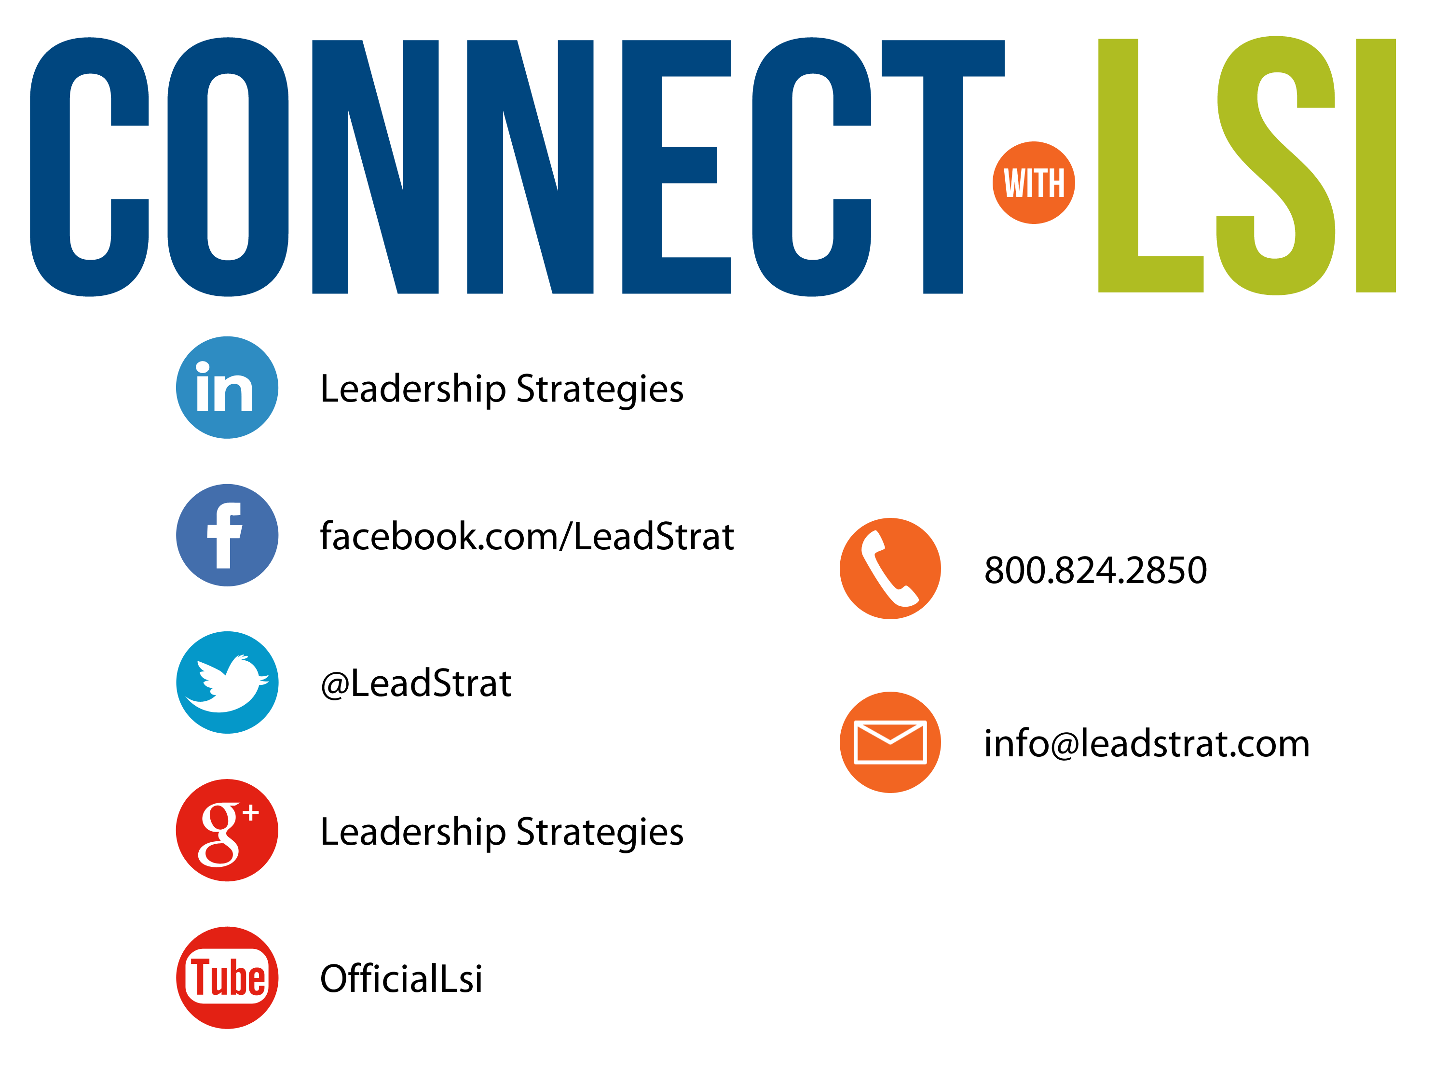


Questions?
etraining@leadstrat.com
800.824.2850
Or, submit your questions for open discussion
on the Linked-In “Leadership Strategies
Facilitation & Leadership Community” Group
Join us on Facebook at
www.Facebook.com/Leadstrat
and Twitter @Leadstrat

Slide 64
The Facilitative Leader
Congratulations!
- Completed Module 4: Facilitating Your Team
- Next: Facilitating Agreement

Slide 65
The Facilitative Leader
Congratulations!
- Completed Module 4: Facilitating Your Team
- Next: Facilitating Agreement
- Evaluations

Slide 66
The Facilitative Leader
Congratulations!
- Course completed!
- Post-test
- MVP
- Classroom to application
- Evaluations

