Slide 1
The Facilitative Leader

Slide 2


3 | Facilitating and Coaching Individuals
-

Slide 3
Checkpoint
1 | Getting Started, Facilitating Yourself
2 | Facilitating Communication
3 | Facilitating and Coaching Individuals
4 | Facilitating Your Team
5 | Facilitating Agreement
6 | Facilitating Your Strategy
7 | Facilitating Meetings Part 1
8 | Facilitating Meetings Part 2
Notes:
OK, while we have this methodology diagram in front of us, let’s go back to our grouped objectives. [Go back to each category from the grouped objectives collected earlier and ask the group where that item will be covered. Match their objectives to the principles – essentially the agenda for the class – and demonstrate how to adapt the agenda to meet the need for any group that will not map to a principle.]

Slide 4
TAFA - What does it mean to “Take a Facilitative Approach?”
The Seven TAFA Principles
Start with the why, not with the what.
Understand and empower, don’t command and control.
Create the vision, not the solution.
Connect first; correct second.
Equip for success; monitor for results.
Engage conflict; resolve dysfunction.
Drive participation, not just input.
-
S
U
C
C
E
E
D

Slide 5
Ground Rules
Always open for questions
The open issues list
Respect the speaker
Avoid “bar discussion”
Start on time, end on time
Repetition to train the mind
No beeps or buzzes
Team Cheers
“Choo Choo”

Slide 6


Your Materials
Course manual
Spring Forward exercise packet
Mini manual
Mobile App: Search “LeadStrat” or “Leadership Strategies”
-
Slide # | Manual #

Slide 7
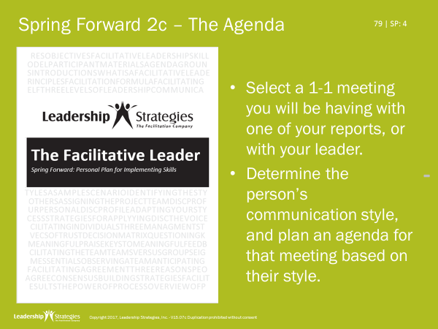
Homework Review
Who did you select (title)?
What was their communication style?
How did you change your agenda to adapt to their style?

Slide 8
3 | Facilitating and Coaching Individuals
3 Management Styles
Exercise: Determining Appropriate Management Styles
5 Cs of Trust
Decision Matrix
The Power of the Starting Question
Using Reacting Questions
Keys to Meaningful Praise
Providing Constructive Feedback
Exercise: Giving Praise and Constructive Feedback
-

Slide 9
3 | Facilitating and Coaching Individuals
3 Management Styles
Exercise: Determining Appropriate Management Styles
5 Cs of Trust
Decision Matrix
The Power of the Starting Question
Using Reacting Questions
Keys to Meaningful Praise
Providing Constructive Feedback
Exercise: Giving Praise and Constructive Feedback

Slide 10
A. 3 Management Styles
Style | Characteristic | When to use
1. Directing | Describe what is to be done, how, when, and where | Lack of ______ Lack of __________ Lack of ______
2. Coaching
3. Delegating
Time
Experience
Trust
-

Slide 11
A. 3 Management Styles
Style | Characteristic | When to use
1. Directing | Describe what is to be done, how, when, and where | Lack of ______ Lack of __________ Lack of ______
2. Coaching | Describe what is to be done and encourage discussion on how | Plenty of _____ Preparing to _________
3. Delegating
Time
Experience
Trust
Time
Delegate
-

Slide 12
A. 3 Management Styles
Style | Characteristic | When to use
1. Directing | Describe what is to be done, how, when, and where | Lack of ______ Lack of __________ Lack of ______
2. Coaching | Describe what is to be done and encourage discussion on how | Plenty of _____ Preparing to _________
3. Delegating | Describe the problem, ask that it be addressed | Plenty of ___________ Plenty of _________
Time
Experience
Trust
Time
Delegate
Experience
Trust
-

Slide 13
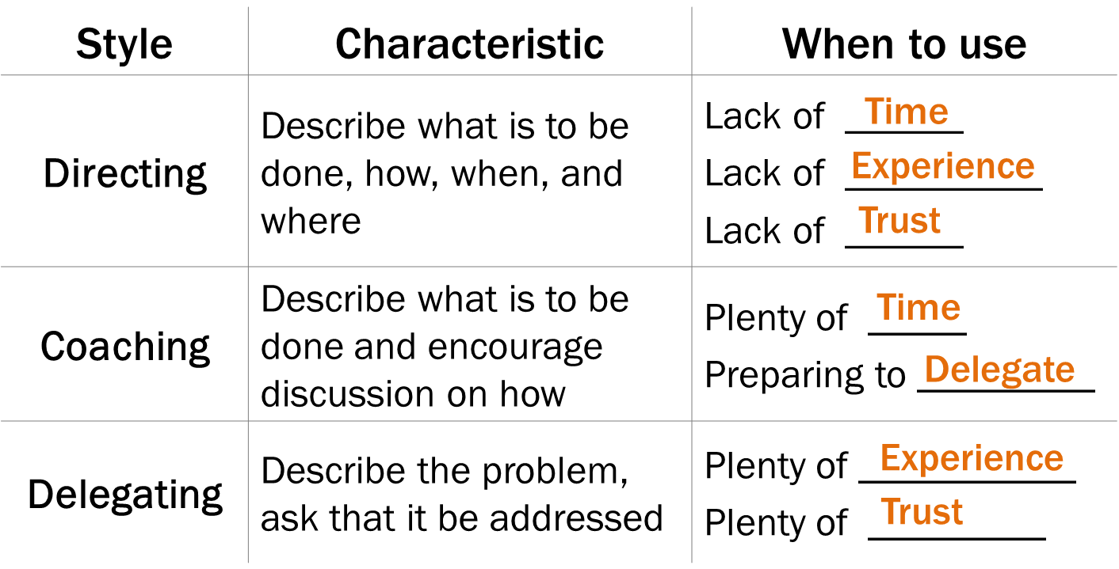

1. What happens when you DIRECT people for whom DELEGATING is more appropriate?
Answer: (Type your response in the question box)
They become frustrated. They consider you a micro-manager.
-

Slide 14
2. What happens when you DELEGATE to people for whom DIRECTING is more appropriate?
Answer:
YOU become frustrated! They don’t get it done.
-
Mismanagement

Slide 15
A. 3 Management Styles
Effective Directing
Effective Delegating
Effective Coaching

Slide 16
A. 3 Management Styles
Effective Directing
Identify the work to be done and why it is important.
Develop a clear picture of the work and the results.
Select a person who has the time, skills, and resources.
Meet with the person.
Set interim review times.
Follow up to check progress.
Upon completion, give feedback.
-

Slide 17
A. 3 Management Styles
Effective Directing
Identify the work to be done and why it is important.
Develop a clear picture of the work and the results.
Select a person who has the time, skills, and resources.
Meet with the person.
Set interim review times.
Follow up to check progress.
Upon completion, give feedback.
Effective Delegating
Which of these steps would be the same and which would you do differently if you were delegating instead of directing?
What are the two biggest obstacles to delegation?
Time
Trust
-

Slide 18








A. 3 Management Styles
Effective Coaching Using the Drivers Model
Where do you want to be?
Barriers
CSFs
Monitor
-
Where are you today?

Slide 19
A. 3 Management Styles
Having a Coaching Conversation
Where are you today? (Your strengths, areas for improvement)
Where would you like to be? What’s your vision of success?
What do you see as the barriers to getting there? Why aren’t you there already?
What are your critical success factors? What are the conditions, that if they are created, well propel you to your vision?
What are key strategies for getting there? What help do you need from the organization?
What do you start on first?
How will we monitor progress?
-

Slide 20
Review
What are the key differences between the 3 Management Styles?
Directing:
Describe what is to be done, how, when, and where
Coaching:
Describe what is to be done, and encourage discussion on how
Delegating:
Describe the problem, ask that it be addressed
-

Slide 21
Review
What happens when you DIRECT people for whom you should be DELEGATING is more appropriate?
They become frustrated.
They feel micromanaged.
What happens when you DELEGATE to people for whom DIRECTING is more appropriate?
You become frustrated.
They don’t get it done.
-

Slide 22
Review
What are the two biggest obstacles to delegating?
Time
Trust

Slide 23
Review
How do you start a coaching conversation?
Where are you today? (strengths, areas for improvement)
What is the last thing you decide in a coaching conversation?
How will we monitor progress?

Slide 24
3 | Facilitating and Coaching Individuals
3 Management Styles ☑
Exercise: Determining Appropriate Management Styles
5 Cs of Trust
Decision Matrix
The Power of the Starting Question
Using Reacting Questions
Keys to Meaningful Praise
Providing Constructive Feedback
Exercise: Giving Praise and Constructive Feedback

Slide 25
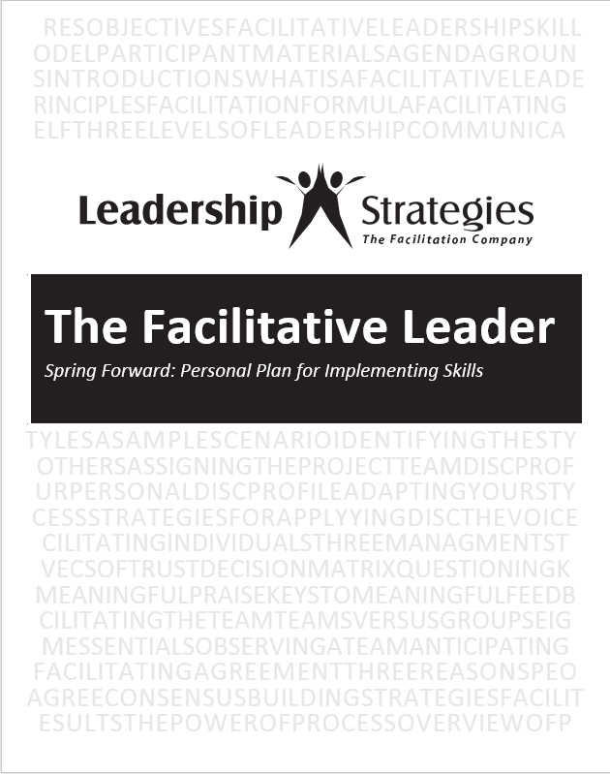
Spring Forward – 3a. Determining Appropriate Management Styles
Consider the individuals on the team you manage. Record the appropriate management style for each individual and any specific actions you might consider taking.

Slide 26
3 | Facilitating and Coaching Individuals
3 Management Styles ☑
Exercise: Determining Appropriate Management Styles ☑
5 Cs of Trust
Decision Matrix
The Power of the Starting Question
Using Reacting Questions
Keys to Meaningful Praise
Providing Constructive Feedback
Exercise: Giving Praise and Constructive Feedback

Slide 27

B. 5 Cs of Trust
Think about someone whom you trust.
It might be someone in your personal or professional life.
What is it about that person that lets you know you can trust him or her?
-
Why do you trust that person?

Slide 28
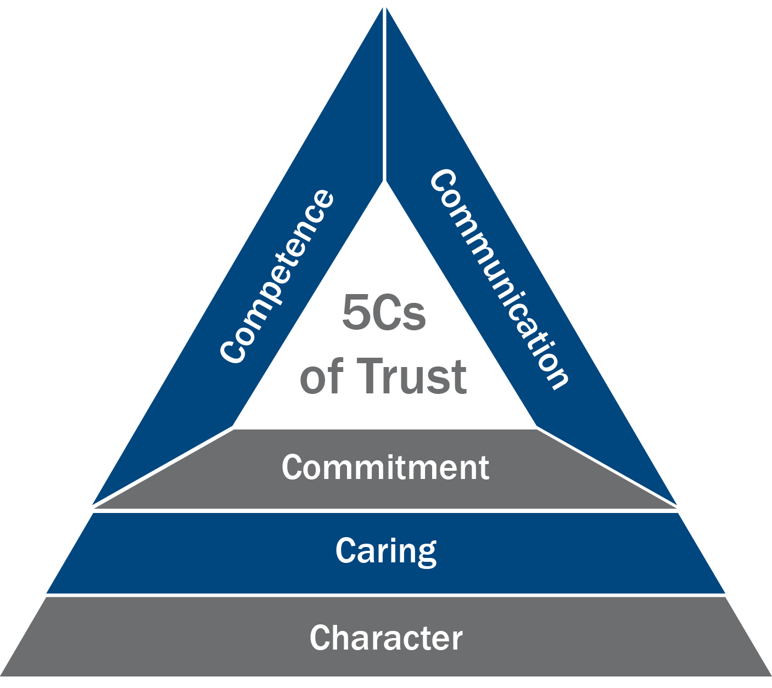
B. 5 Cs of Trust
“I trust you” means…
Competence
You have the necessary skills and expertise.
Communication
We truly hear and understand each other.
Commitment
You are committed to our success.
Caring
You have my interest at heart.
Character
You are honest and ethical.
-

Slide 29
B. 5 Cs of Trust
Key Observation
The lower you go in the triangle, the harder it is to address the issue!
-

Slide 30
B. 5 Cs of Trust: Holding a Trust Conversation
Introduce the 5 Cs
Express desire for trust
Acknowledge current situation
Describe approach to build trust
Ask for feedback
Confirm agreement
Ensure monitoring
-

Slide 31
3 | Facilitating and Coaching Individuals
3 Management Styles ☑
Exercise: Determining Appropriate Management Styles ☑
5 Cs of Trust ☑
Decision Matrix
The Power of the Starting Question
Using Reacting Questions
Keys to Meaningful Praise
Providing Constructive Feedback
Exercise: Giving Praise and Constructive Feedback

Slide 32
C. Decision Matrix
You Suggest
We Discuss
You Decide
-
Their Buy-In
You Suggest
We Discuss
I Decide
You Suggest
I Decide
I Decide
Your Time with Them

Slide 33
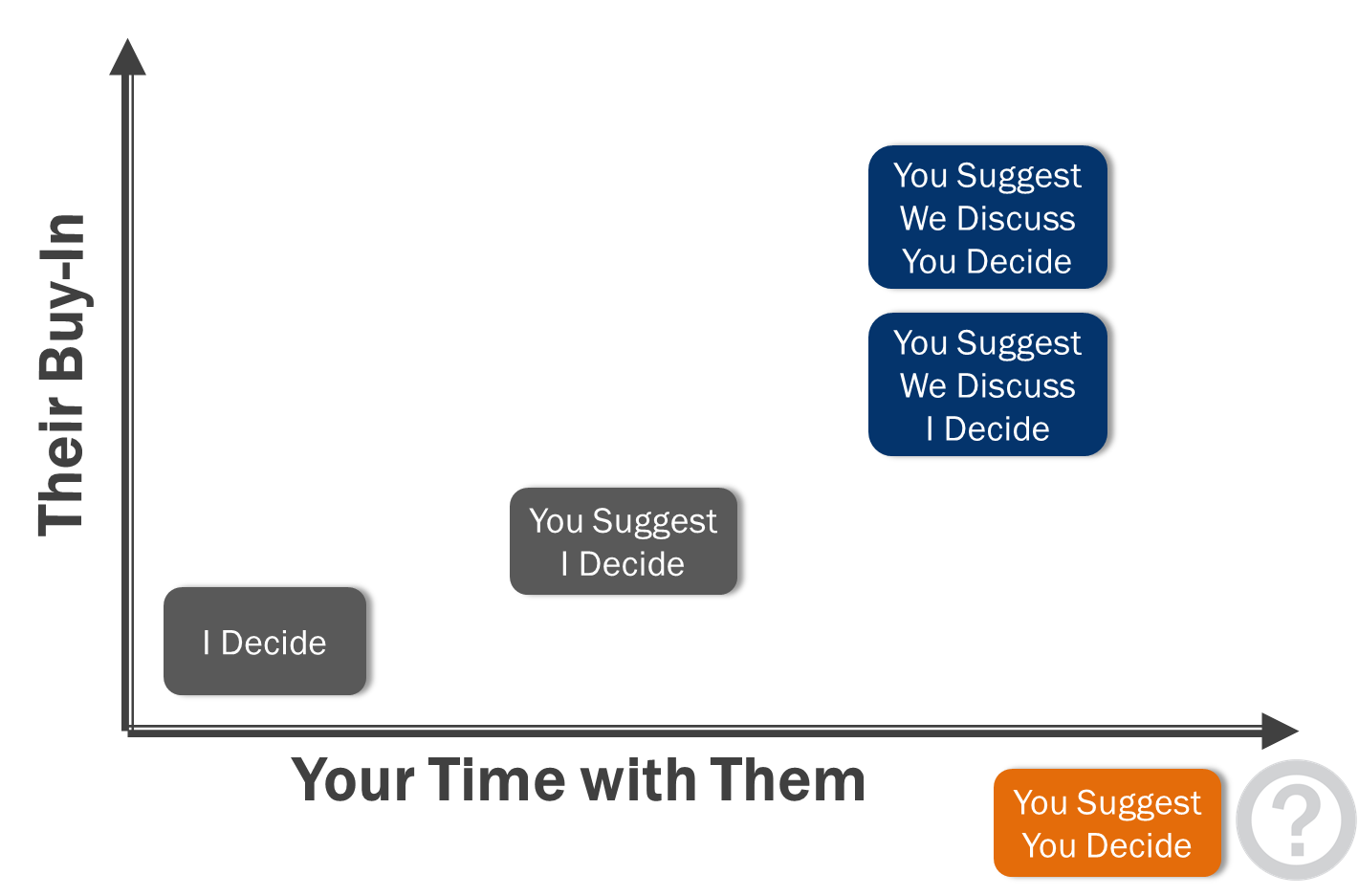
Where does the box go?
C. Decision Matrix
4. Upper Left?
-
3. Upper Right?
1. Lower Left?
2. Lower Right?

Slide 34
C. Decision Matrix
You Suggest
You Decide
Level 3 - Visionary
-
You Suggest
We Discuss
You Decide
Level 2 - Coach
Their Buy-In
You Suggest
We Discuss
I Decide
You Suggest
I Decide
I Decide
Level 1 - Overseer
Your Time with Them
You Suggest
You Decide

Slide 35
C. Decision Matrix
Holding the Decision Matrix Discussion
Introduce the Decision Matrix
Gain agreement on the current decision box
Gain agreement on the desired decision box
Identify why the desired isn’t the case today
Identify what needs to happen to achieve the desired
Outline a possible plan of action
Confirm agreement
Ensure monitoring
-

Slide 36
3 | Facilitating and Coaching Individuals
3 Management Styles ☑
Exercise: Determining Appropriate Management Styles ☑
5 Cs of Trust ☑
Decision Matrix ☑
The Power of the Starting Question
Using Reacting Questions
Keys to Meaningful Praise
Providing Constructive Feedback
Exercise: Giving Praise and Constructive Feedback

Slide 37

D. The Power of the Starting Question
Notes:
MW: One slide, image, reduce words
Record as many of the speaker’s words as is necessary
Not necessary to record all the words
If uncertain, ask for confirmation
If too long, ask for the headline
Use abbreviations cautiously
Do NOT clean up the speaker’s words
How many of you have faced the challenge of having a participant tell you how to build the wrist watch when all you asked for is what time was it?
This headline or bullet point request can be very helpful for these “long winded” participants
3215241

Slide 38
Standing Poll
D. The Power of the Starting Question
TRUE OR FALSE
If you want to ask a question that gets lots of responsive, the most important aspect of the question is that it is open-ended.
ANSWER:
False!
-

Slide 39
D. The Power of the Starting Question
You want to get your team members to improve their customer service. You start by getting them to talk about good customer service they have experienced.
Which is the better question?
Question Type A
The first topic I want us to talk about is customer service over the phone. What would you say are good telephone customer service techniques?
Question Type B
Think about a time when you experienced great customer service over the phone. Think about the things that made it a great experience. Consider the things that the person did or said that made you think, “That was great customer service!” What would you say are good telephone customer service techniques?
-

Slide 40
D. The Power of the Starting Question
Three parts to a great starting question:
Begin with an image-building phrase (“think about”, “imagine”, “consider”, “if”)
Extend the image, so the group can “see” the answers. (at least 2 phrases)
Follow up with the direct (Type A) question.
-
Notes:
The 3 steps to asking the Great Starting Question are:
Begin with an image building phrase: think of it as opening up a blank sheet of paper. There are many ways to do that and we have 4 possibilities on the slide. Think about, imagine, consider and if
Extend….the image [consider a hand gesture for expanding] so the participants can see their answers. At least 2 phrases and, for the next few days, I would like to suggest you use 3 phrases to get used to this extension. This is the part that really “draws that picture” of the answer for each participant.
Ask that direct question. That is the open ended question we would like the participants to answer.
Are there any questions on the steps before we look at some examples to ensure we all understand the technique? [facilitate the discussion]

Slide 41
D. Example: Make This a Type B Question
Make this a Type B Question
Let’s build a list of the things you do to prepare to leave to go to work. What are those things?
Hint
-

Slide 42
D. The Power of the Starting Question
HINT
Build your Type B question in 3-2-1 order.
Use synonyms in step 2.
3. Determine the Type A question
2. Identify synonyms to extend the image
1. Decide the image-building phrase
-
Notes:
While we ask the Type B question in the order described [refer to flip chart] we can better build the Type B question in a different order as follows:
Step 3 first – determine the Type A question; the question we want the participants to answer.
Then Step 1 – begin with the image building phrase
And, then finally, Step 2: extend the image. And, the KEY, is to find the key word or phrase in the Type A question and identify synonyms for that work/phrase.
Let’s use this to build our Type B question on the things we do to prepare to go to work.

Slide 43
D. The Power of the Starting Question
| M: NA
Make this a Type B Question
Let’s build a list of the things you do to prepare to leave to go to work. What are those things?
________________________________________
3. Determine Type A question
2. Identify synonyms to extend the image
1. Decide the image-building phrase

Slide 44
D. The Power of the Starting Question
| M: NA
Make this a Type B Question
Let’s build a list of the things you do to prepare to leave to go to work. What are those things?
One Answer
Imagine the clock has just gone off. It’s time to get up to go to work. Think about all the things you have to do to get out the door, all your activities, all the tasks that you have to get done. What are the things you do to prepare to leave to go to work?
-

Slide 45
D. The Power of the Starting Question
Practice with Type B
What are the major things we do in our department?
What is working well?
What are areas we need to improve?
What are things we could do to improve?
-
________________________________________
3. Determine Type A question
2. Identify synonyms to extend the image
1. Decide the image-building phrase

Slide 46
3 | Facilitating and Coaching Individuals
3 Management Styles ☑
Exercise: Determining Appropriate Management Styles ☑
5 Cs of Trust ☑
Decision Matrix ☑
The Power of the Starting Question ☑
Using Reacting Questions
Keys to Meaningful Praise
Providing Constructive Feedback
Exercise: Giving Praise and Constructive Feedback

Slide 47
E. Using Reacting Questions
Reacting Questions
The most versatile tool – the proactive side of listening
Direct Probe
Playback
Leading
Float an Idea
-

Slide 48

D. Using Reacting Questions
DIRECT PROBE
Purpose:
Challenge or probe
You don’t think what was said is correct, or you need additional explanation.
“Why is that important?”
-

Slide 49

D. Using Reacting Questions
PLAYBACK Purpose:
Confirm understanding
Give the speaker assurance that you understood the point.
“It sounds like what you are saying is …
Is that right?”
-

Slide 50
D. Using Reacting Questions
LEADING Purpose:
Lead to other thoughts
Guide to other solutions or to an area that has not yet been discussed.
“Are there solutions in the area of…?”
-

Slide 51
D. Using Reacting Questions
FLOAT AN IDEA Purpose:
Give a possible solution
A potentially suitable solution has been overlooked.
“What about … ?
What are the benefits?”
-

Slide 52
D. Using Reacting Questions
Reacting Questions
The most versatile tool – the proactive side of listening
Become well-versed in each of the question types
Make the questioning techniques yours by practicing them frequently
Direct Probe
Playback
Leading
Float an Idea
-

Slide 53
3 | Facilitating and Coaching Individuals
3 Management Styles ☑
Exercise: Determining Appropriate Management Styles ☑
5 Cs of Trust ☑
Decision Matrix ☑
The Power of the Starting Question ☑
Using Reacting Questions ☑
Keys to Meaningful Praise
Providing Constructive Feedback
Exercise: Giving Praise and Constructive Feedback

Slide 54

E. Keys to Meaningful Praise
When you praise someone, give a GIFT!
General to specific
Give the Impact of the action
Tell how you Feel about it
Say “Thanks” and “keep up the good work”
-

Slide 55
E. Keys to Meaningful Praise
General to specific
Give the Impact
Tell how you Feel
Say “Thanks”
Let’s Compare:
Typical Praise
“Jane, congratulations on a superb job on the presentation!”
Giving a GIFT
“Jane, you did a superb job on the presentation! Right from the beginning you gave them your recommendation, explained the problem it solved, enumerated the benefits, and went straight to the close.
They were so impressed, how could they not say yes and give our department the budget?
I have to say, it made me feel so proud to see a member of my team give such a stellar presentation to the management team.
I know it was a lot of work, but your preparation really showed. Please keep it up, it was magnificent. Thanks so much.”
-

Slide 56
3 | Facilitating and Coaching Individuals
3 Management Styles ☑
Exercise: Determining Appropriate Management Styles ☑
5 Cs of Trust ☑
Decision Matrix ☑
The Power of the Starting Question ☑
Using Reacting Questions ☑
Keys to Meaningful Praise ☑
Providing Constructive Feedback
Exercise: Giving Praise and Constructive Feedback

Slide 57
G. Providing Constructive Feedback
Think of the last time you had to give someone constructive (negative) feedback.
What approach did you use?
What did you say?
How well did it work?
-

Slide 58
G. Providing Constructive Feedback
Building a PAC
APPROACH P______________
Meet with the person one-on-one or perhaps with one additional person
E___________ WITH THE SYMPTOM
Praise the effort, the level of participation, or anything else sincere
ADDRESS THE R__________ C_____________
Identify the critical issue and the cause. AVOID saying “But …”
GET AGREEMENT ON A S_______________
Seek a mutually agreeable approach to addressing the symptom and the root cause.
-

Slide 59
3 | Facilitating and Coaching Individuals
3 Management Styles ☑
Exercise: Determining Appropriate Management Styles ☑
5 Cs of Trust ☑
Decision Matrix ☑
The Power of the Starting Question ☑
Using Reacting Questions ☑
Keys to Meaningful Praise ☑
Providing Constructive Feedback ☑
Exercise: Giving Praise and Constructive Feedback

Slide 60
Spring Forward – 3a. Determining Appropriate Management Styles
Consider the individuals on the team you manage. Record the appropriate management style for each individual and any specific actions you might consider taking.

Slide 61
Review
What are the three steps in creating a great starting question?
Determine Type A question
Identify synonyms to extend the image
Decide the image-building phrase

Slide 62
Review
Which Reacting Question should be used to give the speaker assurance that you understood the point?
Playback
“It sounds like what you are saying is…. Is that right?”

Slide 63
Review
Which Reacting Question should be used when you don’t think what was said is correct, or you need additional explanation?
Direct Probe
“Why is that important?”

Slide 64
Review
Which Reacting Question should be used when a potentially suitable solution has been overlooked?
Float an Idea
“What about…? What re the benefits?”

Slide 65
Review
Which Reacting Question should be used to guide the speaker to other solutions or to an area that has not yet been discussed?
Leading
“Are there solutions in the area of…?”

Slide 66
Review
What are the four steps for providing someone with a constructive feedback?
Approach privately
Empathize with the symptom
Address the root cause
Get agreement on a solution

Slide 67
Review
What are the four steps for praising someone with a GIFT?
General to specific
Give the Impact of the action
Tell how you Feel about it
Say “Thanks” and “keep up the good work”

Slide 68
Spring Forward – 3b. A Trust Discussion
In Class
Determine a report with whom you would like to have a Trust Discussion and plan your discussion.
Afterwards, note how well you followed the steps, your use of starting and reacting questions, and GIFTs and PACs.

Slide 69
Spring Forward – 3b. A Trust Discussion
Homework
Determine a report with whom you would like to have a Trust Discussion and plan your discussion.
Afterwards, note how well you followed the steps, your use of starting and reacting questions, and GIFTs and PACs.

Slide 70
3 | Facilitating and Coaching Individuals
3 Management Styles
Exercise: Determining Appropriate Management Styles
5 Cs of Trust
Decision Matrix
The Power of the Starting Question
Using Reacting Questions
Keys to Meaningful Praise
Providing Constructive Feedback
Exercise: Giving Praise and Constructive Feedback

Slide 71
TAFA -
“Take a Facilitative Approach”
Tools and Concepts in This Module
S
U
C
C
E
E
D
Start with the why, not with the what.
Understand and empower, don’t command and control.
Create the vision, not the solution.
Connect first; correct second.
Equip for success; monitor for results.
Engage conflict; resolve dysfunction.
Drive participation, not just input.
3 Management Styles
5 Cs of Trust
Decision Matrix
The Power of Questions
Meaningful Praise and Feedback

Slide 72
Checkpoint
1 | Getting Started, Facilitating Yourself
2 | Facilitating Communication
3 | Facilitating and Coaching Individuals
4 | Facilitating Your Team
5 | Facilitating Agreement
6 | Facilitating Your Strategy
7 | Facilitating Meetings Part 1
8 | Facilitating Meetings Part 2

Slide 73
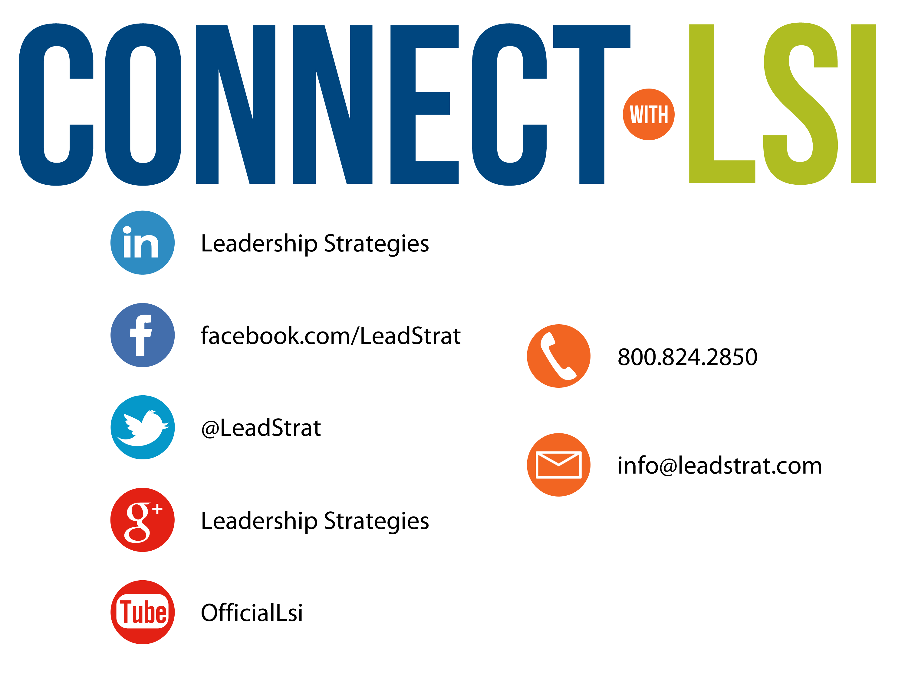


Questions?
etraining@leadstrat.com
800.824.2850
Or, submit your questions for open discussion
on the Linked-In “Leadership Strategies
Facilitation & Leadership Community” Group
Join us on Facebook at
www.Facebook.com/Leadstrat
and Twitter @Leadstrat

Slide 74
The Facilitative Leader
Congratulations!
- Completed Module 1: Facilitating and Coaching Individuals
- Next: Facilitating Your Team

Slide 75
The Facilitative Leader
Congratulations!
- Completed Module 1: Facilitating and Coaching Individuals
- Next: Facilitating Your Team
- Evaluations

Slide 76
The Facilitative Leader
Congratulations!
- Course completed!
- Post-test
- MVP
- Classroom to application
- Evaluations

