Slide 1
The Facilitative Leader

Slide 2
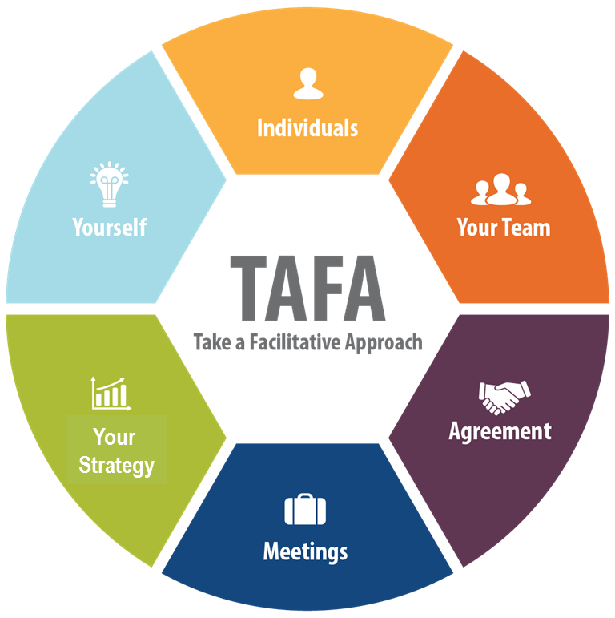

2 | Facilitating Communication

Slide 3
Checkpoint
1 | Getting Started, Facilitating Yourself
2 | Facilitating Communication
3 | Facilitating and Coaching Individuals
4 | Facilitating Your Team
5 | Facilitating Agreement
6 | Facilitating Your Strategy
7 | Facilitating Meetings Part 1
8 | Facilitating Meetings Part 2
Notes:
OK, while we have this methodology diagram in front of us, let’s go back to our grouped objectives. [Go back to each category from the grouped objectives collected earlier and ask the group where that item will be covered. Match their objectives to the principles – essentially the agenda for the class – and demonstrate how to adapt the agenda to meet the need for any group that will not map to a principle.]

Slide 4
TAFA - What does it mean to “Take a Facilitative Approach?”
The Seven TAFA Principles
Start with the why, not with the what.
Understand and empower, don’t command and control.
Create the vision, not the solution.
Connect first; correct second.
Equip for success; monitor for results.
Engage conflict; resolve dysfunction.
Drive participation, not just input.
-
S
U
C
C
E
E
D

Slide 5
Reminder of Ground Rules
Always open for questions
The open issues list
Respect the speaker
Avoid “bar discussion”
Start on time, end on time
Repetition to train the mind
No beeps or buzzes
Team Cheers
“Choo Choo”
Notes:
Slides 4 through 8 should be hidden if the module immediately follows the previous module

Slide 6


Your Materials
Course manual
Spring Forward exercise packet
Mini manual
Mobile App: Search “LeadStrat” or “Leadership Strategies”
-
Slide # | Manual #

Slide 7
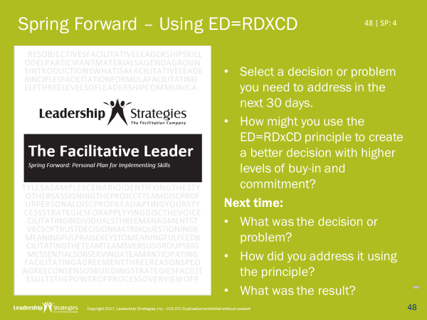
Homework Review
What decision did you select?
What action did you take?
What were the results

Slide 8
2 | Facilitating Communication
Understanding Communication Styles
Adapting to the Styles of Others
Exercise: Adapting to Your Team’s Styles
Identifying Styles
Recognizing and Addressing Style Clashes
Exercise: Communicating Across Styles
Your DISC Report: Understanding Your Biases

Slide 9
2 | Facilitating Communication
Understanding Communication Styles
Adapting to the Styles of Others
Exercise: Adapting to Your Team’s Styles
Identifying Styles
Recognizing and Addressing Style Clashes
Exercise: Communicating Across Styles
Your DISC Report: Understanding Your Biases

Slide 10
A. Understanding Communication Styles
Think about someone with whom you find it difficult to communicate. It may be someone with whom you work – a superior, a peer, or a subordinate – or it may be someone in your personal life.
Describe three specific things about this person’s communication style that you find difficult.
-
10 | 2-2

Slide 11
A. Understanding Communication Styles
Direct
DRIVE
INFLUENCE
D
I
Task Oriented
People Oriented
-
C
S
COMPLIANCE
STEADINESS
Indirect
Notes:
To help people understand the DISC system, using tape to create the four quadrants on the floor in the training room. Explain that you would like to get people to think about that person they are having trouble communicating with. Then first describe the north/south dimension (direct/indirect) and have people represent the person they have trouble communicating with and ask them to physical place themselves above or below the horizontal bar based on if the person they are describing is direct or indirect. Then describe the west/east dimension (task versus people) and have people move to the right or left. This will get people in the quadrants, then use the PowerPoint to name the four dimensions.

Slide 12
A. Understanding Communication Styles
Where did it come from?
What does it mean?
How can we use it?
DRIVE
INFLUENCE
STEADINESS
COMPLIANCE
D
I
S
C
Belligerent
Dreamer
Controlling
Perfectionist
Assertive
Influential
Supportive
Detailed
Pushover
Loner
Scattered
Impulsive
12 | 2-3

Slide 13
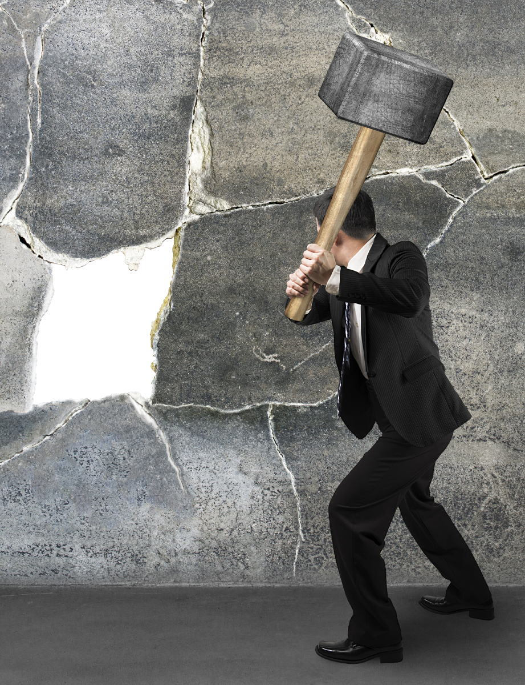
A. Understanding Communication Styles
The High D
Breaks through the wall
Takes a direct, assertive approach
Enjoys challenges
Goal-oriented
-

Slide 14
A. Understanding Communication Styles
The High D
Value to the organization
Focus efforts on getting the job done
Address problems directly
Make tough decisions quickly
Potential weaknesses
Be over-abrasive, pushy, competitive
Be too concerned about the goal, not people
Make decisions too quickly before having all the facts
-

Slide 15
A. Understanding Communication Styles
The High D
Key for D: Time, Getting it Done
Communication DOs
Be prepared – tell them what you are going to tell them
State your points clearly, briefly, specifically
Give only as much detail as necessary
Communication DON’Ts
Don’t waste time with idle chatter
Don’t ramble or tell long stories
Don’t be too detailed unless they ask for it
-

Slide 16
The High D:
Be prepared, be brief, be gone!

Slide 17
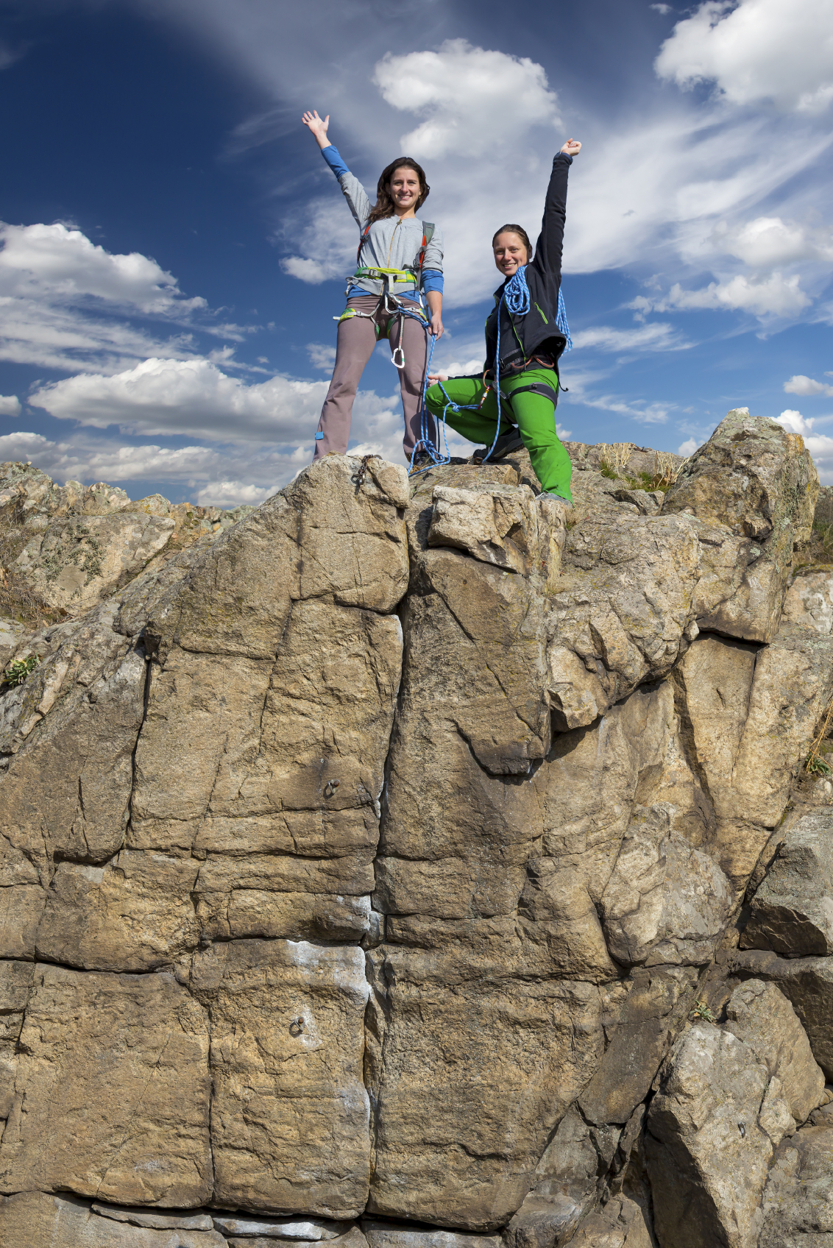
A. Understanding Communication Styles
The High I
Cheers people over the wall
Enjoy seeing the big picture
Motivate and inspire others to succeed
Visionary and creative
-

Slide 18
A. Understanding Communication Styles
The High I
Value to the organization
See the big picture
Motivate and sell others
Develop creative solutions
Potential weaknesses
Can be so talkative, that they they don’t listen
Spend so much time on the vision, that they never execute
Overlook details
-

Slide 19
A. Understanding Communication Styles
The High I
Key for I: Ideas, Being Heard
Communication DOs
Give them the big picture before going into the details
Give them a chance to share their ideas
Keep the conversation friendly and warm
Communication DON’Ts
Don’t dwell on facts and details; provide these in writing
Don’t tell them what to do without giving them an opportunity to respond
Don’t allow them to ramble too long
-

Slide 20
The High I:
Let them sell themselves!

Slide 21
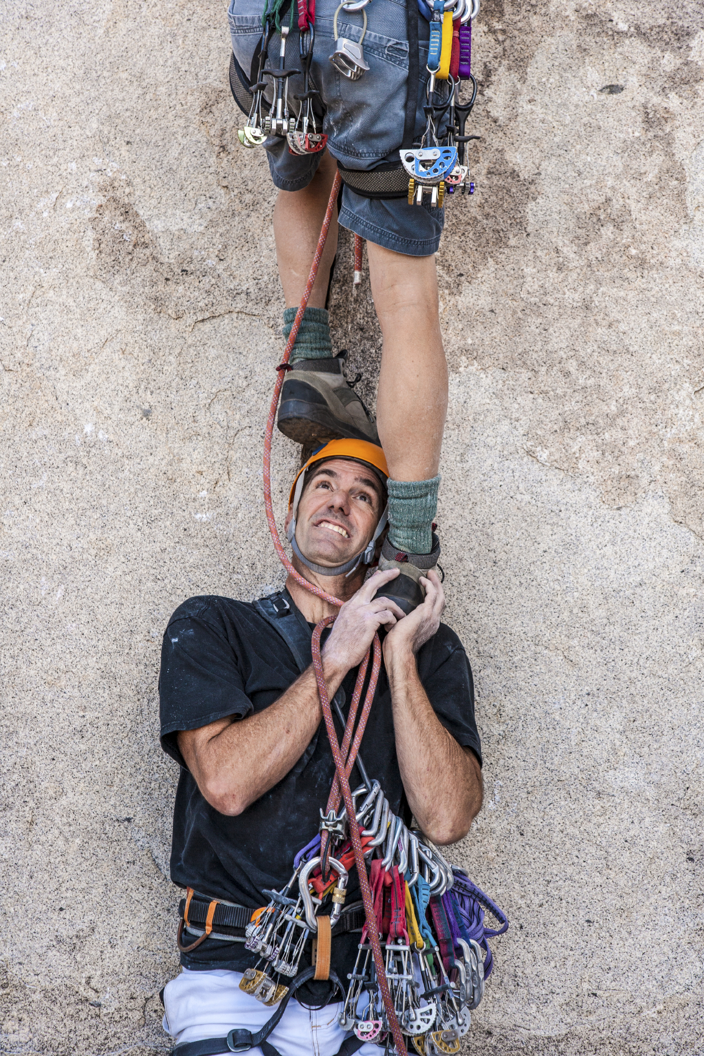
A. Understanding Communication Styles
The High S
Helps others over the wall
Stabilizing force within an organization
Dependable, loyal workers
Concerned with group harmony
-

Slide 22
A. Understanding Communication Styles
The High S
Value to the organization
Supportive, dependable workers
Accommodating and tolerant of others
People-oriented, good listeners
Potential weaknesses
May avoid dealing with issues until they become big problems
May be slow to accept change; hold grudges
May appear to lack vision and creativity
-

Slide 23
A. Understanding Communication Styles
The High S
Key for S: Security, Being Liked
Communication DOs
Start with a personal comment; show them they are liked
Present ideas deliberately; provide assurances
Make sure they are in agreement before moving on
Communication DON’Ts
Don’t dive straight into business
Don’t be demanding or abrasive
Don’t assume that silence means consent
-

Slide 24
The High S:
Start personal; don’t assume

Slide 25

A. Understanding Communication Styles
The High C
Develops detailed plans for scaling the wall
Rely on rational logic and evidence
Make sure things are done “by the book”
Thorough, organized and detail-oriented
-

Slide 26
A. Understanding Communication Styles
The High C
Value to the organization
Be organized and detail-oriented
Make sure decisions are well supported
Ensure that procedures are properly followed
Potential weaknesses
Perfectionists and very hard to please
Too focused on facts and not people
Over-cautious; “analysis paralysis”
-

Slide 27
A. Understanding Communication Styles
The High C
Key for C: Accuracy, Getting it Right
Communication DOs
Present ideas in a logical fashion
Stay on topic
Provide facts and figures that back up claims
Communication DON’Ts
Don’t be disorganized or make random comments
Don’t rely on emotional appeal to gain agreement
Don’t force a rapid decision
-

Slide 28
The High C:
Give them time for the details

Slide 29
Review
Which communication style has the following characteristics?
Stabilizing force within an organization
Dependable, loyal workers
Concerned with group harmony
The High S
-

Slide 30
Review
Which communication style has the following characteristics?
Rely on rational logic and evidence
Make sure things are done “by the book”
Thorough, organized and detail-oriented
The High C
-

Slide 31
Review
Which communication style has the following characteristics?
Takes a direct, assertive approach
Enjoys challenges
Goal-oriented
The High D
-

Slide 32
Review
Which communication style has the following characteristics?
Enjoy seeing the big picture
Motivate and inspire others to succeed
Visionary and creative
The High I
-

Slide 33
Review
Match the letter of the communication style to the communication tip for that style.
The High D
The High I
The High S
The High C
C
Give them time for the details
Start personal; don’t assume.
Let them sell themselves!
Be prepared, be brief, be gone!
S
I
-
C

Slide 34
2 | Facilitating Communication
Understanding Communication Styles ☑
Adapting to the Styles of Others
Exercise: Adapting to Your Team’s Styles
Identifying Styles
Recognizing and Addressing Style Clashes
Exercise: Communicating Across Styles
Your DISC Report: Understanding Your Biases

Slide 35

B. Adapting to the Style of Others
A problem has arisen in your area.
You have fully researched the problem.
You have created an eight-page document that delineates:
the problem, four alternatives, strengths and weaknesses
-
35 | 2-8

Slide 36
B. Adapting to the Style of Others
You favor alternative #4.
You are about to meet with your boss who does NOT know of the problem.
Depending on your boss’s communication style, what would be the first words out of your mouth?
(Hint: What do they want from you?)
-
36 | 2-8

Slide 37

B. Adapting to the Style of Others
Your Boss is a High-D
First: Can you take eight minutes, I need your decision on…
-
37 | 2-8

Slide 38
B. Adapting to the Style of Others
Your Boss is a High-I
First: How was your weekend?
-
38 | 2-8

Slide 39
Your Boss is a High-S
Your Boss is a High-S
First: How are you?
-
39 | 2-8

Slide 40
B. Adapting to the Style of Others
Your boss is a High C
First: (Email sent in advance)
If now is OK, I would like to take as much time as you need to discuss…
-
40 | 2-8

Slide 41
B. Adapting to the Style of Others
 | D | I | S | C
Total Time
Pleasantries
Explanation of the Problem - High-level explanation
- Detailed explanation
- Asking how to solve the problem
Offering your solution(s) - High-level explanation
- Detailed explanation
Benefits of your solution(s) - Asking sponsor for the benefits
- Explaining the benefits
Reaching agreement on the next step
15
45
30
60
Which style do
we use?
1
1
2
2
2
1
2
3
Which style should we use?
1
4
3
3
-
4
5
3
4
5
4
6
5
6
41 | 2-9

Slide 42
2 | Facilitating Communication
Understanding Communication Styles ☑
Adapting to the Styles of Others ☑
Exercise: Adapting to Your Team’s Styles
Identifying Styles
Recognizing and Addressing Style Clashes
Exercise: Communicating Across Styles
Your DISC Report: Understanding Your Biases

Slide 43

Spring Forward: 2a. Adapting to Your Team’s Styles
Consider the individuals on the team you manage. Record each individual’s typical communication style and any specific actions you might consider taking.
-

Slide 44
2 | Facilitating Communication
Understanding Communication Styles ☑
Adapting to the Styles of Others ☑
Exercise: Adapting to Your Team’s Styles ☑
Identifying Styles
Recognizing and Addressing Style Clashes
Exercise: Communicating Across Styles
Your DISC Report: Understanding Your Biases

Slide 45
C. Identifying Styles
Direct
DRIVE
INFLUENCE
D
I
Task Oriented
Getting it done
Being heard
People Oriented
-
Getting it right
Being liked
C
S
COMPLIANCE
STEADINESS
Indirect
45 | 2-10

Slide 46

C. Identifying Styles
The Voice Mail
Suppose you were calling someone at home, and you heard the following on the voicemail. Which style would the person most likely be?
-
46 | 2-10
Notes:
Change to voicemail?

Slide 47
C. Identifying Styles
The Voice Mail
You know what to do. <beep>
-
D
47 | 2-10

Slide 48
C. Identifying Styles
The Voice Mail
No one is here presently to answer your call.
Leave a detailed message with your name, telephone number, and the date and time of your call.
You can expect to hear from one of us within a reasonable time period. <beep>
C
-
48 | 2-10
Notes:
L

Slide 49
C. Identifying Styles
The Voice Mail
Sorry we missed you, but your call is very important to us.
Please leave a message and we will get back with you as soon as we can.
Thanks for calling and have a great day. <beep>
S
-
49 | 2-10

Slide 50
C. Identifying Styles
The Voice Mail
<music playing>
We’re not here right now! Leave a message. <beep>
I
-
50 | 2-10

Slide 51
C. Identifying Styles
Videos
What is the likely DISC style of the speaker?
What were the hints that told you?
51 | 2-11

Slide 52
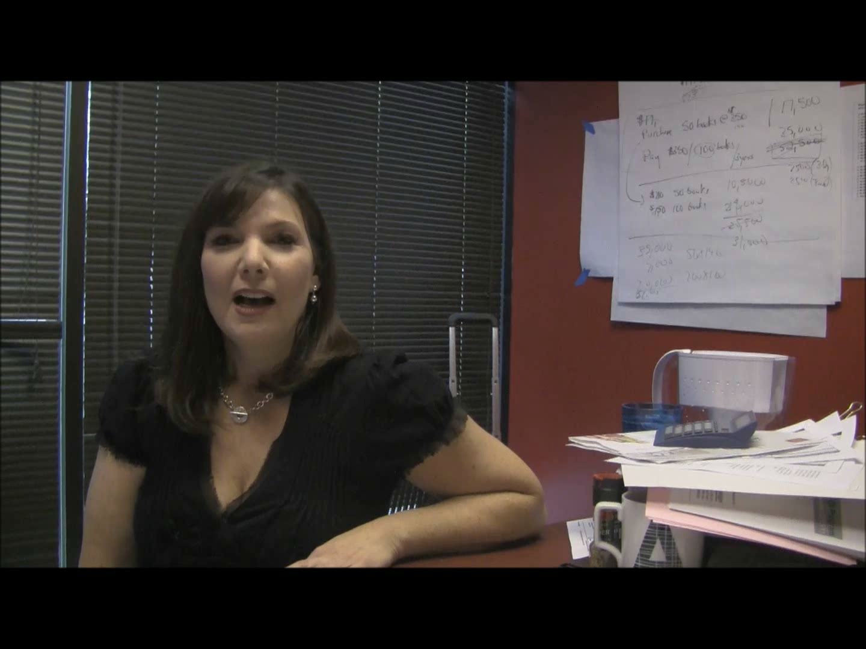
Jamie’s DISC Style

Slide 53
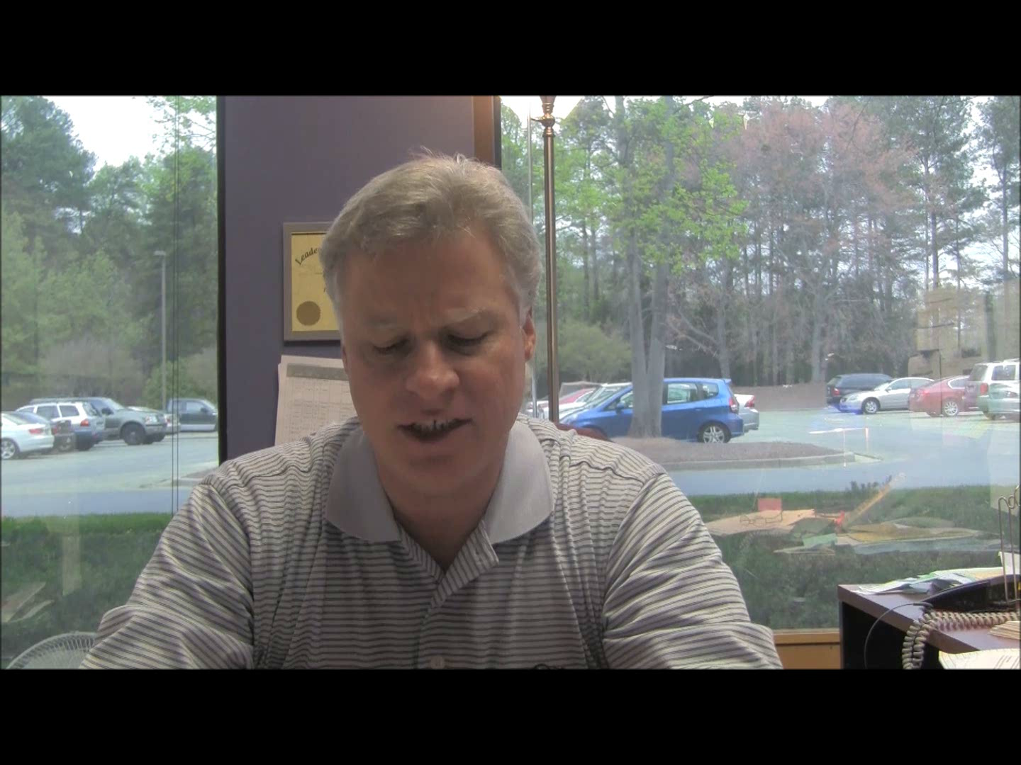
Doug’s DISC Style?

Slide 54
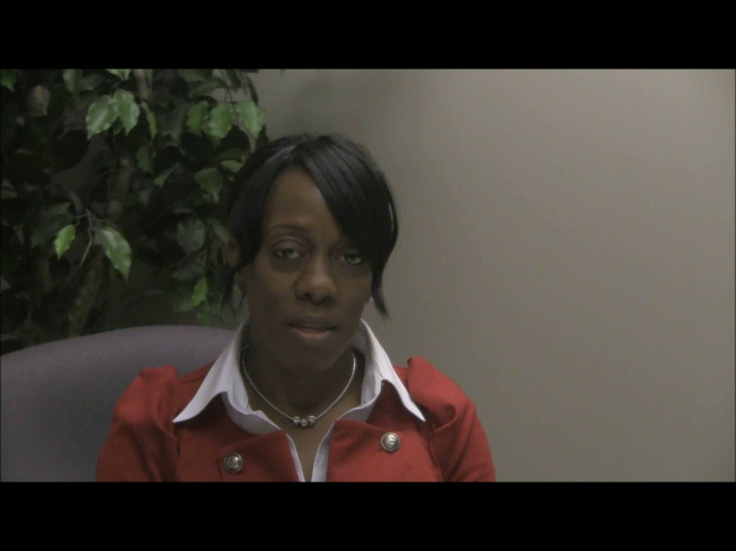
Sandra’s DISC Style

Slide 55
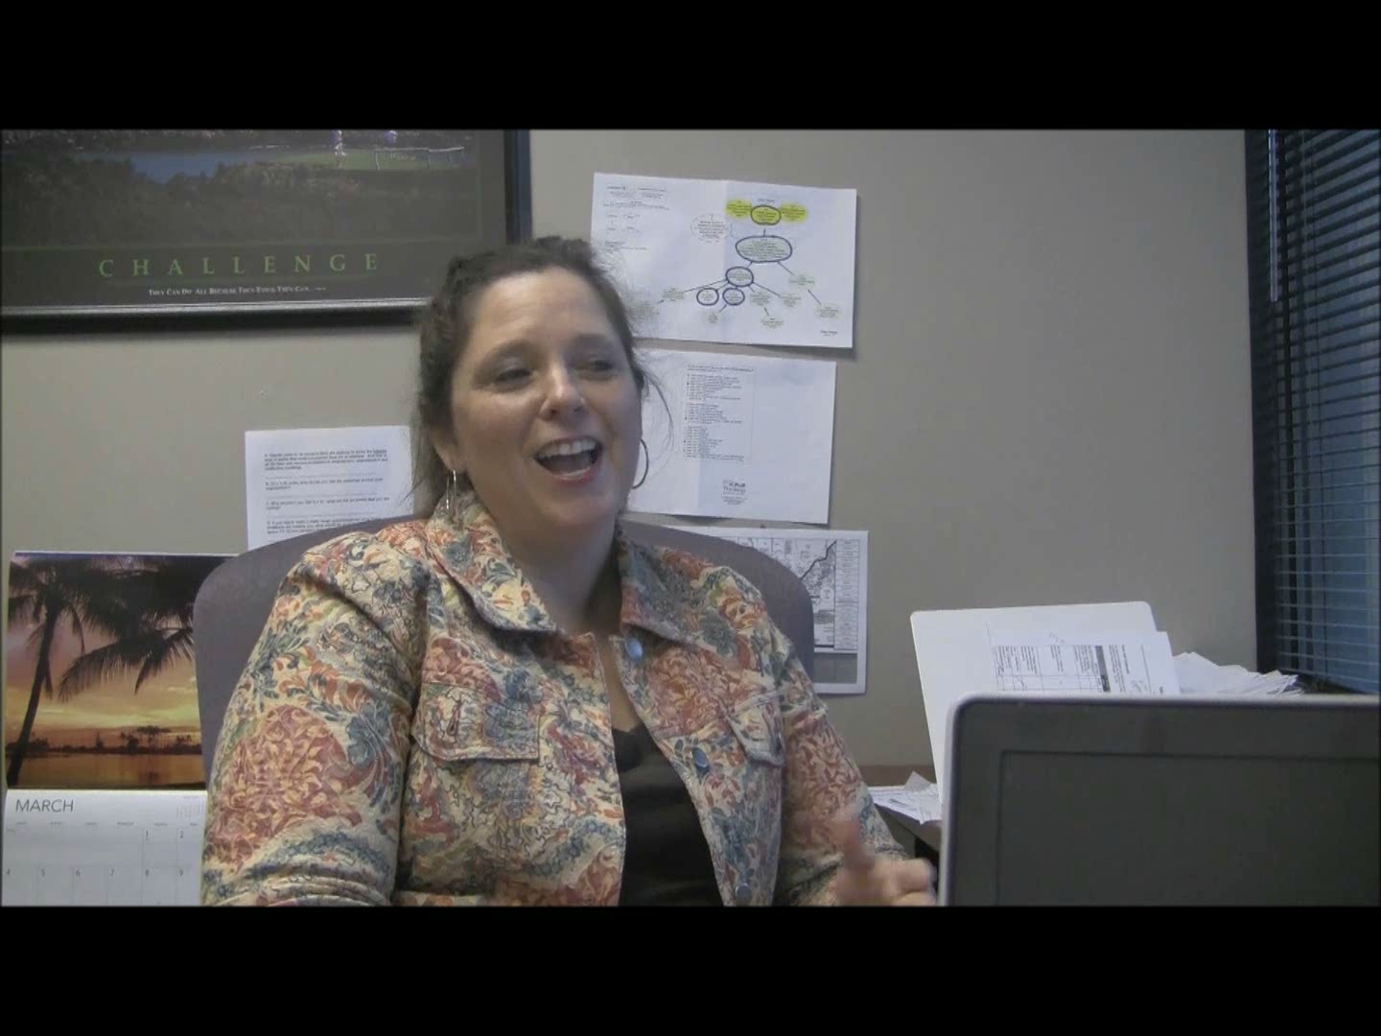
Patty’s DISC Style

Slide 56
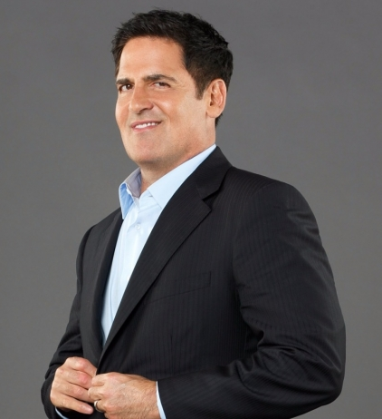
C. Identifying Styles
Celebrity DISC Profiles:
Mark Cuban
D I S C
X
X
X
X
Entrepreneur
-
56 | 2-11

Slide 57
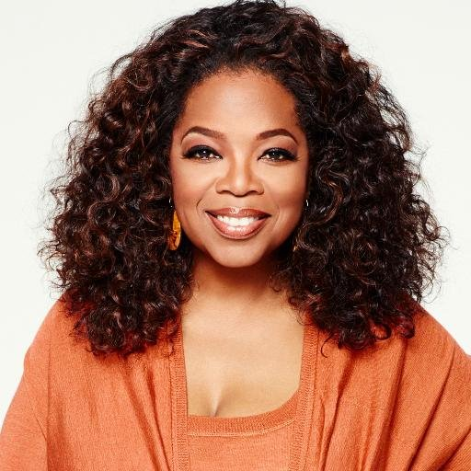
C. Identifying Styles
Celebrity DISC Profiles:
Oprah Winfrey
D I S C
X
X
X
X
Salesperson
-
57 | 2-11

Slide 58
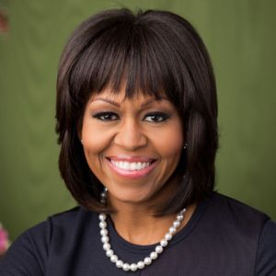
C. Identifying Styles
Celebrity DISC Profiles:
Michelle Obama
D I S C
X
X
X
X
Social Worker
-
58 | 2-11

Slide 59

C. Identifying Styles
Celebrity DISC Profiles:
Bill Gates
D I S C
X
X
X
X
Researcher
-
59 | 2-11

Slide 60
2 | Facilitating Communication
Understanding Communication Styles ☑
Adapting to the Styles of Others ☑
Exercise: Adapting to Your Team’s Styles ☑
Identifying Styles ☑
Recognizing and Addressing Style Clashes
Exercise: Communicating Across Styles
Your DISC Report: Understanding Your Biases

Slide 61
D. Recognizing and Addressing Style Clashes
Which style would most likely STRONGLY DISLIKE the Hi-I approach?
Direct
DRIVE
INFLUENCE
D
I
Task Oriented
Getting it done
Being heard
People Oriented
Getting it right
Being liked
C
S
-
COMPLIANCE
STEADINESS
Indirect
61 | 2-12

Slide 62
D. Recognizing and Addressing Style Clashes
Which style would most likely STRONGLY DISLIKE the Hi-D approach?
Direct
DRIVE
INFLUENCE
D
I
Task Oriented
Getting it done
Being heard
People Oriented
Getting it right
Being liked
C
S
-
COMPLIANCE
STEADINESS
Indirect

Slide 63
D. Recognizing and Addressing Style Clashes
Assigning the Project Team
You have been assigned to observe a task force given two days to identify key problems and develop potential solutions and a detailed implementation plan to improve the organization’s hiring process.
What would be the result at the end of the two days if everyone on the team had the same style?
-
63 | 2-13

Slide 64
D. Recognizing and Addressing Style Clashes
Assigning the Project Team
 | What would be the key issue in the room? | Would they finish? | What would be the quality of what they finished? | How would they feel about one another?
 | “Who ________” | Yes/No/Maybe | High/Medium/Low | Like/Not Like/ Neutral
D
I
S
C
Leads
Yes
Low
Fast/Low Teamwork
Not Like
Speaks
Maybe
Low
High Level/Low Work
Like
Low
Creativity, Challenge
Challenges
Yes
Love
-
Stops
No
High
Neutral
64 | 2-13
Notes:
EC, 1/14 – Needs animation.
MDW, 1/14 – not sure of order. Can be rearranged by facilitator

Slide 65
D. Recognizing and Addressing Style Clashes
Assigning the Project Team
 | Drive | Influence | Steadiness | Compliance
Which style would be best? | D | I | S | C
1. Identifying problems
2. Brainstorming solutions
3. Developing the detailed plan
4. Documenting the plan
5. Selling the plan to management
6. Overseeing plan execution
7. Executing the work plan
X
X
X
X
X
X
X
What are the challenges a team would face that was lacking one of the styles?
-
Notes:
EC, 1/14 – Needs animation.
MDW, 1/14 – not sure of order. Can be rearranged by facilitator

Slide 66
D. Recognizing and Addressing Style Clashes
In working with a team member or client, consider his/her dominant communication style.
Adjust your communication approach so that it is more in line with your team member or client’s style.
Recognize your own communication bias!
Look for signs that you may be miscommunicating.
-
66 | 2-15

Slide 67
D. Recognizing and Addressing Style Clashes
The warning signs that you may be miscommunicating.
Style | Key Factor | What You Are Doing | Warning Sign | Transition Words
D | Getting it done
I | Being heard
Wasting their time
Impatience, looking at watch
“Let’s get straight to the point here…”
-
Not giving them a chance to speak
Interrupting
“Let me ask you…”
67 | 2-15

Slide 68
D. Recognizing and Addressing Style Clashes
The warning signs that you may be miscommunicating.
Style | Key Factor | What You Are Doing | Warning Sign | Transition Words
S | Being liked
C | Getting it right
Being demanding or abusive
Shutting down, passive-aggressive
“I am sorry, I don’t mean to…”
Not giving them time for the details
-
Objecting, arguing
“Maybe we should step back and take a little more time…”
68 | 2-15

Slide 69
2 | Facilitating Communication
Understanding Communication Styles ☑
Adapting to the Styles of Others ☑
Exercise: Adapting to Your Team’s Styles ☑
Identifying Styles ☑
Recognizing and Addressing Style Clashes ☑
Exercise: Communicating Across Styles
Your DISC Report: Understanding Your Biases

Slide 70

Spring Forward 2b. Communicating Across Styles
Select one of the case studies.
Select roles.
Communicator announces selected case, reads scenario and interacts with Other Person.
Other Person interacts with Communicator according to identified DISC style.
Timekeeper allows for three minutes or until end of interaction.
Observer/s observe and record
Timekeeper facilitates feedback.
Shift roles and repeat.

Slide 71
2 | Facilitating Communication
Understanding Communication Styles ☑
Adapting to the Styles of Others ☑
Exercise: Adapting to Your Team’s Styles ☑
Identifying Styles ☑
Recognizing and Addressing Style Clashes ☑
Exercise: Communicating Across Styles ☑
Your DISC Report: Understanding Your Biases

Slide 72
E. Your DISC Report: Understanding Your Biases
Your personal DISC profile is based on your responses to the 24 questions. As you read your profile…
Circle the major items with which you agree.
Cross out the major items with which you disagree.
Put a question mark next to major items of which you are unsure.
Make note of a few major items that you felt were accurate about your communication style.
By focusing on the major items, you will most likely not have more than five items marked on a page.
?
-
72 | 2-16
Notes:
For this evening’s assignment, we would like you to review your DISC Profile and do the following:
Circle the major items with which you agree
For those items with which you do not agree, mark those with an X
For those items you are not certain about….you think that might be you or might not be you….mark those with a ?
We find it very interesting to ask someone that knows you very well to review your DISC Profile and see what they agree or disagree with….you may find their comments very insightful and give you another perspective on how other people may “see you”…….

Slide 73
Optional Activity
Join with the other members from the class who have your similar style. Answer the following questions:
What do you BRING to a group? | What do you NEED from others in the group?
With which style do you MOST PREFER to interact? Why? | With which style do you LEAST PREFER to interact? Why?
73 | 2-17

Slide 74
Review
-
This meeting agenda would be best for which of the communication styles?
High level explanation of the problem
Detailed explanation of the problem
High level explanation of your solution
Detailed explanation of your solution
Explain the benefits of your solution
Reach agreement on next step
Time: 60 minutes
The High C

Slide 75
Review
-
This meeting agenda would be best for which of the communication styles?
High level explanation of your solution
High level explanation of the problem
Explain the benefits of your solution
Reach agreement on the next step
Time 15 minutes
The High D

Slide 76
Review
This meeting agenda would be best for which of the communication styles?
Pleasantries
High level explanation of the problem
High level explanation of your solution
Explain the benefits of your solution
Reach agreement on the next step
Time: 30 minutes
The High S
-

Slide 77
Review
This meeting agenda would be best for which of the communication styles?
Pleasantries
High level explanation of the problem
Ask how to solve the problem
High level explanation of your solution
Asking for the benefits of your solution
Reach agreement on the next step
Time: 45 minutes
The High I
-

Slide 78
Review
Which communication style would most likely strongly dislike the High I approach?
The High C
Which communication style would most likely strongly dislike the High S approach?
The High D
-

Slide 79
Review
Name four warning signs that you may be miscommunicating:
Looking at watch, impatience
Interrupting
Shutting down, passive-agressive
Arguing, objecting
-

Slide 80
Spring Forward 2c – The Agenda
In Class
Select a 1-1 meeting you will be having with one of your reports, or with your leader.
Determine the person’s communication style, and plan an agenda for that meeting based on their style.
-

Slide 81
Spring Forward 2c – The Agenda
Homework
Select a 1-1 meeting you will be having with one of your reports, or with your leader.
Determine the person’s communication style, and plan an agenda for that meeting based on their style.
-

Slide 82
2 | Facilitating Communication
Understanding Communication Styles
Adapting to the Styles of Others
Exercise: Adapting to Your Team’s Styles
Identifying Styles
Recognizing and Addressing Style Clashes
Exercise: Communicating Across Styles
Your DISC Report: Understanding Your Biases

Slide 83
TAFA -
“Take a Facilitative Approach”
Tools and Concepts in This Module
S
U
C
C
E
E
D
Start with the why, not with the what.
Understand and empower, don’t command and control.
Create the vision, not the solution.
Connect first; correct second.
Equip for success; monitor for results.
Engage conflict; resolve dysfunction.
Drive participation, not just input.
Understanding Communication Styles
Adapting to the Styles of Others
Identifying Styles
Addressing Style Clashes
83 | 2-18

Slide 84
Checkpoint
1 | Getting Started, Facilitating Yourself
2 | Facilitating Communication
3 | Facilitating and Coaching Individuals
4 | Facilitating Your Team
5 | Facilitating Agreement
6 | Facilitating Your Strategy
7 | Facilitating Meetings Part 1
8 | Facilitating Meetings Part 2
Notes:
OK, while we have this methodology diagram in front of us, let’s go back to our grouped objectives. [Go back to each category from the grouped objectives collected earlier and ask the group where that item will be covered. Match their objectives to the principles – essentially the agenda for the class – and demonstrate how to adapt the agenda to meet the need for any group that will not map to a principle.]

Slide 85
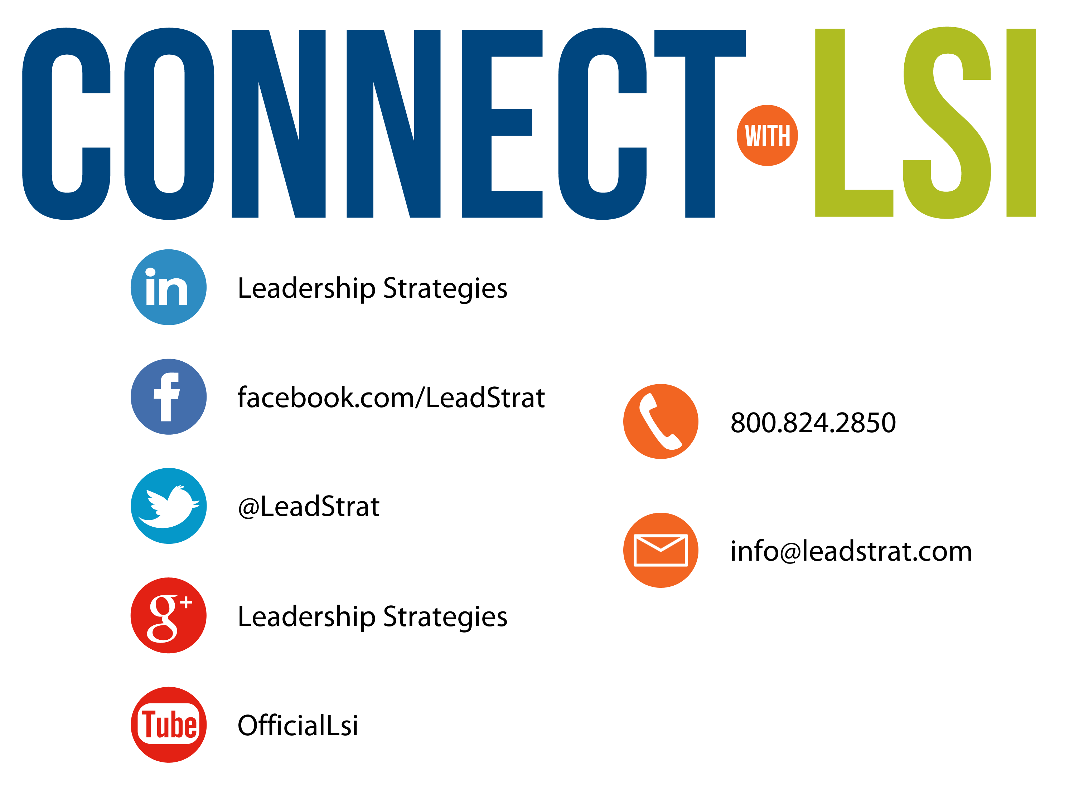


Questions?
etraining@leadstrat.com
800.824.2850
Or, submit your questions for open discussion
on the Linked-In “Leadership Strategies
Facilitation & Leadership Community” Group
Join us on Facebook at
www.Facebook.com/Leadstrat
and Twitter @Leadstrat
Notes:
THIS SLIDE should be hidden if another module will immediately follow this one.
We fundamentally believe facilitation is a skill that applies in a multitude of situations. We also are confident that in our quest to “share the power of facilitation with the world” that connecting via social media is a way for all of us to collectively share our successes, our challenges and our facilitation work. To “facilitate” that process, we want to ensure you are aware of how we can all stay connected using social media.
How many of you have found many of the skills in the class helpful? [raise your hand] I know that one of the things I did after attending was share what I learned with many of my colleagues. Have some of you already thought about that? [nod your head]
Then ,one request we would like to make of you is to update your “education or classes attended” on your LinkedIn profile. That visibility will help all of us to “share the power” I have been referring to. Any questions? [facilitate the discussion]

Slide 86
The Facilitative Leader
Congratulations!
- Completed Module 2: Facilitating Communication
- Next: Facilitating and Coaching Individuals
Notes:
This slide should be hidden if this module will be followed on the same day by another module.

Slide 87
The Facilitative Leader
Congratulations!
- Completed Module 2: Facilitating Communicaiton
- Next: Facilitating and Coaching Individuals
- Evaluations
Notes:
This slide should be hidden if this module will be followed on the same day by another module.

Slide 88
Congratulations!
- Course completed!
- Post-test
- MVP
- Classroom to application
- Evaluations
The Facilitative Leader
Notes:
This slide should be hidden if this module will be followed on the same day by another module.

