Slide 1
The Facilitative Leader

Slide 2
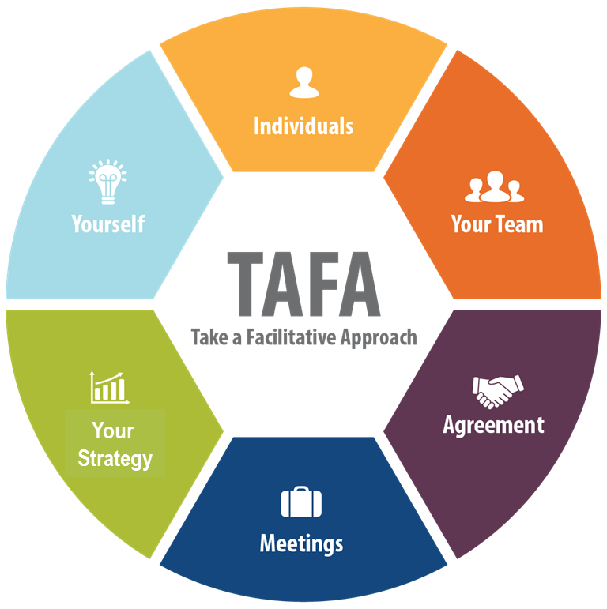

1 | Getting Started, Facilitating Yourself
-

Slide 3

Imagine This…
The young director of a 100-person unit, who understands the power of engagement, is simply fed up with his six managers who just don’t seem to get it.
-

Slide 4

Imagine This…
They were all hired before he arrived five months ago, and they all seem to have the same “command and control” mentality.
They dictate solutions, don’t get their people involved, treat everyone with the same style, and then wonder why they don’t get buy-in or engagement.
-

Slide 5
Imagine This…
He knows from his own experience that when leaders take a facilitative approach to solving a problem, it makes a big difference.

Slide 6
Traditional Approaches to Leadership
Directive Approach
Coaching Approach
Delegating Approach
We believe there is a fourth approach!
4. TAFA: Take a Facilitative Approach
First: Managers versus Leaders
-

Slide 7

A. Manager vs. Leader
> Today
(One-Word Verbs)
> Tomorrow
-
> Reactive
> Proactive
Manager |  | Leader
Supervises
1.People
Inspires
Implements
2.Vision
Creates
Solves
3.Problems
Eliminates
4.Client Needs
Satisfies
Anticipates

Slide 8


B. The 3 Levels of Leadership
-
Level 2 – COACH “People Focus”
Communicating objectives Delegating and grooming Maximizing people's strengths
Level 1 – OVERSEER “Task Focus”
Getting tasks done Staying within budget Meeting deadlines

Slide 9


B: Three Levels of Leadership
Three Principles of Operation
We are in business to make money.
We only deserve to make money when we have satisfied a client need.
We don’t fix problems. We eliminate them.
What happens if they don’t know YOUR principles of operation?
-

Slide 10

B. The 3 Levels of Leadership
Level 3 – VISIONARY “Forward Focus”
Visioning the future Linking to business objectives Anticipating customer needs Continuous improvement
-
Level 2 – COACH “People Focus”
Communicating objectives Delegating and grooming Maximizing people's strengths
Level 1 – OVERSEER “Task Focus”
Getting tasks done Staying within budget Meeting deadlines

Slide 11
B. The 3 Levels of Leadership
Example #1: The CIO
Presentation
23 Subsystems – 8 with a Resident DB
Suppose we create an integrated architecture with a single database?
Police
Her response…
28
There’s more…
-

Slide 12
B. The 3 Levels of Leadership
Example #1: The CIO
2 years later I receive a call from her
“We have a request from the Water Dept. for a new system…”
“It doesn’t make sense to implement this system independently…”
“We need an integration roadmap…”
“Do you guys do that kind of work?”
Why didn’t she get it the first time?
-
-

Slide 13
B. The 3 Levels of Leadership
Level 3 – VISIONARY “Forward Focus” | Visioning the future Linking to business objectives Anticipating customer needs Continuous improvement
-
Level 2 – COACH “People Focus” | Communicating objectives Delegating and grooming Maximizing people's strengths
Level 1 – OVERSEER “Task Focus” | Getting tasks done Staying within budget Meeting deadlines

Slide 14
B. The 3 Levels of Leadership
Example #2: Principal to CEO
Record Relevant Information
From Level-3 Principal at a Big 4 Consulting Firm
To Level-1 Entrepreneur
-

Slide 15

1. What must a leader have accomplished to move from Level 1 to Level 2?
Answer:
A leader must understand what it takes to be successful in the job!
-

Slide 16
2. What must a leader have in place to move from Level 2 to Level 3?
Answer:
A leader must have people who can coach other people.
-

Slide 17
3. What are key reasons managers might never advance past Level 1?
Answer:
They don’t know that there are other levels!
-

Slide 18
4. To be most effective, what should a leader do when he/she takes a new position?
Answer:
Start back at Level 1.
-

Slide 19
Who is responsible for the development of the organization’s leaders?
Answer:
Everyone has a role
-

Slide 20
B. The 3 Levels of Leadership
Responsibility for Leadership Development
Executive Leadership
-
Every Leader
Every Individual

Slide 21

Spring Forward 1a– How do You Move to the Next Level?
At which level are you operating today?
What do you have to put in place for you to move to the next level?
-

Slide 22
1 | Getting Started, Facilitating Yourself
Manager vs. Leader ☑
3 Levels of Leadership ☑
Exercise: How do you move to the next level? ☑
Workshop Introduction
What is Facilitative Leadership?
The TAFA Principles

Slide 23
C. Workshop Introduction
Course Objectives: The Facilitative Leader
As a result of this session, participants will be able to use the TAFA “Take a Facilitative Approach” principles to:
Be more facilitative in leading, decision making, and problem solving
Increase buy-in and engagement
Build consensus and defuse dysfunction
Achieve better results
-

Slide 24
C. Workshop Introduction
Leadership Skills to Improve
Think about a recent leadership experience you’ve had. It may have been a coaching conversation, a meeting with your team, or some other activity.
Think about the challenges you had, the things that did not go well, the things you know you have to get better at handling.
What are the key areas in which you would like to improve your leadership skills?
-

Slide 25
C. Workshop Introduction
Course Modules
1 | Getting Started, Facilitating Yourself
2 | Facilitating Communication
3 | Facilitating and Coaching Individuals
4 | Facilitating Your Team
5 | Facilitating Agreement
6 | Facilitating Your Strategy
7 | Facilitating Meetings Part 1
8 | Facilitating Meetings Part 2
Notes:
OK, while we have this methodology diagram in front of us, let’s go back to our grouped objectives. [Go back to each category from the grouped objectives collected earlier and ask the group where that item will be covered. Match their objectives to the principles – essentially the agenda for the class – and demonstrate how to adapt the agenda to meet the need for any group that will not map to a principle.]

Slide 26
1 | Getting Started, Facilitating Yourself
Manager vs. Leader
3 Levels of Leadership
Exercise: How do you move to the next level?
Workshop Introduction
What is Facilitative Leadership?
The TAFA Principles

Slide 27

2 | Facilitating Communication
Understanding Communication Styles
Adapting to the Styles of Others
Exercise: Adapting to Your Team’s Styles
Identifying styles
Recognizing and Addressing Style Clashes
Exercise: Communicating Across Styles
Your DISC report: Understanding Your Biases

Slide 28

3 | Facilitating and Coaching Individuals
3 Management Styles
Exercise: Determining Appropriate Management Styles
5 Cs of Trust
Decision Matrix
The Power of the Starting Question
Using Reacting Questions
Keys to Meaningful Praise
Providing Constructive Feedback
Exercise: Giving Praise and Constructive Feedback

Slide 29

4 | Facilitating Your Team
Teams v. Groups
8 Team Essentials
Anticipating Team Issues
Team Norms
Accountability: 5 Critical Elements
Solution Processes
Managing Change Resistance
Developing Recommendations
Exercise: Chartering a Team

Slide 30

5 | Facilitating Agreement
Decision-Making Alternatives
Understanding Disagreement
The 3 Reasons People Disagree
Identifying and Resolving Level 3
Using Delineation to Resolve Level 1
Using Strengths and Weaknesses and Merge to Resolve Level 2
5-Finger Consensus
Exercise: Resolving a disagreement

Slide 31

6 | Facilitating Your Strategy
Strategic Planning: The Drivers Model
Sample Strategic Plan Part I: Mission, Vision, Goals, Objectives
Exercise 6a: Defining Goals and Objectives
Sample Strategic Plan Part II: CSFs, Barriers, Strategies, Actions
The Strategy Process
Why Most Plans Fail
Three-Step Monitoring Process
The Leadership Briefing
The 10 Pitfalls to Avoid
Special Applications of the Drivers Model

Slide 32

7-8 | Facilitating Meetings-Parts I-II
Part I
Understanding Meeting Types
Characteristics of Masterful Meetings
Preparing for Success
Exercise7a: The 6Ps
Starting with Impact
Exercise 7b: Starting a Meeting Part II
Maintaining Focus During the Meeting
Closing the Meeting
Preventing, Detecting, and Resolving Dysfunction
Exercise 8: Resolving Dysfunction in a Meeting
Running Virtual Meetings
Using Guerilla Facilitation

Slide 33
C. The Course Modules
1 | Getting Started, Facilitating Yourself
2 | Facilitating Communication
3 | Facilitating and Coaching Individuals
4 | Facilitating Your Team
5 | Facilitating Agreement
6 | Facilitating Your Strategy
7 | Facilitating Meetings Part 1
8 | Facilitating Meetings Part 2

Slide 34
C. Ground Rules
Always open for questions
The Coming Attractions board
Respect the speaker
Avoid “bar discussion”
Start on time, end on time
Repetition to train the mind
No beeps or buzzes
Team Cheers
“Choo Choo”
-

Slide 35


C. Your Materials
Course manual
Spring Forward exercise packet
Mini manual
Mobile App: Search “LeadStrat” or “Leadership Strategies”
-

Slide 36
Introductions
Your name and organization
Your title and the length of time at your organization
Of the topics identified earlier, the one in particular for which you would want to have better strategies

Slide 37
1 | Getting Started, Facilitating Yourself
Manager vs. Leader ☑
3 Levels of Leadership ☑
Exercise: How do you move to the next level? ☑
Workshop Introduction ☑
What is Facilitative Leadership?
The TAFA Principles

Slide 38
D. What is Facilitative Leadership?
The Scenario: Facilitating Solutions
When we created the answers
100% Solution – 15% Implemented
When They created the answers
85% Solution – 80% Implemented
WHY?
Sr. Manager with E&Y
Management Reviews
Facilitated Solutions
-

Slide 39
D. What is Facilitative Leadership?
The Fundamental Principle of Facilitation
ED = RD x CD
Effective Decision
Right Decision
Commitment to Decision
-

Slide 40


D. What is Facilitative Leadership?
Old Way vs. New Way
You lead an organization of 100 people and have an 8-person leadership team. You are going to undertake strategic planning.
Old Way
You and your leadership team develop the plan.
New Way
You invite input from all in advance. Bring all in to review and input on draft.
Old Way
You and your leadership team develop the plan.
New Way?
-

Slide 41
E. The TAFA Principles
What does it mean to “Take a Facilitative Approach?”
Start with the why, not with the what.
Understand and empower, don’t command and control.
Create the vision, not the solution.
Connect first; correct second.
Equip for success; monitor for results.
Engage conflict; resolve dysfunction.
Drive participation, not just input.
-
S
U
C
C
E
E
D

Slide 42
Review
What are two ways that leaders are different from managers?
Managers:
Focus on today
Reactive
Leaders:
Focus on tomorrow
Proactive

Slide 43
Review
Level 1 Leader’s focus?
Task
Level 2 Leader’s focus?
People
Level 3 Leader’s focus?
Forward

Slide 44
Review
What is one key reason managers might never advance past Level 1?
They don’t know there are other levels!

Slide 45
Review
To be most effective, what should a leader do when he/she takes a new position?
Start back at Level 1

Slide 46
Review
In ED = RD x CD, what do the letters E, R, and C stand for?
Effective
Right
Commitment

Slide 47
Review
What does the acronym TAFA stand for?
Take a Facilitative Approach

Slide 48
Spring Forward 1b – Using ED=RDXCD
In Class
Select a decision or problem you need to address in the next 30 days.
How might you use the ED=RDxCD principle to create a better decision with higher levels of buy-in and commitment?
-

Slide 49
Spring Forward 1b – Using ED=RDXCD
Homework
Select a decision or problem you need to address in the next 30 days.
How might you use the ED=RDxCD principle to create a better decision with higher levels of buy-in and commitment?
-

Slide 50
TAFA -
“Take a Facilitative Approach”
Tools and Concepts in This Module
S
U
C
C
E
E
D
Start with the why, not with the what.
Understand and empower, don’t command and control.
Create the vision, not the solution.
Connect first; correct second.
Equip for success; monitor for results.
Engage conflict; resolve dysfunction.
Drive participation, not just input.
Manager vs. Leaders
3 Levels of Leadership
Principles of Operation
ED=RDxCD

Slide 51
1 | Getting Started, Facilitating Yourself
Manager vs. Leader
3 Levels of Leadership
Exercise: How do you move to the next level?
Workshop Introduction
What is Facilitative Leadership?
The TAFA Principles

Slide 52
Checkpoint
1 | Getting Started, Facilitating Yourself
2 | Facilitating Communication
3 | Facilitating and Coaching Individuals
4 | Facilitating Your Team
5 | Facilitating Agreement
6 | Facilitating Your Strategy
7 | Facilitating Meetings Part 1
8 | Facilitating Meetings Part 2

Slide 53
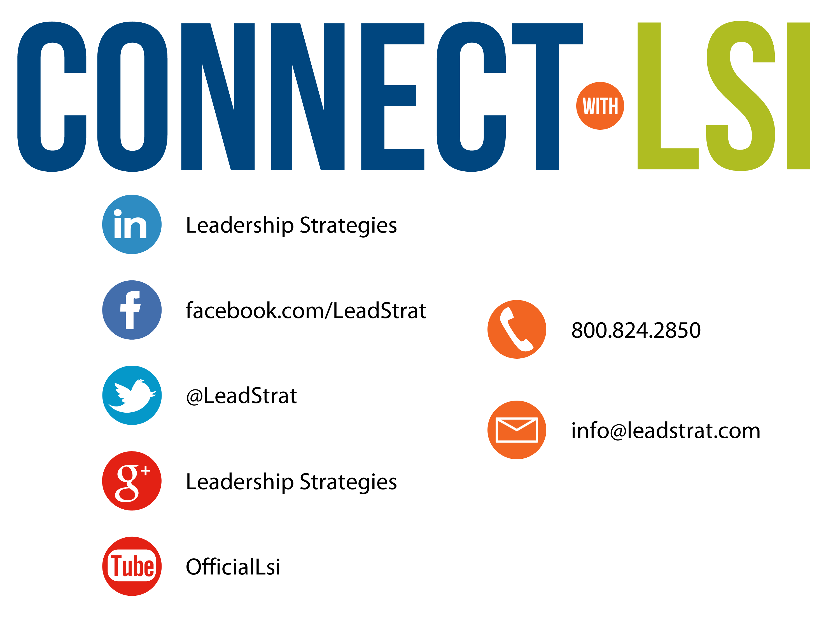


Questions?
etraining@leadstrat.com
800.824.2850
Or, submit your questions for open discussion
on the Linked-In “Leadership Strategies
Facilitation & Leadership Community” Group
Join us on Facebook at
www.Facebook.com/Leadstrat
and Twitter @Leadstrat

Slide 54
The Facilitative Leader
Congratulations!
- Completed Module 1: Facilitating Yourself
- Next: Facilitating Communication

Slide 55
The Facilitative Leader
Congratulations!
- Completed Module 1: Facilitating Yourself
- Next: Facilitating Communication
-Evaluations

Slide 56
The Facilitative Leader
Congratulations!
- Course completed!
- Post-test
- MVP
- Classroom to application
- Evaluations

