Slide 1

VII. proposing
Notes:
Review…..Now that we have completed the client interview…understand the client need….clearly understand the client problem …have selected a Solution Process from which to start based on the problem type….
Preview….We are ready to develop the proposal…..
Big View…..You will find that there are several proposal types based on the situation we are working on with that client…these are: 1) full proposal; 2) letter proposal; and, 3) Statement of Work……..once we have delivered the project proposal we have wrapped up the 1st of our 4 stages in the consulting cycle…..so let’s take a look at the best practices for this module…..
Timing: 60 minutes
Flip Charts:
Types of Proposals
3 Scoping Tools

Slide 2
The Facilitative Consultant
Defining the need
Part III: Proposing
Types of Proposals
Steps for Proposal Development
Developing the Proposal
with the Client
Defining Roles
Scoping the Engagement
Sample Business Area Diagram
Sample Deliverables List
Sample Task List
Sample Statement of Work
Sample Letter Proposal
Sample Full Proposal
Notes:
These are the 11 best practices/techniques we want to look at…so let’s move to the 3 proposal types…..

Slide 3
A. Types of Proposals
After completing the project sponsor interview and holding follow-up discussions, you are ready to document your understanding of the need and your approach to addressing it. There are several formats that may be appropriate. Here are three sample formats.
-
Manual
7-2
Notes:
We have found that there are three primary proposal types. Let’s take a look at each one, and then, I have a question for you.
(Do a read-around or quickly review the slides describing the proposal types.)

Slide 4
A. Types of Proposals
Full Proposal
This type of proposal is most often used with complex needs or when in a competitive situation where “form” may be as important as “content.’ Each section starts a new page. The entire proposal is included in a binder with a customized cover.
-
Manual
7-2

Slide 5
A. Types of Proposals
Full Proposal
Transmittal Letter
Executive Summary
Our Understanding of Your Needs
Our Organization and Services
(references, experience)
Special Considerations for this Project
Our Approach to Meeting Your Needs
Project Organization (resumes)
Timing and Fees
Appendix (as needed)
-
Manual
7-2

Slide 6
A. Types of Proposals
Letter Proposal
This type is most often used with smaller projects, or larger projects in which there is a strong existing relationship. The proposal is in the form of a letter with each topic (next slide) outlined in the body of the letter following a brief introductory paragraph.
-
Manual
7-3

Slide 7
A. Types of Proposals
Letter Proposal
Background (brief description of the problem)
Our Organization (brief description)
Our Approach to Meeting Your Needs (including timing)
Staffing
Fees
Manual
7-3
-

Slide 8
A. Types of Proposals
Statement of Work
This type is most often used when an existing client requests additional services. The purpose is simply to outline the steps that will be taken. The proposal is in the form of a letter with each topic (next slide) outlined in the body of the letter following a brief introductory paragraph.
Manual
7-3
-

Slide 9
A. Types of Proposals
Statement of Work
Statement of Work (activities to be done and timing)
Staffing
Fees
-
Manual
7-3

Slide 10
A. Types of Proposals
Full Proposal
Letter Proposal
Statement of Work
-
Manual
7-2
Notes:
How many of you have worked on a proposal in your consulting work?...(raise your hand)….yes, I have as well…..let me ask those of you who have had that opportunity….which of the 3 proposal types would we, as consultants, most prefer?........(facilitate the discussion)…….OK, so it sounds like we are in agreement….of the 3 proposal types, the one we would most prefer to write is the SOW…..yet, there are times when 1 of the other proposal types will be required……who can share with us when they have written a full proposal……thanks and our experience is that often when working with larger opportunities and, in particular, the federal government, full proposals are a requirement…..in many of these cases, your ability to comply with the proposal format is as important as what is in the proposal itself………
(NOTE: you may refer to the sample proposals of each type at the end of this module in the participant manual to compare/contrast each proposal type……)

Slide 11

B. Steps for Proposal Development
Assumes Full Proposal Format
1.
Isolate the client’s key problems, objectives, and desired deliverables.
-
Manual
7-4
Notes:
(Before covering this slide)……let’s use our teams one more time……
Purpose….we want to see what you think are the steps for developing a proposal….so let’s use our teams
Directions…..first, let’s select a new team leader…..each team lead will be writing the 5 proposal steps their team can identify in 3 minutes…with each step written on its own individual post it note using the makers……
Questions…..are we all clear, any questions……
Starting question…..think about proposals that you may have written in the past…..the key steps that were involved in the development of that proposal…..if you have not written a proposal, think about the steps that you believe should be involved in writing a full proposal….what are the key steps in that proposal development?…….(start the clock…………when the time us up, have the teams give 1 sticky note, in round robin team format with a unique sticky note each time)……….
(When completed:) It looks like we have identified the key steps….now, let’s look at what LSI believes is included in developing a full proposal……(review material on next few slide… Consider using a read around)

Slide 12
B. Steps for Proposal Development
2.
Based on the information gathered, select the appropriate solution process to use as a starting point for developing a task plan.
Manual
7-4

Slide 13
B. Steps for Proposal Development
3.
Modify the task plan included with the solution process to address the specific client issues.
Manual
7-4

Slide 14
B. Steps for Proposal Development
4.
If the proposal is competitive:
  Determine the criteria the client will use for selection..
-
Manual
7-4

Slide 15
B. Steps for Proposal Development
4.
If the proposal is competitive:
  Compare yourself to the competition (if known) to determine your areas of strength and vulnerability.
Manual
7-4

Slide 16
B. Steps for Proposal Development
4.
If the proposal is competitive:
  Determine your key messages and the approach you will take in the proposal to most effectively address the client’s criteria, maximize your strengths, and minimize areas of vulnerability.
Manual
7-4

Slide 17
B. Steps for Proposal Development
5.
Convert the task plan into a high-level work plan by adding high-level estimates of resources and elapsed time…
Manual
7-4

Slide 18
B. Steps for Proposal Development
5.
…compute fees; adjust estimates and the high-level work plan, if it is deemed necessary, to come reasonably close to the client’s budget.
Manual
7-4

Slide 19
B. Steps for Proposal Development
6.
Determine the appropriate consulting personnel references, and past experiences to include in the proposal.
Manual
7-4

Slide 20
B. Steps for Proposal Development
7.
Draft the proposal sections with the exception of the Executive Summary and Appendix.
Manual
7-5

Slide 21
B. Steps for Proposal Development
8.
Draft the Executive Summary to highlight key proposal points.
Manual
7-5

Slide 22
B. Steps for Proposal Development
9.
Consider including the high-level work plan and a sample deliverable in the Appendix.
Manual
7-5

Slide 23

C. Developing the Proposal with the Client
Proposal writing, by definition, is a non-value-added activity. A proposal does not deliver client service nor does it create consulting revenue. (Though for many clients, it is often a necessary step for these other value-added activities.)
Attempt to avoid full proposal writing! Strive instead for the “Statement of Work” which simply states who will do what.
-
Manual
7-6
Notes:
Develop the proposal with the client…….(name), continue with the first point on this slide…..yes, yes, yes…..(raise your hand as you ask) how many would agree with that?……surely, and the key reason is as a consultant YOU are no closer to delivering a service, and as the client, THEY are no closer to solving their problem…….as an aside, on the consulting side of the business this is also a non-revenue generating event…..in other words you are not assigned to billable work when you are writing a proposal……let’s continue with our read-around……..
Close out this slide with the last question about benefits (client involvement with the facilitative consultant, buy-in along the way, etc.) and risks (you have provided the “game plan” to be executed by the client, etc.)………

Slide 24
C. Developing the Proposal with the Client
If you write a proposal and are not awarded the work, the non-value-added nature of the activity becomes readily apparent! One method that can increase the likelihood that you will be awarded the contract is to build the proposal with the client!
Near the end of the project sponsor interview, use a flip chart or board to identify the key deliverables.
Outline a task plan for creating the deliverables.
Get the client’s input in determining who should be involved in each task and the length of time.
-
Manual
7-6

Slide 25
C. Developing the Proposal with the Client
With the client, estimate the hours conservatively.
Apply rates to the hours to give a general idea of fees.
If any concern is expressed about the fees, have the client suggest areas where the estimates should be adjusted.
Discuss a start date and the decision-making process.
Let the client know you will document the task plan in a Statement of Work to finalize the agreement.
-
Manual
7-6

Slide 26
What might be the benefit of building the proposal with the client?
Manual
7-7
Notes:
Fill in the blank in manual

Slide 27
A facilitative consultant builds the proposal with the client to help ensure alignment with the client’s desire and to increase the client’s understanding, buy-in, and involvement.
Manual
7-7

Slide 28
D. Defining Roles
In the proposal, be sure to define the role that the consultant will play. The role is determined by the level
of involvement and the level of responsibility as summarized below.
Consultant Roles
 | RESPONSIBILITY
 | Low | High
INVOLVEMENT Low | Technical Advisor | Prime Contractor (Remote)
High | Sub-Contractor | Project Manager
-
Manual
7-8
Notes:
(Cover the key roles in terms of involvement and responsibility and being clear on the risks of assuming low involvement with high responsibility…..facilitate a conversation around how that can occur and the risks associated with that situation……) and then the risk of a client’s involvement as planned vs. actual and some of the challenges of addressing or not addressing that situation….e.g. a client assigned to participate ½ time and then only participates 2 hours/week, etc.)…….

Slide 29
D. Defining Roles
Role of Client Personnel
 | RESPONSIBILITY
 | Low | High
INVOLVEMENT Low | Subject Matter Experts | Project Sponsor
High | Project Administrator | Project Manager Core Team
-
Manual
7-8
Notes:
(Cover the key roles in terms of involvement and responsibility and being clear on the risks of assuming low involvement with high responsibility…..facilitate a conversation around how that can occur and the risks associated with that situation……) and then the risk of a client’s involvement as planned vs. actual and some of the challenges of addressing or not addressing that situation….e.g. a client assigned to participate ½ time and then only participates 2 hours/week, etc.)…….

Slide 30
E. Scoping the Engagement
Following the interview, there is a critical additional step prior to documenting your understanding of the need and your approach to addressing it.
The engagement scope defines what is included and what is specifically excluded from the engagement. Strive to get agreement on the scope during the interview with the sponsor.
A full scope definition includes:
Business Area Diagram
Deliverables List
Task List
-
Manual
7-9
Notes:
Scoping is one of the essential parts of a proposal….it clearly defines many key components of a project and includes 3 parts (have flip chart with these 3 components):
Business Area Diagram
Deliverables List
Task List
Let’s look at each of the components…….

Slide 31
F. Sample Business Area
Diagram
There are several
steps in the hiring
process.
The scope of this
project sample
includes those
activities inside the boundary.
Need
Identification
Advertising
Screening
OUT OF SCOPE
Negotiation
of Offer &
Start Time
Selection
OUT OF SCOPE
Payroll &
Personnel
Updates
IN SCOPE
Orientation
-
Manual
7-10
Notes:
A Business Area Diagram (BAD) is a clear representation of 2 very important items….1) what is in scope for a project and 2) what is not in scope of the project….in the absence of a clear definition, we as consultants are often accused of “scope creep”….having a BAD identifies the processes that are included within the project scope and those that are not…sometimes this can be even more important than what is in scope…..what we like to say about clear scope defining is….”the faintest of ink is better than the longest of memory”…..do any of you have a situation where a BAD diagram might have helped?.......(facilitate the discussion)…..

Slide 32
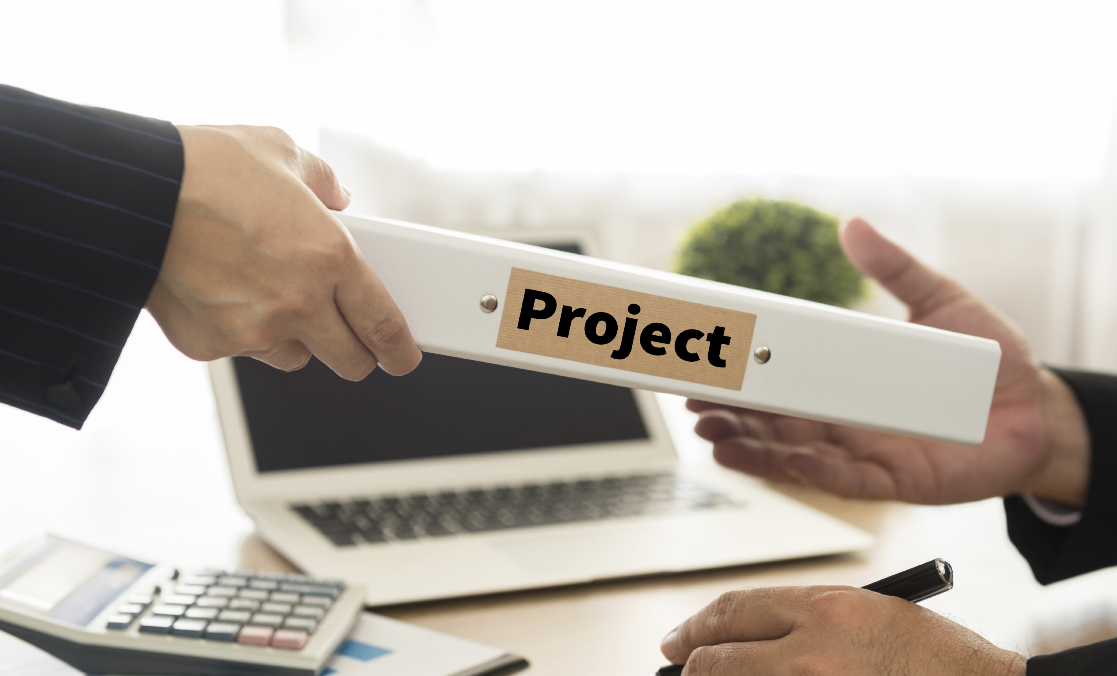
G. Sample Deliverables List
Process Improvement Project
List of current activities
Documentation of transaction
counts and processing times
List of current problems and root cause analysis
List of potential solutions with cost benefit analysis of each
Detailed implementation plan for final solution
PROJECT DELIVERABLE
-
Manual
7-11
Notes:
The next component is a Sample Deliverables List…..this provides a list of the key deliverables in the project that can signify key milestones/checkpoints of progress throughout a project…especially a longer project…….they are the “tangible” output of key tasks in the projects…..

Slide 33

H. Sample Task List
Hold scoping meeting to initiate the project
Hold facilitated session to document current process
Gather transaction counts and cost data
Hold facilitated session to document problems and root causes
Identify potential solutions
Perform cost-benefit analysis on top alternatives
Present report of recommendations
-
Manual
7-12
Notes:
Our 3rd, and last component, is the Task List….this is a list of the key tasks that will comprise the proposed project…....
Notice a full scope definition includes all 3 components: BAD, Deliverables List and Task List……let’s talk about what happens when we do not include all 3 parts (facilitate a discussion to include items like:
What happens when only 2 parts are included? What are the risks or pitfalls of an incomplete scope definition?
What if a BAD and Deliverables List is included by no Task List?
Scope creep…..you think there are 5 steps, the client thinks there are 9 steps that will be completed….you plan to 1) read current procedures and 2) Document the procedures….client thinks you will be 1) reading current procedures, 2) Interviewing department supervisors, and, 3) Documenting the procedures and the results of the interviews……..this “expectation gap”…which we will discuss in more detail later, would have been avoided with a Task List…….
What if you have a BAD and a Task List but no Deliverables List?......there will again be the potential of misunderstandings…..you are thinking the final deliverable is a presentation to the executives with recommendations, and the client thinks there will be a detail report including documented procedures (both as is and to be), all possible recommendations for improvement and your recommendations for “quick hits”…another “expectation gap” that could have been avoided with the 3 components instead of only 2……..

Slide 34
H. Sample Task List
Develop new process including policy and procedure documentation
Develop detailed implementation plan
Train staff on new process
Review and assess performance
-
Manual
7-12

Slide 35
Remaining Sections
Sample Statement of Work
Sample Letter Proposal
Sample Full Proposal
Notes:
The remaining sections include samples of the three proposal types.

Slide 36

MODULE REVIEW PROPOSING

Slide 37
Review
What are the three types of proposals?
Full proposal
Letter proposal
Statement of work

Slide 38
Review
What are the key steps in developing a proposal?
Isolate problems, objectives, deliverables
Choose solution process as a start
Modify task plan to address specific needs
Determine key competitive messages
Convert task plan into a work plan
Determine references and past experiences
Draft sections
Draft executive summary
Add appendices and sample deliverable

Slide 39
Review
What is a Business Area Diagram?
A definition of scope; both what is included in the project scope and what is not included in the project scope

Slide 40
Review
What is the benefit of defining both what is in scope and what is not in scope?
It is a crisp way in which to clearly define the scope of the project and allow a consultant to manage client expectations

Slide 41
Review
What are the key items in the deliverables list?
They key deliverables list provides the major deliverables in a project. Typically, these signify major milestones or checkpoints in the project plan.

Slide 42
Review
What are the key items in the task list?
The steps in the project work plan; these must be at an appropriate level of detail to plan, manage and report the progress of a project effort against the project budget and schedule.

Slide 43
The Facilitative Consultant
Defining the need
Part III: Proposing
Types of Proposals
Steps for Proposal Development
Developing the Proposal
with the Client
Defining Roles
Scoping the Engagement
Sample Business Area Diagram
Sample Deliverables List
Sample Task List
Sample Statement of Work
Sample Letter Proposal
Sample Full Proposal
Notes:
Any questions on the material on Proposing? [facilitate the discussion]

