Slide 1

V. Understanding
Your Client
Notes:
So, let’s dig into Understanding Your Client…….
Timing: 75 minutes Day 1 and 60 – 75 minutes Day 2
Flip Charts:
Communication Challenges
DISC Grid
Many Optional for Engagements
DISC by Style

Slide 2
Checkpoint
1
2
Define
the Need
Prepare to Execute
Client
Relationship
Management
Review
& Assess
Execute the Project
4
3
Ending:
Define the Need
Next:
Understanding Your
Client
-
Notes:
Review: we just completed our module on Defining the Need and we discussed the 6 question areas, SSR-ing problem statements, funneling evaluation statements and some tips on effective note taking……we also practiced some of these techniques in Exercise #1 where you had an opportunity to meet and interview B Porter……
Preview: what we are going to do next is talk about Understanding Your Client…..some great techniques for communicating more effectively with the various clients we will encounter as a consultant…...
Big View: and that’s important because as a consultant our clients expect that we will adapt to them and not for them to change to better communicate with them…..how many of you have worked with multiple clients in your earlier experiences (raise your hand)….yes, me too……now how many of you have found that our clients are all the same (nod your head no)…..that’s what we have discovered as well…..so let’s start by introducing a great tool that I know you will find helpful in improving our relationships with our clients………

Slide 3
The Facilitative Consultant
V. Understanding your client
Typical Communication Problems
Understanding Communication Styles
A Sample Scenario
Identifying the Styles of Others
Assigning the Project Team
DISC Profiles
Your Personal DISC Profile
Adapting Your Style
Success Strategies for Applying DISC
Notes:
In this module, we will cover 9 best practices or techniques….we will start this module today, provide you your personal communication profile to review this evening and then wrap the module up tomorrow morning…….let’s get started……

Slide 4

A. Typical Communication
Problems
Think about someone with whom you find it difficult to communicate. It may be someone with whom you work – a superior, a peer, or a subordinate – or it may be someone in your personal life.
Describe three specific things about this person’s communication style that you find difficult.
-
Manual
5-2
Notes:
Let me ask each of you to take a post-it note and a pen……using that post-it note I would like you to think about…..(use the words on the slide)…..you may want to include the person’s name or at least his/her initials…….let me give you about 30 seconds to do that……(when the time is up)…..let me start with (name) and go around the room clockwise to as you to read those 3 things each of you listed…….(make some comments including things that are similar, different, what they mean about communicating, etc.)…….alright, I would like each of you to keep this post-it note and simply put it aside….we will refer to it later…….

Slide 5
B. Understanding Communication
Styles
If it feels as if you and your client are speaking different languages, you might be right!
-
Manual
5-3
Notes:
Each of us typically have a style or an approach that we are comfortable with in terms of communicating. Some are more forthright, some more reserved; some more face-to-face, some more inclined to written communication. As a Facilitative Consultant, we should understand how to best communicate with our clients and adapt our style to best accommodate theirs. Often times it may “feel” that we are speaking a “different language” and in this module we will talk about “the language of DISC!”

Slide 6
B. Understanding Communication
Styles
-
Manual
5-3
Notes:
What do we mean by communication styles?...how does that relate to us as consultants…how may we use it…….let me ask this…..have you ever been in a situation with someone where you explain and explain and simply do not connect…I mean you have tried your hardest but the person you are trying to explain something to just isn’t getting it……and then to add insult to injury, in comes someone else, they explain it (and you’re thinking, hey, that’s what I’ve been saying) and immediately the other person says, “Oh, I get it that makes a lot of sense to me”……again, you’re thinking that is exactly what I was saying….why were you not getting it when I said it…..essentially, if it feels to you like you are speaking a different language, you just might be…..we call that the language of DISC………..
We want to learn about the DISC Model so that we can communicate more effectively…..at the same time, we do not want to “pigeonhole” people --- by remembering that all of us have some of each characteristic….D, I, S and C

Slide 7
B. Understanding Communication
Styles
The DISC Model
Where did it come from?
What does it mean?
How can we use it?
-
Manual
5-3
Notes:
DISC stands for Drive, Influence, Steadiness and Compliance and is the forerunner to other communication style models (e.g. Myers-Briggs) and it was started at Harvard in the late 20’s by a psychologist named William Marston. He is responsible for the predecessor of the DISC Model we use today.
Marston said that all humans are made up of these 4 characteristics (Drive, Influence, Steadiness and Compliance) but in different proportions. In other words every one of us in this room have all 4 of these characteristics but in different “levels”…..some of us have more D than others, some less, etc.
Most people are “high” in 1 or 2 characteristics and “low” on the others….they key is that DISC describes communications only and not personality….assigning good, bad or indifferent to the communication style or behavior characteristics depends on your own value system….for example both Michael Jordan and Saddam Hussein were both Hi D’s…..some of us would describe 1 of them as good and the other as bad….

Slide 8
B. Understanding Communication
Styles
The DISC Model
Where did it come from?
What does it mean?
How can we use it?
-
Manual
5-3
Notes:
Facilitative consultants tend to adapt their communication style or behavior to adjust to the situation or person/people they are dealing with at that time…….your natural style is the typical behavior or communication style you exhibit when you are in a comfortable environment such as with your family or close friends…..you also have an adaptive style which is representative of the style you exhibit in your environment….since we spend about ½ of our waking time at work, it is most often how you adapt your communication style to accommodate your work environment……..in general, the psychologists say that our natural style is “cemented” in our teens and rarely changes…..on the other hand, your adaptive style typically changes as your environment changes…for example, changing jobs or responsibilities…….adapting is more comfortable for some and challenging for others….it’s not bad to adapt and, in fact, can be very helpful.
By understanding people’s Hi and Low DISC characteristics can help you to communicate more effectively with our clients, our bosses and our peers…without needing that “interpreter” I referred to earlier……as consultants it helps us to contribute to more effective relationships with our clients and to use the glue or client relationship management to sustain our involvement with clients without that 3rd party, or interpreter, to help us…..

Slide 9
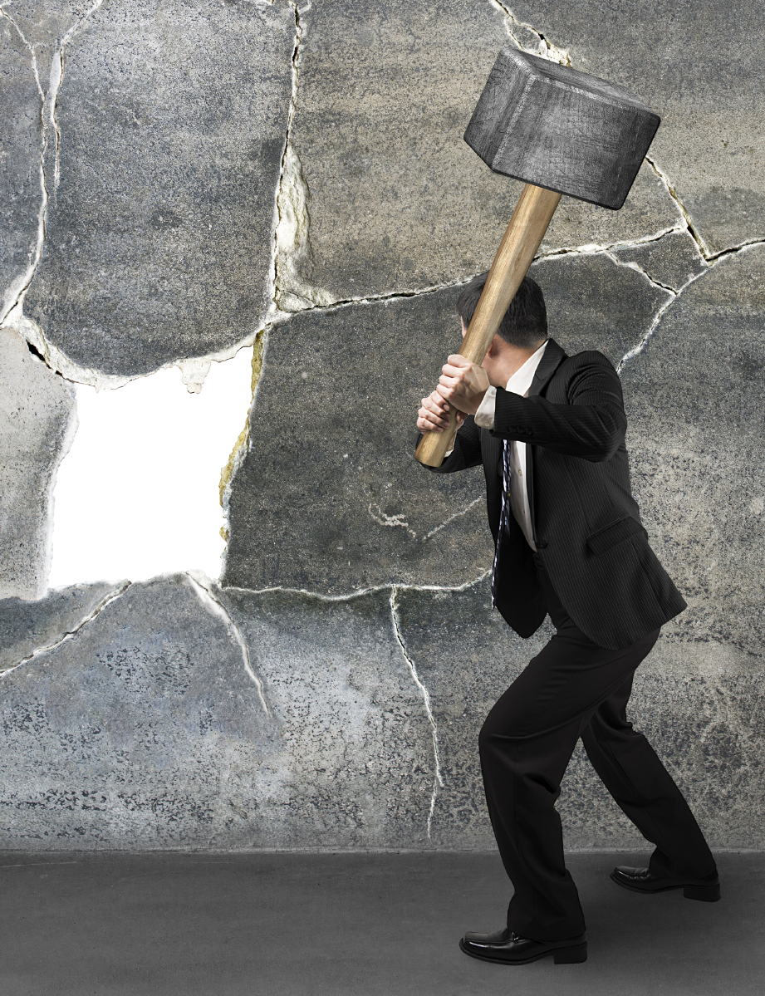
The High D

Slide 10
The High D
“Breaks through the wall”
High Ds tend to take a direct, assertive approach to solving problems. They enjoy challenges and get satisfaction from overcoming them.
Classic Occupations
Entrepreneurs, team leaders, directors
-
Manual
5-4
Notes:
To help us understand the different communication styles, imagine the task in front of you is to get over a brick wall that is standing before you…let’s take a look at how the various styles would tackle that task….keep in mind that most people are not as High as the High characteristics we are going to be talking about for the next few minutes….these are extremes or think about it as if this person had only 1 communication style and not the combination each of us actually do have…..view these extremes as kind of a caricature to help us understand the characteristics of each style…..
So what do you think the Hi D would do about that wall?....(red) team….that’s right the Hi D would:
Lower their shoulder and break through the wall.
The key factor for the D is time

Slide 11
The High D
Value to the Organization
High Ds tend to:
Focus on getting the job done
Address problems directly
Make tough decisions quickly
Potential Weaknesses
High Ds can:
Be overly abrasive, pushy, competitive
Be too concerned about the goal, not people
Make decisions too quickly before having all the facts
-
Manual
5-4
Notes:
(name) get us started read the 3 key points at the top of the slide……next (name) what is the value to the organization of the Hi D……ok, (name), what are those potential weaknesses……take a look at those classic occupations….(name), read those for us please…….

Slide 12
The High D
Key Factors: TIME, BEING DONE, OVERCOMING OBSTACLES
Communication Dos
Be prepared – tell them what you are going to tell them
State your points clearly, briefly, specifically
Give only as much detail as necessary
Communication Don’ts
Don’t waste their time with idle chatter
Don’t ramble or tell long stories
Don’t be too detailed unless they ask for it
-
“Be prepared, be brief, be gone.”
Manual
5-4
Notes:
Notice the Hi D is all about time….please circle time in your manual……(name) what about the communication do’s for the D….and, (name), what about those communication don’ts please…..great, what we like to think of as the tagline for those Hi D’s at Leadership Strategies is the following…..”Be Prepared, Be Brief and Be Gone:….again please make sure that you have circled Time and write that tagline, “Be Prepared, Be Brief, Be Gone” in your Participant Manuals…….before we move on, can you think about people you know like this? (raise your hand)….yes, me too

Slide 13

The High I

Slide 14
The High I
“Motivates people to overcome the wall”
High Is tend to enjoy helping people see the big picture. They motivate and inspire others to succeed.
Classic Occupations
Salespeople, teachers, planners
-
Manual
5-5
Notes:
Here is that wall again……its easy to understand the types by thinking of them as how each type gets to the other side of this wall that is a barrier to their goal but before we look at that Hi I, let’s do some review of the D….
(red) team the how does the D tackle the wall?.....(that’s right the put their shoulder down and go through it)…..
(green) team what are the classic occupations for the D……(that’s right directors, C-level and entrepreneurs….)
(blue) team the value to the organization…....
(purple) team…..the potential weaknesses…….
NOTE: conduct a backward build-up like this as you begin the next communication style each time. ALWAYS START WITH A DIFFERENT TEAM…for example, as you start the S and review both the D and the I, begin with the (green) team instead of the (red) team....and then when you start the C and review the D, the I and the S, start with the (blue) team instead of the (red) or the (green) team…..
Now, back to our Hi I…..how do you think he/she deals with that wall…(take a comment or two)….good, you are on the right track….the Hi I is the one with the megaphone shouting, “Hey, folks, let’s go, we can all get over that wall….it’s great on the other side…”…they are cheering people over that wall…..and making it fun to tackle it…..

Slide 15
The High I
Value to the Organization
High Is tend to:
See the big picture
Motivate and sell others
Develop creative solutions
Potential Weaknesses
High Is can:
Be so talkative that they don’t listen
Spend so much time on the vision that they never execute
Overlook details
-
Manual
5-5
Notes:
(name) get us started read the 3 key points at the top of the slide……next (name) what is the value to the organization of the Hi D……ok, (name), what are those potential weaknesses……take a look at those classic occupations….(name), read those for us please…….

Slide 16
The High I
Key Factors: IDEAS, BEING HEARD
Communication Dos
Give them the big picture before going into details
Give them a chance to share their ideas
Keep the conversation friendly and warm
Communication Don’ts
Don’t dwell on details and facts; instead, provide these in writing
Don’t tell them what to do without giving them an opportunity to respond
Don’t allow them to ramble too long
Manual
5-5
-
“Let them sell themselves!”
Notes:
Notice the Hi I is all about being heard…...please circle Being Heard in your manual……(name) what about the communication do’s for the I….and, (name), what about those communication don’ts please…..great, what we like to think of as the tagline for those Hi I’s at Leadership Strategies is the following…..”Let Them Sell Themselves:….again please make sure that you have circled Time and write that tagline, “Let Them Sell Themselves” in your Participant Manuals…….before we move on, can you think about people you know like this? (raise your hand)….yes, me too

Slide 17
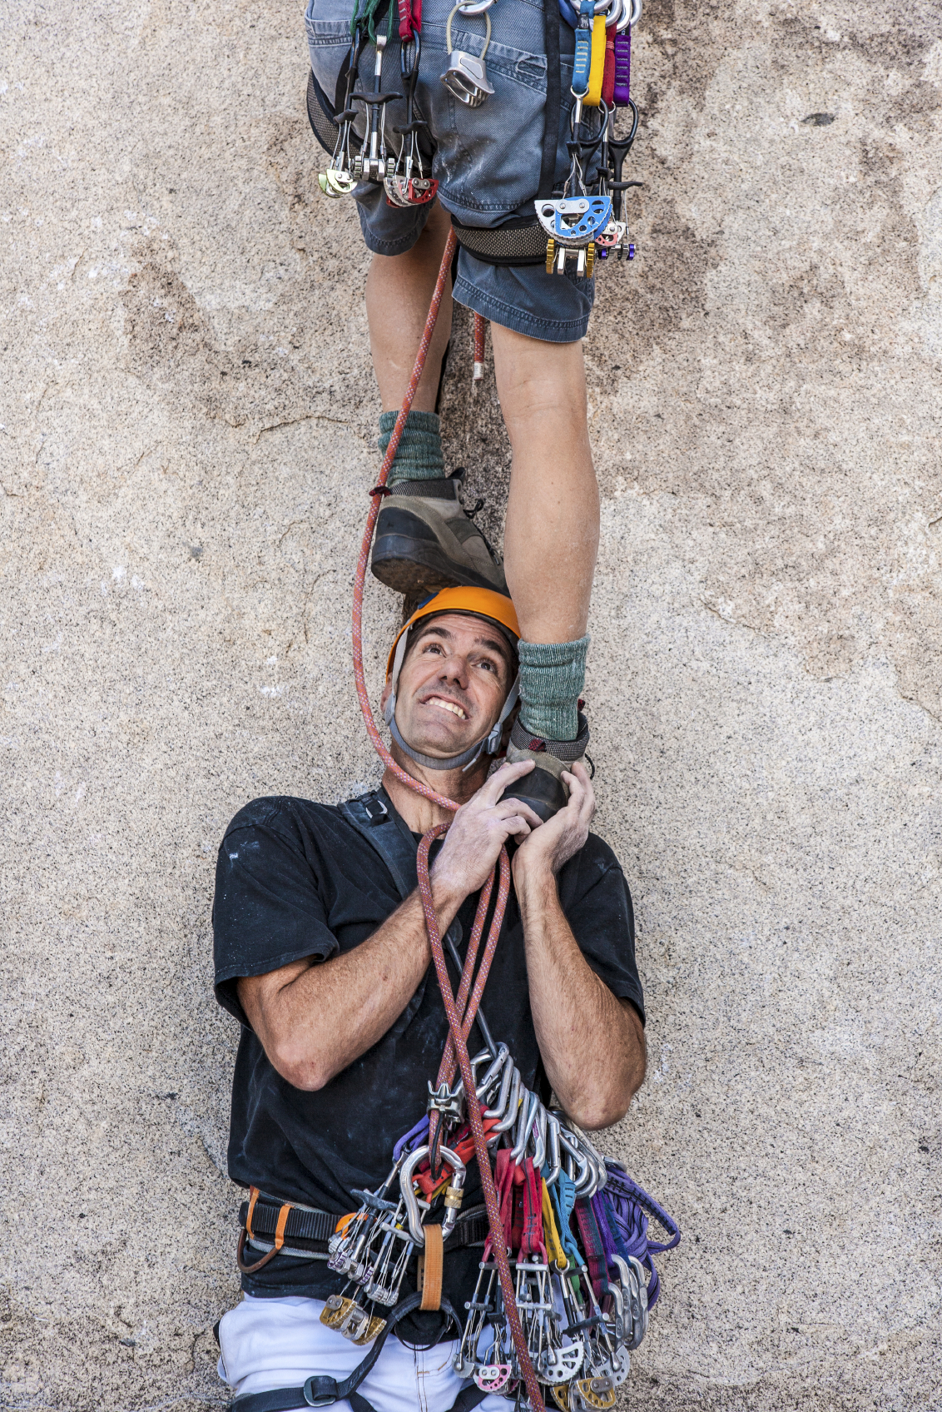
The High S

Slide 18
The High S
“Helps others over the wall”
High Ss tend to be the stabilizing force within an organization. They tend to be dependable, loyal workers who prefer a stable, secure environment.
Classic Occupations
Social service workers, retail clerks, civil servants
-
Manual
5-6
Notes:
Here is that wall again……its easy to understand the types by thinking of them as how each type gets to the other side of this wall that is a barrier to their goal but before we look at that Hi S, let’s do some review of the D and I….
(red) team the how does the D tackle the wall?.....(that’s right the put their shoulder down and go through it)…..
(green) team what are the classic occupations for the D……(that’s right directors, C-level and entrepreneurs….)
(blue) team the value to the organization…....
(purple) team…..the potential weaknesses…….
NOTE: conduct a backward build up like this as you begin the next communication style each time ALWAYS START WITH W DIFFERENT TEAM…for example, as you start the S and review both the D and the I, begin with the (green) team instead of the (red) team....and then when you start the C and review the D, the I and the S, start with the (blue) team instead of the (red) or the (green) team…..
Now, back to our Hi S…..how do you think he/she deals with that wall…(take a comment or two)….good, you are on the right track….the Hi S is the first person to stand in front of that wall with their hands cupped ready to boost/help others over that wall to get to the other side…..being liked is the key factor….so please circle Being Liked in your manual……..LSI’s approach for dealing with that Hi S is….Start with a personal comments and don’t assume silence means consent”……again, please write that tagline in your manuals……let’s see what we can learn about that Hi S……

Slide 19
The High S
Value to the Organization
High Ss tend to be:
Supportive, dependable workers
Accommodating and tolerant of others
People-oriented, good listeners
Potential Weaknesses
High Ss can:
Avoid dealing with issues until they become big problems
Be slow to accept change; hold grudges
Lack vision and creativity
-
Manual
5-6
Notes:
(name) get us started read the 3 key points at the top of the slide……next (name) what is the value to the organization of the Hi S……ok, (name), what are those potential weaknesses……take a look at those classic occupations….(name), read those for us please…….

Slide 20
The High S
Key Factors: SECURITY, BEING LIKED
Communication Dos
Start with a personal comment
Present ideas deliberately and clearly; provide assurances
Make sure they are in agreement before moving on
Communication Don’ts
Don’t dive straight into business
Don’t be demanding or abrasive
Don’t assume “silence means consent”
Manual
5-6
-
“Start personal; don’t assume.”
Notes:
Notice the Hi S is all about being liked…...please circle Being Liked in your manual……(name) what about the communication do’s for the S….and, (name), what about those communication don’ts please…..great, what we like to think of as the tagline for those Hi S’ at Leadership Strategies is the following…..”Start Personal; don’t assume silence means consent”….again please make sure that you have circled Being Liked and write that tagline, “Start personal; don’t assume silence means consent” in your Participant Manuals…….before we move on, can you think about people you know like this? (raise your hand)….yes, I can think of some as well……

Slide 21

The High C

Slide 22
The High C
“Develops detailed plans for scaling the wall”
High Cs tend to rely on rational logic and evidence to reach conclusions. They make sure that things are done “by the book.”
Classic Occupations
Researchers, analysts, accountants
-
Manual
5-7
Notes:
Here is that wall again……its easy to understand the types by thinking of them as how each type gets to the other side of this wall that is a barrier to their goal but before we look at that Hi C, let’s do some review of the D, the I and S….
(red) team the how does the D tackle the wall?.....(that’s right the put their shoulder down and go through it)…..
(green) team what are the classic occupations for the D……(that’s right directors, C-level and entrepreneurs….)
(blue) team the value to the organization…....
(purple) team…..the potential weaknesses…….
NOTE: conduct a backward build up like this as you begin the next communication style each time ALWAYS START WITH W DIFFERENT TEAM…for example, as you start the S and review both the D and the I, begin with the (green) team instead of the (red) team....and then when you start the C and review the D, the I and the S, start with the (blue) team instead of the (red) or the (green) team…..
Now, back to our Hi C…..how do you think he/she deals with that wall…(take a comment or two)….good, you are on the right track….the Hi C gets out the ruler, the spreadsheet and gathers all the data they can…..a few weeks later he/she will tell you something like….”the wind is from the NE at 5 knots, so if you run at a speed of 9 miles/hour, hit the wall at 100-lbs psi at an angle of 45 degrees, you will get over that wall”…..

Slide 23
The High C
“Develops detailed plans for scaling the wall”
High Cs tend to rely on rational logic and evidence to reach conclusions. They make sure that things are done “by the book.”
Classic Occupations
Researchers, analysts, accountants
-
Manual
5-7

Slide 24
The High C
Value to the Organization
High Cs tend to:
Be organized and detail oriented
Make sure decisions are well supported
Ensure that procedures are properly followed
Potential Weaknesses
High Cs can be:
Perfectionists and very hard to please
Too focused on facts and figures and not on people
Overly cautious, take too long to make a decision (analysis paralysis)
-
Manual
5-7
Notes:
(name) get us started read the 3 key points at the top of the slide……next (name) what is the value to the organization of the Hi C……ok, (name), what are those potential weaknesses……take a look at those classic occupations….(name), read those for us please…….

Slide 25
The High C
Key Factors: ACCURACY, BEING RIGHT*
Communication Dos
Present ideas in a logical fashion
Stay on topic
Provide facts and figures that back up claims
Communication Don’ts
Don’t be disorganized or make random comments
Don’t rely on emotional appeal to gain agreement
Don’t force a rapid decision
-
“Give them time for the details.”
Manual
5-7
Notes:
Notice the Hi C is all about being right…...please circle Being Right in your manual……They do not need to be right; they need the solution or answer to be right…..(name) what about the communication dos for the C?….and, (name), what about those communication don’ts, please?…..great, what we like to think of as the tagline for those Hi C’ s at Leadership Strategies is Give them time for the details ….again please make sure that you have circled Being Right and write that tagline, “Give them time for the details” in your Participant Manuals…….before we move on, can you think about people you know like this? (raise your hand)….yes, I can think of some as well……
Time permitting, conduct one final round of review of the key points of each of the 4 styles – but asking the questions differently.
(Team red), tell me what each of the 4 letters in DISC stands for... Next team, tell me what each style does at the wall... Next team, what value does each style bring?... Next team, what is a downside of each style?... Next team, what is the key factor for each?... Next team, what is the shorthand for dealing with each style?
One of the following 2 examples can help as well:

Slide 26
The High C
Key Factors: ACCURACY, BEING RIGHT*
Communication Dos
Present ideas in a logical fashion
Stay on topic
Provide facts and figures that back up claims
Communication Don’ts
Don’t be disorganized or make random comments
Don’t rely on emotional appeal to gain agreement
Don’t force a rapid decision
Manual
5-7
-
“Give them time for the details.”
Notes:
Salad Bar with a C, then S, then I and last a D in the line……
Hi C…examining each item on the salad bar before ever so carefully placing each item in just the right spot on their plate….not letting the salad items touching the bread, etc.
Hi S…stating, “doesn’t this look good….the salad is really fresh…don’t you think it looks good?”
Hi I….turning to the Hi D behind him saying….”what do you think is going on up there in the front of this line?.....have you been here before?...what do you think I should take?”….etc.
Hi D….about ready to explode and make a run to the front of the line……
AND/OR
Elevator with lots of people that have been waiting a long, long time for an elevator to go to the 9th floor
Hi D….keeps pushing the button to call for the elevator…muttering under his/her breath…..”where is the darn elevator….I am in a hurry”….
Hi I….elevator door opens, gets in and starts saying…..”Come on you can fit, come on in here with the rest of us….we can all make it”….
Hi S….starts taking the stairs…..complaining every step he/she takes……to the 9th floor…..
Hi C….gets on the elevator, looks at the loading chart with the weight limit amount and beings calculating the weight on the elevator…..

Slide 27

C. A Sample Scenario
A problem has arisen in your area.
You have fully researched the problem.
You have created an eight-page document that delineates the problem, specifies four possible alternatives, and gives the strengths and weaknesses.
You favor alternative four.
You are about to meet with your boss to discuss the problem. You knock on the door. You hear, “Come in.” Depending on your boss’s communication style, what would be the first words out of your mouth?
-
Manual
5-8
Notes:
Let’s try to apply what we have just covered about the characteristics of the 4 styles by using the scenario as follows…….
Purpose: in teams, apply the ways to adjust our styles based on the communication style of our boss…or client
Example:….do the review of the slide and conduct the Hi D together with your leading the first words out of you mouth……
Directions: now that we are clear on what we need to do, let’s first assign new team leaders/spokesperson for each team…..now, let me ask each team to take 3 minutes to decide how you would approach the I, the S and the C….
Questions: before we begin, are there any questions………
(start the timer…..when time is up have a different team go first for each of the 3 styles checking in with other teams to discuss differences……)

Slide 28
C. A Sample Scenario
Your boss’ DISC style:
High D
Being Done
Can you take eight minutes? I need your decision on…
High I
Being Heard
How was your weekend?
High S
Being Liked
How are you?
High C
Being Right
(E-mail sent in advance.) If now is ok, I would like to take as much time as you need to discuss…
-
Manual
5-8
Notes:
The Hi D
The first words out of your mouth are on the slide……to enter a conversation might include the following key points:
The alternative you are recommending
The problem it solves
Benefits associated with your recommendations
Get confirmation on moving forward with your recommendation
The Hi I
The first words out of your mouth are on the slide. A further conversation might include:
I would like your input on…..
High level of the problem
Ask for possible solutions
Share your alternative…ask for comments/input
Ask for associated benefits
Ask for agreement to moving forward

Slide 29
C. A Sample Scenario
Your boss’ DISC style:
High D
Being Done
Can you take eight minutes? I need your decision on…
High I
Being Heard
How was your weekend?
High S
Being Liked
How are you?
High C
Being Right
(E-mail sent in advance.) If now is ok, I would like to take as much time as you need to discuss…
-
Manual
5-8
Notes:
The Hi S
First words out of your mouth are on the slide….if further conversation ensues might include the following:
I would like your help on something
Summary of the problem
Share your recommendation
Share the benefits
Ask for agreement to move forward
The Hi C
First words out of you mouth on the slide…..further conversation will occur and should include:
Detailed description of the problem area
Review of each alternative, +’s and –’s of each alternative
Detail rationale for the recommended alternative you are recommending
Outline the need for consideration and the cost of any delay beyond (pick a date you need to get recommendation started)
Gain agreement on a solution and timing

Slide 30
C. A Sample Scenario
Of the four types, which would likely take 15 minutes or less? Which type would take 60 minutes or more? Of the two remaining types, give one 30 minutes and the other 45.
D
Total Time ______
I
______
S
______
C
______
15
45
30
60
-
Manual
5-9
Notes:
Alright, let’s try another team engagement……
Purpose…..you are planning to meet with somebody….based on their dominant style, we want to determine how much time we would likely plan to spend with that person and then the tasks and the likely order of those tasks, we would use in meeting with a person of that style……
Example…..for example if we had either 15, 30, 45 or 60 minutes to meet with a particular style…..who would you think we would plan to spend 15 minutes with……(purple) team, what do you think?......(red) team do you agree?.....other teams, any different thoughts……OK, that’s correct it would be the D…..remember our friend the Hi D…..the tagline for communicating with him/her is “be prepared, be brief, be gone”…….so 15 minutes would be correct….
Directions……alright first let’s select a new team leader…..now that we have new team leads, I would like each team to determine which style we would assign 30, 45, and 60 minutes for and then order the tasks we would go through for each style……let me give you 5 minutes co complete that….
(start the timer and when complete, facilitate the discussion of answers with questions, discussion, etc.)…..
OK, any questions of comments……great, then let’s look at the 2 dimensions we have been using for the DISC communication styles and look at some other tips for adapting our styles to improved our communication with that style…..

Slide 31
C. A Sample Scenario
Depending upon the style of your boss, which activities would you do 1st, 2nd, 3rd, etc.?
 | D | I | S | C
Total Time | 15 | 45 | 30 | 60
Pleasantries
Explanation of the Problem - High-level explanation
- Detailed explanation
- Asking how to solve the problem
Offering your solution(s) - High-level explanation
- Detailed explanation
Benefits of your solution(s) - Asking sponsor for the benefits
- Explaining the benefits
Reaching agreement on the next step
1
1
2
2
2
1
2
3
1
4
3
3
4
5
3
4
5
-
4
6
5
6
Manual
5-9
Notes:
[cont’d] Alright, let’s try another team engagement……
Purpose…..you are planning to meet with somebody….based on their dominant style, we want to determine how much time we would likely plan to spend with that person and then the tasks and the likely order of those tasks, we would use in meeting with a person of that style……
Example…..for example if we had either 15, 30, 45 or 60 minutes to meet with a particular style…..who would you think we would plan to spend 15 minutes with……(purple) team, what do you think?......(red) team do you agree?.....other teams, any different thoughts……OK, that’s correct it would be the D…..remember our friend the Hi D…..the tagline for communicating with him/her is “be prepared, be brief, be gone”…….so 15 minutes would be correct….
Directions……alright first let’s select a new team leader…..now that we have new team leads, I would like each team to determine which style we would assign 30, 45, and 60 minutes for and then order the tasks we would go through for each style……let me give you 5 minutes co complete that….
(start the timer and when complete, facilitate the discussion of answers with questions, discussion, etc.)…..
OK, any questions of comments……great, then let’s look at the 2 dimensions we have been using for the DISC communication styles and look at some other tips for adapting our styles to improved our communication with that style…..

Slide 32

D. Identifying the Styles of Others
-
*
Manual
5-10
Notes:
We could carry around a DISC test and ask our clients to complete that so we can know how to communicate with them….how realistic would that be? (nod your head no)……..instead, let’s put more “meat on the bones” and look at the 2 dimensions of DISC…………(NOTE: build the axis 1 at a time with Y then X)…so let’s start with the Y axis…..DISC says there are Direct Communicators and Indirect Communicators….for example, if a Direct Communicator came into this room and the temperature was about 60 degrees…..(red) team, what would a Direct Communicator say…..that’s about right, “It’s cold in here”………or words to that effect….on the other hand if an Indirect Communicator came into the same room at the same temperature, they might say something like, “Is anybody uncomfortable”…..it’s not right, it’s not wrong, it just is……we need to realize that when an Indirect Communicator says, “Is anybody uncomfortable”…..that is the same to the Direct Communicator that says, “It’s cold in here”…….let’s look at the characteristics of each……

Slide 33
D. Identifying the Styles of Others
-
*
Manual
5-10
Notes:
Direct Communicators tend to:
Make statements or tell
Have more voice variety and inflection
Talk through things
Are more forceful
Speak both faster and louder
Have firm handshakes and more eye contact
Use gestures while they speak for emphasis
Display impatience, interrupt to ask questions or make statements

Slide 34
D. Identifying the Styles of Others
-
*
Manual
5-10
Notes:
Indirect Communicators tend to:
Ask questions….is anyone uncomfortable?
Listen rather than talk
Reserve their opinions
Have a more steady cadence of speech and speak more slowly
Speak more softly
Give gentle handshakes and less eye contact
Limit their gestures when speaking; more reserved style
Display patience and avoid interrupting others

Slide 35
D. Identifying the Styles of Others
-
*
Manual
5-10
Notes:
Let’s look at the X axis…….on the right side we have People Oriented communicators…..and on the left side we have Task Oriented people……..let’s think about WWII generals, who would have been the Task Oriented general (allow the group to respond)….yes, Patton ………and our People Oriented general…..yes, Ike would be one……let’s look at the characteristics of each……
People Oriented Communicators tend to:
Tell stories
Share their feelings
Use informal speech
Express opinions directly
Use lots of inflection
Have vocal pitch variation
Show animated facial expressions
Are contact oriented……”let’s get back together to wrap this up”
Exhibit dramatic action

Slide 36
D. Identifying the Styles of Others
-
*
Manual
5-10
Notes:
Task Oriented Communicators tend to:
Talk about facts and data
Not disclose their feelings
Use more formal speech
Use little vocal inflection\
Not vary their voice pitch
Offer fewer facial expressions
Control their hand and body movement
Do not encourage contact….”why don’t you get back to me with an email for follow –up?”
Let’s wrap this up by starting with the (purple) team and moving to my left…..(purple) team, who would be the Direct and Task oriented communicator?....that’s right the D and the D’s key factor is….good, Being Done……(blue) team, who would be the Direct and People oriented communicator?......good, the I and the I’s key factor is…..great, Being Heard…….on to the (green) team, who would be the Indirect and People oriented communicator?....that’s it, our S and the S’ tagline is……that’s it, Being Liked and, finally our (red) team, who would be the Indirect and Task oriented communicator?....yes, the C and the C’s tagline……that’s it, Being Right…….I think we have this, so let’s move on……

Slide 37
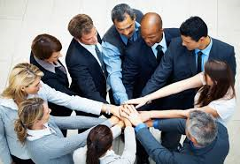
E. Assigning the Project Team
You have been assigned to observe a task force that has been given two days to:
Identify key problems within the hiring process
Develop potential solutions
Document a detailed implementation plan
What would be the result at the end of the two days if everyone on the team had the same style as follows… ?
-
Manual
5-11
Notes:
Let’s try another activity in our teams…..
Purpose…let’s see what would happen if we were using a team of people all of whom have the same communication style (or bias)….in other words, we are observing a group of people working together and all of them have the same Hi D, Hi I, Hi S or Hi C communication styles….we want to ask your team to identify what you are observing as you study that group…..let’s look at the 4 areas we want to ask you about…..

Slide 38
E. Assigning the Project Team
 | What would be the key issue in the room? | Would they finish? | What would be the quality of what they finished? | How would they feel about one another?
 | “Who ________” | Yes/No/Maybe | High/Medium/Low | Like/Not Like/ Neutral
D
I
S
C
Leads
Yes
Low
Fast/Low Teamwork
Not Like
Speaks
Maybe
Low
High Level/Low Work
Like
Low
Creativity, Challenge
Confronts
Yes
Love
-
Stops
No
High
Neutral
Manual
5-11
Notes:
First, let’s assign a new leader of each team…..(will the person that has the most siblings take the team leadership please)……..here are the four questions we would like you and your team to answer for each group………
First is “What would the key issue be with that group?”…………the way to look at that would be to ask if the key factor is _________then what would be the key issue with that group……use 1 word to complete each phrase…….
The 2nd column is answered this way, “if this communication style was assigned that task, would they finish it in the assigned time?”……..in other words would a groups of Hi D’s, Hi I’s, Hi S’ or Hi C’s complete that task assigned to them?......
For the 3rd column, we would like you to ask yourselves this question….”Imagine the team did finish….what would the quality of their overall work be?’…….
The last column would answer the question……”At the end of the task, how would the team members feel about each other?”…..
Are there any questions……….
(NOTE: you may complete 1 row together and then assign a team each 1 row to complete……timing is 2 minutes)………..

Slide 39
E. Assigning the Project Team
 | Drive | Influence | Steadiness | Compliance
Which Style is Naturally Best At… ? | D | I | S | C
1. Identifying problems
2. Brainstorming solutions
3. Developing the detailed plan
4. Documenting the plan
5. Selling the plan to management
6. Overseeing plan execution
7. Executing the work plan
X
X
X
X
X
X
-
X
Manual
5-12
Notes:
Here is another perspective to think about….while we might prefer to interact with certain people…..really effective teams have a multitude of styles to be most effective…..there are many reasons and this activity will demonstrate 1 key reason….that is certain activities are often better suited to different styles…..so let’s complete this activity as follows…..
(NOTE: either do as an entire group with team round robin or break into small teams, each team completes their answers and then do round robin by teams to review responses)……………………….

Slide 40
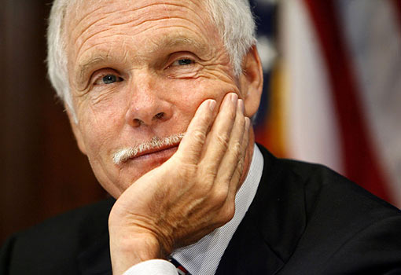
F. Classic DISC Profiles
Ted Turner - CNN
D I S C
X
X
X
X
-
Entrepreneur
-
Manual
5-13
Notes:
Here is a sample of a typical DISC profile for a famous Hi D, Ted Turner…..(Red) team, help us by telling us what your observation is on this profile [guide the discussion]

Slide 41
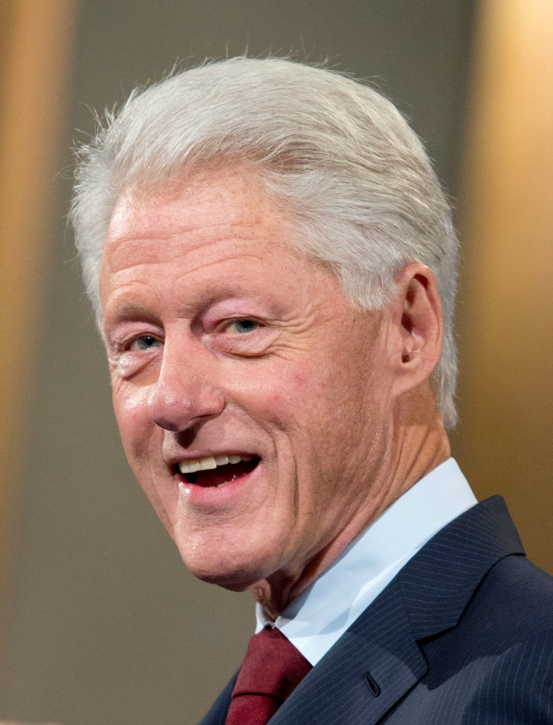
F. Classic DISC Profiles
Bill Clinton
D I S C
X
X
X
X
-
Salesman
-
Notes:
Here is a sample of a typical DISC profile for a famous Hi I, Bill Clinton…..(Green) team, help us by telling us what your observation is on this profile [guide the discussion]

Slide 42
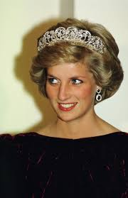
F. Classic DISC Profiles
Princess Diana
D I S C
X
X
X
X
-
Social Worker
-
Notes:
Here is a sample of a typical DISC profile for a famous Hi S, Princess Diana …..(Blue) team, help us by telling us what your observation is on this profile [guide the discussion]

Slide 43
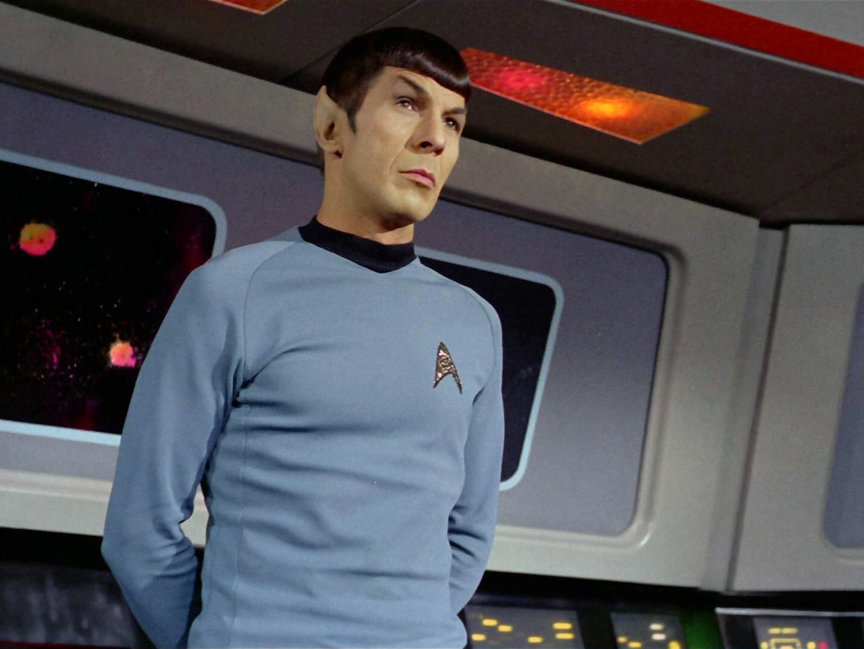
F. Classic DISC Profiles
Mr. Spock – Star Trek (Original)
D I S C
X
X
X
X
-
Researcher
-
Notes:
Finally, here is a sample of a typical DISC profile for a famous Hi C, a character from Star Trek, Dr. Spock…..(Purple) team, help us by telling us what your observation is on this profile [guide the discussion]

Slide 44
F. DISC Profiles
Image source: Target Training International, Ltd
Image source: Target Training International, Ltd
Manual
5-13
Notes:
I am sure you have been thinking, yes, I must be a ______....well we are about to share with each of you the results of your DISC Communication Survey…..the reason we intentionally did not share these with you before we reviewed some of our DISC basics was we wanted you to think about this from the “outside in” instead of from the “inside out”…..in other words, what we find is that when people are provided their DISC results first, they want to know more about themselves and look at all of the traits and characteristics from their own perspective…….so this evening, we are going to ask you to do a short review of your DISC Style Report but before we do, let me make a few comments about the reports……
Left side (bar chart graphs)”
On the right hand graph, you will find your Natural Style…..that is how you are “naturally wired”…..typically this is how you have been since your adolescence…..the natural style typically does not change short of some catastrophic event in our lives….the Natural Style is based on your responses to the “least” responses on the survey….it is actually the least number of “least” responses that indicate what you are really like…..
On the left hand graph, you will find your Adaptive Style…...this is how you adapt to your environment….since we spend a significant amount of our waking time at work, it is often a reflection of how we think we need to communicate at work…..the Adaptive Style does tend to change based on your environment, your responsibilities, etc.
When we see the Natural Style and the Adaptive Style very similar, we like to say….”What you see is what you get”…….

Slide 45
F. DISC Profiles
Image source: Target Training International, Ltd
Image source: Target Training International, Ltd
Manual
5-13
Notes:
On the right hand side, The Wheel
This is a quick and easy reference of “how much you have to stretch” between your Natural and Adaptive Styles. It does not mean that you cannot do this……think of this as a rubber band….if your dot and your star are close together, that rubber band does not need to stretch very much. If your dot and your star a far apart, that rubber band must stretch a lot. Typically that would “feel” like more tiring from a mental or concentration type of focus.

Slide 46
G. Your Personal DISC Profile
Your personal DISC profile is based on your responses to the 24 questions. As you read your profile…
Circle the major items with which you agree.
Cross out the major items with which you disagree.
Put a question mark next to major items of which you are unsure.
Make note of a few major items that you felt were accurate about your communication style.
By focusing on the major items, you will most likely not have more than five items marked on a page.
?
-
Manual
5-14
Notes:
For this evening’s assignment, we would like you to review your DISC Profile and do the following:
Circle the major items with which you agree
For those items with which you do not agree, mark those with an X
For those items you are not certain about….you think that might be you or might not be you….mark those with a ?
We find it very interesting to ask someone that knows you very well to review your DISC Profile and see what they agree or disagree with….you may find their comments very insightful and give you another perspective on how other people may “see you”…….

Slide 47
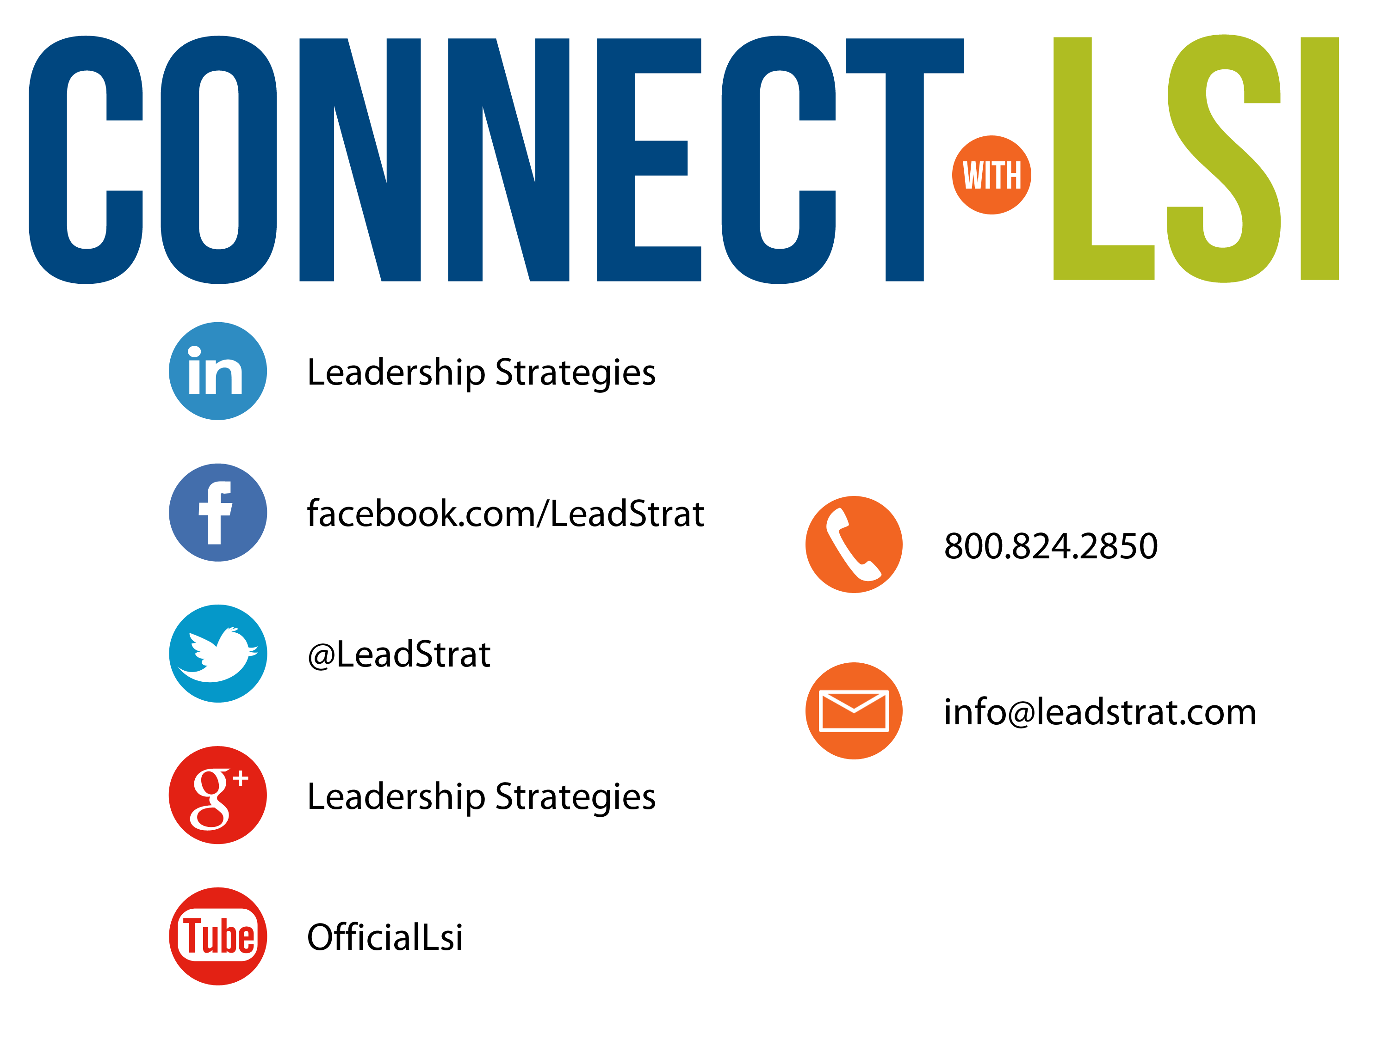


Questions?
etraining@leadstrat.com
800.824.2850
Or, submit your questions for open discussion
on the Linked-In “Leadership Strategies
Facilitation & Leadership Community” Group
Join us on Facebook at
www.Facebook.com/Leadstrat
and Twitter @Leadstrat
Notes:
How many of you have picked up a few key tips or techniques today? [raise your hand] That is great and what I would like to request that you do before we reconvene for Day 2 is so share a key “take way” from today by tweeting that tonight. That visibility will help all of us to “share the power” I have been referring to. Any questions? [facilitate the discussion] Thanks and I look forward to another great day tomorrow.

Slide 48
H. Adapting Your Style
Join with other members from the class who have your similar style. Answer the following questions:
What do you BRING to a group? | What do you NEED from others in the group?
With which style do you MOST PREFER to interact? Why? | With which style do you LEAST PREFER to interact? Why?
-
Manual
5-15
Notes:
Team Activity with teams assigned by their dominant Natural Style (primary or secondary style)…..
Purpose….to ask each team to outline their responses to the 4 areas on the slide on the 4 flip charts….each flip chart should be completed in the quadrants matching the slide……
Directions…..each team will select their documenter to write on the flip chart and their spokesperson to report their flip chart to the entire group….we will allow (8 to 10 minutes for the teams to complete their flip chart)……
Questions…..are there any questions?.....OK, let’s start the activity……(start the clock)
(NOTE: during the team’s working observe and make notes that reflect “typical” behavior from that style….e.g.….look for the I’s to all be talking at the same time, the C’s to have lots of info and neat flip charts, etc….on more than 1 occasion, I have had the D’s come up to me and ask me to tell the I’s to be quiet and get them to work on the assignment as an example….facilitate the exercise debrief to include some of the following:
Think about the process your team went through to complete this activity….how you started and then went through the work together…..what ONE word describes what you felt or thought about the activity
For Least Preferred…..what if your boss or client was one of these communication styles…..what could you do to communicate more effectively with that person?
Then turn to that styles – the one least preferred on that team’s chart…and ask them…..what could that group to do communicate with you more effectively)

Slide 49
I. Success Strategies for Applying
DISC
In working with a client, consider his/her dominant communication style.
Adjust your communication approach so that it is more in line with your client’s style.
Recognize your own communication bias!
Look for signs that you may be miscommunicating.
-
Manual
5-16
Notes:
We’ve talked about the What and the So What….let’s move to the Now What……as consultants it is not enough to understand the communication styles and their characteristics….it’s not enough to by willing to adapt our style for better communication with our clients….yes, it is a start though…..to be truly effective, the Facilitative Consultant, must do these things well and also be constantly vigilant to recognize when we are or may be miscommunicating with our clients….or bosses or project team members…..the key here is to understand your strengths and know how to be versatile or how to adapt your style to complement your clients and your teams……

Slide 50
I. Success Strategies for Applying
DISC
DISC Style | Factor | Miscommunication Sign
High D
High I
High S
High C
Being Done
Impatience, looking at watch
Being Heard
Interrupting
Being Liked
Shutting down, passive-aggressive
Objecting, arguing
-
Being Right
Manual
5-16
Notes:
Let’s take a look at the 4 DISC styles, each of the styles’ key factors and then determine some of the signs we might look for that would alert us that we might be miscommunicating with each of the styles……..(go through each style asking a team and facilitating the discussion….some key points:
D….my work on other things…could even say, “that’s OK, go ahead, I’m listening”….taps their foot, turns to their PC to multitask, looks at their watch for time…..
I…..interrupts constantly…..rambles or goes back to talk about something that has already been covered because they did not get or finish their say….want the floor…..
S….difficult to read….less eye contact and get very quiet…..you may want to be very careful in wording your questions from “what do you think?”….to “how might we make this better”……..over the longer term look for head nods in the meeting but no action after the meeting….
C…keeps asking for more facts, data, research…..asks you to take them through what you did….keeps returning to previous topic to get additional information……

Slide 51
I. Success Strategies for Applying
DISC
A facilitative consultant consciously adapts his/her communication style to the style of the client.
Manual
5-16
Notes:
The key here is as a Facilitative Consultant we want to adapt our communication style to better communication with our clients. And a key part here would be to be aware of the signs when we may be miscommunicating with a client. Let’s take a look.
Let me ask you in your teams to [select a team lead] to discuss a situation where you found yourself communicating in a manner that might not have been most productive….a time when you might not have been getting your point across….or the client was simply, not getting what you were saying…..can you identify a tip or technique that we have discussed where understanding DISC might help in those situations?
[guide a conversation after allowing about 4 minutes in teams]

Slide 52

MODULE REVIEW
DISC

Slide 53
Review
What are the four communication styles?
Driver
Influencer
Steadiness
Compliance
-

Slide 54
Review
What are some of the values to the organization of the D communication style?
Focus efforts on getting the job done
Address problems directly
Make tough decisions quickly
-

Slide 55
Review
What are some of the potential weaknesses of the D communication style?
Be overly abrasive, pushy, competitive
Be too concerned about the goal, not the people
Make decisions too quickly before having all the facts
-

Slide 56
Review
What are some of the DOs in communicating with the D communication style?
Be prepared – tell them what you are going to tell them
State your points clearly, briefly, concisely
Give only as much detail as necessary
-

Slide 57
Review
What are some of the DON’Ts in communicating with the D communication style?
Don’t waste their time with idle chatter
Don’t ramble or tell long stories
Don’t be too detailed unless they ask for it
-

Slide 58
Review
What is the tagline for communicating with the D communication style?
Be prepared, be brief, be gone
-

Slide 59
Review
What are some of the values to the organization of the I communication style?
See the big picture
Motivate and sell others
Develop creative solutions
-

Slide 60
Review
What are some of the potential weaknesses of the I communication style?
Be so talkative that they don’t listen
Spend so much time on the vision that they never execute
Overlook details
-

Slide 61
Review
What are some of the DOs in communicating with the I communication style?
Give them the big picture before going into details
Give the a chance to share their ideas
Keep the conversation friendly and warm
-

Slide 62
Review
What are some of the DON’Ts in communicating with the I communication style?
Don’t dwell on details and facts; provide these in writing instead
Don’t tell them what to do without giving them an opportunity to respond
Don’t allow them to ramble too long
-

Slide 63
Review
What is the tagline for communicating with the I communication style?
Let them sell themselves
-

Slide 64
Review
What are some of the values to the organization of the S communication style?
Supportive, dependable workers
Accommodating and tolerant of others
People-oriented, good listeners
-

Slide 65
Review
What are some of the potential weaknesses of the S communication style?
Avoid dealing with issues until they become problems
Be slow to accept change; hold grudges
Lack vision and creativity
-

Slide 66
Review
What are some of the DOs in communicating with the S communication style?
Start with a personal comment
Present ideas deliberately and clearly; provide assurances
Make sure they are in agreement before moving on
-

Slide 67
Review
What are some of the DON’Ts in communicating with the S communication style?
Don’t dive straight into business
Don’t be demanding or abrasive
Don’t assume silence means consent
-

Slide 68
Review
What is the tagline for communicating with the S communication style?
Start personal and don’t assume
-

Slide 69
Review
What are some of the values to the organization of the C communication style?
Be organized and detail-oriented
Make sure decisions are well supported
Ensure that procedures are properly followed
-

Slide 70
Review
What are some of the potential weaknesses of the C communication style?
Perfectionists and very hard to please
Too focused on the facts and figures and not on people
Overly cautious, take too long to make a decision (analysis paralysis)
-

Slide 71
Review
What are some of the DOs in communicating with the C communication style?
Present ideas in a logical fashion
Stay on topic
Provide facts and figures that back up claims
-

Slide 72
Review
What are some of the DON’Ts in communicating with the C communication style?
Don’t be disorganized or make random comments
Don’t rely on emotional appeal to gain agreement
Don’t force a rapid decision
-

Slide 73
Review
What is the tagline for communicating with the C communication style?
Give them time for the details
-

Slide 74
Review
What are the signs you are miscommunicating with the D communication style?
Impatience (time is the key factor)
-

Slide 75
Review
What are the signs you are miscommunicating with the I communication style?
Interrupting you (being heard is the key factor)
-

Slide 76
Review
What are the signs you are miscommunicating with the S communication style?
Shutting down (being liked is the key factor)
-

Slide 77
Review
What are the signs you are miscommunicating with the C communication style?
Objecting or arguing (being right is the key factor)
-

Slide 78
The Facilitative Consultant
V. Understanding your client
Typical Communication Problems
Understanding Communication Styles
A Sample Scenario
Identifying the Styles of Others
Assigning the Project Team
DISC Profiles
Your Personal DISC Profile
Adapting Your Style
Success Strategies for Applying DISC

