Slide 1
XII. ACTION PLANNING
Notes:
Before we go into action planning, let’s take a few minutes to review key concepts from the course. Let’s pull out your mini-manuals, and let’s review it together. [Facilitate discussion with mini manual.]
Once again, here is our framework or process for consulting engagements…it contains 4 unique stages identified within the circle, and those 4 stages are encircled with the Client Relationship Management process……I would like you to think about the things we have covered over the last 3 days…think about the items that really resonated with you….those techniques that you thought, “Wow, I am going to adopt those….I want to use this or that on my projects”…
Timing: 15-25 minutes
Flip Charts:
None
Checkpoint…..
Review….we have just completed the 4th stage of the consulting cycle….Executing the Project……
Preview….what we are going to do next is complete some actions planning for each of you as participants….
Big view….and, that’s important because we want to ensure you are taking a handful or so of items and committing to put them in play so that you can expand/enhance your consulting tool kit……

Slide 2
The Facilitative Consultant
ACTION PLANNING
Identifying Your Jewels
Planning Change
Notes:
Let’s look at this from the 2 perspectives on this slide…..

Slide 3
A. Identifying Your Jewels
As you consider the key points made in the class, document below what were the “jewels” for you personally.
_________________________________________
_________________________________________
_________________________________________
_________________________________________
_________________________________________
_________________________________________
_________________________________________
-
Manual 12-2
Notes:
Let me set the clock for 3 minutes and ask you to list 5 to 7 on page 12-2 in your participant manual…..(Set the clock and when the time is up, ask the participants to share in their teams for about 4 minutes. Then, follow up with a round-robin by teams sharing 1 per person per team)……..

Slide 4
B. Planning Change
What are three things you can do within the first month after this class to begin implementing the jewels you identified?
_________________________________________
_________________________________________
_________________________________________
Manual 12-3
Notes:
Last let me ask each of you to list 3 things you plan to implement within the next month…..(Allow 3-5 minutes and consider a round-robin by teams to share some key points the participants have made a commitment to do.)

Slide 5
Congratulations!
Notes:
So, let me now congratulate you! [Start the round of applause and move to the class close. Remember, model the close from Principle 9.]

Slide 6


Share your power!
JOIN THE COMMUNITY. In your first 30 days after this course, let your classmates know your success in using the tools and techniques. Be part of the community of thousands of facilitators and consultants. See how facilitation has helped others and share your story.
Follow to join:
Twitter - @leadstrat
Facebook – www.facebook.com/leadstrat
LinkedIn – search “Leadership Strategies”
Download “The Facilitator” app for free tools!

Slide 7
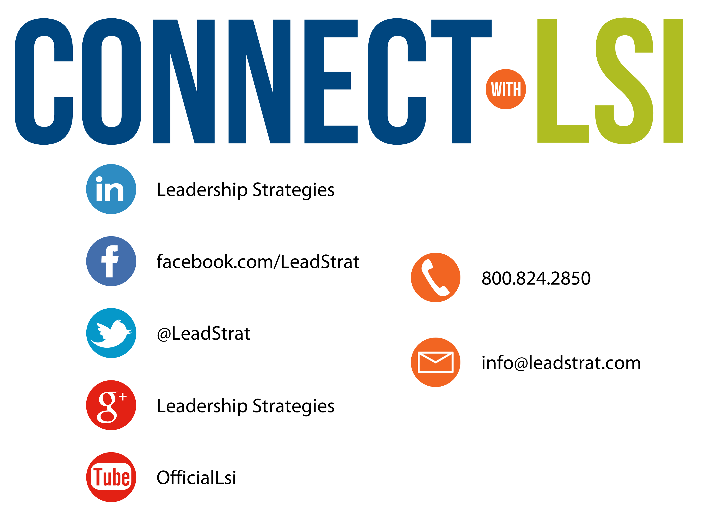


Questions?
etraining@leadstrat.com
800.824.2850
Or, submit your questions for open discussion
on the Linked-In “Leadership Strategies
Facilitation & Leadership Community” Group
Join us on Facebook at
www.Facebook.com/Leadstrat
and Twitter @Leadstrat
Notes:
[THIS SLIDE MAY OR MAY NOT BE INCLUDED →] We fundamentally believe facilitation is a skill that applies in a multitude of situations. We also are confident that in our quest to “share the power of facilitation with the world” that connecting via social media is a way for all of us to collectively share our successes, our challenges and our facilitation work. To “facilitate” that process, we want to ensure you are aware of how we can all stay connected using social media.
How many of you have found many of the skills in the class helpful? [raise your hand] I know that one of the things I did after attending was share what I learned with many of my colleagues. Have some of you already thought about that? [nod your head]
Then ,one request we would like to make of you is to update your “education or classes attended” on your LinkedIn profile. That visibility will help all of us to “share the power” I have been referring to. Any questions? [facilitate the discussion]

