Slide 1

XI. REVIEWING & ASSESSING
Notes:
To improve our consulting skills, Reviewing and Assessing is one of many opportunities to take a full stop and look at things that went well as well as areas for improvement….
Timing: 45 minutes
Flip Charts:
None

Slide 2
Checkpoint
1
2
Define
the Need
Prepare to Execute
Client
Relationship
Management
Review
& Assess
Execute the Project
-
4
3
Ending:
Execute the Project
Next:
Review & Assess
Notes:
Checkpoint….
Review: we have just completed Executing the Project where we addressed……
Preview: next, we want to discuss the last phase of the consulting cycle, Reviewing and Assessing….
Big view: and, that’s important because to capitalize on the key learnings from each engagement we undertake, we want to repeat the successes and identify opportunities for improvement….

Slide 3
The Facilitative Consultant
REVIEWING AND ASSESSING
Review Performance
Establish Recommendations for Improvement
Celebrate the Victory
Send an Engagement Close Letter
Notes:
In this module we will cover the following 4 key points…….let me ask you to think about the last summer Olympics….remember when Michael Phelps swam that last race in which he won his final gold medal?…..as soon as he touched that touch pad, what was the first thing he did?.....yes, that’s right – he looked at the timer….why?.....yes, because he wanted to know how he did – if he beat the world record, his personal best, etc….then, when he got out of the pool, who was the first person he wanted to speak with?....yes, his coach….why his coach?……yes, he wanted to know what he did well and where opportunities were for improvement……

Slide 4

A. Review Performance
Upon project completion, it is important to review and assess performance. The assessment takes many forms.
Project Performance – Were the objectives of the project met?
Individual Performance – How did each individual perform in achieving assigned tasks and deliverables?
Process Performance – Did the solution process work adequately?
-
Manual 11-2
Notes:
So, since we don’t have a time clock or a swimming coach, what will we do as we conclude our projects to improve our performance on future engagements….we will review the following:
Project performance….how well were the project objectives met? Where did we do well? Where might we have done better and how?
Individual performance…..how well did the project team members do?....where did they excel and where were their opportunities for improvement?
Our Solution Process……did our Solution Process work well? What might we do to add/change/delete steps or tasks to make that Solution Process even better on future engagement of this type?
Budget and scheduling…..was the project completed on the estimated budget established as a part of the project? Did the project get completed on schedule? What are the key learning’s regarding project budget and project scheduling?
(Purple) team…..would one of you speak to how you have done a post-project assessment around either of these performance areas….then (red) team, how about you……(facilitate the discussion adding key points for consideration)…..

Slide 5
B. Establish Recommendations for Improvement
Based on the review, identify key recommendations for improvement. Recommendations might include:
Process changes for future projects
Improved estimation guidelines
Personnel development plans
Other types of recommendations that might result:
____________________________________________________________________________________________________________________________________
-
Manual 11-3
Notes:
Next we would want to develop recommendations in several areas….can the (blue) team share approaches any of you have taken regarding recommendation for future projects….other team….(facilitate the discussion)…..

Slide 6

C. Celebrate the Victory
Consider activities such as the following:
Post-project dinner
Awards presentation with mock awards (e.g., “Most Frequently Late to Meetings Award”)
Letters to client project team members highlighting the role they played with copies to supervisors and personnel department
Even for a less successful project, a post-project activity brings closure and energizes the group for the next engagement.
-
Manual 11-4
Notes:
Often times, and especially on larger projects, there is an opportunity to celebrate the successful completion of an important project….do we have any volunteers that can share with us examples you have been a part of……(facilitate the discussion and confirm this key point:) even on projects that are not as successful as others, a post-project activity brings closure to the efforts made.

Slide 7
The Facilitative Consultant
IX. REVIEWING AND ASSESSING
Review Performance
Establish Recommendations for Improvement
Celebrate the Victory
Send an Engagement Close Letter
Notes:
Any questions on Reviewing and Assessing?….[facilitate the discussion]….

Slide 8
D. Send an Engagement Close Letter
An engagement close letter sent to the project sponsor serves several purposes:
Formally closes the project
Documents at a very high level the activities performed and the results achieved or expected
Provides a way to start formally selling the next engagement
Makes it clear that additional work is “on a new ticket” – especially important for fixed price engagements!
-
Manual 11-5
Notes:
A nice “finishing touch” can be the Engagement Close Letter…..for external consultants in particular, one of the key points here is it brings the project to a “formal close” and alerts the client to the fact that future work would be conducted on a different SOW or other proposal…..

Slide 9
D. Send an Engagement Close Letter
What are the ADDITIONAL benefits of sending the engagement close letter?
Manual 11-5
Notes:
[facilitate the discussion; consider using teams]

Slide 10
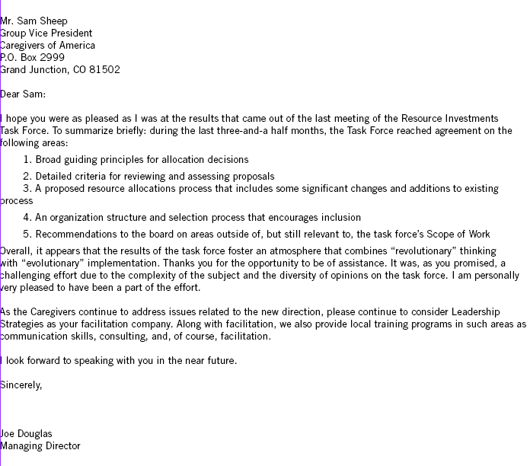
Sample Engagement Close Letter
Manual 11-6
Notes:
Here is a sample Engagement Close Letter…how many of you have used something like this? [raise your hand; facilitate the discussion]…

Slide 11

MODULE REVIEW REVIEWING & ASSESSING

Slide 12
Review
What are the five key areas to review the project performance?
Project performance
Individual performance
Process performance
Budget performance
Schedule performance
-

Slide 13
Review
What are the benefits of identifying recommendations for improvement?
Enhance future efforts
Leverage things that went well
Improve areas that did not go well
-

Slide 14
Review
When are some techniques for celebrating the end of a project, and what are the benefits of “celebrating the victory”?
Rewarding achievements by participants (client and non-client) on the project
A sense of accomplishment
Building relationships for ongoing work with the client
-

Slide 15
Review
What are the benefits of formally closing the project and the risks of not doing this?
Signifies the project is over (statement of work is complete)
Puts your name in front of the client
Communicates to those not on the project the value of the project
-

Slide 16
The Facilitative Consultant
REVIEWING AND ASSESSING
Review Performance
Establish Recommendations for Improvement
Celebrate the Victory
Send an Engagement Close Letter

