Slide 1

X. Executing the project
Notes:
Timing: 75 minutes
Flip Charts:
Meetings
Scope Triangle
Examples of Change
Types of Change
Why People Change?
Addressing Resistance to Change
Resistance and DISC Styles
Recommendations
Checkpoint:
Review: we have just completed Building Consensus where we identified the 3 reasons that people disagree and a 4-step process to guide a group from disagreement to agreement…..
Preview: what we are about to do next is the 3rd stage of the consulting cycle….Executing the Project…..
Big view: and this is important because once we have been awarded the engagement/business we need to have an approach to ensure we satisfy the client needs and we will learn techniques to do that in this stage of the consulting cycle……

Slide 2
The Facilitative Consultant
X. Executing the project
Monitoring the Work Effort
Running Effective Meetings
Management Updates
Project Status Meetings
Data Gathering Sessions
Managing Scope
Managing Change
Managing Change Resistance
Managing Issues
Developing Recommendations
Notes:
The steps to execute the project will depend primarily on the steps in the project plan for the specific consulting engagement you are performing. However, there are a set of best practices common to most engagements.
In this stage of the consulting cycle we have 10 best practices/techniques that can be categorized in 2 broad areas……project management and running meetings……while our intention here is not to provide a course in project management, although those skills are very important to us as consultants, we want to provide techniques in this area to ensure we are keeping the client appraised of project status, building valuable deliverables and responding to issues….in terms of running effective meetings, how many of you have attended meetings that were not a very good use of your time (raise your hand)…..yes, I have as well…..that wasn’t a really good use of our time, was it (nod your head no)……well, let’s provide you a structure for meetings that will avoid those types of meetings…..so let’s get started…..

Slide 3

MONITORING THE WORK EFFORT

Slide 4
A. Monitoring the Work Effort
Monitoring Steps
The work plan will dictate the tasks to be performed, by whom, and by what deadline. (Specific deliverables may or may not have been assigned to each task.)
As a consultant, it is critical that you ensure that each task achieves its desired result. As hours are expanded on tasks, corresponding results must be accomplished in order to achieve the overall project objectives on time and within budget.
-
Manual
10-2
Notes:
Once the project commences, one of the key areas we must be constantly vigilant of is the work effort undertaken as a part of our projects…to do that we must monitor the work that is being done……based on earlier work during the proposal stage and the additional work completed during the Preparing to Execute stage, we have a detailed work plan……(green) team, can you tell me what are the key components of the work plan……good, it includes the tasks, the timing and the effort of the components of the project…….so this work plan dictates what will be done, who will do it and when…….
As a consultant, we must take responsibility to ensure each task achieves its desired results and this requires time, focus and effort on the part of us as consultants…….as with many other things in life….”life is in the details”…….

Slide 5
A. Monitoring the Work Effort
Track project progress utilizing a project management tool or a simple spreadsheet.
Report results as described in the next sub-section.
-
Manual
10-2
Notes:
There are a multitude of project management methods from spreadsheets to more elaborate software tools…..how many of you are using a project management tool on the project you work on today?.....great, (name) can you tell us which tool you are using and how it works for you and your clients?...(facilitate a brief discussion)……..
We must also report status of the project regularly, both through formal documents and status meetings as well as informally to continually manage the Expectation Gap we discussed earlier in the class…….

Slide 6

B. Running Effective Meetings
The communications plan will indicate the types and frequency of meetings and will typically include at least the following:
Management Updates
Project Status Meetings
Data Gathering Sessions
-
Manual
10-3
Notes:
Remember our friend, the Communications Plan, from the Preparing to Execute module…..this plan outlines the key ways in which we will communicate with the defined audiences, their information needs, the vehicle with which we will communicate, who is responsible for that communication and when it will occur…….
As far as meetings…….there are 3 categories of meetings….Management Updates, Project Status Meetings and Data Gathering Sessions……(red) team, get us started with what you think should happen in Management Updates…….(facilitate the discussion making other key points as necessary around the 3 meeting types….NOTE: conclude with meetings essentially fall into Status Meetings and Working Meetings to transition to the next slide……..

Slide 7
B. Running Effective Meetings
Understanding Meeting Types
A. Status Meetings (Leader-focused) | B. Working Meetings (Team-focused)
Status Reporting | Problem Solving
Issue Identification | Issue Resolution
Alternatives Identification | Alternatives Analysis
Idea Generation | Idea Analysis
Decision Reporting | Decision Making
* Some decisions can effectively be made in a status meeting, especially when the decision is minor or consensus is reached after little discussion.
-
Manual
10-3
Notes:
Let’s take a look at the 2 basic types of meetings…..on the one hand we have meeting that are leader-focused…they are primarily 1-way type of communication and they include (read the slide points)…on the other hand, there are team-focused meetings that we refer to as Working Meetings which are typically 2-way type communication….(cover the points on the slide)………..(facilitate a discussion on the meetings participants have experienced on their projects and lead to the next slide)………

Slide 8
B. Running Effective Meetings
Which of the two meeting types generally require the lesser amount of time?
Which of the meeting types generally require fewer people?
What is the most common problem that occurs in status meetings?
What is the most common problem that occurs in working meetings?
When you have done your planning (i.e., set clear objectives, assigned responsibilities, accounted for contingencies, etc.), which meeting type will likely occur less frequently than if you hadn’t done your planning?
-
Manual
10-4
Notes:
Let’s try another team activity…….
Purpose: in our teams, let’s see what we think are some of the key differentiations between Status Meetings and Working Meetings by responding to these questions……
Directions: first, let’s select a new team leader……now, what I would like to do is put 3 minutes on the clock and ask each team to provide their answers to each of the 4 questions on this slide……
Exceptions: none
Questions….before we begin, are there any questions…..OK then….
Starting question: as you think about the meetings that take place during our client projects…..as you imagine the two types of meetings…status and working……think about them across the dimensions we are asking about on this slide……(start the clock….when the clock runs out ask each team their answer….start each questions by beginning with a different team and facilitate the discussion adding key points as necessary……

Slide 9
B. Running Effective Meetings
Which of the two meeting types generally require the lesser amount of time?
Which of the meeting types generally require fewer people?
What is the most common problem that occurs in status meetings?
What is the most common problem that occurs in working meetings?
When you have done your planning (i.e., set clear objectives, assigned responsibilities, accounted for contingencies, etc.), which meeting type will likely occur less frequently than if you hadn’t done your planning?
-
Manual
10-4
Notes:
For the review:
NOTES:
Question 1: status meetings require less time….they are 1 way reporting of items including: plans for the next period, accomplishments of the last period, ahead/behind budget and schedule and key issue identification…..
Question 2: working meetings generally require fewer people…people who understand the topic, have a vested interest in the outcome and have been empowered to make decisions….not just everyone’s the right ones
Question 3: most common problems with status meetings is they turn into working meetings…..we work on issues without the right people and sometimes the wrong expertise in the room…..
Question 4: most common problem with working meetings is they wander…they lose focus…..we will talk more about that in a few minutes…….
Question 5: when we plan our work well we typically have less working meetings…..an example where this does not happen is when we do not do an adequate job during the design stage of an IT project….then when we get to implementation….there will be a need to have meetings to get the details addressed…..avoid this with proper project milestones and checkpoints…….

Slide 10
B. Running Effective Meetings
Too Many Meetings?
Too many working meetings can be a sign of:
- Poor Planning or Lack of Control
Too many status meetings can be a sign of:
- Poor Execution or Lack of Trust
-
Manual
10-4
Notes:
Have any of you ever felt that there were too many meetings on your projects?....(raise you hand)…..and ever thought those meetings were not a very good use of your time…(nod your head yes)…I am sure most of us have had the experience at one time or another…..to look at the cause of too many meetings we can, once again, separate too many working meetings from too many status meetings…….(red) team, what can we do to address the first case of too many working meetings…..(facilitate the discussion and then repeat with too many status meetings)…….

Slide 11
B. Running Effective Meetings
Qualities of an Effective Meeting
The meeting purpose is clearly stated from the beginning.
“The purpose of this meeting is… When we finish, we would like to walk away with…”
The meeting agenda is established after setting the meeting objective and time limits are set.
a. For working meetings, make sure the agenda
is structured to allow people to think through
the issue completely.
-
Manual
10-5
Notes:
Let’s take a look at a quick primer on the qualities of an effective meetings….let’s do this using a read around and we will start with (name)…..conduct the read around inserting key points on several of the key points…..e.g.. PURPOSE sets the stage…..who are the right people…agenda provided to participants in advance……for this and the next 6 slides……

Slide 12
B. Running Effective Meetings
The right people are at the meeting.
  For a status meeting: those who need to know
  or their representatives
  For a working meeting: those who understand
  the issue, have a significant stake in the
  outcome, and are empowered to make a
  decision or recommendation
The meeting attendees understand the meeting purpose and agenda prior to the meeting.
-
Manual
10-5

Slide 13
B. Running Effective Meetings
The right information is available at the meeting. People are instructed to bring with them the information they will need.
a. For working meetings, preliminary analysis is
performed outside the session to use as a
starting point in the meeting.
Ground rules are established by the meeting leader and respected by the participants.
-
Manual
10-5

Slide 14
B. Running Effective Meetings
The meeting stays on track and at the proper level of detail.
a. For a status meeting: status is reviewed
briefly, issues are identified (not resolved),
indirect issues are tabled.
b. For a working meeting: only the issue at hand
is permitted to be discussed.
For working meetings, the session is facilitated, not led.
-
Manual
10-6

Slide 15
B. Running Effective Meetings
The facilitator should:
Use flip charts or boards to record comments and keep the group focused.
Encourage full participation and fresh ideas.
Use questions, not statements, to probe and challenge.
Use focusing techniques to keep the discussion focused and on track.
Use consensus building techniques to facilitate decision making.
Detect and resolve dysfunctional behavior.
Maintain a perception of neutrality to avoid abusing the facilitation role.
(Consider using an outside facilitator for critical working meetings.)
-
Manual
10-6

Slide 16
B. Running Effective Meetings
A discussion time limit (e.g., the five-minute rule) is set and followed to ensure that no issue dominates the meeting.
During the meeting, issues that arise that are inappropriate for discussion are deferred to an issues list; decisions made and actions to be taken are documented.
Prior to ending the meeting, all issues, decisions, and actions are reviewed and appropriate action designated.
Meeting minutes can be bullet points organized by: decisions, actions, issues, and analysis.
-
Manual
10-7

Slide 17

C. Management Updates
To avoid the “expectations gap,” the management team must be kept up-to-date.
Who should be updated and how frequently will depend on the project as well as the DISC styles of the management team.
-
Manual
10-8
Notes:
We have discussed the importance of both formal and informal methods for avoiding the Expectation Gap……think about how we might adjust our techniques for the 4 DISC styles…….for the how often would you meet (facilitate the discussion and realize “it depends” will be a “clear” response and the sharing of some good and/or bad experiences is helpful here)…….

Slide 18
C. Management Updates
Sample
Assume that you are the co-project leader, along with a client co-project leader, for a three-month project that has a project organization similar to the sample project organization chart presented in section 7. How often would you suggest meeting with the following?
 | How often?
Steering Committee (5 members)
Project Sponsor
Client Project Leader
-
Manual
10-8
Notes:
We have discussed the importance of both formal and informal methods for avoiding the Expectation Gap……think about how we might adjust our techniques for the 4 DISC styles…….for the how often would you meet (facilitate the discussion and realize “it depends” will be a “clear” response and the sharing of some good and/or bad experiences is helpful here)…….

Slide 19
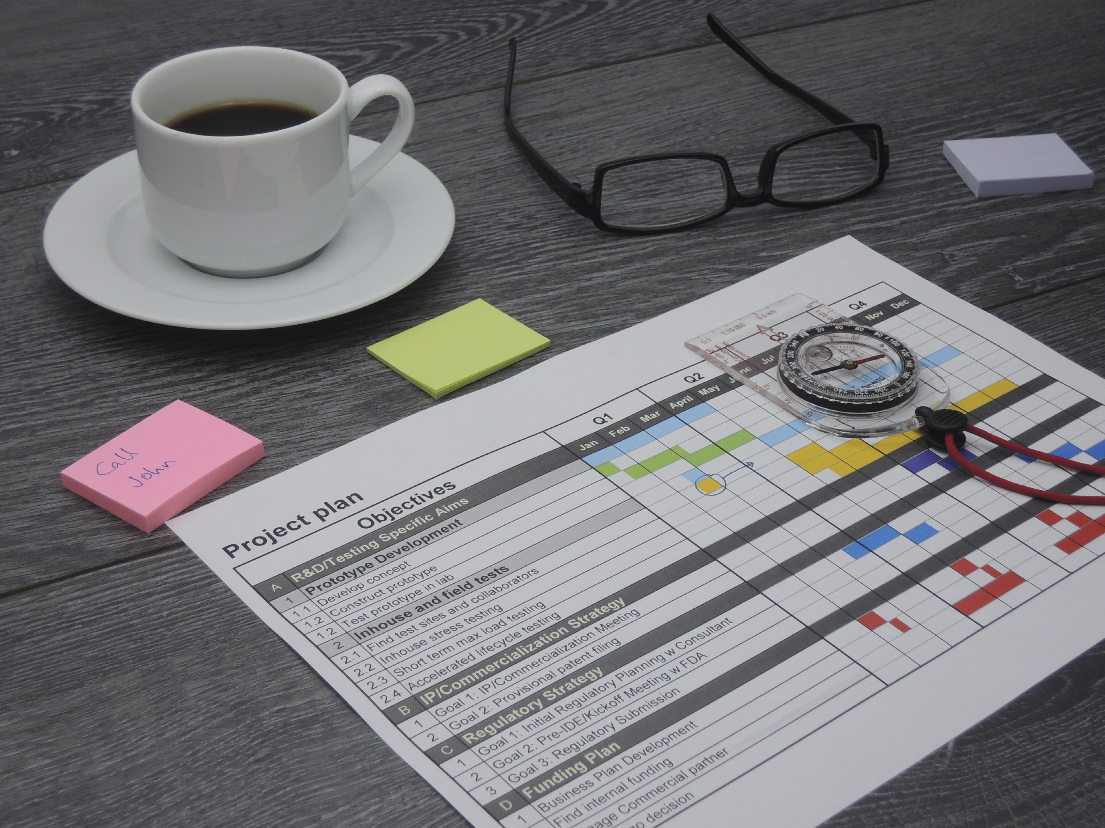
PROJECT STATUS MEETINGS

Slide 20
D. Project Status Meetings
Project status meetings can be long and laborious. Utilize effective meeting techniques to keep them focused and on track.
Prior to the meeting, prepare or request an updated work plan that identifies the following for each task:
    Current status (not started, in progress, completed)
    Number of hours expended
    Number of hours needed to complete
    Hours forecasted (2-3)
    Hours budgeted (one-time entry)
    Hours variance (4-5)
    Anticipated completion date
    Planned completion date (one-time entry)
    Time variance (7-8)
    Status of task deliverable
-
Manual
10-9
Notes:
Status meetings are again an important part of our jobs in the consulting domain…….some of the best practices I have seen have a multi-part status report that includes at least the following:
A high level bar chart with clear, crisp reporting of ahead/behind both budget and schedule for the project
A list of the key plans for the next period….let’s assume our reporting period is every other week…..
A list of accomplishments for the last period…note a key way look here is to compare last period’s key plans to this period’s accomplishments
A list of key issues with any issues that require immediate attention of the Project Sponsor highlighted….or those issues for which there is no known solution yet……..
Then, conduct a quick review of the slide……
Note that of the 10 items, only the five that are bolded require updating for each status meeting. The other five are either fixed or calculated.

Slide 21
D. Project Status Meetings
Consider the following flow for the meeting:
    Review project objectives. (Keep this fresh!)
    Review tasks planned to be completed.
    (Identify problems.)
    Identify issues outstanding and methods for resolution. (Avoid wasting meeting time trying to resolve them.)
    Review overall budget and schedule variances.
    Review plans for next period.
    Discuss team morale, communications, etc.
-
Manual
10-10
Notes:
[discuss key points on slide facilitating the discussion with the group]

Slide 22

DATA GATHERING SESSIONS

Slide 23
E. Data Gathering Sessions
Facilitated data gathering sessions are an excellent tool for gathering information quickly where buy-in is needed from a group of people.
Facilitated Session Checklist
Distribute a memo indicating the
session purpose, agenda, and
suggested documents to bring.
Suggest that participants arrive five to ten minutes early so session can start on time.
Arrive early enough in the room to have flip charts set up and ready to go long before participants arrive.
-
Manual
10-11
Notes:
The next 5 slides are another opportunity to have a read around and to add some key points highlighting key areas….such as:
Preparing in advance…the Inform, Excite Empower and Involve…..
Starting questions are those used to open a dialogue and should create an image of the answer in the minds of the participants…..
The 3 Parking Boards and their uses…..
Using a checkpoint to move from one agenda item to another for clear transitions and focus
Using the “Power of the Pen” to ensure there is ownership in the session for impact……

Slide 24
E. Data Gathering Sessions
Record the session objective, agenda, and ground rules on the flip charts; also record the title for your first discussion item.
Prepare your opening words; attempt to inform about the session objective, excite about the benefits, involve the participants as early as possible, and empower them by telling them the important role they are being asked to play (See item 7.)
-
Manual
10-11
Notes:
[read around and facilitate the discussion]

Slide 25
E. Data Gathering Sessions
Prepare the question you will ask and the example you will give, for each of your agenda items. (With your questions – make them visual with examples – you start, let them finish.)
Give a two-minute warning to participants so you can start on time.
Start with your opening words:
  Show the session objective. (Inform)
  Explain the benefits of the project. (Excite)
  Let them know management is looking to them for answers. (Empower)
  Ask them if there are particular items they want to make sure are covered. (Involve)
-
Manual
10-11
Notes:
[read around and facilitate the discussion]

Slide 26
E. Data Gathering Sessions
For each agenda item:
  Give a checkpoint: review what you just did, tell them what you are about to do, and explain how the next agenda item contributes to the session objective.
  Ask your starting question; be sure to create a vivid image.
  Use brainstorming, listing, and round-robins as appropriate.
  Record what is said as soon as it is said. (Write first, discuss second.) Record it in their words - not yours.
  Ask questions – “Why is that important?”… “What else?”… “What about…?” – as appropriate.
  Get consensus before moving on to the next agenda item.
-
Manual
10-12
Notes:
[read around and facilitate the discussion]

Slide 27
E. Data Gathering Sessions
If tangential topics come up, ask, “That’s an interesting point. Can we put that on the issues list?” Then, move on.
Use issues lists, action lists, and decision lists to maintain control.
When all agenda items have been covered, close the session by reviewing what was done, thanking the participants reminding them of the next step, and formally ending the session.
-
Manual
10-13
Notes:
[read around and facilitate the discussion]

Slide 28
E. Data Gathering Sessions
A facilitative consultant recognizes facilitation as a powerful tool for helping people reach better decisions, often faster, with much higher levels of buy-in and commitment.
Manual
10-13
Notes:
The key is for the Facilitative Consultant to use facilitation skills that get the correctness of the decision (the Right Decision) and ensure the commitment to that decision (the Commitment to the Decision) is as high as possible to improve the Effectiveness of that Decision…the impact of the decision

Slide 29

F. Managing Scope
Many projects fail because
scope is not tightly controlled.
What starts out as a simple
review of order entry may
creep into warehousing,
shipping and receiving, etc.
“Scope creep” is the name
given to this pesky
tendency that projects have.
Define a scope change process.
Use the “Yes, and…” technique.
$
Resources
Time
Scope
-
Manual
10-14
Notes:
Let’s reach back to the elements that create a clear definition of the scope of our projects….(green) team, get me started with 1 of those items…..go around to other teams to create the 3 items: BAD diagram, key deliverables list and the task list……..
So, for example, if scope increases (extend the scope line of the triangle), then either time has to increase, or resources have to increase (or both). Either way, the area of the triangle, which is the resource consumption or costs, also must increase.
Another great opportunity to help with change control is to have a discussion with the client….before the first change is identified….so include this as a part of the Preparing to Execute and/or the Project Kickoff…….the Scope Triangle…in other words, using this triangle, any 2 sides can be identified by someone and then, by definition of a triangle, the 3rd side is defined for us……this is a great way to help with client understand future requests for getting it done earlier or adding another “simple” feature or function……or removing a resource from the project due to another business commitment……
Once we have defined scope and the client has agreed, we earlier talked about the need to have a change control process so that any/all scope changes are quickly and clearly documented and signed-off on by the client…….
With all of these things done…..in advance….when that request comes in for a …..”can you get this done a month earlier than we had planned?”....we do not say, no…..we say, “Yes and should we eliminate a few requirements or add some resources to make that new date?”……OR

Slide 30
F. Managing Scope
Many projects fail because
scope is not tightly controlled.
What starts out as a simple
review of order entry may
creep into warehousing,
shipping and receiving, etc.
“Scope creep” is the name
given to this pesky
tendency that projects have.
Define a scope change process.
Use the “Yes, and…” technique.
$
Resources
Time
Scope
-
Manual
10-14
Notes:
The request is…”Can we add a few new reports we now need?”…..you may respond….”Yes, and would we like to move the end date out a few weeks or add additional reporting resources?”…….we refer to this as the YES AND techniques and our experience is that clients much prefer that to the “No, we can’t do that…..”….as consultants we want to bring solutions and options to our clients……..
Finally, let’s think about the last project we were a part of…we may have been the consultant…a project team member or even part of the client team….think about the things we could have done …..the steps we could have taken…..the preemptive actions we can use in the future……what might some of the techniques be for avoiding scope creep?......(facilitate the discussion and have participants write in their participant manuals……

Slide 31
F. Managing Scope
Techniques for Avoiding Scope Creep
________________________________________
________________________________________
________________________________________
________________________________________
________________________________________
________________________________________
________________________________________
-
Manual
10-14
Notes:
[use a round robin or teams to facilitate a discussion about techniques the participants can use to manage the scope on their engagements]

Slide 32
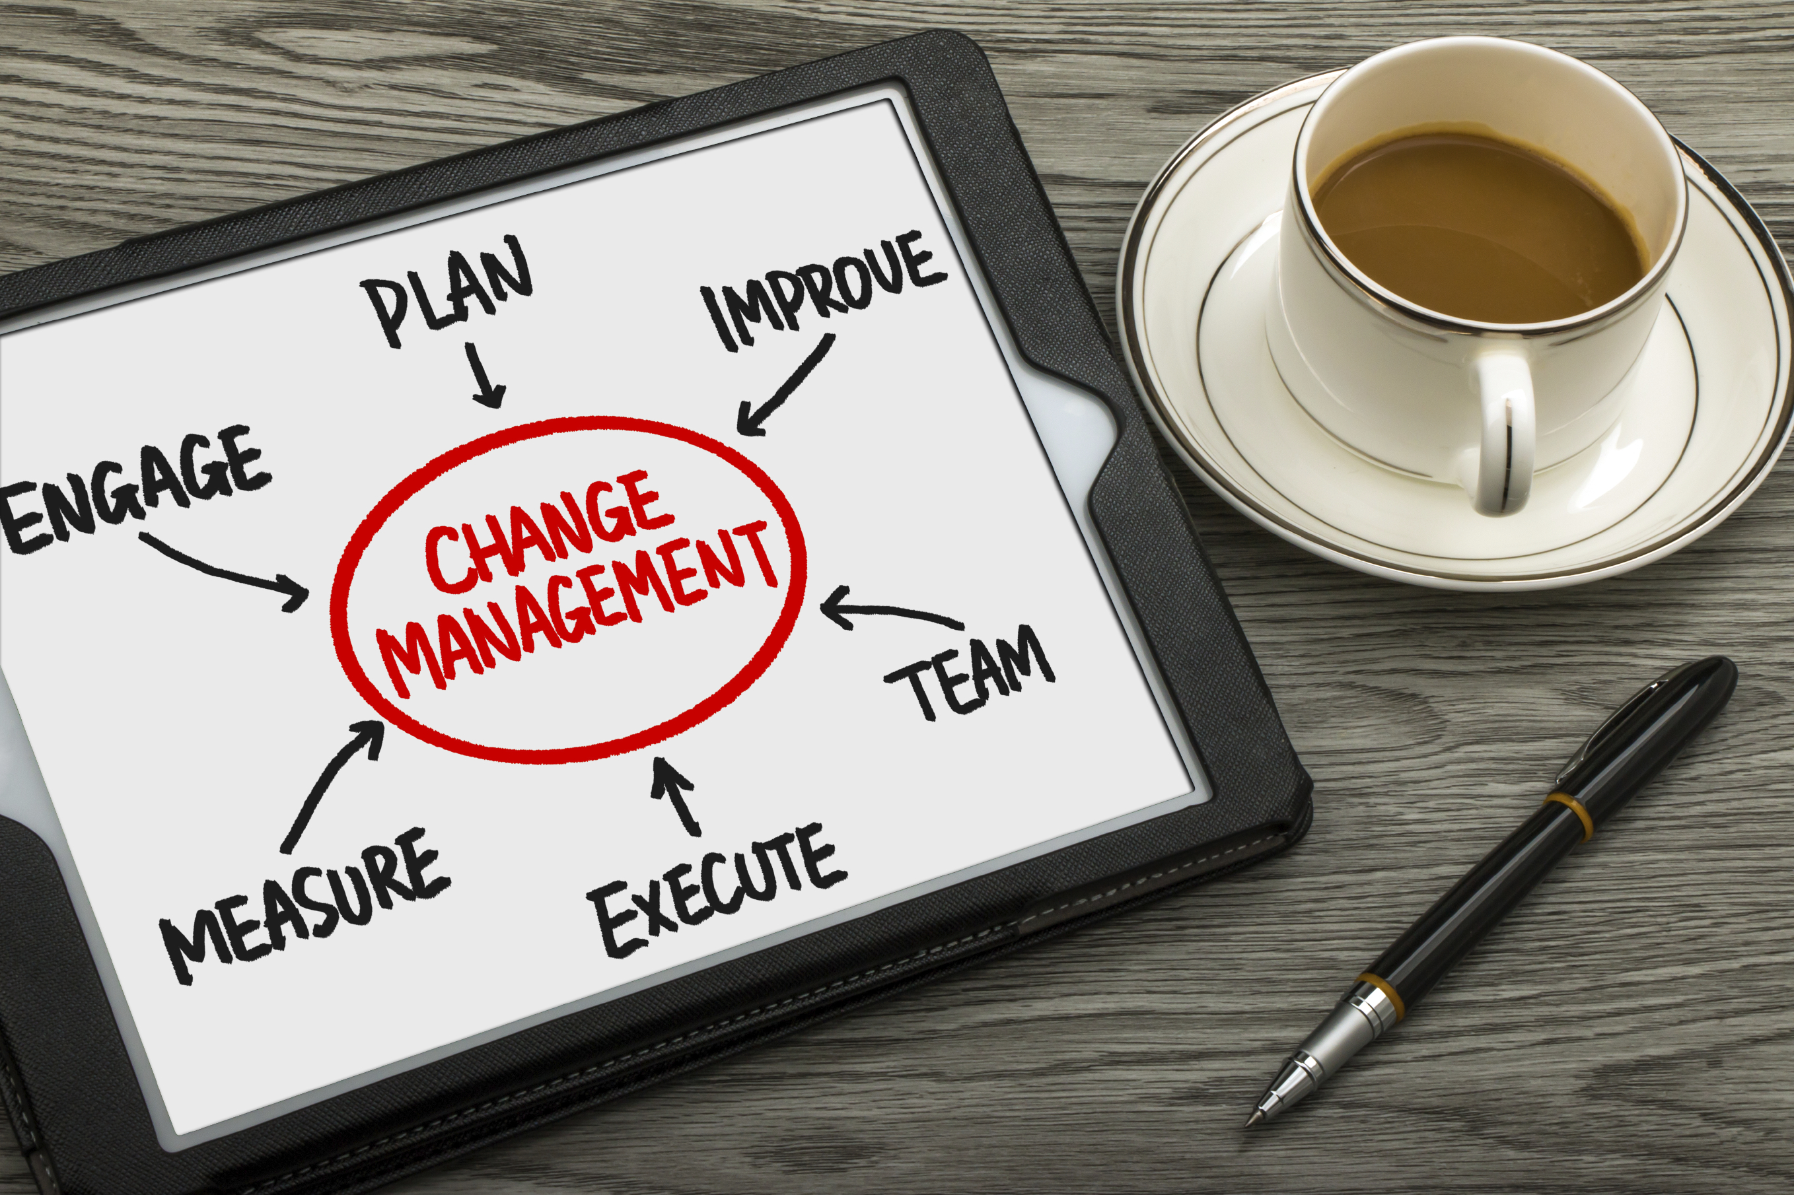
MANAGING CHANGE

Slide 33
G. Managing Change
“We should put our foot down. We should say that we will only do business with clients who don’t change their requirements. We will work with subject matter experts who say what they mean and mean what they say. We will insist that client personnel guarantee they will stay with the project until the end. And, we will not, under any conditions, accept any surprises.”
Dream on… In the real world, change occurs - and occurs often.
-
Manual
10-15
Notes:
(name), would you please read the slide or the first paragraph on page 10-15 of our manual……OK, that’s pretty firm isn’t it?.....also unrealistic, isn’t it….about the only thing we can promise one another is that the future will be different from the past of the present………can we do a round robin by teams and think about a project you were a part of where there was a change that was disruptive?........(blue) team can you get us started……….(facilitate the discussion adding key points as necessary)……some of the disruptive changes in the past…..recent and beyond…..
Mainframe to mini to pc……to tablet to mobile computing
Railroads to air….first for people then for cargo…..can you imagine the folks in the railroad BOD meeting saying something like….”flying”? come on nobody is going to do something so dangerous”….or a few years later….”Passengers OK but cargo….they can’t get that much weight on an airplane…there is nothing to worry about?.......
Cell phones and how 3rd world countries will never have to string all that wire……..
iPod to iPhone…..etc.

Slide 34
G. Managing Change
Consider a project you were on when change was disruptive. What was the change, the root cause, and the impact?
The Change
Root Cause
Impact
-
Manual
10-15
Notes:
Discuss the Change….the Root Cause or why of that change and the Impact…..along the lines of:
Change: moving from Walkman to iPod
Root cause: a visionary as well as the miniaturization of chips, longer battery life and latent needs
Impact: revolutionized the music business……1 of many businesses Apple has so influenced…others include iPad, retail stores, iPhone --- Apple reinvents the phone……

Slide 35
G. Managing Change
Typical Change Issues
Clients typically request a project change in order for them to better meet their perceived needs or to respond to the changing conditions of the business. Often, change is necessary and beneficial.
Our ability to effectively address change is a gift we give to our clients.
-
Manual
10-16
Notes:
As we discussed a prior module, we have to manage scope and avoid scope creep….at the same time, often we can accommodate those little changes that occur in all projects/engagements….in those cases, we may chose to notify or inform the client of that change and, when the change requires no additional effort or work, those changes are a “gift” we provide to our clients……
Let’s count off in pairs……(count off 1-2-1-2-etc.) and set my clock to 3 minutes for each pair to come up with a change in a project that was beneficial and then what the impact to that project would have been if the change had not occurred….if you cannot think of one for a project you have been a part of please feel free to identify one from a book you have read, an article or any other situation……(after the clock is up facilitate the discussion adding where necessary to highlight key points……)….let’s fill in the table on page 10-15 with one of these examples we just discussed……..and then let’s also complete one for change

Slide 36
G. Managing Change
When Has Change Been Beneficial?
What was the change and the root cause? What was the impact? What would the impact have been if the change had NOT occurred?
The Change
Root Cause
Impact
-
Manual
10-16
Notes:
(See prior slide notes)

Slide 37
G. Managing Change
Best Practices for Addressing Change
With your teams, identify best practices in the following areas:
Change You Can Prevent | How to Prevent
Change You Can Anticipate | How to Anticipate
Change You Can’t Anticipate | How to Minimize the Impact
Change That Is Beneficial | How to Optimize the Impact
Manual
10-17
Notes:
Let’s do one last exercise around change and use our teams……first let’s select a new team leader……and then I would like to set the clock for 8 minutes and have each team complete a few examples for each of the following 4 areas found in your participant's manual…those areas are:
Change you can prevent
Change you can anticipate
Change you can’t anticipate
Change that is beneficial
When the clock is up move from team-to-team to share, starting at a different team each time….and add key points during the discussion…….

Slide 38

MANAGING CHANGE RESISTANCE

Slide 39
H. Managing Change Resistance
Resistance to change comes in many forms. An understanding of the four reasons people change helps in determining methods for addressing resistance.
Why Do People Change?
Higher Vision
Desired Outcome
Fear of Consequences
Pain
-
Manual
10-19
Notes:
How many of us have already worked on client engagements?....(raise your hand)…….and, for those of you that have, was there a time on a project or two that there was a change necessary yet the client was reluctant or resisted that change…..(nod your head yes)…..sure, it seems to be natural in many situations for people to be hesitant to move forward with change…….understanding the various “flavors” that resistance may present itself and knowing many of the compelling reasons for change will be very useful for those of us providing consulting services to our clients…..(purple) team, can you share with us the example you were thinking of when you raised your hands before…..(facilitate the discussion)……let’s take a look at 4 key reasons that drive people to change…..
Higher vision……can anyone think of an example?....(name), share that with us….examples to consider would be Gates and Allen with the PC…a computer on every desk…..Jobs with the mouse or the music revolution
Desired outcome……anyone have an example of this?........OK, what about an individual that wants to improve their fitness, lose weight or stop a bad habit such as smoking……
Fear of consequences……(have another participant share)……again, we can go back to the person that wants to stop smoking….he/she may fear poor health, cancer, etc…..
Pain……(another potential participant share)…..anybody ever lost a filling or had a bad toothache….that forces change surfaced by pain……

Slide 40
H. Managing Change Resistance
General Formula for Addressing Resistance
Much like dealing with dysfunctional behavior in a facilitated meeting, the recommended method for addressing change resistance is:
APPROACH PRIVATELY
  Meet with the person one-on-one or, perhaps, with one additional person.
EMPATHIZE WITH THE SYMPTOM
  Praise the effort put forth, the level of participation, the quality of input, or anything else that is both sincere and worthwhile.
-
Manual
10-20
Notes:
Let’s take a look at an approach we find very helpful in addressing that resistance to change…..(name) can you read that first step……that’s right approach privately or generally…….if an individual or a few individuals are pushing back, best to deal with that privately…..if a larger group a group discussion might be appropriate….again, it depends…..that next step is very important…empathize with the symptom……by showing empathy we are showing our concerns, expressing our understanding and inviting an individual or individuals to share their concerns or resistance with us….it is a means to “open the lines of communications”…..

Slide 41
H. Managing Change Resistance
ADDRESS THE ROOT CAUSE
  Identify the critical issue and causes for it. AVOID saying, “But…”
GET AGREEMENT ON A SOLUTION
  Seek a mutually-agreeable approach to addressing the symptom and root cause.
-
Manual
10-20
Notes:
then we want to address the root cause…..they real reason or “why” of the push back….and then finally….get agreement on a solution…….[facilitate a discussion demonstrating this approach with a change a team can identify]

Slide 42
H. Managing Change Resistance
Resistance by DISC Type
What are some of the likely forms of resistance that would come from each of the DISC types? What is a response that a consultant might make based on the general formula?
 | Likely Form of Resistance | Suggested Response
High D
High I
High S
High C
-
Manual
10-21
Notes:
Often the expression of resistance will be, once again, an expression of our communication style……how many of you are D’s?.....what is the form of resistance we might expect from one of you….yes, it will be clear and sometimes, in your face…..for our D’s, let’s remember less is more and focus on the benefits………how about one of our I’s….what does resistance look like from you…….OK, talk around it, ramble with stories, etc….our advice with those Hi I’s is again, let them sell themselves….ask them about it before it is in its final format, gain their buy-in and they will help you “sell it”….what about our S’…….good, gain the support of the team that surrounds them, emphasize the benefits to the team or organization and provide them lots of assurances about how well thought through it is…….how about our C’s……how will we experience resistance from one of you…..thank you…..it’s about the facts, the data, the implementation plan…….with our Hi C’s we want to ensure it is well justified, well documented and well thought through……..

Slide 43

I. Managing Issues
Track all issues through to a resolution.
In defining the issue, strive to identify the root causes.
Use consensus-building techniques when disagreements occur. (See the “Issue Resolution” solution process.)
Know when to go to a higher source for a resolution.
-
Manual
10-22
Notes:
Issues….another one of those items great consultants and project managers are both familiar with and have a process for not only identifying them but for isolating assumptions, developing alternatives and driving to decisions or resolution…….our clients look to us to track the issues that arise from beginning to end……remember our friend SSR-ing for problem statements….well once again we want to clearly differentiate a symptom of an issue…..what do we know about the issue?……from the root cause….or the reason the issue exists……often in the evaluation of alternatives to solve issues we will call on our consensus building techniques we discussed earlier…….(NOTE: time permitting, consider some backward buildup on SSR-ing and Consensus)…….

Slide 44
I. Managing Issues
What is the potential downside of always going to a higher source to resolve issues?
Manual
10-22
Notes:
Fill in the blank in manual

Slide 45

DEVELOPING RECOMMENDATIONS

Slide 46
J. Developing Recommendations
[ Finding ] | FACT BASED observation about the environment (supported by numbers)
[ Conclusion ] | IMPACT of the observation on the organization
[ Recommended Action ] | Specific ACTIVITY to address the impact, with anticipated internal and external costs
[ Benefit ] | QUANTIFIED advantage to the organization of implementing the recommendation
[ Risk ] | POTENTIAL downside or obstacle that could impair the achievement of the recommendation
-
Manual
10-23
Notes:
While developing and presenting recommendation may sound easy, we can separate ourselves even further from presenting these in a well thought out, logical format……we find that our clients prefer something that is crisp, concise and easy to understand……to accomplish this we find the format outlined on this slide is very straightforward……(review the five rows…..definitions, etc.)……………..so (red) team, get us started with what we have to do as a part of the engagement to develop our findings……good, data analysis, interviews, and looking at where the facts may be found…….(green) team, what about the conclusion sections……yes we look at the facts from our findings and then assess the impact that is having within the client’s business…this takes some real think time, as we look at opportunities for our client…..(blue) team, what about recommendations…..good, here we are presenting the specific actions or steps that will address the impact identified above with any costs…both internal and external costs……….(purple) team, what about benefits…….OK, here we are trying to identify measureable impacts of the recommendations or the opportunities that exist for the client…….finally, let me ask the group, what about risks?......what are these and why would we want to address these as a part of presenting our recommendations……..let’s take a look at a specific example on the next slide……

Slide 47
J. Developing Recommendations
SAMPLE
Finding | Conclusion
Over 50% of the positions advertised in the paper were filled by in-house people. Our quarterly advertising expenditures averaged $30,000. | The policy requiring that positions be posted in-house and advertised in the newspaper simultaneously is resulting in wasted dollars.
Recommended Action Change the opening advertisement policy to require outside advertising only if the position is not filled within 45 days by a qualified in-house person. This recommendation is anticipated to require four internal hours of research and policy development and zero out-of-pocket costs.
Benefit Based on data from the past six months, changing this policy should result in a 30 to 35% reduction in advertising – a savings of approximately $9,000 per quarter.
Risks The delay in advertising an open position could result in a delay of finding candidates and leave an opening unfilled for a longer duration of time.
-
Manual
10-23
Notes:
(Review the slide – use read-around)
Which section would be of greatest interest to Ds, Is, Ss, and Cs?
D – recommended action
I – benefit
S – conclusion
C – risk/finding

Slide 48

MODULE REVIEW
EXECUTING THE PROJECT

Slide 49
Review
What are the key differences between a status meeting and a working meeting?
Status meeting = leader focused and one-way communication
Working meeting = team focused and two-way communication
-

Slide 50
Review
What are some of the key frameworks of an effective meeting?
Clear purpose
Agenda
Right people
Right information
Ground rules
Focus/level of detail
Working meetings facilitated
Discussion time limit
Issues/Decisions and Actions
Close
Minutes
-
Notes:
The meeting purpose is clearly stated from the beginning
The agenda is established after setting the objective and time limits are set
The right people are at the meeting
Attendees understand the meeting purpose and objectives prior to the meeting
The right information is available at the meeting
Ground rules are established by the meeting leader and respected by the participants
The meeting stays on track and at the proper level of detail
Working meetings are facilitated, not led
A discussion time limit is set and followed
Issues are deferred to the Issues List and Decisions and Actions are documented
Prior to ending the meeting, all issues, decisions, and actions are reviewed and appropriate action designated
Meeting minutes can be bullet points organized by: Decisions, Actions, Issues, and Analysis

Slide 51
Review
What are the three key components in managing a project?
Scope
Time
Resources
-

Slide 52
Review
A client wants the project to be completed in two weeks earlier than the project plan depicts. How would you respond to that request?
Avoid telling a client “no.” Instead, use the “yes and….” technique. In this case:
  “Yes, we can complete the project earlier, and should we reduce scope or add resources?”
-

Slide 53
Review
What are the types of changes that may occur?
Those that can be anticipated
Those that cannot be anticipated
Those that are beneficial
Those that can be prevented
-

Slide 54
Review
What are the four key reasons that people change?
Higher vision
Desired outcome
Fear of consequences
Pain
-

Slide 55
Review
What is the four-step process for managing change?
Approach privately or generally
Empathize with the symptom
Address the root cause
Get agreement on a solution
-

Slide 56
Review
What are the five steps in developing and presenting recommendations?
Finding
Conclusion
Recommendation
Benefit
Risks
-

Slide 57
The Facilitative Consultant
Executing the project
Monitoring the Work Effort
Running Effective Meetings
Management Updates
Project Status Meetings
Data Gathering Sessions
Managing Scope
Managing Change
Managing Change Resistance
Managing Issues
Developing Recommendations
Notes:
Any questions on the techniques or best practices discussed?.....[facilitate the discussion]…….

