Slide 1
Facilitating Virtual Meetings Please print / have your workbook for the session
Notes:
IMPORTANT NOTE:
Set up the telephone by using Live Meeting Audio and the PIN for organizer is 3651068
Remind people about mute/unmute on PHONE is *6 – it toggles

Slide 2
Virtual Meetings
Session I
Virtual Meetings Introduction
Live Meeting Feature Intro/Review
Virtual Meetings Vision

Slide 3

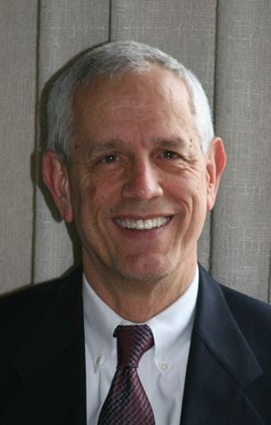
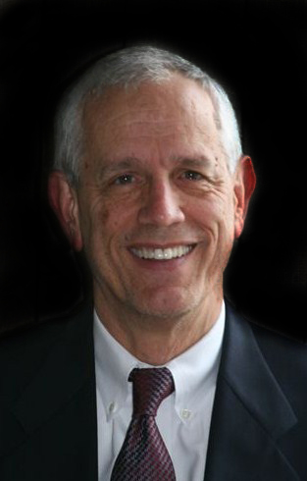
I. Getting Started
Moderator
Facilitator
Richard Smith, CMF Principal Leadership Strategies

Slide 4
A1. Our Webinar Facilitator
Richard Smith, CMF
rsmith@leadstrat.com
Has led the facilitation team within Leadership Strategies including our full-time, core and the NFDB (National Facilitator Database) for over five years.
One of eleven Certified Master Facilitator’s in the world.
Executive with software companies leading sales, services, training and support functions for over fifteen years
Consultant with Accenture focusing on large systems projects and organizational development/change management practice for over eight years.
-

Slide 5
A2. Who is Leadership Strategies?
The leading provider of facilitators and facilitation-related training in the U.S.
Founded in 1992; headquarters in Atlanta, GA
Over 500 facilitators under contract through the National Facilitator Database (www.nfdb.com)
Best known courses:
Masterful Meetings
The Effective Facilitator
The Effective Consultant
Public classes in Atlanta, Boston, Chicago, Dallas, Denver, Los Angeles, New York, Sydney, Toronto, Washington, DC.
-

Slide 6
A3. Course Objectives
Identify Meeting problems and strategies.
Learn the Meetings framework.
Avoid unnecessary meetings and meeting dysfunctions.
Learn techniques for consensus.
Learn how to use key features of Live Meeting to conduct engaging, virtual meetings.
Develop a plan of action.

Slide 7
A4. Handling Questions
If you have a question, type it into the Question Panel or “raise your hand” to let us know (avoid using Feedback to note questions).
Out of respect for everyone’s time, we will get to as many questions as time allows.
From time to time, we will ask you a question, using the Polling feature. You will have about 20-30 seconds to respond and we will show you the results.
-
Notes:
Mention that we will be demonstrating how to do this in just a few minutes using Live Meeting features

Slide 8
A5. Typical Problems with eMeetings
Consider the virtual meetings (or other meetings) you attended in the last 30 days. What were some of the problems you noticed?
?
Notes:
Ask good type B and use a Poll to engage (next slide)
Type B: think about the meetings (eMeetings or any meetings) you have attended over the last 30 years…think about the things you have observed…those things that you knew should not have occurred or should have occurred that did not….the things you knew were wrong…..what were some of these problems you have seen?

Slide 9
Poll #1: Typical Problems
Which of the following problems to you experience in meetings you attend?
Poor planning
Starts late
Lack of participation
Loses focus
Boring
-
Notes:
Make a Polling Question here with Live Meeting
Let’s get a sense of the experience level of the participants with using Live Meeting tool

Slide 10
A5. Typical Problems with eMeetings
Consider the meetings you attended in the last 30 days.
What were some of the problems and/or challenges you noticed?
Poorly planned
No agenda
Wrong people
Loses focus
Doesn’t start on time
Lack of participation
One person dominates
Technical “glitches”
Doing other work
No valuable outcome
-
Notes:
Cover as the most common issues we have found in working with clients for over 17 years
Consider some examples that highlight points which will resonate with participants

Slide 11
A6. The Meeting Framework
Masterful Meetings
Rights
Vision
Meetings Blueprint
Prepare for the Meeting
What If?
Close
and Follow-up
Start the Meeting
Run the Meeting
Master Plan
Notes:
Four major pieces in the masterful meeting framework: rights- what everyone should expect, vision-what a great meeting looks like, blue print – how to execute, master plan-how to transform the meetings throughout the organization

Slide 12
A7. Meetings Course Agenda
Session I
Introduction to Virtual Meetings
Masterful Vision
Session II
C. Masterful Preparation
D. Masterful Starting
Session III
E. Masterful Executing
F. Masterful Info Gathering
Session IV
G. Masterful Close
H. What if there is Dysfunction?
Session V
What if there is Disagreement?
What if Live Meeting is Used?
Next Steps
Notes:
Overall agenda for the five sessions

Slide 13
A8. Today’s Session Agenda
Getting Started & Live Meeting Feature Intro/Review
The Masterful Meeting Vision
Question & Answer
Review & Close

Slide 14
A9. Ground Rules
Focus
Questions at anytime
Round robins/mini round robins
Start/end on time
Announce yourself each time you speak
Be here!
-
Notes:
Importance of special Ground Rules to address “virtual meeting” challenges

Slide 15
Checkpoint
Getting Started & Live Meeting Feature Intro/Review
The Masterful Meeting Vision
Question & Answer
Review & Close

Slide 16
Poll #2: Live Meeting Experience
Your experience/knowledge of Live Meeting software
None – have not used
Low – used very little
Medium – used only as attendee
High – used as presenter and attendee
Expert – power user; could train others on Live Meeting
-
Notes:
Make a Polling Question here with Live Meeting
Let’s get a sense of the experience level of the participants with using Live Meeting tool

Slide 17
Live Meeting Introduction
Live Meeting key feature review
Consider how we can best use the tool to help us with our eMeetings
Introduce the features we will be using today
Expand the use of the features over the course of the five sessions
-

Slide 18
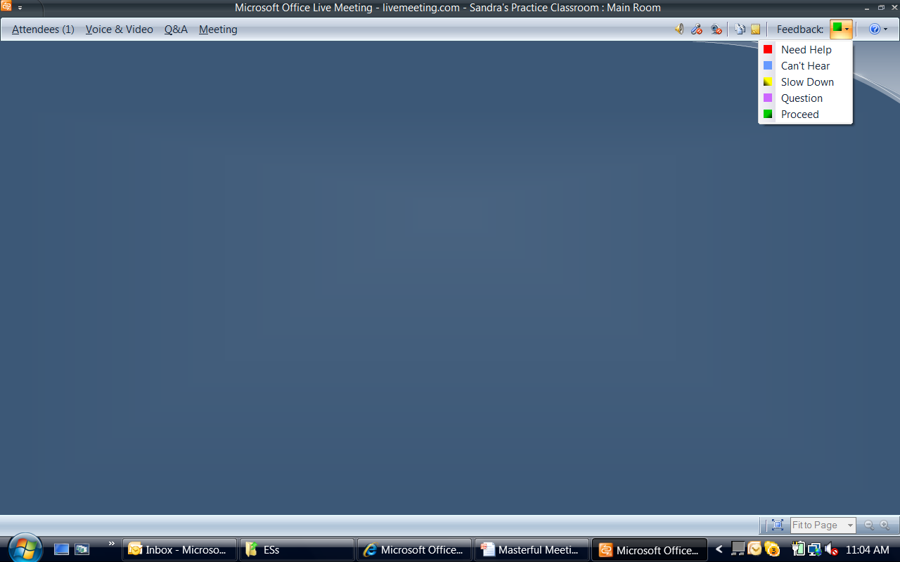
Live Meeting Feature Intro
The Feedback feature allows you (the participant) to let
the Meeting Leader/Presenter know the “status”
of each Attendee
Please do keep us appraised of any issues
you may be having by using this feature
Notes:
The key here is to know Live Meeting well. We will not go over every feature right away, instead just go over those feature we will need to conduct this session including:
Feedback (to keep the meeting leader/presenter appraised of each meeting participant’s “status”
Attendees to show them how we know who is in attendance, their “status,” how to order their Attendees to be used for round robins --- remember how IMPORTANT it is to keep the meeting participants engaged
Voice & Video to ensure their microphone, speaker and Web cam (if they have it) are set up and they know how to mute and unmute when called upon to speak
Q&A to provide questions, “raise their hands,” and ways to use this during meetings

Slide 19
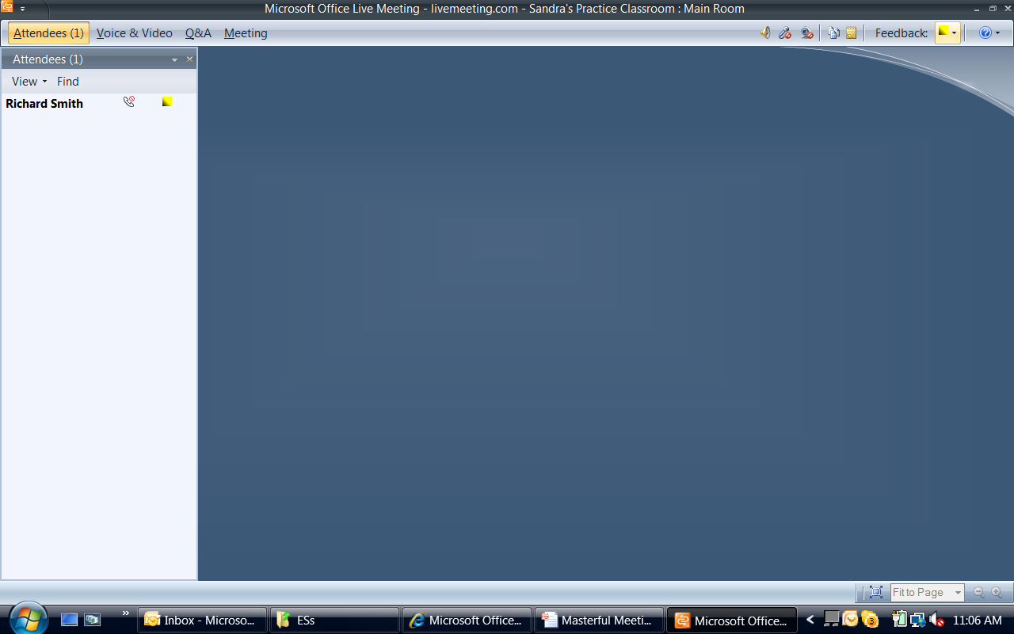
Live Meeting Feature Intro
1
2
Note when the Feedback is
changed to “Slow down” (1) or
“yellow,” how that is reflected
in the Attendee panel (2)

Slide 20
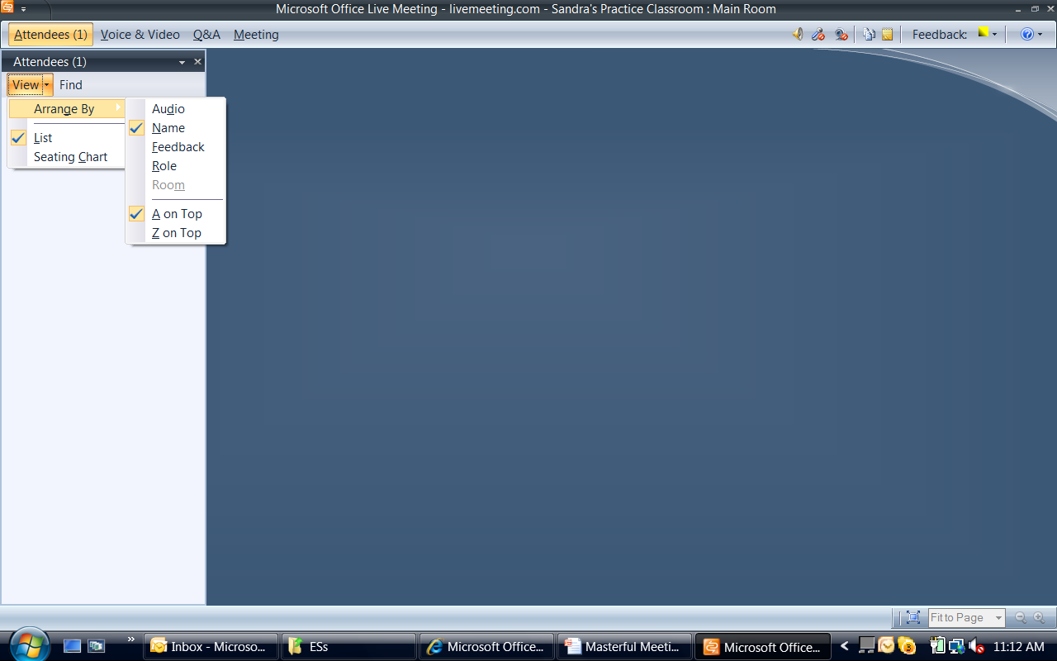
Live Meeting Feature Intro
Have your Attendees arranged in this manner:
> List> Name> A on Top
This will allow us to conduct round robins and
“mini” round robins in an easy to follow manner
Notes:
Make sure that your attendee list is in alphabetical order
A round robin means to go through all participants in order
A “mini round robin” would be something like:
Let’s start with Allan and go to Frank….then next “mini round robin”….
Let’s start this time with George and to go Mike, etc.
That is why it is important that we all have our Attendee list ordered the same way

Slide 21
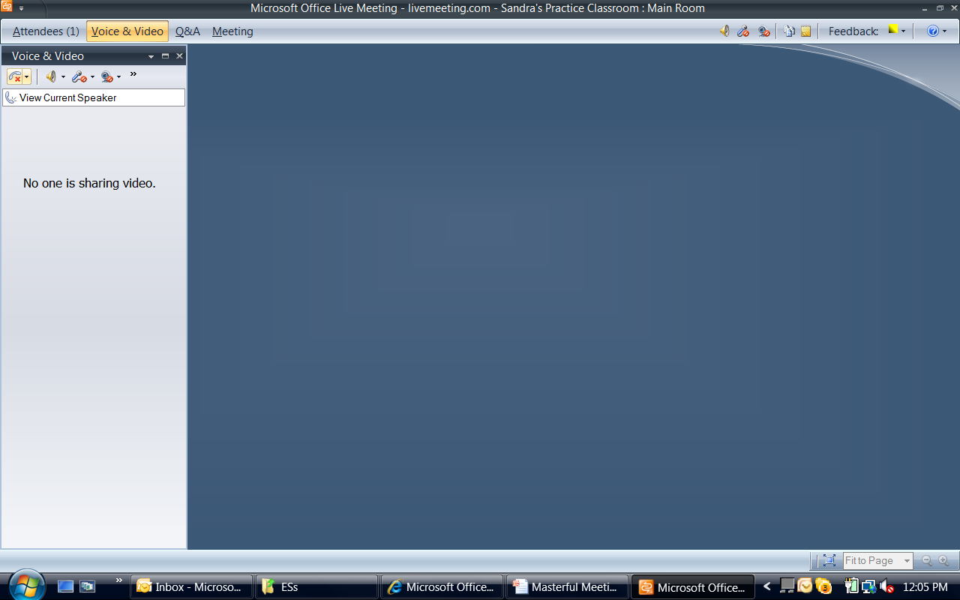
Live Meeting Feature Intro
2
1
(1) From left to right:
Phone -- if not using VoIP; should be muted
Speaker -- should be “on”
Microphone -- should be “off” unless called on
Web Cam -- if you have a Web Cam, this makes an eMeeting
more like a face-to-face meeting; we recommend using it
Chevron -- indicated additional menu options available; in this
example, allows you to set up your audio and video; this
should be done prior to the meeting start time to help meetings
start on time
(2) Note -- you may use the speaker, microphone and Web Cam on
the menu bar as well
Notes:
5.625

Slide 22
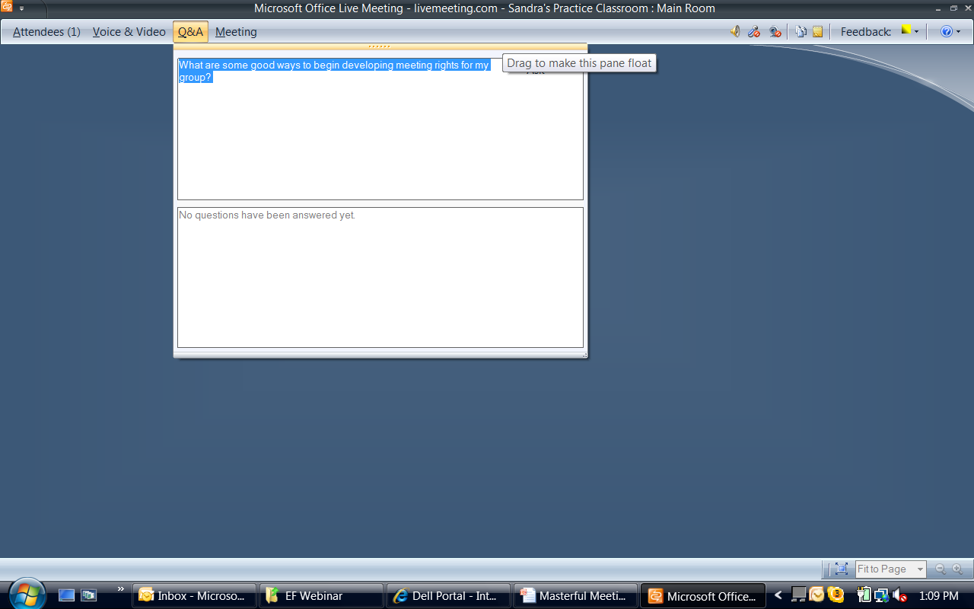
Live Meeting Feature Intro
The Q&A menu is used to either type
a question as in this example
Note: Any menu with the series of dots that
allows the mouse to turn to the cross arrows
may then be dragged to make the menu “float” on
your desktop – shown on next slide. Also referred to as:
“docking panes)
Notes:
Demonstrate how this works by asking the moderator to send a question to a participant and the entire group

Slide 23
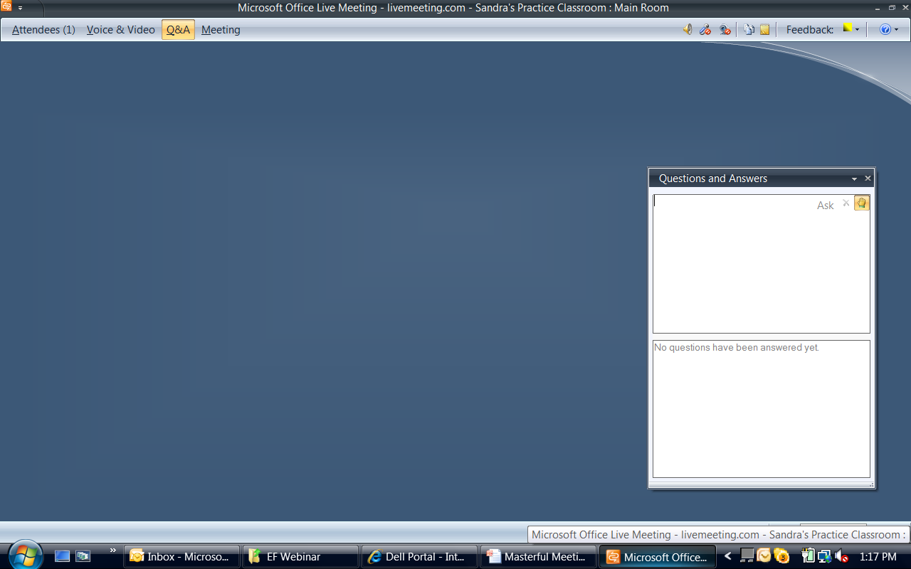
Live Meeting Feature Intro
Here the Q&A menu has been
“dragged and dropped” or
“docked” on my desktop
Note: another way to note a question is
to “raise your hand.” The meeting leader
will see this on their Attendee list
Notes:
We will be using this feature for several things including:
When a participant has a question, this is the preferred way to notify our moderator and facilitator
When we want to check for agreement, OK to proceed, etc. we will be asking for a “show of hands”
Responses to questions we will ask of the group

Slide 24
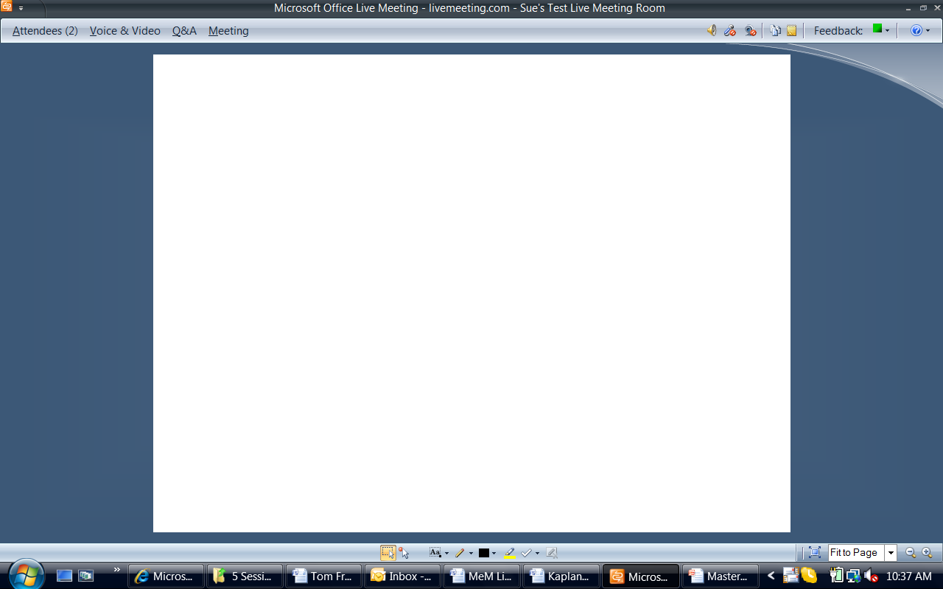
Live Meeting Feature Intro
Below is the Pallet that allows
the participants to annotate the
current content when it is available
Notes:
This “pallet” allows a meeting leader to engage with the participants. We will be providing access to slides, whiteboards, etc. and using this annotation feature often during our 5 sessions

Slide 25
Live Meeting Feature Intro
Annotation Pallet from left to right:
A Select Annotations
B Pointer
C Draw Text (font selection is found here)
D Draw Freehand
E Color Picker
F Highlighter
G Stamp
H Clear Annotations – please do not use
Notes:
Review each of the 8 annotation options
A – user gets to select
B – works like a laser pointer (best used by Meeting Leader to point out things)
C – works like typical font selection (when selected, the font options appear; best to use font size 14 and above for ease of reading)
D – freehand tool for drawing
E – selects the color of the font, drawing, etc. Typically does not appear until after you have “escaped” not as it is typed/drawn/etc.
F – Highlighter – another useful tool for the meeting leader to draw attention to items
G – Stamp (3 options are: green check; red X or tan arrow)
H – Clear Annotations --- this clears any and all annotation on the current whiteboard/slide/etc. Ask the participants NOT to use this during our 5 series of eTrainings

Slide 26
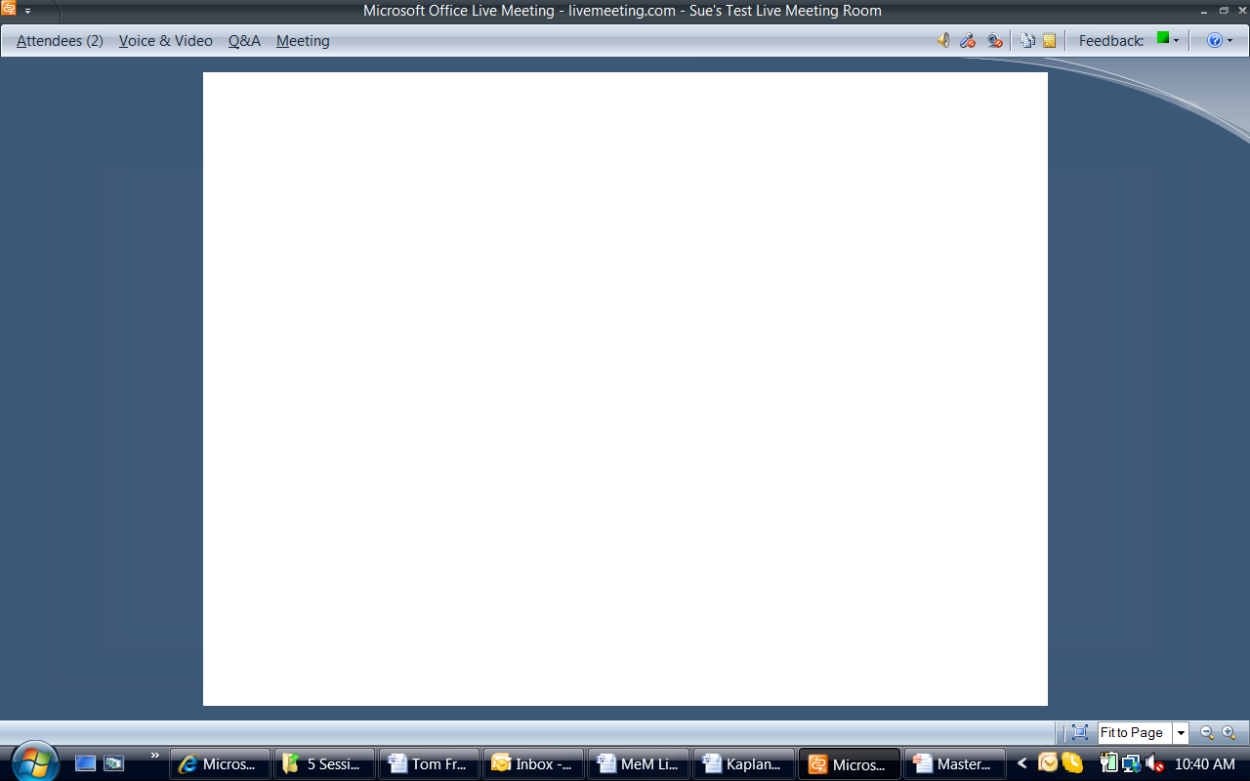
Live Meeting Feature Intro
Note: The Annotation Toolbar is NOT
available in this view. The Meeting
Leader/Presenter can allow this or
not permit participants to annotate

Slide 27
Questions
Time for Practice & Questions
Raise your hands
Type your favorite color in the Q&A and send as ?
Everyone change the Feedback to Slow Down
Now back to Proceed
We will ask 2 of you to speak
Now let’s try the Annotation Tool
Select blue as the color and font size 18
Notes:
Make type B
Ask for volunteers to indicate the multiple ways to indicate a question
Raise hand
Type in the Q&A
Feedback color
Unmute
Annotation tool on, type directly on slide, etc.

Slide 28
Checkpoint
Getting Started & Live Meeting Feature Intro/Review
The Masterful Meeting Vision
Question & Answer
Review & Close

Slide 29
B. Masterful eMeetings Vision
B1. Understanding Meeting Types
B2. What is a Masterful Meeting?
B3. Masterful Meeting Definition
B4. Characteristics of Masterful Meetings
B5. The Role of Participants
B6. Meeting Rights
B7. Raising the Bar on Meetings

Slide 30
Poll #3: Meetings Time
How much time do you spend in meetings each week?
< 2 hours per week
2 hours to < 4 hours per week
4 hours to < 8 hours per week
8 hours or more per week
-
Notes:
Insert a Live Meeting Poll here

Slide 31
B1. Meeting Types
Status Meetings (One-way Communication)
Status Reporting
Issue Identification
Identification of Alternatives
Idea Generation
Decision Reporting
Working Meetings (Two-way Communication)
Problem Solving
Issue Resolution
Analysis of Alternatives
Idea Analysis
Decision Making
Review
Creation

Slide 32
Meeting Types
Status Meetings vs. Working Meeting
Which of the two meeting types should require more time?
Working
Which of the meeting types should generally have fewer people?
Working
What is one of the most common problems with status meetings?
Working
What is one of the most common problems with working meetings?
Focus
Notes:
For these four questions, conduct as follows:
Ensure annotation is available for participants
For first 2 questions, ask them to respond with a W or S and allow about 15-20 seconds on each
For question 3, ask for a volunteer to “raise” their hand and call on one or two
For question 4, ask participants to respond using the Q&A feature and have moderator offer some of their reponses --- DO NOT use names when doing so

Slide 33
B3. Masterful Meeting Definition
A Masterful Meeting is a well-prepared, well-executed, and results-oriented meeting with a timely start, a decisive close, and a clear follow-up plan.

Slide 34
The Case for Masterful eMeetings
For an organization of 20 people…
Spending an average of 13 hours a week in meetings…
Just a 15% increase in the productivity of meetings…
Is equivalent to adding another person to your staff!
Notes:
Consider holding off the last line and ask for a volunteer to estimate what this means
A key point to WHY we want to improve the effectiveness of our eMeetings = increased productivity

Slide 35
Questions
Time for Questions
?
Notes:
Ask for participant questions at this time

Slide 36
B4. Characteristics of Masterful eMeetings
Preparation
Clear Purpose, Products, and Agenda.
The meeting leader defines the purpose, products, and agenda that validate the need for an meeting.
Advance Notification.
Participants know the purpose, products, proposed agenda, and other key information about the meeting in advance.
Right People—Prepared and Present.
The right people are at the meeting. They arrive prepared, they arrive on time, and they stay for the duration.
Right Information.
All necessary information is available at the meeting.
Notes:
Alternate w/ moderator on a read around

Slide 37
B4. Characteristics of Masterful Meetings
Start
Timely Start
The meeting starts on time.
Purpose and Products Reviewed
At the start of the meeting, the meeting leader reviews the meeting purpose and desired products.
Key Issues Identified
Either during the meeting or in advance, all participants have a chance to identify key issues or topics that need to be discussed to achieve the purpose and products.

Slide 38
B4. Characteristics of Masterful Meetings
Start
Agenda Confirmed
The meeting leader confirms the agenda and establishes time limits for each item. The leader may choose to adjust the agenda to ensure all key issues are discussed.
Ground Rules Reviewed
The meeting leader reminds the participants of ground rules. Participants honor the ground rules throughout the meeting.

Slide 39
B4. Characteristics of Masterful Meetings
Execution
Steady Meeting Flow
As the meeting flows from one agenda item to the next, the meeting leader reminds the participants of the purpose for each agenda item, how the agenda item fits into the overall meeting objective, and what the group is being asked to accomplish with the agenda item.
Focused Discussion
The discussion remains focused on the topic at hand. A topic is allowed to exceed its allotted time only with the expressed agreement of a majority and with full knowledge of the effect on the remaining agenda items.

Slide 40
B4. Characteristics of Masterful Meetings
Execution
Positive, Energetic Participation
All participants are actively engaged throughout the meeting. They feel it is safe to speak openly and honestly. People talk and listen with respect. There is energized discussion and debate. No one dominates the discussion.
Constructive Conflict
Disagreement is encouraged and conflict is handled by participants asking questions, identifying strengths, defining concerns, and seeking new alternatives that maximize strengths and reduce concerns.
Thoughtful Decision-making
Prior to decision-making, appropriate time is given to inviting input, identifying alternatives, and evaluating potential solutions.

Slide 41
B4. Characteristics of Masterful Meetings
Close and Follow-up
Decisions and Actions Reviewed
During the meeting, issues that arise that are inappropriate for discussion are deferred to an issues list; decisions made and actions to be taken are documented. Prior to ending the meeting, all issues, decisions, and actions are reviewed, and appropriate action designated.
Timely Finish
The meeting ends on time.
Summary Provided
Following the meeting, a meeting summary is distributed to all participants. The meeting summary includes issues, decisions, actions, and relevant analysis.
Follow-up on Actions
A follow-up process is put in place to ensure all assigned actions are performed.
-

Slide 42
B6. Rate the Meetings You Attend
How would you rate the meetings you typically attend against the eighteen characteristics of masterful meetings?
Notes:
Add a Live Meeting Poll here to assess how the participants evaluate their meetings now

Slide 43
Poll #4: Rate Your Meetings
How would you rate the meetings you typically attend against the eighteen characteristics of masterful meetings?
Notes:
Poll here

Slide 44
Pre-Course Survey
10 Question Assessment
Do this as part of registration & present summary of results here
Notes:
Insert a summary slide of the survey review of the 10 question Survey taken by the participants prior to their initial session

Slide 45
Questions
Time for Questions
?
Notes:
Check for questions – remind them of the three options to indicate/ask questions:
Feedback (least preferred)
Raise a hand using Q&A
Type in a question using Q&A

Slide 46
B7. Raising the Bar on Meetings
What would have to happen to significantly raise the bar on meetings in your organization?
What might each of the following groups have to do?
Organization Leaders
Meeting Leaders
Meeting Participants

Slide 47
The Leadership Team Memo
What would be the impact on meetings in your organization if one morning, all employees received the following e-mail and acted on it?

Slide 48
The Leadership Team Memo
We take great pride in our organization’s ability to continuously increase the value we provide to our customers and stakeholders. We do this through our relentless drive to improve what we do and how we do it. Unfortunately, bad meetings (face-to-face and virtual) are undermining this drive for excellence. Bad meetings waste our time, waste our resources, have a negative effect on the passion we have for our work, and, far too often, result in poor decisions. Meetings are a key vehicle for how we function as an organization, and we must demand a higher value from them. With Your Meeting Rights, the Leadership Team is seeking to ignite a meetings revolution. We are asking you and everyone in our organization to help make bad meetings unacceptable. We believe meetings will change if individuals stand up and exercise these rights. It will be uncomfortable initially, especially when you have to tell a Leadership Team member that he or she is violating one of the meeting rights! But if we stick with the program, we will get past this awkwardness, and the result will be meetings that are more focused, more efficient, and far more effective than what we have today. Help us get there. We invite you and encourage you to exercise these meeting rights. The Leadership Team
Notes:
Have moderator read this slide

Slide 49
Your Meeting Rights! (expanded)
To be effective, meeting rights should identify both the right and the action the person can take if the right is violated.
Example
You have the right to attend meetings that start on time. If, despite your repeated request for the meeting to begin, a meeting does not start within eight minutes of the scheduled start time, you have the right to leave the meeting unless a majority of participants agrees to delay the start.
Notes:
Key to cover for a right comes a responsibility
The rights require some action on parties

Slide 50
Sample Meeting Rights!
Meeting Notice. You have the right to be informed about the purpose, expected products, and proposed agenda for a meeting, verbally or in writing, at least twenty-four hours in advance of the meeting.
Timely Start. You have the right to attend meetings that start on time.
Right People. You have the right to have all major viewpoints critical to decision-making represented at the meeting.
Right Information. You have the right to have the information necessary to facilitate decision-making available at the meeting.
Notes:
Change to only titles of the ten

Slide 51
Review of Meeting Rights
Likes
Things I like about these Meeting Rights..
Concerns
Concerns I have about these Meeting Rights.
How to Implement
Considerations in implementing these Meeting Rights.
Changes
Changes I would make to these Meeting Rights to adapt in our environment.
Assignment
Notes:
Assign this for participants to complete after this session and prior to Session #2:
Likes --- ask for round robin and you type
Concerns – open annotation and ask them to type; stay on top and do the “drag and drop” to organize
Changes – ask them to offer their suggestions (leave annotation open)
How to implement – use some discussion with “mini” round robin

Slide 52
Meeting Rights Feedback
Things I Like About Meeting Rights

Slide 53
Meeting Rights Feedback
Concerns I Have About Meeting Rights

Slide 54
Meeting Rights Feedback
How I Would Implement Meeting Rights

Slide 55
Meeting Rights Feedback
How Meeting Rights Might be Implemented

Slide 56
B5. What is the role of Participants?
Notes:
Alternate with you and moderator….you read do, they read don’t

Slide 57
B5. What is the role of Participants?

Slide 58
Poll #5: Meeting Types
What are the general meeting types?
Review meeting
Planning meeting
Working meeting
Design meeting
Status meeting
-
Notes:
Add a Live Meeting Polling question here

Slide 59
Poll #6: Meeting Types
The key differences between Status Meetings and Working Meetings are:
None – they are both similar
Status Meetings are for creation
Status Meetings are for review
Working Meetings are for creation
Working Meetings are for review
-
Notes:
Another Live Meeting Polling question

Slide 60
Live Meeting Feature Review
Select three participants to change their feedback status
Conduct a round robin to review one new Live Meeting feature that was identified today
Conduct a round robin to identify participants that have set up and conducted a Live Meeting as a Meeting Leader
Notes:
Some further review of Live Meeting feature with “hands on”

Slide 61
Questions
Time for Questions
?

Slide 62


Questions & Answers
Virtual Meetings
Richard Smith Principal
Leadership Strategies

Slide 63
Session #1 Feedback
Things I Liked About the Session | Things to Make it Better

Slide 64
Thank You & Next Session
Thank you for your time and participation
Assignments:
Prepare a Meeting Right for your organization to be shared during Session II
Ensure you have updated your e-Biz card
Download your workbook
Next session
Date: _______ Time: __________
Notes:
Remember to show the eBiz card on the next slide so they can complete and leave the meeting open for an extra 10-15 minutes as well as informing the participants that the “meeting room” will be open 30 minutes early each session so they can complete their eBiz card then, if they choose
Update the date and time for next session

Slide 65
See You Next Session!
Virtual Meetings
Richard Smith Principal
Leadership Strategies
Notes:
For this Webinar….if you get nothing else out of this Webinar…..
Status vs working meetings
- 5P;’s

Slide 66
Questions
Time for Questions
?
Notes:
Make type B

