Slide 1
Checkpoint
DAY 1
DAY 2
DAY 3
Getting Started
Planning for Results
Review
Ex #2: Your Start
D. Delivering for Results
Review
  F. Confirming Results & Closing
  G. Managing Dysfunction
LUNCH
LUNCH
LUNCH
Ex #1: Experiential Learning
Starting with Impact
Homework
Ex #3: Inviting Participation
E. Managing Visual
Information
Homework
Ex #4: Redesigning Your Session for Results
H. Next Steps
Close
Notes:
Here is our agenda for the entire course. On this flip chart (Flip Chart 3 w/ agenda for Day One), you will note that I have placed our agenda for the day as well. Before we move on, let’s take a look at your personal objectives and see where you believe we will address the categories in which we have grouped these objectives…..So, (blue) on the category of (poor behavior), where in the agenda do you believe we will cover that? OK, next team…….
Note: Ensure participants are identifying where their personal objectives will be addressed in the class. If there is an area or areas that are not addressed, guide the group to whether or not to adjust the agenda to meet their needs.

Slide 2

E. MANAGING VISUAL
INFORMATION
Duplication prohibited without consent
Notes:
Timing: Between 40 and 45 minutes
Flip Charts:
Flip Chart 1: List of Media Used
Flip Chart 2: Get Points in a Performance Review (to demonstrate as many of the do not’s as possible)
Flip Chart 3: Personal Objectives
Flip Chart 4: Day One Agenda and Sample Agenda

Slide 3
E. Managing Visual Information
E1. Using Visual Aids in Training
E2. Recording Information
E3. Recording Techniques
E4. Maintaining Interest and Order
Manual
89
Notes:
Checkpoint: We have just completed Application Exercise #3 where we had the opportunity to practice several of the new techniques with an emphasis on inviting participants…..What we are going to do now is address Managing Visual Information……And, this is important because our ability to integrate a variety of media and use that media in the right way can have a great impact of our effectiveness in the facilitation of our training sessions……
In this module we are going to cover the four best practices or techniques on this slide……Let’s get started…..

Slide 4


E1. USING VISUAL AIDS IN TRAINING
Duplication prohibited without consent

Slide 5
E1. Using Visual Aids in Training
Are the visual tools we use today the most effective?
  What are the tools that we use to present information?
    Which are most beneficial and successful?
    Which are least?
    What can we do to improve this in the our setting?
Notes:
To start this module, let me first select some new team leads…….If you have been the team lead already today, you are eliminated from being the team lead for this engagement……Of the remaining folks, let’s have the person that drove the longest to get here today be our team lead……Has each team selected their team leads?.......Good, we are going to ask each team to share with us the following three things:
Those visual aids/tools you find most beneficial and successful
Those that are the least……and,
What we can do to improve those that we find least effective…….
Let me set the clock for four minutes and have each team prepare their flip charts……..
NOTE: Facilitate the debrief as each team lead reports on their flip charts; something like: 1) Things we liked about what the (red) team had to say…..and then, 2) Ways to make it better or other considerations.
Another key is that by varying the media, we increase the variety – one of the key points from our VISIRRRR.

Slide 6


Send a Message with a Picture
Notes:
Part of making our visual presentations, including PowerPoint, is to make the message clear with the right visuals on the slides; don’t make your training about “reading the slides” to the participants….Pictures, like stories, help with learning retention and reinforcement….Ensure the pictures are consistent with the message……

Slide 7
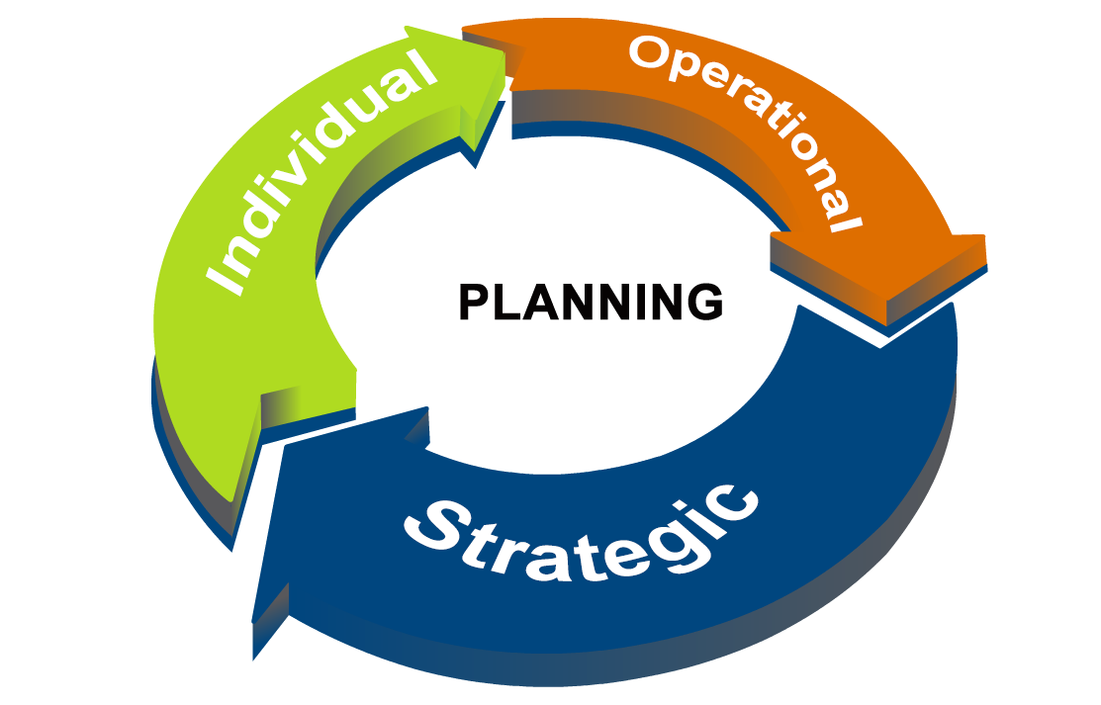
Creating Graphic Models
Manual
91
Notes:
Let’s see what this graphic says to you…..(Red) team, share with us what this graphic would communicate to your team?…..Other teams, anything to add?

Slide 8


E2. RECORDING INFORMATION
Duplication prohibited without consent

Slide 9

E2. Recording Information
    Use It; Don’t Abuse It; Make It Theirs!
The power of pen
Notes:
Another tool that we find useful in the classroom is a flip chart…..The analogy to the flip chart and markers in the virtual setting would be the whiteboard and keyboard….So, keep that in the back of your mind for those of you that do virtual training or meetings……When you see the “Use it, Don’t Abuse It,” what does that mean to you?...Let’s start with the (green) team this time…..(Facilitate the discussion.)
NOTE: Key points to ensure to be made – “honoring what people say” by writing it down and the dynamic that it creates in the training session for others (especially those that are more reluctant to speak).

Slide 10
Write First, Discuss Second
Record what is said without regard to value
of completeness
    If what is said is incomplete…
    If what is said can be improved upon…
    If what is said is not what you were looking for…
    If what is said is wrong…
    Still Record It!
By recording what is said, you are saying “Thank You” for making a contribution
You can use your questioning techniques to make sure that the comment is refined or deleted later
-
Manual
92
Notes:
Let’s turn to your participant manual, and you will note that the first statement in the manual is filled in….It reads, “If what is said is incomplete, still record it.”…..(Blue) team, what do you think we do if what is said can be improved upon?……That’s right – we still record it…..On to the (green) team, what about if what is said is not what you were looking for?….What should we do as the facilitators of learning?…..You got it – we still record it…..Now, on to the (purple) team, what if what is said is wrong?…….What are you thinking?…..Yes, as difficult as that may seem at first, we still record it…..Now, let’s see the whys……
Here we go: 1) in a manner of speaking (or, in the case, writing) we are saying to that participant, “Thank you for making a contribution”….You will find this helps to make the training session a “safe environment” and, over time, encourages those less-reluctant participants to “take a chance” or makes it more comfortable for them to engage…..So, the key here is “Write First, Discuss Second.”……You will find when this becomes a natural order, you will more naturally help you use their words rather than your paraphrasing what they said……Then, you move on to……
Use your questioning techniques to “guide the learning process.” When the response is wrong and you use your questioning techniques, learning occurs, and participants move from an incorrect answer to the correct one during that process……

Slide 11
Make it Theirs
Record as many of the speaker’s words as is necessary
It is not necessary to record all the speaker’s words
If you are not certain what was said, ask for confirmation, or ask for the Headline
Use abbreviations cautiously
Do not try to clean up the speaker’s words
Manual
93-94
Notes:
By adopting that first technique of Write First, Discuss Second, you will naturally start using their words rather than your interpretation of their words….This increases the learning and ownership of the content being facilitated……..Now, we are not suggesting that you need to write every “the,” “and,” or “a” – but enough of their words to convey the meaning ……..At the same time, in addition to Wandering Willie, how many of you have also had Long-Winded Larry or Lorrie in your sessions? (Raise your hand.)....Yes, we do too….A great technique for those participants is to ask them for the headline or the bumper sticker…..That way, they shorten their response, and you are capturing their words rather than paraphrasing for them……….
Watch out for those sessions when we start opening Campbell’s alphabet soup….Those acronyms may really lose some participants – especially if you have some who are afraid that asking what an acronym means is a demonstration of a lack of knowledge…As the facilitator of learning, when you hear an acronym for the first time in your session, ask someone to define it to ensure everyone’s understanding……..

Slide 12

Add Your Words Discriminately
There may be times when adding your own words is important for clarity
or correctness
Put your own words in parentheses and in a different color to distinguish their words from yours
-
Manual
94
Notes:
With all of that said, there are times in a session when, by adding your words, you add to the clarity or context of the session… In those cases, we recommend that you differentiate your words from those of the participants by using a different colored marker……Does anyone else have a technique they find helpful in those situations?.......Alright then, let’s move on…….

Slide 13

Ask, Don’t Tell
WHY?
You may be perceived as losing neutrality (not for content facts)
You get verbal agreement, but the participants never own it
You don’t get agreement and time is wasted
Use your questioning techniques to turn any statement into a question
If you find yourself making statements, you may have slipped into another role
If you say it, they can disagree. If they say it, it’s theirs.
-
Manual
94-95
Notes:
How many of you consider yourselves natural questioners? (Raise your hand.)....Great, some of you are, and some may not be….Wouldn’t you agree that this is a skill that would help us in many situations? (Nod your head.)….. So, remember the key point that – “A Professor Tells, and a Facilitator Asks.”…..Earlier we added several questioning techniques to your “bag of tricks.” Make an effort to start adding a few at a time, and in no time at all, you will find yourself being a much better questioner when you are facilitating in the classroom……….Often times, to make a key point, I will make an erroneous statement to see if I can get the participant(s) to correct me, or I follow up with questions to test their learning……….

Slide 14
E3. RECORDING TECHNIQUES
Duplication prohibited without consent

Slide 15
Write So They Can Read It
Write large
Write straight
Leave plenty of space between lines
Avoid using red as a base color
Write neatly
Form letters distinctly
Rule: No more than 10 total lines on a page
-
Write large and take your time,
the rest will follow
Manual
96
Notes:
Take a look at these points……The one on the bottom right is likely a great summary for most of us…..If you take your time, right large and allow for about no more than 10 lines per chart, you will find that the rest will kind of follow……Note the comment about avoiding the color red….What might be some of the reasons for this?…….OK, great points…..Any other questions or comments?.....Then, let’s move on……

Slide 16
Use Additive Editing
Leave plenty of space between lines for corrections
Use a different color pen for corrections
If there are too many corrections, re-write the information
-
Manual
96
Notes:
By following the tips on the previous slide, you will allow for Additive Editing by the participants….By limiting each chart to about 10 lines, you will find there is room between the lines to come back and place additive comments….And, to distinguish these from the original comments, we recommend using a different colored pen to differentiate that Additive Editing……..

Slide 17

E4. MAINTAIN INTEREST & ORDER
Duplication prohibited without consent

Slide 18
Avoid Lulls While Writing
Techniques for avoiding lulls:
Stay __________ to the __________
Begin _________ as soon as they start __________
______ what they ______ as you write
Ask them to __________
________ a direct ________
close
flip chart
writing
speaking
Repeat
say
repeat
Ask
probe
Manual
97
Notes:
Once we show you these tips to Avoid Lulls While Writing, you will find those lulls you may not have noticed in the past very painful…..Let me demonstrate the technique by asking, (name), to read the first bullet point in E4 in your participant manual when I ask you to….What I am going to do is do it twice. The first time I am going to do it the correct way….Then, when I do it the second time, I will intentionally do it incorrectly….Then, I am going to ask you to help me define the five steps to Avoiding the Lulls While Writing…..Are we ready?....OK, (name), how can the facilitator influence the pace of the session? (Have that person read the first bullet point…..In the first demonstration, be close to the flip chart, start writing as soon as the person starts speaking, repeat while you write, ask him/her to repeat, and ask some probes………Then, reset and ask the question again while you are standing close to the person….As he/she reads the second time, casually walk to the flip chart, start writing and do not say a word while you are writing.)……..At the end of the second demonstration, ask the group, “How painful is this for you?.....Right, so let’s fill in the blanks on the slide and in your participant manual.”
(Red) team, stay ______ to the _____________ ___________________________
(Green) team, begin _______________as soon as they start _____________, etc.
NOTE: Ensure to make the key point that when a facilitator allows those long and/or frequent lulls, it “takes the energy right out of the room.”

Slide 19
Use Multiple Flip Charts
Have enough flip charts to allow all pages on one topic to be viewed at one time
Three or four charts are best
Two flips charts are acceptable
In most cases, one chart is not enough
Establish a flip chart protocol with your documenters
REORGANIZATION
Communication
(Comm)
a. Memos
b. E-Mails
c. Whitepapers
d. News bulletins
notices
e. Phone
-
Manual
97-98
Notes:
How many of you use flip charts or white boards in your training sessions? (Raise your hand.)......Let me ask someone from the (purple) team, how many flip charts do you typically have in the training room?.......Thanks, any particular reason
(s)?......Others?.......
We find it very helpful to have four flip charts…..Typically that allows us to complete any agenda item without flipping the chart back and forth or having to rip and post a flip chart…...Does anyone else have some tips for the use of flip charts and/or white boards?

Slide 20

Additional Tips
Label every chart
Avoid “mis-tears”
Capitalization
  Center and capitalize the label
  Comment & Sub-comment: capitalize first letter of first word
Punctuation
  No periods
  Use semi-colons
Spell out abbreviations the first time
Make a short tear at the top on each side, grip both sides, and pull straight down
-
Manual
98
Notes:
Here are some Additional Tips that you will find helpful when using flip charts in your sessions……Are there any other points you would like to discuss or add?……Thanks.

Slide 21
Employ the Right Recording Tool
Tool | Advantages | Disadvantages
Flip Charts
Whiteboard
Copyboard
Computer Projection
Post-Its
Manual
99
Notes:
The following chart is our +’s and –’s for the various Recording Tools……We have covered the key points on flip charts…Who uses white boards?.....Good, (name), can you share with us any additional points?……How about copy or smart boards?……Is there anyone that uses these?......Great, anything to add?
NOTE: Point out that this page is a great reference when they find themselves using a media where they have no or limited experience with that media…..Also, point out to vary the media for variety.

Slide 22
E. Managing Visual Information
E1. Using Visual Aids in Training
E2. Recording Information
E3. Recording Techniques
E4. Maintaining Interest and Order
Notes:
Checkpoint: We have just completed Application Exercise #3 where we had the opportunity to practice several of the new techniques with an emphasis on inviting participants…..What we are going to do now is address Managing Visual Information……And, this is important because our ability to integrate a variety of media and use that media in the right way can have a great impact of our effectiveness in the facilitation of our training sessions……
In this module we are going to cover the four best practices or techniques on this slide……Let’s get started…..

Slide 23


The Engaging Trainer

