Slide 1
Checkpoint
DAY 1
DAY 2
DAY 3
Getting Started
Planning for Results
Review
Ex #2: Your Start
D. Delivering for Results
Review
  F. Confirming Results & Closing
  G. Managing Dysfunction
LUNCH
LUNCH
LUNCH
Ex #1: Experiential Learning
Starting with Impact
Homework
Ex #3: Inviting Participation
E. Managing Visual
Information
Homework
Ex #4: Redesigning Your Session for Results
H. Next Steps
Close
Notes:
Here is our agenda for the entire course. On this flip chart (Flip Chart 3 w/ agenda for Day One), you will note that I have placed our agenda for the day as well. Before we move on, let’s take a look at your personal objectives and see where you believe we will address the categories in which we have grouped these objectives…..So, (blue) on the category of (poor behavior), where in the agenda do you believe we will cover that? OK, next team…….
Note: Ensure participants are identifying where their personal objectives will be addressed in the class. If there is an area or areas that are not addressed, guide the group to whether or not to adjust the agenda to meet their needs.

Slide 2

D. DELIVERING FOR RESULTS
Duplication prohibited without consent
Notes:
Timing: between 100 and 120 minutes depending upon the size of the class; a break in the middle of this module is recommended; a good place for this could be an assignment of PeDeQs by each team with a break included
Flip Chart:
Flip Chart 1:
+’s of Type A +’s of Type B
Flip Chart 2: Great Starting Question
Begin with an image-building phrase
Extend…..the image (2-3 phrases)
Ask the direct question
Key Tips:
Ask it: 1, 2, 3 – Build it: 3, 2, 1
Synonyms
Flip Chart 3: Reacting Questions
Direct Leading
Indirect Prompt
Redirect Tag
Playback Float
Flip Chart 4: Focus: 1 Flip Chart per Team:
Signs a Group is Focused
Signs a Group has Lost Focus
Things a Facilitator Does to Keep a Group Focused
Things a Facilitator Does to Allow a Group to Lose Focus
Flip Chart 5: Checkpoint
Review
Preview
Big View
Flip Chart 6: Giving Directions
Purpose
Examples
Directions
Exceptions
Questions
Starting question
Flip Chart 7: Problems with the Current Performance Review Process
Problems Symptoms Root Cause
Flip Chart 8: 3 Es of Energy
Engage the participants
Energizes the participants….if he/she is excited, maybe I should be, too
Elevates the facilitator (in the eyes of the participants)

Slide 3
Exercise 2: Starting
Create your opening (I-E-E-I)
Choose and engagement strategy that would be appropriate for a class opening, and prepare it for tomorrow. For example, you might choose an introduction activity from Appendix B, or you might request personal objectives. (See C3.)
After your involvement question, you can pretend to record responses.
Use your reacting question techniques to keep the session going until the time is up.
-

Slide 4
Exercise 2: Starting
Timing
You will work in groups of four and have:
  8 minutes for individual delivery, and
  4 minutes for debrief
  Be sure your entire presentation does not exceed 8 minutes.
Use the feedback forms in your exercise packet to record your feedback for other participants that present.
-

Slide 5
D. Delivering for Results
D1. Training vs. Facilitation
D2. Ask Starting Questions
D3. Ask Reacting Questions
D4. Use Checkpoints for Transitions
D5. Warm-up the Group
D6. Use PeDeQs to Give Directions
D7. Redirect Side Issues
D8. Order Speakers to Maintain Control
D9. Summarize Results
D10. Be Conscious of Time
D11. Keep the Energy High
Manual
59
-
Notes:
We have just completed our Application Exercise where we had an opportunity to work on the starting of our training…..Next, we are going to address Delivering for Results…..And, this is important so that in our training we can use the tools to keep our training interesting and focused while we, as the facilitators of the training, “carry the group through the process”………
Let’s do a brief review of some of the key point from Starting with Impact……(Conduct a few questions for backward build-up.)

Slide 6

D1. Training vs. Facilitation
Copyright 1992-2015, Leadership Strategies, Inc. V15.03
Duplication prohibited without consent

Slide 7
Training vs. Facilitation--Is there a difference?
 | PRESENTATION | TRAINING | FACILITATION
Focus
Deliverable
Approach
Telling vs. Listening
Focus on
Content
Focus on both Content & Process
Focus on Process
Information/
Inspiration
Group Insight/Decisions
Skill Development
Presents/Tells
Teaches/Involves
Asks/Guides
-
80% Telling
20% Listening
50% Telling
50% Listening
20% Telling
80% Listening
Manual
60
Notes:
As you can see on this slide, the columns show the three categories of Presentation, Training and Facilitation……(Red) team, think about the differences between Presentation and Training, the items that are different, the things that contrast a Presentation from Training….Are there other things you would add?......Thank you…..How about the (blue) team?… The same differentiation between Training and Facilitation – any other items you would like to consider?……(NOTE: Cover the key point about the participants creating, understanding and agreeing to the results of a Facilitated Session.)
Alright then, let me ask each team to take a minute and give us your team’s thought on how much “telling vs. listening” the facilitator does in each of the 3 types of sessions…….
NOTE: Facilitate the discussion and emphasize the importance of engagement to attain these types of telling vs. listening in each…. Consider asking questions about techniques that can be used to achieve this type of participant dialogue….Refer back to all the items earlier discussed around engagement strategies, instructional techniques, etc. as well as what you are modeling as you facilitate this class.

Slide 8
Facilitator and Trainer Roles
Objective Observer | Facilitator | Fact Finder | Identifier of Alternatives & Linker to Resources | Joint Problem Solver | Trainer/ Educator | Information Specialist | Advocate
Participant (empowerment)
Consultant (empowerment)
Manual
61
Notes:
This chart is a nice graphical representation of what we have just talked about…….(Purple) team, what does this say to your team?.....Any other teams have something to add?......Great, let’s move on…….
Inquiry vs Advocacy perspective here

Slide 9




Trainer Characteristics
There are four cornerstones of a good instructor:
Manual
62

Slide 10
Expertise
Knowledgeable and Prepared

Slide 11
Empathy
Understanding & Consideration
How would you respond?
-
During class Jamie shares out loud, “I don’t know how you people figure out these ratios so quickly. It takes me forever.”
Gwendolyn made a perfect 100% on her post-course, certification test.

Slide 12
Clarity
Language & Organization
Notes:
NOTE: Change this to “Explicit” for the 4 E’s of a great Trainer--- be clear and explicit with examples, relevancy, etc….don’t let the participants leave with an ASSUMPTION of what is being discussed

Slide 13
Enthusiasm
Commitment & Animation
Rapid, uplifting, and varied vocal delivery
Rapid, wide-open eyes
Frequent, demonstrative gestures
Varied, dramatic body movements
Varied, emotive facial expressions
Selection of varied words, especially adjectives
Ready, animated acceptance of ideas and feelings
Exuberant overall energy level
-

Slide 14

D2. The Starting Question
Copyright 1992-2015, Leadership Strategies, Inc. V15.03
Duplication prohibited without consent

Slide 15
D2. The Starting Question
You are teaching a customer service program. You want to talk about characteristics of effective customer contact people. Which is the better starting question? Why?
Question Type A
Question Type B
-
The first thing we want to talk about are telephone techniques. What are the techniques good customer service people use?
Think about a time when you received excellent customer service over the telephone. Think about what the person did that made you comfortable; consider the things that happened that made it a great customer service experience. What are the techniques that good customer service people use?
Manual
64
Notes:
Alright, let’s dig into one of the techniques we at Leadership Strategies find so important…..Of all the techniques we will cover, you will likely find this to be one of the most beneficial, but it will also take some work…..Let me show you what I mean….
How many of you ask questions when you are training? (Raise your hand.) Sure, just about everybody…..Have you ever asked a question and received what we refer to as the thing most facilitators simply hate –“deafening silence”? (Nod your head.)……Sure, almost all of us….Well, this “secret of the starting question” will reduce that likelihood to almost 0…….Let me show you……
Let’s assume you are training a group of customer service people in your company…..You want to start a conversation by asking the participants what they think are the characteristics of a good customer facing person…….Let’s look at two questions and see which one we think would solicit better responses….
(Name), would you read for us Question Type A?…….(Pause after the question is read.)…..OK, pretty good, isn’t it? And, notice it is open-ended…….
(Name), let’s try another approach. Please read Question Type B for us………Thank you…..
OK, folks, which of you think Question Type A is a better starting question? (Raise your hand.)…..Wow, not very many of you……How about Question Type B? (Raise your hand.)......Gee, almost everyone….
So, let’s make a list on the flip chart of what we like about each question type…..(Flip chart with T format of +’s of Type A and Type B)
(Green) team, think about the Type A question…Think about the things that helped you with this question – the things that made this question good….Give me one or two……..Great, (blue) team, anything to add?
Repeat this for the Type B question……
NOTE: When this flip chart is completed, if the point about imagery or people “seeing” their answers with a Type B question has not been made, either lead the group to this or add it to the discussion…The KEY POINT to be made about the Type B question is this – when you have asked a good Type B question, participants see their answers………It helps them to respond by seeing those answers…..
OK, as with all the other classes, we have shown these two starting questions. You, too, believe the Type B questions is better…..Now, we absolutely know this based on over 20 years of experience…..And, this Type B question is OK, but we can make it even better…….Let us show you the three steps that will allow us to construct a Type B question to start or open up dialogue with a group of participants or, for that matter, a 1-on-1 situation as well…….Here we go….

Slide 16
D2. The Starting Question
The Starting Question is the question the trainer asks prior to participants responding
Three parts to a great starting question
  Start with an image building phrase (“think about”, “imagine”, “consider”, “if”)
  Extend the image to the answers (2-3 phrases)
  Ask the direct question (Type A) to get the information you want
-
Manual
65
Notes:
The three steps to asking that Great Starting Question are as follows:
Begin with an image-building phrase…..(Purple) team, read the four examples of an image-building phrase for me…..
Extend (use hand motions to extend that phrase) the image to the answers…..(Green) team, how many phrases?....Good, as you get started with this technique, I strongly suggest you use the three phrases….
Now, ask the direct question – that open-ended question that you want the participants to answer…..
NOTE: A key “tip” to asking a Great Starting Questions is as follows:
You ask the question 1,2,3…..BUT….you build the question 3,1 2….Let me explain……First, decide the question you want the answer to….Example from prior slide – what are the characteristics of effective customer contact people?....Ask yourself, what is the key word in that question?……
Now, start with that image-building phrase.
As you do the extension, identify synonyms for the key word identified above. (Keyword: characteristics; synonyms: things, skills, features, personalities, etc.). The toughest part of the Type B question is that extension. By doing Step 3 first, then identifying the keyword or phrase, we can then find synonyms for that word/phrase and develop great extensions.

Slide 17
D2. The Starting Question
Form Type-B Questions for
Typical mistakes customer service people make
The best way to handle an irate customer
Strategies for staying motivated and energized while answering calls
-
Manual
66
Notes:
Alright, now that we have looked at the why, the what and the how of building a great starting question, let’s try building one…..Here is how we would like to do that……Follow the slide………………
NOTES:
If you do this by teams, consider having team 1 read their Type B and team 2 “grading” it (1 point for each part). Team 2 reads, and team 3 grades, etc…..Then, at the end of the team sharing, add your comments for making those questions better; provide tips for building great Type B questions.
If you do this individually, consider having each team select their “best” Type B question to share with the group, and you facilitate feedback on those questions – e.g. “What did we like, or what was good about that question?”……Then, “what would we suggest to make that Type B question even better?”

Slide 18
D3. REACTING Questions
Copyright 1992-2015, Leadership Strategies, Inc. V15.03
Duplication prohibited without consent

Slide 19
D3. Reacting Questions
Direct Probe
Indirect Probe
Redirect
Playback
Leading
Prompt
Tag Question
Float and Idea
Manual
67-68
Notes:
Sample Script
Great, we all now have a good technique for asking that question to start or open a dialogue……Now, we are facilitating a discussion like the one about characteristics of a great customer contact person……The participants are responding…..What will we do with those responses?......That’s right – we will guide that conversation….And, how will we do that? With statements or with questions…..(Facilitate that discussion.)……
So, if we want to guide that conversation, we will want to have a nice variety of questions to do that…….Think about the last session you trained….Think about those questions you asked that generated a ton of responses……There was simply a bonfire of input from many participants…..Why would we want to have several question types to guide that conversation?......(Call on those with their hands up or ask for team responses.)……
That’s great…..So, there are many reasons for a variety…..(You may add things like different responses for a more assertive person vs. the reluctant participant, those questions to help or guide, those to ensure common understanding, those to lead to new areas, etc.)
Alright, let’s take a look at eight question types that we find will fill your tool kit with some great reacting or probing questions…..We are going to go through these eight question types by using an individual round-robin and a team round-robin…..I will explain as we get started……Here we go…

Slide 20
Direct Probe
Purpose: Challenge or Probe
You don’t think what was said is targeted to the discussion, or you need additional explanation
“Why is that important?”
Notes:
(Name), can you read the slide for the Direct Probe?……That’s good…..A participant responds with something you think is incorrect or you want to go deeper with that response….It would sound like, “Richard, that was interesting….Why is that important?......Let’s move on……

Slide 21
Indirect Probe
Purpose: Probe or Clarify
Close-ended probe to provide additional explanation, especially appropriate for less confident participants
“Is the reason that’s important because …?”
Notes:
Now, instead of that more assertive participant, Reluctant Ralph has just engaged for the first time in the session…..You think he may be wrong or you want to go deeper or clarify the response….Can you imagine with this reluctant participant if you tried something like….“Hey, Ralph, WHY is that important?”…So, (name), let’s look at the next question type. Would you read the slide please?…….That’s good… “So, Ralph, is the reason that is important because all customer contact people need to have a degree in psychology?”…..Ralph might say, “Yes, I think that would be preferable”…..Or, he might say, “No, what I meant was that would be a nice tool…….” etc……
So, let’s go back to the (red) team. What is the Direct Probe?.....[Let them give a choral response…..You will likely need to go back the first time or two before the group gets into it….The key here is by doing this, the time you have introduced all eight question types, many of the participants will remember at least a handful of them.]

Slide 22
Redirection Question
Purpose: Get Back on Track
The point is not relevant to the current discussion
“That’s an interesting point. Can we put that on the issues list?”
Notes:
Let’s try this one…..How many of you have ever had one of my favorite participants in your class, Wandering Willie? (Raise your hand.) Yes, we are in the middle of making a list of customer contact people characteristics, and Willie wants to talk about the steps in responding to a customer complaint…….Yes, and how many of you have seen a facilitator take the entire class down that bunny trail? Yes, me too……Here is a great question type to avoid that….(Name), read this slide for us……
Great, so our friend, Willie, tries to take us down that “bunny trail,” and what we do is say, “Willie, great point…Since that is not relevant to the characteristics of a great customer contact person, can we put that on the Coming Attractions list and cover that later?”……A great way to keep the conversation on topic and serve as a facilitator of the training……Now, let’s do a quick review…..
(Green) team, what is the Direct Probe? …….(choral response)…….That’s it….
(Blue) team, the Indirect Probe?……(choral response)…..That’s it…..And…
(Purple, the Redirection?………

Slide 23
Playback
Purpose: Confirm Understanding
Give the participant assurance that you understood the point
“It sounds like what you are saying is … Is that right?”
Notes:
Here is a great technique for us, as facilitators, to ensure what was said by one person is understood by the group…..(Name), read this slide for us, please…….Great, the Playback is a way to ensure we are “connecting the dots” for our group……Let’s do another round of review….
(Blue) team, the Direct Probe?……
(Purple) team, the Indirect Probe?……
(Red) team, the Redirection?……
(Green) team, the Playback? ….
[NOTE: Ensure you start at a different team each time, so there is variety and, hence, retention.]

Slide 24
Leading Question
Purpose: Lead to Other Thoughts
You want to guide the group to other thoughts or conclusions
“Are there approaches that also …?”
Notes:
Often times, when we are facilitating the learning process, it is better to “lead the group or participant(s)” rather than simply tell them……When we tell them, often it can be like “water running off a duck’s back” rather than stimulating their minds or curiosity……When they say it is theirs, they are confirming or learning….When we say it, it is ours…..So, let’s look at the Leading Question….(Name), take us through this slide…….
Alright, time for another round of review…..
(Blue) team, the Direct Probe?……
(Purple) team, the Indirect Probe?……
(Red) team, the Redirection?……
(Green) team, the Playback? ….
(Orange) team, the Leading question?……

Slide 25
Prompt
Purpose: Keep the Ideas Flowing
The group has temporarily stalled and needs prompting
“What else? We have [x], [y], and [z] …what else?”
Notes:
We find this next question type is one of the “Go Tos” for many facilitators – the Prompt……(Name), can you read this one for us?……
Now, another round of choral responses…….
(Red) team, the Direct Probe?……
(Green) team, the Indirect Probe?……
(Blue) team the Redirection?……
(Purple) team, the Playback? ….
(Red) team, the Leading question?……
(Green) team, the Prompt?…..

Slide 26
Tag Question
Purpose: Get Acknowledgement
You are warming up the group or keeping it alert
“That’s important, isn’t it?”
Notes:
Here is another question type that can do several things for us as facilitators…..(Name), tell us about the Tag Question……Thanks….This is another good one to acknowledge, buy some time or adjust the pace of the session……..You know what we are about to do, so let’s get started……
(Green) team, the Direct Probe?……
(Blue) team, the Indirect Probe?……
(Purple) team, the Redirection?……
(Red) team, the Playback? ….
(Green) team, the Leading question?……
(Blue) team, the Prompt question?…….
(Purple) team, the Tag question?……..

Slide 27
Float an Idea
Purpose: Give a Possible Solution
An important thought or conclusion has been overlooked
“What about …What are the benefits?”
Notes:
Finally, our last question type….We have tried to gently get the group to an area heretofore that has not been covered with the Leading Question, and they did not get to an area we would like to address….We try the Float an Idea…..(Name), take this one for us…….
For our last round of choral responses….please, with vigor, let me hear these……
(Blue) team, the Direct Probe?……
(Purple) team, the Indirect Probe?……
(Red) team, the Redirection?……
(Green) team, the Playback?….
(Blue) team, the Leading question?……
(Purple) team, the Prompt question?…….
(Red) team, the Tag question?……..
Oh, let’s be different here…..Everyone, the Float an Idea?……..
Give yourselves a hand!!!!!

Slide 28
Team Flip Charts
4 Flip Charts
    Signs a group has lost focus
    Signs a group is focused
    Things a good instructor does to keep a group focused
    Things an instructor does that allows a group to lose focus
-
Notes:
Mini checkpoint: We have just completed the various question types from the Great Starting Question to the Eight Reacting Questions……Next, let’s talk about a great technique to move from one agenda item to another….And, the reason this is important is because as the facilitators of learning, we must “carry the group through the process or agenda.”…………
Let’s start this by first selecting a new team lead….Will the person who is seated closest to the back door on each team please serve as the team lead for this engagement?….We are going to ask each team to move to the flip chart in front of your team and stand by that flip chart……Now, think about the last few training sessions you have led or attended….Think about the focus you were seeing in that session whether it was a group that was laser focused or a group that was all over the map….Please prepare a list of items for the title of your flip chart……I will give you two minutes……
[At the end of the two minutes, have each team lead report to the entire group.]
NOTE: Vary the number of flip charts based on number of participants/teams.

Slide 29

D4. Use Checkpoints
Copyright 1992-2015, Leadership Strategies, Inc. V15.03
Duplication prohibited without consent

Slide 30

D4. Use Checkpoints
Make Transitions with Checkpoints
Review
  Review what has just been covered
Preview
  Describe briefly what will be covered next
Big View
  Explain how the previewed topic item fits into the overall objective of the program.
Why take a checkpoint?
-
Manual
69
Notes:
So, now that we have discussed the tips/techniques you have shared regarding focus or the lack thereof, here is a great technique that we find helps keep a group focused…We call it a Checkpoint…..It is comprised of three parts….Let’s take a look….
As we move from one agenda item to another we……
Review…..what has just been covered or all that has been covered
Preview….briefly describe what we will be covering next…..and then
Big View…..explain how that item we just Previewed fits into the overall objective of the training program……..
Isn’t this a great technique to help us “carry the group from one item to another and through the entire process”?

Slide 31
Sample Agenda
-
Application
Overall Course Objectives:
  As a result of this class, participants will be able to:
  Apply practical techniques for making incremental and breakthrough improvements in processes that produce products and services for your clients; and
  Implement tools for tracking both quality and productivity improvements as well as expense reductions.
Agenda:
  Module 1 - Introduction to Process Management
  Module 2 - Process Overview
  Module 3 - Setting Project Goals
  Module 4 - Collecting and Analyzing Data
  Module 5 - Generating and Selecting Improvement Ideas for
  Process Design
Manual
70
Notes:
Let me demonstrate a checkpoint…But, first, let me ask you, (blue) team, what do we do in Agenda item A for Module 1?......That’s right – the IEEF…..So, when we have wrapped up Agenda item A and are about to move to Module item 2, the checkpoint might sound something like this:
Folks, we have just completed our Introductions where we reviewed the course objectives and your personal objectives listed on the flip charts……..(Review)
What we are about to do next is conduct a review of the way the process works today for new products and services…..(Preview)
And, this is important because before we talk about improving this process, let’s ensure we are all on the same page about how the process works at our company…..(Big View)……
Did everybody hear that checkpoint? (Raise your hand.).......How long did that take, (green) team? Yes, less than a minute often times…But, doesn’t it really help with keeping the group focused? (Nod your head.)
Alright, let’s ask each team to practice putting together a great checkpoint….We need a new team lead, so if you have led this afternoon, please remain seated…..All others, please stand up……Will the person with the most number of siblings that is standing assume the team leadership?…..Have we all determined our new team leads?....Great, I am setting the clock for two minutes…..In those two minutes, here are the assignments:
(Purple) team, take us from Agenda item 2 to 3…
(Blue) team, from Agenda item 3 to 4…
(Green) team, from Agenda item 4 to 5…
(Red) team, another one from Agenda item 1 to 2…..
Let’s get started……

Slide 32
Using Checkpoints
Check off the agenda item to mark progress.
Be brief, no more than a minute or two
-
Notes:
Here are some other techniques that help to give a sense of accomplishment that we are making progress toward our overall objectives, etc…..You will find that you can inject energy in the room by celebrating as you check off an agenda item or ask the group to give it a “whoosh”……One of things I would like to ask each of you is the following:
Can you remember the time you were in a class where you looked at your watch at about 3pm and thought to yourself, “Oh, man, only another hour or so, and we will be finished”… ? (Raise your hand.) Yes, I have had those experiences…..Compare this to the following….
Can you think of a time when you looked at your watch after 4pm and thought to yourself, “Wow, where did the day go?”...Which would you like your participants to be thinking? I know what I prefer, and many of the tips/techniques we have been covering help this to be the case.

Slide 33

Why Take a Checkpoint?
What is the purpose of taking a checkpoint?
Ensures participants that a transition is taking place
Explains the relationship between what you’ve just discussed and what you will be discussing.
-
Manual
70
Notes:
So, think about the techniques we have just covered….Think about that tip called the Checkpoint, the Review—Preview—Big View….What are some of the reasons for that Checkpoint?.....(Facilitate the conversation.)

Slide 34
Restart with Extended Checkpoints
An extended checkpoint gets the participants "back in the room“
Use extended checkpoints when:
    Significant time has passed since the last session.
    You are restarting a session on a new day
    After an extended break
-
Manual
71
Notes:
We have just talked about the Checkpoint, and that is a very valuable technique as you move from agenda item to agenda item….How many of us teach multi-day or, at least, all-day classes? (Raise your hand.)….Yes, this class is an example of that….Well, when we take extended checkpoints…..those times when we take a longer break such as_________(pause and let them answer)…..Yes, things like lunch or the beginning of a new day……In these cases we typically take an Extended Checkpoint – very similar with a key exception or two….Here we go…..

Slide 35

Restart with Extended Checkpoints
Remind the participants of the overall course purpose/objective
Review all agenda items completed to date
Preview all the remaining agenda items
Big View on the specific items to be completed in the current session
To take an extended checkpoint:
-
Manual
71
Notes:
So, (purple) team, look at the components of an Extended Checkpoint and think about the things I have been doing after extended breaks. What are the key differences between a Checkpoint and an Extended Checkpoint?………Good…..The key here is we want to “get the participants’ heads back in the game or back in the training session.”….And, we do that with Extended Checkpoints……

Slide 36
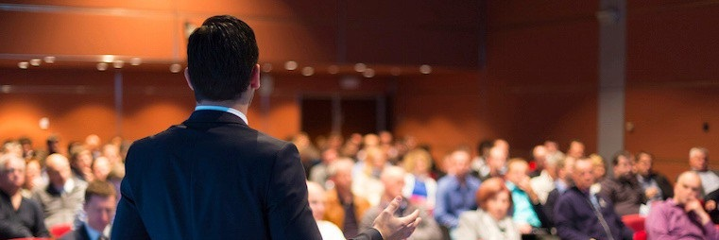
D5. Warm Up the Group
Copyright 1992-2015, Leadership Strategies, Inc. V15.03
Duplication prohibited without consent

Slide 37
D5. Warm Up the Group
Participants might be reserved initially
Get them used to responding, first non-verbally, then verbally
Ask a series of pre-questions that require a non-verbal response
Pre-questions should require some level of non-verbal participation
-
Manual
72
Notes:
We have covered both the Checkpoint and the Extended Checkpoint…..(Red) team, give me one of the 3 parts of a Checkpoint……(Blue) team, another….And, (green) team, that third and last part is…?
OK, (purple) team, give me a key difference between the Checkpoint and the Extended Checkpoint…..Great job….Give yourselves a hand. (Applaud.)
Let’s look at another technique to get your participants ready to engage….We call this Warming Up the Group……Can I ask (name) to read the example in the participant manual? And, as you read the example, simply model the text that is in bold……..Thank you…..
Everybody see the technique?…..Personally, I find this metaphor helps “connect the dots for the Warming Up the Group and the Great Starting Question”…Think of a 100-yard dash or the beginning of a short race…Compare that to the beginning of new agenda items in a training session…..Well, the outgoing folks, those that are more assertive, they are ready to “start” or engage when they hear a word like “what,” “when,” “how,” etc…..But, for the more pensive participants, those that are not quite at the starting block and need a little more time to “collect their thoughts,” well, we find that when you use the Warming Up the Group and then follow it with that visual, Great Starting Question, you will experience a broader and deeper response when you start a new agenda item or initiate a new conversation……Any questions or comments?...........

Slide 38

D6. Use PeDeQs for Directions
Copyright 1992-2015, Leadership Strategies, Inc. V15.03
Duplication prohibited without consent

Slide 39
D6. Use PeDeQs for Directions
Give the overall Purpose of the activity.
Use an Example if appropriate.
Give general Directions; use verbal pictures and gestures.
Give specific Exceptions and special cases
Ask for Questions.
Ask your Starting Question.
-
Manual
74
Notes:
Think back to the Engagement Strategies we covered earlier or those activities that you currently use in the sessions you facilitate…..Have you ever been in a class where the instructor asked you to work on some activity, either individually or in teams/groups?…..Ever had the “what is he/she asking me to do?” or, “why are we doing this?”moment of question?……Yes, I have as well…..This next technique is about giving instructions that “tie everything together” anytime you ask the participants to do something……Let’s look at how we mind our PeDeQs……..
(Go through the slide and then model some good PeDeQs using the flip chart of “Problems with Current Employee Performance Review Process.” Then, provide a great example of a Checkpoint and then the PeDeQs to start the activity.)
[After providing examples, assign each team the development of one PeDeQs for their opening engagement activity – from their IEEI – and combine this with a 10-minute break for a total of 20 minutes between the assignment and the break. Following that break, allow each team to present their PeDeQs and facilitate the debrief. For example, ask, “what did we like?” Then, “what could have made them better?” Or, have one team present, the next team provide feedback and rotate clockwise through the teams that way.]
Are there any questions?……..Good, this is a great, methodical process to provide the Why, the What and the How for any directions you provide in the classes you facilitate…..Any questions before we move on?.......

Slide 40
Sample PeDeQs
Problems with Our Performance Review Process
Problems | Symptoms | Root Causes
-
Notes:
Example of the flip chart to be used to demonstrate giving the PeDeQs…….

Slide 41

D7. Re-Direct Side Issues
Copyright 1992-2015, Leadership Strategies, Inc. V15.03
Duplication prohibited without consent

Slide 42

D7. Re-Direct Side Issues
Monitor comments for relationship to process underway
3 Tools:
    Objectives/Directions
    Ground Rules
    Parking Boards
-
Use a “Redirection Question.”
“Ask” don’t “Tell.”
Manual
77
Notes:
Remember our friend, Wandering Willie? Yes, as facilitators of the learning process, we must remain focused on the discussions or conversations in our classes…..We are monitoring every comment for how it applies or its relevance to the topic at hand…….Then, in addition, we have three other tools for ensuring we help keep the group focused….These are:
Clarity of objectives and directions…..
Ground rules to help the group self regulate…..and
Our three Parking Boards – the ABCs……(Green) team, the A is for… ?…….(Blue) team, the B is for…?……And, (purple) team, the C?……..
Finally, remember that Reacting Question we covered earlier…….Someone on the (red) team, take us back to what that is and when to use it…..Very good…..

Slide 43

D8. Order Speakers for Control
Copyright 1992-2015, Leadership Strategies, Inc. V15.03
Duplication prohibited without consent

Slide 44

D8. Order Speakers for Control
If several people want to speak, assign an order to your speakers
    “Let’s allow Mary to
    complete her thought, then
    we’ll go to Fredrick and then
    Emile”
Ensure that the order is maintained
Mary
Emile
Fredrick
-
Manual
78
Notes:
It is not unusual for me to have lots of people that want to add to a discussion….This is a great technique for maintaining order and knowing when to “end the conversation” while it is on a high rather than letting every participant that wants to engage on every topic every time……For example, there may be a half-dozen folks with their hands up, and you sense the topic being addressed has pretty much been covered. You might say something like, “You know, I think we are about there on the key parts on starting an employee performance review…..Let me take three more comments….And, I will take Paula, Rob and Jean in that order.”
Once you do that, maintain that order so that when you need to repeat that process, the participants will know that you order your speakers and then honor that order…..Any questions?........

Slide 45
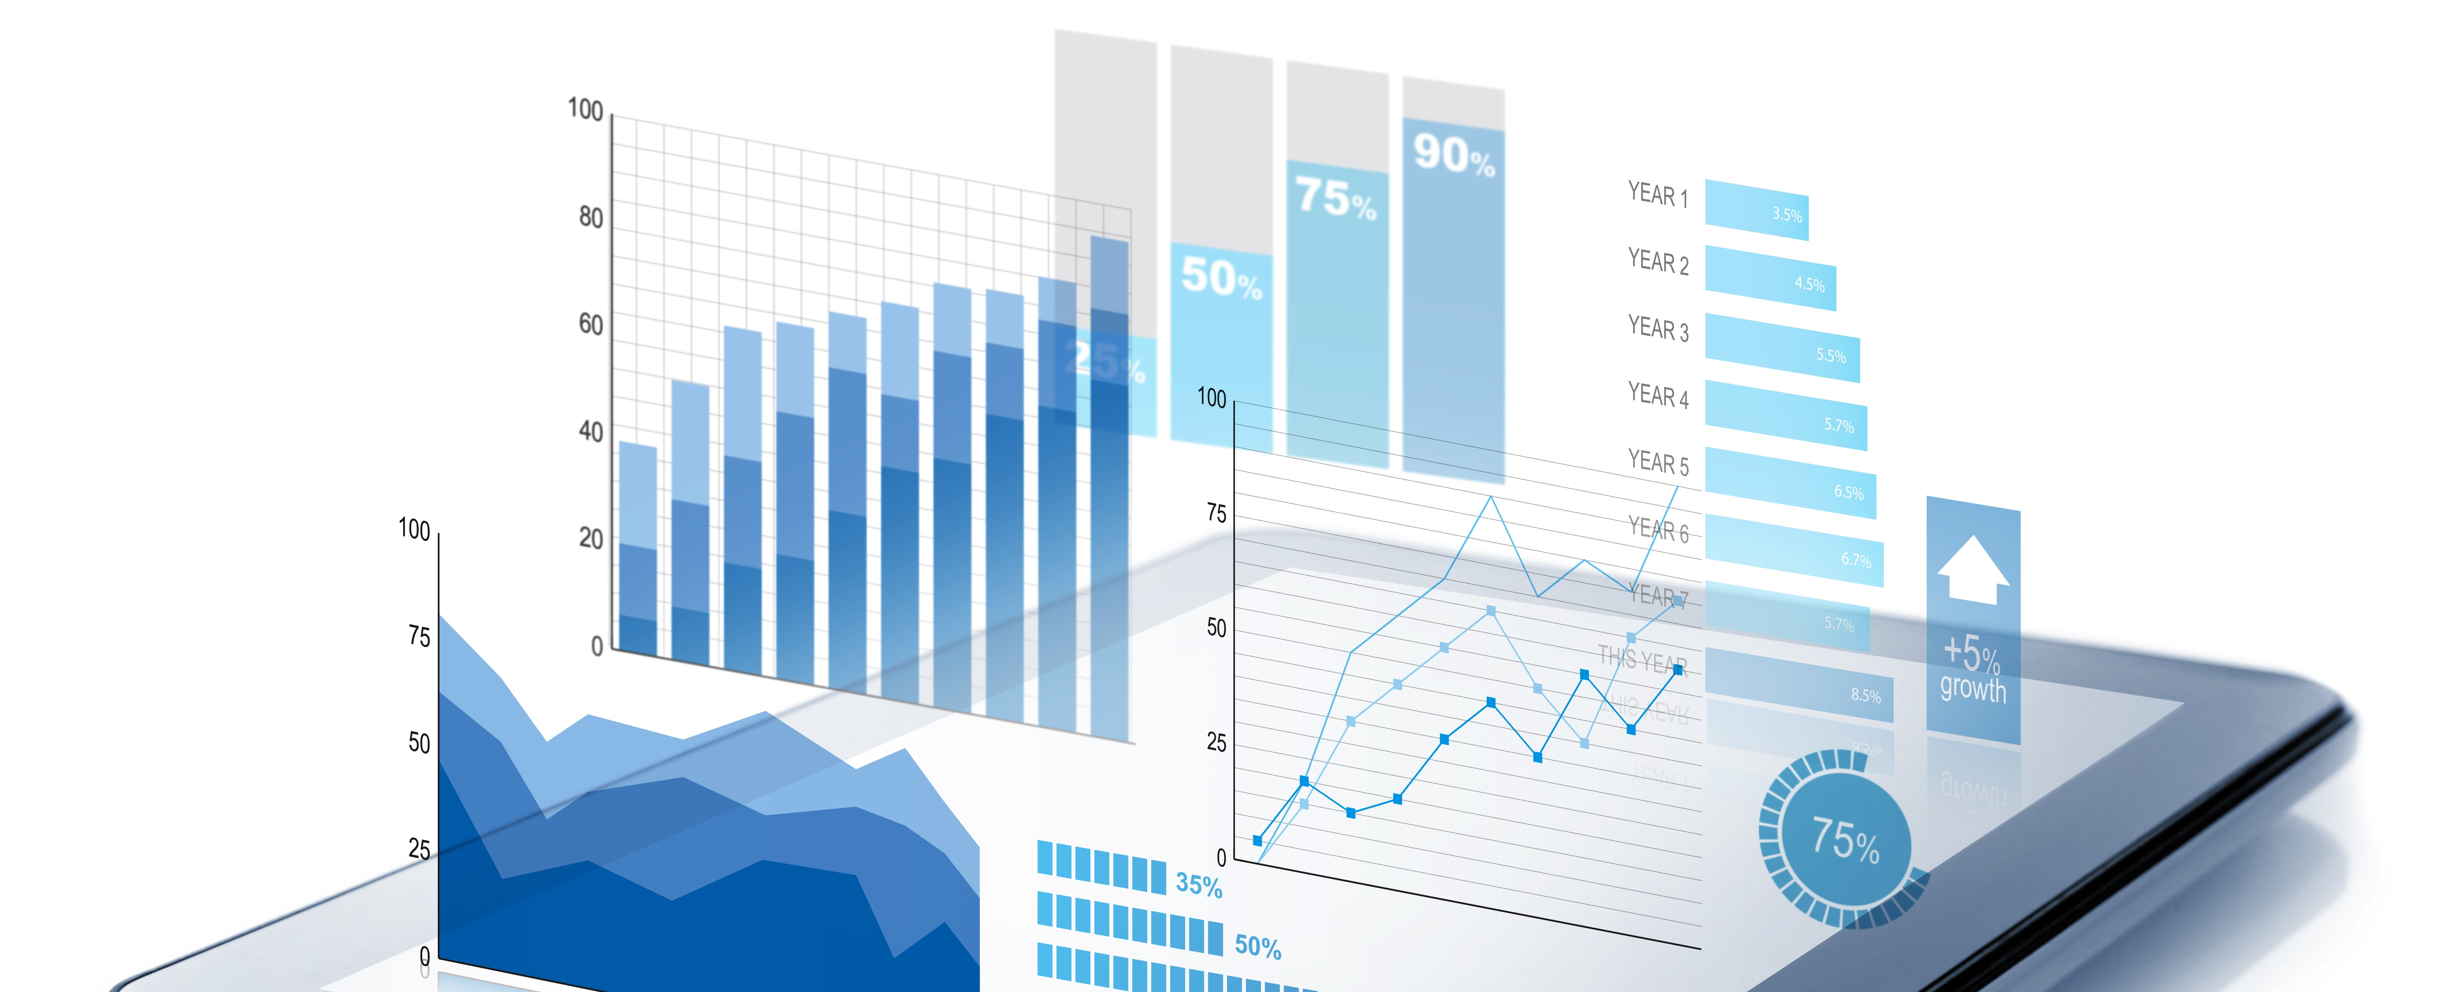
D9. Summarize Results
Copyright 1992-2015, Leadership Strategies, Inc. V15.03
Duplication prohibited without consent

Slide 46

D9. Summarize Results
Helps refocus the group
When?
If the group begins to stall
If an agenda item is completed
-
Summary
Consensus Check or Extended Prompt
Manual
80
Notes:
How many of you Summarize?.....Great, (name,) give us examples of when you Summarize….(Facilitate the conversation and cover the key points from the slide.)…..A key point to make is that most facilitators have only one or two techniques for focus and tend to use Summarizing to indicate the closing of an agenda item…..We now have filled your tool kit with a multitude of techniques – Summarizing being one of those tools…….

Slide 47

D10. Be Conscious of Time
Copyright 1992-2015, Leadership Strategies, Inc. V15.03
Duplication prohibited without consent

Slide 48
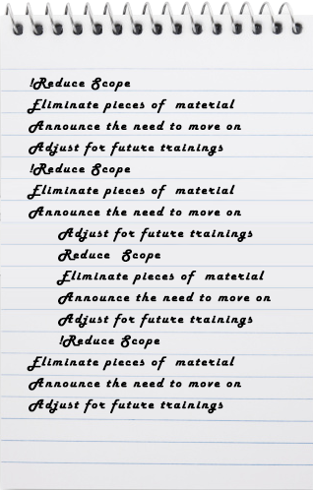
D10. Be Conscious of Time
Always start on time
Track start and end times for each section of material
Practice each section and time yourself
If behind…
Don’t
Speed up!
Reduce
Scope!
Eliminate pieces of material
Announce the need to move on
Adjust for future trainings
-
Manual
81-82
Notes:
When we first facilitate, be that a training session or a meeting, timing is one of the most prevalent challenges……Think about the techniques you use – the way you ensure you stay on time and topic…..What are some of the techniques you use today?….Let me start with the (red) team…..(Facilitate the conversation and wrap up with any key points that were missed.).
NOTES: Often, the difference between a WAG and a SWAG is covered here.
Also, ensure the tradeoff between scope, time and resources – and, to avoid speeding up to cover everything and doing justice to very little…It is best to adjust scope and allow the group to help you make an “informed decision” when falling behind…….

Slide 49

D11. Keeping the Energy High
Copyright 1992-2015, Leadership Strategies, Inc. V15.03
Duplication prohibited without consent

Slide 50
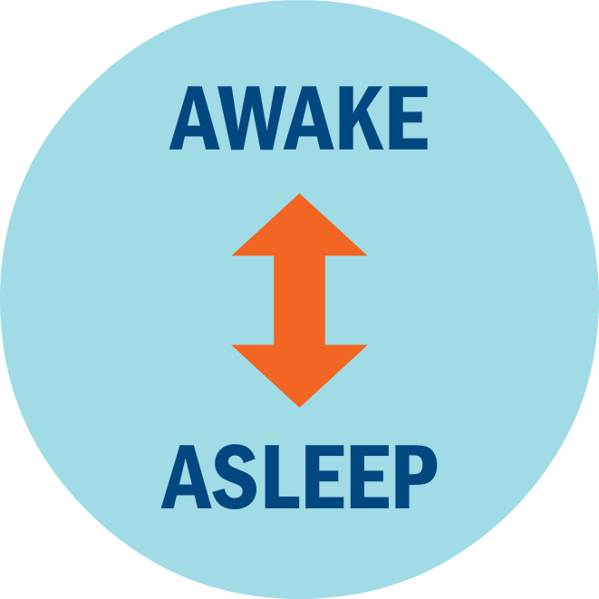
D11. Keeping the Energy High
Set an Energetic Pace
Your opening words establish the energy level
SET IT HIGH!
-
Manual
83
Notes:
Based on our experience, we find the single biggest differentiator between a good facilitator and a great facilitator is Energy……Think about that – think about the times you have been in a class with an instructor that just “grabbed you and kept you enthusiastic” for just about the entire session……What are the key reasons we find about Energy and a facilitator?…..(Blue) team, get me started…..(Facilitate the conversation.)
NOTE: If the key about Energy projecting confidence does not come up, try to lead and then float to get to this very key point…
Great, let’s begin with the 3 Es of Energy…..These are:
Engage the participants….We have talked about many different ways to engage…..Great area to be focused on in your preparation.
Energizes the participants….Energizes them around the topic…..If you are energized, it must be something good or exciting.
Elevates you as the facilitator in the eyes of the participants…….
With that, let’s talk about how to get to that appropriate level of energy using this Awake/Asleep construct…….

Slide 51
Level 1 Energy
For most of us, our normal speak voice has just enough energy to keep people awake.
3
2
Energy Level
1
AWAKE
0
ASLEEP
Time
Over the course of a training session, however, our voices tend to trail off and we fall below the line.
Notes:
Let’s start with Level 1 energy….What is that?…..Most of us conduct a telephone conversation at Level 1. (Pretend to have a telephone conversation and use Level 1 energy.)……If I were meeting with a project sponsor…..(Name), let’s pretend I am speaking to you, my project sponsor……(Grab a chair.) And, say a few sentences to this person at Level 1……
Now, can you imagine my getting up in front of all of you and facilitating this class at that level of energy?......Level 1? No way….It simply would not be effective…It does not work…….
So, let’s look at that next energy level.

Slide 52
Level 2 Energy
If you raise your energy to level 2, you start out great.
3
2
Energy Level
But you still trail
off below the line.
1
AWAKE
0
ASLEEP
Time
Notes:
Level 2 energy…..And, that is much better than Level 1…(Do a quick demonstration.)……But, we find that at Level 2 energy –which most people think is, frankly, speaking more loudly – while that is better than Level 1 energy, it, too, will eventually get below that Awake/Asleep threshold…….Now, let’s take a look at the next level – Level 3 energy……

Slide 53
Level 3 Energy
Start your energy
at level-3.
3
When it trails off, you will be at your normal speaking voice.
2
Energy Level
1
AWAKE
0
ASLEEP
Time
Notes:
Let me go back and do this opening at Level 1, then Level 2 and then Level 3 Energy…..After I have done all three levels, I will start a round-robin with (name), and let’s list the key differences of Level 3 Energy……..(Simply do a “Good Morning, it is a pleasure to be here this afternoon” at each of the three energy levels… Then, make a list of the key differences of Level 3 Energy.)
OK, does everyone get it?.......Any questions?…….Great, then let’s do a quick round of “Pass or Play.”….We will start with (name) and go clockwise around the room asking each person to either pass or play….What they will be doing, if they elect to play is saying, “Good afternoon, it is a pleasure to be here,” in their Level 1 and then their Level 3 Energy Level….When they are done, we will provide feedback by telling them whether or not they reached Level 3 Energy…..Are there any questions?......Good, let’s get started.
NOTE: This Exercise can really bring the room to a great energy level if it is done with real passion.
OK, give yourselves a hand…Nicely done…..Let me ask – do you think we only use this Level 3 Energy once in each session? (Shake your head.)

Slide 54
Resetting the Energy Level
Reset the energy level following every break.
3
2
Energy Level
1
AWAKE
0
Time
ASLEEP
Notes:
So, what is it we want to do?…….Let’s say our session starts at 8:30am….We start that session at Level 3 Energy….Around 9:45 or 10am, we take our first break…..When that break is over, you get back to Level 3 Energy….Then, we break for lunch….And, when we return from lunch, that’s right – back to Level 3 Energy at the start, etc……
In the eyes of the participants, what does this look like?…..Yes, the Red line……Our instructors are all recognized for the energy, enthusiasm and passion that they bring to the classroom….Isn’t that what all of you want as well? (Nod your head.)

Slide 55
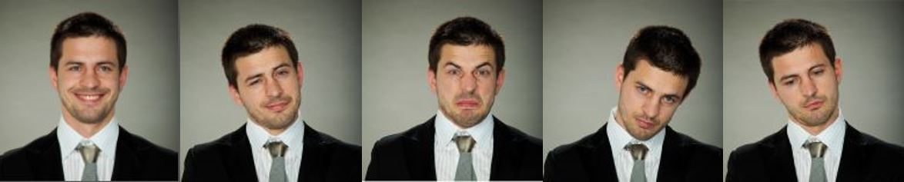
Standard Lullaby Times
Mid-morning | 10:30 – 11:00
After lunch | 1:30 – 2:00
Mid-Afternoon | 3:00 – 3:30
End of Day | 4:30 – 5:00
8:00 AM
5:00 PM
Manual
84
Notes:
OK, now many of us have been in that classroom when, after a heavy pasta lunch, the instructor comes in and turns the lights down, so we can review a video of how to conduct a great performance review or asked us to take 20-30 minutes reading an article or chapter in our manual. (Nod your head.)…..Let’s think about those times during the day when we typically see a lower energy level………These may not be exact…..Aren’t they the approximate times of those lulls times? (Nod your head.)…….So, what do we do?.........

Slide 56
Adjust to Lull Times
Schedule during the standard lull times:
  Icebreaker
  Small group break-out
  Facilitated process requiring movement
Avoid during the lull times:
  Lecture or long monologue
  Reading
  Individually assigned exercises
-
Manual
84
Notes:
Here are some dos and don’ts for those lull times…..Let me ask for your experience or tips around these times in our training sessions…..(Facilitate a discussion with the participants.)
NOTE: You may want to refer to the activities you have been doing during these times of the day and how you plan differently for agenda items early in the AM vs. right after lunch.

Slide 57
Establish a Recharge
Establish a simple recharge activity early on
Use praise to keep the energy high
“Choo choo!”
  "All aboard!”
  "Let's see the wave!"
  "Good job,"
  "Well done."
Manual
84-85
Notes:
(Blue) team, do you remember how we assigned our Choo Choo……What did you think?.....How has that been working for us?......You know it really is a little silly….But, hasn’t it really helped any and all of us to recognize when the energy level is diminishing and reenergize the group by doing that quick recharge?……My experience is that, while it may sound a little silly, over 50% of the clients we work with wind up adopting a Choo Choo for their training and meetings…….It really is a simple but effective tool….Any questions?........

Slide 58
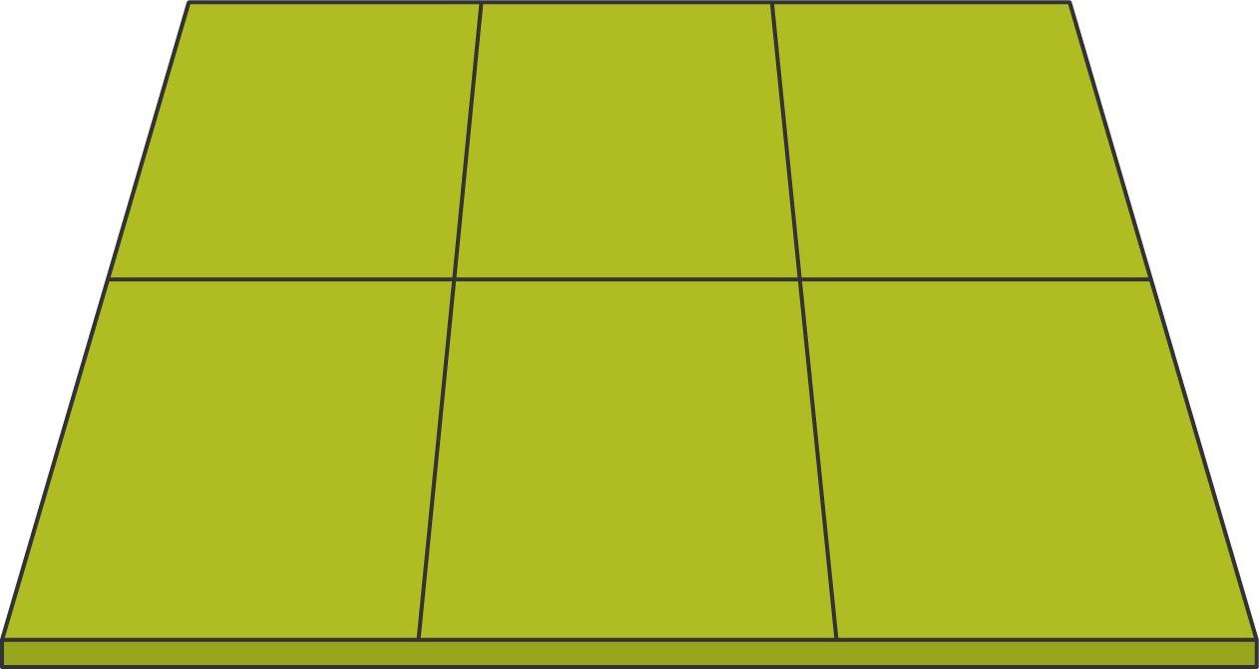

Move and Manage the Room--
Greatest Position of Strength
Manual
85
Notes:
The next few slides depend upon the size of your room and the number of participants, but they will show the better places for us, as instructors, to position ourselves when we are facilitating our training sessions……Let me know what you think and how you position yourselves today……
While this is the greatest position of strength, when using a projector we may have to slightly adjust this…..

Slide 59
Second Greatest Position of Strength
Notes:
Here are the next two best positions of strength…..

Slide 60
Weak Position
Notes:
Especially bad with that projector – isn’t it? (Shake your head.)

Slide 61
Weakest Position
Notes:
Weaker positions and typically too far away from the group…..Might indicate we are “intimidated” or carry a lack of confidence by stepping back and/or away…..

Slide 62
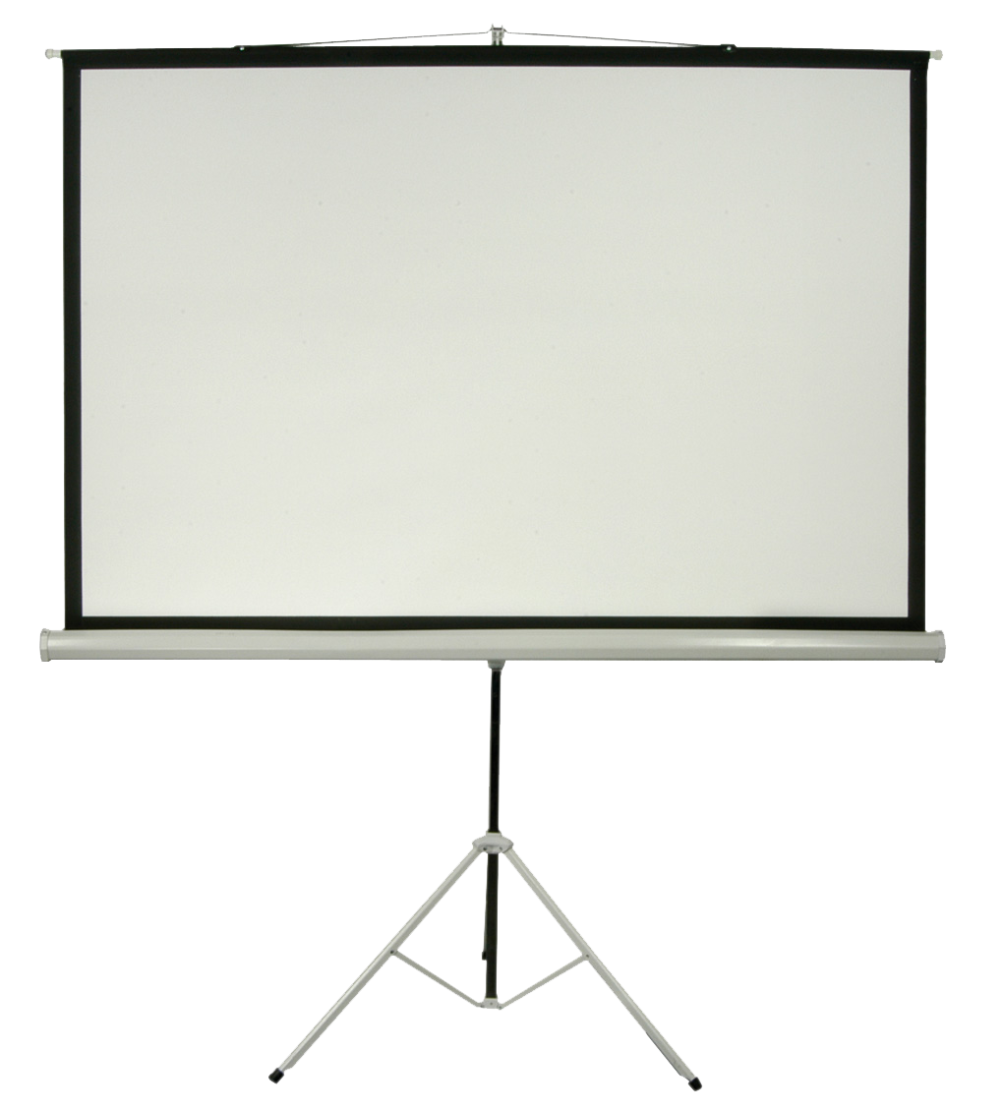
Best Place for Screen
Notes:
Pretty clear, isn’t it?……..Any comments or questions? Laziness vs comfortableness vs engaging vs being a part of them

Slide 63
Best Place for Speaker with Screen

Slide 64
Use Brainteasers, Icebreakers, Engagement Strategies
Brainteasers are positive mental games to keep the mind alert
They also help get people to think outside the box
-
Manual
85-86
Notes:
How many of you use brainteasers or icebreakers? (Raise your hand.) Good, can I ask a few of you to share your favorite and when you use them in your training sessions?......(Facilitate the conversation.)……..They are another form of engagement, and we support the use of these….The one word of caution is to ensure that the brainteasers, icebreakers or engagement strategies are focused on the training topic/agenda to both accomplish something as well as keep the group focused……Any further comments/questions?.......

Slide 65
Get People Involved and Moving
Direct questions to specific individuals
Use the standing method to brainstorm
Have people stand to ask a question
Pass a toy between speakers
Hold an oral quiz to review progress
Get participants to clap
  After each person gives objectives
  At the end of each activity
  Before every break
-
Manual
69
Notes:
Let’s me start at the (red) team and ask you to share which of these you have used and why/when……(Facilitate the discussion going from team to team.)……[Add your comments where appropriate to enrich the dialogue or stress key points.]

Slide 66

Break If Necessary
When the participants begin to wind down, the trainer should work extra hard to keep the energy high
If inattention continues to be a problem, recommend a break
-
Manual
87
Notes:
We talked about the 90/20/8 rule earlier today….And, we try to plan for breaks accordingly……At the same time, if we sense the group needs a break, we would recommend more breaks of a shorter duration rather than a session that seems to go on and on and on………

Slide 67
D. Delivering for Results
D1. Training vs. Facilitation
D2. Ask Starting Questions
D3. Ask Reacting Questions
D4. Use Checkpoints for Transitions
D5. Warm-up the Group
D6. Use PeDeQs to Give Directions
D7. Redirect Side Issues
D8. Order Speakers to Maintain Control
D9. Summarize Results
D10. Be Conscious of Time
D11. Keep the Energy High
-
Manual
59
Notes:
We have just completed our Application Exercise where we had an opportunity to work on the starting of our training…..Next, we are going to address Delivering for Results…..And, this is important so that in our training we can use the tools to keep our training interesting and focused while we, as the facilitators of the training, “carry the group through the process”………
Let’s do a brief review of some of the key point from Starting with Impact……(Conduct a few questions for backward build-up.)

Slide 68
Exercise 3: Inviting Participation
The objective of this exercise is to invite participation from the group and record information as required.
Use the material you brought from a training program you teach.
Create an engagement question that fits some part of the material. Use the PeDeQs model for giving directions (make sure your Starting Question is a Type B!)

Slide 69
Exercise 3: Inviting Participation
Timing
You will work in groups of four and have:
  20 minutes of prep time
  6 minutes for individual delivery
  4 minutes for debrief
Be sure your entire presentation does not exceed 6 minutes.
Use the feedback forms in your exercise packet to record your feedback for other participants that present.

Slide 70


The Engaging Trainer

