Slide 1
Checkpoint
DAY 1
DAY 2
DAY 3
Getting Started
Planning for Results
Review
Ex #2: Your Start
D. Delivering for Results
Review
F. Confirming Results & Closing
G. Managing Dysfunction
LUNCH
LUNCH
LUNCH
Ex #1: Experiential Learning
Starting with Impact
Homework
Ex #3: Inviting Participation
E. Managing Visual Information
Homework
Ex #4: Redesigning Your Session for Results
H. Next Steps
Close
Notes:
Here is our agenda for the entire course. On this flip chart (Flip Chart 3 w/ agenda for Day One), you will note that I have placed our agenda for the day as well. Before we move on, let’s take a look at your personal objectives and see where you believe we will address the categories in which we have grouped these objectives…..So, (blue) on the category of (poor behavior), where in the agenda do you believe we will cover that? OK, next team…….
Note: Ensure participants are identifying where their personal objectives will be addressed in the class. If there is an area or areas that are not addressed, guide the group to whether or not to adjust the agenda to meet their needs.

Slide 2

C. STARTING WITH IMPACT
Notes:
Timing: Between 75 and 90 minutes depending upon the size of the class
Flip Chart:
Flip Chart 1: Items to Cover to Start a Training Session
Flip Chart 2: Great Starts: IEEI
Inform: Purpose/Why
Excite: Benefits (to Them)
Empower: Roles they will play (Why me?)
Involve: Their personal objectives
Flip Chart 3: Parking Boards: The ABCs
Actions
Best Practices
Coming Attractions
Flip Chart 4: Order of the Start

Slide 3
Exercise 1:
Scenario 1: Changing from HP to a Mac computer
Scenario 2: Learning a new language
Scenario 3: New e-mail system
Scenario 4: A new partner/new leader
Scenario 5: Improving our meetings
Notes:
NOTE: In those rare cases when a participant has not arrived with a module for him/her to work with, you may assign one of these to work with for Application Exercise #1….In these cases, it would be very helpful for that participant to call his/her office and ask for a training module to be sent for the remaining exercises on Days 2 and 3.

Slide 4
C. Starting with Impact
C1. When You Arrive…
C2. Your Opening Words: I-E-E-I
C3. Request Participant Objectives
C4. Review the Agenda
C5. Establish Ground Rules
C6. Define the Parking Boards (ICA)
C7. Review Housekeeping Items
Manual 43
Notes:
Checkpoint: We have just completed Application Exercise #1 where we have the opportunity to apply some of the engagement activities we talked about earlier today……Next, we are going to cover how to Start with Impact…..And, that is important because, as we all know, we get one chance to make a good first impression. In this module we are going to provide you with seven techniques or best practices that will ensure you Start with Impact……
While these best practices or techniques are presented sequentially, we are going to start with C2, Your Opening Words, because we find this to be one of the critical parts of starting….Before we begin, I would like to use one of our Engagement Strategies called Last Person Standing to get us started….To do this, I would like to…

Slide 5
Starting with Impact
What are the most important things to do at the beginning of a training session?
Notes:
To begin this module, let’s try a round-robin……The way this works will be I will ask a question, and then, starting with (name) from the (red) team and then moving clockwise from participant to participant, you will have a chance to respond with an answer….Please feel free to pass or to say ditto (#4) if somebody else has offered one of the responses you had…..Are there any questions?.....OK, here we go….
Think about the last training session you conducted or the next session you have coming up…. You either kicked off that session or will be kicking that next session off……Think about the things you will want to do, the most important items to cover at the kick off……What are the most important things to do at the beginning of a training session?
(Name), get us started…….
NOTE: List on a flip chart and number the items, so they may be referred to as you conduct the round-robin…….
When completed, move to Section C2. Remember the tips/techniques are listed chronologically – Section C2 is the most important……..

Slide 6

C2. YOUR OPENING WORDS: IEEI

Slide 7
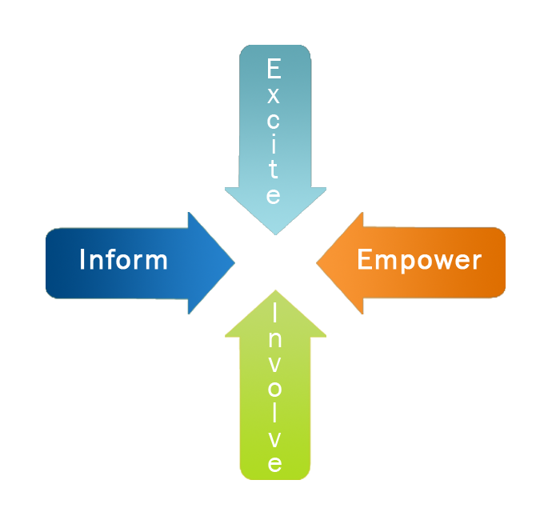
C2. Your Opening Words: IEEI
Through your opening words, you must:
Manual 47

Slide 8

C2. Your Opening Words: IEEI
Inform participants about the session purpose and learning objectives.
Why is the session being held?
What will they learn?

Slide 9

C2. Your Opening Words: IEEI
Excite participants about benefits.
What is the overall benefit of attending this training program?
What will they be able to do as a result of attending?

Slide 10

C2. Your Opening Words: IEEI
Empower participants by discussing the important role they play in the process.
What expertise/experience do they bring?
Are they willing to share with others?

Slide 11

C2. Your Opening Words: IEEI
Involve participants through personal objectives and participation.
What do they want to get out of the program?

Slide 12
C2. Your Opening Words: IEEI
Which are we best at?
Which are we worst at?
Let’s look at 2 Examples
Notes:
Now that we have looked at the 4 parts of a Great Start, let me ask, by a show of hands:
How many of you think you are best at the Inform? (Raise your hand.).....About x%
How about best at Excite? (Raise your hand.)
How about Empower? (Raise your hand.)
Finally, how about the Involve? (Raise your hand.)
In general, the participants in both our Facilitation Skills for Trainers as well as our The Effective Facilitator courses tell us they are worst at the Excite. And, when you think about it, this is also all about the Why or the WIIFM…..So, let’s take a look at the following examples and pick up a tip on how to build those great Excite statements……

Slide 13
Excite Example #1
Good morning, it’s a pleasure to be here this morning.
Our objective for the next two days is to walk away with an approach to conduct better performance reviews (inform).
What is exciting about this?
If we are successful, we will walk away with a new process that will help our organization provide feedback to our employees about their performance.
Notes:
(Name), would you please read this Excite Statement?…….Thank you……
Folks, what do you think? (Facilitate the discussion….Ensure to make the point that this isn’t bad….It is, however, more about what’s in it for the organization or the other person.)
So, let’s take a look at another example……

Slide 14
Excite Example #2
Good morning, it’s a pleasure to be here this morning.
Our objective for the next two days is to walk away with an approach to conduct better performance reviews (inform).
What is exciting about this?
Today you may have people on your staff who don’t have the skills or the attitude you need. As a result, you are having to work much harder to make up for what they are or aren’t doing. This is your opportunity to learn how to conduct performance reviews to coach your people to improve their performance, to focus on their strengths and develop in those areas necessary; and, in the end, make your jobs easier.
-
Notes:
(Name), would you please read this Excite statement?….
(Again, facilitate a discussion about things that are good, bad, or other about this example.)
Now, let’s look at them side-by-side……

Slide 15
Which is better? Why?
If we are successful, we will walk away with a new process that will help our organization provide feedback to our employees about their performance.
Today you may have people on your staff who don’t have the skills or the attitude you need. As a result, you are having to work much harder to make up for what they are or aren’t doing. This is your opportunity to learn how to conduct performance reviews to coach your people to improve their performance, to focus on their strengths and develop in those areas necessary; and, in the end, make your jobs easier.
Notes:
Take a look at these two examples of Excite statements………Would you please stand if you think the statement on the left is better?……OK, about x%.....
Now, those of you that are standing, please take a seat…..Those of you that think the Excite statement on the right is better, would you please stand?
(Take a look.) About x%.....And, that is typical in the other classes where we ask which is best……Typically over 90% of participants prefer the statement on the right…….And, for many of the reasons you have shared……(Add any others you would like to cover.)

Slide 16
Which is better? Why?
If we are successful, we will walk away with a new hiring process that will help our organization get the right people hired and get them hired quickly.
Today you may have people on your staff who don’t have the skills or the attitude you need. As a result, you are having to work much harder to make up for what they aren’t doing. This is your opportunity to put strategies in place to ensure that you get the people you need to get the work done.
Notice the # of “you” and “your”!
With Excite:
Say “you” or “your” at least 4 times!
Notes:
Take a look at these two examples of Excite statements………Would you please stand if you think the statement on the left is better?……OK, about x%.....
Now, those of you that are standing, please take a seat…..Those of you that think the Excite statement on the right is better, would you please stand?
(Take a look.) About x%.....And, that is typical in the other classes where we ask which is best……Typically over 90% of participants prefer the statement on the right…….And, for many of the reasons you have shared……(Add any others you would like to cover.)

Slide 17
Exercise: Practice with Excite
Masterful meetings training
Or for a session from your training module
-
Notes:
Now, what we would like to do is give you an opportunity to practice building great Excite statements……In your teams, can each of you build an Excite statement for either of the following?
A training to establish masterful meetings in your organization OR
The training module you brought with you
We will give you five minutes to write your Excite statement individually…..
Then, after each of you has completed this, we will give each of you two minutes to share the statement you built with your team members…..
Once you have shared your Excite statement within your team, we would like each team to select one team member to share his/her Excite statement with the entire class…..Are there any questions……..OK, let’s get started……
[When this exercise is completed, ask the group to return to Section C1 of this module.]

Slide 18

Practice Your Opening
Being nervous is normal.
The best remedy is PRACTICE.
Practice allows you to focus on establishing maximum rapport through eye contact, movement and gestures.
Use the mnemonic technique
Manual 48
Notes:
Back again to getting those “butterflies to fly in formation”…..In our opening, we really are in complete control until we ask that Involve question…..So, why would we not have this “down pat”?……There are several techniques, and practice is certainly a common one. And, for some of us the mnemonic technique is very helpful…….Are there any other approaches some of you would like to share?

Slide 19
Common Mnemonics
Mnemonics are memory devices.
Create mnemonics for your trainees to help them remember…
MADD
EGBDF
___ before ___ except after ___
30 days hath September, etc…
A,B,C,D,E,F,G,etc. (song)
-
Notes:
What is a mnemonic?…..Here are a few……(Green) team, what is MADD?…….[Go through as many of these as you would like.]….Well, next is a possible mnemonic that you might find helpful for the start of a session…..

Slide 20
Sample Opening Words
Good Morning …
I always enjoy . . .
My experience with . . .
Your role is . . .
Objective for the next three days . . .
Session will be fast-paced . . .
Introductions . . .
.
-
Manual 49-50
Notes:
GIMYOSI.......In many of the classes we teach, our experience has been that several of the participants find this very helpful……

Slide 21
Effectively Deliver Opening
Stand Tall
Speak loudly and clearly
Avoid speaking too fast or too slow
Be animated
Make eye contact
Use defined gestures
Avoid “self-talk”
Avoid filler words like “ah”, “um”, “okay”
Avoid extremes in dress or grooming
Ensure facial expressions match your words.
Use appropriate movement
-
Manual 51
Notes:
On this slide we have many reminders or another checklist for your consideration…..Let me have a little fun with this and highlight some key points…..During your start, this is not a good time for the:
Front fig leaf
Reverse fig leaf
Cement feet
Reading your notes (Good morning, it is a pleasure to be here this morning……)
Eye contact…..Look into some of the participants’ eyes for a count of 3, then move on to another participant, etc.
Have your gestures and facial expressions reflect the same message as your words……
How about self-talk? How many of you are aware or have experienced a trainer or meeting leader that does that?.....[Have them share what it is and the impact it has.]
What about the filler words? Somebody else share with us what that does to you as a participant………

Slide 22
Effectively Deliver Opening
Move deep into the U to build rapport
Avoid turning your back to participants
Don’t hold papers
Don’t speak to slides
Don’t talk to flip charts
-
Manual 51
Notes:
Here is some “icing on the cake.”…..As the facilitator of training, how would you prefer the dynamic of the room to be? Do you want it to be you vs. them? (Shake your head.) Or, do you want the participants to see you as their aid, their facilitator of the learning process? (Nod your head.)……Great, so a key point here is to break that invisible barrier between the group and you, as the facilitator……….Also, avoid the other key points on the slide like turning your back reading papers and/or slides…..etc.

Slide 23

C1. WHEN YOU ARRIVE
Duplication prohibited without consent

Slide 24

C1. When You Arrive
Set-up with 30 minutes to spare
Estimate your set-up time
Unfamiliar location: Add 30 minutes
Familiar location: Add 10-20 minutes
Total = ?
Manual 44
Notes:
How many of you have ever waited until the last minute to do anything? (Raise your hand.).....Yes, I have too, but it isn’t a very good feeling, is it? (Shake your head.)…….Well, the #1 fear remains public speaking, and delivering training is a form of public speaking. It is OK to have butterflies in your stomach…The key is to get those butterflies “flying in formation.”…….Here are some tips to ensure you do that…..
The first is to arrive early with at least 30 minutes to spare when in an unfamiliar location……So, (blue) team, let me ask you:
You will be training in a new office location
The training is schedule to kick off at 8:30am
You will need about 20 minutes to set the room up and get everything you need set up
What time should you arrive?.......[Allow them to answer.]
ANSWER: No later than 7:40am…..That gives you until 8am to set up, and then, you will have 30 minutes to spare.
So, who can tell me why we want that much time to spare? ….[Open up for discussion.]
Great, now in a familiar location, of course, we need less time, and we find allowing 10-20 minutes typically is sufficient….The overall key here is, frankly, Murphy’s Law – what can go wrong, will go wrong… and at the most inopportune time possible….Don’t let that happen to you!!!

Slide 25
Optimize Your Set-Up
Ensure that chairs and tables are arranged
Ensure adequate supplies
Multi-colored markers and tape
Flip Charts
Projector and screen
Spare bulb
Set-up and post:
Session Objective
Session Agenda
Parking Boards
Ground Rules
Put out name cards and sign-in sheet
Manual 44
Notes:
Now, during that set-up time, here are some of the activities to perform or a checklist to help ensure you leave no stone unturned……..
[Facilitate a discussion by asking participants to speak to some of their key experiences, both good and bad, and discuss the importance of each……A key point here is to start with the items that will have the most adverse effect on your session if they go wrong (the burned out lamp in the projector) to give you as much time as possible to correct it.]

Slide 26

Use the Gathering Period
Establish personal rapport
Suggested topics to chat about:
Completing pre-course/readiness activities
Training content and topics
Their background with
course content
Need for high participation
Other suitable, neutral
topics
-
Manual 45
Notes:
Now, when you allow that “time to spare,” you can take advantage of the Gathering Period……(Purple) team, what do we mean as the Gathering Period?……..Good, anything to add from the other teams?……..
(Red) team, can you tell us what the first two bullet points mean to you?…….(Blue) team, how about the last two?……Let me open this up to everyone – are there any other activities that you ensure you address during the Gathering Period?

Slide 27

Start Promptly
Ensure that the person who will kick-off the session is aware of his/her role and that you agree on timing.
Give the two-minute warning.
Other methods to ensure that the session starts on time?
Manual 46
Notes:
The key point here is DON’T PUNISH THE PUNCTUAL!!! How many of you find this to be an issue in your organization? (Raise your hand.) Yes, we find this to be a common challenge in more organizations than we would like to see…….
A key here is to “set people up for success” rather than “punish them” for behavior you do not want……With that in mind, what are some of the techniques we might use to ensure we have a prompt start? ……[Facilitate the discussion.]

Slide 28

C3. REQUEST PARTICIPANT
OBJECTIVES
Duplication prohibited without consent

Slide 29
C3. Request Participant Objectives
WHY?
Involves them immediately
Lets them know their needs and desires are being considered
Provides opportunity to integrate their interests into the training
-
Manual 52
Notes:
Remember the last part of the IEEI? Let’s do a quick review of them all:
(Purple) team, what is included in the Inform? (Purpose)
(Blue) team, how about the Excite? (Benefits…WIIFM)
(Green) team, how about the Empower? (Roles they will play)
And, now back to the Involve, (red) team? (Their personal objectives)
Why do we find it so helpful to get the Involved so early in the session? Have you ever had the dreaded “deafening silence” when you asked a question of the participants, and you received no responses? So have we….One of the keys is to involve them early – to let them know their needs are important to you, and here is a great way to do just that…..Ask them their needs and desires and give both you and them an opportunity to integrate those needs into the training….Help make it theirs!

Slide 30
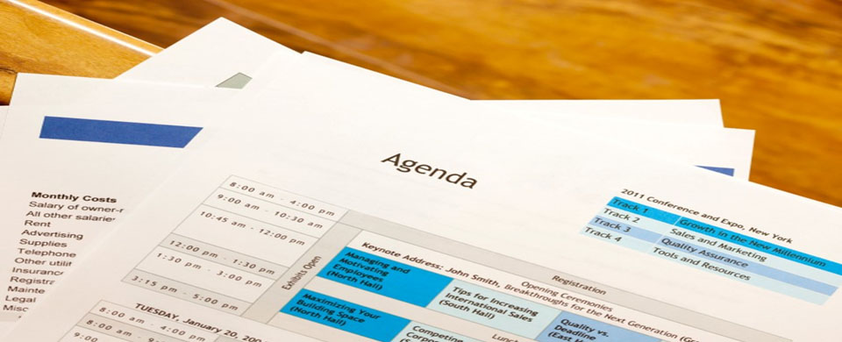
C4. REVIEW THE
AGENDA
Duplication prohibited without consent

Slide 31

C4. Review the Agenda
Review the agenda for the session.
Return to the participants' objectives:
Indicate when/how each item will be covered
Highlight items that will not be discussed
Suggest or allow the group to suggest how highlighted items are to be handled
Cover times set aside for each topic
Overview homework and exercises
-
Manual 53
Notes:
A powerful technique once you have addressed their needs through the Involve part of the IEEI is to next cover the agenda. And, at the end of covering the agenda, who can tell me what I did earlier this morning?
Great, that’s right – I asked you, the participants, to map your categorized needs to our agenda. That does two very important things:
It demonstrates where their need will be addressed. (It is most important for them to see their needs are planned to be addressed.)
It give you the opportunity to address any items that may need to be covered or deferred at the beginning of the session.
Notice that we do cover the “administrative” topics like lunch time, breaks, where the restrooms are, etc. – but at the end rather than at the beginning of the training. They need to be covered, yet why would we start with these C-level items?…..Let’s cover the most important items first……

Slide 32


C5. ESTABLISH GROUND
RULES
Duplication prohibited without consent

Slide 33
C5. Establish Ground Rules
Encourage self-correction
Can address issues you identified during preparation stage
Serve to prevent dysfunctional behavior
Can be used to take an issue off the table
Get agreement on the ground rules before moving forward!
-
Manual 54
Notes:
This is a really important point – Ground Rules…….Why? How many of you have had some sort of poor/bad behavior in the classes you teach or attend? (Raise your hand.) Yes, isn’t it a shame that this is the rule rather than the exception? (Nod your head.)…..Having Ground Rules is a great technique to eliminate, or at least avoid, much of this behavior.
Do most of you use Ground Rules?…Let me see a show of hands. (Name), how do you use them? When do you cover them? …[Facilitate a discussion about Ground Rules pointing out some potential Ground Rules to “take issues off the table” as a part of our facilitating the learning process.]
One of the key points I want to leave us with here is the need to get the participants to “agree” to the Ground Rules…..It is part of “making it theirs” and allows you to remind them that if they agree to them, they will agree to assist you in enforcing them…..So, for example, if a Ground Rule is “Respect the Speaker” or “One Conversation” and a neighbor of theirs starts whispering to another participant, we expect them to help remind the whisperer of the Ground Rules…….

Slide 34
Sample Ground Rules
Everyone Speaks
Respect the Speaker
No Idea is Dumb
Use the Parking Boards
Avoid "Bar Discussion”
"Choo Choo”
Cell Phones Off.
Start on Time / End on Time
Manual 54
-
Notes:
Here are some Sample Ground Rules….Do any of you have others you have found helpful?..... [Allow them to share and then have some of yours to share such as:
nEtiquette
Spelling does not count
Share the air
Seek first to understand]

Slide 35
C6. DEFINE PARKING BOARDS - ICA
Duplication prohibited without consent

Slide 36
C6. Define Parking Boards (ICA)
Issues List
Items relevant to the training but need to be discussed outside the session
Actions List
Actions to be performed
sometime after the
completion of the session
(or later in the session).
Coming Attractions Board
Items or Questions that surface before they are scheduled to be taught in the session.
Manual 55-57
Notes:
Part of the Ground Rules is the introduction of the three Parking Boards: the ICAs……[Cover the slide.]

Slide 37

C7. REVIEW
HOUSEKEEPING
Duplication prohibited without consent

Slide 38
C7. Review Housekeeping
Discuss any housekeeping items such as the following:
Schedule for lunch and breaks
Location of bathrooms and phones
-
Manual 58
Notes:
Another reminder, as we discussed before – these are necessary but not critical, so we cover them toward the end of the start of our session.

Slide 39
What is the recommended order?
Learning Objectives
Parking Boards
Agenda
Purpose of the Class
Ground Rules
Participants’ Objectives
Excite/Empower
-
Notes:
We have just completed Starting with Impact……Are there any questions or comments?
Great, then let’s select a new team lead. (Select the team lead.)…..Now, let me ask each team to order the items on this slide, have the team lead put them on a single sticky note, and give me that sticky note….I will give you three minutes……..

Slide 40
The Recommended Order
D. Purpose of the Class
A. Learning Objectives
G. Excite/Empower
F. Participants’ Objectives
C. Agenda
E. Ground Rules
B. Parking Boards
Inform
Excite
Empower
Involve
Notes:
[Review the correct order to Starting with Impact and cover any final questions.]

Slide 41
C. Starting with Impact
C1. When You Arrive…
C2. Your Opening Words: I-E-E-I
C3. Request Participant Objectives
C4. Review the Agenda
C5. Establish Ground Rules
C6. Define the Parking Boards (ICA)
C7. Review Housekeeping Items
Manual 43
Notes:
Checkpoint: We have just completed Application Exercise #1 where we have the opportunity to apply some of the engagement activities we talked about earlier today……Next, we are going to cover how to Start with Impact…..And, that is important because, as we all know, we get one chance to make a good first impression. In this module we are going to provide you with seven techniques or best practices that will ensure you Start with Impact……
While these best practices or techniques are presented sequentially, we are going to start with C2, Your Opening Words, because we find this to be one of the critical parts of starting….Before we begin, I would like to use one of our Engagement Strategies called Last Person Standing to get us started….To do this, I would like to…

Slide 42


The Engaging Trainer

