Slide 1
The Effective Facilitator: Virtual Link
Principle 9

Slide 2
Checkpoint
8:30 – 10:00
1:30 – 3:00
Getting Started
Information Gathering
Preparing
Review
Dysfunction
Consensus
Energy
10:30 – 12:00
3:30 – 5:00
Starting
Focusing
Power of the Pen
Closing
Agenda Setting
Special Cases
Review and Close

Slide 3
Checkpoint
The Facilitation Cycle
VIRTUAL PLATFORM
4.
The Power of the Pen
1.
Preparing for Success
2.
Getting the Session
Started
3.
Focusing the Group
9.
Closing the Session
9.
Closing the Session
5.
Information Gathering
6.
Managing Dysfunction
7.
Consensus Building
8.
Keeping the Energy High
Group
Dynamics
10.
Agenda Setting

Slide 4
The Virtual Dilemma
You are at the end of the agenda and are ready to wrap up your virtual session. There are two actions that have been identified, one decision, and two issues that remain outstanding.
At the end of a virtual session, what should you do with outstanding issues?
-
Manual 9-2

Slide 5
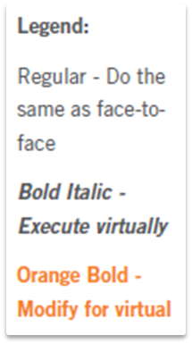
Principle 9
Closing the session
Review, Evaluate, Close, Debrief
Request Time Extensions if Needed
Review the Activities Performed
Review Session Purpose
Review the Participants’ Key Topics
Review Parking Boards
Ask Participants to Evaluate
Close and Set the Stage
Use Partial Close as Needed
Debrief with Planning Team
Debrief with Sponsor
Document Session Results

Slide 6

Review, evaluate, close, debrief

Slide 7

a. Request time extensions if needed
7
Copyright 1992-2015, Leadership Strategies, Inc. V15.02
Duplication prohibited without consent

Slide 8

B. REVIEW the ACTIVITIES PERFORMED
8
Copyright 1992-2015, Leadership Strategies, Inc. V15.02
Duplication prohibited without consent

Slide 9

c. REVIEW the session purpose
9
Copyright 1992-2015, Leadership Strategies, Inc. V15.02
Duplication prohibited without consent

Slide 10

d. Review the partICIPANTs’ KEY TOPICS
Manual 9-3
10
Copyright 1992-2015, Leadership Strategies, Inc. V15.02
Duplication prohibited without consent
Notes:
Changed font to white

Slide 11
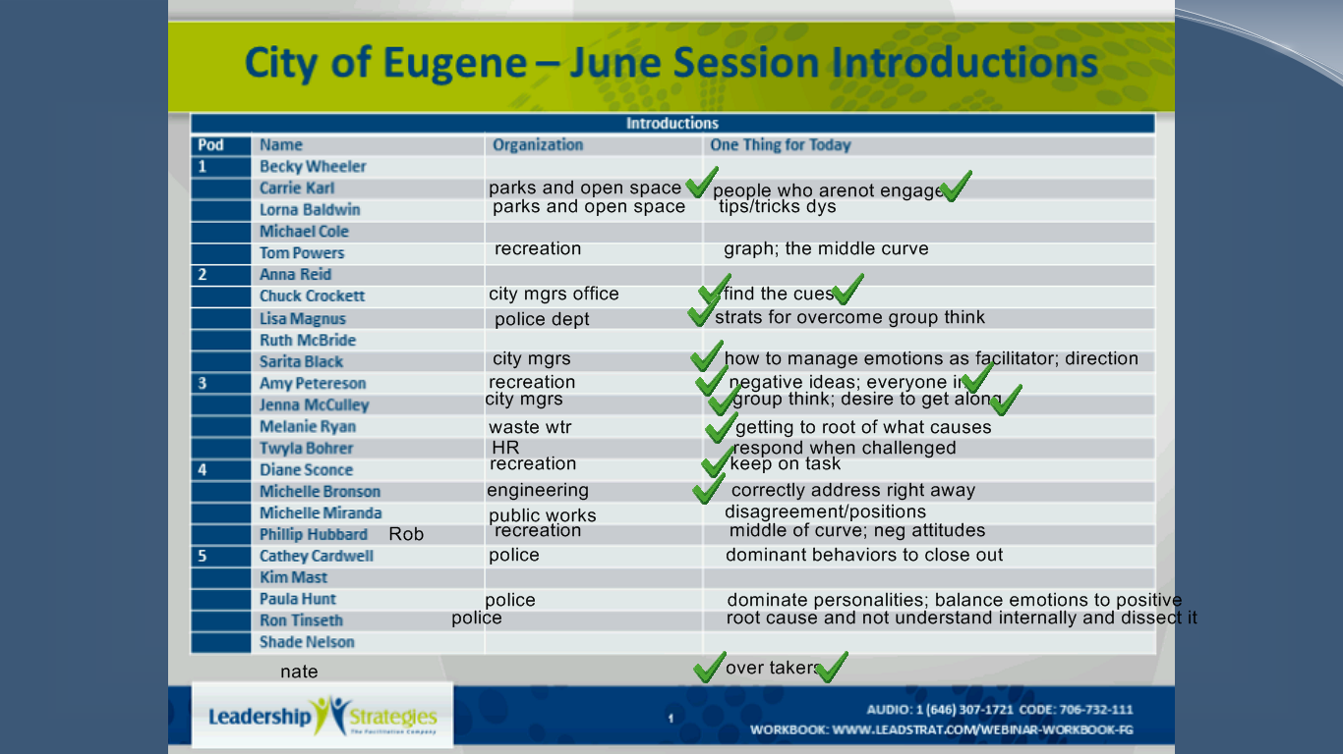
D. Review Participants’ Key Topics
Manual 9-3
Notes:
HERE IS AN EXAMPLE SLIDE BOARD USED TO REVIEW PARTICIPANT KEY TOPICS

Slide 12

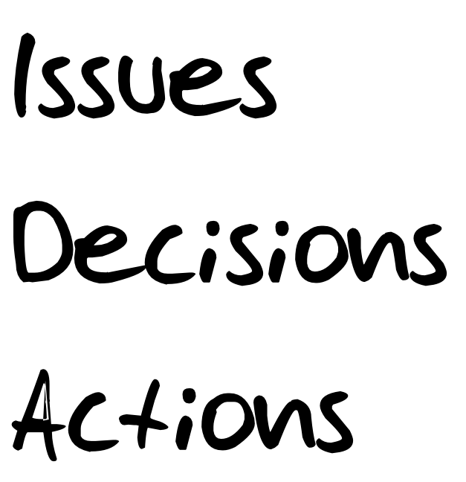
e. Review parking boards
12
Copyright 1992-2015, Leadership Strategies, Inc. V15.02
Duplication prohibited without consent
Notes:
Changed font to white

Slide 13
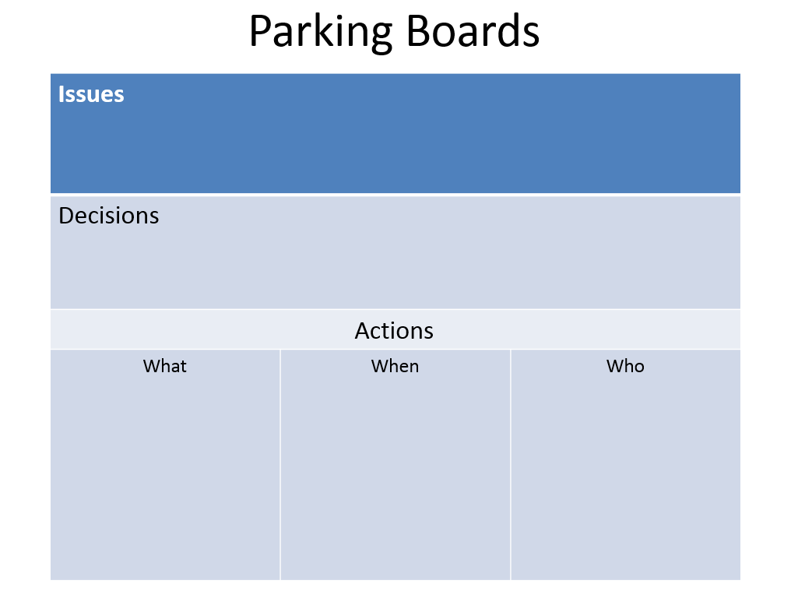
E. Review Parking Boards
Manual 9-4

Slide 14

f. Ask participants to evaluate
14
Copyright 1992-2015, Leadership Strategies, Inc. V15.02
Duplication prohibited without consent
Notes:
Changed font to white

Slide 15
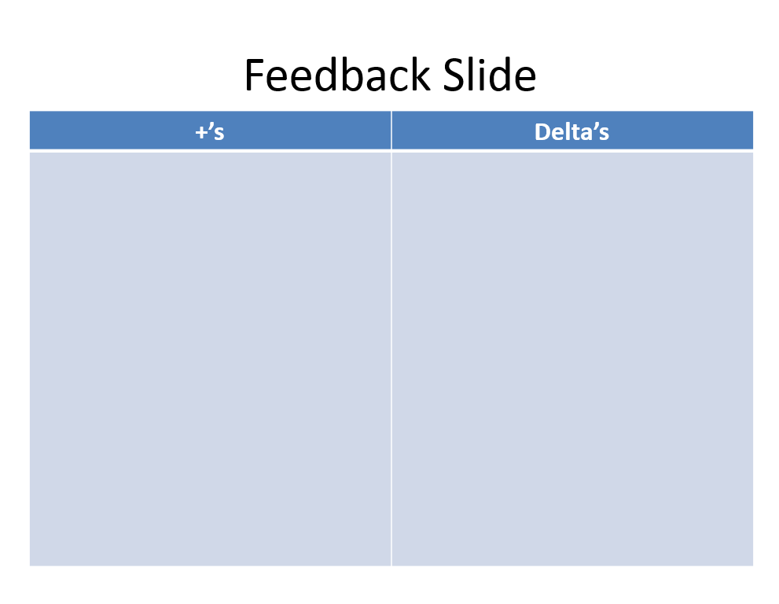
F. Ask Participants to Evaluate
Use a whiteboard, slideboard or screen share to document the feedback.
Encourage specific comments – whether positive or negative.
Manual 9-5
Notes:
SAMPLE FEEDBACK SLIDE
Use a whiteboard, slideboard or screen share to document the feedback.
Encourage specific comments – whether positive or negative.

Slide 16
Feedback Slide
More Of | Less Of

Slide 17
Feedback Slide
Things We Liked | Ways to Make It Better

Slide 18

G. Close and set the stage
18
Copyright 1992-2015, Leadership Strategies, Inc. V15.02
Duplication prohibited without consent

Slide 19

h. Use partial close
As needed
19
Copyright 1992-2015, Leadership Strategies, Inc. V15.02
Duplication prohibited without consent

Slide 20

i. Debrief with the planning team
20
Copyright 1992-2015, Leadership Strategies, Inc. V15.02
Duplication prohibited without consent

Slide 21
I. Debrief with the Planning Team
The debriefing should occur some time shortly after the session -
preferably within 24 hours following it.
The debriefing session should cover:
How well were the key topics or objectives of the session met?
Did the participants effectively use the necessary features of the virtual meeting platform? Should additional features be introduced in future sessions?
How well did the participants respond during the session?
How sufficient are the deliverables from the session?
What follow-up activities are needed?
Manual 9-6

Slide 22

j. Debrief with the sponsor
22
Copyright 1992-2015, Leadership Strategies, Inc. V15.02
Duplication prohibited without consent

Slide 23
J. Debrief with the Sponsor
Schedule a virtual meeting with the sponsor to discuss the session process and the results.
The debriefing session should occur some time shortly after the session - preferably within 24 hours following it - and cover similar topics to those described in the previous section.
Manual 9-7

Slide 24

k. Document session results
24
Copyright 1992-2015, Leadership Strategies, Inc. V15.02
Duplication prohibited without consent

Slide 25
Solving the Virtual Dilemma
You are at the end of the agenda and are ready to wrap up your virtual session. There are two actions that have been identified, one decision and two issues that remain outstanding.
At the end of a virtual session, what should you do with outstanding issues?
-
Notes:
LEAD THE DISCUSSION AND SHOW SOME SAMPLE PARKING BOARDS (THE SHARED NOTES FROM LIVE MEETING AND THE NEXT SLIDE AS EXAMPLES OF HOW TO USE PARKING BOARDS EFFECTIVELY IN VIRTUAL SESSIONS

Slide 26
Parking Boards
Issues
Decisions
Actions
What | When | Who

Slide 27
Checkpoint
The Facilitation Cycle
VIRTUAL PLATFORM
4.
The Power of the Pen
1.
Preparing for Success
2.
Getting the Session
Started
3.
Focusing the Group
9.
Closing the Session
9.
Closing the Session
5.
Information Gathering
6.
Managing Dysfunction
7.
Consensus Building
8.
Keeping the Energy High
Group
Dynamics
10.
Agenda Setting

Slide 28
Principle 9
Closing the session
Review, Evaluate, Close, Debrief
Request Time Extensions if Needed
Review the Activities Performed
Review Session Purpose
Review Key Topics
Review Parking Boards
Ask Participants to Evaluate
Close and Set the Stage
Use Partial Close as Needed
Debrief with Planning Team
Debrief with Sponsor
Document Session Results

