Slide 1
The Effective Facilitator: Virtual Link
Principle 8

Slide 2
Checkpoint
8:30 – 10:00
1:30 – 3:00
Getting Started
Information Gathering
Preparing
Review
Dysfunction
Consensus
Energy
10:30 – 12:00
3:30 – 5:00
Starting
Focusing
Power of the Pen
Closing
Agenda Setting
Special Cases
Review and Close

Slide 3
Checkpoint
The Facilitation Cycle
VIRTUAL PLATFORM
4.
The Power of the Pen
1.
Preparing for Success
2.
Getting the Session
Started
3.
Focusing the Group
9.
Closing the Session
5.
Information Gathering
6.
Managing Dysfunction
7.
Consensus Building
8.
Keeping the Energy High
8.
Keeping the Energy High
Group
Dynamics
10.
Agenda Setting

Slide 4
The Virtual Dilemma
You are about to begin working with your first task force, and the work will be conducted virtually. How will you avoid becoming that “lifeless” virtual session leader that you have experienced frequently when others lead virtual meetings?
-
Manual 8-2

Slide 5

Principle 8
Keep the energy high
Set the Pace, Anticipate the Lulls, React Accordingly
Set an Energetic Pace
Reset the Energy Level Following Every Break
Adjust to Lull Times
Establish a Recharge Activity
Use Brainteasers
Get People Involved and Moving
Encourage Team Building
Break If Necessary

Slide 6

Set the pace,
Anticipate the lulls,
React accordingly

Slide 7
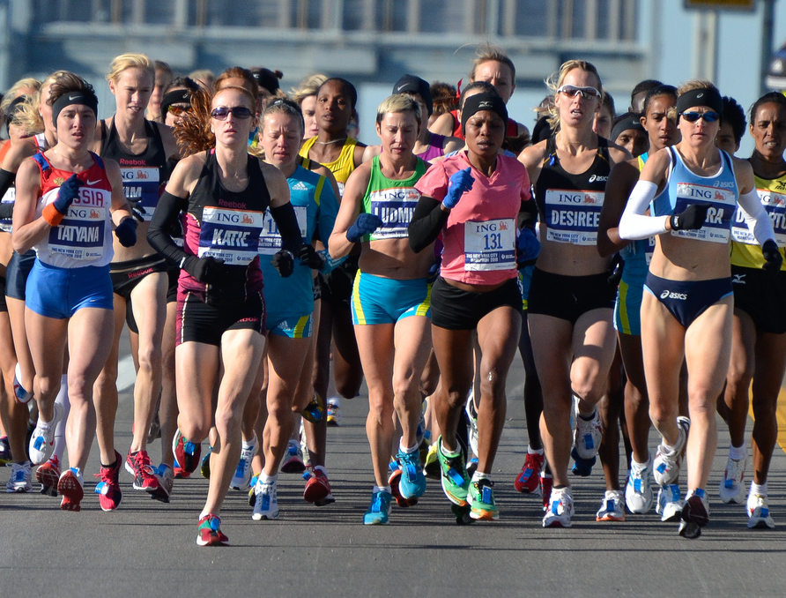
A. Set an energetic pace
-
Manual 8-2
7
Copyright 1992-2015, Leadership Strategies, Inc. V15.02
Duplication prohibited without consent

Slide 8

b. Reset the energy level
8
Copyright 1992-2015, Leadership Strategies, Inc. V15.02
Duplication prohibited without consent

Slide 9
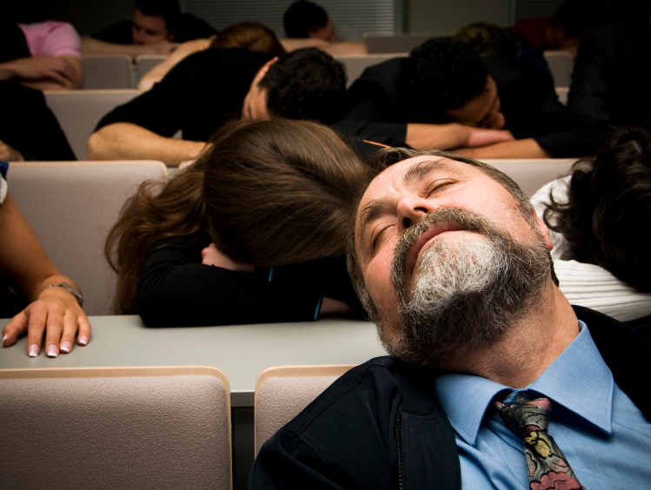
C. Adjust to lull times
9
Copyright 1992-2015, Leadership Strategies, Inc. V15.02
Duplication prohibited without consent

Slide 10
C. Adjust to Lull Times
Consider the multiple time zones of the various participants.
Limit individual virtual sessions to a maximum of two hours.
Remember – meaningful engagement at least every 10 to 15 minutes.
-
Manual 8-3

Slide 11
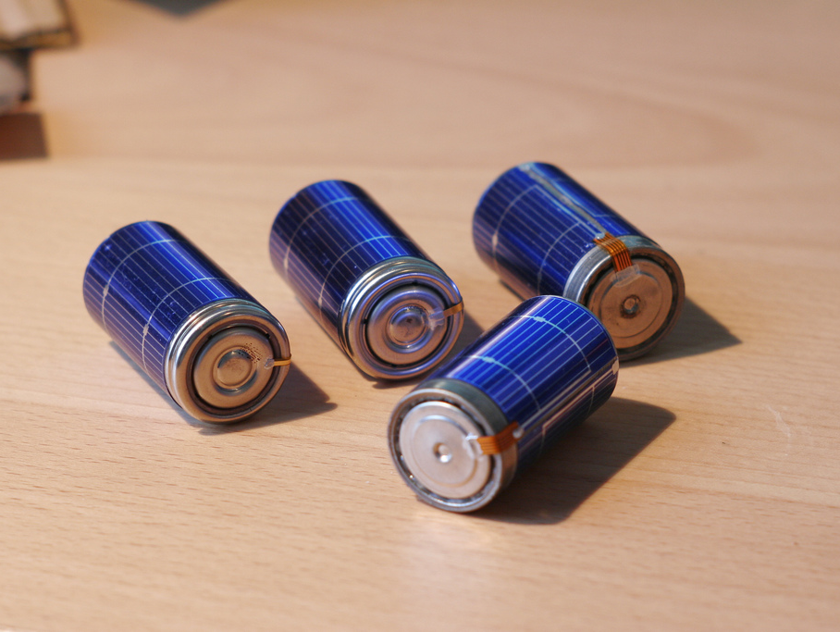
D. Establish a recharge activity
11
Copyright 1992-2015, Leadership Strategies, Inc. V15.02
Duplication prohibited without consent

Slide 12



D. Establish a Recharge Activity
A recharge is typically unnecessary due to the two-hour limit for virtual sessions.
Use praise to keep energy high.
-
Manual 8-4

Slide 13

e. Use brainteasers
13
Copyright 1992-2015, Leadership Strategies, Inc. V15.02
Duplication prohibited without consent

Slide 14

f. Get People involved and moving
14
Copyright 1992-2015, Leadership Strategies, Inc. V15.02
Duplication prohibited without consent

Slide 15
F. Get People Involved and Moving
Stand periodically as the facilitator.
Use the roll call list and track contributions during round robins and mini round robins.
Vary engagement activities for increased interest.
Praise participant contributions throughout.
-
Manual 8-5

Slide 16

g. Encourage team building
16
Copyright 1992-2015, Leadership Strategies, Inc. V15.02
Duplication prohibited without consent

Slide 17

h. Break if necessary
Limit virtual sessions to no more than two hours.
Allow for a minimum of a 30-minute break in between each virtual session.
-
Manual 8-6
17
Copyright 1992-2015, Leadership Strategies, Inc. V15.02
Duplication prohibited without consent

Slide 18
The Virtual Dilemma
You are about to begin working with your first task force, and the work will be conducted virtually. How will you avoid becoming that “lifeless” virtual session leader that you have experienced frequently when others lead virtual meetings?
-
Notes:
REVIEW THE KEY COMPONENTS OF LEVEL 3 ENERGY
OFFER SPECIFIC TIPS FOR VIRTUAL SESSIONS INCLUDING:
MULITPLE VOICES
ROLE CALL LIST
STANDING UP FOR ENERGY
ENGAGEMENT

Slide 19
SURVEY: How can we improve? Help us enhance this beta class.
Before we break…
Check your e-mail.
Open the e-mail you received from the moderator that contains a unique URL.
Click the URL to begin the short survey (only five questions).
Submit.
Enjoy your break!
Thank you for providing your helpful feedback about this new course.

Slide 20
Checkpoint
8:30 – 10:00
1:30 – 3:00
Getting Started
Information Gathering
Preparing
Review
Dysfunction
Consensus
Energy
10:30 – 12:00
3:30 – 5:00
Starting
Focusing
Power of the Pen
Closing
Agenda Setting
Special Cases
Review and Close

Slide 21
Principle 8
Keep the energy high
Set the Pace, Anticipate the Lulls, React Accordingly
Set an Energetic Pace
Reset the Energy Level Following Every Break
Adjust to Lull Times
Establish a Recharge Activity
Use Brainteasers
Get People Involved and Moving
Encourage Team Building
Break If Necessary

