Slide 1
The Effective Facilitator: Virtual Link
Principle 5

Slide 2
Checkpoint
8:30 – 10:00
1:30 – 3:00
Getting Started
Information Gathering
Preparing
Review
Dysfunction
Consensus
Energy
10:30 – 12:00
3:30 – 5:00
Starting
Focusing
Power of the Pen
Closing
Agenda Setting
Special Cases
Review and Close

Slide 3
Checkpoint
The Facilitation Cycle
VIRTUAL PLATFORM
4.
The Power
of the Pen
1.
Preparing
for Success
2.
Getting
the Session
Started
3.
Focusing
the Group
9.
Closing the
Session
5.
Information
Gathering
6.
Managing
Dysfunction
7.
Consensus
Building
8.
Keeping the
Energy High
Group
Dynamics
10.
Agenda
Setting

Slide 4

Know your tools and how to use them
Duplication prohibited without consent

Slide 5
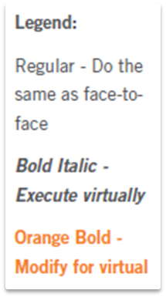
Principle 5
Information gathering
Know Your Tools and How To Use Them
Importance of Engagement
Ask Great Starting Questions
Guide with Reacting Questions
Float Ideas If Necessary
List to Gather Details
Brainstorm to Generate Ideas
Group to Categorize
Prioritize to Identify
Key Items
Lobby to Gain Buy-In
The Whip

Slide 6
The Virtual Dilemma
How do you achieve similar or better levels of engagement in a virtual session as you would if face-to-face?
-
Manual
5-2

Slide 7

The Importance of Engagement
Meaningful engagement every 10 to 15 minutes!
Manual
5-3

Slide 8
Engagement Tools for the Virtual Environment
Polls
Whiteboards
Slideboards
Screen Sharing
Round Robins
Chat
-

Slide 9
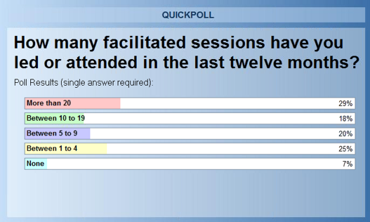
The Importance of Engagement
Polls
Manual
5-3

Slide 10
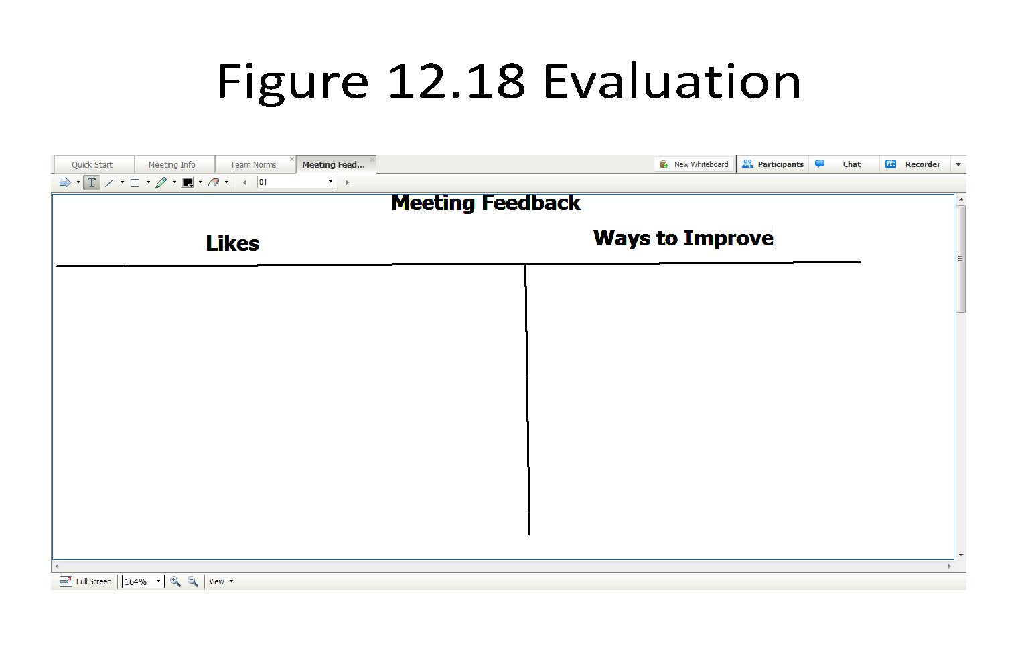
The Importance of Engagement
Whiteboards
Carla K: Better communication
Pamela Q: Got to make it work
Tony J: Worker smarter not just harder
Fran T: Roles aren’t clear
-
Joe D: The approach
Joe D: We have to NOT major
in the minors
Rob P: Good as is
Rob P: Getting it done now
Carla K: Start with why, not what
Samuel L: Involves everyone
Mary R: Too many hands can
spoil the result
Pamela Q: Structure
Tim H: Decisions aren’t top-down
Samuel L: Need clear milestones
Mary R: The Drivers Model
Tony J: How do we make sure it stays alive?
Fran T: We are working to same end
Tim H: Is it over-engineered
Manual
5-3

Slide 11
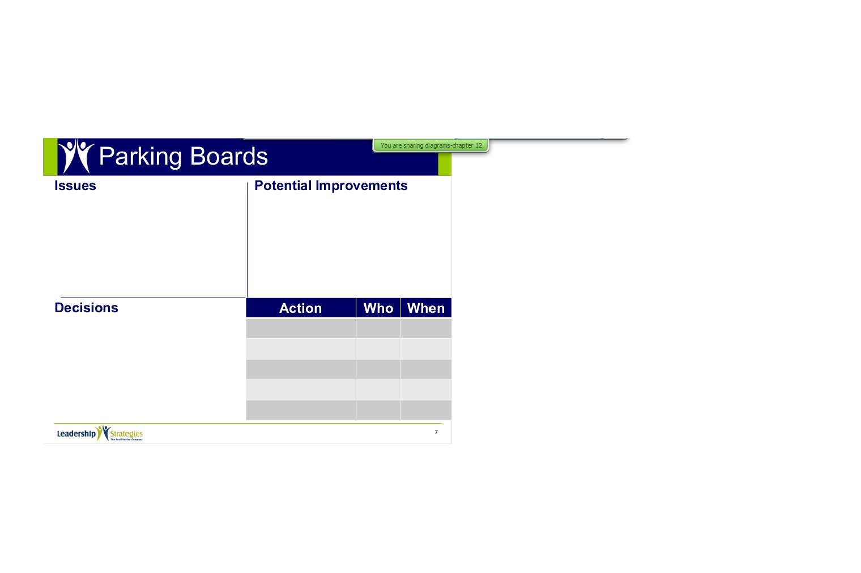
The Importance of Engagement
Slideboards
Manual
5-4

Slide 12
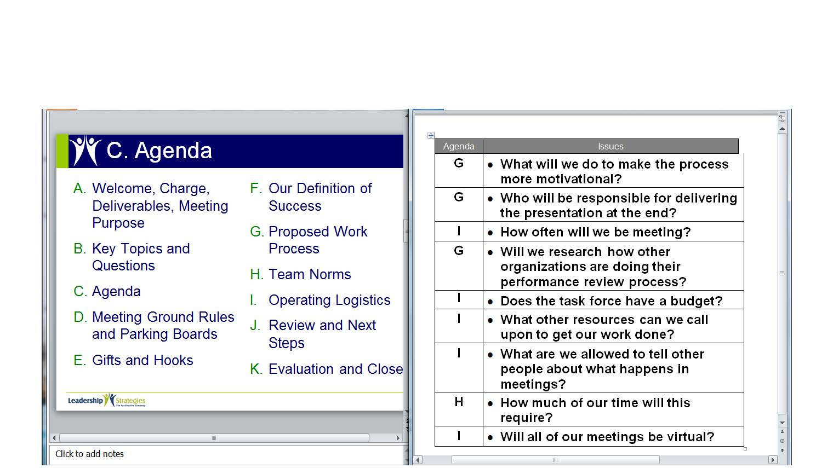
The Importance of Engagement
Screen Sharing
-
Word
PowerPoint
Manual
5-4

Slide 13
The Importance of Engagement
Round Robins
Roll call lists, round robins and mini round robins are an effective way to engage the participants during a virtual meeting.
-
My Favorite:
The WHIP
√ |  |  |  |  |  | Andrea, Atlanta
√ |  |  |  |  |  | Bill, Boston
√ |  |  |  |  |  | Cleve, Chicago
√ |  |  |  |  |  | Ken, Dallas
√ |  |  |  |  |  | Trina, Denver
√ |  |  |  |  |  | Vanessa, San Diego
√ |  |  |  |  |  | Kathy, Atlanta (project manager)
Manual
5-5

Slide 14
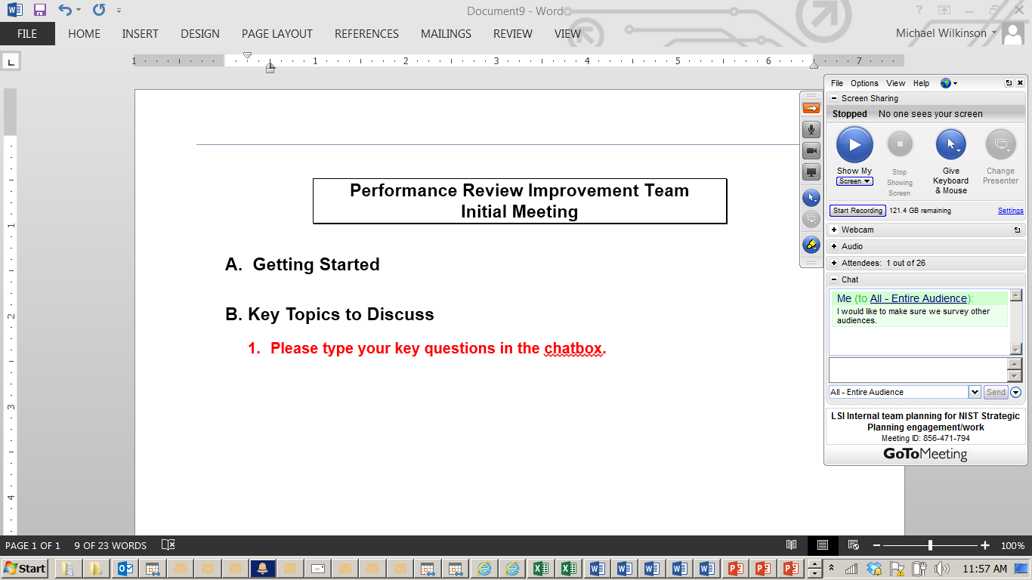
The Importance of Engagement
Chat
-
Manual
5-5

Slide 15

a. ASK Great starting questions
Copyright 1992-2015, Leadership Strategies, Inc. V15.02
Duplication prohibited without consent

Slide 16
A. Ask Great Starting Questions
Four parts to a great starting question in virtual sessions:
Announce who will respond first.
Begin with an image-building phrase
(“think about”, “imagine”, “consider”, “if”).
Extend the image to the answers
(at least two phrases).
Ask the direct question (Type A) to get the information you want.
-
Manual
5-6

Slide 17
Why is it important to notify who will respond first in a virtual session?

Slide 18
HINT REMINDER
Build your Type B question in
3-1-2 order.
Use synonyms in step 2.
3. Type A question
1. Begin with an image-building phrase.
2. Expand the image.
-

Slide 19
How Many Type B Questions?
We will be using the following practice agenda throughout the class.
PURPOSE
Define the changes necessary to increase the efficiency and effectiveness of the hiring process.
AGENDA
Introduction
How does it work today?
What are the problems and root causes?
Potential improvements
Prioritize improvements
Develop an implementation plan
Review and close

Slide 20

b. Guide with reacting questions
Copyright 1992-2015, Leadership Strategies, Inc. V15.02
Duplication prohibited without consent

Slide 21

C. Float ideas
if necessary
Copyright 1992-2014, Leadership Strategies, Inc. V14.10
Duplication prohibited without consent

Slide 22

d. List to gather details
Copyright 1992-2014, Leadership Strategies, Inc. V14.10
Duplication prohibited without consent

Slide 23
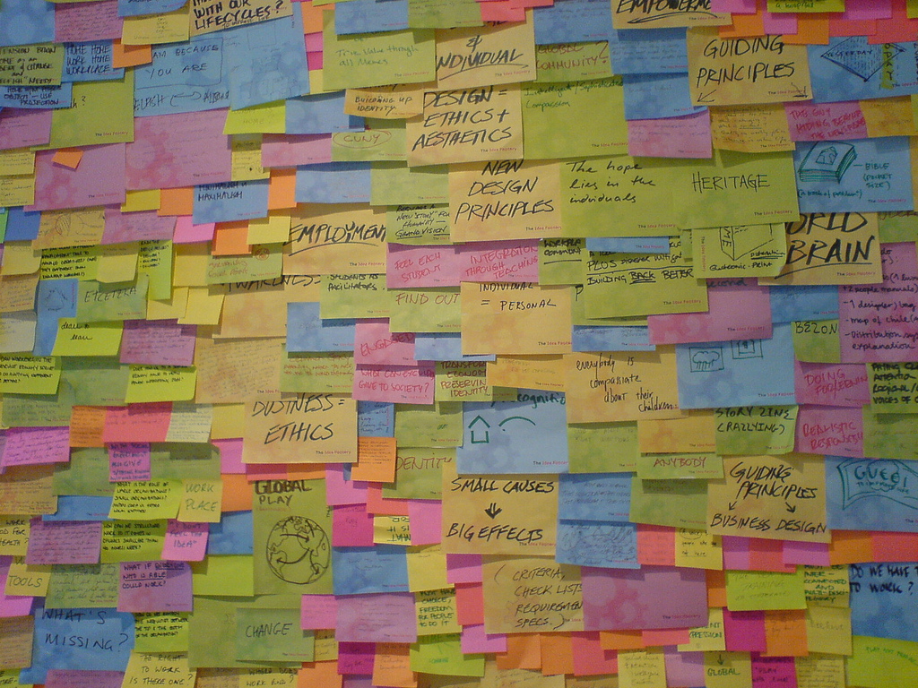
e. Brainstorm to
generate ideas
Copyright 1992-2014, Leadership Strategies, Inc. V14.10
Duplication prohibited without consent

Slide 24
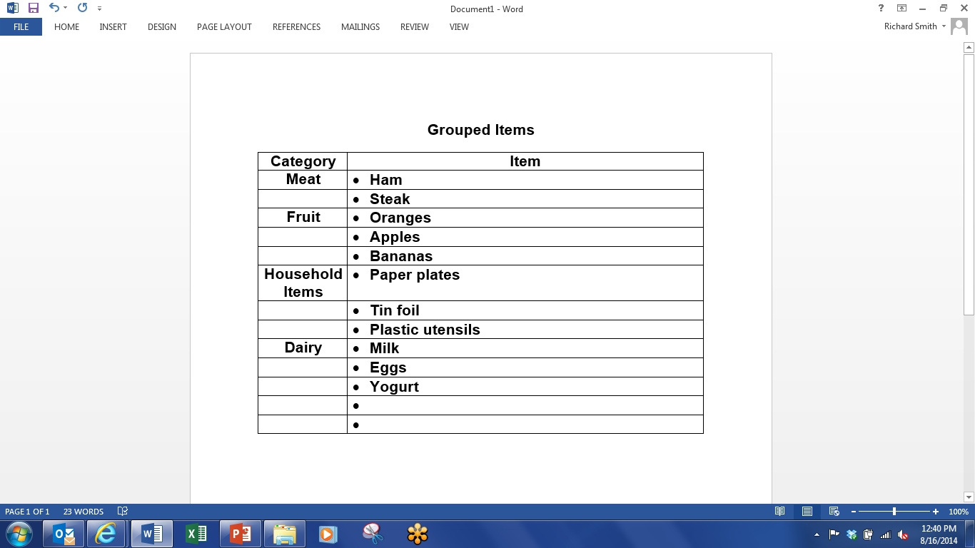
F. Group to Categorize
-
Manual
5-8

Slide 25

G. Prioritize to Identify Key Items
Copyright 1992-2014, Leadership Strategies, Inc. V14.10
Duplication prohibited without consent

Slide 26

H. Lobby to gain buy-in
Copyright 1992-2014, Leadership Strategies, Inc. V14.10
Duplication prohibited without consent

Slide 27
I. THE WHIP

Slide 28
The Whip
Purpose
  Gain rapid feedback by having everyone respond with a very short answer to a question.
Sample Use
  Give a one or two-word response to the question, “How are you feeling about the session right now?”
Manual
5-8

Slide 29
Solving the Virtual Dilemma
How do you achieve similar or better levels of engagement as you would if face-to-face?
-

Slide 30
Solving the Virtual Dilemma
What are the tools available to me to gather input and information during a virtual session?
-
Notes:
LEAD DISCUSSION AND INCLUDE
TECHNIQUES YOU HAVE BEEN USING
ASK WHAT OTHERS PARTICIPANTS HAVE FOUND HELPFUL IN THEIR VIRTUAL SESSION EXPERIENCE
REMEMBER TO REINFORCE: ENGAGEMENT, USE OF VMP TOOLS, GETTING SKILLED ON THOSE TOOLS FOR BOTH FACILITATOR AND PARTICIPANT STANDPOINT, EFFECTIVE USE OF PRODUCER AND MODERTATOR, BASED ON VMP

Slide 31
Checkpoint
8:30 – 10:00
1:30 – 3:00
Getting Started
Information Gathering
Preparing
Review
Dysfunction
Consensus
Energy
10:30 – 12:00
3:30 – 5:00
Starting
Focusing
Power of the Pen
Closing
Agenda Setting
Special Cases
Review and Close

Slide 32
Principle 5
Information gathering
Know Your Tools and How To Use Them
Importance of Engagement
Ask Great Starting Questions
Guide with Reacting Questions
Float Ideas If Necessary
List to Gather Details
Brainstorm to Generate Ideas
Group to Categorize
Prioritize to Identify
Key Items
Lobby to Gain Buy-In
The Whip

