Slide 1
The Effective Facilitator: Virtual Link
PRINCIPLE 4

Slide 2
Checkpoint
8:30 – 10:00
1:30 – 3:00
Getting Started
Information Gathering
Preparing
Review
Dysfunction
Consensus
Energy
10:30 – 12:00
3:30 – 5:00
Starting
Focusing
Power of the Pen
Closing
Agenda Setting
Special Cases
Review and Close

Slide 3
Checkpoint
The Facilitation Cycle
4.
The Power
of the Pen
4.
The Power
of the Pen
1.
Preparing
for Success
2.
Getting
the Session
Started
3.
Focusing
the Group
9.
Closing the
Session
5.
Information
Gathering
6.
Managing
Dysfunction
7.
Consensus
Building
8.
Keeping the
Energy High
Group
Dynamics
10.
Agenda
Setting

Slide 4
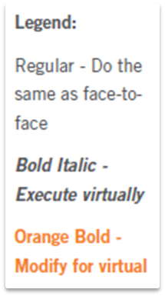
Principle 4
POWER OF THE PEN
Use It, Don’t Abuse It, Make It Theirs
Write First; Discuss Second
Write What is Said
Add Your Words Discriminately
Ask; Don’t Tell
Write So the Group Can Read It
Use Additive Editing
Avoid Lulls While Writing (Typing)
Assign an Order to Your Speakers
Use Multiple “Flip Charts”
Employ the Right Recording Tool
Post According to Your “Wall” Plan

Slide 5
The Virtual Dilemma
Your organization has just adopted a new virtual meeting platform for conducting virtual sessions. What are some of the techniques you can use to help your remote participants to see what they have previously only been able to hear?
-

Slide 6

Use it,
don’t abuse it, make it theirs

Slide 7



a. Write first;
discuss second
Copyright 1992-2015, Leadership Strategies, Inc. V15.02
Duplication prohibited without consent

Slide 8

B. Write what is said
Copyright 1992-2015, Leadership Strategies, Inc. V15.02
Duplication prohibited without consent

Slide 9

c. Add your words discriminately
-
Copyright 1992-2015, Leadership Strategies, Inc. V15.02
Duplication prohibited without consent

Slide 10

d. ask; don’t tell
Copyright 1992-2015, Leadership Strategies, Inc. V15.02
Duplication prohibited without consent

Slide 11

e. Write so the group
can read it
Copyright 1992-2015, Leadership Strategies, Inc. V15.02
Duplication prohibited without consent

Slide 12

F. Use additive editing
Copyright 1992-2015, Leadership Strategies, Inc. V15.02
Duplication prohibited without consent

Slide 13


g. Avoid lulls
while writing (Typing)
Copyright 1992-2015, Leadership Strategies, Inc. V15.02
Duplication prohibited without consent

Slide 14
G. Avoid Lulls While Writing (Typing)
Stay close to the boards
Begin typing as soon as they start speaking
Repeat what they say as you write
Ask them to repeat
Ask a direct question
-
Manual
4-3

Slide 15
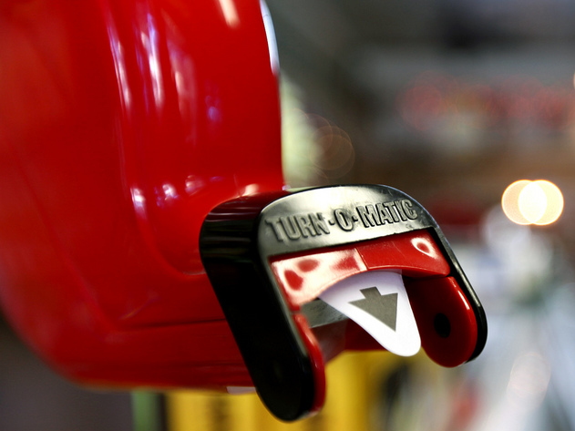
h. Assign an order
to your speakers
Copyright 1992-2015, Leadership Strategies, Inc. V15.02
Duplication prohibited without consent

Slide 16
H. Assign an Order to Your Speakers
Use the roll call list and maintain the same order beginning with a different participant at each opportunity you use to conduct a round robin or a mini round robin.
Example:
“Let’s begin a round robin to determine if everyone is in agreement that we can move on to the next agenda item. We will start with Jerry and go in our roll call order. Please respond with a ‘yea’ or ‘nay’ as I call your name. Jerry….”
-
Manual
4-4

Slide 17
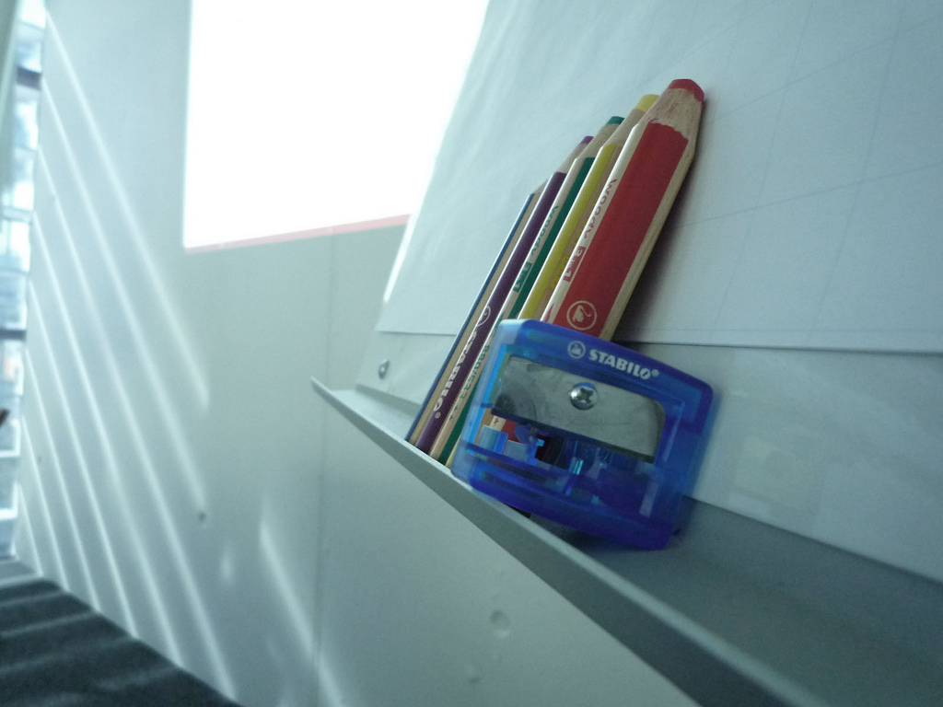
i. Use Multiple
“FLIP charts”
Copyright 1992-2015, Leadership Strategies, Inc. V15.02
Duplication prohibited without consent

Slide 18
I. Use Multiple “Flip Charts”
Use a variety of documentation tools to improve the focus of a virtual session including:
  Whiteboards
  Slideboards
  Polling
  Word/Excel/PowerPoint document(s) – split screens
-
Manual
4-5

Slide 19
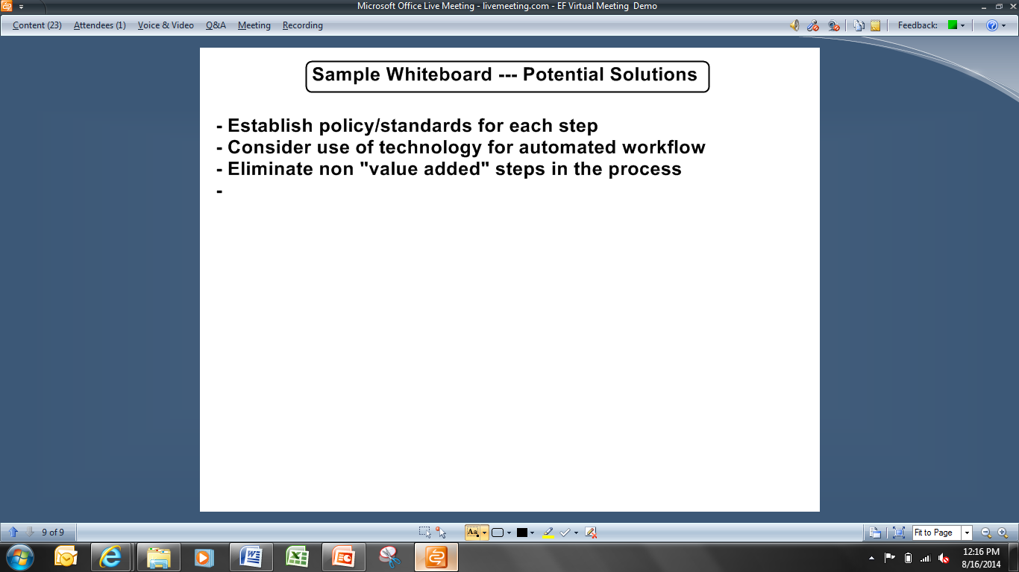
Whiteboard
-

Slide 20
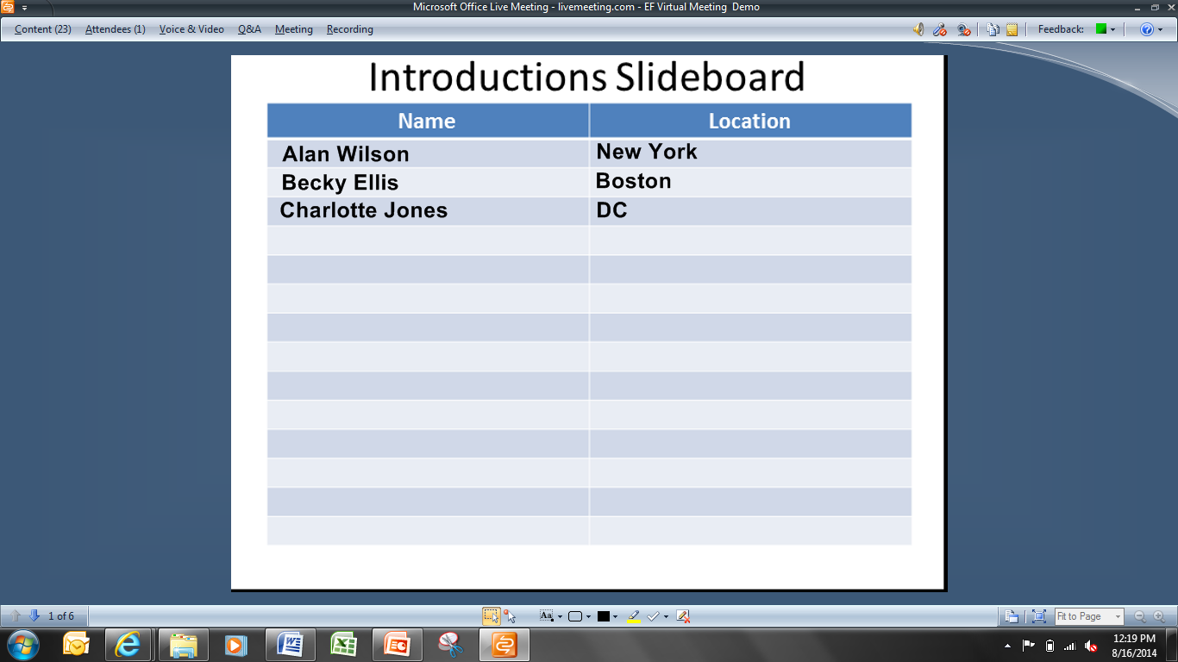
Slideboard
-

Slide 21
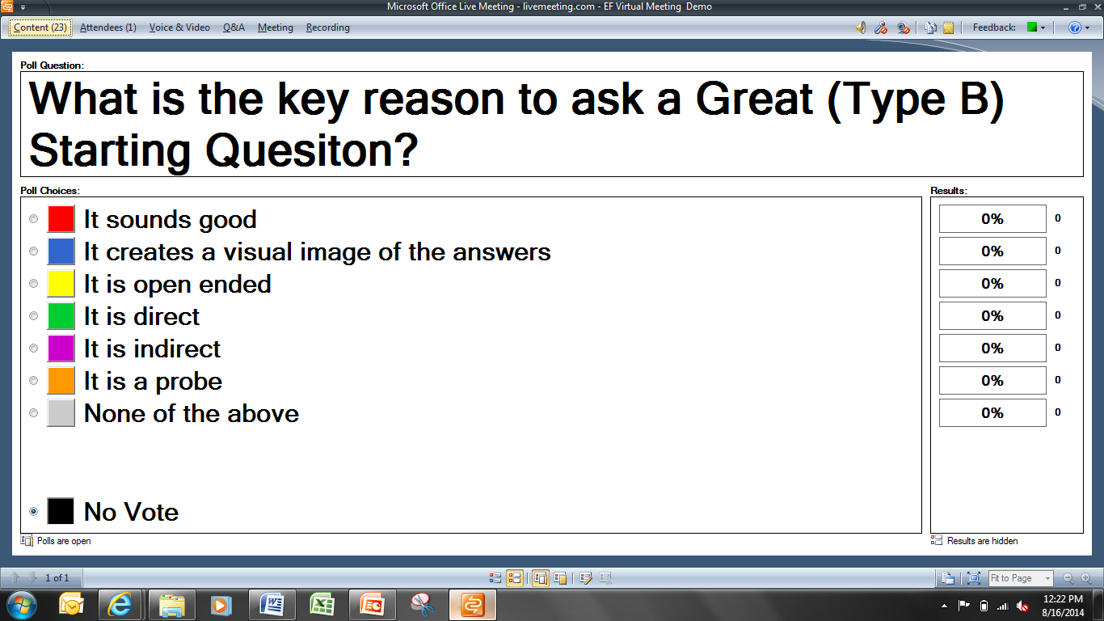
Polling
-

Slide 22
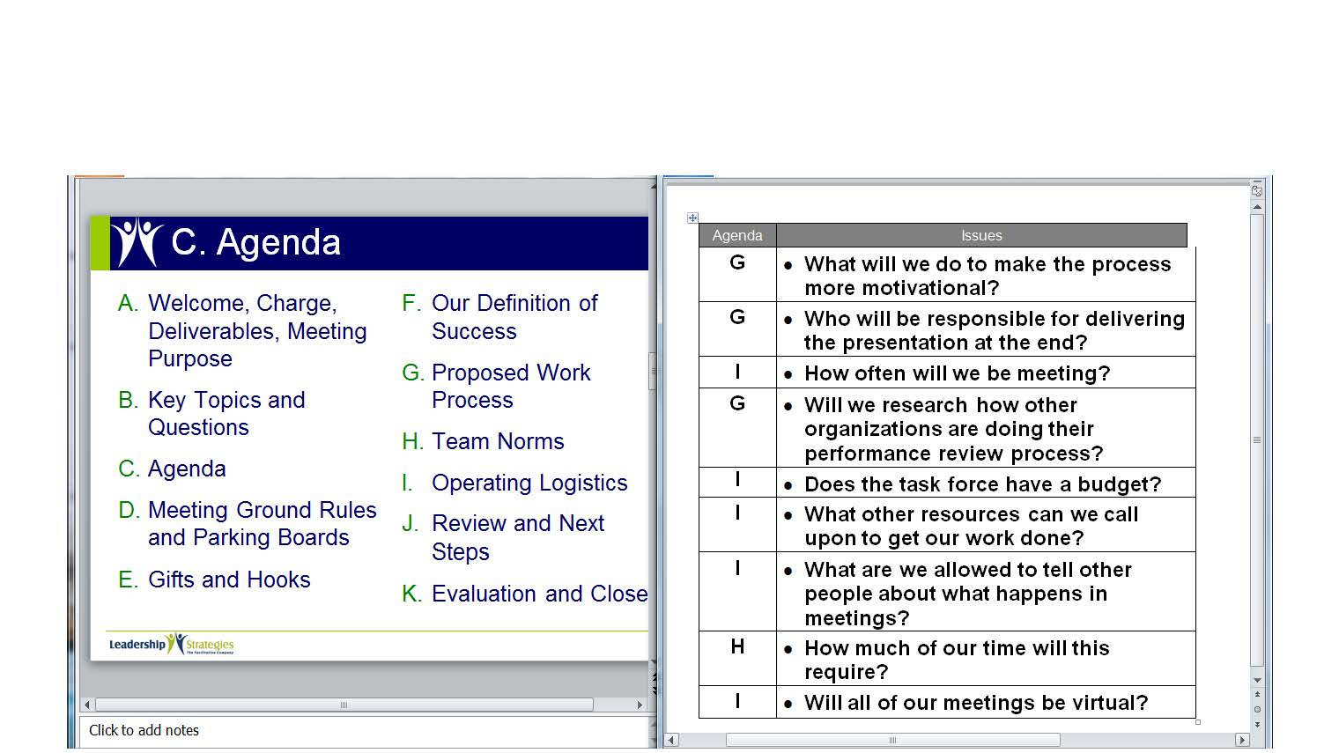
Screen Sharing
Word
-
PowerPoint

Slide 23

J. EMPLOY the right recording tool
Copyright 1992-2015, Leadership Strategies, Inc. V15.02
Duplication prohibited without consent

Slide 24
J. Use the Right Recording Tool
TOOL | ADVANTAGES | DISADVANTAGES
Whiteboard
Slideboard
Polling
Word/Excel/PowerPoint Screen Sharing
Manual
4-6

Slide 25

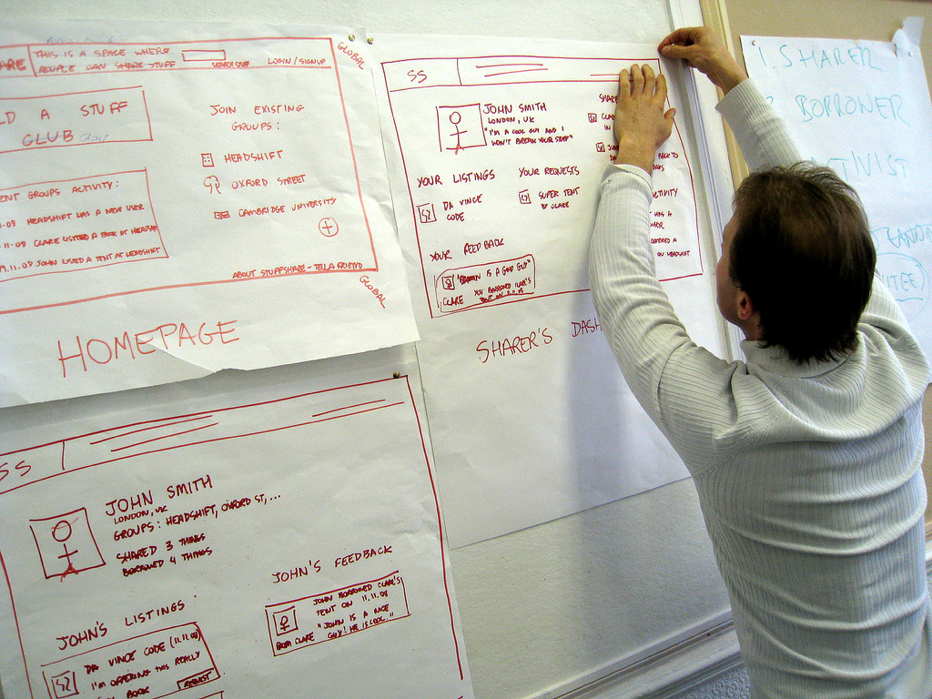
k. Post according
to Your “wall” plan
Copyright 1992-2015, Leadership Strategies, Inc. V15.02
Duplication prohibited without consent

Slide 26
K. Post According to “Wall” Plan
Refer to session documentation frequently to assist with focus.
  Agenda
  Whiteboards and slideboards
Provide/share documentation before, during, and after the session.
-
Manual
4-7

Slide 27
Solving the Virtual Dilemma
Your organization has just adopted a new virtual meeting platform for conducting virtual sessions. What are some of the techniques you can use to help your remote participants to see what they have previously only been able to hear?
-
Notes:
REVIEW THE TECHNIQUES YOU HAVE BEEN USING INCLUDING:
WHITEBOARDS W/ AND W/O ANNOTATION ON
SLIDEBOARDS W AND W/O ANNOTATION ON
WRITING WHAT PEOPLE SAY
ASK FOR OTHERS USED BY PARTICIPANTS

Slide 28
Principle 4
POWER OF THE PEN
Use It, Don’t Abuse It, Make It Theirs
Write First; Discuss Second
Write What is Said
Add Your Words Discriminately
Ask; Don’t Tell
Write So the Group Can Read It
Use Additive Editing
Avoid Lulls While Writing (Typing)
Assign an Order to Your Speakers
Use Multiple “Flip Charts”
Employ the Right Recording Tool
Post According to Your “Wall Plan”

Slide 29
SURVEY: How can we improve?
Help us enhance this beta class.
Before we break…
Check your e-mail.
Open the e-mail you received from the moderator that contains a unique URL.
Click the URL to begin the short survey (only five questions).
Submit.
Enjoy your break!
Thank you for providing your helpful feedback about this new course.

Slide 30
Checkpoint
The Facilitation Cycle
VIRTUAL PLATFORM
4.
The Power
of the Pen
1.
Preparing
for Success
2.
Getting
the Session
Started
9.
Closing the
Session
2.
Getting
the Session
Started
3.
Focusing
the Group
5.
Information
Gathering
-
6.
Managing
Dysfunction
7.
Consensus
Building
8.
Keeping the
Energy High
Group
Dynamics
10.
Agenda
Setting
Notes:
REPLACE w DIAGRAM OF OVAL AROUND SHOWING VMP

