Slide 1
The Effective Facilitator: Virtual Link
PRINCIPLE 3

Slide 2
Checkpoint
8:30 – 10:00
1:30 – 3:00
Getting Started
Information Gathering
Preparing
Review
Dysfunction
Consensus
Energy
10:30 – 12:00
3:30 – 5:00
Starting
Focusing
Power of the Pen
Closing
Agenda Setting
Special Cases
Review and Close

Slide 3
Checkpoint
The Facilitation Cycle
VIRTUAL PLATFORM
4.
The Power
of the Pen
1.
Preparing
for Success
2.
Getting
the Session
Started
3.
Focusing
the Group
9.
Closing the
Session
3.
Focusing
the Group
5.
Information
Gathering
6.
Managing
Dysfunction
7.
Consensus
Building
8.
Keeping the
Energy High
Group
Dynamics
10.
Agenda
Setting

Slide 4
The Virtual Dilemma
In a virtual session, the facilitator loses some of the cues available in a face-to-face session (e.g. non-verbal signals). To encourage focus throughout a virtual session, what are some of the tools available to a facilitator to maintain focus and interest on the part of session participants?
-
Manual
3-2

Slide 5
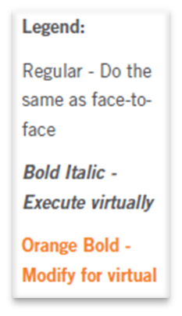
Principle 3
FOCUSING THE GROUP
Establish the Course, Avoid Detours
Set the Course with Checkpoints
Restart with Extended Checkpoints
Warm Up the Group
Use Your PeDeQs
Label “Charts” to Improve Focus
Redirect Side Issues
Use Extended Prompt Questions
Summarize the Results
Be Conscious of Time
Use Breakout Sessions
Know When to Regroup

Slide 6
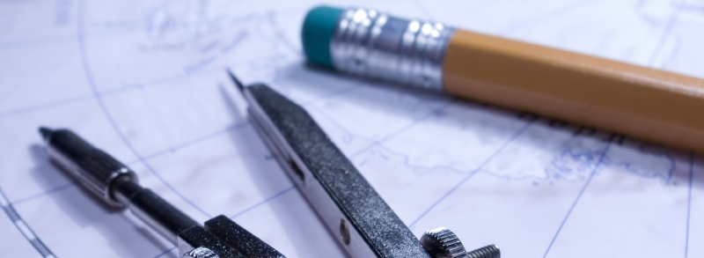
Establish the course

Slide 7

A. Set the course with checkpoints
Review, Preview, Big View
Copyright 1992-2015, Leadership Strategies, Inc. V15.02
Duplication prohibited without consent

Slide 8

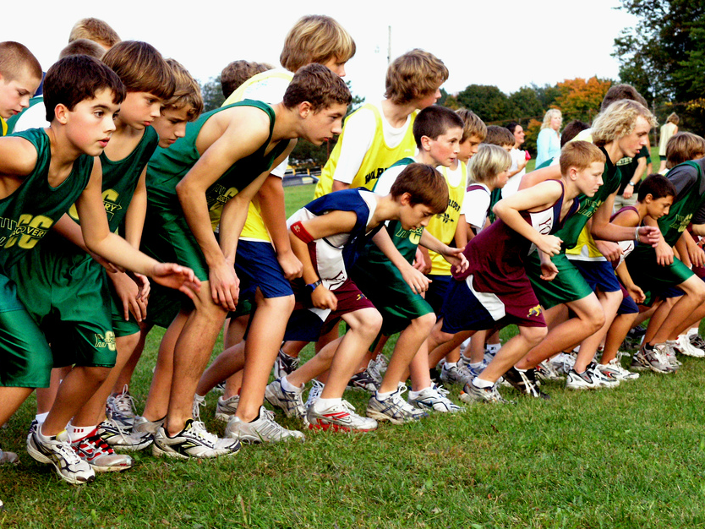
b. Restart with extended checkpoints
Remind, Review, Preview, Big View
Copyright 1992-2015, Leadership Strategies, Inc. V15.02
Duplication prohibited without consent

Slide 9

c. Warm up the group
Copyright 1992-2015, Leadership Strategies, Inc. V15.02
Duplication prohibited without consent

Slide 10
How Do You Keep a Virtual Session Focused?
What are the most important things for a meeting leader to do to keep a virtual session focused?
?
Manual
3-2

Slide 11
C. Warm Up The Group
Purpose
Get them prepared to respond
How?
Ask two pre-questions that require a non-verbal response or simple “yea”/”nay.”
Use the virtual platform features for participant responses and/or round robins with a “yea” or “nay” type response.
Track progress of responses using the roll call list.
-
Manual
3-3

Slide 12

d. Using pedeqs
for directions
Purpose—example—directions—exceptions—questions--starting question
Copyright 2015 Leadership Strategies, Inc.
Duplication prohibited without consent

Slide 13

e. Label “charts” to improve focus
Copyright 2015 Leadership Strategies, Inc.
Duplication prohibited without consent

Slide 14

E. Label “Charts” to Improve Focus
Labeling your “charts” helps to focus the participants.
  Whiteboards
  Slideboards
  Screen sharing documents
B-1
B-2
Manual
3-4

Slide 15
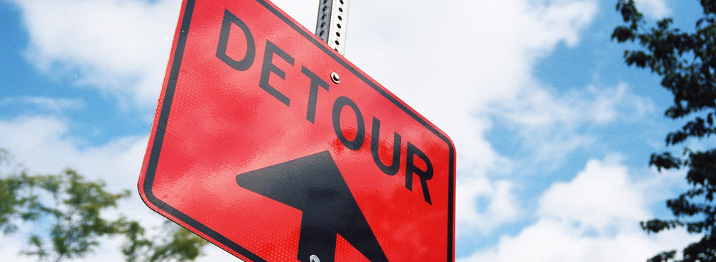
Avoid detours

Slide 16

F. Redirect side issues
Copyright 1992-2015, Leadership Strategies, Inc. V15.02
Duplication prohibited without consent

Slide 17

G. Use extended prompt questions
Copyright 1992-2015, Leadership Strategies, Inc. V15.02
Duplication prohibited without consent

Slide 18

H. Summarize results
Copyright 1992-2015, Leadership Strategies, Inc. V15.02
Duplication prohibited without consent

Slide 19

I. Be conscious of time
Copyright 1992-2015, Leadership Strategies, Inc. V15.02
Duplication prohibited without consent

Slide 20

j. Use breakout sessions
Divide the participants into teams
  Count Off
  Assign
  Ask
Copyright 1992-2015, Leadership Strategies, Inc. V15.02
Duplication prohibited without consent

Slide 21
J. Use Breakout Sessions
Many virtual meeting platforms include the breakout room feature.
Ensure your familiarity with the breakout room feature and provide the appropriate PeDeQs for the session participants.
Determine whether or not you will be able to monitor the progress of the breakout rooms based on your virtual meeting platform.
Follow the standard best practices for breakout groups.
-
Manual
3-5

Slide 22
J. Use Breakout Sessions
Using breakout sessions:
Let them know it is coming.
Complete the first element as one group.
Determine the number of teams to be used.
Divide into teams.
Give final directions to the teams.
Monitor the activity.
Have each team report their results.
-
Warning: Breakout sessions don’t always save time!
Manual
3-6 – 3-8

Slide 23
Experience with Breakout Rooms
What experience have you had using breakout rooms in your virtual meeting platforms, and what challenges/benefits have you had?
(Please “raise your hand,” so we may choose people to share their experiences.)
?

Slide 24
Solving the Virtual Dilemma
In a virtual session, the facilitator loses some of the cues available in a face-to-face session (e.g. non-verbal signals). To encourage focus throughout a virtual session, what are some of the tools available to a facilitator to maintain focus and interest on the part of session participants?
-
Notes:
MW: Corrections were made the first time this slide appears. Copy here.
LEAD DISCUSSION ON HOW THIS DILEMMA IS SOLVED
INCLUDE:
ENGAGEMENT, ENGAGEMENT, ENGAGEMENT
USE OF ROLL CALL LIST
FEATURES OF VIRTUAL MEETING PLATFORM
RS: agreed; done

Slide 25
Solving the Virtual Dilemma
How do you get participants ready to engage, and are there a variety of ways to maintain focus and interest on the part of session participants?
-
Notes:
MW: Corrections were made the first time this slide appears. Copy here.
LEAD DISCUSSION ON HOW THIS DILEMMA IS SOLVED
INCLUDE:
ENGAGEMENT, ENGAGEMENT, ENGAGEMENT
USE OF ROLL CALL LIST
FEATURES OF VIRTUAL MEETING PLATFORM
RS: agreed; done

Slide 26
Principle 3
FOCUSING THE GROUP
Establish the Course, Avoid Detours
Set the Course with Checkpoints
Restart with Extended Checkpoints
Warm Up the Group
Use Your PeDeQs
Label “Charts” to Improve Focus
Redirect Side Issues
Use Extended Prompt Questions
Summarize the Results
Be Conscious of Time
Use Breakout Sessions
Know When to Regroup

Slide 27
Checkpoint
The Facilitation Cycle
VIRTUAL PLATFORM
4.
The Power
of the Pen
1.
Preparing
for Success
2.
Getting
the Session
Started
3.
Focusing
the Group
9.
Closing the
Session
3.
Focusing
the Group
5.
Information
Gathering
6.
Managing
Dysfunction
7.
Consensus
Building
8.
Keeping the
Energy High
Group
Dynamics
10.
Agenda
Setting
Notes:
REPLACE w DIAGRAM OF OVAL AROUND SHOWING VMP

Slide 28
The Effective Facilitator: Virtual Link
PRINCIPLE 3

