Slide 1
The effective facilitator: virtual Link
Principle 2

Slide 2
Checkpoint
The Facilitation Cycle
VIRTUAL PLATFORM
4.
The Power
of the Pen
1.
Preparing
for Success
2.
Getting
the Session
Started
9.
Closing the
Session
2.
Getting
the Session
Started
3.
Focusing
the Group
5.
Information
Gathering
6.
Managing
Dysfunction
7.
Consensus
Building
8.
Keeping the
Energy High
Group
Dynamics
10.
Agenda
Setting

Slide 3
The Virtual Dilemma
Your virtual session with 15 participants is scheduled to start promptly at 10am.
You are set and ready to go.
13 (out of the 15 expected) participants are logged on and awaiting the session start time at 9:58am.
You receive a frantic call from two participants.
  One cannot get the software to download.
  The other has a firewall preventing software access.
What do you do?
-
Manual
2-2

Slide 4
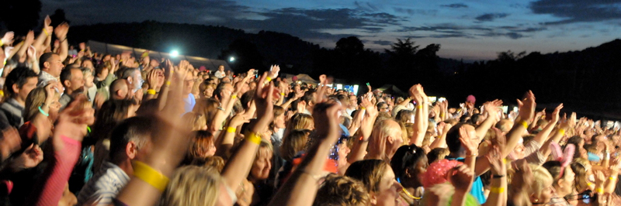
Inform, excite, empower, involve
Duplication prohibited without consent

Slide 5
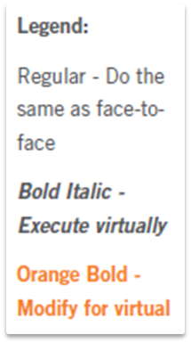
Principle 2
GETTING THE SESSION STARTED
Inform, Excite, Empower, Involve
Set Up with 40 Minutes to Spare
Optimize Your Setup
Utilize the Gathering Period
Kick Off Promptly
Set the Stage with
Your Opening: I-E-E-I
Memorize Your Opening
Effectively Deliver Your Opening
Request Participants’ Key Topics
Review the Agenda
Establish Ground Rules
Define the Parking Boards
Define Consensus
Open “On the Fly”
-

Slide 6

a. Set up with 40 minutes to spare
Copyright 1992-2015, Leadership Strategies, Inc. V14.10
Duplication prohibited without consent

Slide 7

A. Set Up with At Least 40 Minutes to Spare
Estimate your setup time.
Unfamiliar virtual platform: Add 40 minutes
Familiar virtual platform: Add 20 minutes
Total = ?
-
Manual
2-3

Slide 8

b. Optimize
your setup
Copyright 1992-2015, Leadership Strategies, Inc. V15.02
Duplication prohibited without consent

Slide 9
B. Optimize Your Setup
Get permission in advance to start the session on time
Ensure that the virtual meeting room is set up in advance
  Whiteboards
  Slideboards
  Polling questions
  Screen sharing
Include in the meeting notice:
  Gathering time
  Starting time
  Moderator contact information
  Ground rules
Consider gaining agreement on a suitable penalty for arriving late.
-
Manual
2-4

Slide 10
B. Optimize Your Setup
Minimize technical issues
  Assign a moderator for sessions with more than three to four participants
  Test all features to be used well in advance of the session
  Encourage participants to download and test the link at least 24 hours in advance
  Include the contact information of the moderator
  Request participants to access the virtual session at least ten minutes ahead of the start
-
Manual
2-4

Slide 11

c. Utilize the gathering period
Have the moderator’s name, e-mail address, and telephone number visible
Use a countdown slide deck or clock to ensure participants are aware of punctual start time
Clear participants invited to the “lobby”
Establish rapport and consider review of virtual platform features to be used
Manual
2-6
Copyright 1992-2015, Leadership Strategies, Inc. V15.02
Duplication prohibited without consent

Slide 12

Kick off promptly
Copyright 1992-2015, Leadership Strategies, Inc. V15.02
Duplication prohibited without consent

Slide 13

E. Set the Stage With Your Opening: i-e-e-i
Manual
2-7
Copyright 1992-2015, Leadership Strategies, Inc. V15.02
Duplication prohibited without consent

Slide 14
E. Set the Stage With Your Opening
Through your opening words, you must:
Excite
Inform
Empower
Involve
Manual
2-7

Slide 15
E. Set the Stage With Your Opening: I-E-E-I
Through your opening words you must…
Inform participants about the session purpose and product.
What is going to happen?
(Include the deliverable)
-

Slide 16
E. Set the Stage With Your Opening
Through your opening words you must…
EXCITE participants about the benefits
to them.
What is the overall result to be achieved? WII-FM?
-

Slide 17
E. Set the Stage With Your Opening
Through your opening words you must…
EMPOWER participants by discussing the important role they play in the process.
Why they were selected? What authority have they been given?
-

Slide 18
E. Set the Stage With Your Opening
Through your opening words you must…
INVOLVE participants using one of the following
  Requesting their key issues or key topics
  Personal outcomes approach
  One-minute check-in

Slide 19
E. Set the Stage With Your Opening: I-E-E-I
Perform a roll call by saying the names of the participants and their location.
 |  |  |  | Andrea, Atlanta
 |  |  |  | Bill, Boston
 |  |  |  | Cleve, Chicago
 |  |  |  | Ken, Dallas
 |  |  |  | Trina, Denver
 |  |  |  | Vanessa, San Diego
 |  |  |  | Kathy, Atlanta (project manager)
Manual
2-7
Notes:
Added the fill-in-the blanks for workbook on this slide

Slide 20
Roll Call List
What are some of the uses and benefits of the roll call list?
?

Slide 21

Memorize
your opening
Copyright 1992-2015, Leadership Strategies, Inc. V15.02
Duplication prohibited without consent

Slide 22
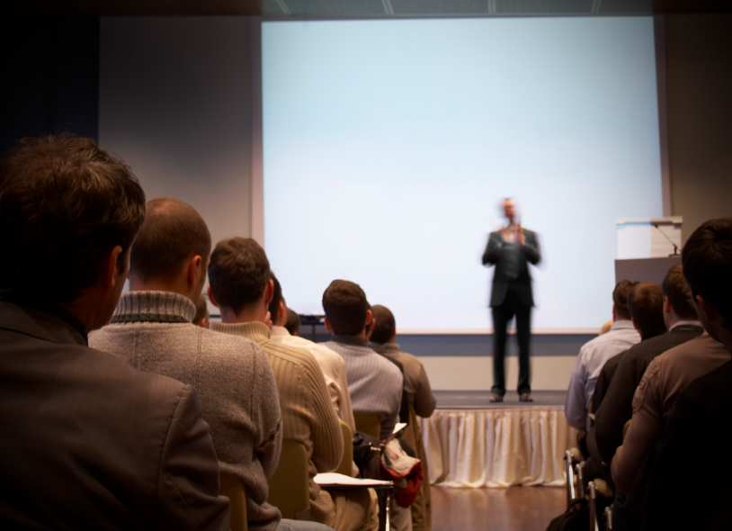
G. Effectively
deliver your opening
Copyright 1992-2015, Leadership Strategies, Inc. V15.02
Duplication prohibited without consent

Slide 23
G. Effectively Deliver Your Opening
Consider standing to ensure better energy
Speak loudly and clearly
Avoid speaking too fast or too slow
Consider the use of a webcam especially during the opening
Position webcam for best view of presenter
Ensure facial expressions match your words
Be animated
Use defined gestures
Avoid “self-talk”
Avoid filler words like “ah,” “um,” “okay”
-
Manual
2-8

Slide 24
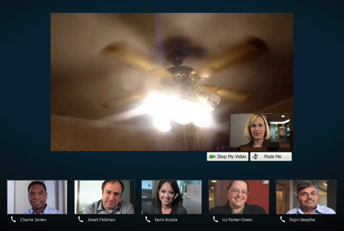
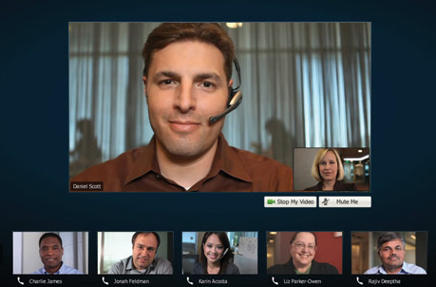
G. Effectively Deliver Your Opening
Use of webcam
-
Manual
2-7

Slide 25

H. Request
participants’ key topics
Manual
2-8
Copyright 1992-2015, Leadership Strategies, Inc. V15.02
Duplication prohibited without consent
Notes:
Added H

Slide 26
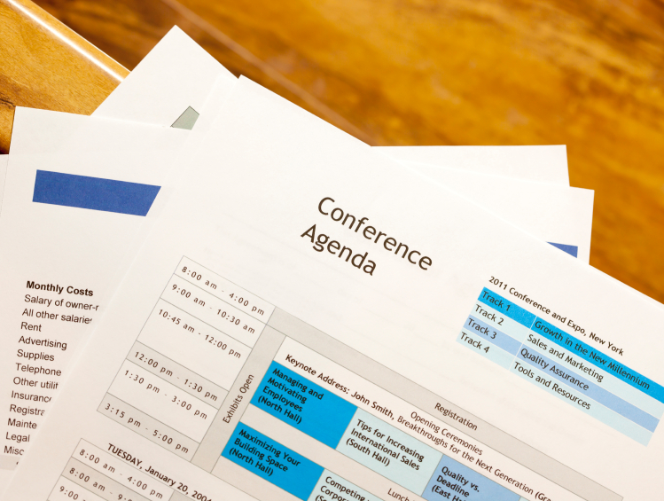
I. Review the agenda
Copyright 1992-2015, Leadership Strategies, Inc. V15.02
Duplication prohibited without consent
Notes:
Added I

Slide 27

J. Establish
ground rules
Copyright 1992-2015, Leadership Strategies, Inc. V15.02
Duplication prohibited without consent

Slide 28
J. Establish Ground Rules
Encourages self-correction
Can address issues identified in prep
Serves to prevent dysfunction
Can take issues off the table
BEWARE: Gain agreement on ground rules!
-

Slide 29
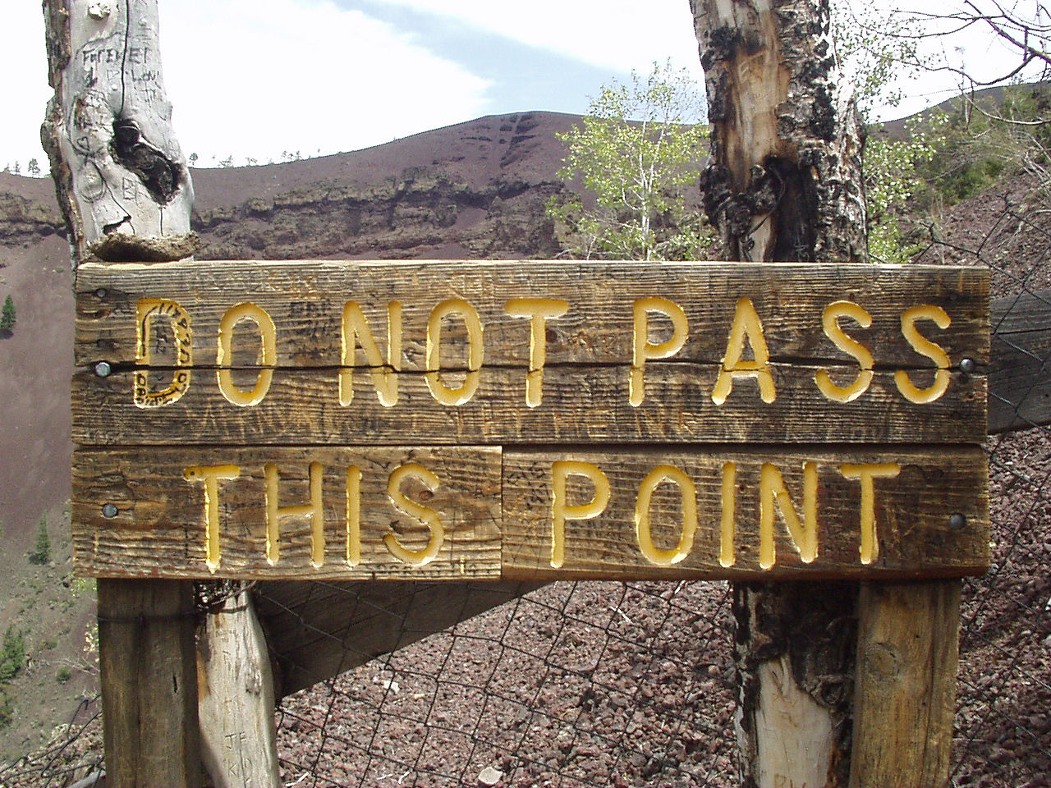
Prepare your ground rules
Encourage group interaction taking into account virtual session challenges
Address potential issues
Copyright 1992-2015, Leadership Strategies, Inc. V15.02
Duplication prohibited without consent

Slide 30
Ground Rules for Virtual Sessions
What are some ground rules you believe would be beneficial for virtual sessions?
?

Slide 31
J. Establish Ground Rules
Sample Virtual Session Rules
Everyone speaks; respect the speaker
Titles left outside the door
No idea is dumb
End point first
Use the parking boards
Avoid “chat discussion”
Session work only (no multi-tasking)
Start on time / end on time
Announce yourself when joining/leaving and every time you speak
-
Manual
2-9

Slide 32

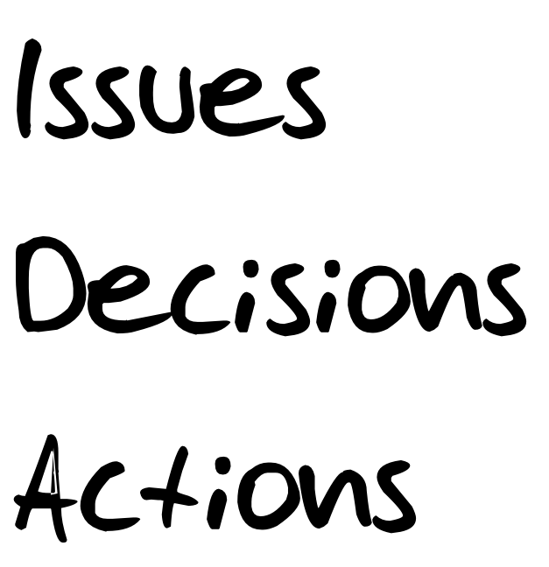
K. Define parking boards (IDA)
Copyright 1992-2015, Leadership Strategies, Inc. V15.02
Duplication prohibited without consent
Notes:
Added the K

Slide 33
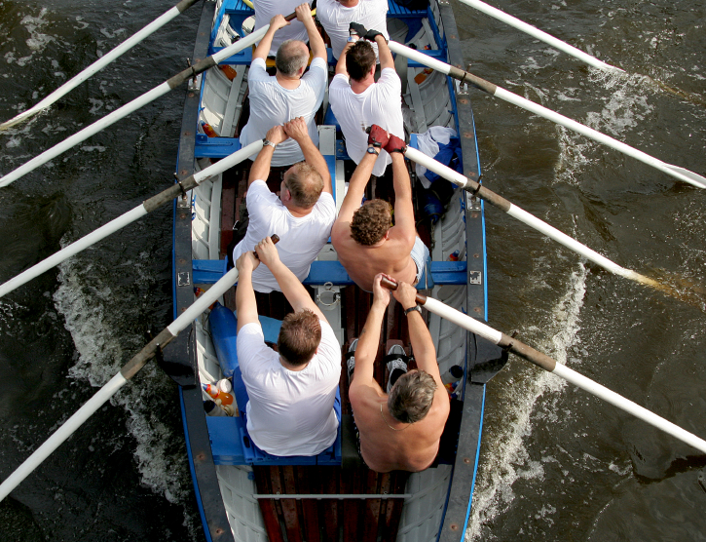
L. Define consensus
Copyright 1992-2015, Leadership Strategies, Inc. V15.02
Duplication prohibited without consent
Notes:
Added the L

Slide 34

M. Open on the fly
Copyright 1992-2015, Leadership Strategies, Inc. V15.02
Duplication prohibited without consent
Notes:
Added the M

Slide 35
Solving the Virtual Dilemma
Your virtual session with 15 participants is scheduled to start promptly at 10am.
You are set and ready to go.
13 (out of the 15 expected) participants are logged on and awaiting the session start time at 9:58am.
You receive a frantic call from two participants.
  One cannot get the software to download.
  The other has a firewall preventing software access.
What do you do?
-

Slide 36
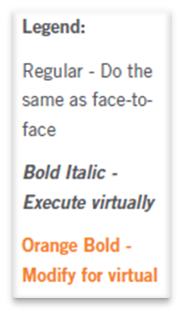
Principle 2
GETTING THE SESSION STARTED
Inform, Excite, Empower, Involve
Set Up with 40 Minutes to Spare
Optimize Your Set-up
Utilize the Gathering
Kick Off Promptly
Set the Stage with
Your Opening
Memorize Your Opening
Effectively Deliver Your Opening
Request Participants’ Objectives
Review the Agenda
Establish Ground Rules
Define the Parking Boards
Define Consensus
Open “On the Fly”
-

Slide 37
Checkpoint
The Facilitation Cycle
VIRTUAL PLATFORM
4.
The Power
of the Pen
1.
Preparing
for Success
2.
Getting
the Session
Started
9.
Closing the
Session
2.
Getting
the Session
Started
3.
Focusing
the Group
5.
Information
Gathering
6.
Managing
Dysfunction
7.
Consensus
Building
8.
Keeping the
Energy High
Group
Dynamics
10.
Agenda
Setting

Slide 38
The Effective Facilitator: Virtual Link
PRINCIPLE 2

