Slide 1
The Effective Facilitator: Virtual Link
Special Cases

Slide 2
Checkpoint
8:30 – 10:00
1:30 – 3:00
Getting Started
Information Gathering
Preparing
Review
Dysfunction
Consensus
Energy
10:30 – 12:00
3:30 – 5:00
Starting
Focusing
Power of the Pen
Closing
Agenda Setting
Special Cases
Review and Close

Slide 3
What have been some of the unusual cases you have experienced with virtual sessions?
?

Slide 4
Special Cases
Think about the last few virtual meetings or conference calls you have participated in or led.
Think about the special circumstances that special rules or guidelines might have helped to address.
What are some specific recommendations for these types of meetings?

Slide 5
Special Cases
Tips for four special cases
Only a Few Participants are Remote
A Large Number of Participants are Remote
You Are the Only Person Remote
The Virtual Session is Audio Only
Manual
11-1

Slide 6

A. ONLY A FEW PARTICIPANTS ARE REMOTE

Slide 7
A. Only a Few Participants Are Remote
Ensure agenda and handouts sent to remote participants in advance of the session.
Use a virtual meeting platform with webcam feature and project the remote participants.
Use whiteboards, slideboards and screen sharing.
Add ground rules to address the environment.
  “Remember the remote.”
Use roll call list and consider starting with remote participants.
Use name tents for remote participants at empty seats.
Assign remote participants to specific breakouts.
Manual
11-2

Slide 8
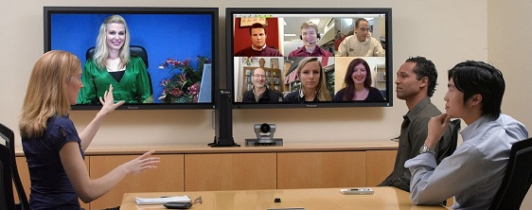
B. A largE number of PARTICIPANTS ARE REMOTE

Slide 9
B. A Large Number of Participants Are Remote
Use a roll call list and refer to participants by name.
Use engagement strategies such as The Whip.
Assign participants to teams to limit team size.
  Limit each team to four or five participants.
  Use round robins by teams.
When whiteboarding, assign certain participants to “write” and ask others via round robin for additions.
Increase the use of polls to encourage engagement.
Manual
11-3

Slide 10
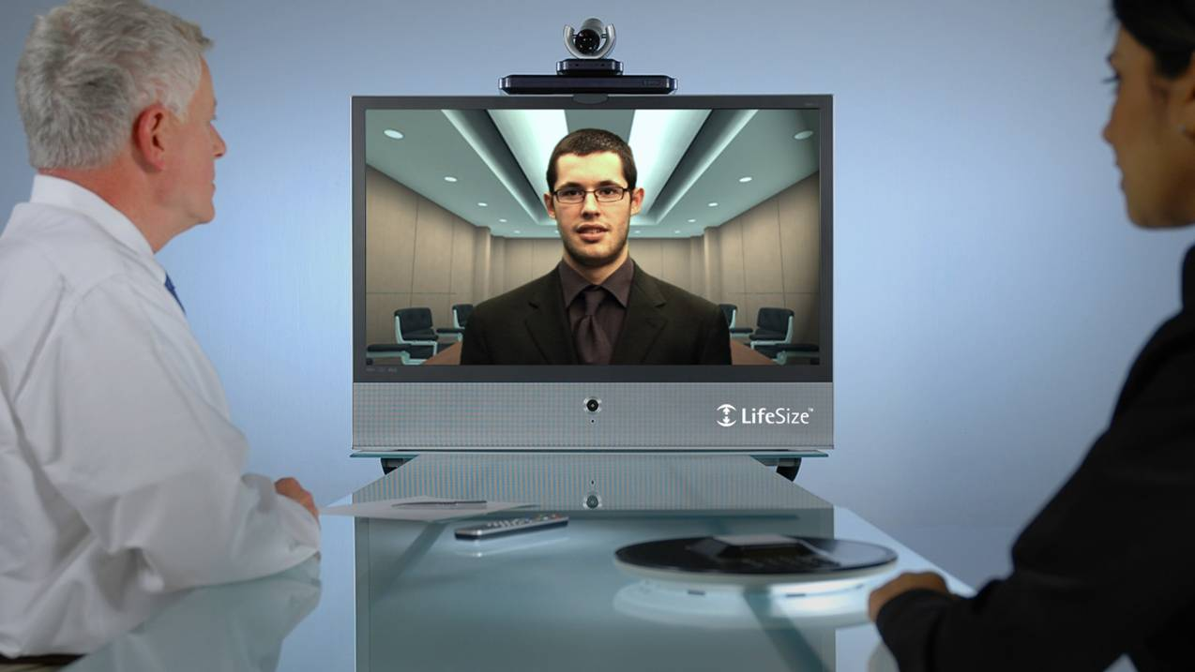
c. you ARE the only person REMOTE

Slide 11
C. You Are the Only Person Remote
Have a webcam of the meeting room.
Have your screen projected in the meeting room.
Assign participants to teams at separate tables.
  Use a webcam to view each table/team.
  Assign a participant in the meeting room to serve as your “eyes and ears.”
Use the virtual meeting platform tools for session documentation and ensure everyone can view.
Use the virtual meeting platform features such as whiteboards for breakout session documentation.
Manual
11-4
Notes:
Revised to match the fill-in-the-blanks in manual

Slide 12

D. The Virtual session is audio only

Slide 13
D. The Virtual Session is Audio Only
Do as much pre-writing as possible and distribute the objectives, agenda, ground rules, and any relevant handouts prior to the call.
Make sure everyone has received a copy of the session objective, agenda, and ground rules at least 24 hours in advance of the call.
Manual
11-5

Slide 14
D. The Virtual Session is Audio Only
Be sure to specify the correct time zone when informing participants of the start and end times.
Make sure that the call-in locations have a suitable environment to allow participants to focus and participate effectively. (Airport departure gates and Interstates with heavy traffic rarely provide the right kind of environment!)
Manual
11-5

Slide 15
D. The Virtual Session is Audio Only
Consider having participants do preliminary brainstorming prior to the call, and sending in their ideas prior to the call. These ideas can be summarized into “brainstorm lists” that can be provided along with the agenda and other written materials. Then, more time in the call can be spent grouping, prioritizing, or evaluating the brainstormed material.
Manual
11-5

Slide 16
D. The Virtual Session is Audio Only
Consider having any activities that need to be done in breakout groups completed prior to the call. Then, the call time can be used for each group to present their results
Limit agenda items so that the call can be completed in 2 hours or less. Break the meeting into several calls. It is difficult to be productive and to maintain group energy and participation with longer call times.
Manual
11-5

Slide 17
D. The Virtual Session is Audio Only
Conduct a roll call at the beginning and end of the call, and try to address participants by name.
Explain the purpose and objective of the call at the beginning, and reinforce this frequently throughout the call.
Manual
11-6

Slide 18
D. The Virtual Session is Audio Only
If there are multiple people at the call-in locations, appoint a scribe at each location to document the call on flip charts. In addition, assign a lead at each location to act as the “eyes” of the facilitator to note agreement, questions, etc. and notify the facilitator at the appropriate time.
Consider adding specific ground rules to assist with “conference call etiquette.”
Manual
11-6

Slide 19
D. The Virtual Session is Audio Only
Use round robins frequently, following the same order each time. Establish this order early in the call.
Establish a verbal method for doing consensus checks (such as a round robin where each person says Yea or Nay).
Manual
11-7

Slide 20
D. The Virtual Session is Audio Only
Consider using virtual meeting software so that all participants can view the documentation on a computer screen as it is being recorded and take advantage of the collaboration features available in each of these tools.
  GoToMeeting (Citrix)
  Live Meeting/Lync (Microsoft)
  WebEx (Cisco)
Manual
11-7

Slide 21
D. The Virtual Session is Audio Only
Keep in mind that as the facilitator, you will have to do a lot of summarizing and playback questions to make sure that everyone understands what is being said.
Make sure that all issues, decisions and action items are reviewed prior to closing the call.
Publish a re-cap immediately after the call.
Manual
11-7

Slide 22
Review and Close!
The Facilitation Cycle
VIRTUAL PLATFORM
4.
The Power
of the Pen
1.
Preparing
for Success
2.
Getting
the Session
Started
3.
Focusing
the Group
9.
Closing the
Session
5.
Information
Gathering
6.
Managing
Dysfunction
7.
Consensus
Building
8.
Keeping the
Energy High
Group
Dynamics
10.
Agenda
Setting

Slide 23
Course Objectives
Review the roles of a facilitator and identify key roles for virtual session success.
Identify the key differences in applying the Leadership Strategies’ facilitation principles when facilitating virtually.
Describe the best practices related to each principle in the virtual environment.
Demonstrate virtual engagement activities to make your virtual sessions more interactive.
DELIVERABLE: Conscious Competence
-
Manual
0-2

Slide 24
How Do You Feel?
Starting with ______...
Think about the information you just learned about virtual facilitation – the techniques and tools…
Think about your past virtual meetings and how you’ll apply what you learned today moving forward.
In just ONE or TWO words, can you share with the group how you feel now that you’ve finished this training?
?

Slide 25
SURVEY: How can we improve?
Help us enhance this beta class.
Before we end our training…
Check your e-mail.
Open the e-mail you received from the moderator that contains a unique URL.
Complete the short survey (only five questions).
Open the e-mail you received from the moderator that contains the full class evaluation.
Complete the class evaluation.
Keep us posted on your progress!
CONGRATULATIONS! YOU COMPLETED VIRTUAL LINK!

Slide 26
The Effective Facilitator: Virtual Link
Special Cases

