Slide 1
The effective facilitator: Virtual Link
Principle 10

Slide 2
Checkpoint
8:30 – 10:00
1:30 – 3:00
Getting Started
Information Gathering
Preparing
Review
Dysfunction
Consensus
Energy
10:30 – 12:00
3:30 – 5:00
Starting
Focusing
Power of the Pen
Closing
Agenda Setting
Special Cases
Review and Close
Notes:
Use tool to check what has been done

Slide 3
Checkpoint
The Facilitation Cycle
VIRTUAL PLATFORM
4.
The Power of the Pen
1.
Preparing for Success
2.
Getting the Session
Started
3.
Focusing the Group
9.
Closing the Session
5.
Information Gathering
6.
Managing Dysfunction
7.
Consensus Building
8.
Keeping the Energy High
Group
Dynamics
10.
Agenda Setting
10.
Agenda Setting

Slide 4
What are the types of sessions you have conducted or plan to conduct virtually?
?

Slide 5
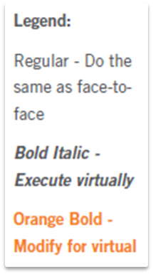
Principle 10
Agenda setting
Adapt Your Agenda to Address the Need
Choose an Agenda Based on Objectives
Tailor the Agenda to the Specific Need
Incorporate Consensus-Building Principles
Construct a New Agenda as Needed
Confirm the Agenda with the Planning/Project Team
Prepare a Detailed Agenda
Track Performance Against the Agenda
Record Process Notes
Incorporate Recommendations
Manual 10-1

Slide 6
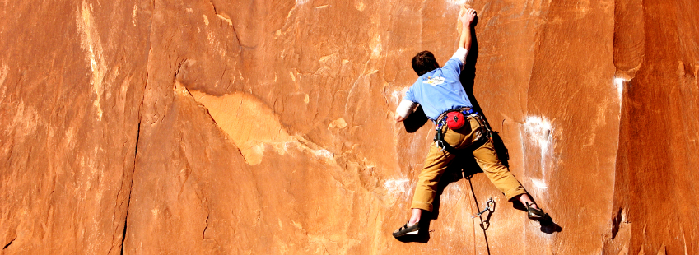
Adapt your agenda to address the need

Slide 7
Agenda Models
Strategic Plan
Project Plan
Project Status
Issue Resolution
Basic Improvement Model
Process Re-engineering
Information Needs Analysis
Process Modeling
Data Modeling
Procedure Design
Notes:
FLY BY SLIDE

Slide 8
“Which ones can be conducted virtually?”
1
6
2
7
3
8
4
9
5
10
Notes:
WHITEBOARD OF THE SESSION TYPES DONE BY PARTICIPANTS

Slide 9
A. Choose an Agenda Based on Objectives
Notes:
FLY BY SLIDE

Slide 10
“Number 9 will work”
1
6
2
7
3
8
4
9
5
10

Slide 11
B. Tailor Agenda to Needs
Notes:
FLY BY SLIDE

Slide 12
C. Incorporate Consensus-Building Principles
Notes:
FLY BY SLIDE

Slide 13

D. Construct a New Agenda as Needed
Notes:
FLY BY SLIDE

Slide 14
E. Confirm the Agenda with the Planning Team
Notes:
FLY BY SLIDE

Slide 15
F. Prepare a Detailed Agenda

Slide 16
F. Prepare a Detailed Agenda
Helps you think through the entire session
Communicates expectations to the producer, moderator, and documenter
Be sure to limit virtual sessions to no more than two hours with a minimum of a 30-minute break between sessions
Use a basis for each duration estimate
Agenda
Detailed
Agenda
Manual 10-2

Slide 17
F. Prepare a Detailed Agenda
Order of the process (the agenda)
Process technique (listing, brainstorming, grouping, prioritizing) with the virtual details
Question (starting question and explanation given to kick off each process)
Recording method (three-column matrix, basic list, etc.)
Supplies (use of platform features)
Timing (start/end/duration for each process)
Manual 10-2
Notes:
MW: Added the point about the virtual details
MW: Richard,– post-it and dots would NOT be used in a virtual session, so remove these here.
RS: will refer to things like checkmarks, annotation tools as a part of Supplies

Slide 18
Sample Detailed Agenda
A. Getting Started
Process | List the key topics participants want to discuss; group the topics into categories
Virtual Details | Have participants record their key topics on whiteboard Move items on whiteboard into groups
Timing | 10 minutes (2 + (12 issues x 0.5/issue) + 2)
Manual 10-3

Slide 19
Recording Format
Since flip charts are not an option, consider alternatives including:
Whiteboards: facilitator writing
Whiteboards: participants writing
Slideboards: facilitator writing
Slideboards: participants writing
Polling
Screen sharing
Engage, engage, engage
-
Manual 10-3

Slide 20
Supplies
Options to replace items such as Post-it notes, dots, etc. available in the face-to-face session including:
Annotation of whiteboards, slideboards, slides, screen sharing
Virtual dots for participation
-
Manual 10-4

Slide 21

G. Track Performance Against the Agenda
Notes:
FLY BY SLIDE

Slide 22
H. Record Process Notes
Notes:
FLY BY SLIDE

Slide 23
I. Incorporate Recommendations into the Agenda Model
Notes:
FLY BY SLIDE

Slide 24
Principle 10
Agenda setting
Adapt Your Agenda to Address the Need
Choose an Agenda Based on Objectives
Tailor the Agenda to the Specific Need
Incorporate Consensus-Building Principles
Construct a New Agenda as Needed
Confirm the Agenda with the Planning/Project Team
Prepare a Detailed Agenda
Track Performance Against the Agenda
Record Process Notes
Incorporate Recommendations

Slide 25
Checkpoint
The Facilitation Cycle
VIRTUAL PLATFORM
4.
The Power of the Pen
1.
Preparing for Success
2.
Getting the Session
Started
3.
Focusing the Group
9.
Closing the Session
5.
Information Gathering
6.
Managing Dysfunction
7.
Consensus Building
8.
Keeping the Energy High
Group
Dynamics
10.
Agenda Setting

