Slide 1
The Effective Facilitator: Virtual Link
Principle 1

Slide 2
Checkpoint
The Facilitation Cycle
VIRTUAL PLATFORM
4.
The Power of the Pen
1.
Preparing for Success
1.
Preparing for Success
2.
Getting the Session
Started
3.
Focusing the Group
9.
Closing the Session
5.
Information Gathering
6.
Managing Dysfunction
7.
Consensus Building
8.
Keeping the Energy High
Group
Dynamics
10.
Agenda Setting

Slide 3

Cover all
The bases
Duplication prohibited without consent

Slide 4
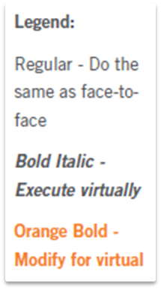
Principle 1
Preparing for Success
Cover All the Bases
Interview the Sponsor
Identify Key Roles in the Session
Define Purpose and Agenda
Prepare Sample Deliverable
Know the Process Cold
Educate the Planning Team
Prepare for the Hat Technique
Interview the Participants
Get Oriented on the Business Area
Prepare the “Room”
Prepare Your Opening

Slide 5
The Virtual Dilemma
With limited time to prepare for a virtual session, should I focus on learning how to use the virtual meeting platform or focus on figuring out what we want to get out of the session?
-
Manual 1-2

Slide 6
THE SIX Ps

Slide 7






A. Interview the Sponsor
The SIX PS
1.
2.
3.
PURPOSE
PRODUCT
PARTICIPANTS
4.
5.
6.
-
PROBABLE ISSUES
PROCESS
PLACE
Manual 1-3

Slide 8
A. Interview the Sponsor
The SIX Ps
Who will be attending?
What are their attitudes?
What are the locations and time zones of the participants?
3.
PARTICIPANTS
Manual 1-3

Slide 9
A. Interview the Sponsor
The SIX PS
What are the probable issues that will need to be discussed to create the product and achieve the purpose?
Challenges with the use of virtual meeting platform and participant familiarity with the planned use of features for the session
4.
PROBABLE ISSUES
Manual 1-3

Slide 10
A. Interview the Sponsor
The SIX PS
6.
What technology will be used, and how will it be used to conduct the session?
Virtual meeting platform
Conference call sessions
PLACE
Manual 1-3

Slide 11

b. IDENTIFY key roles in the session
Copyright 2015 Leadership Strategies, Inc.
Duplication prohibited without consent

Slide 12
B. Identify Key Roles in the Session
Discuss the session roles and responsibilities
See Section II, “The Virtual Approach: Why and How,” for the responsibilities of each role
Unique roles for virtual sessions are the following:
Producer: for technology assistance
Moderator: for content and execution assistance during the session
-
Manual 1-4

Slide 13
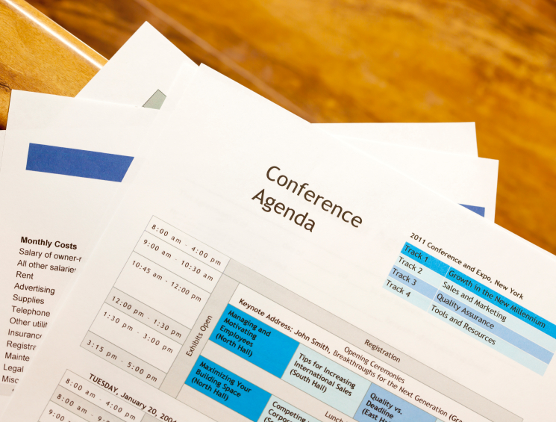
c. Define purpose and agenda
Copyright 2014 Leadership Strategies, Inc.
Duplication prohibited without consent

Slide 14

d. Prepare sample deliverables
Copyright 2013 Leadership Strategies, Inc.
Duplication prohibited without consent

Slide 15

E. Know the process cold
Copyright 2015 Leadership Strategies, Inc.
Duplication prohibited without consent

Slide 16
E. Know the Process Cold
Sample Detailed Agenda
A. Getting Started
Process | List the key topics participants want to discuss; group the topics into categories
Virtual Details | Have participants record their key topics on whiteboard Move items on whiteboard into groups
Timing | 10 minutes (2 + (12 issues x 0.5/issue) + 2)
Order of the processes
Process technique
Question (starting)
Recording method
Supplies
Timing
-
Manual 1-5

Slide 17

f. Educate the planning team
Copyright 2013 Leadership Strategies, Inc.
Duplication prohibited without consent

Slide 18

G. Prepare for the hat technique
Copyright 2013 Leadership Strategies, Inc.
Duplication prohibited without consent

Slide 19

h. Interview the participants
Copyright 2013 Leadership Strategies, Inc.
Duplication prohibited without consent

Slide 20

i. Get oriented on the business area
Copyright 2013 Leadership Strategies, Inc.
Duplication prohibited without consent

Slide 21

j. Prepare the “room”
Copyright 2015 Leadership Strategies, Inc.
Duplication prohibited without consent
Notes:
FIND A PIC THAT HAS WEBCAM OF VIRTUAL SESSION TYPE

Slide 22
J. Prepare the “Room”
Set up the virtual meeting room in advance of the session.
Ensure integration of features to maximize interaction and engagement.
Polling questions
Whiteboards
Slideboards
Screen sharing
Chat
Round robins/Mini round robins
-
Manual 1-6

Slide 23
OTHER “ROOM” NEEDS

Slide 24

Ensure “room” is set up early
Upload materials
Pre-prepared boards
Audio considerations (VoIP or telephony)
Other virtual meeting platform features
Copyright 2015 Leadership Strategies, Inc.
Duplication prohibited without consent

Slide 25
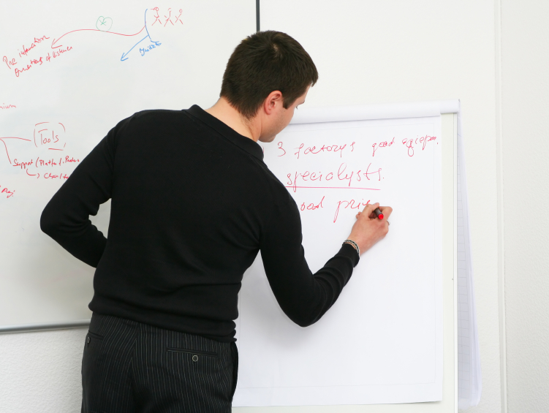
Establish your VIRTUAL MEETING FEATURE Plan
Polling questions
Whiteboards
Slideboards
Desktop Sharing
Chat
Round Robins/Mini Round Robins
-
Assume new participants will not be familiar with the virtual meeting platform features.
Copyright 2015 Leadership Strategies, Inc.
Duplication prohibited without consent

Slide 26
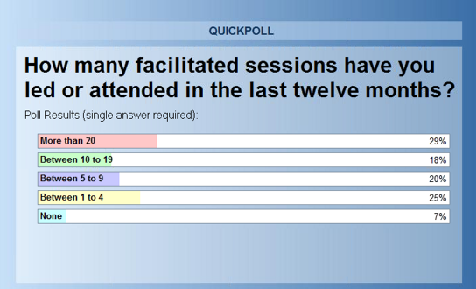
II. The Virtual Dilemma
Engagement Tools for the Virtual Environment.
Polls

Slide 27
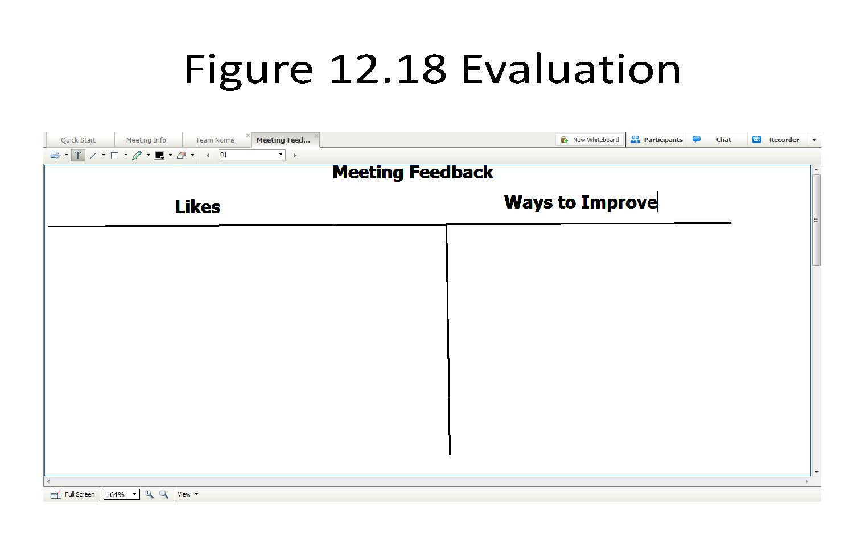
II. The Virtual Dilemma
Engagement Tools for the Virtual Environment.
Whiteboards
Carla K: Better communication
Pamela Q: Got to make it work
Tony J: Worker smarter not just harder
Fran T: Roles aren’t clear
-
Joe D: The approach
Joe D: We have to NOT major in the minors
Rob P: Good as is
Rob P: Getting it done now
Carla K: Start with why, not what
Samuel L: Involves everyone
Mary R: Too many hands can spoil the result
Pamela Q: Structure
Tim H: Decisions aren’t top-down
Samuel L: Need clear milestones
Mary R: The Drivers Model
Tony J: How do we make sure it stays alive?
Fran T: We are working to same end
Tim H: Is it over-engineered

Slide 28
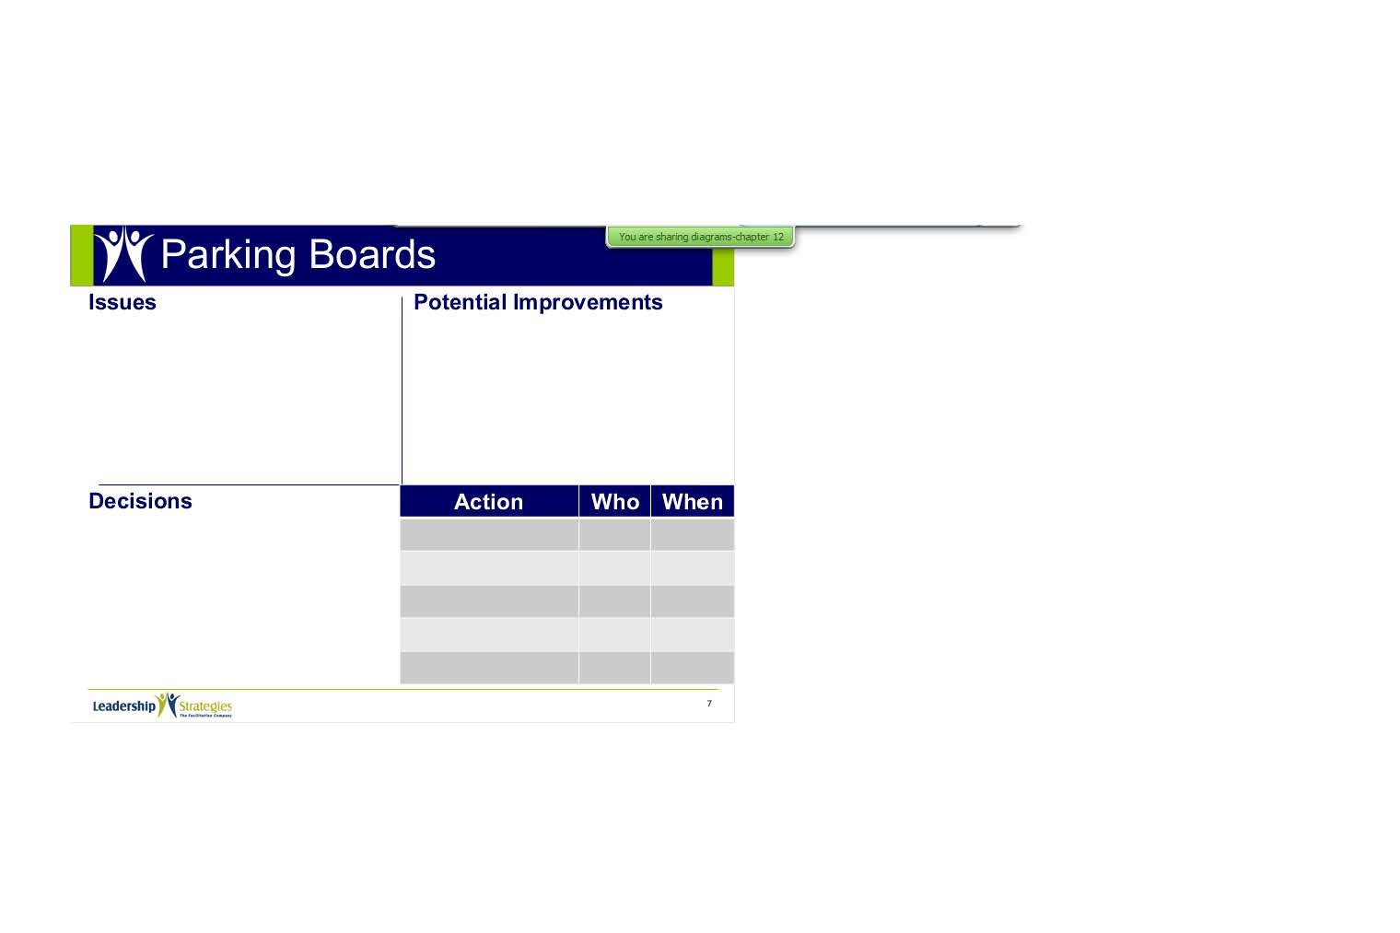
II. The Virtual Dilemma
Engagement Tools for the Virtual Environment.
Slideboards

Slide 29
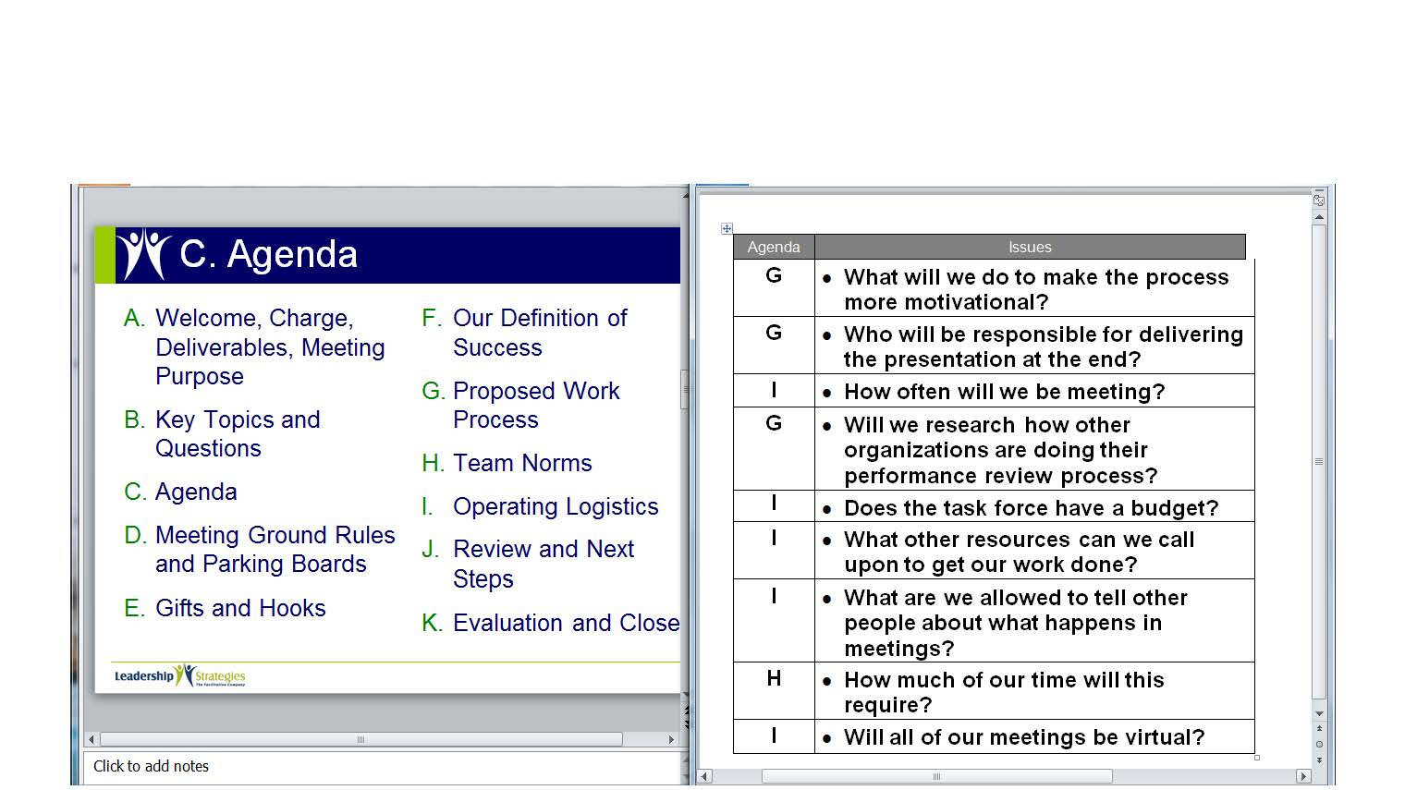
II. The Virtual Dilemma
Engagement Tools for the Virtual Environment.
Screen Sharing
-
PowerPoint
Word

Slide 30
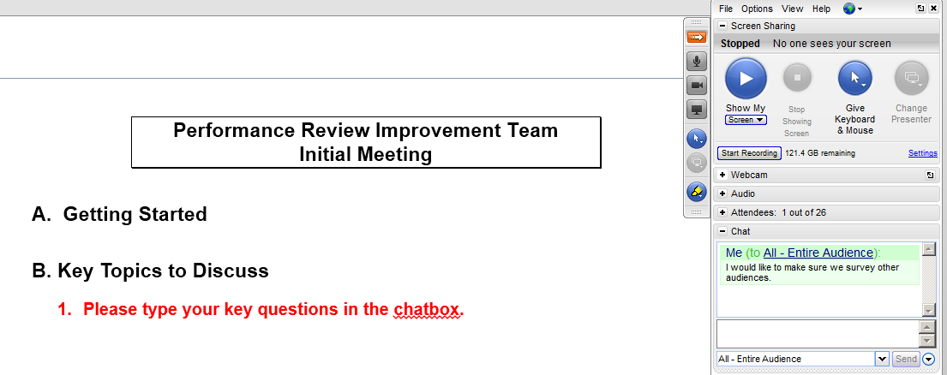
II. The Virtual Dilemma
Engagement Tools for the Virtual Environment.
Chat
-

Slide 31
II. The Virtual Dilemma
Engagement Tools for the Virtual Environment.
Round Robins
Using a roll call list, round robins and mini round robins are an effective way to engage the participants during a virtual meeting.
-
My Favorite: The WHIP
√ |  |  |  |  |  | Andrea, Atlanta
√ |  |  |  |  |  | Bill, Boston
√ |  |  |  |  |  | Cleve, Chicago
√ |  |  |  |  |  | Ken, Dallas
√ |  |  |  |  |  | Trina, Denver
√ |  |  |  |  |  | Vanessa, San Diego
√ |  |  |  |  |  | Kathy, Atlanta (project manager)

Slide 32

k. Prepare your opening
Copyright 2015 Leadership Strategies, Inc.
Duplication prohibited without consent

Slide 33
K. Prepare Your Opening
Through your opening words, you must inform, excite, empower, and involve.
Prepare your ground rules. These must establish a baseline for group interaction.
Excite
Inform
Empower
Involve
Manual 1-7

Slide 34
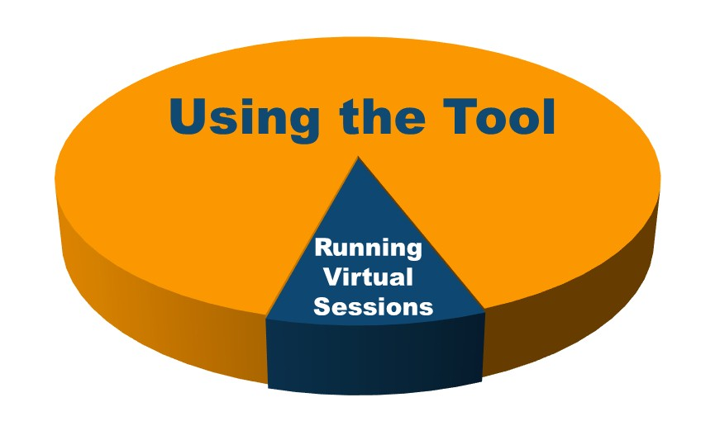
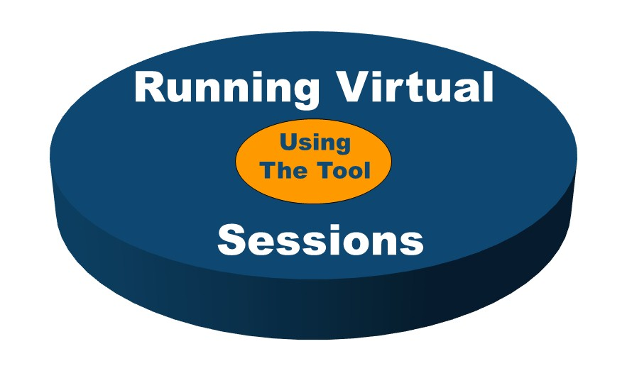
Poll
Assume that you have a dozen people that you want to become better at running virtual sessions. What would you want the training to focus?
-
-
A. Using the Virtual Tool
B. Facilitating Virtual Sessions

Slide 35
Principle 1
Preparing for Success
Cover All the Bases
Interview the Sponsor
Identify Key Roles in the Session
Define Purpose and Agenda
Prepare Sample Deliverable
Know the Process Cold
Educate the Planning Team
Prepare for the Hat Technique
Interview the Participants
Get Oriented on the Business Area
Prepare the Room
Prepare Your Opening

Slide 36
SURVEY: How can we improve? Help us enhance this beta class.
Before we break…
Check your e-mail.
Open the e-mail you received from the moderator that contains a unique URL.
Click the URL to begin the short survey (only five questions).
Submit.
Enjoy your break!
Thank you for providing your helpful feedback about this new course.

Slide 37
Checkpoint
The Facilitation Cycle
VIRTUAL PLATFORM
4.
The Power of the Pen
1.
Preparing for Success
1.
Preparing for Success
2.
Getting the Session
Started
3.
Focusing the Group
9.
Closing the Session
5.
Information Gathering
6.
Managing Dysfunction
7.
Consensus Building
8.
Keeping the Energy High
Group
Dynamics
10.
Agenda Setting

