Slide 1
The Effective Facilitator: Virtual Link
Welcome!

Slide 2
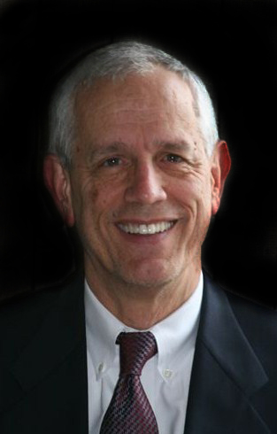

For Today’s Session…
Facilitator
Richard Smith, CMF
Moderator
Dana Barr

Slide 3

Your Workbook
Input fill-in-the-blanks and notes electronically
Print (if preferred)
Follow along
Reference your manual from The Effective Facilitator (if needed)
Note: We’ll begin with Principle 5 before Principle 1
Manual Page #

Slide 4

I. Getting started
Duplication prohibited without consent

Slide 5
The Effective Facilitator: Virtual Link
Getting started
Course Objectives
Virtual Facilitation Skills
The Principles
Methodology
Virtual Facilitation Techniques
Agenda
Ground Rules
Course Overview
Introductions

Slide 6

a. Course objectives
Copyright 1992-2015, Leadership Strategies, Inc. V15.02
Duplication prohibited without consent

Slide 7
A. Course Objectives
Review the roles of a facilitator and identify key roles for virtual session success.
Identify the key differences in applying the Leadership Strategies’ facilitation principles when facilitating virtually.
Describe the best practices related to each principle in the virtual environment.
Demonstrate virtual engagement activities to make your virtual sessions more interactive.
DELIVERABLE: Conscious Competence
-
Manual 0-2

Slide 8
Poll: The Effective Facilitator Class
When did you attend The Effective Facilitator?
Less than a year ago
1-3 years ago
3-5 years ago
More than 5 years ago
I have not attended The Effective Facilitator class.
-

Slide 9

B. Virtual Facilitation skills
Copyright 1992-2015, Leadership Strategies, Inc. V15.02
Duplication prohibited without consent

Slide 10
B. Virtual Facilitation Skills
Think about the last time that you led or participated in a virtual session… Think about the things that went well, think about the things that did not work… What are the key areas for which you would like to have better techniques when facilitating virtually?
What would you like to have learned from this class to prepare you for your next virtual session?
-
Manual 0-3

Slide 11
c. The principles
Manual 0-4
Duplication prohibited without consent

Slide 12

Principle 1. preparing for success Cover All The Bases
Duplication prohibited without consent

Slide 13

Principle 2. getting the session started Inform, Excite, Empower, Involve
Duplication prohibited without consent

Slide 14

Principle 3. focusing the group Establish the Course, Avoid Detours
Duplication prohibited without consent

Slide 15

Principle 4. power of the pen Use It, Don’t Abuse It,
Make It Theirs
Duplication prohibited without consent

Slide 16

Principle 5. information gathering Know Your Tools and How To Use Them
Duplication prohibited without consent

Slide 17

Principle 6. managing dysfunction Conscious Prevention, Early Detection, Clean Resolution
Duplication prohibited without consent

Slide 18

Principle 7. consensus building Generate a Consensus-Focused Process
Duplication prohibited without consent

Slide 19

Principle 8. keep the energy high Set the Pace, Anticipate the Lulls, React Accordingly
Duplication prohibited without consent

Slide 20
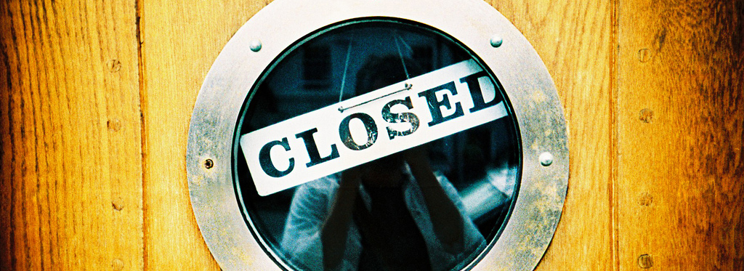
Principle 9. closing the session Review, Evaluate, Close, Debrief
Duplication prohibited without consent

Slide 21
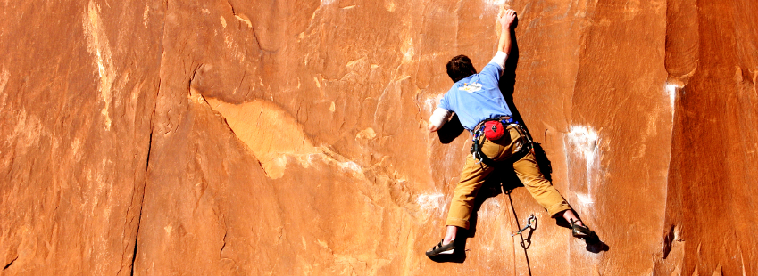
Principle 10. agenda setting Adapt Your Agenda to Address the Need
Duplication prohibited without consent

Slide 22

d. methodology
Copyright 1992-2015, Leadership Strategies, Inc. V14.10
Duplication prohibited without consent

Slide 23
The Facilitator’s Methodology
The Facilitation Cycle
VIRTUAL PLATFORM
4.
The Power of the Pen
1.
Preparing for Success
2.
Getting the Session
Started
3.
Focusing the Group
9.
Closing the Session
5.
Information Gathering
6.
Managing Dysfunction
7.
Consensus Building
8.
Keeping the Energy High
Group
Dynamics
10.
Agenda Setting
Manual 0-5

Slide 24

e. Virtual Facilitation techniques
Copyright 1992-2015, Leadership Strategies, Inc. V15.02
Duplication prohibited without consent

Slide 25
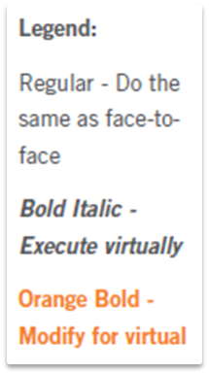
E. Virtual Facilitation Techniques
Preparing for Success
Cover All the Bases
Interview the Sponsor
Identify Key Roles in the Session
Define the Purpose and Agenda
Prepare Sample Deliverable
Know the Process Cold
Educate the Planning Team
Prepare for the Hat Technique
Interview the Participants
Get Oriented on the Business Area
Prepare the Room
Prepare Your Opening

Slide 26
Your Workbook
Input fill-in-the-blanks and notes electronically
Print (if preferred)
Follow along
Reference your manual from The Effective Facilitator (if needed)
Note: We’ll begin with Principle 5 before Principle 1
Manual Page #

Slide 27

f. agenda
Copyright 1992-2015, Leadership Strategies, Inc. V15.02
Duplication prohibited without consent

Slide 28
Agenda
8:30 – 10:00
1:30 – 3:00
Getting Started
Information Gathering
Preparing
Review
Dysfunction
Consensus
Energy
10:30 – 12:00
3:30 – 5:00
Starting
Focusing
Power of the Pen
Closing
Agenda Setting
Special Cases
Review and Close

Slide 29

g. Ground rules
Copyright 1992-2015, Leadership Strategies, Inc. V15.02
Duplication prohibited without consent

Slide 30
G. Ground Rules
Always open for questions – use the platform tools
The open issues list
Everyone speaks
Avoid “chat discussions”
Be here (eliminate mail client, IM, texting, etc.)
Start on time, end on time
Repetition to train the mind
Always identify yourself when you join/leave/each time you speak
___________
-
Manual 0-8

Slide 31

h. Course overview
Copyright 1992-2015, Leadership Strategies, Inc. V15.02
Duplication prohibited without consent

Slide 32
H. Course Overview
Group
Techniques
Process
Techniques
Virtual Engagement
Techniques
Manual 0-9

Slide 33

I. introductions
Copyright 1992-2015, Leadership Strategies, Inc. V14.10
Duplication prohibited without consent

Slide 34
I. Introductions (45-second version)
Your name, organization and location
Your title and the length of time that you have been with your organization
Your past experience with virtual facilitation
The primary virtual meeting platform you use for virtual sessions
-
Manual 0-10

Slide 35
Introductions
Name/Time w/ Org | Past Experience with Virtual Facilitation | Virtual Meeting Platform

Slide 36
Introductions
Name/Time w/ Org | Past Experience with Virtual Facilitation | Virtual Meeting Platform

Slide 37

II. The virtual approach: why & how
Duplication prohibited without consent

Slide 38
EF: Virtual Link
The Virtual approach
Why Virtual Sessions?
When Should a Session be Virtual?
What Virtual Meeting Platform Should be Used?
How Does the Role of a Facilitator Change?
What Other Roles Exist in a Virtual Session?

Slide 39
A. Why virtual sessions?
Duplication prohibited without consent

Slide 40



Why Virtual Sessions?
Three key reasons
Access
Price
Need
Manual 0-12

Slide 41

A. Why Virtual Sessions?
1.
Laptops
Tablets
Smart Phones
ACCESS

Slide 42
A. Why Virtual Sessions?
2.
More tools available
Span of price range down to $0 – “freemium”
PRICE

Slide 43
A. Why Virtual Sessions?
3.
Collaboration is important
Reduced budgets
Virtual is a viable option
NEED

Slide 44
Costs of a Face-to-Face Versus Virtual Session
Face-to-Face | Expense | Virtual
$2,000 | Airline Travel (average ticket price of $400/remote participant) | $0
$250 | Local Transportation ($50/remote participant to/from airport to hotel and return) | $0
$400 | Meals ($40/remote participant/day for 2 days) | $0
$250 | Mileage and Parking ($50/remote participant) | $0
$0 | Facilities Cost (room charges if necessary) | $0
$2,900 | TOTAL EXPENSES | $0
Manual 0-13
Download our Cost of Meetings Calculator at www.leadstrat.com/meetings-calculator

Slide 45
B. When should a session by virtual?
Duplication prohibited without consent

Slide 46
B. When Should a Session Be Virtual?
 |  | Loss of Effectiveness if Virtual
 |  | Low | Medium | High
Additional Cost of Meeting Face-to-Face | High | Virtual | Virtual | ?
 | Medium | Virtual | ? | Face-to-Face
 | Low | ? | Face-to-Face | Face-to-Face
Manual 0-14

Slide 47
C. What virtual meeting platform should be used?
Duplication prohibited without consent

Slide 48
What Virtual Meeting Platform Should Be Used?
10
Face-to-Face: People can hear one another, see one another, view the same information, provide written input at the same time, work in sub-teams, fully observe non-verbal communication, and physically interact (e.g., shake hands).
8
Audio, Video and Screen Sharing, Whiteboard and Breakout Groups: People can hear one another, see one another, view the same information, provide written input at the same time, and work in sub-teams.
6
Audio, Video and Screen Sharing: People can hear one another, see one another and view the same information.
3
Audio and Screen Sharing: People can hear one another and see the same information.
1
Audio Only: People can hear one another (conference call).
Manual 0-15

Slide 49
What Virtual Meeting Platform Should Be Used?
1 | Full Features
2 | Basic Features
3 | Limited Features
4 | Special Purpose
Manual 0-16

Slide 50
What Virtual Meeting Platform Should Be Used?
1 | Full Features | Includes basic features such as video and screen sharing as well as advanced features such as annotation, breakouts, polling, and whiteboards.
2 | Basic Features
3 | Limited Features
4 | Special Purpose

Slide 51
What Virtual Meeting Platform Should Be Used?
1 | Full Features | Includes basic features such as video and screen sharing, as well as advanced features such as annotation, breakouts, polling, and whiteboards.
2 | Basic Features | Includes basic features such as video and screen sharing but typically does not include one or more of the following: annotation, breakouts, polling, and whiteboards.
3 | Limited Features
4 | Special Purpose

Slide 52
What Virtual Meeting Platform Should Be Used?
1 | Full Features | Includes basic features such as video and screen sharing, as well as advanced features such as annotation, breakouts, polling, and whiteboards.
2 | Basic Features | Includes basic features such as video and screen sharing, but typically does not include one or more of the following: annotation, breakouts, polling, and whiteboards.
3 | Limited Features | Excludes one or more basic features such as video or screen sharing or supports fewer than fifteen users.
4 | Special Purpose

Slide 53
What Virtual Meeting Platform Should Be Used?
1 | Full Features | Includes basic features such as video and screen sharing, as well as advanced features such as annotation, breakouts, polling, and whiteboards.
2 | Basic Features | Includes basic features such as video and screen sharing, but typically does not include one or more of the following: annotation, breakouts, polling, and whiteboards.
3 | Limited Features | Excludes one or more basic features such as video or screen sharing, or supports fewer than fifteen users.
4 | Special Purpose | Provides features for a special purpose or a special audience.

Slide 54
What Virtual Meeting Platform Should Be Used?
1 | Full Features | Adobe Connect Live Meeting WebEx
2 | Basic Features
3 | Limited Features
4 | Special Purpose

Slide 55
What Virtual Meeting Platform Should Be Used?
1 | Full Features | Adobe Connect Live Meeting WebEx
2 | Basic Features | GoToMeeting ClickMeeting 4Webcom
3 | Limited Features
4 | Special Purpose

Slide 56
What Virtual Meeting Platform Should Be Used?
1 | Full Features | Adobe Connect Live Meeting WebEx
2 | Basic Features | GoToMeeting ClickMeeting 4Webcom
3 | Limited Features | join.me Google Hangouts Skype
4 | Special Purpose

Slide 57
What Virtual Meeting Platform Should Be Used?
1 | Full Features | Adobe Connect Live Meeting WebEx
2 | Basic Features | GoToMeeting ClickMeeting 4Webcom
3 | Limited Features | join.me Google Hangouts Skype
4 | Special Purpose | Blackboard Collaborate Powernoodle Facilitate.com

Slide 58
Choosing the Virtual Platform
Manual 0-17
Determine the why, the what, and the constraints.
View a variety of platforms.
Identify the most critical product features.
Narrow your choices based on product tiers.
Select the platform.
 | Product Tiers
 | 1 Full | 2 Basic | 3 Limited | 4 Special
To maximize engagement, it is important to have annotation, breakout rooms, polling, or whiteboard. | √ | Eliminate
To increase productivity, it is important for everyone to see one another and see the leader’s desktop. | √ | √ | Eliminate
More than 25 people need to attend the virtual meeting at the same time. | √ | √ | Eliminate Most | √
The virtual meeting platform must be free. | Eliminate |  | √ | Eliminate

Slide 59
d. How does The Role of a facilitator change?
Duplication prohibited without consent

Slide 60
Roles of the Facilitator
Guide
Motivator
Bridge Builder
Clairvoyant
Peacemaker
Taskmaster
Praiser
Active Listener
Engager
Help them see what they may only hear
Manual 0-18

Slide 61
E. What Other Roles Exist in a Virtual Session?
Producer
Moderator
-
Manual 0-19
Notes:
Producer Sets up the virtual meeting platform for the session. This may include unique chat rooms, whiteboards, parking boards, polls, etc. depending upon the meeting needs, the featuers of the virtual meeting platform and the requests of the session facilitator
Moderator Works with the facilitator to serve as a technical liaison for session participants experiencing technical issues during the session.
May also support the faciliator, as requested throughout the session to include items such changing permissions, opening/closing polls, starting breakout rooms, etc. based on the features of the virtual meeting platform

Slide 62
The Effective Facilitator: Virtual Link: Webex feature introduction

Slide 63
Poll: WebEx Experience
Your experience/knowledge of WebEx Meeting Center
None – have not used
Low – used very little
Medium – used only as attendee
High – used as presenter and attendee
Expert – power user; could train others
-
Notes:
Put 2 polls; 1 for Meeting Center and 1 for Training Center

Slide 64
WebEx Introduction
WebEx Training Center key feature review
Consider how we can best use the tool to help us with our virtual sessions
Introduce the features we will be using today
-

Slide 65
Poll: Your WebEx Experience with Training Center
Your use of WebEx Training Center software (not just WebEx Meeting)
Yes
No
-

Slide 66
WebEx Training Center Introduction
WebEx key feature review
Consider how we can best use the tool to help us with our virtual sessions
Introduce the features we will be using today
-

Slide 67
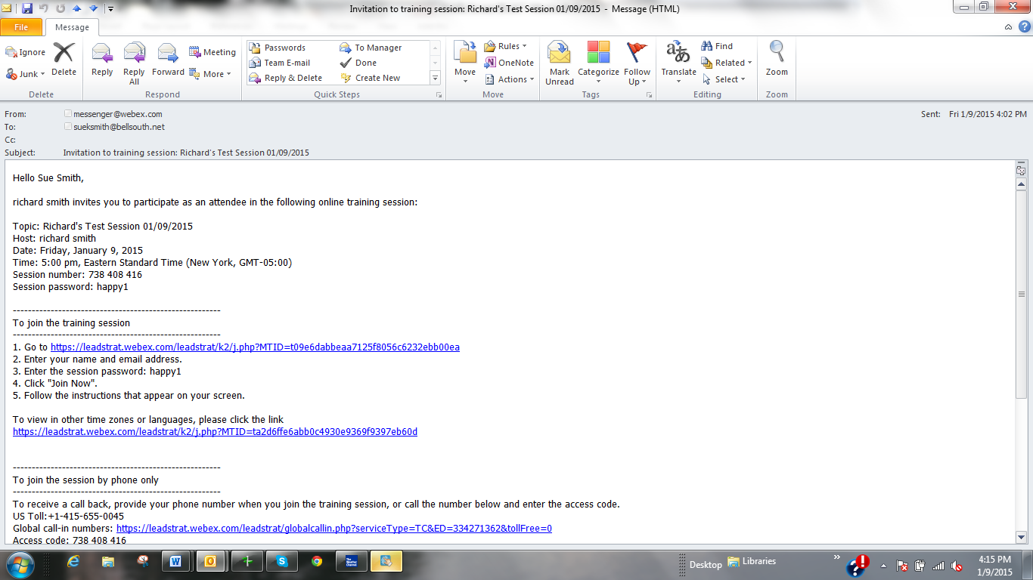
The WebEx Invitation

Slide 68
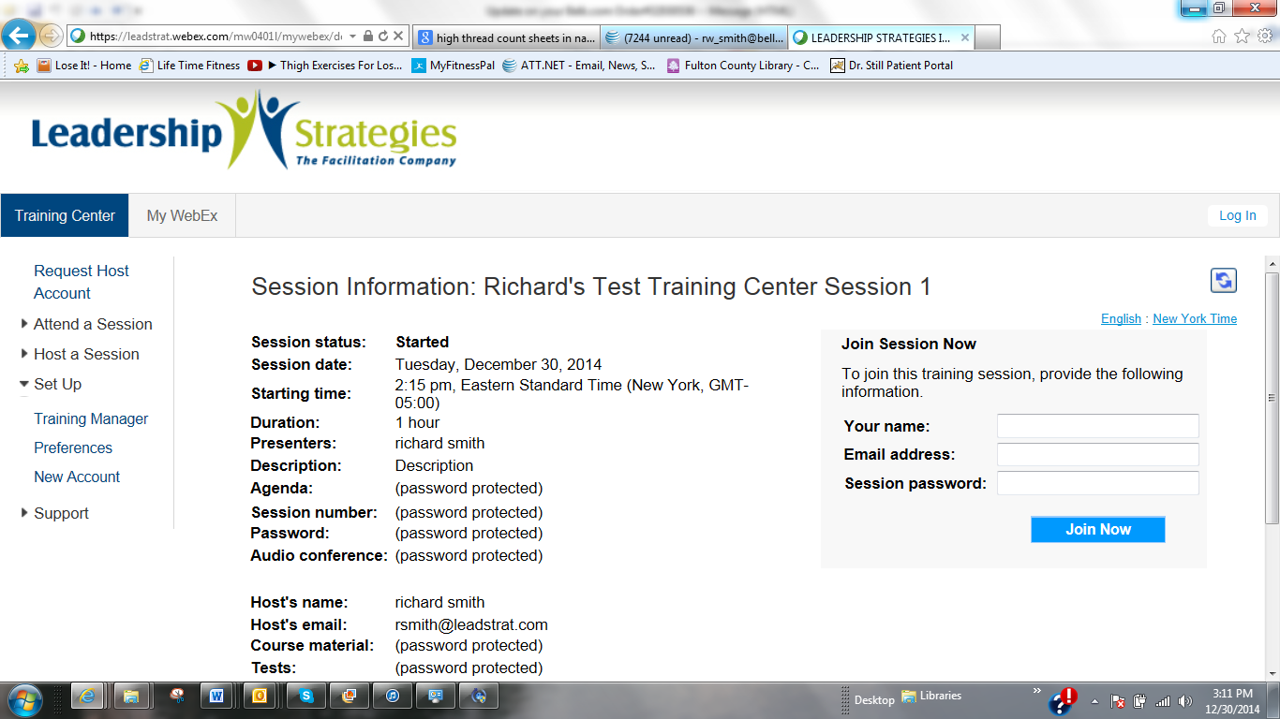
WebEx Welcome Screen
The default welcome
screen

Slide 69
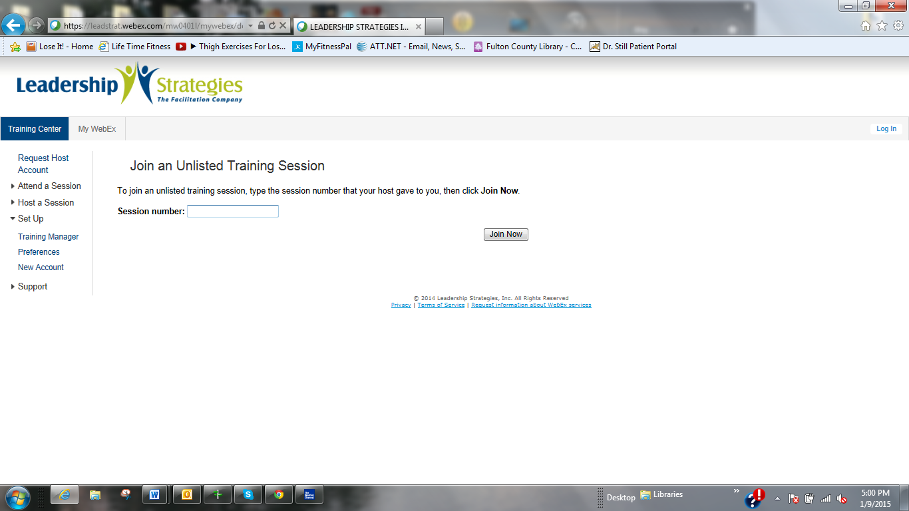
The WebEx Welcome Screen
Another way to join; you will see this screen
if you inadvertently click through the initial
welcome

Slide 70
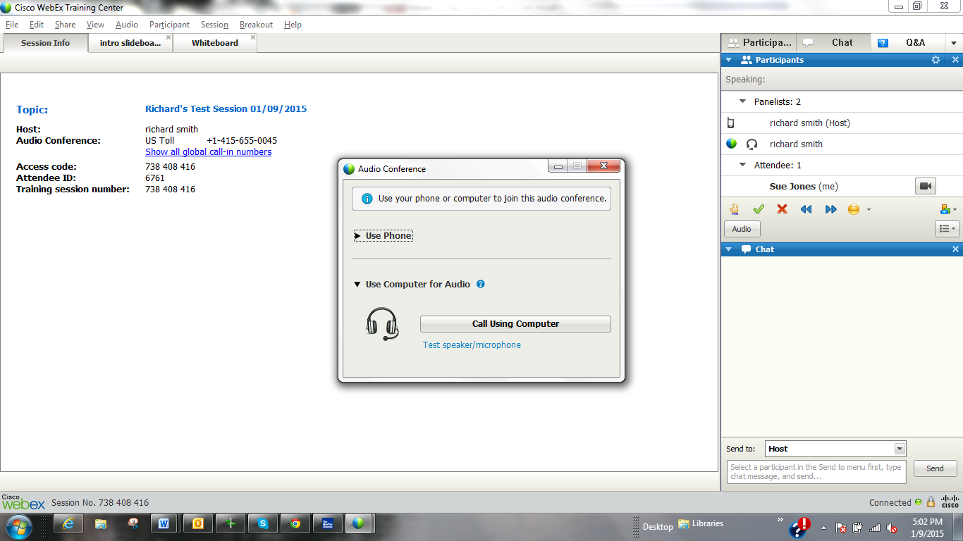
WebEx: First Screen after Login
Select your audio option;
remember VoIP is the most
cost effective choice
You may also “tune” your
audio here

Slide 71
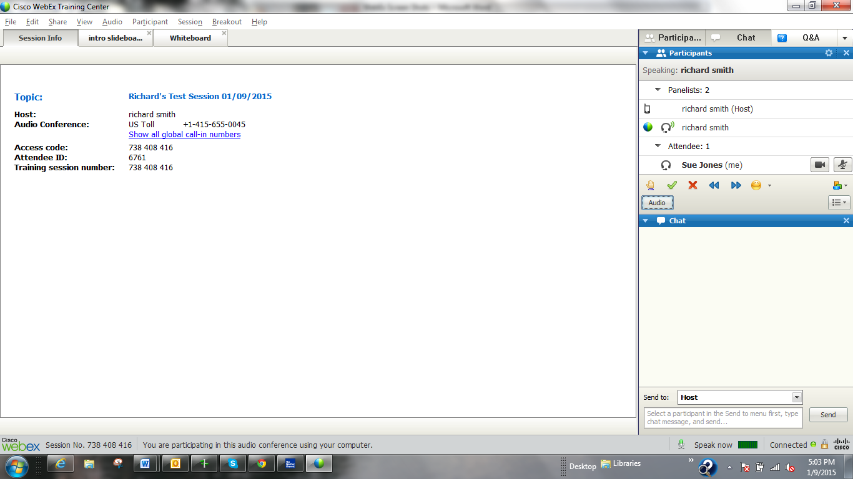
WebEx: After Selecting Audio
This is the first WebEx Training Center screen you will see.
Note the tabs at the top of the screen
The right hand side is referred to as the Participant Panel.
Note the default for Participant List (both Panelists and
Attendees; Chat; and, Q&A

Slide 72
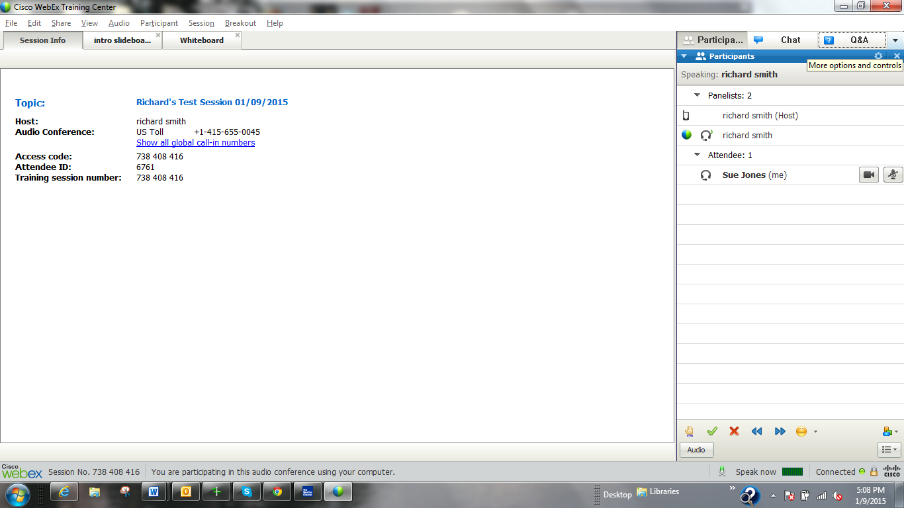
WebEx: Feedback Panel
The Feedback panel allows Participants to alert/respond
to the Meeting Leader as follows:
Raising your “hand”
Yes or No
Slow down or Speed Up
Emoticons (they thought of almost everything)

Slide 73
WebEx: Practice Feedback
Raise hands
Select 3 participants
Can you indicate either “yes” or “no”; are you with us?
Select 2 people to indicate “Slow Down”
Select 2 people to indicate “Speed Up”
Check for questions

Slide 74
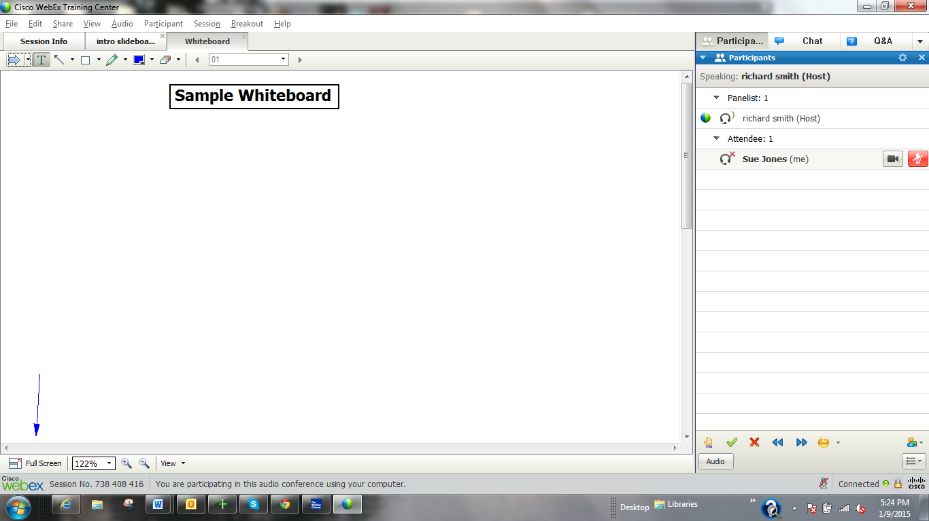
WebEx: Full Screen View
To avoid the temptation of multi-tasking, often it is helpful to
select the Full Screen view. Simply click on the selection.
Often, when conducting a meeting, you might request participants
to use this view.

Slide 75
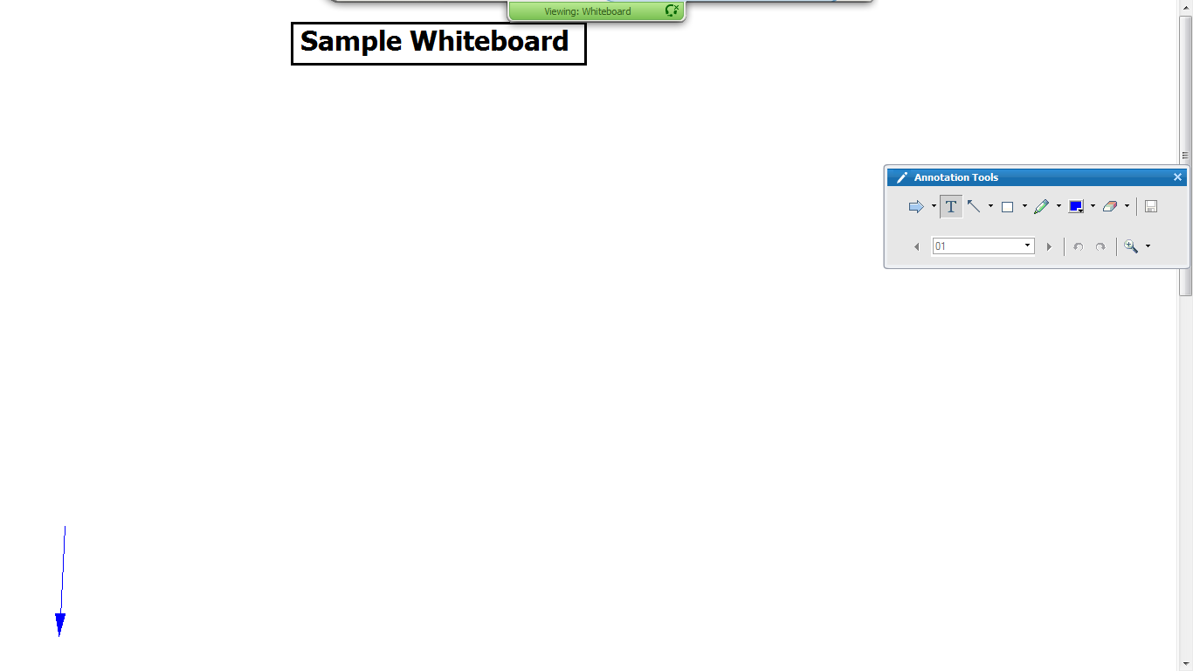
WebEx: Full Screen View
This is what the Full Screen view looks like. You may
select “Escape” to return to the earlier view. Note,
the Annotation Tool Bar appears in the Full Screen
View. We will cover these features shortly.

Slide 76
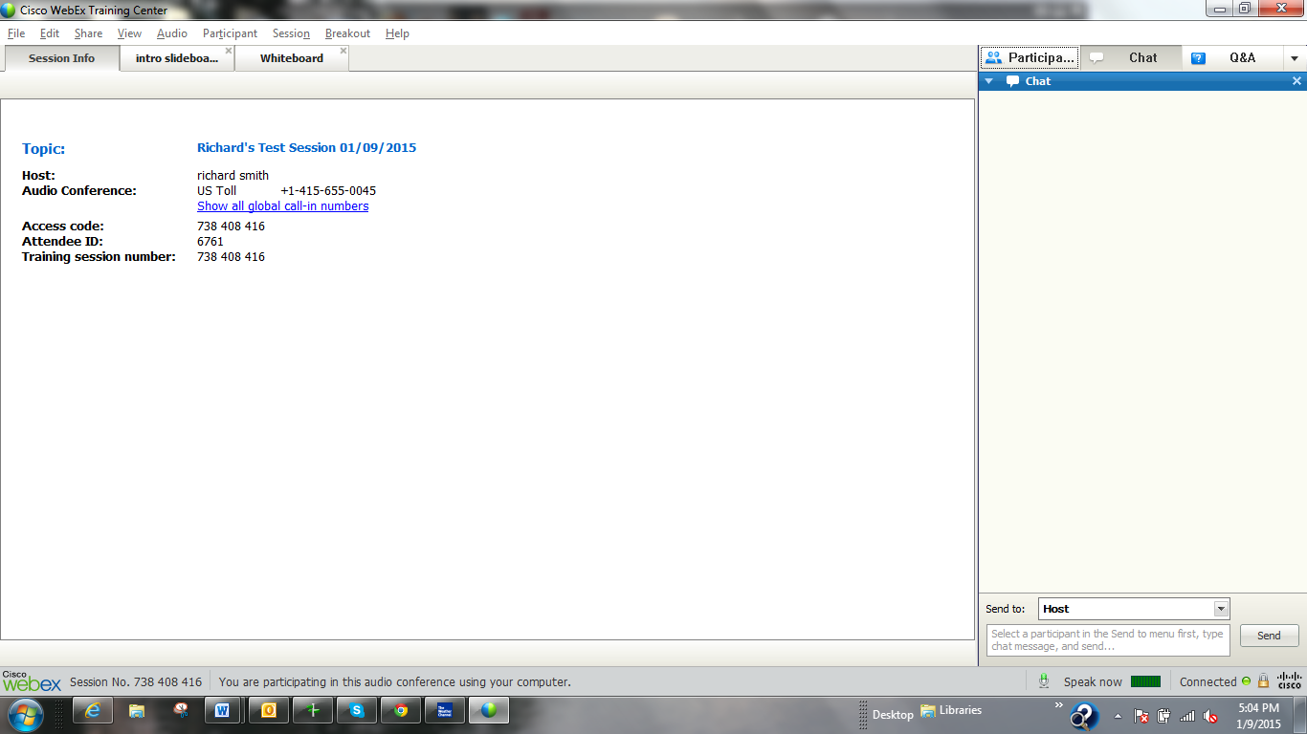
WebEx: Chat Feature
Clicking on Chat allows you to send a
Chat message. We would like you to use
this to communicate with our Moderator,
Dana Barr.
Do not do that now, we will practice in a few
minutes. Thanks.

Slide 77
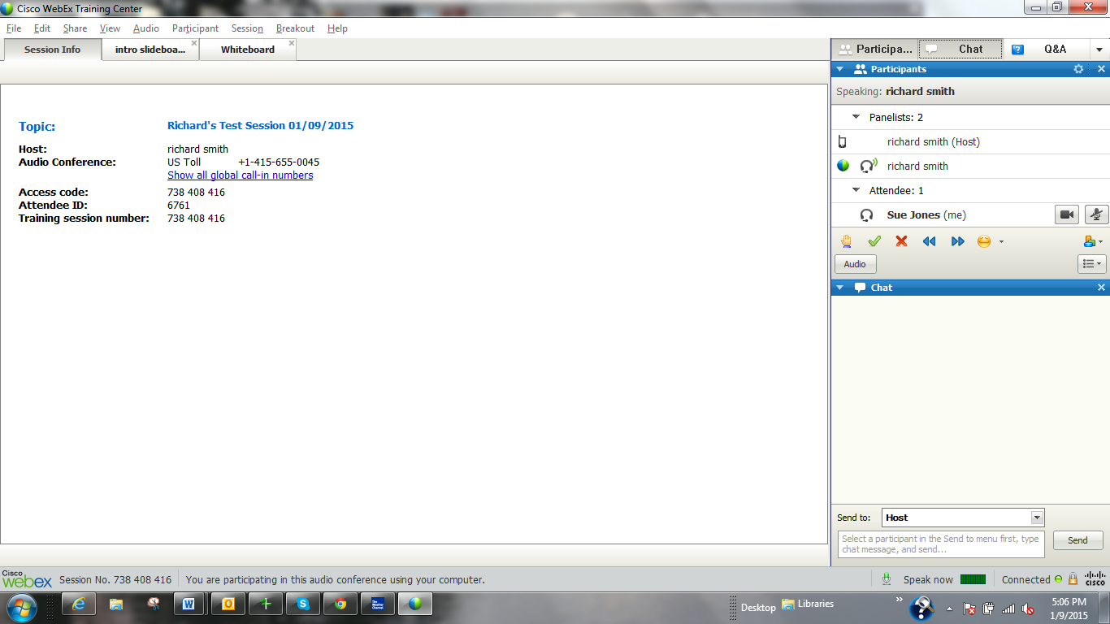
WebEx: Chat Feature
Simply, click again to return to the default setup
for the Participant Panel.

Slide 78
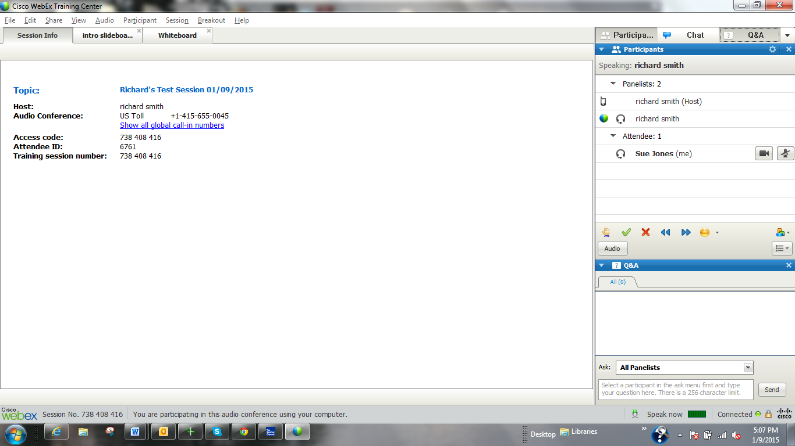
WebEx: Q&A Feature
The Q&A feature works the same way as the Chat feature.

Slide 79
WebEx: Feature Review
Click the arrow for additional options.

Slide 80
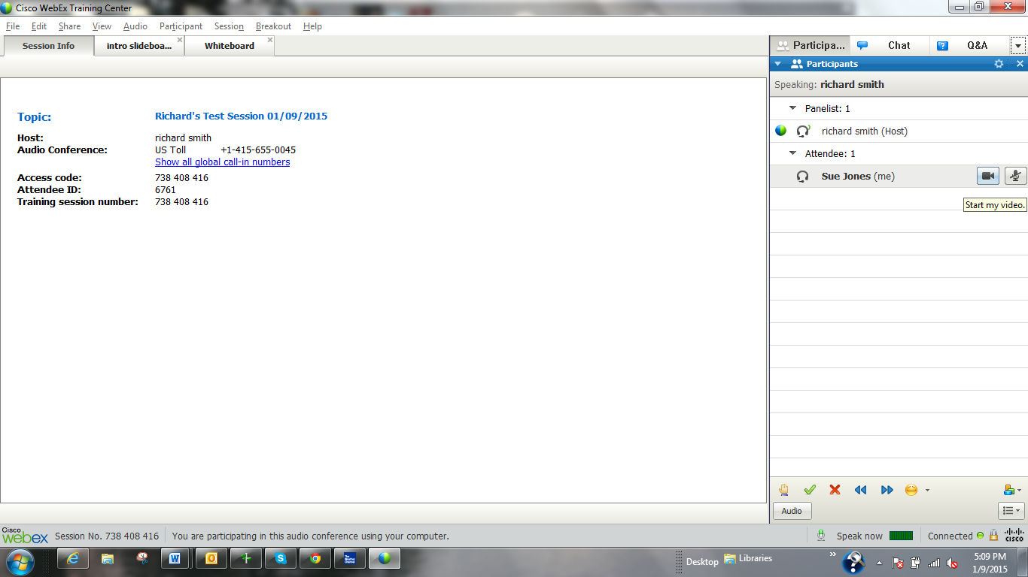
WebEx: WebCam Feature
Click the WebCam icon to start you video.

Slide 81
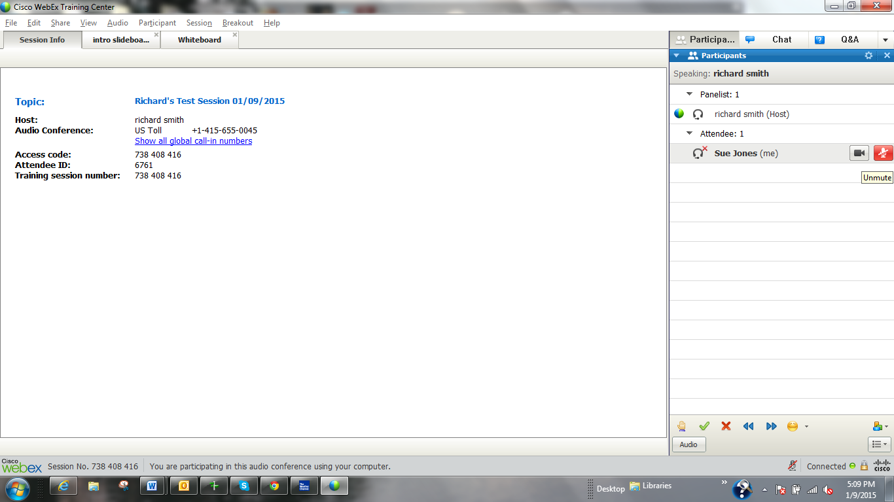
WebEx: Mute/Unmute
A best practice is to remain unmuted
when we are not speaking.

Slide 82
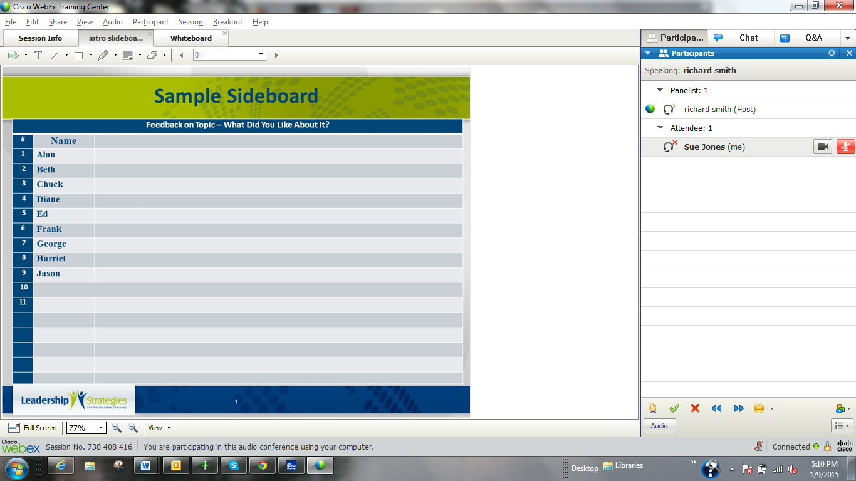
WebEx: Slideboards
A Slideboard is a
formatted template
which provides
more structure
to participant
responses.

Slide 83
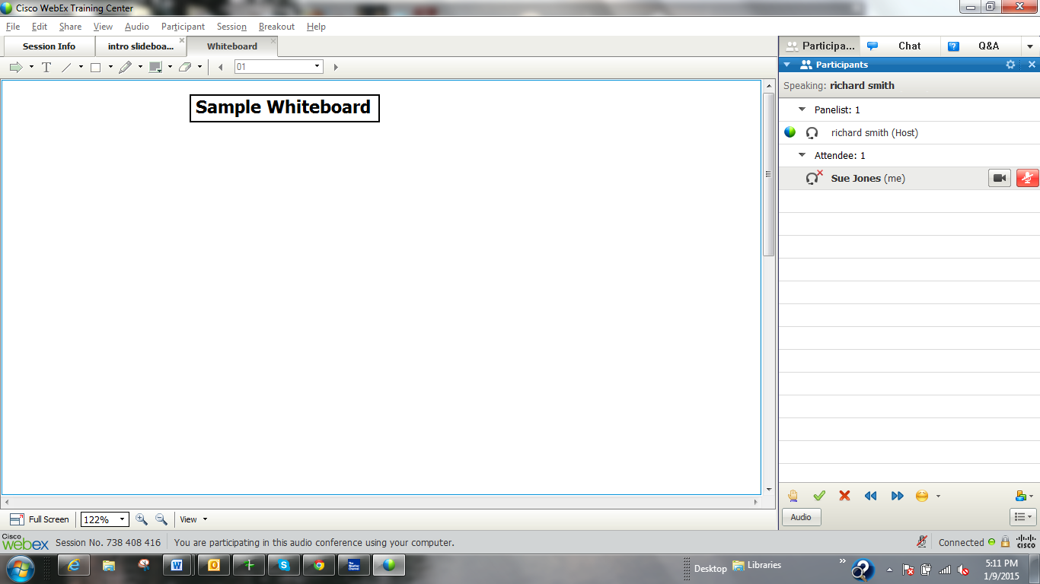
WebEx: Whiteboard
A Whiteboard is an unformatted way to process
information. It should look a lot like the Flip Chart
in the face-to-face meeting.

Slide 84
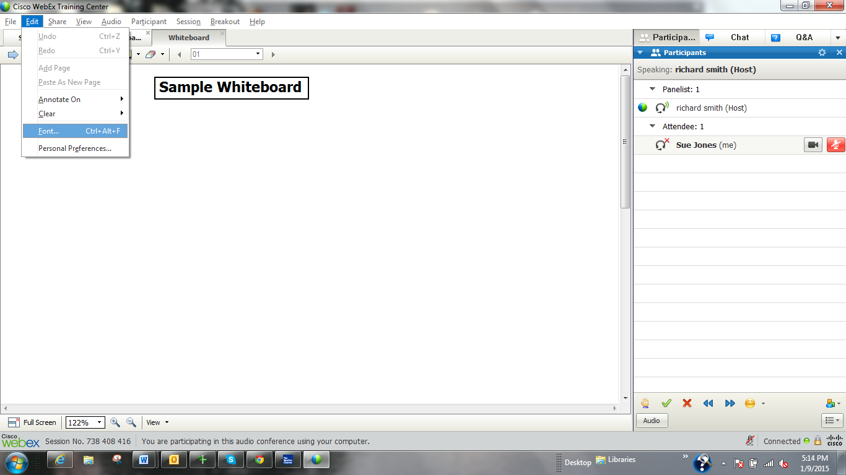
WebEx: Annotation Feature
When the host allows participants to annotate,
you may select Edit<Font to select a font size.
We suggest using font size 14 and bold.

Slide 85
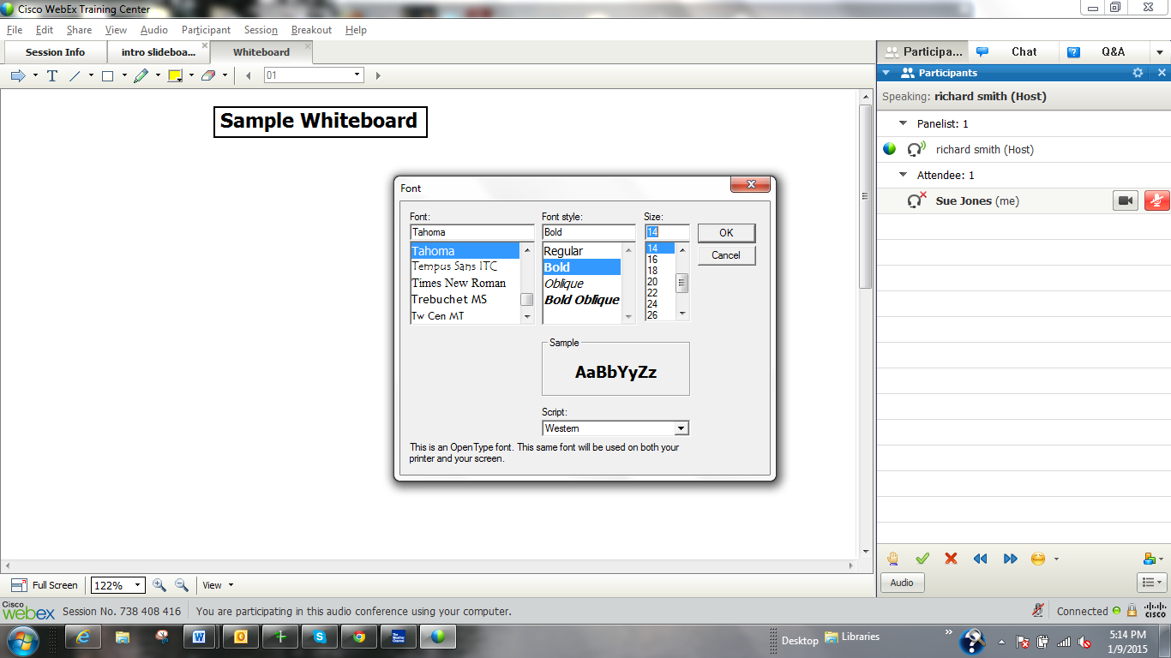
WebEx: Font Selection
Select your choice of font
and then the color.
Avoid the light colors, they
are very difficult to read.

Slide 86
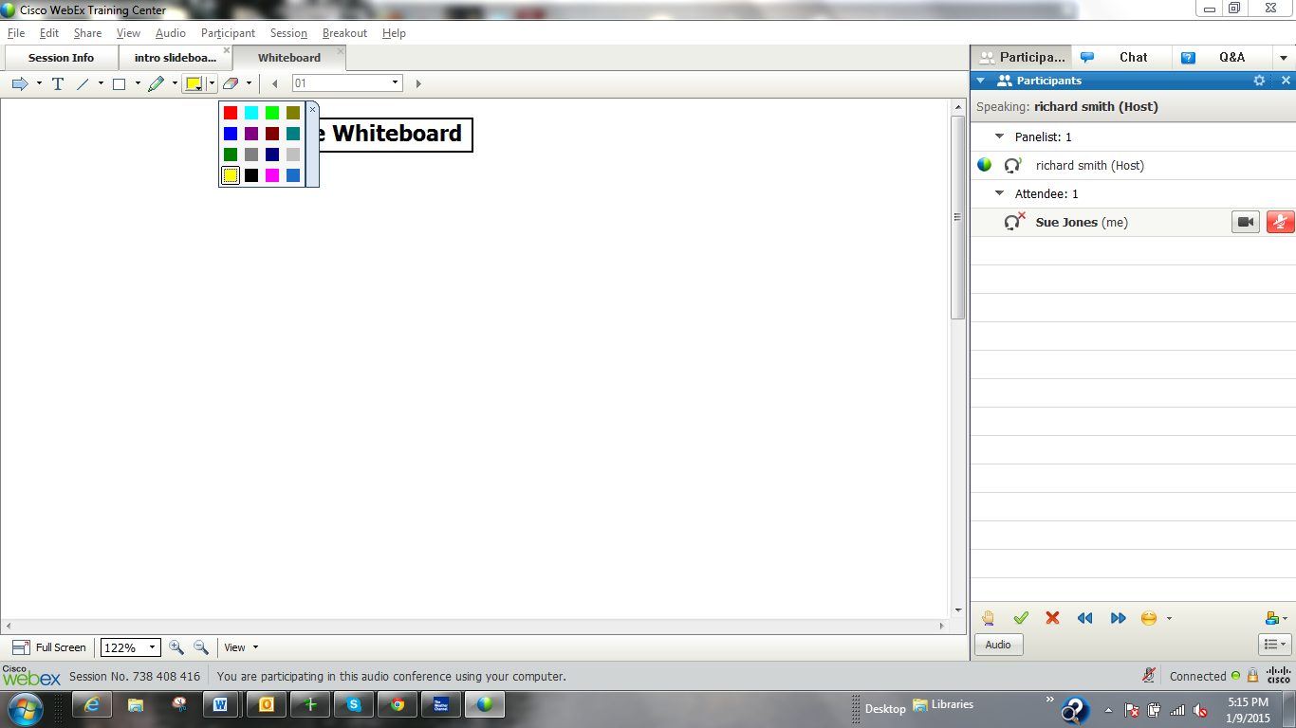
WebEx: Font Colors
Here are the color choices. Again, let’s try the darker
colors, font size 14 and bold.
We will turn on the annotation feature in just a minute
or two so we can all practice with these rich
features that allow us to make our virtual meetings
much more engaging.

Slide 87
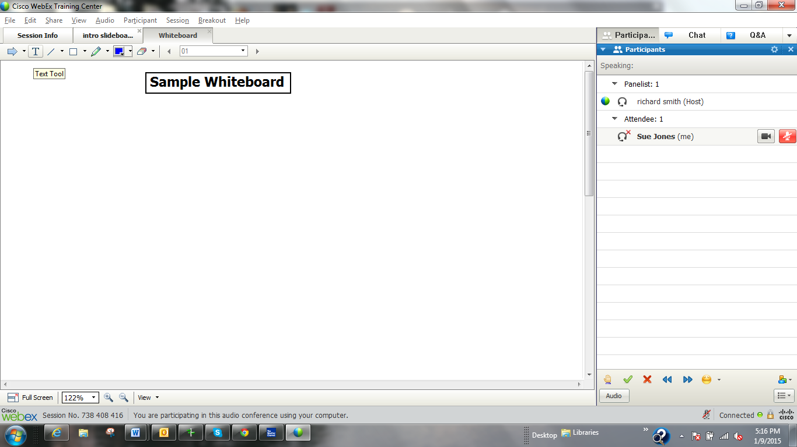
WebEx: Annotating Content
Once the annotation feature has been enabled, you have
selected your font size, type and color, the last step is to
make the Text feature active. To do that, click on the Text Tool
icon.
Remember, whatever menu selection you last made will remain
active until you click another icon.

Slide 88
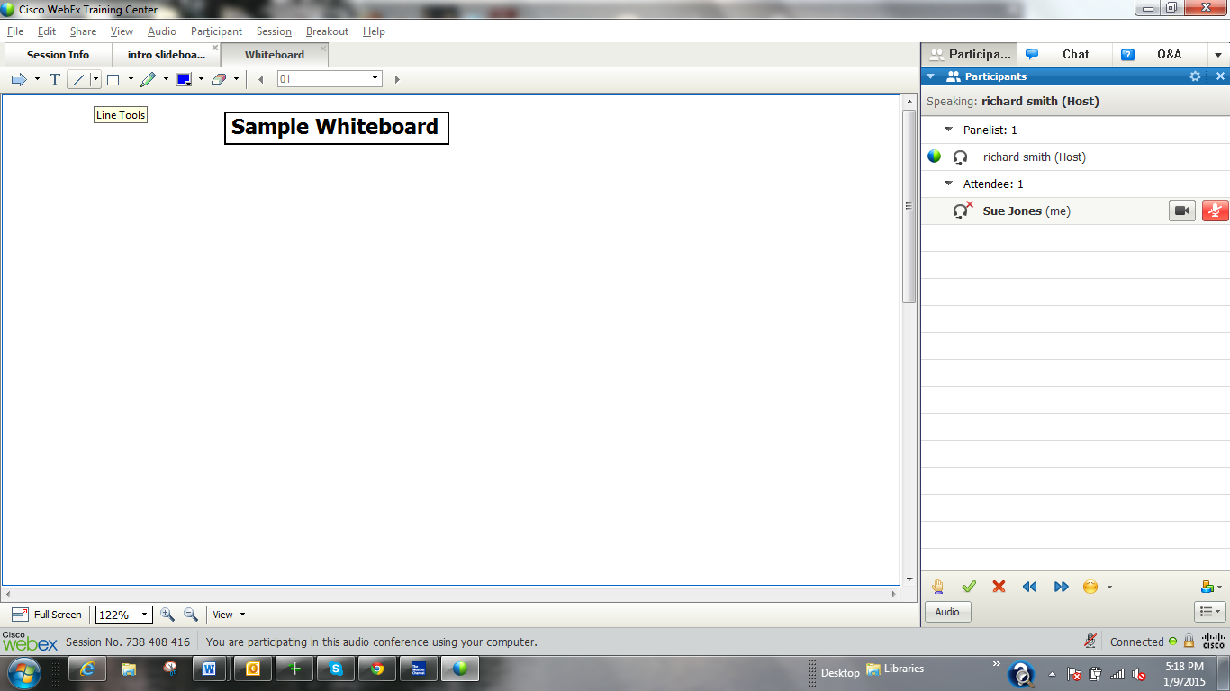
WebEx: Line Tools
There are also Line Tools.

Slide 89
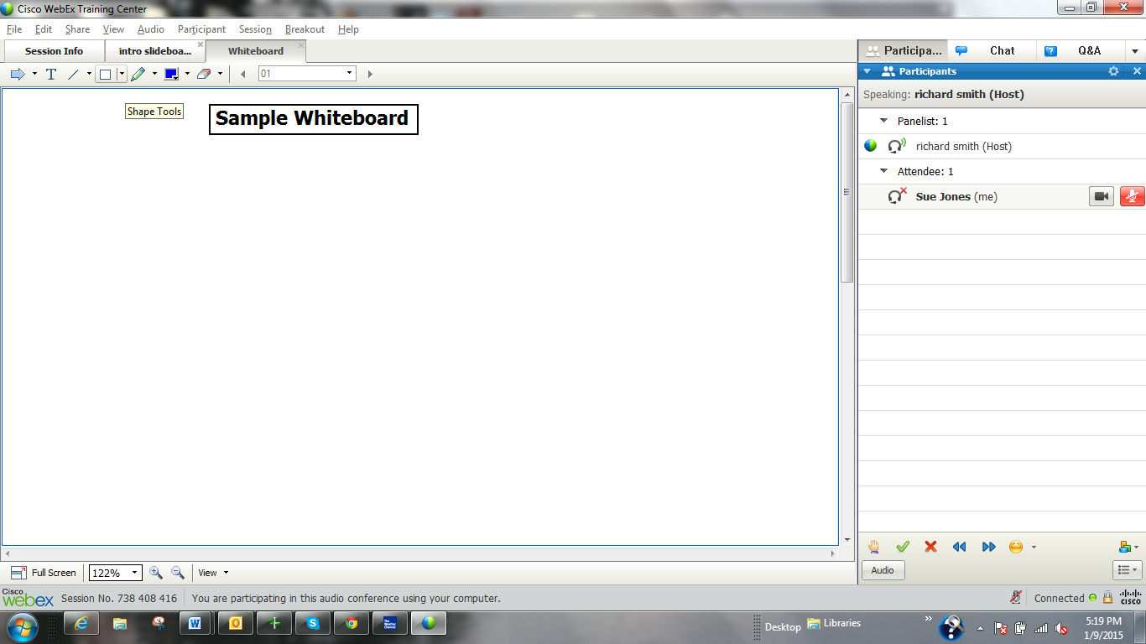
WebEx: Shape Tools
There are also Shape Tools.

Slide 90
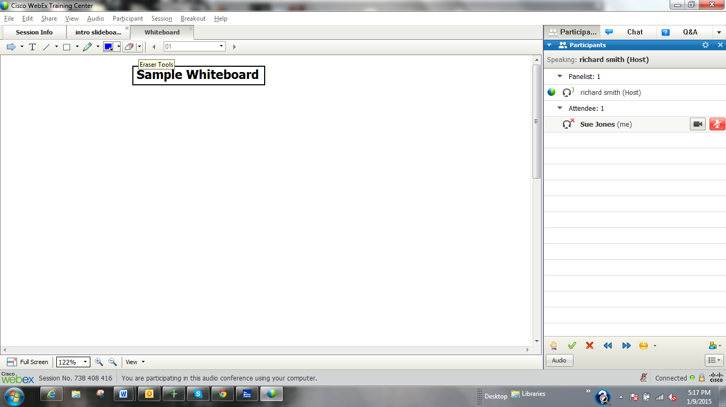
WebEx: Erasing
Before we enable Annotation, when you would like
to erase something, you may simple select the eraser
and then chose the item(s) you would like to erase.
We ask that you only erase items you created.

Slide 91
WebEx Practice
Let’s be creative on this Whiteboard and then a see how useful a Slideboard can be to format responses in a predetermined manner

Slide 92
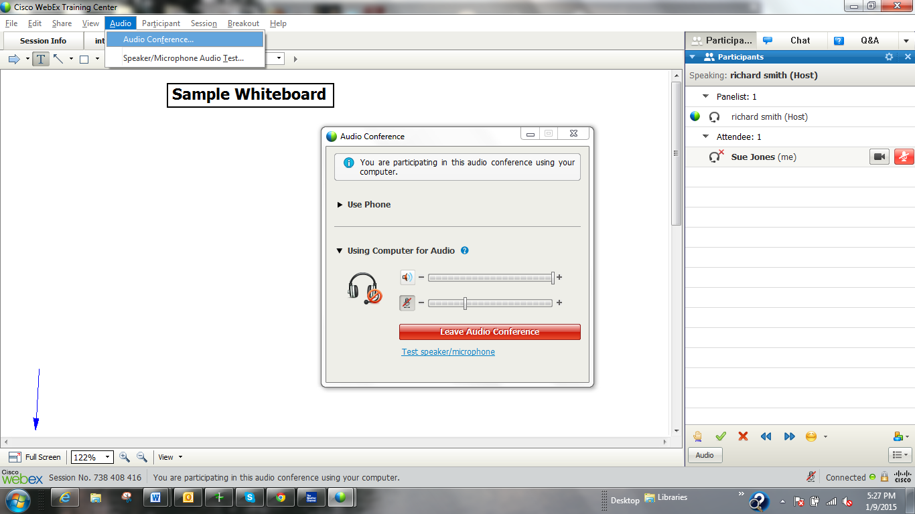
WebEx: Changing Audio Option
If you encounter a problem
with your Audio, you may
change your Audio Option.

Slide 93
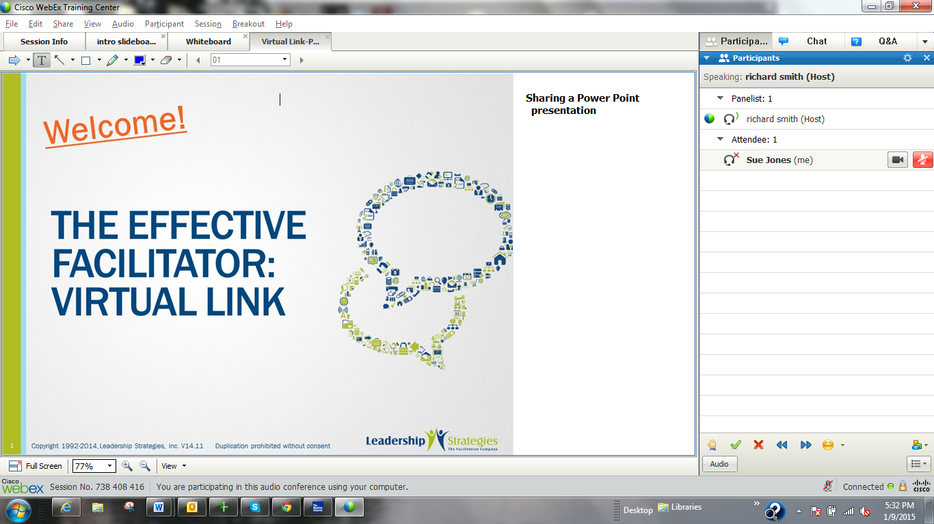
WebEx: Annotating Content
When the Annotation Toolbar is enabled,
you may annotate any content. This
example is a Power Point slide.

Slide 94
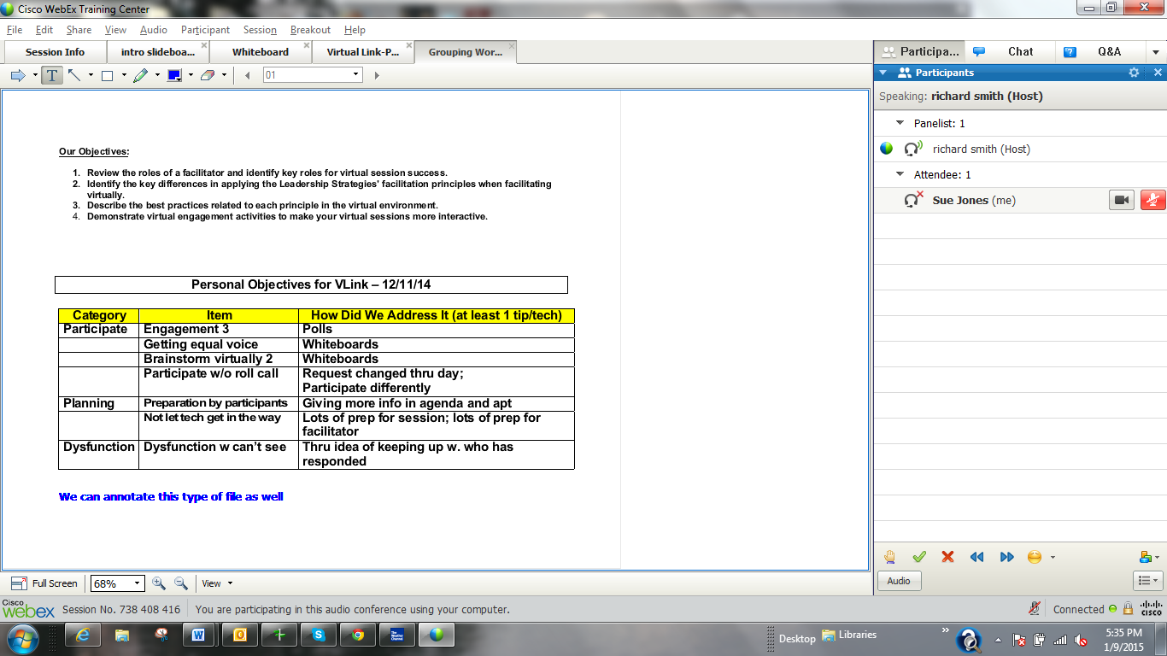
WebEx: Annotating Content
Or a Word document
as here.

Slide 95
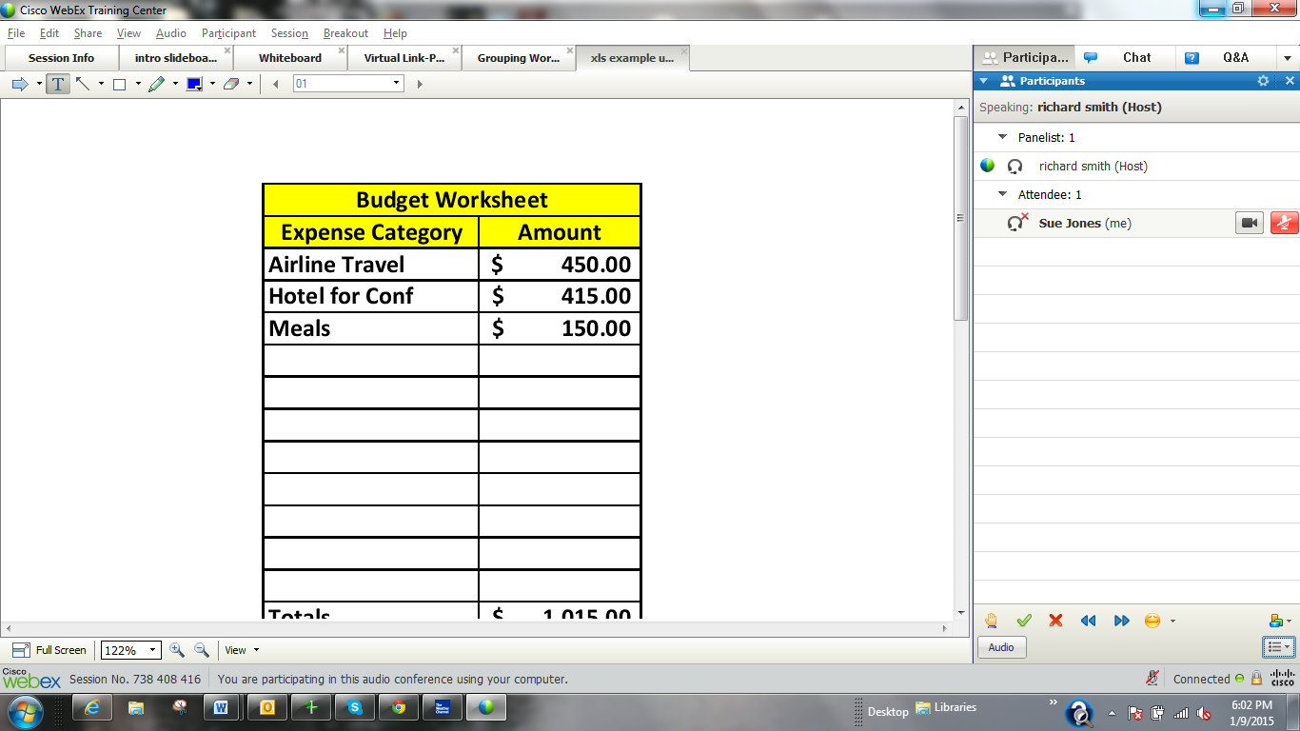
WebEx: Annotating Content
Or work on an Excel
spreadsheet.

Slide 96
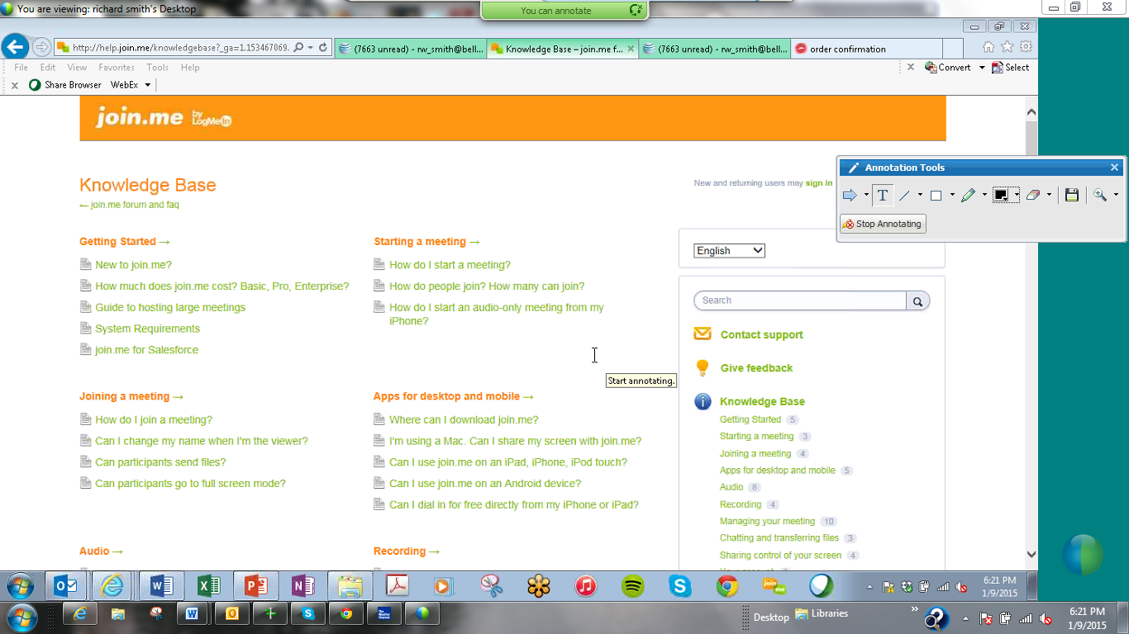
WebEx: Annotating Content
Or while sharing your screen.

Slide 97
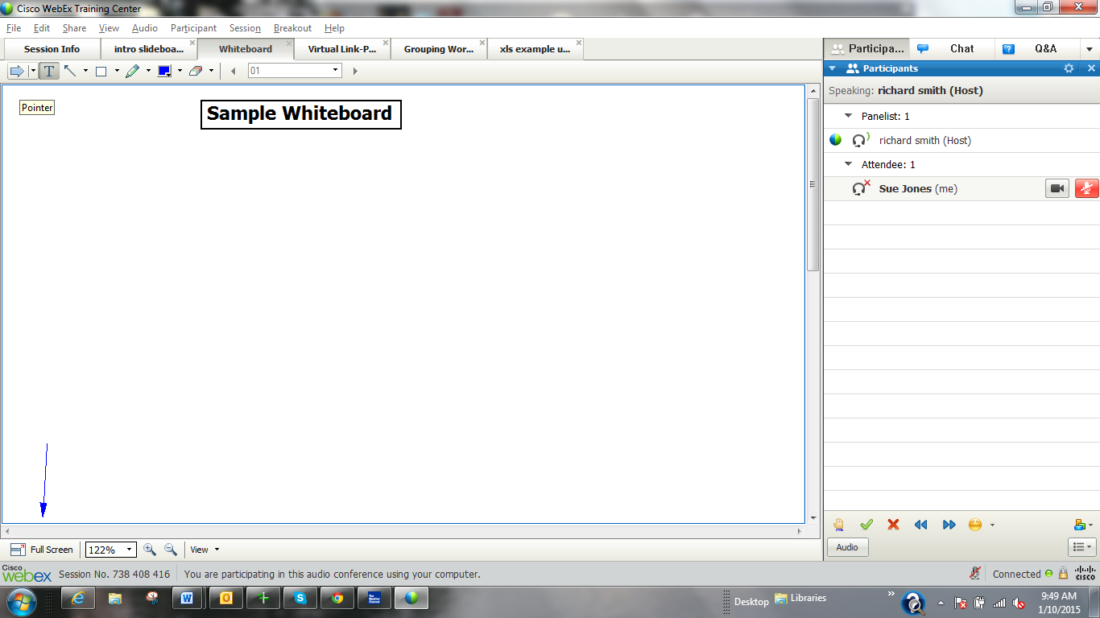
WebEx: The “Real Estate” Challenge
One of the challenges in using WebEx is that the screen “real estate” is
not protected. In other words if two participants select the same place
on the screen to type, they will write over each other. Currently, there
is no way to move what has been written.
To avoid this issue, we find the use of the Pointer can help. Simply
select the Pointer and then click where you would like to annotate
on the screen.

Slide 98
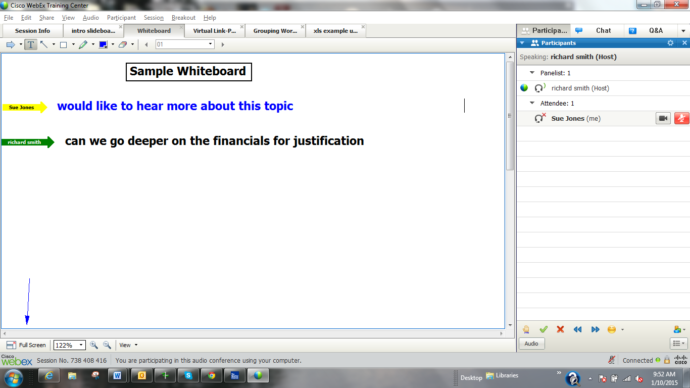
WebEx: The “Real Estate” Challenge
The results should like something like this.

Slide 99
Time for Practice
Raise your hands
Type your favorite color in the Q&A and send as ?
Everyone change the Feedback to “Slow Down”
Back to OK
We will ask two of you to speak
Let’s try the Annotation Tool
Select blue as the color and font size 14

Slide 100
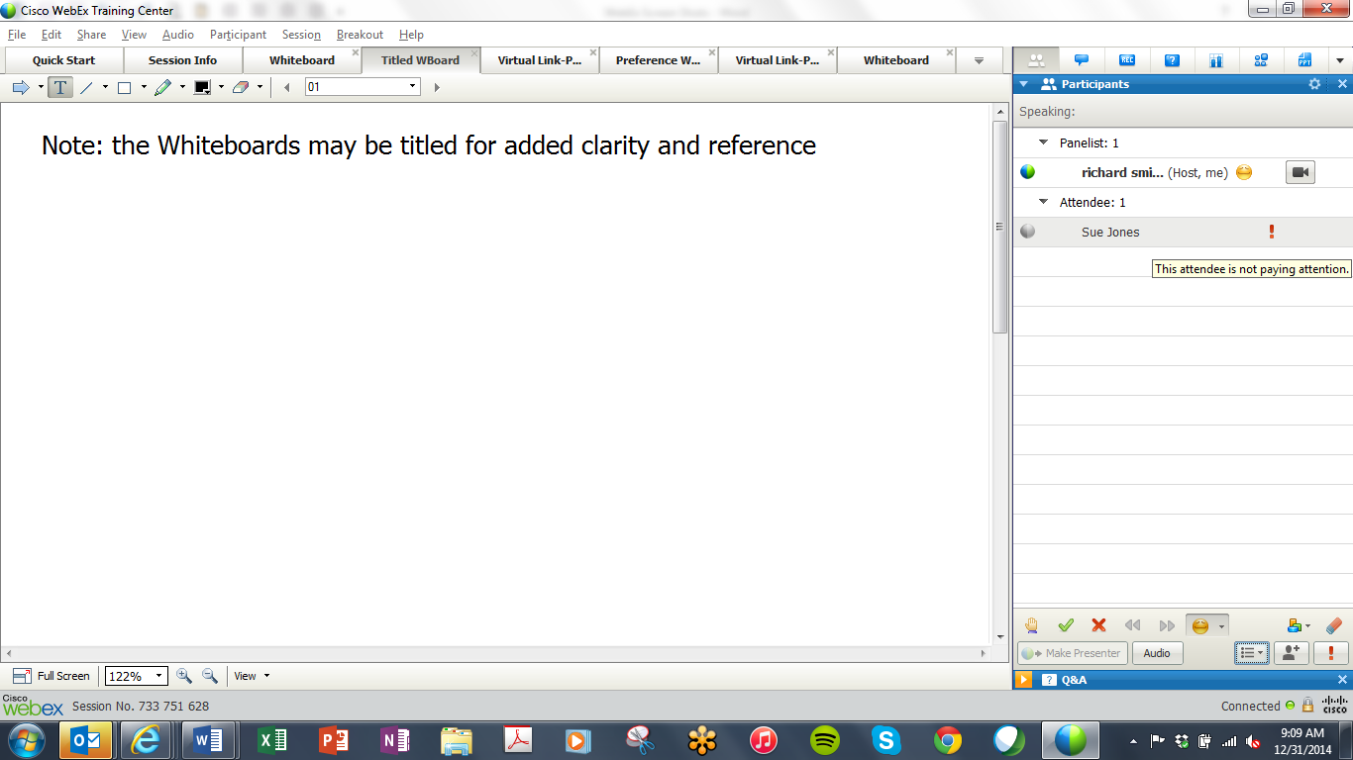
WebEx: Monitoring Engagement
When a participant does not have
their screen in the foreground,
the host is notified as shown here

Slide 101
Time for Questions
?
Notes:
Make type B

Slide 102
Review & Reminder of Next Session
8:30 – 10:00
1:30 – 3:00
Getting Started
Information Gathering
Preparing
Review
Dysfunction
Consensus
Energy
10:30 – 12:00
3:30 – 5:00
Starting
Focusing
Power of the Pen
Closing
Agenda Setting
Special Cases
Review and Close

Slide 103
The Effective Facilitator: Virtual Link
Notes:
End with the agenda slide so they know what is next?

