Slide 1
THE EFFECTIVE FACILITATOR
PRINCIPLE 9
Notes:
Timing: 60 minutes
Engagement Strategies:
Last Person Standing: closing activities with flip chart in quadrants (for Review, Evaluate, Close and Debrief)
Flip Charts:
Steps for Closing a Session (for last person standing)
DON’Ts
Read the slides
Overuse the read-arounds

Slide 2
Checkpoint
The Facilitation Cycle
4.
The Power
of the Pen
1.
Preparing
for Success
2.
Getting
the Session
Started
9.
Closing the
Session
3.
Focusing
the Group
9.
Closing the
Session
5.
Information
Gathering
6.
Managing
Dysfunction
7.
Consensus
Building
8.
Keeping the
Energy High
Group
Dynamics
10.
Agenda
Setting
Notes:
[Checkpoint:]
[Review:] We have just completed Principle 8 – Keeping the Energy High where we learned about Level 3 energy and the impact of energy on the session.
[Preview:] What we are about to do next is Principle 9 – Closing the Session.
[Big View:] And the reason that is important is that too many sessions close with, “OK, it’s 4pm, let’s get out of here.” After putting all the time you put into planning the meeting and all the time and energy the participants put into creating the results, it would be awful to waste all that because we closed the session poorly. Closing effectively ensures we maximize the impact of the decisions made and actions agreed to during our facilitated session.

Slide 3

Review, evaluate, close, debrief
Copyright 1992-2015, Leadership Strategies, Inc. V15.02
Notes:
Our tagline here is Review, Evaluate, Close, Debrief.

Slide 4
Principle 9
Closing the session
Review, Evaluate, Close, Debrief
Request Time Extensions if Needed
Review the Activities Performed
Review Session Purpose
Review Key Topics
Review Parking Boards
Ask Participants to Evaluate
Close and Set the Stage
Use Partial Close as Needed
Debrief with Planning Team
Debrief with Sponsor
Document Session Results
Manual
9-1
Notes:
This principle has the following 9 best practices/techniques. Before we begin let’s try another engagement activity, Last Person Standing.
[Purpose:] The purpose of this engagement is to identify all of the activities you can think over to close a session in the most effective manner
[Example: not needed.]
[Directions:] The way we will do this is as follows. First, let’s appoint a new team lead. Will the person (that is closest to me/farthest from me/etc.) serve as our team lead? Let me check in with each team – do we have a team lead? [Verify each team leader.] Team leads you will be recording all of the answers for your team by writing each on an individual Post-it using your markers. Again, each individual answer will be on its own unique Post-it note. We will give you (2) minutes to complete this.
[Exceptions: none.]
[Questions:] Are there any questions before we begin? [Respond to questions.]
[Starting question:] Think about the last several meetings you have attended or planned. Think about all the things you would want to ensure got done as a part of the wrap-up of a session. Think about all the things that will be most helpful in ensuring that close was most effective. What are those things?
[When the time runs out, proceed with next step.] OK, folks time is up. Now, each team lead would you please gather all of your Post-its and bring them with you to the front of the room. What we are going to next is ask each team lead to read one of their post –its and give it to me and I will place it on the flip chart [Have flip chart in quadrants for Review, Evaluate, Close and Debrief and place Post-its accordingly.]
The job of the remaining participants in the audience is to listen for a duplicate. When you hear a duplicate, I would like you to cross your arms over your heads, let me see you do that [demo with them] and, at the same time “honk.” Let’s try that together. OK, nicely done. When the first duplicate is identified, I will hold that Post-it and the team lead will go to the back of the line. The 2nd duplicate for any team and that team is eliminated. Which team wins? The last person standing, and I will award that team 10 dots.
Any questions? [Address and then conduct the engagement.]

Slide 5

What if the session will run over?
Copyright 1992-2015, Leadership Strategies, Inc. V15.02
Notes:
What if the session will run over? When do we, the meeting leader, typically become aware of that? [Facilitate the discussion.]

Slide 6
What if the Session Will Run Over?
Alert participants
Conservatively estimate additional time needed
Ask for alternatives
Check impact of continuing
Confirm agreement
Hold firmly to agreement
Manual
9-2
Notes:
We find that too often, when a session is running behind, the facilitator tends to rush the last few agenda items in order to complete the session in its original timeframe. So, let me ask, where are the more important agenda items or the critical agenda items? Early in the session [shake your head] or towards the end of the session [nod your head]? So, what happens when we allow a session to rush at the end to complete the session on time? Well, we reduce the impact of that session.
Here are tips when you realize the session is running late. [Review the points on the slide.]

Slide 7

a. Request time extensions
Duplication prohibited without consent.
Notes:
Let’s look at how to go about Requesting Time Extensions.

Slide 8
A. Request Time Extensions
Track actual vs. estimated time for each activity
If ending time will slip, get permission from participants to continue
Follow the steps provided to establish agreement on proceeding
If decision is made not to extend the time, proceed with closing activities
Manual
9-3
Notes:
We covered some of these tips during our discussion on Principle 3 – Focusing the Group. [Review points on slide; consider referring to Exercise Packet to review how to estimate with determining basis for estimates.]
What do some of you do to track time and ask for extensions when needed? [Facilitate the discussion.]

Slide 9

B. REVIEW ACTIVITIES PERFORMED
Review each activity performed
Use wall charts to point out documentation that resulted
Manual
9-4
Duplication prohibited without consent.
Notes:
Now, it is time to close – we want to close with rigor and to ensure that we maximize the impact of the session. We start with a Review of Activities Performed. We can figuratively walk the walls. This gives a sense of accomplishment and highlights everything that was accomplished during our session.

Slide 10

c. REVIEW session purpose
Ensure purpose has been accomplished
Manual
9-4
Duplication prohibited without consent.
Notes:
Next, we move on to cover the Session Purpose – the purpose we started the session with as a part of our IEEI. Often, we ask the participants, “Objective 1 was……did we cover that?” Have the participants confirm that was addressed and move on to all the objectives. Again, the sense of accomplishment is reinforced.

Slide 11

d. Review participant KEY TOPICS
Manual
9-4
Duplication prohibited without consent.
Notes:
Now, it is the time to ensure the participants key topics were addressed.

Slide 12

D. Review Participant Key Topics
Step through participants’ key topics documented earlier
With each ask, “Was this fulfilled?”
Check off each “yes”, circle each “no”
Discuss why the circled topics were not met and what should be done to follow-up
KEY TOPICS
Topic 1
Topic 2
Topic 3
Topic 4
Topic 5
Manual
9-4
Notes:
Now that we have confirmed the objectives we established were achieved, we move to the key topics identified by the participants. One way to review these is highlighted on the slide. [Review the slide points.]
An alternative – and I will be using this to close the class later in the session – is to return the key topics to the teams and allow about (5) minutes for each team to discuss how the key topics assigned to their team were achieved. For those that were not achieved, we can check in with the other teams, decide to put them on the Actions List for future assignment, or address them prior to closing the session.
Any questions or comments on the Review of Participant Key Topics? [Facilitate the discussion.]

Slide 13

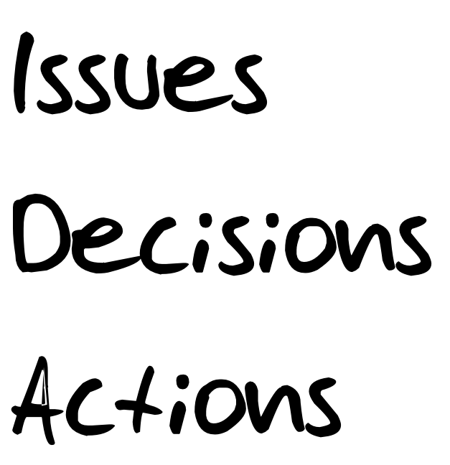
e. Review parking boards
Duplication prohibited without consent.
Notes:
On to our Review of the Parking Boards… To avoid having the Parking Boards becoming the “cemetery” – the place where things go to die – next, begin the review of these. Let’s see how we recommend accomplishing this.

Slide 14
E. Review Parking Boards
Review the
Issues List
For each issue, ask:
  Have we covered it?
  Do we need to cover it?
  Do we need to cover it now?
issues
Issue 1
Issue 2
Issue 3
Issue 4
Issue 5
Manual
9-5
Notes:
Starting with our Issues List, for each issue, ask the participants a series of questions and have them respond. [Review the slide points; consider having placed some mock Post-it notes on the Issues List to use as examples.]

Slide 15
E. Review Parking Boards
Review the
Decision List
For each decision:
  What is the benefit of this decision?
  Potential barriers and success strategies for implementing the decision
  Poll the group – can everyone live with and support the decision?
Decisions
Decision 1
Decision 2
Decision 3
Decision 4
Decision 5
Manual
9-5
Notes:
Next, let’s close the Decisions List. [For each decision review the slide points; reinforce when the participants articulate a benefit how that increases the CD. In polling the group, it is like re-polling the jury after they have found somebody guilty.]

Slide 16
E. Review Parking Boards
Review the Action List
Have the group select a person
Ask the person to establish a date
What | Who | When
Manual
9-6
Notes:
For our last Parking Board, the Action List… Here is where we get the person assigned, if it was not done earlier and the date the action will be completed.

Slide 17
E. Review Parking Boards
Assigning an action to an individual requires them to ensure that it is done, not to do it him/herself
Assigning an action to someone not present in the room is not appropriate
Instead, assign the action to a person of authority in the room, whose responsibility it is to delegate
Notes:
Too often, we find actions are assigned to individuals that were not part of the session. This diminishes the ownership since they were not a part of that process. In those cases, have a participant in the room, in a role of authority, take the responsibility of delegating that action.
And, then, remember to commit to how the Actions List will be used for accountability. This is a great chance to help create that cadence of accountability within your organization.
This ends all the steps in the Review. Are there any questions about the Review part of closing? [Facilitate the discussion.]

Slide 18
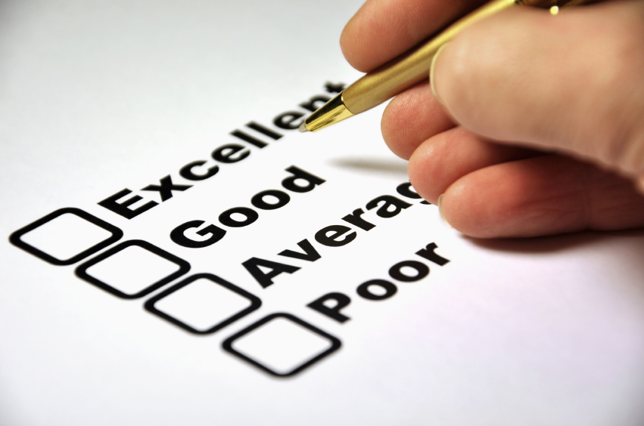
f. Ask participants to evaluate
Duplication prohibited without consent.
Notes:
Having completed the review, we may now move on and Ask Participants to Evaluate.

Slide 19
F. Ask Participants to Evaluate
Feedback is critical to continuous improvement
Strive to gain documented feedback from every session
evaluate
Session
Facilitator
Performance
Comments
Manual
9-7
Notes:
As we discussed during our exercises, to get better or to hone our skills, we must use feedback as a part of that process. There are 4 key areas to evaluate. [Use the slide to address the 4 elements and Facilitate the discussion.; refer to the non-copyrighted page for a facilitated session feedback form.]

Slide 20

G. Close the set and the stage
Duplication prohibited without consent.
Notes:
Having completed our Review and Evaluation, it is time to Close and Set the Stage.

Slide 21
G. Close the Set and the Stage
Thank the participants for their involvement
Remind participants of next steps
Confirm the place, date, time,
and purpose of:
  The next session
  A status session to ensure that outstanding actions are proceeding
Formally end the session
Manual
9-9
Notes:
How many of you have attended a meeting in the last several months and were not thanked for investing your time? [raise your hand] Yes, I have as well. Your participants had other valuable things they might have been able to do; instead, they attended your session. To start our close, begin by thanking them for their time and their engagement. Then, ensure you are clear about next steps, confirm any future sessions, and then formally close your session.

Slide 22

h. Use partial close As needed
Duplication prohibited without consent.
Notes:
Use the Partial Close as Needed.

Slide 23
H. Use Partial Close as Needed
Do:
Don’t:
Review the activities performed
Review the Parking Boards (IDA)
Close the session
Review the participant key topics
Evaluate the process
Hold the debriefing session
Manual
9-9
Notes:
Be certain to understand, this partial close does not mean what to do if there is insufficient time for the close; avoid that at all times. Instead, what we mean by the Use Partial Close as Needed, is that in a multi-day session, we complete the Dos at the end of each session or day. We only complete the DON’Ts at the end of the last day or session. In other words, we DON’T have to cover those items at the end of the interim sessions – only the last or final session.
Any questions about the partial close? [Facilitate the discussion.]

Slide 24

i. Debrief with planning team
Duplication prohibited without consent.
Notes:
We may now move to our Debrief – first with the Planning Team and then with the Session Sponsor.

Slide 25
I. Debrief with Planning Team
Meet with planning team as soon as possible to discuss session process and results
Debriefing session should cover:
  How well were the session objectives met?
  How well did the participants respond?
  How sufficient are the deliverables?
  What follow-up activities are needed?
Manual
9-10
Notes:
The sooner the debrief after the session, the more accurate it typically will be. [Review/facilitate the points on the slide.]

Slide 26
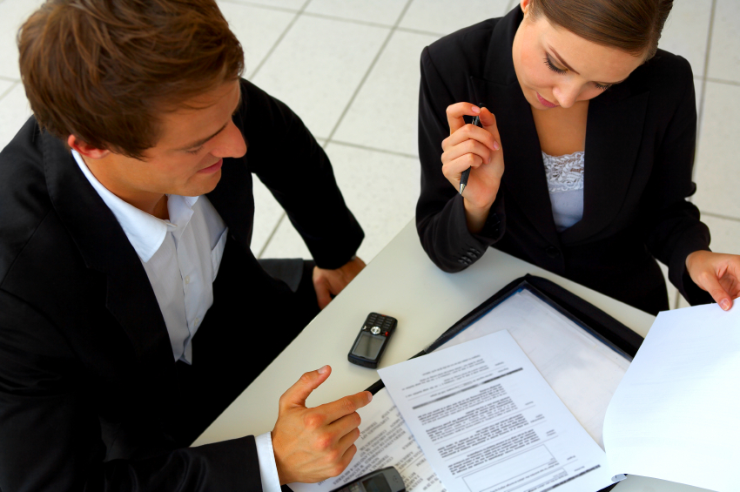
j. Debrief with sponsor
Duplication prohibited without consent.
Notes:
Finally, we will Debrief With the Sponsor.

Slide 27
I. Debrief with Sponsor
Meet with Sponsor as soon as possible to discuss session process and results
The debriefing session should cover:
  How well were the session objectives met?
  How well did the participants respond?
  How sufficient are the deliverables?
  What follow-up activities are needed?
Manual
9-10
Notes:
Can everyone see how familiar this debrief is with that we conducted with the Planning Team? [nod your head] They are identical with the exception of the audience.
Are there any questions regarding the debrief? [Facilitate the discussion.]

Slide 28
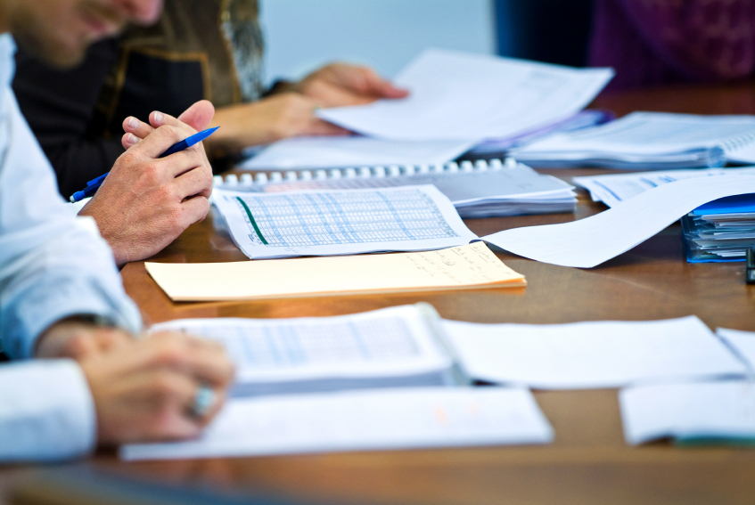
k. Document session results
Duplication prohibited without consent.
Notes:
To make sure that we put a bow on our session, we will want to Document the Session Results.

Slide 29
K. Document Session Results
The facilitator is responsible for ensuring the session results are documented and distributed
The documentation should include:
  Decisions made
  Actions to be taken
  Outstanding issues (if any)
  Relevant analysis
Notes:
Although we, as the facilitator, may not do the documentation, we will want to ensure the session results are documented and distributed to the participants. The results will include the 3 parking boards and any relevant analysis.
What are some of your “rules of thumb” today for documenting your session results? [Facilitate the discussion.]

Slide 30

FULL PRINCIPLE REVIEW
Notes:
Time for our principle review. Let’s begin with our (green) team and move to my (left/right). [Award dots and complete the review.]

Slide 31
Review
What are the four parts of the closing sequence?
Review
Evaluate
Close
Debrief

Slide 32
Review
What are the methods for increasing buy-in and successful implementation of items on the decision list?
Have participants identify benefits to each decision
Have participants identify barriers and strategies for overcoming these barriers

Slide 33
Review
What are the questions to clear the issues list?
Have we covered this issue?
Do we need to cover this issue?
Do we need to cover this issue now?

Slide 34
Review
What are the three parts of the action list?
What
Who
When

Slide 35
Review
What are the items to evaluate for a facilitated session?
Session
Facilitator
Performance
Comments

Slide 36
Review
What are the steps to close a facilitated session?
Thank participants
Remind participants of next steps
  Confirm place, date, time and purpose of any next session
Formally end the session

Slide 37
Review
What are the key questions to ask as for the session debrief?
How well were the session objectives met?
How well did the participants respond?
How sufficient are the deliverables?
What follow-up activities are needed?

Slide 38
Review
What are the steps in a partial close?
Review the activities performed
Review the Parking Boards (IDA)
Close the session
When do we conduct a partial close?
In a multi-day session

Slide 39
Principle 9
Closing the session
Review, Evaluate, Close, Debrief
Request Time Extensions if Needed
Review the Activities Performed
Review Session Purpose
Review Key Topics
Review Parking Boards
Ask Participants to Evaluate
Close and Set the Stage
Use Partial Close as Needed
Debrief with Planning Team
Debrief with Sponsor
Document Session Results
Manual
9-1

Slide 40
Checkpoint
The Facilitation Cycle
4.
The Power
of the Pen
1.
Preparing
for Success
2.
Getting
the Session
Started
9.
Closing the
Session
3.
Focusing
the Group
9.
Closing the
Session
5.
Information
Gathering
6.
Managing
Dysfunction
7.
Consensus
Building
8.
Keeping the
Energy High
Group
Dynamics
10.
Agenda
Setting

Slide 41
THE EFFECTIVE FACILITATOR
PRINCIPLE 9

