Slide 1
THE EFFECTIVE FACILITATOR
PRINCIPLE 8
Notes:
Timing: 60 minutes
Engagement Strategies:
Level 1 and Level 3 round robin with all participants [they are asked if they would like to pass or play]
Flip Charts:
3 Es of Energy
Engage the participants
Energizes the participants (around the topic)
Elevates the facilitator in the eyes of the participants
Review Characteristics of an Energetic Start from Principle 2
DON’Ts
Read the slides
Overuse the read-arounds

Slide 2
Checkpoint
The Facilitation Cycle
4.
The Power
of the Pen
1.
Preparing
for Success
2.
Getting
the Session
Started
3.
Focusing
the Group
9.
Closing the
Session
5.
Information
Gathering
6.
Managing
Dysfunction
7.
Consensus
Building
8.
Keeping the
Energy High
8.
Keeping the
Energy High
Group
Dynamics
10.
Agenda
Setting
Notes:
[Checkpoint:]
[Review:] We have just completed Principle 7 – Consensus Building where we covered the reasons people disagree and several techniques on guiding a group from disagreement to agreement.
[Preview:] What we are about to do next is Principle 8 – Keep the Energy High.
[Big View:] And that’s important because energy projects confidence. Therefore, (red) team, what does a lack of energy project? [Facilitate the discussion..] That’s right – confidence. So, what does a lack of energy project? To exude confidence and increase engagement early, we recommend that most sessions start at Level 3. Unfortunately, most people don’t know where Level 3 is for them. Today, you’ll have the opportunity to find out where it is for you.

Slide 3

Set the pace,
Anticipate the lulls,
React accordingly
Notes:
Set the Pace, Anticipate the Lulls, React Accordingly is our tagline.
We like to refer to the 3 Es on Energy which are:
E: Engage your participants.
E: Energize your participants and energize them around the topic/content that you are about to undertake.
E: this Elevates the facilitator in the minds of the participant.
And, often we have members of the E suite in the audience. When they hear that energy, they sense that confidence. And, as we stated in Principle 2, this gives them comfort that “they are in good hands” and they transfer or cede their power to you for the session.

Slide 4
Principle 8
Keep the energy high
Set the Pace, Anticipate the Lulls, React Accordingly
Set an Energetic Pace
Reset the Energy Level After Breaks
Adjust to Lull Times
Establish a Recharge Activity
Use Brainteasers
Get People Involved and Moving
Encourage Team Building
Break if Necessary
Notes:
In this principle, we have the following 8 best practices/techniques, so let’s get started.

Slide 5
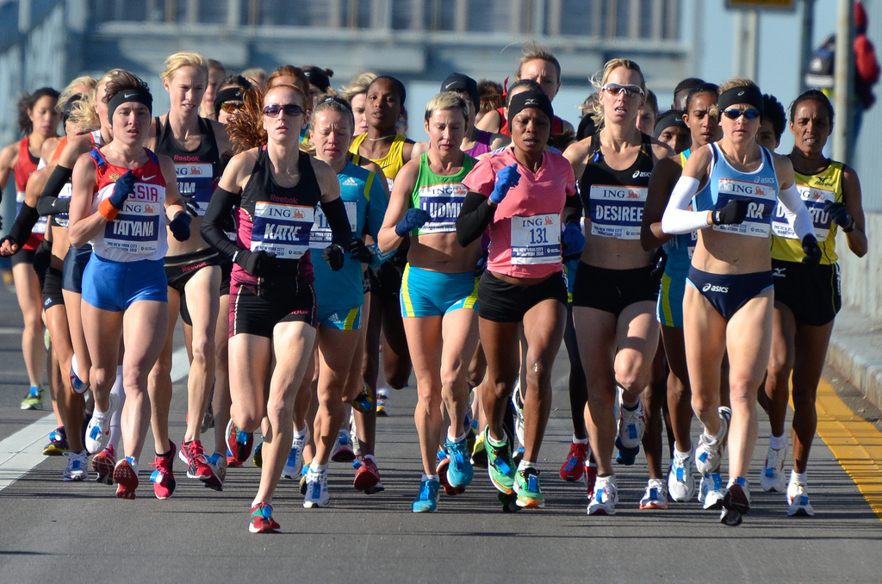
A. Set an energetic pace
Your opening words establish the energy level
SET IT HIGH!!
-
Manual
8-2
Duplication prohibited without consent.
Notes:
The first key item in this Principle is to ensure you open that session with HIGH ENERGY; set that energy level high.

Slide 6
Level 1 Energy
For most of us, our normal speaking voice has just enough energy to keep people awake.
3
2
Energy Level
1
Awake
0
Time
Asleep
Over the course of a meeting, however, our voices tend to trail off, and we fall below the line.
-
Manual
8-2
Notes:
How do we do that? Let’s look at the various “levels” of energy.
Level 1 energy is our telephone or our coaching or our consulting volume [Demonstrate that by talking to one of the participants; sit down by them, kneel down; etc.]
For some of us, Level 1 energy is not low, but it is typically not how we want to guide a group as the facilitator.

Slide 7
Level 2 Energy
If you raise your energy level to level 2, you start out great.
3
2
-
Energy Level
But you still trail off below the line
1
Awake
0
Time
Asleep
Manual
8-2
Notes:
Level 2 is better; most of us, especially the lower volume speakers will typically see this as louder or increased volume; yet, we find that when people start at Level 2 energy, they still will fall below the awake/asleep thresh hold over time. And, that is not good.

Slide 8
Level 3 Energy
Start your energy
at level 3
3
-
When it trails off, you will be at your normal speaking voice
2
Energy Level
1
Awake
0
Time
Asleep
Manual
8-2
Notes:
So, let’s all commit to getting the session started at Level 3 energy. In a moment, I will demonstrate my Level 1, my Level 2 and my Level 3 energy. You told me what much of that looked like when we talked about the characteristics of a great start when we covered Principle 2. So, before I demonstrate, let’s take a look and review what many of those items are. [Review the highlights such as volume, movement, gestures, eye contact, pause, etc.]
Great meetings or facilitated sessions are fun; we like to look at it this way. Our job, as a facilitator, is not to entertain the participants. If you want to be entertained, they can do something like view a movie in the evening. But, sessions/meetings should be fun. What do we mean by fun? Toward the end of the day, say 4pm, participants will look at the time, and they will either say to themselves, “only an hour, and we will get out of here.” That is not fun. Or, they might say to themselves, “Wow, only an hour left. Where did the day go?” That session was fun!
How do you think about the recent sessions you have attended in terms of the energy the leader displayed at the kickoff of the session? [rhetorical question]

Slide 9
Level 3 Energy
“
Good morning!
It is a pleasure to be here this morning.
One thing I always enjoy is speaking with people who want to get better at what they do.
“
Manual
NA
Notes:
Let me demonstrate my Level 1, Level 2 and Level 3 energy for you [Demonstrate each stopping and asking what they see/hear as the differences.]
Alright, before we begin our round of pass and play, are there any questions about what we should all be looking for from each other as we demonstrate first our Level 1 energy and then our Level 3 energy? [Facilitate the discussion..]
OK, then we are going to start on my (right/left) and move (clockwise/counterclockwise) and ask each participant to first tell us if they want to pass or play. Then, if they decide they will play, they will first demonstrate their Level 1 energy level followed by their Level 3 energy level. While each of us is taking our turn, I will be asking those that are listening to tell me what energy level they are experiencing for our Level 3. In other words, is it Level 1, Level 2, maybe Level 2.5 etc.? That way we each can learn what our Level 3 has to be for the group. Any questions? [Take questions and then conduct the round-robin leading the feedbacks on what energy level the participants are hearing/seeing.]

Slide 10
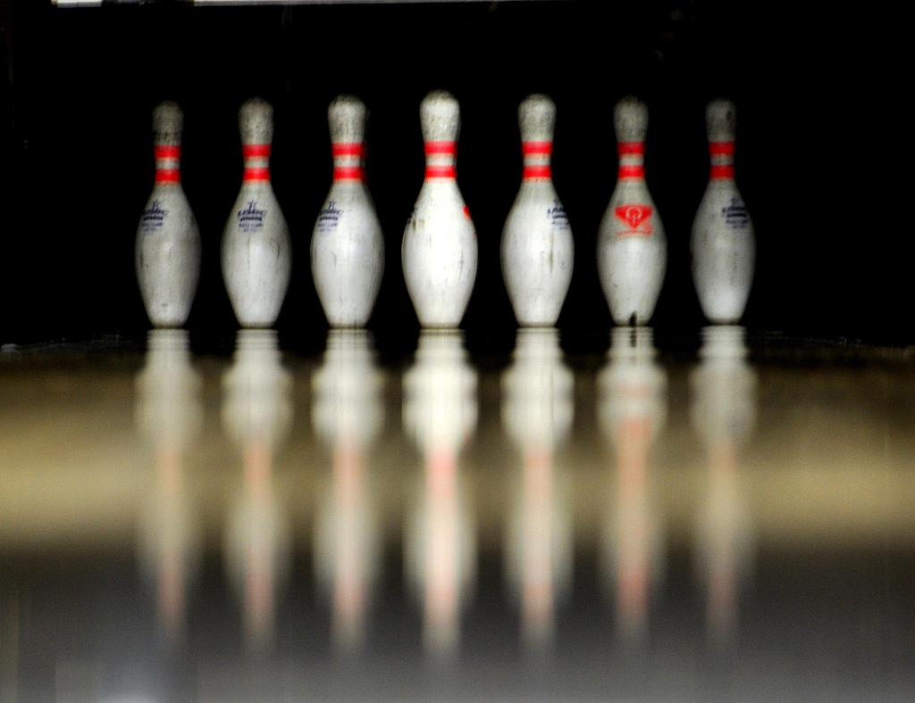
b. Reset the Energy Level
Duplication prohibited without consent.
Notes:
Reset the Energy Level. Think about it – think about what the statement says to you. What do you think we mean by Resetting the Energy Level? [Facilitate the discussion..]

Slide 11
B. Reset the Energy Level
Reset the energy level following every break
-
3
2
Energy Level
1
Awake
0
Time
Asleep
Manual
8-2
Notes:
Great, so essentially what we want to remember is that all of us allow our Level 3 to trail off. For almost all of us, it still never goes below the Awake/Asleep threshold, and if you then include Resetting the Energy level, it will look like the red line to the participants – steady High Energy! For example, if we are conducting a two-day session, we start the session at Level 3. We take our first break at mid-morning and when we return to the session, that’s right – we start again at Level 3. We break for lunch. And when we return, yes, Level 3 energy again. It projects CONFIDENCE….even if you get lost for a few minutes; use that Level 3 energy and your questions. You will get back on track.

Slide 12
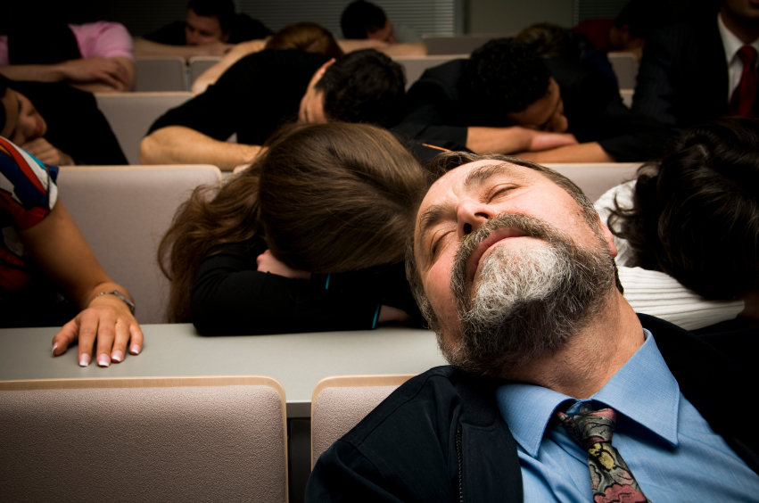
C. Standard Lullaby Times
Duplication prohibited without consent.
Notes:
Standard Lullaby Times: can we all remember a teacher or a professor that we once had for a class right after lunch. That particular professor would then do something like show a 30-45 minute movie to show empathy or how to prepare a great paper or speech, etc. You get the picture.

Slide 13
C. Standard Lullaby Times
Mid-morning
Just after lunch
Mid-afternoon
End of the day
Manual
8-3
Notes:
We all know those times during a day when the energy is simply low. In general, these 4 times outline those timeframes.

Slide 14

Adjust to Lull Times
Schedule during the standard lull times
  Team building exercise
  Small group break-out
  Facilitated process requiring movement
Manual
8-3
Notes:
So, as facilitators, in planning our session the time of day is an important consideration in determining what activity we will plan to complete that portion of our session. (Red) team, would you please read the 3 activities to schedule during these times to Adjust to Lull Times? Thank you.

Slide 15

Adjust to Lull Times
Avoid the following during these times
  Lecture or long monologues
  Reading
  Individually-assigned exercises
Manual
8-3
Notes:
And, on to our (green) team, would you please read the activities to avoid? Any other activities that you either use or avoid to help with energy in the meetings you lead today? [Facilitate the discussion.]

Slide 16
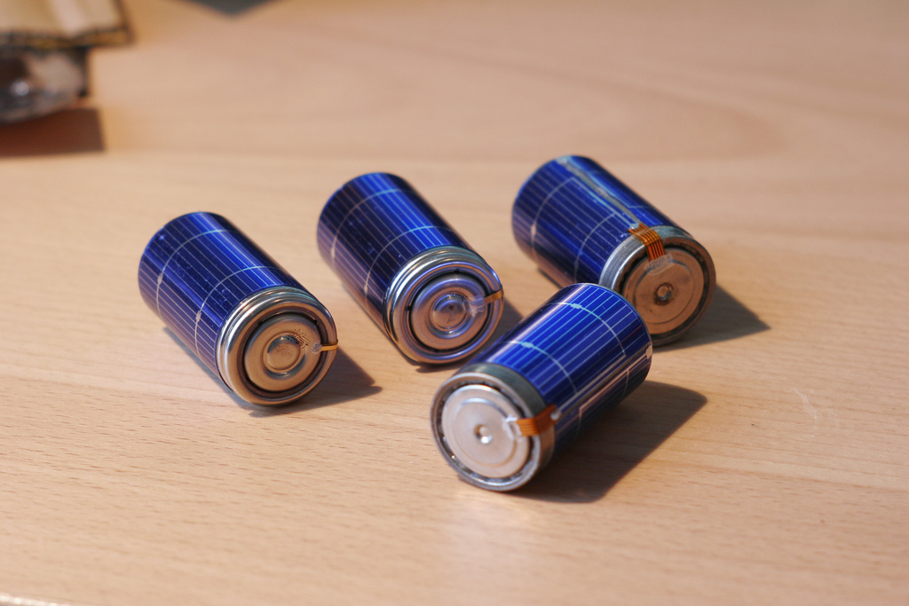
D. Establish a recharge
Duplication prohibited without consent.
Notes:
Establishing a Recharge is another technique to assist with energy.

Slide 17



D. Establish a Recharge
Establish simple recharge activity
Use recharge at least once in AM, and when needed in PM
Use praise to keep energy high
-
Manual
8-4
Notes:
I know many of you thought this was “silly” and would not work in your sessions. We find it is one of many techniques to bring back that energy when the session hits a lull. You must believe in it, and what we would like to think is that you see its value. When we work with our clients, more than ½ wind up establishing a recharge for their organizations.
Has anyone used something like this? [Raise your hand; ask volunteer to share his/her experience.]

Slide 18

REVIEW
Notes:
Let’s do a quick review starting with our (blue) team.

Slide 19
Review
What are the 3 “E’s” of energy?
Engage the participants
(more interesting to listen to)
Energizes the topic
(it must be important since the facilitator is excited about it)
Elevates the facilitator
(project self-confidence)
-

Slide 20
Review
What are some of the tips to start a session with high energy?
Voice projection
Modulation
Eye contact
Gestures/animation
Movement
Etc.
-

Slide 21

e. Use brainteasers
Duplication prohibited without consent.
Notes:
Use Brainteasers – a form of an engagement, our 1st E of energy.

Slide 22
E. Use Brainteasers
Brainteasers are positive mental games to keep the mind alert
They also help get people to think outside the box
-
Manual
8-4
Notes:
Use Brainteasers and keep in mind a few key points:
Tie them to the session agenda or process; this adds focus to the session and ensures all the participants understand how the activity, the brainteaser, relates.
Use your PeDeQs to add clarity; this ensures we provide the Why, the What and the How of each activity in our sessions.
Has anyone every used this example in their session? [Raise your hand; then ask one of the participants to share his/her experience.] The key is you cannot connect all the dots and only cross the line one time – unless you go outside the box. (This is what we want when we brainstorm.)

Slide 23

f. Get them involved and moving
Duplication prohibited without consent.
Notes:
Have you noticed, during our time together, the time we had to Get Them Involved and Moving? [Raise your hand.] (Purple) team, would you share one for us? [Facilitate the discussion.; they can make many of the points before you get to the next slide.]

Slide 24
F. Get Them Involved and Moving
Direct questions to specific individuals
Use the standing method to brainstorm
Have people stand to ask a question
Pass a toy between speakers
Hold an oral quiz to review progress
Get participants to clap
-
Manual
8-5
Notes:
We have covered some of these in our discussion. Let’s look at the others. [Review the slide emphasizing the points that were not discussed in the previous discussion; prior slide.]

Slide 25

g. Encourage team building
Duplication prohibited without consent.
Notes:
Encourage Team Building. When we conduct sessions for our clients, team building is often a key component of that session. For example, a Strategic Plan is one of the few times during the year that a team comes together to specifically look at ways or approaches to move the organization to that next level – to plan for the future. This is an opportunity for us to Encourage Team Building.

Slide 26
G. Encourage Team Building
State the purpose of the exercise in advance
Select an appropriate activity
Use PeDeQs for directions
Monitor the activity
Be certain participants
understand how activity relates to the session
-
Manual
8-6
Notes:
When we facilitate team building the right way, we can make help teams achieve impact. Let’s review these key points. (Red) team, get us started with the first point [Review slide and Facilitate the discussion.]

Slide 27

h. Break if necessary
When participants begin winding down, the facilitator works extra hard to keep energy high
If inattention continues to be a problem, recommend a break
-
Manual
8-6
Duplication prohibited without consent.
Notes:
Breaks are important. To plan properly, consider breaks at least every 90 minutes and sometimes more frequently. If you notice the group has lost focus or has been sitting too long, Break If Necessary.

Slide 28
Sample Group Activities
Defining a team
Crossing a river
Tinkering
Singing commercials
-
Notes:
You will notice several non-copyrighted pages in this section. Let me set the clock for a minute, allow you in your teams to look at these pages, and then, I will discuss any that you may want to go deeper on. [Set clock for a minute and then facilitate the discussion around these activities.]

Slide 29
FULL PRINCIPLE REVIEW
Notes:
Now for our final review of Principle 8… [Use round-robin by teams awarding dots, etc.]

Slide 30
Review
What are the 3 “E’s” of energy?
Engage the participants
(more interesting to listen to)
Energizes the topic
(it must be important since the facilitator is excited about it)
Elevates the facilitator
(project self-confidence)
-

Slide 31
Review
What are some of the tips to start a session with high energy?
Voice projection
Modulation
Eye contact
Gestures/animation
Movement
Etc.
-

Slide 32
Review
When are the four lullaby times?
Mid-morning
Early afternoon – right after lunch
Mid-afternoon
End of day
-

Slide 33
Review
What are the activities to do during the lullaby times?
Team building exercises
Small group break-outs
Facilitated process requiring movement
-

Slide 34
Review
What are the activities to avoid during the lullaby times?
Lecture or monologue
Reading
Individually assigned exercises
-

Slide 35
Principle 8
Keep the energy high
Set the Pace, Anticipate the Lulls, React Accordingly
Set an Energetic Pace
Reset the Energy Level After Breaks
Adjust to Lull Times
Establish a Recharge Activity
Use Brainteasers
Get People Involved and Moving
Encourage Team Building
Break if Necessary
Notes:
In this principle, we have the following 8 best practices/techniques, so let’s get started.

Slide 36
Checkpoint
The Facilitation Cycle
4.
The Power
of the Pen
1.
Preparing
for Success
2.
Getting
the Session
Started
3.
Focusing
the Group
9.
Closing the
Session
5.
Information
Gathering
6.
Managing
Dysfunction
7.
Consensus
Building
8.
Keeping the
Energy High
8.
Keeping the
Energy High
Group
Dynamics
10.
Agenda
Setting

Slide 37
THE EFFECTIVE FACILITATOR
PRINCIPLE 8

