Slide 1
THE EFFECTIVE FACILITATOR
PRINCIPLE 4
Notes:
Timing: 45-60 minutes
Engagement Strategies:
Participants are asked to flip char Steps in the Hiring Process while a script is read to show how difficult charting can be.
Participants observe two demonstrations of charting by the instructor. The first uses the lull-filling techniques, while the second does not. Participants are asked to describe the differences.
Flip Charts:
Steps in the Current Hiring Process OR Placed We’d Rather Be
Assigning an Order to Your Speakers
Assigning an Order to Your Speakers
DON’Ts
Read the slides
Overuse the read-arounds

Slide 2
Checkpoint
The Facilitation Cycle
4.
The Power of the Pen
4.
The Power of the Pen
1.
Preparing for Success
2.
Getting the Session
Started
3.
Focusing the Group
9.
Closing the Session
5.
Information Gathering
6.
Managing Dysfunction
7.
Consensus Building
8.
Keeping the Energy High
Group
Dynamics
10.
Agenda Setting
Notes:
[Checkpoint:]
[Review:] We just completed Principle 3 – Focusing the Group where we looked at 5 techniques for Establishing the Course and 6 techniques for Avoiding the Detours.
[Preview:] What we are about to do next is cover Principle 4 – Power of the Pen: Use It, Don’t Abuse It, Make It Theirs.
[Big View:] And the reason this is important is if we believe in ED=RD x CD, then the techniques we use when flip charting, white boarding, keyboarding, etc. help us to enhance the CD or diminish the CD. They also provide us the ability to recognize contributions of the participants when they offer their thoughts.

Slide 3

Use it, don’t abuse it, make it theirs
Notes:
The tagline for this Principle is Use It, Don’t Abuse It, Make It Theirs.

Slide 4
Principle 4
POWER OF THE PEN
Use It, Don’t Abuse It, Make It Theirs
Write First, Discuss Second
Write What is Said
Add Your Words Discriminately
Ask, Don’t Tell
Write So They Can Read It
Use Additive Editing
Avoid Lulls While Writing
Assign an Order to Your Speakers
Use Multiple Flip Charts
Employ the Right Recording Tool
Post According to Your Wall Plan
Notes:
This Principle has 11 best practices/techniques and before we begin covering these items, I would like to start with an engagement activity.
[Purpose:] The purpose of this engagement is to demonstrate the variations that may occur if we are not well versed in the Power of the Pen.
[Example: not necessary.]
[Directions:] First I need 2 brave volunteers. [Ask each volunteer to move to a flip chart. [Ensure these flip charts are turned toward the side of the room (one on the right side of the room and the other on the left side) so that they cannot be read by anyone other than the volunteer who is writing on the flip chart. All other participants will use the Principle 4 divider in their participant manual as if it were a flip chart. You will also need a volunteer for each role on the blue card. You will serve as the facilitator role and pretend to be writing on a flip chart for pacing to ensure you allow sufficient time for writing on the actual flip charts.]
[Exceptions: none.]
[Starting question: not necessary simply move to the roles on the flip chart.]
[Upon conclusion a good approach to reinforce how differently people capture the same information that everyone heard, you might try this:]
If you had 10 steps can you please stand; count them
If you had 9 steps, can you please stand; count them
If you had 8 steps can you please stand; count them
If you had 7 steps, can you please stand; count them; continue until the point is well made
[Debrief:] The key point is we all heard the same exact words. Yet we varied from people that had as many as (x) steps and as few as (y). Once we have covered the material in Principle 4 – Power of the Pen, we can eliminate this disparity and increase our Commitment to the Decisions reached in a facilitated session.

Slide 5

7 deadly sins OF FACILTATION
Duplication prohibited without consent.
Notes:
Let’s start with (name) on our (green) team and read the 7 Deadly Sins of Facilitation.

Slide 6
7 Deadly Sins of Facilitation
The Facilitator:
Chooses which comments merit recording
Records his/her own interpretation
Permits group to wander from objective
Permits ground rules to be broken
Is perceived as losing neutrality
Speaks/tolerates emotionally charged words
Allows atmosphere of distrust or disrespect
Results in dysfunctional behavior
-
Manual 4-2
Notes:
[Read around making comments about each as they are read.]
Why do we refer to these as the 7 Deadly Sins of Facilitation? Because if the group is not dysfunctional these deadly sins can lead to dysfunctional behavior

Slide 7



a. Write first, discuss second
Duplication prohibited without consent.
Notes:
The most important technique in this Principle is this first one, Write First, Discuss Second.

Slide 8
A. Write First, Discuss Second
Record what is said without regard to value or completeness
If what is said is incomplete
If what is said can be improved upon
If what is said is not what you were looking for
If what is said is wrong
Still record it!
-
Manual 4-3
Notes:
Let’s follow along in your participant manual so we can complete the blanks that are on this page, page 4-3. The first sentence reads,
If what was said is incomplete, still record it; let me go to our (green) team, would you read the 2nd point?
If what is said can be improved upon --- what do you think (green) team, what should we do? That’s right, we still record it!
OK, (blue) team the next one --- If what is said is not what you were looking for – as facilitators we should not be looking for answers; therefore (blue) team, we would? That’s right, we still record it!
Finally, (purple) team, -- what if what is said is wrong. Do you think we still record it? [If yes, ask them why and add, if necessary. If no, ask another team and facilitate the discussion; key point, if we write it and it was wrong it can be deleted by lining through it.]

Slide 9
A. Write First, Discuss Second
By recording what is said, you are saying “Thank You” for making a contribution
You can use your questioning techniques to make sure that the comment is refined or deleted later
-
Manual 4-3
Notes:
And, now for the why! 2 key reasons: 1) in a manner of speaking, we are saying to that participant, thank you for engaging and 2) we can then use our reacting questions to refine, enhance, delete, etc. the comment and “it is theirs”

Slide 10

B. Write what is said
Duplication prohibited without consent.
Notes:
One way to ensure we Write First, Discuss Second is to Write What is Said.

Slide 11
B. Write What Is Said
Record as many of the speaker’s words as is necessary
Not necessary to record all the words
If uncertain, ask for confirmation
If too long, ask for the headline
Use abbreviations cautiously
Do NOT clean up the speaker’s words
-
Manual 4-4
Notes:
By no means are we saying the facilitator must write every word that was said. We can extract the key words, but they are the words spoken by the participant. If we are not certain about the comment, we may ask for confirmation of what we heard.
Of course, if we ask a participant what time it is and they build us a wristwatch, we have a great technique; we ask for the headline. Something like, “Joe, let me ask you, if I were reading the Sunday newspaper, what would the headline say?” Now we get the participant to use his words to summarize his point.
Abbreviations can be very challenging. Some people may not know what they stand for and are reluctant to ask. If we are not careful, we will need an “interpreter” to decipher; so use them carefully and, if there is any question, spell it out the first time an abbreviation is used.
Many facilitators think they are “helping” participants when they ask permission to paraphrase what they heard. We know this is disempowering and, in a manner of speaking, we are telling a participant something like, “You know you do not speak so well, so let me speak for you!” Not a good idea for the ED = RD x CD!

Slide 12

c. Add your words discriminately
May need to add words for clarity
Put in parenthesis
Manual 4-5
Duplication prohibited without consent.
Notes:
There are times that as facilitators you may need to Add Your Words Discriminately.
Our recommendation is to set them off in a different color and in parenthesis. Typically this is done to add to clarity or for context.

Slide 13

d. ask, don’t tell
Duplication prohibited without consent.
Notes:
While we discussed this as a part of Principle 5 when we discussed our questioning tools, we want to Ask, Don’t Tell in the role of the facilitator.

Slide 14
D. Ask, Don’t Tell
Why?
You may be perceived as losing neutrality
You get verbal agreement, but the participants never own it
You don’t get agreement and time is wasted
-
Manual 4-5
Notes:
The key is ensuring you stay in the role of the objective facilitator. When we make statements as the facilitator, we may get heads nodding yes but the heart may not be where the head is, and we may not know it. Then we get to the end of a session and we think there was consensus when there was not. Good news early is bad news. This is a technique that is powerful, and we will get practice on it later today.

Slide 15
D. Ask, Don’t Tell
Use Your Questioning Techniques
Turn any statement into a question
If you find yourself making statements, you may have slipped into another role
If you say it, they can disagree. If they say it, its theirs
ed = rd x cd
-
Manual 4-6
Notes:
For some of you, questioning may be something that comes more naturally. For others, your go to might be making statements.
In the role of a facilitator we must remember that when we say it, it is ours; when they say it, it is theirs. [Time permitting, do a round of making a statement and in a round robin fashion, have them turn that statement into a question.]

Slide 16

e. Write so they can read it
Duplication prohibited without consent.
Notes:
While we do not need to have flip charts that we can frame, but some of you will write that neatly, we must Write So They Can Read It.

Slide 17
E. Write So They Can Read It
Write LARGE
Write straight
Leave plenty of space between lines
No more than 10 lines per page
Avoid using red as a base color
Write neatly
Form letters distinctly
-
Manual 4-6
Notes:
Here are the tips that make us Write So They Can Read It. [Facilitate the discussion around these points.]

Slide 18

F. Use additive editing
Duplication prohibited without consent.
Notes:
Additive editing is when the participants add, change or delete earlier comments. To do this we have to have followed many of the tips we just covered; things like about 10 lines per flip chart page.

Slide 19
F. Use Additive Editing
Edit by lining through – not deleting
Leave plenty of space for correcting
Use a different color for corrections
Re-write if too many corrections
-
Manual 4-7
Notes:
Here are the key tips for Use Additive Editing. Any questions or comments on these? [Facilitate the discussion.]

Slide 20

g. Avoid lulls WHILE WRITING
Duplication prohibited without consent.
Notes:
The importance of Avoiding Lulls When Writing is key for keeping the energy in the room. There are a multitude of ways to do this and I would like to demonstrate what I mean and while using the next slide.

Slide 21
G. Avoid the Lulls While Writing
close
boards
Stay _____ to the _______
Begin _______ as soon as they start _________
_______ what they say as you write
Ask them to _________
____ a direct ________
writing
speaking
Repeat
Repeat
Ask
question
-
Manual 4-7
Notes:
[Arrange for a participant to read the first sentence in Section G to conduct this demonstration.]
Folks, what I am about to do is ask (name) to read a statement for me. I am going to do this engagement twice. The first time, I am going to do it the correct way. Watch and listen for what I am doing.
Then, I am going to repeat the engagement and the 2nd time I am going to do it the wrong way.
Once I am done, then I would like to see if you can help me fill-in-the-blanks that will show us 5 ways to Avoid the Lulls When Writing. [Conduct the engagement.]
Great job, folks. Really, wasn’t that painful when it was done incorrectly? [Nod your head.]

Slide 22
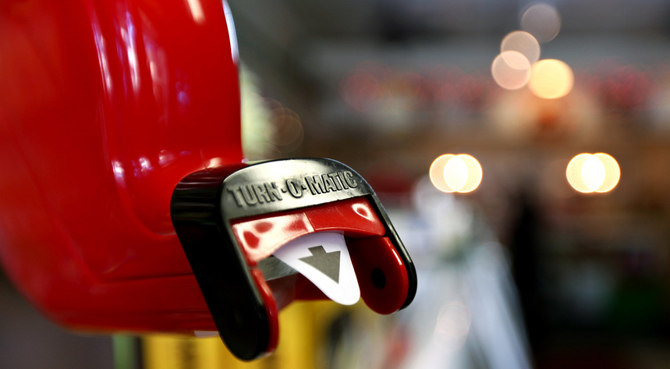
h. Assign an order TO SPEAKERS
Duplication prohibited without consent.
Notes:
There are times when we will want to Assign An Order to Speakers.

Slide 23
H. Assign an Order to Speakers
If several people want to speak, assign an order to your speakers
“Let’s allow Jerry to complete his thought, then we’ll go to Carla and then Robert.”
Ensure that the order is maintained
-
Manual 4-8
Notes:
This can be very effective. Note, that we do not have to take every comment every time. When we do Assign An Order to Speakers it is important that we honor the order.

Slide 24
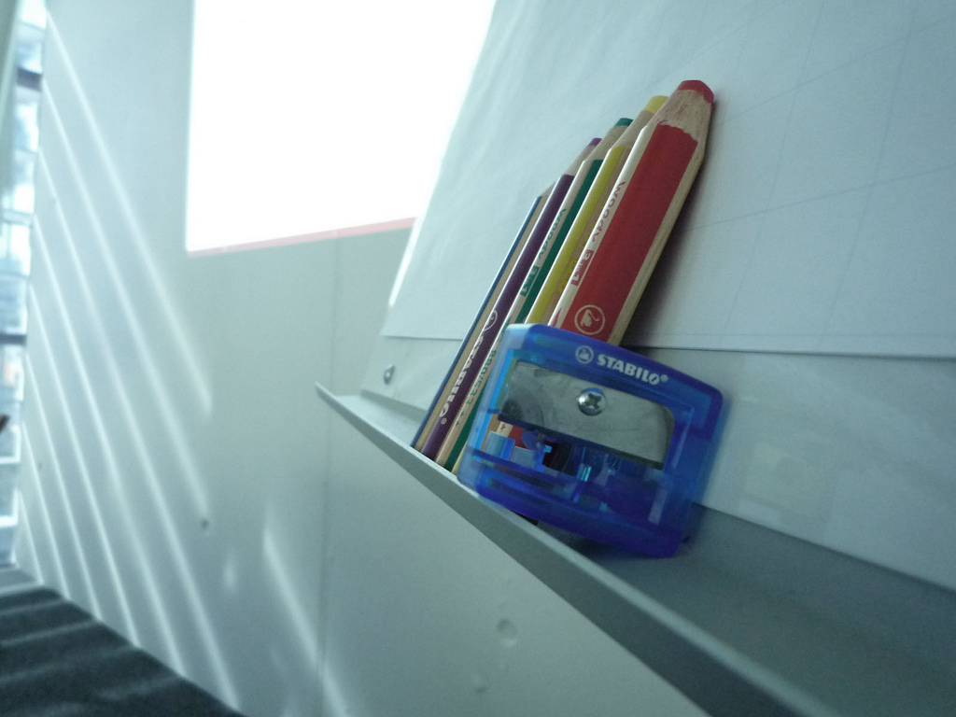
i. Use Multiple FLIP CHARTS
Duplication prohibited without consent.
Notes:
Flip charts are very effective in facilitating groups. We Use Multiple Flip Charts.

Slide 25
I. Use Multiple Flip Charts
Have enough flip charts for all items from a topic to be viewed
Four flip charts = best
Two charts = acceptable
One chart = not enough in most cases
Establish a flip chart protocol
-
Manual 4-8
Notes:
The reason or the why for this is to ensure any agenda item in our session can be in full view of the participants. When we rip and post, often some part of the audience can no longer refer to that flip chart. When we “flip” one chart paper to write on the next sheet, we no longer can refer to that earlier flip chart paper.

Slide 26
Flip Chart Protocol (Sample)
A-1
A-2
A-3
REORGANIZATION
REORGANIZATION
REORGANIZATION
Structure
Physical
Reporting relationships
Jobs
Protocol
Top management (Mgt.)
Communication (Comm)
Memos
E-mails
White papers
News bulletins notices
Phone
Budget
Projections
Quarterly reviews; annual reviews; final resolution
Manual 4-9
Notes:
This is very similar to what we covered earlier regarding focus. Flip Chart Protocol is very helpful when compiling the final documentation of the session based on what was written on the flip charts during the session.
[To bring this point home go back and place a 4-1, 4-2 etc. on each Flip Chart for this Section.]

Slide 27

J. Use the right recording tool
Duplication prohibited without consent.
Notes:
There will be times when we may be forced to use a recording tool we may not be accustomed to. This section provided guidance to Use the Right Recording Tool.

Slide 28
J. Use the Right Recording Tool
TOOL | ADVANTAGES | DISADVANTAGES
Flipcharts
Whiteboard
Copyboard
Computer Projection
Post-Its
Manual 4-10
Notes:
Let me set the clock for a minute and then ask each team if there is a specific row that you would like to discuss. We will start with the (red) team and move clockwise when the minute is up. [Set the time and facilitate the discussion when the time is up.]

Slide 29

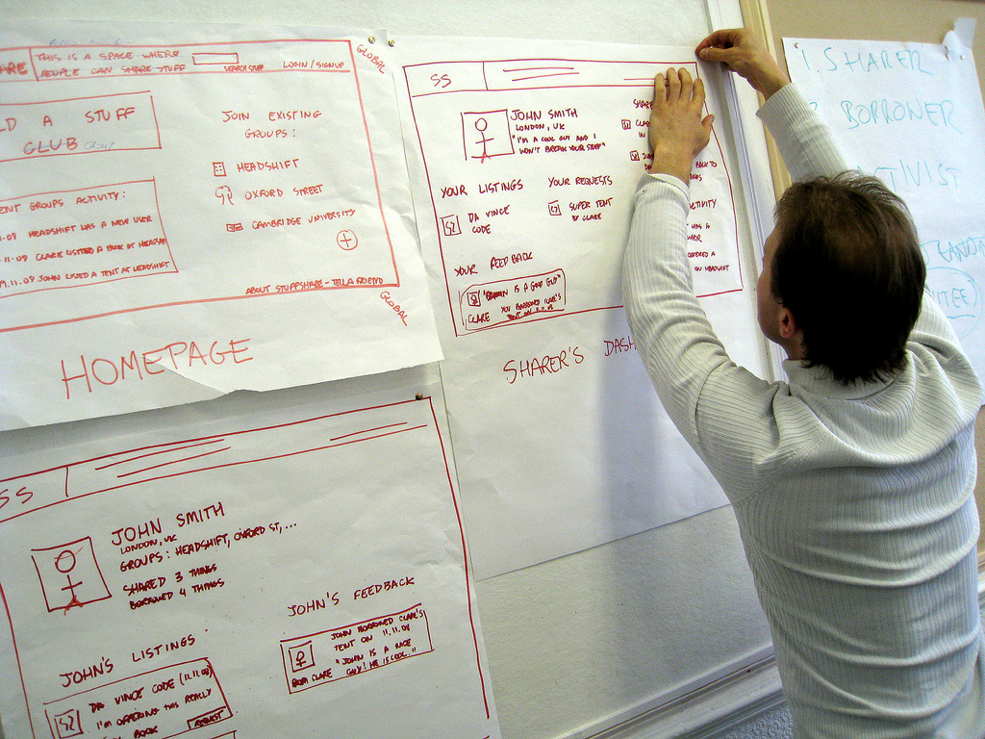
k. Post according to wall plan
Duplication prohibited without consent.
Notes:
Again, very similar to the point we made during Principle 3 – Focusing the Group. We will want to Post According to the Wall Plan.

Slide 30

K. Post According to Wall Plan
Make a short tear on the top of each side
Grip both sides and pull straight down
-
Manual 4-11
Notes:
This allows the participants to see the session unfold, go back and refer to earlier points and assists with focus as we discussed earlier.

Slide 31

FULL PRINCIPLE REVIEW
Notes:
OK, it is time for our Principle review. Let’s go from my right to left starting with the (purple) team. [Review, award dots, etc.]

Slide 32
Review
When writing the facilitator should always?
Write first, discuss second
Write what was said
-

Slide 33
Review
What are the techniques to “avoid the lulls” when writing?
Stand close to the board
Begin writing as soon as they start speaking
Repeat what they said while writing
Ask them to repeat
Ask a direct question
-

Slide 34
Review
A participant offers a response that is very long. What is a technique to eliminate paraphrasing?
-
Ask for the “headline”

Slide 35
Principle 4
POWER OF THE PEN
Use It, Don’t Abuse It, Make It Theirs
Write First, Discuss Second
Write What is Said
Add Your Words Discriminately
Ask, Don’t Tell
Write So They Can Read It
Use Additive Editing
Use Additive Editing
Avoid Lulls While Writing
Assign an Order to Your Speakers
Use Multiple Flip Charts
Employ the Right Recording Tool
Post According to Your Wall Plan

Slide 36
Checkpoint
The Facilitation Cycle
4.
The Power of the Pen
4.
The Power of the Pen
1.
Preparing for Success
2.
Getting the Session
Started
3.
Focusing the Group
9.
Closing the Session
5.
Information Gathering
6.
Managing Dysfunction
7.
Consensus Building
8.
Keeping the Energy High
Group
Dynamics
10.
Agenda Setting

Slide 37
THE EFFECTIVE FACILITATOR
PRINCIPLE 4

