Slide 1
THE EFFECTIVE FACILITATOR
PRINCIPLE 2
Notes:
Timing: 60 minutes
Engagement Strategies:
Last Person Standing for You Know the Session Started Well When
Lots of backward buildup on the IEEI
Team development of an Excite statement on the slide or one for a session a participant will be doing in the near future
Flip Charts:
Great Starts (to be used with Engagement Strategy above)
Great Starting Components
Inform
Purpose
Product
Excite
Benefits to THEM
WII-FM
Empower
Roles THEY will play
Why me?
Involve
THEIR key topics
Sample Agenda for Hiring Process
DOs:
Model every technique (e.g. checkpoint, questioning, engagement, flip charting, asking teams vs. individuals, brainstorming and grouping etc.)
Engage: 1) you know you the session started well when [last person standing]; 2)repeat the IEEI as you go through it in the same manner the Reacting Questions were reviewed during Principle 5 – Information Gathering
DON’Ts
Read the slides
Overuse the read-arounds

Slide 2
Checkpoint
The Facilitation Cycle
4.
The Power
of the Pen
1.
Preparing
for Success
2.
Getting
the Session
Started
2.
Getting
the Session
Started
3.
Focusing
the Group
9.
Closing the
Session
5.
Information
Gathering
6.
Managing
Dysfunction
7.
Consensus
Building
8.
Keeping the
Energy High
Group
Dynamics
10.
Agenda
Setting
Notes:
Checkpoint…
[Review:] We have just completed Principle 1 – Preparing for Success where we identified the 6 P’s of preparation and all the bases to cover to ensure we prepare for our sessions well.
[Preview:] What we are going to address now is Principle 2 – Getting the Session Started.
[Big View:] And, the reason this is important is when we start with confidence and clarity, we get the participants and, in particular, the senior participants (C level folks) in the session to transfer their power to us as the facilitator.

Slide 3
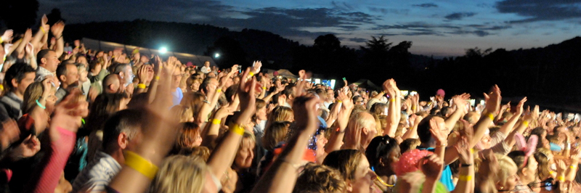
Inform, excite, empower, involve
Notes:
Our tagline for this Principle is Inform, Excite, Empower and Involve, IEEI or, as it is often affectionately referred to, the LSI EIEIO.

Slide 4
Principle 2
GETTING THE SESSION STARTED
Inform, Excite, Empower, Involve
Set-up with 30 Minutes to Spare
Optimize Your Set-up
Utilize the Gathering
Kick-off Promptly
Set the Stage with
Your Opening
Memorize Your Opening
Effectively Deliver Your Opening
Request Participants’ Objectives
Review the Agenda
Establish Ground Rules
Define the Parking Boards
Define Consensus
Open “On the Fly”
-
Notes:
In this Principle we are going to cover the following 13 best practices/techniques. While they are all listed chronologically on this slide, I would like to ask you to turn to Section E. We will start here, since it is the critical component in our starting.

Slide 5
Sample Agenda: Hiring Process
PURPOSE
Define the changes necessary to increase the efficiency and effectiveness of the hiring process
AGENDA
Introduction
What is the current process?
What are the problems and root causes?
Prioritize improvements
Prioritize improvements
Develop an implementation plan
Review and close
-
Notes:
This slide [also refer to flip chart] contains our Sample Agenda for the Process Improvement Session on the Hiring Process. When we start this session how any of us have been told how important the start of a meeting is to its success? [Raise your hand.] How about the old adage of you get once chance to make a good impression or hook them at the start? [Nod your head.] Great, looks like many of us know about this. But, how many of us have been given an almost failsafe way to make that happen? No, I really hadn’t either until I met the LSI EIEIO. No really the IEEI. Let’s go there

Slide 6


E. Set the Stage With Your Opening
Manual
2-5
Duplication prohibited without consent.
Notes:
When we kick off that facilitated session that we did a great job of preparing, for we want to…

Slide 7
E. Set the Stage With Your Opening
Through your opening words, you must:
Excite
Inform
Empower
Involve
Manual
2-5
Notes:
Set the Stage with Our Opening by…

Slide 8
E. Set the Stage With Your Opening
Through your opening words you must…
Inform participants about the session purpose and product.
What is going to happen? (Include the deliverable)
-
Manual
2-5
Notes:
Inform participants about the session objective. In the Inform we will cover the purpose and the product. It might sound something like…
Good morning, it is a pleasure to be here with you this afternoon. We have a very important objective for this session. We are going to identify and agree to all the changes this group agrees needs to be made to the hiring process [product]. And when we are done what we will have will be a list of the changes you have agreed to be made and a plan to implement those changes [product].
So, what do we cover in the Inform? [Choral response from all: purpose and product.]

Slide 9
E. Set the Stage With Your Opening
Through your opening words you must…
EXCITE participants about the benefits
to them.
What is the overall result to be achieved? WII-FM?
-
Manual
2-5
Notes:
Next, we will get the participants to tune in to radio station WII-FM by covering the benefits to them. Let me come back to an example of this in a few minutes
So, (red) team, with our choral response, the Inform covers? [Choral response: purpose and product.]
And, (green) team the Excite covers? [Choral response: benefits to them or WII-FM.]

Slide 10
E. Set the Stage With Your Opening
Through your opening words you must…
EMPOWER participants by discussing the important role they play in the process.
Why they were selected? What authority have they been given?
-
Manual
2-5
Notes:
The third component of our IEEI is Empower. Here we will tell them the roles they will play. Can you see why it was important to determine from the Session Sponsor whether the group was going to make a decision or provide a recommendation? Yet, we will now use that information to tell the participants the role they will play. In other words, put ourselves in the seat of a participant and answer this question, why me?

Slide 11
E. Set the Stage With Your Opening
Through your opening words you must…
INVOLVE participants by requesting the key issues or key topics they believe must be addressed to achieve the session purpose.
Manual
2-5
Notes:
The last part of that powerful opening is to get the participants engaged early. That tell them the session is really theirs; it’s all about them. We do this with our first question to engage them early; typically in the first 3 to 7 minutes of a session. And (purple) team, what kind of question do you think this will be to open that dialogue? That’s right our first Type B question. The Type A question is “what are your key topics?” Turn that into that great, visual starting question that allows the participants to see their answers.

Slide 12
E. Set the Stage With Your Opening
Through your opening words you must…
Which are we best at?
Which are we worst at?
Let’s look at two examples
Worst
-
Excite
Best
Inform
Empower
Involve
Manual
2-5
Notes:
This is an interesting slide. Let’s try a (standing/show of hands) poll to see what this group thinks they are best and worst at and then we will compare that to what we have discovered in our 20+ years of experience.
How many of you think you are best at…? [Go through all four and give #’s or %’s.]
How about which we are worst at? [Same approach.}
Typically we find that facilitators are best at the Inform.
And they are worst at the Excite.

Slide 13

EXAMPLES
Notes:
Let’s take a look at two examples of Excite statements for our Hiring Process session.

Slide 14
Excite Example #1
Good morning, it’s a pleasure to be here this morning.
Our objective for the next two days is to walk away with a plan for improving the hiring process (inform).
What is exciting about this?
If we are successful, we will walk away with a new hiring process that will help our organization get the right people hired and get them hired quickly.
-
Manual
NA
Notes:
(Name), would you please read Example #1.
Thank you, pretty good don’t you think folks? [Nod your head.] Probably better than most Excite statement I have heard. Let’s compare that to the next example.

Slide 15
Excite Example #2
Good morning, it’s a pleasure to be here this morning.
Our objective for the next two days is to walk away with a plan for improving the hiring process (inform).
What is exciting about this?
Having staff with the skills and attitude you need is the key to your success. When you have the right people in the right jobs, your day gets easier, and it’s also easier for your team to accomplish its goals. This is your opportunity to put strategies in place to ensure that you get the people you need to be truly successful.
-
Manual
NA
Notes:
(Name), would you please read Example #2?
OK, show of hands, how many of you think this Example, #2, is better? [Announce the # or %.] Yes, this one is more about THEM. While the first one is good it is not as directly tied to the participants.

Slide 16
Which is better? Why?
#1
If we are successful, we will walk away with a new hiring process that will help our organization get the right people hired and get them hired quickly.
#2
Today you may have people on your staff who don’t have the skills or the attitude you need. As a result, you are having to work much harder to make up for what they aren’t doing. This is your opportunity to put strategies in place to ensure that you get the people you need to get the work done.
Manual
NA
Notes:
Looking at them side-by-side there is one really neat tip that will help us build better Excite statements. Can anyone see differences that appeal to them? [Facilitate the discussion.]

Slide 17

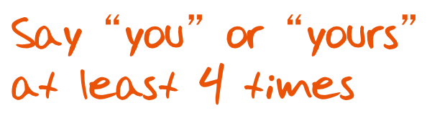
Which is better? Why?
#1
If we are successful, we will walk away with a new hiring process that will help our organization get the right people hired and get them hired quickly.
#2
Today you may have people on your staff who don’t have the skills or the attitude you need. As a result, you are having to work much harder to make up for what they aren’t doing. This is youR opportunity to put strategies in place to ensure that you get the people you need to get the work done.
-
Manual
NA
Notes:
Some really good points. We also find that by using the words “you” or “your” at least 4 times it makes that Excite statement more like the WII-FM that is so important about our Excite statements.
Are there any questions about the Excite statement? [Facilitate the discussion.]

Slide 18
Examples of Exciting
Making supplies order processing faster
Potential improvements to the process for paying expenses
Improvements to our methods for handling sales leads
Addressing problems with customer order processing
-
…back to A
Manual
NA
Notes:
What I would like to do now is to ask each team to prepare an Excite statement. [Assign the statements to each team; or offer the alternative for one of the participants from each team to describe an upcoming session they will be leading and build an Excite statement for that.]
Let’s take (3-4) minutes to prepare those Excite statements. [Assign new team leads, etc. review the Excite statements providing feedback from other participants as well as yours.]
[Award dots as appropriate.]

Slide 19

SET UP WITH 40 MINUTES TO SPARE
Duplication prohibited without consent.
Notes:
How many of you have challenges getting your meetings started on time? [raise your hand] Let take a look at some tips to make that a “thing of the past” and it starts with Setting Up with 30 Minutes to Spare.

Slide 20

A. Set Up with 30 Min to Spare
Estimate your set-up time
Unfamiliar location: Add 30 minutes
Familiar location: Add 10-20 minutes
Total = ?
-
Manual
2-2
Notes:
What do we mean by Set Up with 30 Minutes to Spare? (green) team, if it takes me 20 minutes to get set up and my start time is 8:30am, what time should I arrive at my session? [Facilitate the discussion; answer is 7:40am; gives you 20 minutes to set up and then 30 minutes to “spare.”]
Of course, if you are familiar with the location, we typically find only 10-20 minutes to spare is sufficient.
Does that make sense to everyone? [nod your head] Any questions on setting up with time to spare? [Facilitate discussion.]

Slide 21

OPTIMIZE YOUR SETUP
Duplication prohibited without consent.
Notes:
By arriving with time to spare, we can Optimize Our Setup.

Slide 22
B. Optimize Your Set-up
Ensure that chairs and tables are arranged
Ensure adequate supplies
  Multi-colored markers and tape
  Flip Charts
  Projector and screen
  Spare bulb
Set-up and post:
  Session Objective
  Session Agenda
  Parking Boards
  Ground Rules
Put out name cards and sign-in sheet
-
Manual
2-3
Notes:
This is a great slide to turn into a checklist for Optimizing Your Setup. Essentially, you want to be a gracious host and get the room setup to avoid being harried or rushed at the last minute as your participants begin to arrive.
Any points on setup that we should go deeper on? [Facilitate discussion.]

Slide 23

c. Use the gathering period
Establish personal rapport
See suggested topics to chat about
Manual
2-4
Duplication prohibited without consent.
Notes:
With all of our setup successfully complete, we now have that “time to spare” and we can Use the Gathering Period. Often this is a good time to meet those participants you were unable to contact during the preparation phase or focus on neutral topics to establish rapport, open dialogue and begin to establish that “safe” environment conducive to engaging even the most reluctant participant.
Any other items you think important for the gathering period? [Facilitate discussion.]

Slide 24

KICK OFF PROMPTLY
Confirm with person who will kick-off
Give 10- and 2-minute warnings
Other methods to start on time?
Manual
2-4
Duplication prohibited without consent.
Notes:
Most of us agreed before that too many sessions start when the last few people or the senior exec arrives. Can we all agree that we should not “punish the [let them respond; punctual or timely]”. That’s right let’s look at several tips that will allow us to Kick Off Promptly. We covered many of these as a part of preparation so let’s review all of them and add a few more that we find work successfully.
Ask the person that will kick off, often the Sponsor, to arrive 10 minutes early
Ask the Planning Team to arrive 10 minutes early
Ask the participants to arrive 10 minutes early
Provide a 10 minute warning
Provide a 2 minute warning
Project the countdown timer [available on the LSI web site]
Are there other methods you have that we should consider? [Facilitate the discussion.]
Remember, kicking off the session sets the tone; it establishes the precedence that a time schedule will be followed. It sends the message to the participants that we will respect ALL of their time.

Slide 25

Memorize your opening
Why?
Use the mnemonic technique
Manual
2-6
Duplication prohibited without consent.
Notes:
Now that we know the 4 key parts of the opening are, let me hear a choral response of the 4 letters please, those are…? [Choral response of IEEI.]
Many facilitators find it helpful to have a mnemonic to help them remember their opening sequence. They Memorize Their Opening. Let’s open to Table 9 [or use the next slide] in the participant manual and start with (name) from our (blue) team to review the bolded text for the mnemonic GOEOSI.
This really helps us to make that lasting first impression. Any questions or comments on Memorizing Your Opening? [Facilitate the discussion.]

Slide 26
Sample Opening Words
Good Morning…
One part of my job that I always enjoy
Easy to get caught up in the day-to-day
Objective for the next three days
Session will be fast-paced
Introductions
-
Manual
2-7
Notes:
[See previous slide for notes.]

Slide 27

REVIEW
Notes:
Another round of review. [Same approach as previous.]

Slide 28
Review
What are the 4 parts of the great opening?
Inform
Excite
Empower
Involve

Slide 29
Review
What should be included in the inform?
Purpose
Product

Slide 30
Review
What should be included in the excite?
Benefits…to Them
WII-FM

Slide 31
Review
What should be included in the empower?
Their role
Why they were selected

Slide 32
Review
What should be included in the involve?
Their key topics

Slide 33
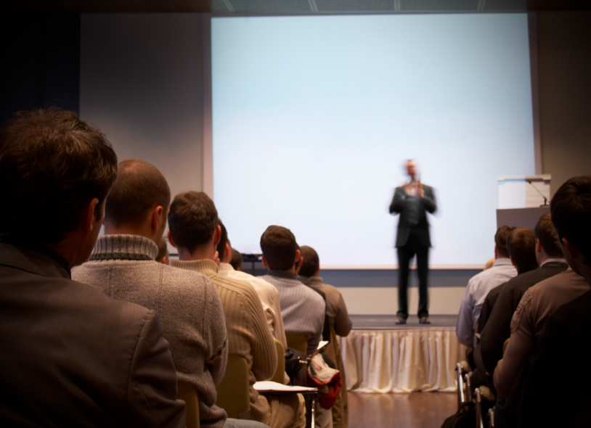
Effectively deliver your opening
Duplication prohibited without consent.
Notes:
Let’s look at some tips to Effectively Deliver the Opening.

Slide 34
G. Effectively Deliver Opening
Stand Tall
Speak loudly and clearly
Avoid speaking too fast or too slow
Avoid extremes in dress or grooming
Ensure facial expressions match your words
Use appropriate movement
Be animated
Make eye contact
Use defined gestures
Avoid “self-talk”
Avoid filler words like “ah,” “um,” “okay”
-
Manual
2-8
Notes:
Let’s go through these bullet points because they are really helpful to Effectively Deliver the Opening.
Read through the bullets and elaborate how to avoid those distracting, bad habits (e.g. filler works, speaking to rapidly, importance of eye contact for rapport and projecting confidence by not being intimidated, etc.).
Remember, regardless of whether or not you use the million-dollar words or the discounted words for your opening it is how they are delivered that makes the difference!

Slide 35
G. Effectively Deliver Opening
Bolster important ideas
Move deep into the U to build rapport
Avoid turning your back to participants
Don’t hold papers
Don’t speak to slides
Don’t talk to flip charts
-
Manual
2-8
Notes:
The opening is the time to address the key ideas or items. There is also this “invisible barrier” between you, the facilitator, and them, the participants. Cross that invisible barrier by moving deep into that U or semi circle.
Public speaking is still the biggest fear of the majority of people. We find that those butterflies can be an asset. We make them an asset by following these tips and getting those butterflies to fly in formation. We also want to deliver those opening words with what we refer to as “Level 3” energy and we will cover that more in Principle 8 – Keeping the Energy High. We will figuratively, grab them by their collars and shake them so they know they are in good hands and this meeting will be well run and results oriented.

Slide 36
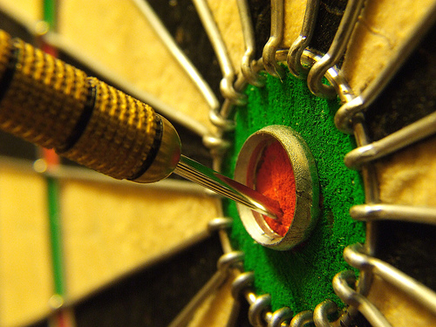
Request participants’ key topics
Involves immediately
Considers their desires
Provides opportunity to adjust agenda
Manual
2-9
Duplication prohibited without consent.
Notes:
In the typical meeting you attend, how long is it before you typically are involved or are engaged in that meeting? My experience has been not soon enough. By Requesting Participants’ Key Topics as the Involve part of our IEEI, we involve them immediately in the session; it kind of “makes it theirs” sooner rather than later. It also allows us, as the facilitator, to consider their desires early enough that we can do something about it if we had not included it in our session plan.
A nice technique to accomplish this is the Think-Pair-Share engagement activity Where participants are paired up, share each other’s key topics and then report each other’s topics to the entire group. This also helps the participants become comfortable with each other and minimizes their reservations to speak.

Slide 37
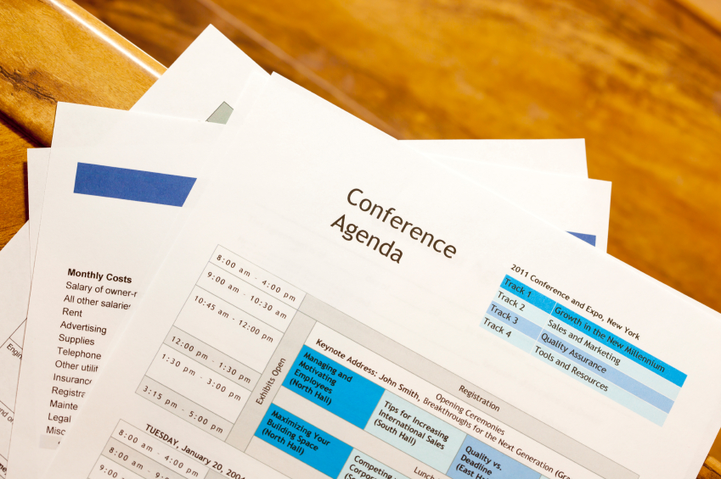
I. Review the agenda
Duplication prohibited without consent.
Notes:
Once we have collected the participants’ key topics we want to demonstrate to them that we will address them, where appropriate. We do this as a part of Reviewing the Agenda.
.

Slide 38
I. Review the Agenda
Return to the participants’ key topics
  Indicate when and how each item will be covered
  Highlight items that will not be discussed
  Suggest how highlighted items are to be handled
-
Manual
2-9
Notes:
Now we can ask the participants where on the agenda we will address their key topics, which we have grouped in categories. Just as we did earlier this morning. I collected your individual topics in our teams, we then grouped all of your objectives on the categorized flip chart. After our review of the 10 Principles, I asked you, the participants, where we would address each of these categories. It accomplished at least 2 things:
It demonstrates where each of your key topics will be addressed, and
It makes us aware of any “holes” that may exist so that we have time to adjust the agenda to meet your needs; a topic we will review as a part of Principle 10 – Agenda Setting
Any questions or comments? [Facilitate the discussion.]

Slide 39
I. Review the Agenda
Show the sample deliverable if you haven’t already
Discuss any housekeeping items:
  Lunch and breaks
  Restrooms and phones
  Role of documenters
-
Manual
2-10
Notes:
After, or as a part of, Reviewing the Agenda, this is also the best time to show the sample deliverable so the participants have clarity around what will be developed as the deliverable of the session. We can then discuss the administrative items including lunch, breaks, etc. This helps with minimizing or to ““Consciously Prevent” any possible dysfunctional behavior; i.e. leaving early. We will go deeper on dysfunctional behavior when we cover Principle 6 – Managing Dysfunction later in the course.

Slide 40
Starting Non-Facilitated Meetings
Clearly State:
Meeting purpose
  The purpose of our meeting is…when we finish, we would like to walk away with…Are we agreed?
Meeting agenda
Timed agenda
-
Manual
2-10
Notes:
What do we mean by a non-facilitated meeting. It could be a meeting that you were requested to lead with limited time to prepare or it could be a meeting, not a facilitated session where the participants will not necessarily be asked to create, understand and accept the results. Or, it could be we find it a best practice to begin with the session purpose; it would sound something like “the purpose of our meeting is … when we finish, we would like to walk away with … Are we agreed?”
Then a review of the meeting agenda.
Followed by the time limits assigned for each agenda item.
Any further discussion on Starting Non-Facilitated Meetings? [Facilitate the discussion.]

Slide 41
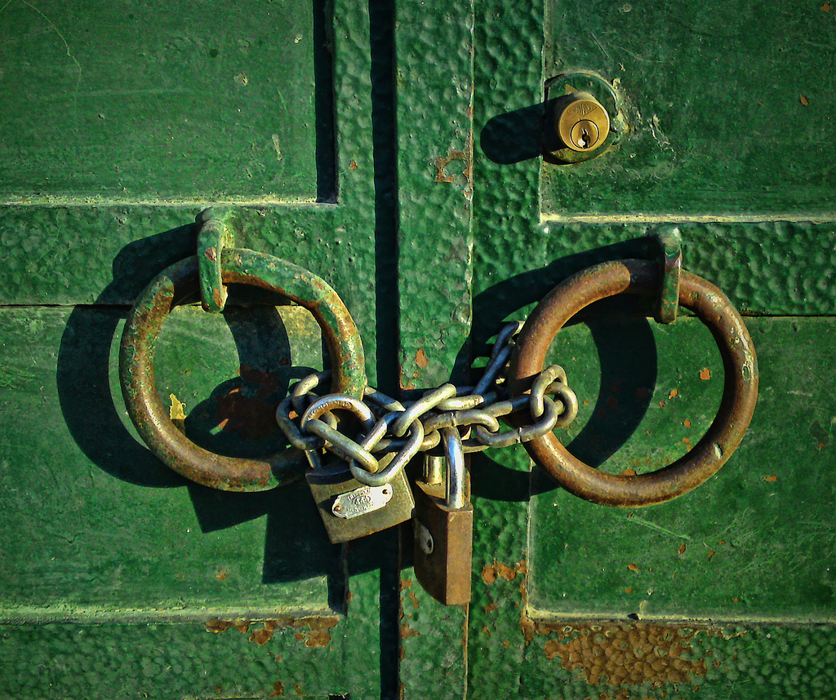
Request participants’ key topics
Duplication prohibited without consent.
Notes:
How many of you use ground rules in your sessions? [Raise your hand.] Do you find them a useful tool? [Nod your head yes.]
(Name), would you share the key purpose for your ground rules?
Thanks for that.

Slide 42
J. Establish Ground Rules
Encourages self-correction
Can address issues identified in prep
Serves to prevent dysfunction
Can take issues off the table
-
BEWARE: Gain agreement on ground rules!
Manual
2-11
Notes:
We find Establishing Ground Rules serves many purposes from getting the participants to self-correct, identifying means to address those probable issues we discovered as a part of our 6 P’s, preventing potential dysfunction and taking an issue off the table.
One of the key tips here is to ensure the group agrees to the ground rules. How do some of you do that today? [Facilitate the discussion.]
We often we call for a motion to adopt the proposed ground rules; then as for a 2nd; and, finally call for a vote on the ground rules to be adopted.
The key “why” for ground rules are addressed in this slide. Ground rules may be already established, or they may be created. An important message about ground rules or session guidelines, if you prefer that wording, is that it sends a message that you value the participants time and these ground rules assist in ensure the session is productive.
Any further points on ground rules? [Facilitate the discussion.]

Slide 43
Sample Ground Rules
Everyone Speaks Respect the Speaker
Titles Left Outside the Door
No Idea is Dumb
End Point First
Use the Parking Boards
Avoid "Bar Discussion”
"Choo Choo”
Start on time / End on time
-
Manual
2-11
Notes:
[Conduct a discussion (ask a Type B question) about their experiences with ground rules they had or wished they would have had, etc.]

Slide 44


Define parking boards (ida)
Manual
2-12
Duplication prohibited without consent.
Notes:
How many of you have used parking boards in sessions before? [raise your hand] Great, we find these are extremely beneficial in the session we conduct as the repositories of the 3 key items: issues, decisions and actions or (sister/cousin) IDA. Our earlier IDA represented how we arrived as session purpose. (purple) team what did that IDA stand for? That’s right Interview, Deliverable and Agenda.

Slide 45
K. Define Parking Boards (IDA)
Issues
Decisions
Actions
Manual
2-12
Notes:
(Sister/cousin) IDA for our Defining Parking Boards stand for: issues, decisions and actions.

Slide 46
K. Define Parking Boards (IDA)
Issues list
  Items relevant to the session that require a decision but will be discussed later or outside the session.
Manual
2-12
Notes:
(Name), can you read for us what the Issue List is used for?
Thank you.

Slide 47
K. Define Parking Boards (IDA)
Decisions list
  Decisions that are made by participants during the session.
Manual
2-12
Notes:
(Name), how about our Decisions List?
Thank you.

Slide 48
K. Define Parking Boards (IDA)
Actions list
  Actions to be performed sometime after the completion of the session.
Manual
2-12
Notes:
And, finally (name), what about our Actions List?
Thank you.
Any further discussion on the 3 Parking Boards? [Facilitate the discussion.]

Slide 49
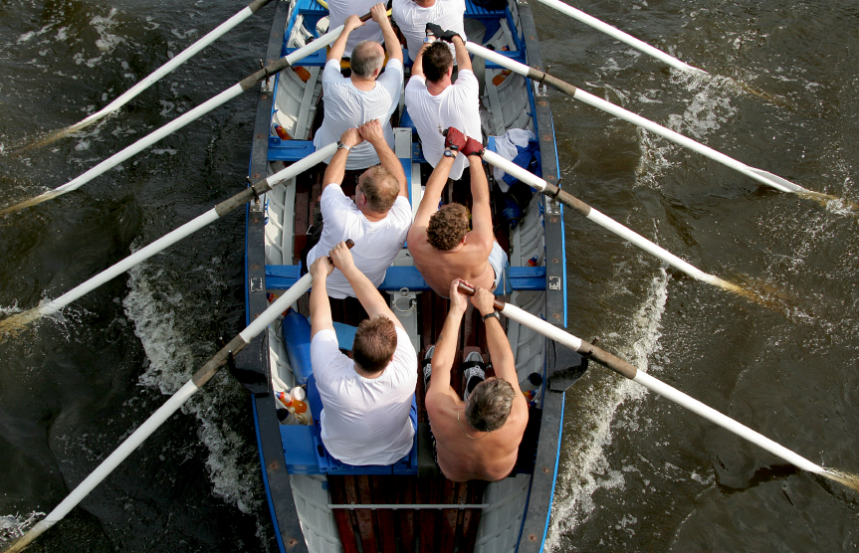
Define consensus
Duplication prohibited without consent.
Notes:
While we will go into consensus thoroughly when we cover Principle 7 – Generate a Consensus Focused Process, it is important to define what consensus is as a part of the start of a facilitated session.

Slide 50
L. Define Consensus
Consensus means:
  “I can live with that and support it”
Consensus DOES NOT mean:
  “I think this is the best solution”
Manual
2-13
Notes:
Again, although we will have an in-depth discussion about consensus later, we want to define consensus early in our session. The more participants the more difficult it would be to use the definition of consensus as the best solution. Rather, we believe the definition of consensus for group should be this is a decision I can live with and support. It also ensures every participant has a common understanding of the meaning of the word decision. Since the participants must create, understand and AGREE to the results of a facilitated session gaining an understanding of what agreement is becomes critical.

Slide 51

Open on the fly
Duplication prohibited without consent.
Notes:
Have any of you ever had to Open on the Fly? [Raise your hand.] (Name), can you share with us what happened and what you did in that case? [Facilitate the discussion.]
One reason could also be your boss will now know, if they do not already, that you are now a really Effective Facilitator. They may then call on you at the last moment to lead a meeting. Or it might sound something like, “we are here today to talk about ______. (Joe), why don’t you run this meeting?” Not much time to prepare, right?

Slide 52
M. Open on the Fly
Why do it?
Short on time
Can’t prepare an opening
How?
Use IEEI as a guide
-
Manual
2-13
Notes:
We open on the slide when we are rushed for time and there is insufficient time to do all, or any, of the desired preparation. You will find a simple use of our IEEI will be very helpful in those situations.

Slide 53
M. Open on the Fly
Keep your Mini Manual with you at all times.
Ground rules
Parking boards
Definition of consensus
-
Manual
2-13
Notes:
At the close of our session, we will also be providing each of you with a copy of our Mini-Manual that will provide you with tips for items including the 3 on this slide as well as many others

Slide 54
FULL PRINCIPLE REVIEW
Notes:
Let’s do our final review of the best practices/techniques from this Principle. [Give directions on where you will start, the order you will go, etc. ; award dots, etc.]

Slide 55
Review
What are the 4 parts of the great opening?
Inform
Excite
Empower
Involve
Notes:
What are the 4 parts of the Great Opening?
IEEI
Inform
Excite
Empower
Involve

Slide 56
Review
What should be included in the inform?
Purpose
Product
Notes:
What should be included in the Inform?
Purpose
Product

Slide 57
Review
What should be included in the excite?
Benefits…to Them
WII-FM
Notes:
What should be included in the Excite?
Benefits…..to Them
WII-FM

Slide 58
Review
What should be included in the empower?
Their role
Why they were selected
Notes:
What should be included in the Empower?
Their ROLES
Why me?

Slide 59
Review
What should be included in the involve?
Their personal objectives/key issues
Notes:
What should be included in the Involve?
Their Personal objectives/Key issues

Slide 60
Review
What is the key purpose of ground rules?
Self correcting by the participants
Notes:
What is the key purpose of Ground Rules?
Self correcting by the participants

Slide 61
Review
What are the 3 parking boards?
IDA
  Issues
  Decisions
  Actions
Notes:
What are the 3 parking boards?
IDA
Issues
Decisions
Actions

Slide 62
What is the Recommended Order?
All Teams Respond
Product
Parking Boards
Agenda
Purpose
Ground Rules
Personal Objectives
Excite/Empower
Manual
NA
Notes:
Let’s tie it all together. [Appoint new team leaders and assign each team to put these in proper order based on the materials that were just covered; when completed, post on a flip chart, award dots, etc.]

Slide 63
What is the Recommended Order?
D. Purpose
A. Product
G. Excite/Empower
F. Personal Objectives
C. Agenda
E. Ground Rules
B. Parking Boards
INFORM
EXCITE, EMPOWER
INVOLVE
Manual
NA

Slide 64
Principle 2
GETTING THE SESSION STARTED
Set-up with 30 Minutes to Spare
Optimize Your Set-up
Utilize the Gathering
Kick-off Promptly
Set the Stage with Your Opening
Memorize Your Opening
Effectively Deliver Your Opening
Request Participants’ Objectives
Review the Agenda
Establish Ground Rules
Define the Parking Boards
Define Consensus
Open “On the Fly”

Slide 65
Checkpoint
The Facilitation Cycle
4.
The Power
of the Pen
1.
Preparing
for Success
2.
Getting
the Session
Started
2.
Getting
the Session
Started
3.
Focusing
the Group
9.
Closing the
Session
5.
Information
Gathering
6.
Managing
Dysfunction
7.
Consensus
Building
8.
Keeping the
Energy High
Group
Dynamics
10.
Agenda
Setting

Slide 66
THE EFFECTIVE FACILITATOR
PRINCIPLE 2

