Slide 1
Exercise #5 – Key Points
Consensus with Facilitator #1 Delineating Alternatives and Facilitator #2 Strengths & Weaknesses & Merging Alternatives
Let’s open the Exercise Packet and go through the details
Preparation time
Notes:
[A slide to post to conduct the fifth exercise – it give the key points about timing and when to return to the main room.]
[Upon return to the main room, the instructor should conduct a debrief, flip charting the Key Observations. While flip charting, ensure we model the techniques from Principle 4 including: writing first, writing their words, asking not telling, alternate colors, etc.]

Slide 2
Timing Exercise #5
Start time: About 1:15pm
6 people x (5min + 3min) = 48 minutes
Break: 15 minutes
End Time: 2:10pm

Slide 3
Exercise #5 Debrief
Flip chart Key Observations

Slide 4
THE EFFECTIVE FACILITATOR
PRINCIPLE 10
Notes:
Timing: 60 minutes
Engagement Strategies:
Review of Agenda Models
Creating an Agenda from Scratch
Determine the critical question
Determine the preparation questions
Determine the logical order of preparation questions
Transform questions into agenda items
Prepare the detailed agenda
OPQRST
Flip Charts:
Steps for Closing a Session (for last person standing)
DON’Ts
Read the slides
Overuse the read-arounds

Slide 5
Checkpoint
The Facilitation Cycle
4.
The Power
of the Pen
1.
Preparing
for Success
2.
Getting
the Session
Started
3.
Focusing
the Group
9.
Closing the
Session
5.
Information
Gathering
6.
Managing
Dysfunction
7.
Consensus
Building
8.
Keeping the
Energy High
Group
Dynamics
10.
Agenda
Setting
10.
Agenda
Setting
Notes:
[Checkpoint:]
[Review:] We have just completed our Application Exercise on Consensus Building.
[Preview:] What we are about to do next is cover our last of the 10 Principles, Principle 10 – Agenda Setting.
[Big View:] And this Principle is important because 1) we want to share with you the power of the agenda models that are a part of The Effective Facilitator Class and provide you with a technique for building an agenda for a session when one of the agenda models in the manual do not “fit the bill.” Our agenda models could be purchased from our web site and they would be helpful. But now that you have gone through the class, in a minute you will see that your eyes have been opened. You will be able to recognize all the techniques you learned in the 10 Principles conveniently packaged together in the Agenda Model manual.

Slide 6
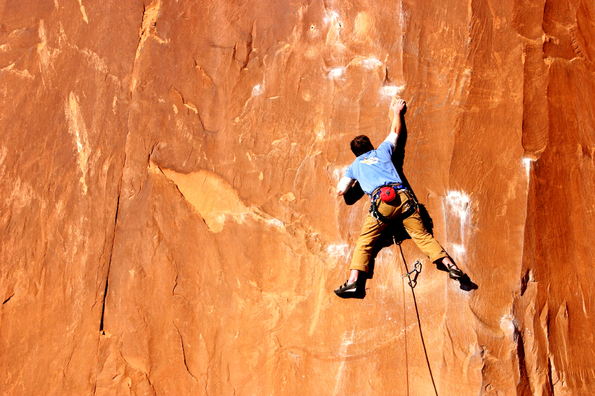
Adapt your agenda to address the need
Notes:
Let’s start with how to Adapt Your Agenda to Address the Need.

Slide 7
Principle 10
Agenda setting
Adapt Your Agenda to Address the Need
Choose Agenda Based on Objectives
Tailor Agenda to Specific Need
Incorporate Consensus-Building Principles
Construct a New Agenda as needed
Confirm Agenda with Project Team
Prepare a Detailed Agenda
Track Performance Against Agenda
Record Process Notes
Incorporate Recommendations
Manual
10-1
Notes:
There are 9 best practices/techniques in this principle.

Slide 8
Agenda Models
Strategic Plan
Project Plan
Project Status
Issue Resolution
Basic Improvement Model
Process
Re-engineering
Information Needs Analysis
Process Modeling
Data Modeling
Procedure Design
Manual
10-2
Notes:
On this slide are a list of the 10 agenda models in the 2nd manual that is a part of the class. Where do we begin with 10 agenda models?

Slide 9
“Which one?”
1
6
2
7
3
8
4
9
5
10
Notes:
How do we decide where to start?

Slide 10
A. Choose an Agenda Based on Objectives
Notes:
We Chose an Agenda Model Based on Session Objectives and Purpose. Let’s turn to page (10-2) in your participant manual.

Slide 11
Choose Agenda Based On Objectives
The agenda identifies the major activities (facilitated processes) to be done to meet the session objectives
The agenda communicates what will happen during the session
Select the agenda model whose purpose and content most closely match your session
Manual
10-3
Notes:
This is a great starting point for determining which agenda model would best serve as your starting point. [Review the columns on this page to explain how to select the appropriate agenda model and review the key points on the slide.]

Slide 12
“Number 9 will work”
1
6
2
7
3
8
4
9
5
10
Notes:
Now, again, we have selected a starting point and only a starting point.

Slide 13
B. Tailor Agenda to Needs
Manual
10-4
Notes:
Next, we Tailor the Agenda to the Needs. How will we accomplish this?

Slide 14
B. Tailor Agenda to Needs
Use your notes from the sponsor interview and your understanding of the session objective
Always customize the Introduction and Review/Close sections
Take a layered approach
High level information
Details
Details
Details
It’s generally best NOT to include specific start and ending time for each facilitated process
Notes:
Remember our interview with the session sponsor? [nod your head] Now, we take our notes from that interview to select the agenda model that is closest to the session purpose/objective. At a minimum we will tailor or customize the opening and the closing. It is also best to take the layered approach to the session –“peel the onion” a layer at a time.

Slide 15
Incorporate Consensus-Building Principles
Notes:
Remember we want to generate a consensus-focused process. To do that we must Incorporate Consensus Building.

Slide 16
C. Incorporate Consensus-Building Principles
Design agenda to provide a common set of information early in the process
Session attendees need early successes before tackling more difficult issues
Have attendees build a common set of values by which a decision can be made
Manual
10-6
Notes:
Looking at our session, we will want to provide the information needed earlier in the session to allow the participants to know how decisions will be made as well as enjoy early successes prior to tackling the more controversial or difficult items.

Slide 17

REVIEW
Notes:
Let’s try a little bit of review. We’ll start with our (purple) team and move to my left. [Conduct the review, award dots, etc.]

Slide 18
Review
Where are the agenda models in the participant manual?
Separate manual labeled, “Agenda Models”
How many agenda models are included?
Ten (10)

Slide 19
Review
How would you determine which agenda model to use as a starting point?
From the session purpose identified during the Project Sponsor interview.
Page 10-2 is a nice summary of each agenda model.

Slide 20

D. Construct a New Agenda
Notes:
What we have just covered is all about having a best practice, a methodology or technique that exists. What do we do when we must Construct a New Agenda? Here is a great process for doing just that.

Slide 21
D. Construct New Agenda
Determine critical question
Determine preparation questions
Determine logical order of preparation questions
Transform questions into agenda items
Prepare detailed agenda
Session Objective
Critical Question
Preparation Questions
Order of Questions/Processes
Manual
10-7
Notes:
Use the 5 steps identified on this slide:
Determine the critical question: that is the question, when answered, you may move to the last agenda item, Review & Close.
Next, determine the preparation questions: these are the questions that will allow the participants to most informatively answer the critical question.
Now we can order those preparation questions; of course those will be followed by the critical question.
Now we convert our questions into agenda items; make your agenda parallel.
Unfortunately, our work as facilitators has just begun. We must now prepare our detailed agenda.
Before we look at a few examples, are there any question on constructing a new agenda item? [Facilitate the discussion.]

Slide 22
D. Construct a New Agenda
Example:
Assume we did not have a Process Improvement Agenda Model
We are about to do a facilitated session whose purpose is:
  Identify the changes necessary to improve the efficiency and effectiveness of the hiring process
Manual
10-8
Notes:
Let’s use the Sample Agenda we have been using for the last 3 days and assume we did not have an agenda model for Process Improvement, and the purpose of our session has been agreed to as listed on this slide.

Slide 23
D. Construct New Agenda
Example:
What is/are the critical question(s)?
What are the preparation questions?
What would the agenda look like?
Notes:
Let me ask each team to take a minute and identify what they believe would be the critical question. [Set clock and facilitate the discussion. When the time has run out; reinforce the point by asking, “Would we be able to move to the review and close?” as you facilitate their answers.]
Great, now let’s identify some of the preparation questions. [Facilitate by moving from team to team.]
And finally our agenda? [same as above]

Slide 24
Sample Agenda: Hiring Process
Purpose:
Define the changes necessary to increase the efficiency and effectiveness of the hiring process
Agenda:
Introduction
Define the steps in the current hiring process
Identify the problems and root causes with existing system
Develop the potential improvements
Establish a priority for improvements
Develop an implementation plan
Review and close
Notes:
Here is what that final agenda might look like.

Slide 25

A call from the executive
Duplication prohibited without consent.
Notes:
Let’s take a look at a session we were asked to facilitate based on “A Call from the Executive.”

Slide 26
A Call from the Executive
“The Board is concerned because 80% of our staff received pay for performance. They believe that this is too much.”
“I would like for you to facilitate a session with me and my senior team to determine our response.”
What is the critical question?
Notes:
(Name) from the (green) team, would you please read this slide? OK, that is a realistic situation. Let me give the teams each a minute to determine the critical question. Remember, ask yourself, can we move to the review and close when we answer that question? [Start the clock and facilitate the discussion when the time has run out.]

Slide 27
The Critical Question:
What steps should we take to respond to the Board’s Concerns about pay for performance?
Notes:
Here we go. That critical question would be: what steps should we take to respond to the board’s concerns about pay for performance?

Slide 28
E. Confirm with Planning Team
Notes:
Once we have the agenda, we would want to Confirm with the Project Team.

Slide 29
E. Confirm with Planning Team
Review with:
Ensure that the agenda includes the processes necessary to achieve the objective
Project Manager
Methodologist
Project Team
Manual
10-9
Notes:
Remember the members of the planning team – here are 3 examples. Are there others that you have found in your experience? [Facilitate the discussion.]

Slide 30
F. Prepare a Detailed Agenda
Notes:
And, then Prepare a Detailed Agenda in order to be able to do the great job as a facilitator

Slide 31


F. Prepare a Detailed Agenda
Helps you think through the entire session
Communicates expectations to documenters
Be sure to include a 10-15 minute break every 60-90 minutes
Use a basis for each duration estimate
Agenda
Detailed
Agenda
Manual
10-9
Notes:
Here are some key areas to consider. [Review points on the slide.]

Slide 32
F. Prepare a Detailed Agenda
Order of the process (the agenda)
Process technique (Listing, Brainstorming, Grouping, Prioritizing)
Question (Starting question and explanation given to kick off each process)
Recording format (Three column matrix, basic list, etc.)
Supplies (Post-its, dots, etc.)
Timing (Start/end/duration for each process)
Manual
10-10
Notes:
And, back to our OPQRST… Let’s review one more time. [Review slide.]

Slide 33

Track Performance Against Agenda
Notes:
Then, we want to get into the habit of Tracking Performance Against the Agenda.

Slide 34
Track Performance Against Agenda
Record actual start and end time as you proceed
At each break, adjust the target start times and durations for future activities as needed.
Manual
10-10
Notes:
We can improve by following these techniques. [Review slide.]
Any other tips you have found helpful? [Facilitate the discussion.]

Slide 35
H. Record Process Notes
Notes:
And, we look at not only our timing but Recording Process Notes for making future sessions even better.

Slide 36
H. Record Process Notes
What to record?
Variations in estimation basis
Areas that participants found difficult
Ideas for improving the agenda or a specific process
Manual
10-11
Notes:
Process notes would include items such as:
Variations in estimation basis.
Areas that participants found difficult.
Ideas for improving the agenda or a specific process.

Slide 37
I. Incorporate Recommendations
Notes:
And, then, to wrap it up we will Incorporate Recommendations.

Slide 38
I. Incorporate Recommendations
Review
  Notes made during the session
  Actual start and end times
  Participant evaluations
Update your agenda model to improve your effectiveness in future efforts
Manual
10-11
Notes:
[Review points on slide.]
Other tips you may use as a part of your continuous improvement? [Facilitate the discussion.]

Slide 39
FULL PRINCIPLE REVIEW
Notes:
And, now for our last review. [Use teams, award dots, etc.]

Slide 40
Review
Where are the agenda models in the participant manual?
Second manual
How many agenda models are included?
Ten (10)

Slide 41
Review
How would you determine which agenda model to use as a starting point?
From the session purpose identified during the Project Sponsor interview.
Page 10-2 is a nice summary of each agenda model.

Slide 42
Review
What is the critical question?
The question, when answered, the facilitated session is over

Slide 43
Review
What are the steps to construct an agenda from scratch?
Determine the critical question
Determine the preparation questions
Order the preparation questions
Transform the questions into agenda steps
Prepare the detailed agenda

Slide 44
Review
What are the items to include in the detailed agenda?
Order of the process
Process technique
Question
Recording format
Supplies
Timing

Slide 45
Principle 10
Agenda setting
Adapt Your Agenda to Address the Need
Choose Agenda Based on Objectives
Tailor Agenda to Specific Need
Incorporate Consensus-Building Principles
Construct a New Agenda as needed
Conform Agenda with Project Team
Prepare a Detailed Agenda
Track Performance Against Agenda
Record Process Notes
Incorporate Recommendations
Manual
10-1

Slide 46
Checkpoint
The Facilitation Cycle
4.
The Power
of the Pen
1.
Preparing
for Success
2.
Getting
the Session
Started
3.
Focusing
the Group
9.
Closing the
Session
5.
Information
Gathering
6.
Managing
Dysfunction
7.
Consensus
Building
8.
Keeping the
Energy High
Group
Dynamics
10.
Agenda
Setting
10.
Agenda
Setting

Slide 47
Congratulations!
Notes:
So, let me now congratulate you [start the round of applause] and move to the class close [remember, model the close from Principle 9]

Slide 48
THE EFFECTIVE FACILITATOR
PRINCIPLE 10

Slide 49
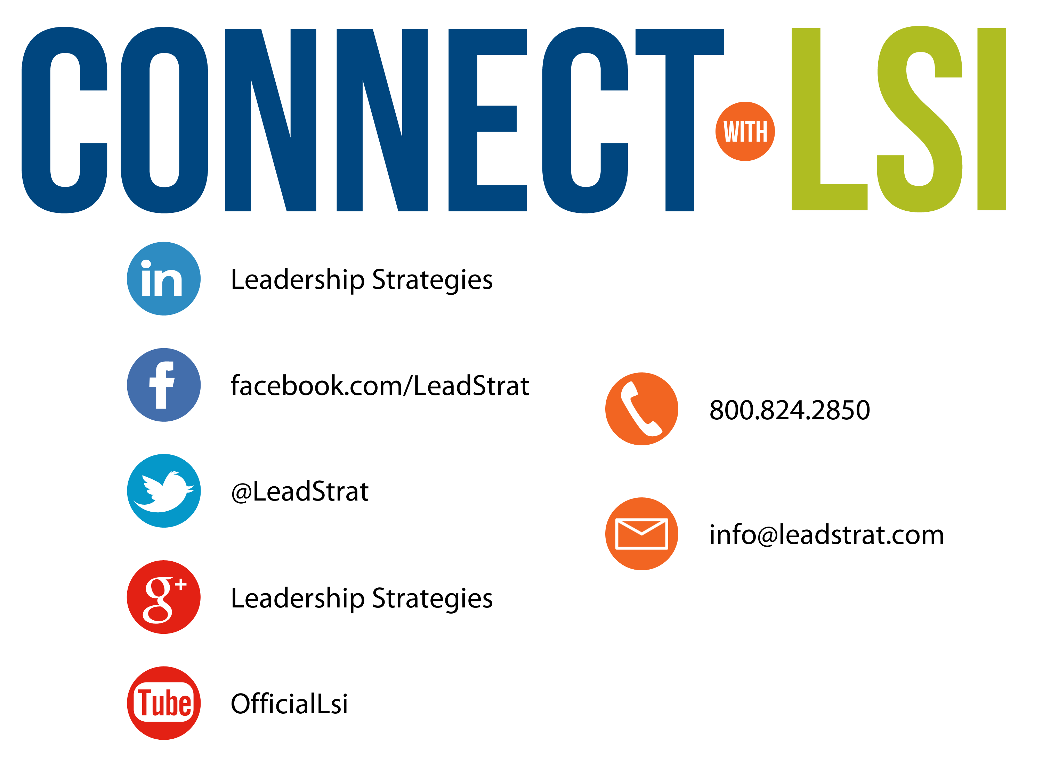

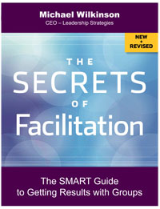
Questions?
etraining@leadstrat.com
800.824.2850
Or, submit your questions for open discussion
on the Linked-In “Leadership Strategies
Facilitation & Leadership Community” Group
Join us on Facebook at
www.Facebook.com/Leadstrat
and Twitter @Leadstrat
Notes:
[THIS SLIDE MAY OR MAY NOT BE INCLUDED]
We fundamentally believe facilitation is a skill that applies in a multitude of situations. We also are confident that in our quest to “share the power of facilitation with the world” that connecting via social media is a way for all of us to collectively share our successes, our challenges and our facilitation work. To “facilitate” that process, we want to ensure you are aware of how we can all stay connected using social media.
How many of you have found many of the skills in the class helpful? [Raise your hand.] I know that one of the things I did after attending was share what I learned with many of my colleagues. Have some of you already thought about that? [Nod your head.]
Then, one request we would like to make of you is to update your “education or classes attended” on your LinkedIn profile. That visibility will help all of us to “share the power” I have been referring to. Any questions? [Facilitate the discussion.]

Slide 50
A Request from LSI to You
When you receive invitations from Leadership Strategies to attend one of our free Webinars, we ask that you please consider forwarding that invitation to five people you know.
Our Webinars are 60 minutes of tips and techniques that participants can begin using immediately. They include a workbook and the content is extracted from our courses. Thank you in advance for your help. It is part of our effort to “share the power of facilitation with the world!”
-
Notes:
Review slide.

Slide 51


Raving facilitators,
Share your power!
SHARE. In your first 30 days after this course, let your classmates know your success in using the tools and techniques. Like/follow us and post on our social media:
    Twitter -- @leadstrat
    Facebook – www.facebook.com/leadstrat
    LinkedIn – search “Leadership Strategies”
JOIN THE COMMUNITY. Become part of the community of thousands of facilitators who have taken The Effective Facilitator or who are interested in facilitation. See how facilitation has helped others and share your story.
Download our meeting app LeadStrat! Mini Manual in the app!
Notes:
Review slide.

Slide 52


3 ways to show you’re an Effective Facilitator
1.
You will receive an email tomorrow that shows you how to add The Effective Facilitator Certification to your LinkedIn Profile
2.
Provide feedback and help others know what to expect from the course
3.
Show your facilitation in action by tagging us and #effectivefacilitator #Leadstrat – Quarterly Award
@leadershipstrategies
@LeadStrat
Notes:
Review slide.

Slide 53
What’s Next?
The path to facilitation mastery:
The Effective Facilitator
(4-day class)
EF Virtual Link
(1-day virtual class)
Advanced Facilitation
(3-day class)
Certification Preparation
(2-day class)
Certified Master Facilitator
Learning from the Masters
(Webinars, March-August)
Notes:
[Use the following information to explain the Mastery program.]
Foundation Skills
The Effective Facilitator Workshop, 4-days
Achieve mastery over the 10 principles of facilitation and over 100 tools and techniques for leading effective group sessions.
Virtual Skills
The Effective Facilitator—Virtual Link, 1 day (virtual)
Learn how to apply the 10 principles to create engaging and effective virtual meetings. Get the key insights that put you in control.
Advanced Skills and Certification Preparation
Advanced Facilitator Skills Workshop, 3 days, Atlanta
Raise your skills to the next level with baseline exercises to identify your key areas of need and intense coaching and feedback to accelerate your learning curve.
Facilitator Certification Preparation, 2 days, Atlanta
Create the INIFAC case study video required for certification and gain key tips for answering the 30 written submission questions and documenting your facilitation experience.
Learning from the Masters, monthly, one-hour virtual discussions, March-August
Take this opportunity to pick up additional learning and gain advice on your upcoming sessions or facilitation challenges.
Application for Certification: Optional program fees cover your application for certification as a Certified Master Facilitator by the International Institute for Facilitation (INIFAC)

Slide 54
What’s Next?
The path to consulting mastery
The path to leadership mastery
The path to meetings mastery
The path to training mastery
The Facilitative Consultant
The Facilitative Leader
Facilitating Masterful Meetings
The Engaging Trainer
All offered virtually
Notes:
[Use the following information to explain the other courses offered by LSI.]
The Facilitative Consultant
Are you an internal or external consultant, or do you use a consultative style in your work? The Facilitative Consultant is a dynamic, interactive course that builds critical skills by using a highly-interactive case study approach. This course outlines a comprehensive framework for all stages of the consulting process from defining client needs to running a project to reviewing results. The Facilitative Consultant focuses on relationship management, allowing you to increase your credibility and trust with clients, enhance your communication effectiveness and better manage expectations. This team-based course offers you the opportunity to solve a real-life client problem by applying your new skills.
The Facilitative Leader
The Facilitative Leader is for individuals who want to improve their leadership skills and move to the next level in their organization. Create an action plan that uses facilitation principles to engage and inspire others to drive results. The course can be done consecutively in 3-4 days or in ½ day modules listed below and can event be delivered virtually in 2-hour segments over time. You can select all or just a few, depending on your needs:
The 3 Levels of Leadership
Facilitating Communication
Facilitating and Coaching others
Facilitation Success in Your Team
Facilitating Consensus
Strategic planning and thinking
Leading Masterful Meetings 1
Leading Masterful Meetings 2
Facilitating Masterful Meetings
Facilitating Masterful Meetings is a convenient two-day course designed to help you improve your daily meetings with smart (and practical) meeting facilitation skills and techniques. This course also expands on how to create a meeting “revolution” inside your organization to help others stop the common problems perpetuated in most meetings – late starts, unproductive time misused, discussions without purpose, and group dysfunction – all culprits of wasted resources and money. You will walk away with a transformed vision of effective meetings plus the necessary tools to equip you in your everyday meetings.
The Engaging Trainer
Facilitating Impactful Learning (formerly Facilitation Skills for Trainers)- 3 days | Designed for trainers and instructors, this three-day course equips you with a full toolbox of strategies for engaging participants in dynamic and interactive training segments. Trainers and instructors will be able to design and employ an approach that engages ANY audience and makes training really stick. Special Feature: Bring a module from your own class to get feedback and recommendations for transforming it using the techniques from The Engaging Trainer! (can be done in shorter customized versions)

Slide 55
The Effective Facilitator After Training Support
From Classroom to Application
A 30-day check-in to confirm your progress on implementing specific techniques
12 monthly webinars on each of the 10 Principles to keep you refreshed on the course
The Monthly Refresher
The Maximizer
An email communication covering one of the course techniques each month
Notes:
Because we want to ensure that you retain what you’ve learned, we offer three ongoing opportunities. [Review slide.]

Slide 56
Exercise #6 – Key Points
An opportunity to team up with another participant
Identify a facilitated session you would like to use to demonstrate your facilitation skills
Prepare a summary agenda for that entire session
Prepare a detailed agenda for any ___ minutes you plan to facilitate

Slide 57
Timing Exercise #6
Start time:
Each person will have ___ minutes to facilitate
We will provide a 5 minute and 2 minute warning
I will lead the debrief that will last ___ minutes
We will take a ___ minute break after every four sessions

