Slide 1
THE EFFECTIVE FACILITATOR
PRINCIPLE 1
Notes:
Timing: 60 minutes
Engagement Strategies:
Post-its by teams of items to prepare for a session; then later posted on flip chart with the three areas of: People, Method and Logistics
Flip Charts:
Preparation Areas
People
Method
Logistics
Getting to Session Purpose (IDA)
Interview the sponsor
Deliverable: sample
Agenda
6 P’s of Preparation
Purpose
Product
Hand
Head
Heart
Participants
Probable issues
Process
Place
Know the Process Cold
Order of the process
Process technique
Question: starting
Recording format
Supplies
Timing
DOs:
Model every technique (e.g. checkpoint, questioning, engagement, flip charting, asking teams vs. individuals, brainstorming and grouping etc.)
Engage: 1) how to prep for a session 2) changing team leaders with the why
DON’Ts:
Read the slides
Overuse the read-arounds

Slide 2
Timing Exercise #1
Start time: About 1:15pm
4 people x (4min + 3min) = 28 minutes
Break: 15 minutes
End Time: 2:00pm
Notes:
A slide to post to conduct the first exercise – it give the key points about timing and when to return to the main room.
[Upon return to the main room, the instructor should conduct a debrief, flip charting the Key Observations. While flip charting, ensure we model the techniques from Principle 4 including: writing first, writing their words, asking not telling, alternate colors, etc.]

Slide 3
Checkpoint
The Facilitation Cycle
4.
The Power
of the Pen
1.
Preparing
for Success
1.
Preparing
for Success
2.
Getting
the Session
Started
3.
Focusing
the Group
9.
Closing the
Session
5.
Information
Gathering
6.
Managing
Dysfunction
7.
Consensus
Building
8.
Keeping the
Energy High
Group
Dynamics
10.
Agenda
Setting

Slide 4
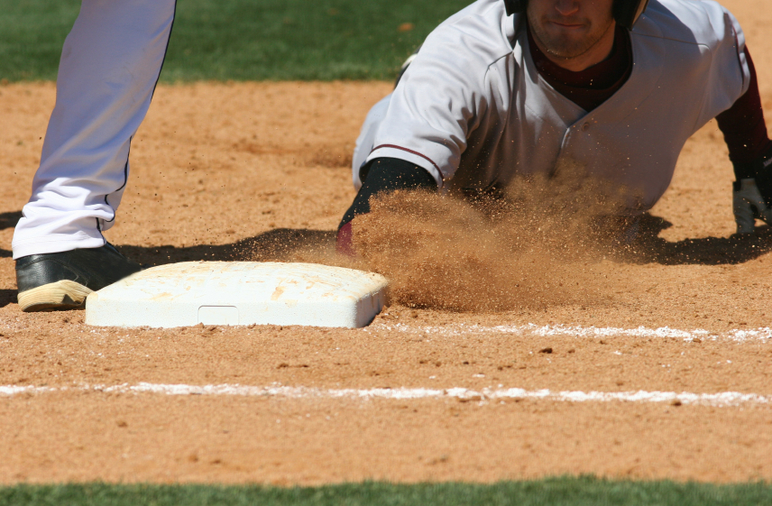
Cover all The bases
Notes:
The tagline of this Principle is Cover All the Bases. How many of you have children, nieces or nephews? [Raise your hand.] Those young relatives that ever participated in T-ball? [Nod your head.] Can you remember what happened the first time they hit that ball off the T, especially if they were right-handed batters? Where did they run? [Get a response and add about how often they run to 3rd base.] Well you can’t score a run going to third base. Similarly, you cannot be successful in conducting a great facilitated session if you don’t know how to cover all those bases; and, in some cases, order can be important.
Let’s see what we will be covering here. [Engagement with PeDeQs.]
[Purpose:] To start this Principle, I would like to see what we do today as we prepare for a session.
[Example: not necessary]
[Directions:] The way I would like to do this is to, again, use our teams. I would like a new team lead, so if you have led your team already today, you are eliminated as the team lead this time. Of the remaining team members, I would like the person whose (first/last) name is closest to the (beginning/end) of the alphabet. Do we all have our new team leads? [Check on each team.] OK, now we are going to use our Post-it notes again, each answer on its own individual Post-it note, using the markers to write and as many as possible because quantity counts. I will give each team two minutes to answer after I have asked the question.
[Exceptions: none]
[Questions:] Any questions? [Answer questions.]
[Starting question:] Think about it – you return to your offices next week. Your boss comes into your office and says to you, “Hey, you just completed that facilitation training, and my boss has a very important meeting he would like you to facilitate two weeks from tomorrow.” Think about all the things you need to do, all the things you will need to do from the time your boss walks out of your office until the session begins two weeks from tomorrow. Starting the clock for two minutes.
[When the time is up, have teams cap their pens and hold their Post-it notes until the slide with all the bases are listed is projected.]

Slide 5
Principle 1
Preparing for Success
Covering All the Bases
Interview Sponsor
Identify Key Roles in Session
Define Objective and Agenda
Prepare Sample Deliverable
Know the Process Cold
Educate the Project Team
Prepare for Hat Technique
Interview the Participants
Get Oriented on the Business Arena
Prepare the Room
Prepare Opening
Notes:
We have the 11 best practices/techniques in this principle. So, let’s get started with Interviewing the Sponsor.

Slide 6



Cover All the Bases
Twelve bases grouped into three categories
The People
Method
Logistics
Manual
1-2
Notes:
In our methodology we have 12 bases that we believe are needed to be addressed. These 12 bases can be grouped into three categories. These categories are People, Method and Logistics. [Refer to the flip chart.] Let’s start by looking briefly at the bases within each category and then go deeper in each.

Slide 7
The 12 Bases to Cover
Sponsor
Planning Team
The People
Participants
-
Notes:
First is People including the Sponsor, the Planning Team and the Participants.

Slide 8

The 12 Bases to Cover
Purpose
Product
Process/AGENDA
The Method
Probable issues
-
Business Area
Notes:
Next is Method. In Method we have five of the 12 bases.

Slide 9
The 12 Bases to Cover
location
schedule
materials
Logistics
MEETING notice
-
Notes:
Finally, in Logistics we have four specific bases.

Slide 10

The 12 Bases to Cover
Which is the most important base to cover?
-
The People
The Method
Logistics
Sponsor
Purpose
location
Planning Team
Product
schedule
Participants
Process
materials
Probable issues
notice
Business Area
Notes:
Now what I would like to do is ask each of the team leaders to come up to the flip chart and post their preparation steps, written on unique Post-it notes in the proper category on the flip chart. (green) team, get us started. [Have team leads read their Post-it and guide them to the correct category. Award dots and recognize each team with a round of applause as they are finished. Consider a quality award if a team gets at least one Post-it in each category.]
Great job, teams. Now, let me ask a question of each team. Of all of the 12 bases which is the most important base to cover first? And, why? [Facilitate the discussion; give each team about 30-60 seconds to arrive at their answer.]
Great. What LSI believes is that the most important base to cover first is the session purpose. Why? You can have a great session and cover each of the other bases, but what will the result of the session be? A lot of potentially wasted time.
So, how do you ensure that you clearly understand the session purpose? Let me introduce you to IDA.

Slide 11


The Most Critical Preparation Activity:
The Project Sponsor Interview
The Sample Deliverable
The Agenda
-
Manual
1-3
Notes:
The acronym is IDA stands for:
Interview the Project Sponsor
The Sample Deliverable
The Agenda
Can you understand that if you get the purpose wrong, you might invite the wrong people? You may arrive at the wrong deliverable or product? Etc.?
Any questions on why purpose is the most important base to cover first?

Slide 12

a. Interview the SESSION sponsor
Notes:
Let’s take a look at our “I” or Sponsor Interview.

Slide 13
THE SIX Ps
Notes:
This is a great best practice/technique to create your own template for, and we call it the 6 Ps of Preparation.

Slide 14





A. Interview the Sponsor
The Six Ps
1.
2.
3.
PURPOSE
PRODUCT
PARTICIPANTS
4.
5.
6.
-
PROBABLE
ISSUES
PROCESS
PLACE
Manual
1-4
Notes:
The 6 Ps are: [Refer to flip chart.]
Purpose
Product
Participants
Probable issues
Process
Place
Let’s take a look at each of the 6 Ps.

Slide 15
A. Interview the Sponsor
The 6 Ps
1.
Why are we having this session?
PURPOSE
Notes:
Purpose: why are we having the session. In our interview with the sponsor, (blue) team, what type of question might you think we will use to ask about the purpose? [Should be Type B; be prepared with a Type B to demonstrate how you might use that and how helpful you find it in practical situations.]

Slide 16
A. Interview the Sponsor
The 6 Ps
2.
What are the key results you would like to achieve?
Hands
Head
Heart
-
PRODUCT
Notes:
The next P is Product. When we look at Product, we use the first 3 Hs from the 4H Club:
Hands: when we are done with this session, what will we have in our hands? What is the tangible deliverable?
Head: when we are done with this session, what will we have in our heads? What will we know?
Hearts: when we are done with this session, what will we believe? What we have in our hearts?
Those “WEs” are the participants.

Slide 17
A. Interview the Sponsor
The 6 Ps
3.
Who will be attending?
What are their attitudes?
PARTICIPANTS
Notes:
The third P is Participants. Note, it is not only who are the participants that will best be able to achieve the session purpose and product but also WHERE are they coming from? Who are your prisoners (people who don’t want to attend), who are your vacationers (who look at meetings as a place to relax), and who are your seekers?

Slide 18
A. Interview the Sponsor
The 6 Ps
4.
What are the probable issues that will need to be discussed to create the product and achieve the purpose?
PROBABLE
ISSUES
Notes:
The fourth P, Probable issues… Given those participants to achieve your intended purpose and build the intended product, what are the Probable issues that will arise? And, what will your strategy be for tackling those issues?

Slide 19
A. Interview the Sponsor
The 6 Ps
5.
What thoughts do you have about the steps that should be taken in the meeting to achieve the purpose?
PROCESS
Notes:
The fifth P is Process. What is the process that will get you from Purpose to Product? Do you know the process? Have you done this before? Or, are you building a new process to achieve the purpose?

Slide 20
A. Interview the Sponsor
The 6 Ps
6.
Where will the session be held and with whom should I speak about the needs for the room?
PLACE
Notes:
Our last P, Place... Where will the session be conducted? (Is it VIRTUAL?) Have arrangements been made? Who will the your contact be for administrative items?

Slide 21
LOGISTICS
Notes:
Logistics always seem to go well. When we address them Like Murphy’s Law, when we fail to address these details, they seem to always go wrong. So, let’s take a look at Logistics.

Slide 22
A. Interview the Sponsor
PRESENCE AND REMARKS
Importance of sponsor’s presence
Sponsor’s kickoff remarks
  Praising on their selection
  Exciting about importance of project and role they will play
  Encouraging creativity
  Empowering participants
-
Manual
1-5
Notes:
This may sound like it should not be necessary. At the same time, how many of us [Raise your hand.] have had a start from the Sponsor that sound like this, “Thanks for coming. I know many of you would like to be somewhere else, but we have to get this done.”
Ouch, that hurts! Let’s avoid this by covering these details like the Sponsor’s remarks – the need to praise, excite, encourage and empower. We will go very deep on this later. In many cases, I ask the Sponsor if he/she would like me to draft some words for their consideration, and that often works.

Slide 23
PARTICIPANTS
Notes:
On to the Participants.

Slide 24
A. Interview the Sponsor
participants
Specifically identify:
People not in favor of holding the session
Those who stand to lose something
Those on unfavorable terms
Those that tend to point out problems
-
Manual
1-5
Notes:
Let’s look at our Sample Agenda. [Refer to flip chart.]
(Red) team, who will likely not be in favor of holding this session? [Facilitate discussion; be prepared for a real situation to share.]
(Green) team, who will think they stand to lose something because we were invited to facilitated this session instead of them? [Likely HR.]
(Blue) team, why would we want to know who are on unfavorable terms with each other?
(Purple) team, why would it be helpful to the facilitator to know which participants tend to point out problems?

Slide 25
A. Interview the Sponsor
LOGISTICS
Specifically review:
Session dates, times and locations
How session will begin
Agreement to arrive 10 minutes early
-
Manual
1-6
Notes:
Again, life is in the details. So, let’s ensure we know these session details and that the participants will all be apprised of this information well in advance of the actual session.

Slide 26

  b. IDENTIFY key
  roles in the session
Duplication prohibited without consent.
Notes:
Remember earlier today when we covered those other roles that exist in the session? Let’s ensure we have addressed those.

Slide 27
B. Understand Key Roles
Discuss the session roles and responsibilities
See Section B, “The Facilitation Process,” for the responsibilities of each role
-
Manual
1-6
Notes:
Often, it is a good idea to refer back to that page in the participant manual to ensure we have not overlooked any of these important roles.

Slide 28
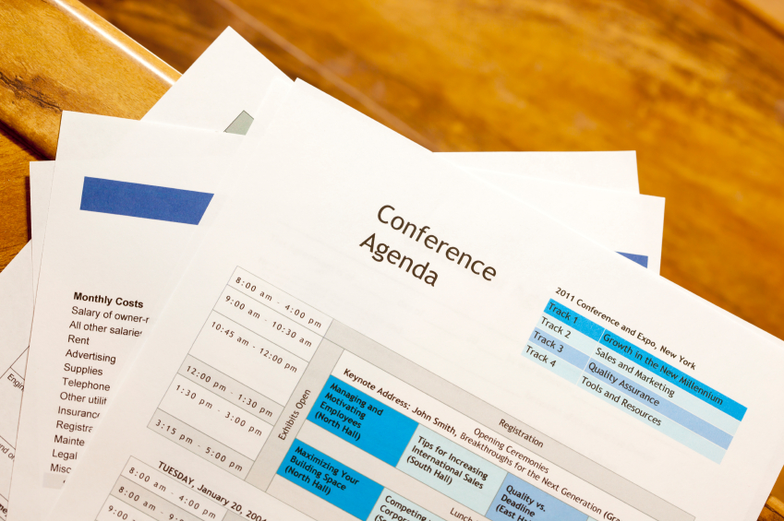
c. Define purpose and agenda
Duplication prohibited without consent.
Notes:
Prior to the session, we find it is a good idea to create an overall purpose of the session and the agenda. We recommend sending this to the participants well in advance of the session.

Slide 29



C. Define Purpose & Agenda
Consider drafting a “Session Objectives” statement
Document the session and confirm with sponsor
Distribute the session information to attendees
-
Manual
1-7
Notes:
When planning a meeting , what do you send out ahead of time? [The agenda.]
What are the benefits of sending out an agenda prior to a meeting? [Facilitate the discussion; key point to ensure that is covered: participants can come prepared, and this allows their expectations to be managed.]
When you create an agenda for a meeting, always state the purpose – when the session is completed, what is it you want to have accomplished? State this up front and first.
In the meeting, always get agreement on the session purpose first. Then, get agreement that the agenda will fulfill the session purpose. We will discuss this again as part of Principle 10, Agenda Setting, and in referring to the agenda models that are a part of the class materials.

Slide 30

d. Prepare sample deliverables
Duplication prohibited without consent.
Notes:
Preparing sample deliverables is like the adage, “A picture is worth a thousand words.” Having a sample deliverable helps people to “begin with the end in mind.” Everyone knows that target they are shooting for – what a strategic plan looks like or a document of the new process…

Slide 31
D. Prepare Sample Deliverables
Prepare or obtain a sample deliverable
Review the sample deliverable with the project sponsor, the project manager and the methodologist
Agenda models follow Principle 10, "Agenda Setting"
-
Manual
1-7
Notes:
To do this, ensure the sample deliverable has been reviewed first by the Sponsor and the Planning Team, the Project Manager and the Methodologist – if one exists for that client. Again, we will show you later the power in the agenda models when we cover Principle 10.
Any questions on the sample deliverable?

Slide 32
CLOSE BOOKS!
What is the test that you can take in advance to ensure that you know your process cold?
Notes:
Before we go to our approach to Knowing the Process Cold, think about the steps you take today from the time you have gained agreement on the session purpose and the high-level agenda. What are the steps you take to prepare your detailed agenda or to Know Your Process Cold?
[Consider a round-robin or a team engagement to complete this.]

Slide 33

KNOW THE PROCESS COLD
Duplication prohibited without consent.
Notes:
Here is a great technique to always Know the Process Cold.

Slide 34
E. Know the Process Cold
Order of the processes
Process technique
Question (starting)
Recording format
Supplies
Timing
-
Manual
1-8
Notes:
It is OPQRST and it stands for: [Refer to flip chart.]
Order of the process: does Agenda Item C naturally follow B and precede D?
Process technique: what process technique will you use to have the participants complete that agenda item?
Question: starting: what is your Type B starting question for that agenda item?
Recording format: what will the recording device be: flip chart, Post-its; 2 columns and 3 rows…..?
Supplies: what supplies will be necessary to complete that agenda item (dots, markers, Post-its, tape, etc.)?
Timing: how long will this agenda item take?
Won’t this OPQRST be helpful to all of you? [Nod your head.] It has been for me.

Slide 35

f. Educate the planning team
Duplication prohibited without consent.
Notes:
Now, it is time to Educate the Planning Team. How many of you have planning teams? [Raise your hand and call on someone to share what a planning team is and how they have used the planning team. Be prepared to share one such as a large system’s implementation of an SAP/Oracle/SFDC implementation and how planning teams typically exist in larger, more complex sessions like these.]

Slide 36
F. Educate the Planning Team
Meet with the project team in advance
Discuss the role of the team members
Discuss any issues or concerns
Discuss the session participants
Review the deliverables
Obtain a commitment to arrive at least 10 minutes early
Set at least one specific gathering time
-
Manual
1-9
Notes:
In Educating the Planning Team the key is to ensure they are a part of the process before, during and after the session as appropriate. [Review the slide and the key points.]

Slide 37
A Typical Project Organization
PROJECT Sponsor
PROJECT
LEADER
FACILITATOR
PROJECT
TEAM
SUBJECT MATTER EXPERTS
TECHNICAL EXPERTS
Manual
1-10
Notes:
There are many different project structures. The key is to know what the structure of your project is and to whom its ultimate success will be measured. There are, of course, times when these roles exist in the same as well as multiple people.
We also want to ensure we consider the participants and the right blend of functional or subject matter experts (SMEs) and technical experts. All SMEs and no technical participants may be a lot of fun, but who will get the technical work done and what buy-in will exist? All technical people and no functional people? Say no more. Really, it is again about buy-in and our ED = RD x CD.

Slide 38

REVIEW
Notes:
Time for a brief review. Let’s start with our (red) team this time and go clockwise. Here we go.

Slide 39
Review
What are the 6 Ps to ask the project sponsor?
Purpose
Product
Participants
Probable Issues
Process
Place

Slide 40
Review
What are the types of participant attitudes to identify early?
People not in favor of session
Those who stand to lose
Those on unfavorable terms
Naysayers

Slide 41
Review
If you know your process cold, what are the six things you will know?
Order of the processes
Process technique
Question (starting)
Recording format
Supplies
Timing

Slide 42

PREPARE FOR THE HAT TECHNIQUE
Duplication prohibited without consent.
Notes:
You remember the slide we used in our discussion about the LSI facilitation methodology and how ours is different from the majority of other methodologies? Well, here is the last example of when we are in the role of the facilitator and the participants have missed something that we must have included. We will likely have tried both the Lead and the Float, and neither worked. The reason we would suggest that approach is that as you move from Leading to Floating to this Hat Technique, the content involvement moves from softer to harder.

Slide 43
G. Prepare for the Hat Technique
There may be times during facilitated sessions when you are the facilitator as well as the project sponsor or a participant
Alert participants when you are transferring from facilitator to the role of participant by changing hats
-
Manual
1-11
Notes:
There may be times during facilitated sessions when you are the facilitator as well as the Project Sponsor. You may have already tried the Lead and the Float to no avail. To use the Hat Technique, alert the participants that you are transferring from facilitator to the role of participant by changing hats.
Often, I will make it very visible by first saying, “I need to get involved here as a participant.” Then, I will take a seat as a participant and provide my input as if I were talking to the facilitator. When I am done, I stand up, assume the role of the facilitator and clearly point out to the participants that I am back in my role as the facilitator.

Slide 44

  h. Interview the participants
Duplication prohibited without consent.
Notes:
As we mentioned earlier, while we may not be able to interview all of the participants, it is always beneficial to speak to as many participants as feasible. Let’s look at the key considerations associated with Interviewing the Participants.

Slide 45




H. Interview the Participants
Identify individual concerns, establish expectations, anticipate issues and pitfalls
Face-to-face
Phone
As a group
3 Ways
-
Manual
1-11
Notes:
While it is often not possible to interview all of the participants, by interviewing as many as possible, we are able to gain another perspective on the session. There are at least three ways to do this:
Face-to-face
Via telephone
Setting up group meetings with several participants at a time
How many of you have used one or more of these approaches? (name), would you be willing to share what you did and how that worked for you? [Facilitate the discussion.]

Slide 46
H. Interview the Participants
Key questions:
  Why is the session being held?
  What are the key results to be achieved?
  What are the potential problems that may surface?
  How do we ensure that the session is not a waste of time?
Provide list of items to bring to session
-
Manual
1-12
Notes:
Here are the key questions to use when Interviewing the Participants. All of them are very insightful. [Go through key points on slide.] And, I especially like: “What is it that I must do to ensure this session is not a waste of your time?”
I almost always get the response, “Nothing.” I am clear to respond to those participants with, “OK, that means whatever we do in the session or whatever results we get, you will be OK. Is that what you are saying?” To which, I get much more information that is often helpful about the group dynamics around that session.
Has anyone else had the same or different types of results? [Facilitate the discussion.]

Slide 47
Selecting Session Participants
EACH PARTICIPANT
AS A GROUP
Understand issue
Have a stake
Be empowered
Be perceived as leader
Be open
Four Communication styles
Knowledgeable all areas
Cross-functional
Various levels
-
Manual
1-12
Notes:
Here is another important point regarding the overall “look and feel” of the session and increasing the effectiveness of our sessions. We might select every participant, and every participant might be just great. But what if they are all from one functional area? Or all very analytical? Or very “touchy feely?” To avoid this from occurring, we should look at each participant individually and then the group as a whole. Do you have key representation? Different communication styles? Etc.
Any questions on the Selecting Session Participants?

Slide 48
H. Interview the Participants
Identify participants with concerns:
Not in favor of holding the session
Believe they stand to lose something
Not on favorable terms
Tend to point out problems
Get agreement to arrive 10 minutes early
-
Manual
1-13
Notes:
This slide contains some of the key areas to explore regarding the participants. What are some of the benefits of determining the answers to these questions? [Facilitate the discussion; key points including avoiding dysfunctional behavior, asking questions the right way to the right people at the right time, who to go to for solutions, etc.]

Slide 49

i. Get oriented on the business area
Duplication prohibited without consent.
Notes:
When we facilitate a session, as facilitators, we do not need to be experts in that subject area. At the same time, we should not be unprepared or ill informed. So, we will want to Get Oriented on the Business Area.

Slide 50
I. Get Oriented on Business Area
Hold an Orientation
Session
Background info
Organization
Project
Unfamiliar business processes
Understand the Key
Issues
Industry
Company
Department
Project
-
Manual
1-14
Notes:
Typically, there is a lot of information on the web, or, we find when asking the Sponsor for information, they are more than willing to provide us information we need – as are many of the participants. The areas we would look into are included on this slide.
Any comments or questions regarding any or all of these? [Facilitate the discussion.]

Slide 51

j. Prepare the “room”
Duplication prohibited without consent.
Notes:
We find it very helpful to ensure we Prepare the Room in the most advantageous setup possible. Let’s look at what we mean.

Slide 52
J. Prepare the Room
Survey room to understand constraints
Preferred seating arrangements:
Semi-Circle
Open
“U”
-
Manual
1-15
Notes:
Our preferred setup is either the semi-circle or the open “U.” Think about the sessions you have been a part of. Think of the physical setup for the sessions that worked the best for you. Why might the two setups on this slide work best for us as facilitators? [Facilitate the discussion; key points: participants can see the non-verbal responses, facilitator can break eye contact when a disagreement arises, facilitator can better “control” the group dynamics, etc.]

Slide 53
HANDLING DIFFICULT
ROOM SETUPS:
Manual
1-16
Notes:
In spite of these preferred room setups, there are times when we are in a situation that may be less than ideal. Let’s look at some of these as well as ways to mitigate the negative impact associated with those difficult setups.

Slide 54

CONFERENCE ROOM TABLES
Issues:
Facilitator can’t move to manage discussion
Control reduced
Solutions:
Use round robins
Walk the room
Duplication prohibited without consent.
Notes:
First, there is the conference room tables. Often, in a boardroom we find this setup. Who can share some of the techniques they use when faced with this setup? [Facilitate the discussion; then, use the slide to highlight key points.]

Slide 55

CLASSROOM STYLE
Issues:
Participants can’t see one another
Interaction limited
Solutions:
Use break-outs
Use names
Duplication prohibited without consent.
Notes:
How about the classroom or auditorium setup where there are rows of people, one row behind the other? How have some of you handled this room setup? [Facilitate the discussion; then, use slide to add additional points.]

Slide 56
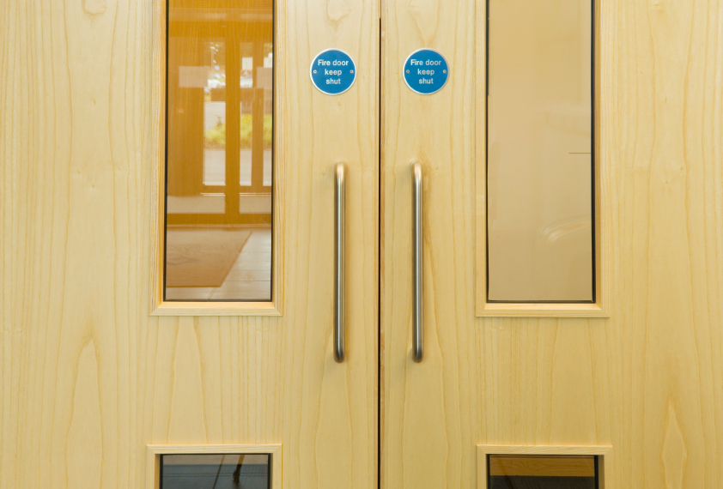
ENTRANCE WAY IN FRONT OF ROOM
Duplication prohibited without consent.
Notes:
There are other points to consider as part of the room setup, and one is the entrance way in front of the room. It is best if the entrance is in the rear of the room to avoid distractions.

Slide 57
OTHER ROOM NEEDS:
Manual
1-16
Notes:
Some additional room needs include…

Slide 58

ENSURE ADEQUATE SUPPLIES AND BACKUP EQUIPMENT
Tape and multi-colored markers
Flip charts
LCD projector and screen
Duplication prohibited without consent.
Notes:
Ensure adequate supplies and backup equipment. Consider building a “facilitator kit” that can go with you every time you conduct a facilitation engagement. [Review the slide.] Are there other items any of you find you use routinely? [Facilitate the discussion.]

Slide 59
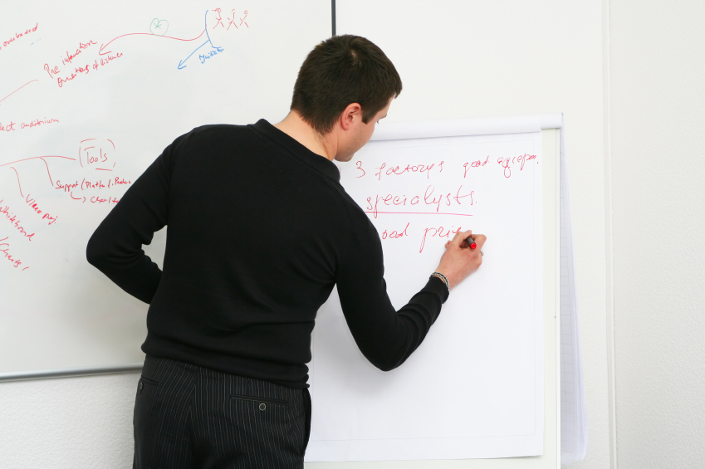
Establish your wall plan
Charts for front
Starting points
for charts
Direction for posting
Chart placement
Communicate any facility changes or additional needs
-
Duplication prohibited without consent.
Notes:
We find using flip charts have many benefits. One of the keys is the way we use the wall. To do that it is important to Establish Your Wall Plan. Look for a good place to post things like the agenda, ground rules, and the parking boards. And, then, ensure there is a starting point for posting the charts developed as the session progresses, so the participants can “see the session unfold” as you progress through the agenda. We will also cover the importance of this for focus when we cover Principle 3 – Focusing the Group.

Slide 60
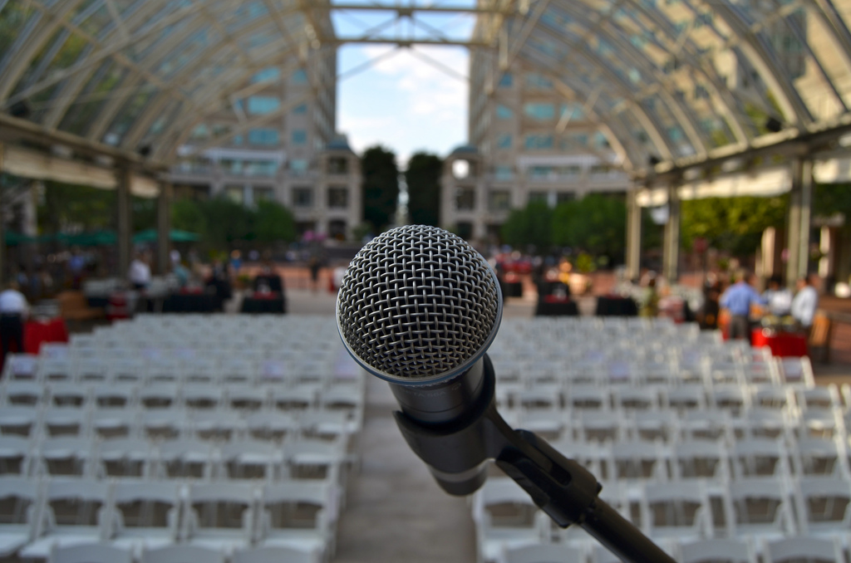
PREPARE YOUR OPENING
Duplication prohibited without consent.
Notes:
If we wait until we are ready to start to Prepare Your Opening, you will be “winging it,” and that does not allow us to make sure we make that lasting first impression. So, during our preparation we want to ensure we address this.

Slide 61
K. Prepare Your Opening
Through your opening words, you must:
Excite
Inform
Empower
Involve
Manual
1-17
Notes:
The four key areas to address in the preparing our opening are the Inform, Excite, Empower and Involve. We will be going deep on these in the next principle, Principle 2 – Getting the Session Started. We will cover the details of this IEEI at that time.

Slide 62
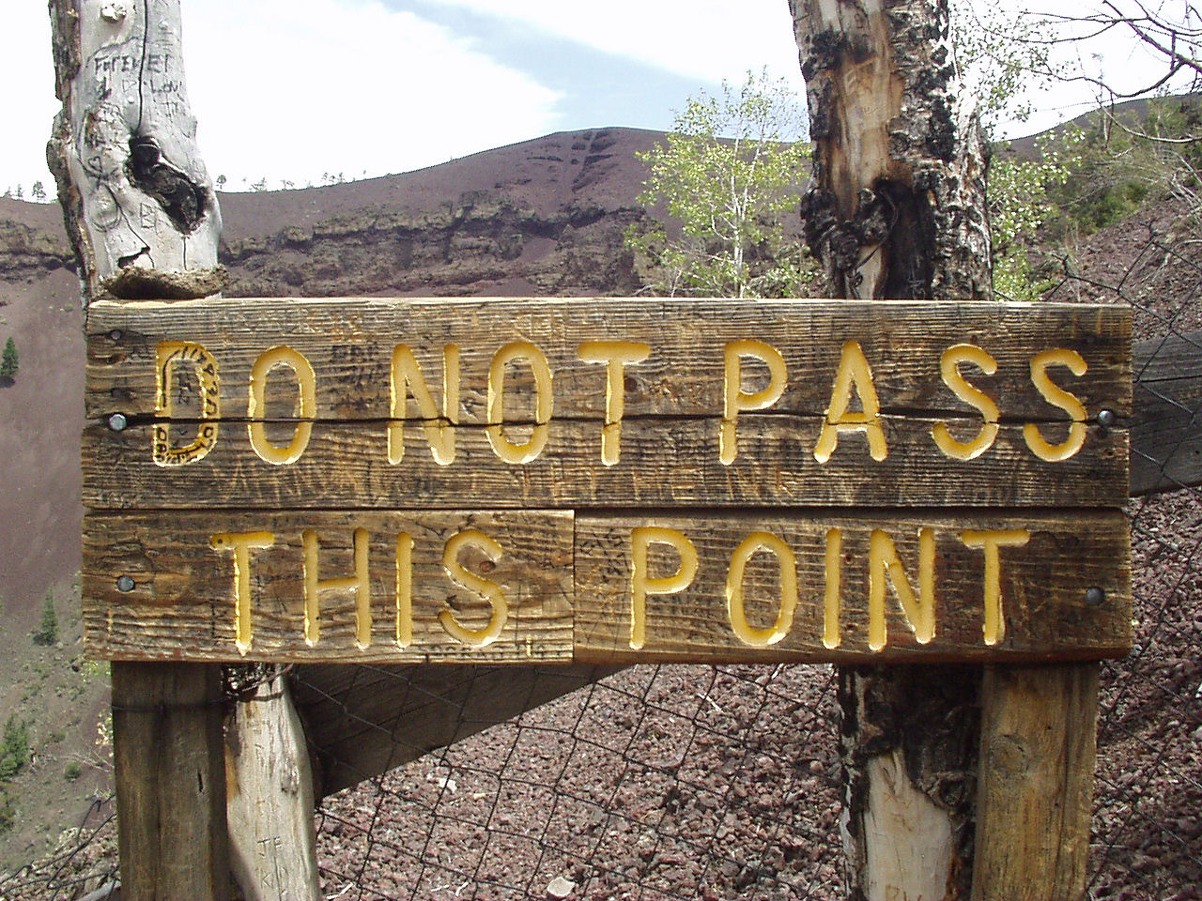
PREPARE YOUR GROUND RULES
Encourage group interaction
Address potential issues
Duplication prohibited without consent.
Notes:
How many of you use ground rules? [Raise your hand.] They really can work to help us, can’t they? [Nod your head.] In our preparation with both the sponsor and the participants, we can often learn about issues for which the right ground rules can help us avoid or address. Ground rules may also encourage more group participation and interaction.
Think about some of the issues you have had in sessions you have led or participated in. Think about situations that have arisen that might have been avoided with some ground rules. What are some ground rules that did or could have addressed those situations? [Facilitate the discussion and have an example or 2 to share with the group such as 1) silence means consensus or 2) build up, etc.]

Slide 63
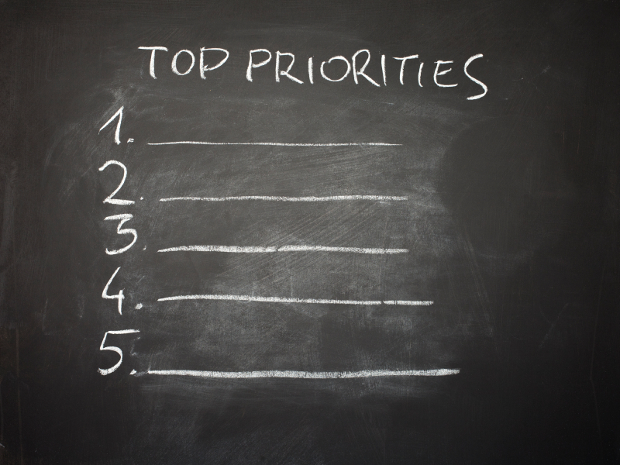
PREPARE THE SESSION OBJECTIVE STATEMENT
Duplication prohibited without consent.
Notes:
When we Prepare the Session Objective Statement, it helps to provide the laser focus successful sessions have. We find it helpful to include these on a flip chart posted in a prominent place in the meeting room for easy reference.

Slide 64
FULL PRINCIPLE REVIEW
Notes:
Let’s do a final review of this principle. We will begin with our (blue) team and move counter clockwise. [Conduct the review with high energy, awarding dots, etc.]

Slide 65
Review
What are the 6 Ps to ask the project sponsor?
Purpose
Product
Participants
Probable Issues
Process
Place

Slide 66
Review
What are the types of participant attitudes to identify early?
People not in favor of session
Those who stand to lose
Those on unfavorable terms
Naysayers

Slide 67
Review
If you know your process cold, what are the six things you will know?
Order of the processes
Process technique
Question (starting)
Recording format
Supplies
Timing

Slide 68
Review
Why use the “hat technique?”
To temporarily move from the role of a facilitator to that of a participant
The facilitator “changes hats” from that of a facilitator to that of a participant and then “changes hats” back to the facilitator role
How do you use the “hat technique?”
-

Slide 69
Review
What is the preferred room set-up for a facilitated session?
The U-shape or
Semi circle

Slide 70
Review
When the set-up is a conference room, what are some strategies for addressing that room set-up?
Round-robins and walking the room

Slide 71
Review
When the set-up is classroom style, what are the strategies?
Breakouts and use of names

Slide 72
Principle 1
Preparing for Success
Covering All the Bases
Interview Sponsor
Identify Key Roles in Session
Define Objective and Agenda
Prepare Sample Deliverable
Know the Process Cold
Educate the Project Team
Prepare for Hat Technique
Interview the Participants
Get Oriented on the Business Arena
Prepare the Room
Prepare Opening
Notes:
We have just completed a look at all of the best practices/techniques associated with Principle 1 – Preparing for Success. Are there any further questions or comments? [Facilitate the discussion; then, set up for a break.]

Slide 73
Checkpoint
The Facilitation Cycle
4.
The Power
of the Pen
1.
Preparing
for Success
1.
Preparing
for Success
2.
Getting
the Session
Started
3.
Focusing
the Group
9.
Closing the
Session
5.
Information
Gathering
6.
Managing
Dysfunction
7.
Consensus
Building
8.
Keeping the
Energy High
Group
Dynamics
10.
Agenda
Setting

Slide 74
THE EFFECTIVE FACILITATOR
PRINCIPLE 1

