Slide 1
THE EFFECTIVE FACILITATOR
Notes:
Timing: 75 minutes (Timing can vary based on introductions due to the size of the class.)
Engagement Strategies:
Introduce the teams; get volunteer, award and explain the use of dots
Ask if anyone has ever used dots, explain, etc.
Have volunteer select a team lead for first exercise
Three rules: 1) large marker/small pad, so write legibly but small; 2) one objective per Post-it (So, “red team” if you have 4 objectives, how many Post-its will you have?); and 3) pen should be capped and in the air when the time is up
Model directions in the objective activity, the Type B question for asking of objectives, reacting questions as you probe about them and grouping of their objectives into categories – all that will be taught later with Principle 5 (P5)
When each team proposes their Choo Choo, have them demo it for the group and post the decision on the Decisions Parking Board for modeling
Flip Charts:
Welcome to the Class – posted outside door to classroom
Course Objectives and Deliverable
Personal Objectives/Key Topics Grid – to post and group their first team engagement (model the technique from P5)
Agenda: Day One
Map Their objectives to the Principles (use the diagram in slide deck)
Ground Rules
Sample Agenda (Hiring Process)
IDA Parking Boards
DOs:
Model every technique (e.g. questioning, engagement, flip charting, grouping, etc.)
Level 3 energy
IEEI
Consider using personal example of how you got into facilitation
Consider having the countdown timer from the LSI website projecting
Provide the 10-minute and 2-minute warnings; START the class on time
DON’Ts:
Read the slides
Overuse the read-arounds

Slide 2

I. Getting started
2
Copyright 1992-2015, Leadership Strategies, Inc. V15.02
Notes:
Good morning, it is a pleasure to be here with you this morning. Welcome to The Effective Facilitator. You know, of all the courses we train people in at LSI, facilitation is personally my favorite. As we go along, I think you will see the reason. Why? Because I love facilitating. Although it is what we do for a living at LSI, most of us just cannot stop ourselves, whether it be a biz meeting, a client session, or a church board meeting. If things begin to stall out or get unfocused, we are the people in the room that will say, “If it’s OK, I’d like to try something that may help us focus a little better… May I?”
What is really great about facilitation is that the questioning techniques, the methods for focusing a group or building consensus go far beyond the business environment. These skills and techniques can be used in your social life as well. It works with family and friends. Whether you are trying to build a strategic plan, deciding where to take the family for vacation, or planning a surprise party for Grandma’s 70th birthday, facilitation will serve the purpose.
With that said, we realize that facilitation is an art, not a science. No one can tell you that if you do A, B and C you will end up with X, Y and Z. But there are a set of broad fundamental principles that, if you use them and understand them, will serve you well.
Over the next (three) days, we are going to build a framework for you to use in facilitating sessions. The foundations of the framework are the 10 fundamental principles. What makes the framework so applicable are the 100+ techniques for applying the principles. In our time together, you will hear about the techniques, use them, and get feedback on them. We want to teach you how to be an extremely effective facilitator; and, in those rare moments when you are not, we want to provide a framework to help you understand why. It’s a fast-paced course, and we are not going to waste any time. When it’s over, our goal is to have you walk away saying this was one of the most productive (three) days you have spent in your life. If you think about it, that’s what facilitation is all about – making us all more productive!

Slide 3
The Effective Facilitator
Getting Started
Course Objectives
Facilitation Skills
The Principles
Methodology
Techniques
Agenda
Ground Rules
Course Overview
Excellence by Design
Introductions
Notes:
So, let’s get started with the opening where we will cover the following 10 topics.

Slide 4

a. Course objectives
4
Copyright 1992-2015, Leadership Strategies, Inc. V15.02
Duplication prohibited without consent.
Notes:
Beginning with our four course objectives, which are…

Slide 5
A. Course Objectives
Define the role of a facilitator
Identify key facilitation principles
Describe the best practices related to each principle
Provide participants with facilitation practice and feedback
DELIVERABLE: Conscious Competence
-
Manual 0-2
Notes:
Define the role of a facilitator; this will allow us to provide the context for the methodology and the 100+ best practices/techniques.
Identify key facilitation principles; we will provide a high-level review of the pillars that provide the overall framework of the LSI facilitation methodology.
Describe the best practices related to each principle; as we go through the 10 Principles, we will address the 100+ best practices/techniques and ensure we address the why, the what and the how for them.
Provide participants with facilitation practice and feedback; throughout our time together we will have lots of opportunity for each of you to practice many of these techniques. Here you will have the opportunity to try many of these techniques and get feedback from your colleagues as well as me during these exercises.
The product or deliverable for the course is:
Deliverable: Conscious Competence; we want to ensure you understand the techniques and again, the why, the what and the how of each.

Slide 6

B. Virtual Facilitation skills
6
Copyright 1992-2015, Leadership Strategies, Inc. V15.02
Duplication prohibited without consent.
Notes:
These, our objectives, are important, and we want to ensure every participant has the opportunity to understand this facilitation methodology, the best practices and techniques that make up the methodology. But, let’s make a deal – this is your class. As I stated earlier, I want this to be the most productive (three) days that you have ever spent. I value your time, so I want to make sure I cover what is important to you. However, to do that, you have to tell me what that is. Here is how I would like to accomplish that.
[Introduce the teams.]
Over to my left we have the (red) team. Can we give the (red) team a hand? And, next we have the (green) team, etc. [Introduce each team, clap and raise the energy level, get people ready to engage and demonstrate how engagement starts early and the impact that can have in a room/meeting/training.]
To help in the team process, I need a volunteer from each team to stand. Now, I want to tell you that with risk, comes reward --- and that is
at LSI, we protect our volunteers. So, trust me, it is a good thing to volunteer. (Red) team, can I have a volunteer? Thank you, (name).
[Award the volunteer a dot.] Has anyone here ever used dots? Great, (name), would you share with us what you have used dots for in the
past? Anyone else? OK, great, so what we are going to use dots for during the next (three) days are to recognize participation. We will
award dots for questions, for answers, and for helping to “share the power of facilitation” with the group. At the end of our (three) days,
we are going to award a great prize, well maybe it’s not a great prize but it is a good prize, to the person with the most dots.
[After each team has their volunteer…]
Now, volunteers, I need each of you to grab the pad and color marker in one hand and with your other hand, touch the shoulder of one of
your teammates. The person you are touching is now the Team Leader for this exercise. Volunteers, you may now sit down. [Award first dots to each Volunteer --- introduce rewarding of dots concept.]
We now have instructions for the Team Leaders and Team Members. Team Leaders, you and your teams will have 90 seconds to identify as many topics as you can that you want to see covered in this class related to facilitation. There are only three rules:
You must use the pad and marker you have been given. Note, the marker is pretty big, and the Post-it notes are pretty small. So, write accordingly.
Each answer must be written on its own, individual Post-it note. That’s right, only one item per Post-it and you can have as many items as you please. So, (blue) team, if you have 5 items, how many post –its will you have? Great, 5, and that is as complicated as the math will be for the next few days.
When the two minutes are up, you must have your pens capped and in the air; otherwise, you will lose two Post-its. When you lose two Post-its, guess how many dots you lose?
That’s right quantity and quality count. The more Post-its, the more dots. Team Members, your job is to contribute.
Any questions? [Take questions and remember this was a chance to model the PeDeQs for this engagement.]

Slide 7
B. Facilitation Skills
Think about the last few times that you facilitated a group. Think about the challenges you had. Think about the things that did not go well or that had you struggling. What are the key areas in which you would like to improve your facilitation skills?
If you have never facilitated before, imagine that you are about to conduct your first facilitated session. What are the skills you would like to have learned from this class to prepare you for that session?
-
Manual 0-3
Notes:
[Use this slide to model the Great Starting Question. When the time is up, collect the Post-it notes and group and post them on a flip chart. As you group the personal objectives, use Principle 5 to guide the group through the grouping process]
[When the grouping is complete, award the quality award to the team that has at least 1 Post-it note in the most # of categories.]

Slide 8
THE PRINCIPLES
8
Copyright 1992-2015, Leadership Strategies, Inc. V15.02
Notes:
OK, now that we have the items each of you would like to ensure we cover in the next (three) days, let’s take a quick look at the 10 Principles.

Slide 9
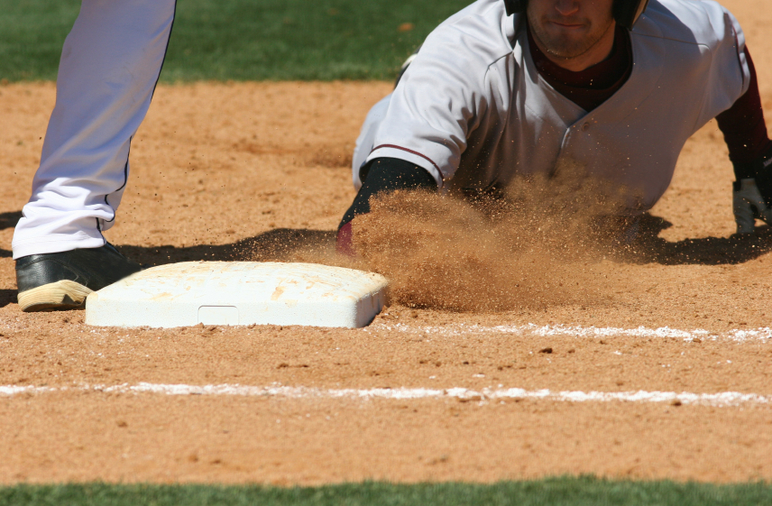
Principle 1. preparing for success Cover All The Bases
9
Copyright 1992-2015, Leadership Strategies, Inc. V15.02
Notes:
(Name), let’s do this using the read-around process. Following along on page number (0-x), can you read Principle #1 and the tagline associated with that principle?
In this principle we will be covering all the steps necessary to ensure we have prepared thoroughly for our facilitated session. How many of you have children or nieces/nephews? [Raise your hand to model the non-verbal warm-up.] Can you remember the first time that right-handed batter hit the ball in T-ball [nod your head]? Where did they run?
That’s right – to 3rd base. Well, you can’t score a run going to 3rd base, and in this principle, we will provide a wealth of things for us to do in preparing for our sessions including the 6Ps of preparation.

Slide 10
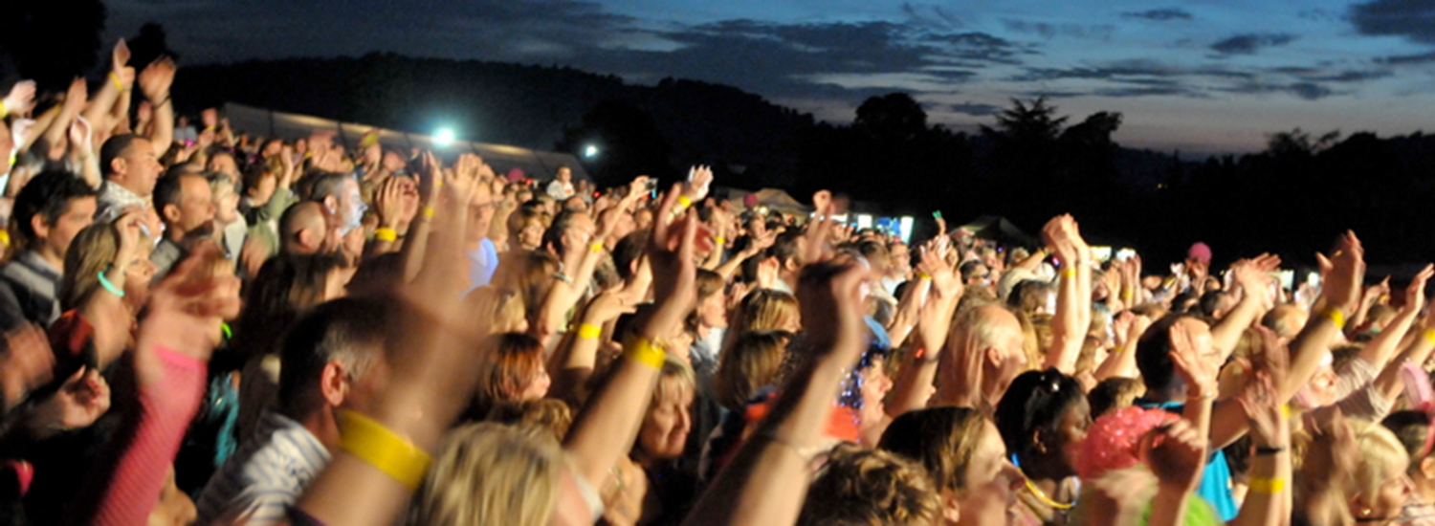
Principle 2. getting the session started Inform, Excite, Empower, Involve
10
Copyright 1992-2015, Leadership Strategies, Inc. V15.02
Notes:
(Name), how about Principle 2? Great, how many of us know that it is important to make a good first impression? [raise your hand] Or, that you have to “hook” them in the beginning? [nod your head]
Yes, well in Principle 2 we will teach you the LSI E-I-E-I-O – really, the I-E-E-I – how to Inform, Excite, Empower and Involve your participants to “grab their attention” as a part of your powerful start. This technique can be used in every facilitated session, every training session, every presentation. It is a great way to capture their heads and their hearts early in the session.

Slide 11
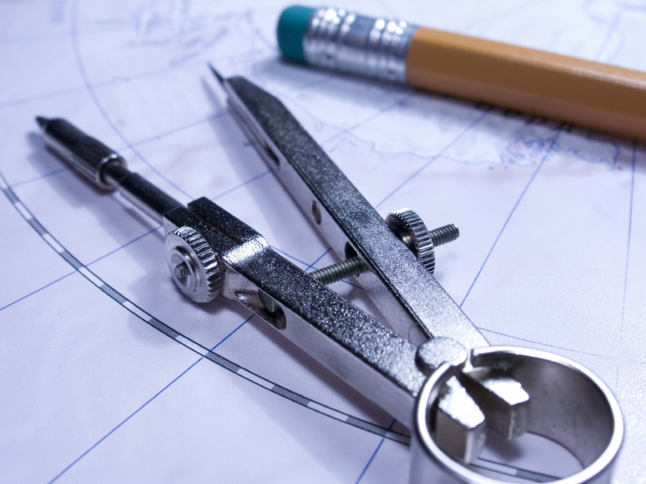
Principle 3. focusing the group Establish the Course, Avoid Detours
11
Copyright 1992-2015, Leadership Strategies, Inc. V15.02
Notes:
(Name), on to Principle 3. Yes, in keeping everyone focused. You know in a long meeting, say an entire day, I find that everyone will, on occasion, allow their mind to “go to the beach.” Like when you remember in the middle of the day that you have to stop by the grocery store on the way home to pick up a dozen eggs. Well, in this principle we will give you 11 tools to establish the course as you move through a session and avoid those inevitable detours as the session proceeds.

Slide 12

Principle 4. power of the pen Use It, Don’t Abuse It, Make It Theirs
12
Copyright 1992-2015, Leadership Strategies, Inc. V15.02
Notes:
(Name), Principle 4, please. OK, when we are facilitating a session, we hold in our hands these great tools. [hold up a marker or 2] In the hands of a skilled facilitator, these are powerful tools and can be used to build commitment to discussions and actions identified during our sessions.

Slide 13

Principle 5. information gathering Know Your Tools and How To Use Them
13
Copyright 1992-2015, Leadership Strategies, Inc. V15.02
Notes:
(Name), next, please. In this principle, what we like to say is, “If the only tool you have in your tool belt is a hammer, everything starts to look like a nail.” So, we are going to start with this principle and fill your tool belt with a multitude of tools that will allow you to navigate through a facilitated session.

Slide 14

Principle 6. managing dysfunction Conscious Prevention, Early Detection,
Clean Resolution
14
Copyright 1992-2015, Leadership Strategies, Inc. V15.02
Notes:
(Name), next principle, please. OK, Principle 6 – the most fun of all the principles… But, isn’t it a shame we have to include it? We will look at three ways to manage dysfunctions: 1) conscious prevention: what do we do before we get to a session to prevent this behavior?; 2) early detection: what are the signs we should be looking for to “head off dysfunction at the pass”? and 3) when we finally have to handle dysfunction, how we can resolve it cleanly?

Slide 15

Principle 7. consensus building Generate a Consensus-Focused Process
15
Copyright 1992-2015, Leadership Strategies, Inc. V15.02
Notes:
(Name), on to Principle 7. At LSI in over 20 years of facilitating groups of 5 to more than 100, we have discovered that people only disagree for three reasons! That’s right – only three! That’s the good news. The bad news is that to apply the right technique, we need to understand what type of disagreement we are dealing with in order to guide the group from disagreement to consensus.

Slide 16

Principle 8. keep the energy high Set the Pace, Anticipate the Lulls,
React Accordingly
16
Copyright 1992-2015, Leadership Strategies, Inc. V15.02
Notes:
(Name), next principle, please. You know, of all the things that separate a good facilitator from the great, at LSI we have discovered that ENERGY is the single biggest differentiator. Do you know why? [raise your hand. If others raise their hand, ask, and discuss] That’s right – energy projects confidence. Therefore, what does a lack of energy project? Yes, a lack of confidence. And, in particular, when senior-level folks are in the audience which, in general, they are, this disempowers us as the facilitator if we neglect the need for energy.

Slide 17

Principle 9. closing the session Review, Evaluate, Close, Debrief
17
Copyright 1992-2015, Leadership Strategies, Inc. V15.02
Notes:
(Name), on to Principle 9. Yes, Closing. You know, I see a continuum of the ways meetings get closed. On the one end, it looks like this, “Oops, it’s 4pm. Let’s get out of here.” You have just invested two days with the senior management team, you have agreed to three things and committed to four actions items. And, we close like that. Is there any wonder some sessions do not have the impact they could? Of course, there is the other end of the spectrum, and it sounds like this: “Well, it’s 4pm, and we are not done. So, we will stay here until we are done.” We should honor people’s time. And, to do that, we want to remember SOT to the 3rd power: Start on Time, Stay on Time and Stop on Time. We will always allow enough time to Review, Evaluate, Close and Debrief.

Slide 18
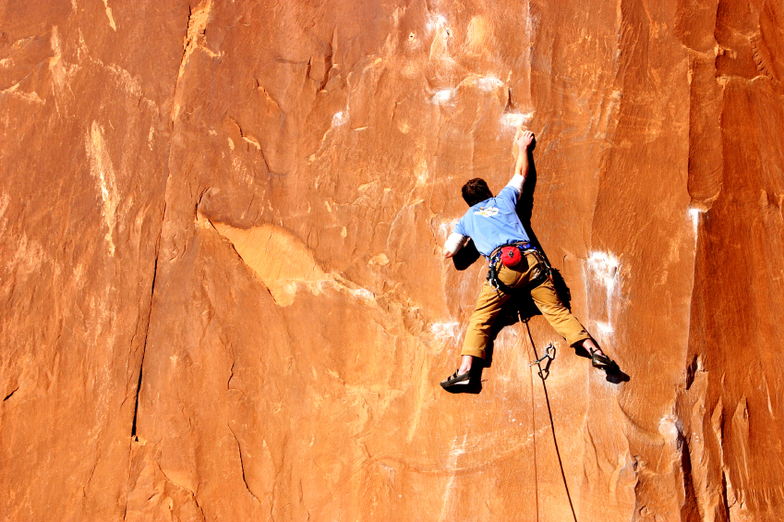
Principle 10. agenda setting Adapt Your Agenda to Address the Need
18
Copyright 1992-2015, Leadership Strategies, Inc. V15.02
Notes:
(Name), our last principle, #10. You know we refer to Principle 10 as the “dangling principle.” Why? Let me show you that in the diagram that depicts the way the 10 Principles hang together.

Slide 19
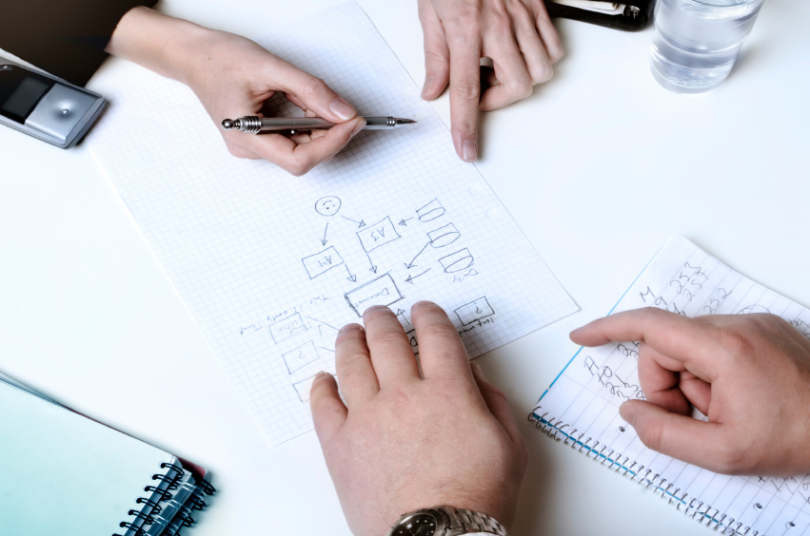
d. methodology
19
Copyright 1992-2015, Leadership Strategies, Inc. V15.02
Duplication prohibited without consent.
Notes:
We call this the Facilitator's Methodology.

Slide 20
Facilitator’s Methodology
The Facilitation Cycle
4.
The Power of the Pen
1.
Preparing for Success
2.
Getting the Session
Started
3.
Focusing the Group
9.
Closing the Session
5.
Information Gathering
6.
Managing Dysfunction
7.
Consensus Building
8.
Keeping the Energy High
Group
Dynamics
10.
Agenda Setting
Manual 0-5
Notes:
Here we go. In this soft skills diagram, look at how they all “hang together.” We do Principles 1, 2 and 9 one time for each session. We prepare, we start, and we close. Throughout the session, we go through the Facilitation Cycle, Principles 3, 4 and 5 iteratively. We focus the group, we document using the Power of the Pen, and we use Information Gathering Tools from Principle 5. While we are going through the Facilitation Cycle, one or more of the Group Dynamics principle may come into play.
Then, Principle 10: Agenda Setting – Adapt the Agenda to Meet the Needs. We will certainly use this as a part of our preparation. Then, anywhere along the way during our session, at the opening, or midway through the session, something may arise that will need to be addressed. And, we will do that by Adapting the Agenda.
Any questions about the Facilitators Methodology? [Facilitate the discussion.]
OK, while we have this methodology diagram in front of us, let’s go back to our grouped objectives. [Go back to each category from the grouped objectives collected earlier and ask the group where that item will be covered. Match their objectives to the principles – essentially the agenda for the class – and demonstrate how to adapt the agenda to meet the need for any group that will not map to a principle.]

Slide 21

e. Facilitation techniques
21
Copyright 1992-2015, Leadership Strategies, Inc. V15.02
Duplication prohibited without consent.
Notes:
Applying the techniques can vary from one session to another. In the class materials, you will find reference sources to help in a multitude of ways.

Slide 22
E. Facilitation Techniques
10 FUNDAMENTAL PRINCIPLES
A. Interview Sponsor
B. Identify Key Roles
Principle 1.
Preparing for success
Cover all the bases
C. Define Objective & Agenda
D. Prepare Sample Deliverable
E. Know the Process Cold
…and more
Manual 0-6
Notes:
Let’s review the materials that we have for each of you. First, we have the training manual. Notice how it is organized. We have the starting section, where we are now, followed by the 10 Principles and then the Appendix. Let me point out the last page in your training manual now. Everyone turn to that last page. [Open book to last page: Personal Action Plan.] Some of you may prefer to tear this page out; others may simply want to turn back to this page occasionally. Back to Principle 1. Look at the first page. This page includes a list of the best practices/techniques for that principle as outlined on this slide. And, every principle is laid out in the same manner.
Next, we have the second bound book, the Agenda Models. There is “gold in them pages.” We are going to go through these in detail as a part of Principle 10 on (Wednesday), but suffice it to say, I would recommend that you make an appointment with yourselves in the next few weeks to have lunch with the Agenda Models. Have a sandwich and thumb through each agenda in the book. You will find one or more that you will then be able to come back to and use at the appropriate time.
Next, we have The Secrets of Facilitation book by Michael Wilkinson, the CEO of LSI. In our homework for Day 1, we will refer to a chapter in this book. It is a great resource, and it supplements the first two items in an easy to read manner with many examples and stories that solidify the concepts covered in each principle.
Finally, we have the clear plastic insert in the back of the training manual. Here you will find the exercise packet and other reference material. We will go through the exercise packet after lunch when we do our first exercise. [This may not be applicable. →] The other inserts include a list of all the classes LSI conducts, the public class calendar of the classes by city as well as other referral items.
Any questions on the materials we will be using or how we will use them?

Slide 23

f. agenda
23
Copyright 1992-2015, Leadership Strategies, Inc. V15.02
Duplication prohibited without consent.
Notes:
Let’s take a look at our agenda for the next (four) days.

Slide 24
F. Two-Day Agenda
DAY 1
DAY 2
Getting Started
Facilitation Process
Information Gathering
Preparing
Review
Application Exercise
Power of the Pen
Dysfunction
LUNCH
LUNCH
Application Exercise
Starting
Focusing
Review and Close
Application Exercise
Consensus
Summary: 8, 9, 10
Review and Close
Notes:
[Cover if appropriate – use the words from the “Four Day Agenda” slide and modify.]

Slide 25
F. Three-Day Agenda
DAY 1
DAY 2
DAY 3
Getting Started
Facilitation Process
Principles Overview
Information Gathering
Review
Ex. 2: Starting
Focusing
Power of the Pen
Review
Consensus
Energy
Closing
LUNCH
LUNCH
LUNCH
Ex. 1: Questioning
Preparing
Starting
Review
Ex. 3: Using the Pen
Dysfunction
Ex. 4: Dysfunction
Review
Ex. 5: Consensus
Agenda Setting
Review
Close
Notes:
[Cover if appropriate – use the words from the “Four Day Agenda” slide and modify.]

Slide 26
F. Four-Day Agenda
DAY 1
DAY 2
DAY 3
DAY 4
Getting Started
Facilitation Process
Principles Overview
Information Gathering
Review
Ex. 2: Starting
Focusing
Power of the Pen
Review
Consensus
Energy
Closing
Set up for Video Session
Ex. 6: Facilitated Sessions
LUNCH
LUNCH
LUNCH
LUNCH
-
Ex. 1: Questioning
Preparing
Starting
Review
Ex. 3: Using the Pen
Dysfunction
Ex. 4: Dysfunction
Review
Ex. 5: Consensus
Agenda Setting
Agenda Models
Session Prep
Ex. 6: Facilitated Sessions
Review
CLOSE
CLOSE
CLOSE
CLOSE
Manual 0-7
Notes:
Here is our agenda for the next four days. On this flip chart, I have placed the agenda for Day 1. [Review the agenda and gain consensus.]
Now that we have reviewed the agenda, do I have a motion to adopt the agenda as proposed? [Call on a participant that offers.] Do I hear a 2nd on the motion? [Gain the 2nd.] I have a motion to adopt the agenda as proposed and seconded. All in favor? [Gain consensus on the agenda – modeling the technique of guiding the group to consensus.]

Slide 27

g. Ground rules
27
Copyright 1992-2015, Leadership Strategies, Inc. V15.02
Duplication prohibited without consent.
Notes:
Well, as you can see, we have a very ambitious agenda over the next (four) days. In order to get through it smoothly, I would like us to come up with some “Ground Rules” or “Session Guidelines.” By a show of hands, how many of you have been in some type of training class before? [Raise your hand.] So, you know those things that work and don’t work. I value your time. I want this to be a productive session for you. So, what are those guidelines that we need to have in place to make this a productive session for you? Let’s take a look at these ground rules for how we will conduct our session for the next (four) days and reach an agreement on them.

Slide 28
G. Ground Rules
Always open for questions
The open issues list
Respect the speaker
Avoid “side bar discussion”
“Choo Choo”
Start on time, end on time
Repetition to train the mind
nEtiquette
ELMO
___________
-
Manual 0-8
Notes:
Here are a few to get us started:
1. Always open for questions: let’s agree that when any of us have a question, we will raise our hand and let me know.
2. The open issues list: there will be times when you will raise a question or a topic that I have planned to cover later. In those cases, I will ask you if we can place that topic on the “Open Issues List,” one of our three parking boards, and cover it at that time.
3. Respect the speaker: let’s all agree that when any of us are speaking, we will respect the person that has the floor.
4. Avoid “sidebar discussion“: you know what I mean here. Those discussions that are better conducted over a drink while at the bar.
5. "Choo Choo“: you know what is going to happen at around (10:45) this morning or late this afternoon, don’t you? [Raise your hand; call on someone that raises his/her hand or nods head and discuss.] To avoid that, I am going to ask each team to come up with a proposed Choo Choo or recharge in just a moment.
6. Start on time, end on time: I value your time and because I do, I commit to you that we will start on time and end on time, if not a little early. That means each day, after lunch or a break, etc.
7. Repetition to train the mind: to ensure we help you master some of the best practices/techniques we will be covering, there will be time where we will repeat items to help us all put this in our long-term memories.
8. nEtiquette: We are all like moths to the flame with our phones and other gadgets, aren’t we? We will have [review breaks] throughout the day, so there will be plenfy of time to return calls and emails. If you do get text or call that you must return immediately, please step out, take care of it, and rejoin us as soon as you can.
9. ELMO: this stands for Enough, Let’s Move On. At any time we may be talking about a topic, and one or more of you might feel like we have done all we need to do regarding that topic. Or, in a meeting, you may feel like the group is “in the weeds.” Should this occur, any of us may raise an ELMO. Now, we can’t let any one or two of us ELMO a topic. Instead, we will stop the conversation immediately and call for a vote on ELMO. If more than ½ of us vote to ELMO the topic, we will stop the discussion and move on. Does that work for everybody? [Raise your hand.] Any questions?
10. OK, let’s go back to our Choo Choo. First, let’s appoint a new team leader. If you were the team lead for the first activity, please remain seated. The rest of the people, please stand up. OK, the (tallest/shortest/etc.) will be our team leader for this activity. Here is what I would like us to do. We have talked about the why. We will use our Choo Choo whenever the energy in the room has gone down. I can call for a Choo Choo, or any of you may call for a Choo Choo. When that occurs, we will stop and do a quick Choo Choo. That will put energy back in the session, and we will go back to work. Any questions? [Cover these.]
So, I am going to put a minute on the clock, and I would like each team to develop a recommendation for a Choo Choo. For example, I have seen the wave with a whoosh, the YMCA, the Hokey Pokey, etc. If we are unable to come up with any recommendations, then we will use the default, which is a “Choo Choo!” That would work as follows: I (or anyone else that calls for the Choo Choo) would say, “All Aboard,” and everyone else would stand up and say, “Choo Choo, chuck-a-chuck-a-chuck-a-chuck-a...” – while pulling the train whistle as follows. [Show the hand motion.] Any questions?
OK, then I will start the clock for one minute. [At the end of the minute, have each team present their recommendation. Have them model their Choo Choo and then call for a vote on consensus to have the participants select their Choo Choo. Place the proposed Choo Choos on Post-it notes and place the Choo Choo that wins the vote on the Decisions Parking Board.]
Great, now may I have a motion to adopt the ground rules as proposed? [Get the motion.] Good, any 2nd? [Gain the 2nd on the motion.] All in favor, raise your hands. [Get consensus on the ground rules.]

Slide 29

h. Course overview
29
Copyright 1992-2015, Leadership Strategies, Inc. V15.02
Duplication prohibited without consent.

Slide 30
H. Course Overview
Group
Techniques
Practice
Sessions
Process
Techniques
Manual 0-9
Notes:
Course overview is a combination of:
Group Techniques – we will point out many of these as we use them to engage the group
Process Techniques –”Without a process, you do not do it on purpose,” so let’s define many processes from how to ask a good question, to an orderly way to do listing or brainstorming, etc.
Practice Sessions – on to next slide

Slide 31

i. Excellence by design
31
Copyright 1992-2015, Leadership Strategies, Inc. V15.02
Duplication prohibited without consent.
Notes:
Excellence in Design – what do we mean by that? Have you ever run a great meeting or round of golf, etc. and had someone come up to you after that event was over and say to you, “Hey, that was great”? And, you thought to yourself, “Wow, that’s great, but I don’t know how or why I did that well.” That is exactly what we want to avoid. What we want to do is create an approach for you so that when someone does say that to you after one of your sessions, you will think to yourself, “Yes, I know. I planned it that way and can repeat it.” And, in those rare cases that you do not have one of those great sessions, you will know why and how to fix it in the future.

Slide 32

I. Excellence by Design
Practice makes _______ ?
Practice
-
Application
Feedback
Manual 0-10
Notes:
Let me demonstrate for you what we mean by this chart. First, many of us have been taught that practice makes… [Let them offer the statement.] That’s right – “perfect.” Well, practice does not always make perfect. Practice make permanent. Let me show you what I mean.
[Have a volunteer come up to a flip chart and ask them to draw a 12” horizontal line. Have him/her do that three times.]
[Suggested approach/words:]
Can I have a brave volunteer to help me demonstrate this? (Name), would you please draw a horizontal line on the flip chart that is 12” long? [As he/she is about to sit back down, ask him/her to do it again.] Do that one more time, please. [Participant tries to draw 12” line three total times.]
Now, let’ see how (name) did. He/she was a little (short/long) the first time and (short/long) the second... What could I have done to help him/her improve each time they attempted to draw that 12” line? [Have group respond.]
So, Practice + Feedback + Application = Perfect! And, as I stated earlier, we are going to cover each principle in detail and then give you a chance to practice those techniques. Your teammates will give you feedback, and it will be up to you to apply the feedback in your next feedback session.
Any questions on this approach of Practice, Feedback and Application? [Facilitate the discussion.]

Slide 33

I. introductions
33
Copyright 1992-2015, Leadership Strategies, Inc. V15.02
Duplication prohibited without consent.
Notes:
Alright, it’s time for us to get to know a little about each person in the session.

Slide 34
J. Introductions (30-second version)
Your name and organization
Your title and the length of time that you have been with your organization
Your past experience with facilitation
-
Manual 0-11
Notes:
Before we get into the session formally, I would like each person to introduce himself/herself by stating:
Your name and organization
Your title or role and length of time at your organization
Your past experience with facilitation
[Model the use of the three steps by conducing your introduction.]
Before we start… Please, we want the Reader’s Digest version and not the, “I was born in a log cabin where we had no running water, walked uphill both to and from school, etc.” So, let’s not make it more than one minute/person. Now, if we start here with (name), by the time we get to (5th or so person), he/she will have been so busy thinking of what to say, that they won’t remember anything anyone said prior to them. So, let’s take a minute for each of you to jot down or think about what you will say. And, when the minute is up, we will start with the (blue) team and with (name). Any questions? [Take questions.]
Alright, let me start the clock, so you can prepare what you will each say. [Start the clock for a minute, and when the minute is up, begin with the person you announced at the beginning.]
[When all introductions are complete, take the first break.]
Alright, thanks everybody. We are at (almost 10am), so let’s take our first break. I am going to start the clock for (12) minutes. We will begin again in (12) minutes. [Start clock and consider showing the LSI timer on the screen.]
Before we start the break, let me tell you about one more thing. At the end of each break, if each member of your team is back AND, in their seat,, that will result in a dot for each team member. If any member of the team is not back AND, in their seat,, you know what that means? Yes, no dots for any member of that team. So, team members, help each other. Let’s start the break.

Slide 35


Raving facilitators,
Share your power!
SHARE. In your first 30 days after this course, let your classmates know your success in using the tools and techniques. Like/follow us and post on our social media:
Twitter -- @leadstrat
Facebook – www.facebook.com/leadstrat
LinkedIn – search “Leadership Strategies”
JOIN THE COMMUNITY. Become part of the community of thousands of facilitators who have taken The Effective Facilitator or who are interested in facilitation. See how facilitation has helped others and share your story.
Download our meeting app LeadStrat! Mini Manual in the app!
Notes:
Review slide.

Slide 36

II. The Facilitation Process
36
Copyright 1992-2015, Leadership Strategies, Inc. V15.02
Notes:
Thanks for getting back on time. [Checkpoint]
[Review:] Prior to the break, we completed an overview of the 10 Principles, collected the personal objectives from each of you and provided an overview of the next (four) days.
[Preview:] What we are about to do next is conduct an overview of the facilitation process.
[Big View:] And, that’s important because before we jump into the 10 Principles, let’s provide a context for facilitation including… [Go to next slide.]

Slide 37
The Effective Facilitator
THE FACILITATION PROCESS
What is a Facilitated Session?
When is Facilitation Appropriate?
What Types of Sessions Might Be Facilitated?
What is the Facilitator’s Role?
What Other Roles Exist?
Notes:
[Go over slide – what a facilitated session is, when facilitation is appropriate and the roles associated with facilitation.]

Slide 38
WHAT IS A FACILITATED SESSION?
38
Copyright 1992-2015, Leadership Strategies, Inc. V15.02
Notes:
Often, we use terminology without being clear about the terms we are using, don’t we? [Nod your head.] Let’s avoid that by starting with a clear definition of a facilitated session.

Slide 39
A. What is a Facilitated Session?
A highly structured meeting in which the meeting leader (the facilitator) guides the participants through a series of pre-defined steps to arrive at a result that is created, understood, and accepted by all participants.
ED = RD X CD
Manual 0-14
Notes:
(Name), please read the slide or the definition on (O-11). Thanks, (name). Now, let’s review the key parts of this definition. First, a facilitated session is a highly-structured meeting. That means we as facilitators must help provide that structure.
Next, the facilitator must GUIDE the participants through a series of PRE-DEFINED steps. That means we must have an agenda! How many times have each of you attended a meeting without an agenda? [Raise your hand.] Me, too. We cannot do that if we want to run a facilitated session.
Finally, (purple) team, what are the three things the participants must do in that facilitated session? [Ensure coverage of the CREATE, UNDERSTAND and AGREE to the results.]
So, let’s think about it. Let me ask you a few questions:
(Red) team, why is it not enough to just create a result?
We create everyday. We know how to do that.
(Green) team, why is it important to understand the result?
Ownership and avoid the water cooler talk. There may be people in the room that do not understand it or the rationale behind it. If someone were to ask them why they are doing this or that, they may not be able to articulate the reason. And, this can eliminate that water cooler discussion that goes, “Oh, I really did not understand that, so I do not support it.”
(Blue) team, why does the result have to be accepted by all participants?
Have you ever left a session with a great planning process that was created and ended up with no follow-through? The entire time, they were saying, “Yeah, yeah,” but never really accepted it.
This can be summarized in an equation that is from Dr. Robert Zawacki’s work, Transforming the Mature Information Technology Organization. What he said was:
ED = RD x CD
Each of the Ds in that formula stand for the word, “Decision.” What Zawacki said was, ED, an Effective Decision, was equal to RD, the Right Decision, times the C of the Decision. Who can tell me what you think the C stands for? [Facilitate the discussion to get to, “Commitment to the Decision.”]
Think about it – are we better off with:
A 100% Right Decision with 10% Commitment OR
An 80% Right Decision with 80% Commitment?
[Review the results from this and the difference]

Slide 40
WHEN IS FACIITATION APPROPRIATE?
40
Copyright 1992-2015, Leadership Strategies, Inc. V15.02
Notes:
(Purple) team, with that as a backdrop, when might we want to use facilitation? [Facilitate the discussion.]

Slide 41
B. When is Facilitation Appropriate?
Outside clients
Internal customers
Personally
Large groups (over 16)
Small groups (3-16)
One-on-one (2)
-
Manual 0-15
Notes:
Essentially, if you need others to “buy in” to projects, or plans, or any decision, it is best to facilitate to that conclusion so that it is created, understood and accepted by all parties.

Slide 42
WHAT TYPES OF SESSIONS?
42
Copyright 1992-2015, Leadership Strategies, Inc. V15.02
Notes:
With the WHEN behind us, let’s consider WHAT types of sessions can be facilitated.

Slide 43
C. What Types of Sessions?
-
Strategic Planning
Project Planning
Status Reporting
Issue Resolution
Basic Process Improvement
Process Re-engineering
Information Needs Analysis
Process Modeling
Data Modeling
Procedure Design
Manual 0-16
Notes:
Essentially, any time you have more than one person involved and there is a purpose and agenda, a meeting/session may be appropriate to be facilitated, and/or the use of the principles and techniques we will be addressing over the next several days can be great tools to assist you in leading/facilitating that meeting/session.
These are the 10 agenda models (processes) that are included in your second book that we briefly reviewed earlier and will discuss in detail when we cover Principle 10.

Slide 44
THE FACILITATOR’S ROLE
44
Copyright 1992-2015, Leadership Strategies, Inc. V15.02
Notes:
I would like to have you consider for a moment a time you have been in a session or responsible for a session, where you needed to use skills you think are necessary to be an effective facilitator. Think about what those characteristics or behaviors are, the things you did to help the participants arrive at the result of a meeting… Let’s list those behaviors or skills. [Write answers on a flip chart by going team to team.]
Great list, folks. Let’s take a look at the 8 roles we believe a facilitator must play. [Consider using hand signals for each role to help with their learning each role.]

Slide 45

GUIDE
45
Copyright 1992-2015, Leadership Strategies, Inc. V15.02
Duplication prohibited without consent.
Notes:
Let’s do this using another read-around – we will start with the (red) team and (name). Can you read the role of the Guide please? [Hand signal.]
That’s right and to be a Guide we, as a facilitator, must know where we are, where we have been and where we are going. We need to listen to comments to ensure their relevance and ensure the conversation stays on track.

Slide 46

MOTIVATOR
46
Copyright 1992-2015, Leadership Strategies, Inc. V15.02
Duplication prohibited without consent.
Notes:
(Name), the Motivator. [Hand signal.]
The motivator means we “bring it” to each session. If, as the facilitator, we are not excited about the session, why will the participants be excited? We need to bring energy and motivation to each session. That type of energy is contagious. When we give it, we get it back from the participants.
Any comments? [Facilitate the discussion.]

Slide 47

Bridge builder
47
Copyright 1992-2015, Leadership Strategies, Inc. V15.02
Duplication prohibited without consent.
Notes:
The Bridge Builder – would you please, (name)? [Hand signal.]
By being a Bridge Builder, we are looking for areas to bring together a group rather than allowing chasms to grow – for example, asking sales to view a lead from the marketing perspective and marketing to view a lead from a sales perspective… to ask management to view a problem from the employees’ view and vice versa.

Slide 48

Clairvoyant
48
Copyright 1992-2015, Leadership Strategies, Inc. V15.02
Duplication prohibited without consent.
Notes:
The next role – a Clairvoyant. (name), please, would you read the role? [Hand signal.]
Yes, as the facilitator, we must look for the signals that things are not going well or the group is worn out. We must be ahead of the group and pick up on those signals that help us as a Clairvoyant avoid situations that are not conductive to a great facilitated session.

Slide 49

peacemaker
49
Copyright 1992-2015, Leadership Strategies, Inc. V15.02
Duplication prohibited without consent.
Notes:
Next is the Peacemaker. (Name), would you please read that for us?
As a Peacemaker we are trying to find solutions to the differences as they arise. We look for ways to bring disparate views together, to allow each participant to see the big picture and the need for inquiry versus advocacy when that is needed. We will cover tools like the “better words to use” when, as the facilitator, we step in to a disagreement. Little things like the choice of the right words can help us be the Peacemaker that helps the group arrive at a consensus solution.

Slide 50

TASKMASTER
50
Copyright 1992-2015, Leadership Strategies, Inc. V15.02
Duplication prohibited without consent.
Notes:
How about the Taskmaster, (name)? [Hand signal.]
Yes, the Taskmaster… Most of us probably do a pretty good job of this. It means keeping people on topic, knowing how much time is allotted to each agenda item, etc. Yet, it is but one of many roles rather than the only one.

Slide 51

PRAISER
51
Copyright 1992-2015, Leadership Strategies, Inc. V15.02
Duplication prohibited without consent.
Notes:
And, (name) the next role, the Praiser... [Hand signal.]
The Praiser helps in many ways. Note what they Praise – contribution and effort – not the content. We leave that up to the group to determine content. We also find that by praising effort, we encourage the more reluctant participant to engage with the group.

Slide 52

ACTIVE LISTENER
52
Copyright 1992-2015, Leadership Strategies, Inc. V15.02
Duplication prohibited without consent.
Notes:
Finally, (name), the Active Listener… [Hand signal.]
Notice the Listener is ACTIVE. The facilitator needs to listen to not only the words that are said but the why, the what and the how they are expressed. That is an Active Listener.
Let’s go back and review the 8 roles. Without looking at the manual, follow my hand signals and let’s see how we can do. [Go through each of the 8 roles by providing the hand signal for each.]
Alright, before we move on to other roles, are there any questions on the roles of a facilitator? [Facilitate the discussion.]

Slide 53
WHAT OTHER ROLES EXIST?
53
Copyright 1992-2015, Leadership Strategies, Inc. V15.02
Notes:
Now that we have covered the roles the facilitator must play, let’s look at some of the other roles that exist in our facilitated sessions. Think about the last several sessions you have led or attended. Think about the other roles that existed, the areas that needed to be covered, the areas that needed to be addressed for the session to be successful… What are some of those other roles?
[Facilitate the discussion.]

Slide 54
D. What Other Roles Exist?
Session Sponsor
Project Manager
Methodologist
Recorder
Documenter
Timekeeper
Participant
Observer
-
Manual 0-18
Notes:
This list includes many of the roles you just mentioned. Some of these roles are played by the same person; some may be played by the facilitator. The key is to ensure we, as the facilitator, are aware of these roles, who will fulfill them and when we will fulfill the role.
[Facilitate the discussion; note that the observer would not have a “voting” role in the session.]

Slide 55
Leadership Strategies Facilitator Difference
55
Copyright 1992-2015, Leadership Strategies, Inc. V15.02
Notes:
Now that we have covered the key roles that the facilitator must fulfill as well as other roles that exist, let’s take a look at where the LSI methodology is different from many other facilitation approaches or methodologies.

Slide 56
LSI Facilitator Difference
Facilitator Creates Solution
Participants Own the Process
Results Focused
Dynamic Facilitation
Leadership Strategies
Traditional Facilitators
Participants Create Solution
Facilitator Owns the Process
Experience Focused
Passive Facilitation
Manual NA
56
Copyright 1992-2015, Leadership Strategies, Inc. V15.02
Notes:
Key Points to Cover on this Slide:
There are several “schools of thought” on the facilitator's role in terms of content. Most facilitation methodologies take a firm stand that the facilitator is about process and the participants have absolute control on the content. At LSI, we take a different approach, and we would like to address that, in general, and point out the specific tips or techniques as we go through the 10 Principles that are different from many other approaches.
[Instructor Note: those three key tips/techniques are:
Leading question (P5)
Floating question (P5)
Changing “hats” (P1)]
Leadership Strategies believes that a facilitator is objective BUT NOT a passive role. If we, as the facilitator, are aware of something the participants are not aware of or miss, we want to have tips or techniques that can help the participants arrive at better results.
While we believe the facilitator has primary responsibility for the process, if a participant knows something we recommend would not work for that group or they have a better approach, we want to create an environment where they would offer their suggestions; if it is better for the group, we want a participant to be willing to suggest it.
While many other methodologies lean towards the experience, we want the experience to be good as well – but, we lean more towards the results.
Finally, the passive versus the dynamic nature of the facilitation… Our facilitators consistently receive feedback about their performance. And, the words we hear are around the PDI experience: Practical, Dynamic and Interactive. We find that leads to better results, a good experience and a productive session.
There will be several techniques that we will include in the class to demonstrate how, as a facilitator, we can offer participants insight or recommendations for their consideration while maintaining our role as a facilitator.

Slide 57
Facilitator’s Methodology
The Facilitation Cycle
4.
The Power of the Pen
1.
Preparing for Success
2.
Getting the Session
Started
3.
Focusing the Group
9.
Closing the Session
5.
Information Gathering
6.
Managing Dysfunction
7.
Consensus Building
8.
Keeping the Energy High
Group
Dynamics
10.
Agenda Setting
Manual 0-5
Notes:
[Review methodology. Explain that the course is structured around the ten principles that make up the methodology.]

Slide 58
THE EFFECTIVE FACILITATOR

