Slide 1









Moving Beyond Being “Happy”
Collaboration
Innovation
Being Rewarded
Execution
Consensus
Getting Heard
Repeatable Success
On-Target Results
Notes:
So, we are really happy when you have learned great skills and enjoyed the class, but what your sponsor and Leadership Strategies is striving for is BEHAVIORS to change, which results in IMPACT to the business.

Slide 2
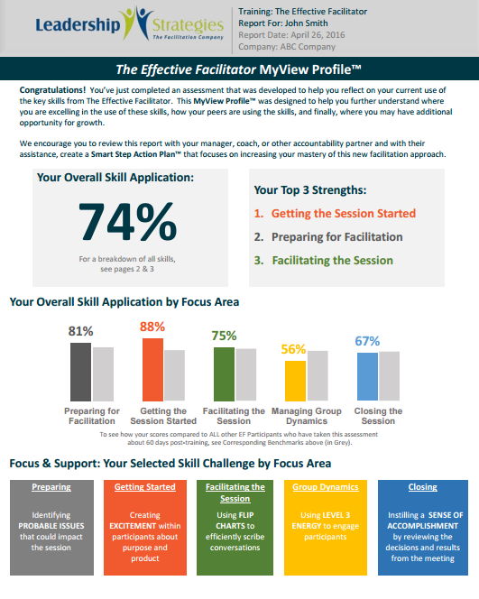
Want access to cool data about YOU?
Your individual report tracks:
Your progress since this training
The skills you’re using
Your success and growth areas
How you’re contributing to your team
The time and money your team is saving
Notes:
We want to provide you with a view of how you are doing 60 days after this class. We want to share data on your progress since the training, where you are excelling at and where you should be focusing on to continue growing in the art of facilitation. Your articulation of what is happening for you in meetings will lead to data that will be shared with the sponsor to show the successes you are experiencing! You will get the results of your own report and your sponsor will get an aggregate of everyone’s information.

Slide 3



After this class…
1. Confirm your e-mail address with your training facilitator or sponsor.
2. Complete the survey you will receive from your sponsor 60 days following today.
3. Access your individual report!
Notes:
It’s pretty simple… Just confirm your e-mail address on the sign-in log, and in 60 days, you will get an e-mail from your sponsor to fill out the survey. Once you complete that, your report will come directly to you. [Facilitators should have a copy of a sample report to pass around or show as an example.] Once all of you fill out the survey, your sponsor will get an aggregate report that shows how much time and money is being saved, and you will be really amazed at what kind of an impact you will make as a team.

